Slide 1
Sweet’s Syndrome

Slide 2
What is Sweet’s syndrome?
Sweet’s syndrome is known as ‘Acute febrile neutrophilic dermatoses’, which has been classified under the heading of ‘neutrophilic dermatoses’.

Slide 3
Neutrophilic dermatoses (ND)
Neutrophilic dermatoses are heterogeneous but closely linked group of disorders that are characterized by the presence of a noninfectious infiltrate composed predominantly of mature neutrophilic leukocytes in variable depths of skin.

Slide 4
Common features of ND
  Histologically: sterile mature neutrophilic infiltrates
  Vasculopathic reaction, but not frank vasculitis
  Significant proportion of cases have reactive or systemic origin
  Potential of extracutaneous infiltrates (lung, bones, joints, liver, lymph nodes, eyes, nerves, heart)
  Possibility of overlap, coexistence, or sequential occurrence of ND
  Neutrophilic process on its own may lead to systemic manifestations i.e. fever, malaise, arthralgia etc.
  Non contagious; negative skin and blood cultures for infectious agents; no effects of antibiotics in treatment of the disease
  Response to systemic corticosteroids and other immunosuppressants

Slide 5
History:
  First to be identified: EED (1894)
  ‘Neutrophilic dermatoses’ term first used while describing the case of ‘Acute febrile neutrophilic dermatosis’ (Sweet’s syndrome) by Robert Douglas Sweet.

Slide 6
Classification of NDs
Primarily epidermal:
  SCPD
  Intraepidermal neutrophilic IgA dermatosis
  Infantile acropustulosis
  Transient neonatal pustular dermatosis
  Acute generalized exanthematous dermatosis
  Neutrophilic spongiosis

Slide 7
Primarily dermal:
  Classical NDs: SS, PG
  Overlap with vascultis: BD, pustular vasculitis of hands, EED
  Asso. With GI diseases: BADAS, pyostomatitis vegetans
  Asso with acne: SAPHO syndrome
  Asso with granulomatous reaction: rheumatoid ND, SLE asso ND, palisaded neutrophilic granulomatous dermatitis, relapsing polychondritis, cutaneous Crohn’s disease

Slide 8
  Paraneoplastic: neutrophilic figurate erythema
  Systemic NDs: neuro- SS, neuro- BD, CRMO
  Autoinflammatory diseases: FMF, NOMID, Muckle- Wells Syndrome, FCAS, TRAPS, PAPA syndrome, HIDS, Majeed syndrome
  Miscellanous: abscess forming ND, neutrophilic FDR, Marshall’s syndrome, histiocytoid SS, Rasheed syndrome

Slide 9
Primary appendageal:
  Neutrophilic eccrine hidradenitis
  Idiopathic recurrent palmoplantar hidradenitis
  Neutrophilic sebaceous adenitis

Slide 10
Sweet’s Syndrome
It is an ‘Acute Febrile Neutrophilic Dermatoses’.
It was first described by Dr. Robert Douglas Sweet in 1964.
It was also known as Gomm-Button disease in honour of the first two patients Dr. Sweet diagnosed with the condition.
It is the most frequent ND to occur.

Slide 11
Etiology and classification
SS is traditionally classified into following groups based upon the underlying etiology:
  Classical/ idiopathic SS
  Malignancy associated SS
  Drug induced SS

Slide 12
Classic/ Idiopathic SS:
  It follows an episode of URTI, tonsillitis or GI tract infection, especially caused by Yersinia enterocolitica.
  It may be associated with IBD and pregnancy.
  More frequent in women and recurrence is common.
  Initial episode usually occurs between 30-60 years of age.

Slide 13
Malignancy associated SS:
  Presence of associated malignancies
  Commonly hematological malignancies, and less frequently tumors of other organs.
  The disorder may appear concurrently or precede or follow the diagnosis of malignancy.
  Most common hematological malignancy is acute myelogenous leukemia
  Other common tumors associated with SS are: Ca of genitourinary organs, breast and GI tract.

Slide 14
Drug induced SS:
  Due to systemic administration of certain drugs
  G-CSF is the most common
  Other drugs are: all-trans retinoic acid, isotretinoin, hydralazine, minocycyline, oral contraceptives, furosemide, bortezomib, imatinib, norfloxacin, ofloxacin etc.
  Temporal relation between drug ingestion and onset of lesions

Slide 15
Diagnostic criteria
For Classical/Idiopathic and malignancy associated SS:
  Major Criteria:
    Abrupt onset of painful erythematous papules, plaques, or nodules
    HP showing dense neutrophilic infiltrate without evidence leukocytoclastic vasculitis
  Minor criteria:
    Fever >38˚ C (100˚ F)
    Association with underlying malignancy, inflammatory disease, pregnancy, or preceded by an URTI or GI tract infection or vaccination
    Excellent response to treatment with corticosteroids or KI
    Abnormal lab values of the following (3/4):
      ESR > 20 mm/hr
      Positive CRP
      TLC < 8000/μL
      Neutrophils > 70%

Slide 16
Presence of both the major criteria and any two of the four minor criteria are required for the diagnosis of classical/ idiopathic or Malignancy associated SS.

Slide 17
For Drug induced SS:
    Abrupt onset of painful erythematous papules, plaques, or nodules
    HP showing dense neutrophilic infiltrate without evidence leukocytoclastic vasculitis
    Fever >38˚ C (100˚ F)
    Temporal relation between drug ingestion and onset of lesions, or temporally related recurrence after oral challenge
    Temporally related resolution of lesions after drug withdrawal or treatment with corticosteroids

Slide 18
Presence of all the five criteria are required for the diagnosis of drug induced SS.

Slide 19
Pathogenesis
There are a number of hypotheses, but none of them are definitely proved.
It may be caused by hypersensitivity reaction to an infective agent- bacterial or viral.
It may be associated with dysregulation and overexpression of some of the cytokines
A possible role of photosensitivity
Tumor associated production of G-CSF might be a cause in malignancy associated SS
Neutrophil monoclonality has been documented in few cases.

Slide 20
Cytokines that are responsible for SS:
  Dysregulation of: G-CSF, GM-CSF, IFN-α, IL-1, IL-3, IL-6, IL-8
  Overexpression of: TNF-α, MMPs, VEGF

Slide 21
Clinical features
General symptoms:
  Fever: commonly present, may precede the appearance of the skin lesions by several weeks to days or appear concurrently.
  Other constitutional symptoms: arthralgia, myalgia, malaise, and headache

Slide 22
Cutaneous manifestations:
  Single or multiple; temder; papules, nodules, and/or plaques; red to purple red in colour.
  Presence of intense dermal edema gives rise to pseudovesicular appearance.
  Sites involved commonly: upper extremities, face and neck; although it may occur anywhere
  Older lesions may show central clearing leading to annular or arcuate formations.
  Uncommon morphological variants: bullous, ulcerative, pustular, necrotic (rare) lesions

Slide 23
  Bullous lesions: in malignancy associated SS
  Pustular lesions: in association with IBD and may include ‘pustular eruption of ulcerative colitis’
  Subcutaneous SS mimics erythema nodosum and appears as erythematous, tender nodules on extremities.
  Lesions localised to the dorsum of hands and clinical entity known as pustular vascultis of dorsum of hands, represent a localized form of SS.

Slide 24
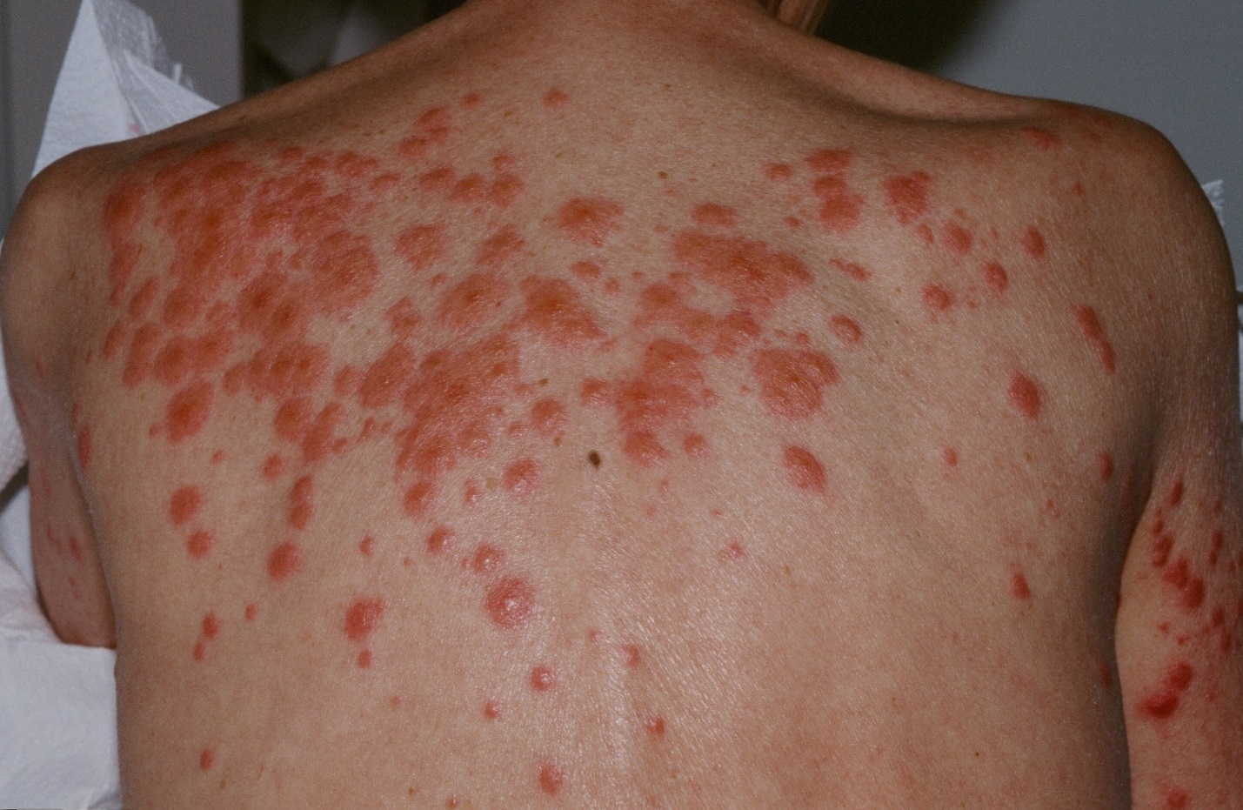

Slide 25
Oral mucosa:
  Aphthous lesions, pustules, papules, nodules, bullae and vesicles
  Periodontitis, swelling of the tongue and ulcers on palate and buccal mucoca
  More common in SS associated with hematological malignancy

Slide 26
Conjunctiva:
  Congestion, hemorrhage, erythematous lesions
  Blephartis and conjunctivitis along with inflammation of other ocular tissues (episcleritis, iridocyclitis, retinal vasculitis, keratitis)

Slide 27
Extracutaneous manifestations:
  Bones and joints: acute sterile arthritis, sterile osteomyelitis, focal aseptic osteitis
  CNS: encephalitis, meningitis, neuro-sweet disease
  Eyes: blepharitis, iridocyclitis, conjunctivitis
  Ears: lesions on TM, ext auditory canal
  Kidneys: glomerulonephritis, proteinuria
  Liver: hepatomegaly, abnormal liver enzymes
  Intestines: diffuse neutrophilic infiltration, pan colitis
  Heart: aortitis, cardiomegaly, heart failure
  Lung: edema and obstruction, chest skiagram abnormalities
  Muscles: neutrophilic myositis, fascitis
  Spleen: splenomegaly

Slide 28
Associated conditions
Associations probably exist between SS and following conditions:
  Other NDs like PG, BD, EED, SCPD, neutrophilic eccrine hidradenitis, neutrophilic vasculitis
  Other conditions such as erythema nodosum, relapsing polychondrtis, rheumatoid artheritis, sarcoidosis, Graves’s disease, Hashimotos’s thyroiditis

Slide 29
Pathology
HP shows:
  Dense infiltrate comprising of mature neutrophils throughout the papillary and reticular dermis
  Occasionally, eosinophils may be found
  In later stages, lymphocytes and histiocytes predominate
  Prominent edema of upper dermis which may result in subepidermal bullae formation.
  Exocytosis of neutrophils may result in neutrophilic spongiotic vesicles or subcorneal pustules

Slide 30
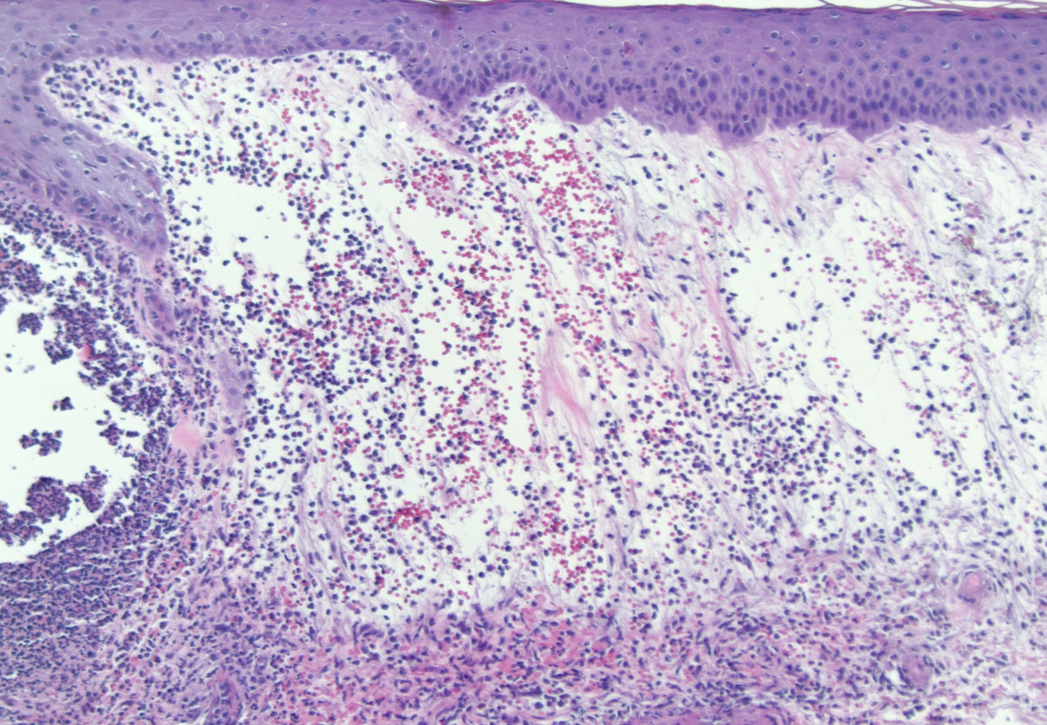

Slide 31
Differential diagnosis
Cellulitis
Erysipelas
Leprosy ± reaction
Granuloma faciale
EED
Erythema multiforme
Erythema nodosum
Cutaneous lymphoma
Leukemia cutis
Panniculitis‘
Pyoderma gangrenosum
Behcet’s disease
Bowel bypass syndroma
LE
Sarcoidosis
Cutaneous PAN

Slide 32
Diagnostic workup
CBC: increased TLC with neutrophilia, elevated ESR. TLC may not be raise in malignancy associated SS or Drug induced SS. In malignancy associated SS, neutropenia, anemia, thrombocytopenia, blasts may be seen on PS.
CRP: raised
Lesional skin biopsy for HP and culture for bacteria, fungus, mycobacteria
LFT
RFT/ Urinalysis

Slide 33
ASO titre
RA factor
Thyroid function tests
Others: CT and MRI scan, EEG, CSF analysis
Chest skiagram
A thourough workup for detection of malignancy

Slide 34
Treatment
Cutaneous lesions of drug induced SS resolve after the offending drug is stopped.
Regression of underlying malignancy with treatment leads to improvement in malignancy associated SS.
In classical SS, the lesions may persist for weeks to months, but may eventually resolve.
Resolution usually occurs without scarring.

Slide 35
Local therapy:
  Topical or intralesional corticosteroids
  Usually high potency topical corticosteroids are needed.
  Intralesional triamcinolone acetonide may be used in ranging from 3 to 10 mg/mL.

Slide 36
Systemic therapy:
  First line Drugs:
    Corticosteroids:
      Gold standard
      Results in prompt improvement of symptoms
      Start with 1 mg/kg/day, can be tapered upo 10 mg/day according to the response.
      Symptoms resolve in 4-6 weeks
      In cases not responding to oral therapy: daily pulse methyl prednisolone at doses upto 1000 mg/day for 3-5 days.

Slide 37
    Potassium iodide:
      Enteric coated tablets or as a saturated solution of potassium iodide (1 g/mL)
      The solution is started at the dose of three drops three times a day (one drop equals 0.05 mL)
      The dose is increased by one drop each day to reach the final dose of 21-30 drops TDS
      Side effects: vasculitis and hypothyroidism

Slide 38
    Colchicine:
      Given at a dose of 0.5 mg orally TDS for 10-21 days.
      Side effects: diarrhea, abdominal pain, vomiting

Slide 39
  Second line drugs:
    Have been used alone after first line treatment have failed or as corticosteroid sparing agents.
    Indomethacin: 150 mg/day for 7 days, then 100 mg/day for 14 days
    Clofazimine: 200 mg/day for 4 weeks, then 100 mg/day for 4 weeks
    Cyclosporine: 2-4 mg/kg/day
    Dapsone: 100-200 mg/day

Slide 40
Other drugs:
  Various antimicrobials: metronidazole, doxycycline, minocycline, tetracycline
  Cytotoxic drugs: cyclophosphamide, chlorambucil, IVIg, IFN- α
  TNF antagonists: etanercept, infliximab
  Thalidomide
  Pentoxifylline

Slide 41

Everything that sounds sweet, is not always sweet,
Some things are sweeter, and others might turn out to be neutrophilic also.

Slide 42
THANKS
☺

