Slide 1
VASCULAR AND LYMPHATIC SUPPLY OF SKIN

Slide 2
BLOOD SUPPLY OF SKIN
The skin has a rich vascular network with distributing and collecting channels.
The dermal microcirculation includes :
Arterioles, terminal arterioles
Pre-capillary sphincters, arterial and venous capillaries
Post-capillary venules and collecting venules

Slide 3
INTRODUCTION
The DERMAL VASCULATURE is divided into two important strata :
Superficial Vascular Plexus
Defines the boundaries between the papillary and the reticular dermis
Deep Vascular Plexus
Connected to the first by vertically oriented reticular dermal vessels and separates the reticular
dermis from subcutaneous fat

Slide 4
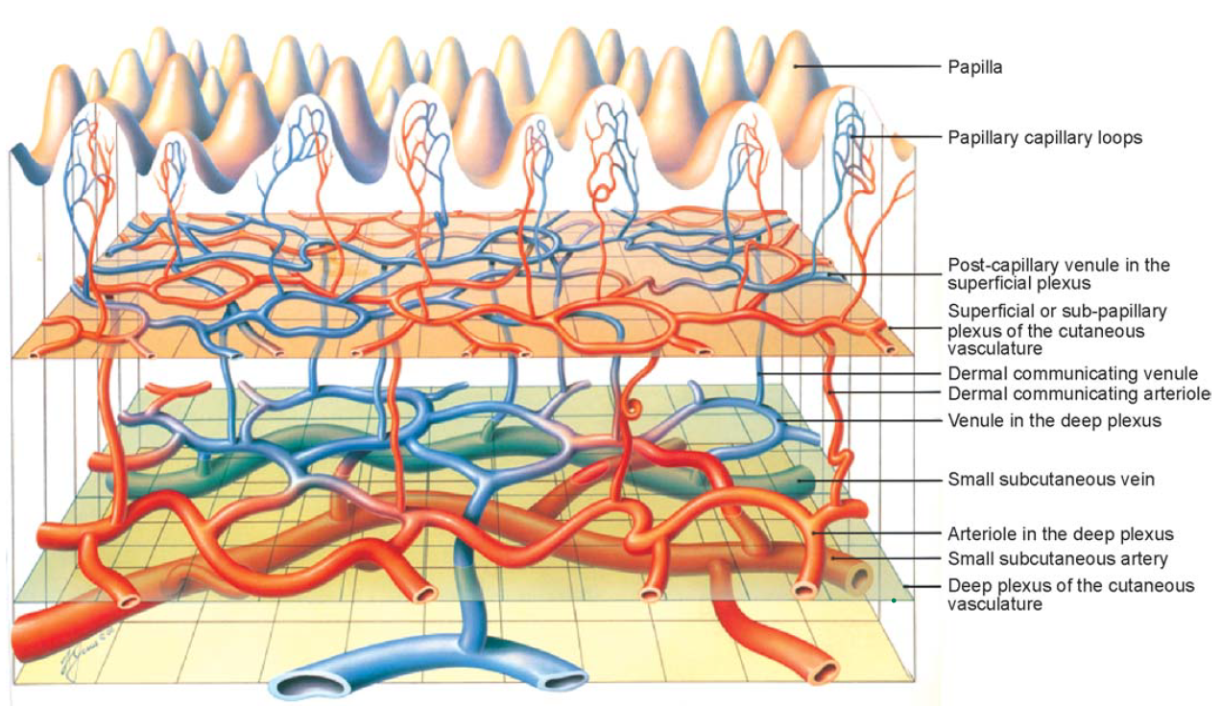

Slide 5
Superficial Vascular Plexus
This plexus forms a layer of anastomosing arterioles and venules in close approximation to the overlying epidermis and is normally surrounded by other cellular components of the dermal microvascular unit.
Small capillary loops emanate from the superficial vascular plexus and extend into each dermal papilla

Slide 6
Deep Vascular Plexus
Is connected to the first by vertically oriented reticular dermal vessels
Many of these vessels are of larger caliber and communicate with branches that extend within fibrous septae that separate lobules of the underlying subcutaneous fat.
They originate from musculocutaneous arteries that penetrate the subcutaneous tissue to enter the deep reticular dermis.

Slide 7
STRUCTURE AND ULTRASTRUCTURE
The innermost component of the blood vessels is the endothelium, consisting of adjoining endothelial cells that surround the lumen.
Arterioles are characterized by a subendothelial layer of elastic tissue while venules generally do not have elastic tissue in their walls.
Histology of microvessels in the reticular dermis. Arterioles (A) can be distinguished from venules (V) by the presence of elastic lamina, which stains red.

Slide 8
The endothelium of capillaries and small arterioles and venules is surrounded by pericytes, which appear to share certain characteristics with both endothelial and smooth muscle cells.
Capillaries contain a single discontinuous layer of pericytes, whereas venules may include more than one pericyte layer in their periendothelial investment.
Smooth muscle cells are found chiefly in the walls of ascending arterioles but also within the arterioles of the superficial and deep plexus and in collecting venules.
Smooth muscle cells and pericytes are surrounded by a basement membrane, which also encompasses the outer surface of endothelial cells.
Transmission electron microscopy of a cross‐section through a small arteriole in the skin. smooth surface of the endothelial cell(E) surrounding the lumen (L) and the presence of smooth muscle (SM) with an associated nerve (N). There is a small amount of elastic tissue (el) adjacent to the endothelial basement membrane
The surface of the endothelial cells (E) in the lumen (L) is more convoluted than in its arteriolar counterpart. The endothelial cells are surrounded by pericytes (P), and not smooth muscle cells. The arrowheads indicate
Weibel–Palade bodies.

Slide 9
Veil cells are long, thin cells with an attenuated cytoplasm, and they more closely resemble fibroblasts than pericytes. They do not have a basement membrane investment and are located outside the vessel wall.
The capillary loops can be divided into intrapapillary portion and extra papillary portion.
The extra papillary ascending limb and intrapapillary portion have the the characteristics of an arterial capillary , that is, homogenous basement membrane, whereas the extra papillary descending limb has venous characteristics, that is a multilayered basement membrane.

Slide 10
At the ultrastructural level, endothelial cells possess many of the common cellular organelles, including rough and smooth endoplasmic reticula, mitochondria and lysosomes; macropinocytotic vesicles are also evident.
Intermediate filaments containing vimentin are present and have been reported to be more abundant on the venous than on the arterial site.
Dense bodies associated with actin‐like filaments of 5–6 nm diameter are found in the endothelial cells of the larger arterioles, and they may have a role in endothelial contraction.
Weibel–Palade bodies are endothelium‐specific inclusions that occur more frequently in the venous side of the microvasculature. They are not found in dermal lymphatics but have been reported in larger lymph vessels. Weibel–Palade bodies contain factor XIII‐related antigen, von Willebrand factor and GMP‐140, a protein that was first described in platelet α‐granules.

Slide 11
A major feature distinguishing arterial from venous microvessels is the ultrastructural appearance of the basement membrane.
Venules and venous capillaries have a multilaminated basement membrane, whereas arterioles possess a more homogeneous matrix, lacking the electron‐dense strands.
Vascular basement membrane contains laminin 111, type IV collagen, fibronectin and heparan sulphate proteoglycans.

Slide 12
A number of endothelium‐specific antigens have been recognized, and they may have a special value in studies of cutaneous pathology.
Endothelial cells are the major source of angiotensin converting enzyme as well as various cytokines and adhesion molecules.
The microvasculature is also a rich source of enzymes that may be involved in cellular processes, such as endocytosis and vesicular transport.
Acid phosphatase has been localized to lysosome‐like structures in the endothelium, and alkaline phosphatase reactivity has been used extensively to map the distribution and arborization of the arterial network in the upper dermis.

Slide 13
FUNCTIONS
Providing nutrients and oxygen to the skin
Plays a major role in regulating the body temperature.
This is accomplished by controlling the blood flow through the capillaries in the upper dermis so that opening blood vessels allows dissipation of excess heat while constriction of blood vessels slows the blood flow to the skin and conserves the core energy.
The color of the skin is largely determined by melanin. However, except in very dark skin, the hue is also influenced by the presence of blood in the capillary loops and sub-papillary venous plexus. The color may be red, blue or a shade in between, depending on the degree of oxygenated blood in the cutaneous vasculature.

Slide 14
APPLIED ASPECTS
Defects in vascular development can lead to Klippel–Trenaunay and Sturge–Weber syndrome.
Klippel–Trenaunay syndrome
Unilateral cutaneous vascular malformations develop,with associated venous varicosities, edema, and hypertrophy of associated soft tissue and bone.
Sturge–Weber syndrome
Many cutaneous capillary malformations are seen in the lips, tongue, nasal and buccal mucosa.

Slide 15
GLOMUS BODY
Glomus body is a special arteriovenous shunt without the interposition of capillaries that is seen in finger pads, nail bed, palms and soles
When open these shunts cause a great increase in blood flow in the area.
It is located within the reticular dermis and is concerned with temperature regulation
Each glomus consists of an arterial and a venous segment.
The arterial segment, called the Sucquet–Hoyer canal, branches from an arteriole and has a narrow lumen and a thick wall measuring 20 to 40 μm in diameter.
The venous segment is thin walled and has a wide lumen which functions as a reservoir and drains into a dermal venule.
The wall shows a single layer of endothelium, surrounded by a PAS-positive, diastase resistant
basement membrane zone, and a media that is densely packed with 4 to 6 layers of glomus cells
Electron microscopy reveals the glomus cells to be vascular smooth muscles.

Slide 16
THE CUTANEOUS LYMPHATICS
In the skin, lymphatic vessels form two horizontally running networks:
A narrow-meshed superficial network lying subepidermally
A deeper wide-meshed network
The networks are connected to each other through obliquely running vessels.
Lymphatics are essentially of two types:
(1) smaller, non-contractile, initial lymphatics which commence or initiate the drainage process within the tissues
(2) larger, contractile, lymphatic collectors or trunks into which the initial lymphatics drain

Slide 17
Embryology
The embryonic development of lymphatics is closely related to the development of the venous system.
The endothelial budding that originates from the embryonic veins form the primitive lymph sac. The skin lymphatics develop by endothelial sprouting from these primary lymph sacs.
Alternatively, it has been suggested that initial lymph sacs develop from precursor cells (lymphangioblasts) in the mesenchyme

Slide 18
DRAINAGE OF LYMPH
Lymphatic vessels are of four types: lymph capillaries (initial lymphatics), precollectors, collectors and lymphatic trunk.
The lymphatic capillaries or the initial lymphatics originate as blindending endothelial-lined tubes in the superficial dermis.
At the junction between papillary and reticular dermis, they form a polygonal meshed network, the superficial sub-papillary lymphatic plexus.

Slide 19
The post-capillary vessels or pre-collectors form a deep dermal network of lymphatics at the interface between the reticular dermis and the subcutaneous tissue.
The superficial and deep lymphatic plexus are connected by obliquely running vessels. T
The lymph is drained from the deep dermal plexus through prefascial collectors and collectors to the lymph nodes. The collectors are contractile, large lymphatic vessels which can be demonstrated radiographically.
Valves can be demonstrated in all lymphatics except the smallest initial lymphatics, and ensure unidirectional flow of lymph. The larger lymphatic trunk connects the lymphatic system to the venous system.

Slide 20
Lymphatic vessels have a larger lumen than blood vessels but a thinner vessel wall, consisting of flattened endothelial cells, discontinuous basal lamina and elastic fibres.
The endothelium contains very few pinocytotic vesicles and lacks Weibel–Palade bodies and fenestrae.
Attached to the outside of the endothelium is a network of reticulin and elastic fibers which act as anchoring filaments. The elastic fibers form a partial envelope around the dermal lymphatics.
In addition to the flap valves in the lymphatic wall, there are bileaflet intralymphatic valves.
Smooth muscle fibers in the lymphatic vessel wall are present only at the level of subcutaneous tissue. On electron microscopy, lymphatic endothelial cells contain cytoplasmic filaments that represent vimentin filaments.

Slide 21
FUNCTION
The cutaneous lymphatics regulate the interstitial fluid by resorption of leaked fluid.
They also clear the tissues of unwanted proteins, lipids, organisms, cells and degraded material.
The lymphatics form an integral part of an immune system. They transport antigens to the regional lymph nodes where it is processed and an appropriate immune response is generated. Lymphatics are also a major exit route for T lymphocyte and macrophages from the skin.
APPLIED ASPECTS
Patients with hereditary lymphedema have been found to have defects in the VEGF-3 gene.

Slide 22
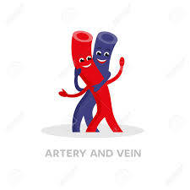
THANK YOU

