Slide 1
Laryngeal Paralysis
Vocal cord paralysis is a common problem found in the practice of Otolaryngology. It is a sign of disease and not a diagnosis.

Slide 2
The Vagus
The vagus nerve has three nuclei located within the medulla:
  1. The nucleus ambiguus
  2. The dorsal nucleus
  3. The nucleus of the tract of solitarius

Slide 3
The nucleus ambiguus is the motor nucleus of the vagus nerve.
The efferent fibers of the dorsal (parasympathetic) nucleus innervate the involuntary muscles of the bronchi, esophagus, heart, stomach, small intestine, and part of the large intestine.
The afferent fibers of the nucleus of the tract of solitarius carry sensory fibers from the pharynx, larynx, and esophagus

Slide 4
The superior laryngeal nerve branches into internal and external branches.
The internal superior laryngeal nerve penetrates the thyrohyoid membrane to supply sensation to the larynx above the glottis.
The external superior laryngeal nerve innervates the one muscle of the larynx not innervated by the recurrent laryngeal nerve, the cricothyroid muscle.

Slide 5
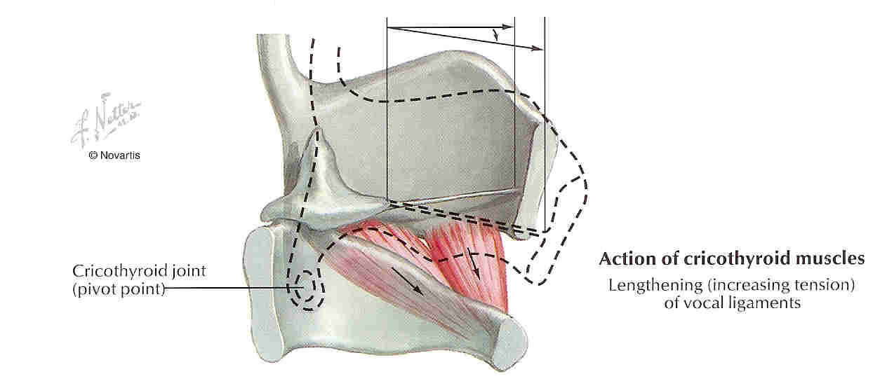
Adductors of the Vocal Folds

Slide 6
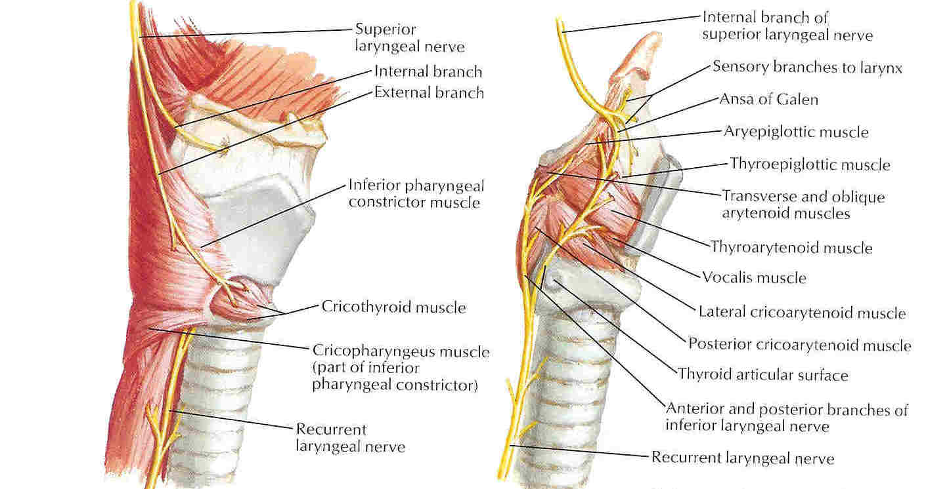

Slide 7
The right vagus nerve passes anterior to the subclavian artery and gives off the right recurrent laryngeal nerve. This loops around the subclavian and ascends in the tracheo-esophageal groove, before it enters the larynx just behind the cricothyroid joint.
The left vagus does not give off its recurrent laryngeal nerve until it is in the thorax, where the left recurrent laryngeal nerve wraps around the aorta just posterior to the ligamentum arteriosum. It then ascends back toward the larynx in the TE groove.

Slide 8
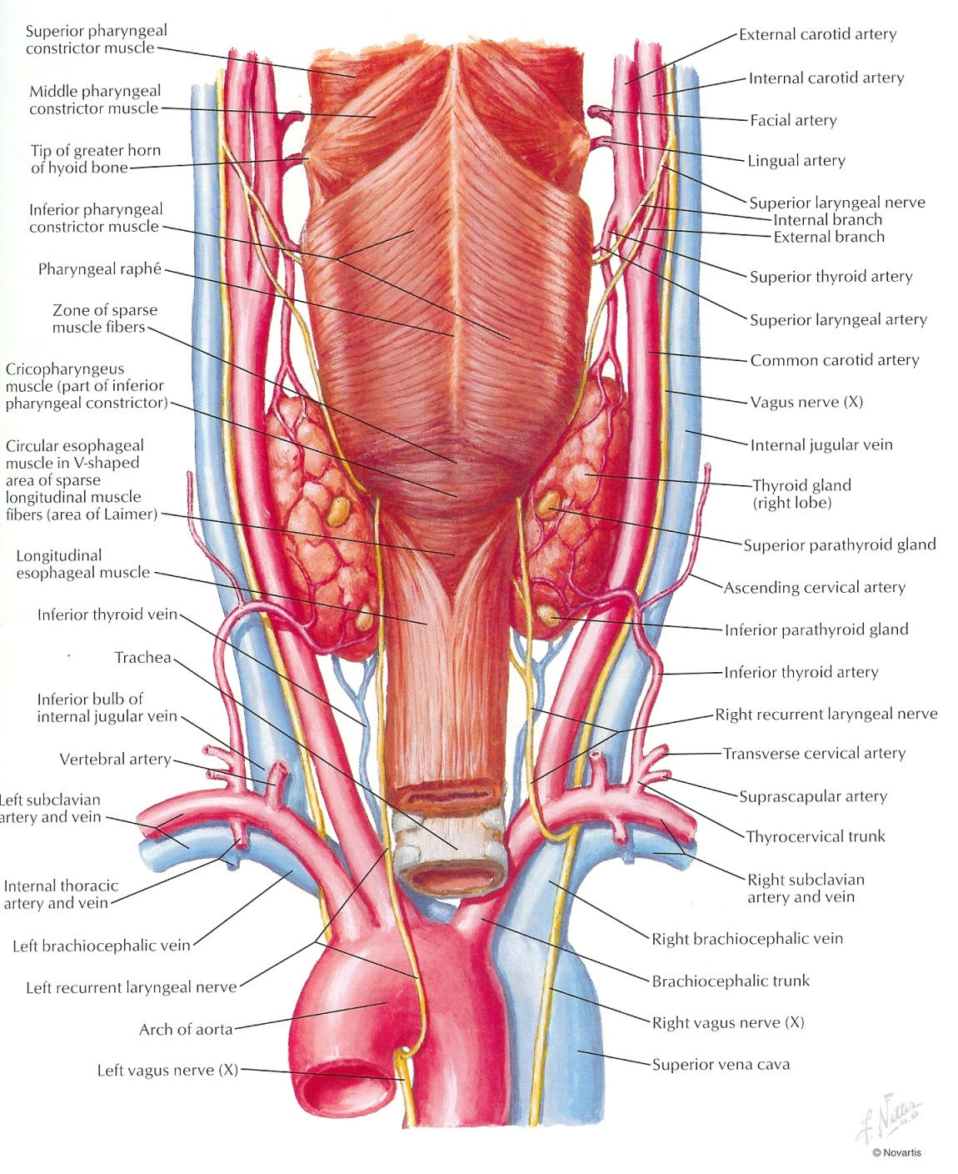

Slide 9
The Laryngeal Musculature
The intrinsic muscles of the larynx, all of which are innervated by the recurrent laryngeal nerve, include the:
  Posterior cricoarytenoid - the ONLY abductor of the vocal folds.
  Functions to open the glottis by rotary motion on the arytenoid cartilages.
  Also tenses cords during phonation.

Slide 10
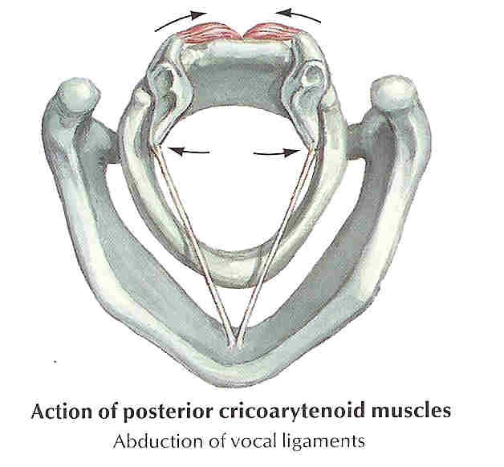
Abductor of Larynx

Slide 11
Lateral cricoarytenoid - - functions to close glottis by rotating arytenoids medially.
Transverse arytenoid - - only unpaired muscle of the larynx. Functions to approximate bodies of arytenoids closing posterior aspect of glottis.
Oblique arytenoid - - this muscle plus action of transverse arytenoid function to close laryngeal introitus during swallowing.

Slide 12
Thyroarytenoid - - very broad muscle, usually divided into three parts:
  Thyroarytenoideus internus (vocalis) - adductor and major tensor of free edge of vocal fold.
  Thyroarytenoideus externus - major adductor of vocal fold
  Thyroepiglotticus - shortens vocal ligaments

Slide 13
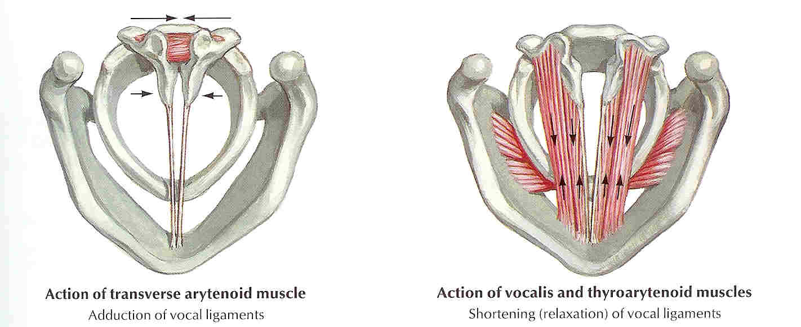
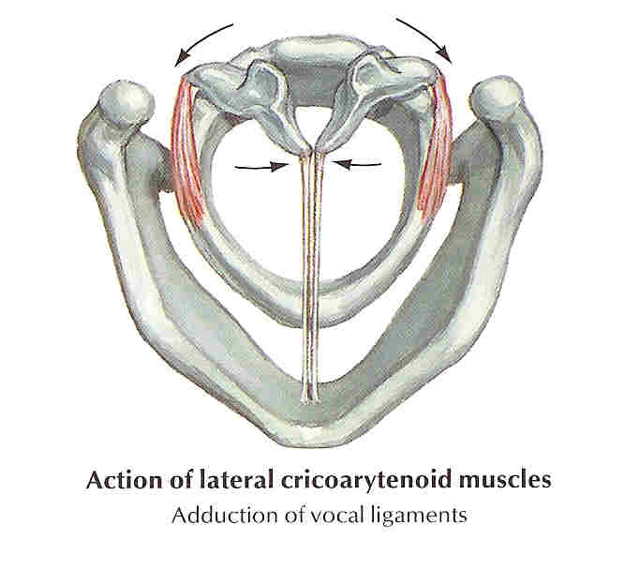
Anatomy of the Larynx - Motion
Adductors of the Vocal Folds:

Slide 14
Wegner and Grossman Theory
“In the absence of cricoarytenoid joint fixation, an immobile vocal cord in paramedian position has total pure unilateral recurrent nerve paralysis, and an immobile vocal cord in lateral position has a combined paralysis of superior and recurrent nerves (the adductive action of cricothyroid muscle is lost)”

Slide 15
Causes of vocal cord paralysis
Malignant : This accounts for 25% of cases, one half being caused by carcinoma of lung

Slide 16
Causes of vocal cord paralysis
Surgical/Traumatic: (20% cases)
  Thyroidectomy
  Pneumonectomy
  CABG
  Penetrating neck or chest trauma.
  Post intubation
  Whiplash injuries
  Posterior fossa surgery

Slide 17
Causes of vocal cord paralysis
Neurulogical (5-10%)
  Wallenberg syndrome (lateral medullary stroke)
  Syringomyelia
  Encephalitis
  Parkinsons,
  Poliomyelitis
  Multiple Sclerosis
  Myasthenia Gravis,
  Guillian-Barre
  Diabetes

Slide 18
Causes of vocal cord paralysis
Inflammatory:
  Rheumatoid arthritis ,( really a "fixed" cord here)
Infectious:
  Syphilis
  Tuberculosis
  Thyroiditis
  Viral

Slide 19
Causes of vocal cord paralysis
Idiopathic (20-25%):
  Sarcoidosis,
  Lupus
  Polyarteritis nodosa
  Ortner's syndrome (left atrial hypertrophy).

Slide 20
Intracranial causes
Head injury
CVA
Bulbar poliomyelitis
Distinctive features
Other neurological signs and symptoms due to combined paralysis of soft palate, pharynx and larynx

Slide 21
Cranial
Fracture base of skull
  Juglar foramen lesions (Glomus tumours, Naspharyngeal Carcinoma)
  Skull base osteomyelitis
Distinctive features
  Other cranial nerve palsies (IX,X,XI)
  Pharyngeal, superior and Recurrent Laryngeal nerve

Slide 22
Neck
Thyroidectomy
Thyroid Tumours
Post Cricoid Carcinoma
Malignant Cervical Lymph nodes
Distinctive features
Superior and Recurrent Laryngeal nerves involved

Slide 23
Chest
Bronchogenic Carcinoma
Cardiothoracic Surgery
Aortic Aneurysm
Mediastinal Lymphadenopathy
Tracheal/Oesophageal surgery
Distinctive feature
  Involvement of Left Recurrent Laryngeal Nerve

Slide 24
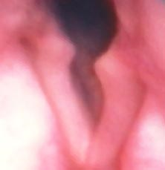
Unilateral Superior Laryngeal Nerve Injury
Normal vocal fold position during quiet respiration.
Noticeable deviation of posterior commissure to paralyzed side during phonatory effort
At rest, the vocal fold on paralyzed side is slightly shortened and bowed, and may be depressed below level of normal side.

Slide 25
Unilateral Superior Laryngeal Nerve Injury
Loss of sensation to the supraglottic larynx can cause subtle symptoms such as frequent throat clearing, paroxysmal coughing, voice fatigue, vague foreign body sensations.
Loss of motor function to cricothyroid muscle can cause a slight voice change, which the patient usually interprets as hoarseness. Most common finding is diplophonia (with decreased range of pitch, most noticeable when trying to sing.

Slide 26
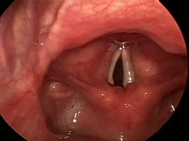
Unilateral Recurrent Laryngeal Nerve Injury
Nonfunction of the intrinsic muscles of the larynx on the affected side (loss of abduction with intact adduction by cricothyroid) cause the vocal cord to assume a paramedian position.
The voice is breathy but compensation occurs, though rarely back to normal.
The airway is adequate and may become compromised only with exertion.

Slide 27
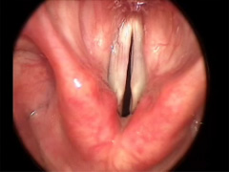
Bilateral Recurrent Laryngeal Nerve Injury
Usually result of damage to both RLN.
Cords lie in paramedian position
Voice is good
Variable degree of stridor

Slide 28
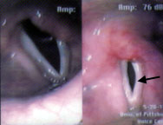
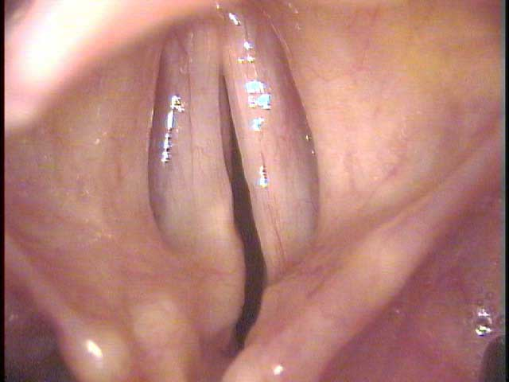
Evaluation – Physical Examination
Complete Head and Neck Examination
Flexible Fiberoptic Laryngoscopy
90 degree Hopkins Rod-lens Telescope
Adequacy of Airway, Gross Aspiration
Assess Position of Cords
  Median, Paramedian, Lateral
  Posterior Glottic Gap on Phonation

Slide 29
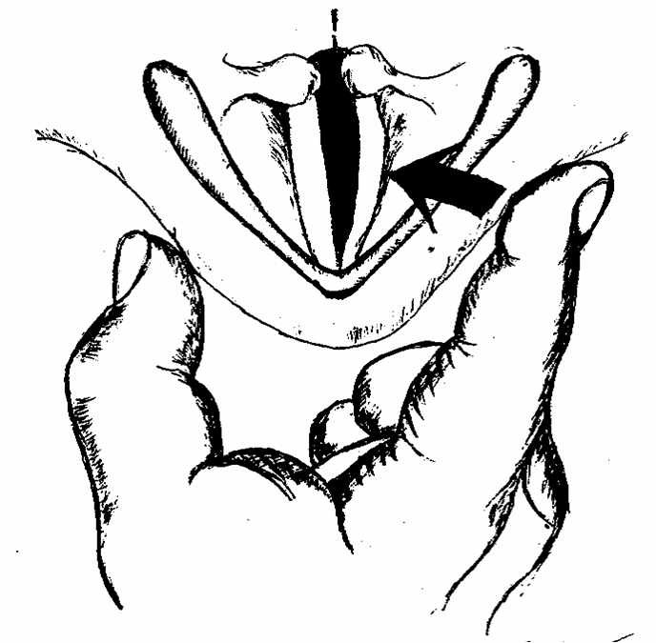
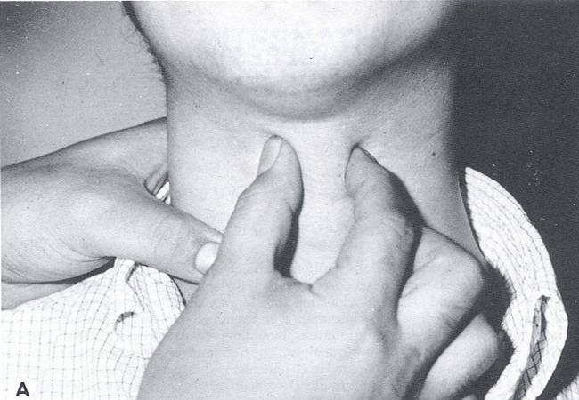
Evaluation – Unilateral Paralysis
Manual Compression Test

Slide 30
Management – Unilateral Paralysis
Vocal Cord Injection
Adds fullness to the vocal cord to help it better appose the other side
Injection technique is similar regardless of material used
Injection into thyroarytenoid/vocalis
Injection can be done endoscopically or percutaneiously
Poor correction of posterior glottic gap

Slide 31
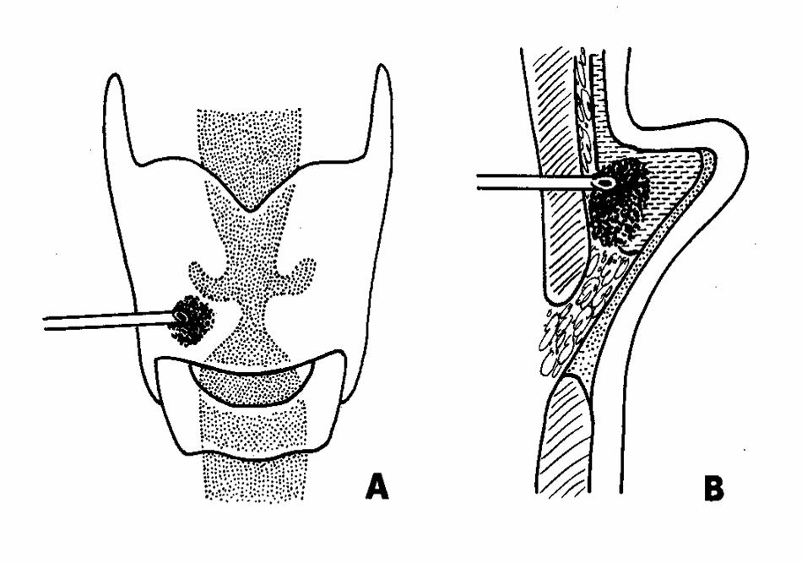
Management – Unilateral Paralysis
Vocal Cord Injection

Slide 32
Management – Unilateral Paralysis
Vocal Cord Injection - Materials
Teflon
Fat
Collagen
  Autologous Collagen
  Homologous Micronized Alloderm (Cymetra)
  Heterologous Bovine Collagen (Zyderm
Hyaluronic Acid
Calcium Hydroxyapatite gel (Radiance FN)
Polydimethylsiloxane gel (Bioplastique)

Slide 33
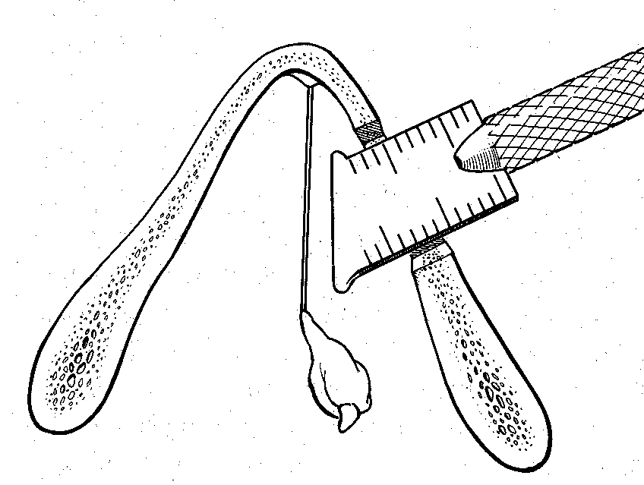
Management – Unilateral Paralysis
Type I Thyroplasty

Slide 34
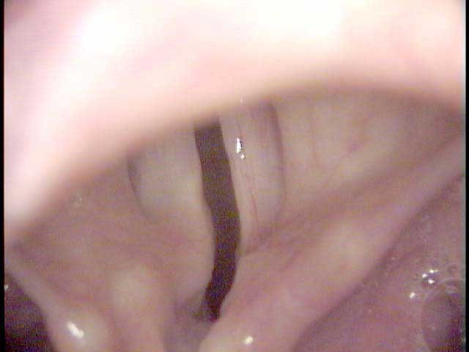
Management
Bilateral Abductor Paralysis
Patients exhibit lack of abduction during inspiration, but good phonation
Maintenance of airway is the primary goal
Airway preservation often damages an otherwise good voice
Inspiration
Expiration

Slide 35
Management
Bilateral Abductor Paralysis
Tracheostomy
  Gold standard
  Most adults will require this
  Speaking valves aid in phonation
Laser Cordectomy
Laser Cordotomy
Woodman Arytenoidectomy

Slide 36
Conclusions – Key Points
Management – Unilateral Paralysis
  Anterior and Posterior Glottic gap must be addressed
  Arytenoid adduction is irreversible
  Continued improvement up to 1yr after Type I thyroplasty
Management – Bilateral Paralysis
  Preservation of airway is most important goal

Slide 38
References

Slide 39
MCQ

Slide 40
1. Which is the only muscle for abduction of vocal cord?
Posterior cricoarytenoid
Lateral cricoarytenoid
Inter arytenoid
Thyroarytenoid

Slide 41
2. Which muscle is supplied by external branch of superior laryngeal nerve?
Cricoarytenoid
Cricothyroid
Interarytenoid
Oblique arytenoid

Slide 42
3. Which of the following nerve is supplying the larynx above the level of vocal cord?
Internal branch of SLN
External branch of SLN
Recurrent laryngeal nerve
Vagus nerve

Slide 43
4. Which are the folowing muscles are supplied by recurrent laryngeal nerve?
Posterior cricoarytenoid
Cricoarytenoid
Cricothyroid
Interarytenoid
Oblique arytenoid

Slide 44
5. What is otrner’s syndrome?
Left atrial hypertrophy
Right atrial hypertrophy
Recurrent laryngeal nerve paralysis
Superior laryngeal nerve paralysis

Slide 45
Thank you

