Slide 1
Congenital Laryngeal
Anomalies
Dr Nirali Chauhan
Associate professor
Department of ENT

Slide 2
Levels of Evidence
Grade A – Systemic reviews, Meta analyses, RCT
Grade B – Non-randomized studies
Grade C – Observational studies
Grade D – Case Series, Expert opinion

Slide 3
Levels of Evidence
**** ~ Systematic reviews, meta analysis of randomized control studies
*** ~ Non randomised studies
** ~ Observational or non experimental studies
* ~ Expert opinion

Slide 4
Laryngeal embryology
Laryngeal development
3rd week
 Respiratory primordium is derived from primitive foregut
4th -5th weeks
Tracheoesophageal (TE) septum forms by fusion of (TE) folds

Slide 5
Larynx develops from the 4th & 5th arches
 Primitive laryngeal aditus is T-shaped with 3 eminences
Hypobranchial eminence becomes the epiglottis
2nd & 3rd eminence develops into the arytenoids
Laryngeal lumen obliterates & then recanalize by the 10th week

Slide 6
Laryngeal Function
Breathing passage
Airway protection
Vocalization
Aid in clearance of secretion

Slide 7
Differences in Adults vs Infants
 1/3 size at birth
 Narrow dimensions of subglottis and glottis
 subglottis is the narrowest (4-5mm in diameter)
 Higher in the neck
 C4 at birth vs C6-7 at 15 y/o
 Epiglottis is narrower

Slide 8
Clinical Manifestations of congenital anomalies
Respiratory obstruction
Stridor
Weak cry
Dyspnoea
Tachypnea
Aspiration
Cyanosis
Sudden death

Slide 9
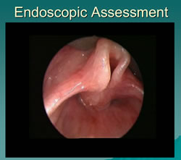
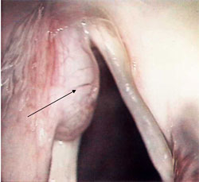
Supraglottic Abnormalities

Slide 10
Laryngomalacia
Most common congenital laryngeal anomaly.
Accounts for approximately 60 percent of laryngeal problems in the newborn.
Boys are affected twice as often as girls.
It is usually a self-limiting condition, but when severe may produce:
  Life-threatening obstructive apnea,
  Cor pulmonale,
  Failure to thrive.
Fatal outcomes have been described.
Severe cases may require intubation or tracheotomy to secure the airway.

Slide 11
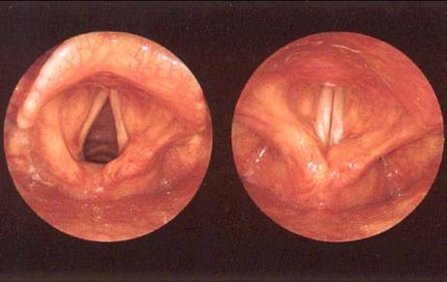
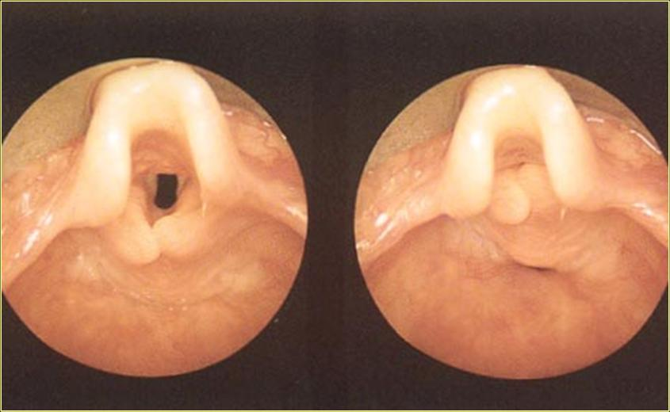
Normal Larynx
Collapse of arytenoid mucosa; shortened aryepiglottic folds; tubular epiglottis with posterior collapse
The supraglottic structures are pulled into the lumen around a vertical axis with inspiration
Laryngomalacia

Slide 12
Stridor is typically noted in the first few weeks of life and is characterized by fluttering, high-pitched inspiratory sounds.
Position changes of the infant may help alleviate the stridor as it typically worsens in the supine position.
Diagnosis is by flexible laryngoscopy

Slide 13
Reassuring the parents that the prognosis for the child is favorable.
In the past, tracheotomy was the surgical procedure of choice for severe cases.
Supraglottoplasty has proven successful for the correction of supraglottic obstruction and is now the surgical procedure of choice.
Stridor is usually improved immediately after surgery [ Grade B]

Slide 14
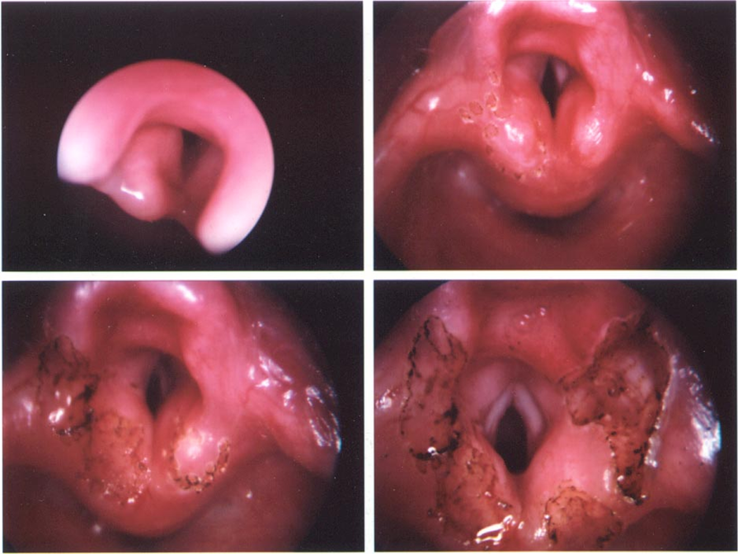
Supraglottoplasty

Slide 15
Laryngocoele & Saccular cyst
 Saccule- cecal pouch of mucous membrane in anterior roof of the laryngeal ventricle
Dilated sac filled with air (ventricle)
Present commonly in trumpet player or glass blower
Internal vs. external
May present at birth– stridor*
Difficult to diagnose– CT?
Bryce sign
Endoscopic or open procedures
Recurrences low

Slide 16
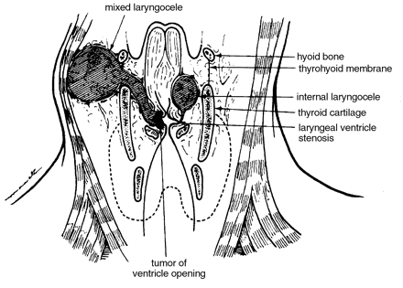
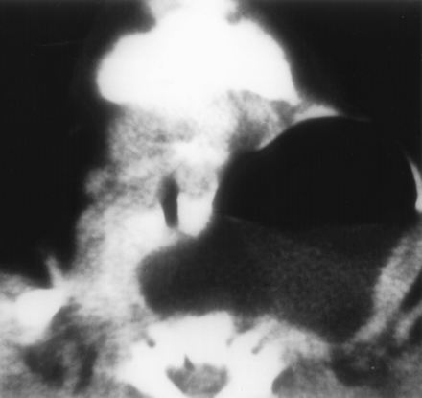
Internal laryngocoeles are within the larynx itself and do not cross the thyrohyoid membrane.
External laryngocoeles penetrate the thyrohyoid membrane at the neurovascular bundle.
Mixed laryngocoeles are dilated in both segments.

Slide 17
Treatment
These are rare in infants and can cause intermittent hoarseness and dyspnoea that increases with crying.
Diagnosis may be difficult as these can contract and may not be visualized under anesthesia. A CT may be valuable in these instances.
Endoscopic and open procedures have been advocated depending on the size and location of the laryngocoele.

Slide 18
Saccular cysts
Congenital cyst of the larynx or laryngeal mucocele
No communication with the laryngeal lumen
Filled with mucous (no air)
Developmental- failure to maintain patency of the saccular orifice
Two types-Anterior saccular cyst- Protrudes into the ventricle
-Lateral saccular cyst - Extends into the false vocal cords and aryepiglottic folds
Best treated with initial endoscopy by wide endoscopic marsupialization. [Grade C]

Slide 19
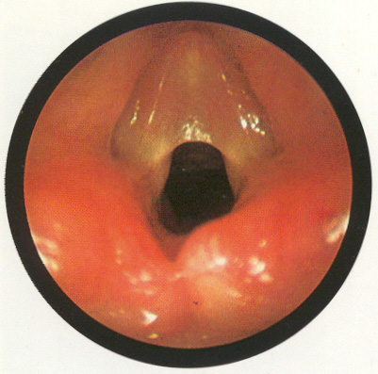
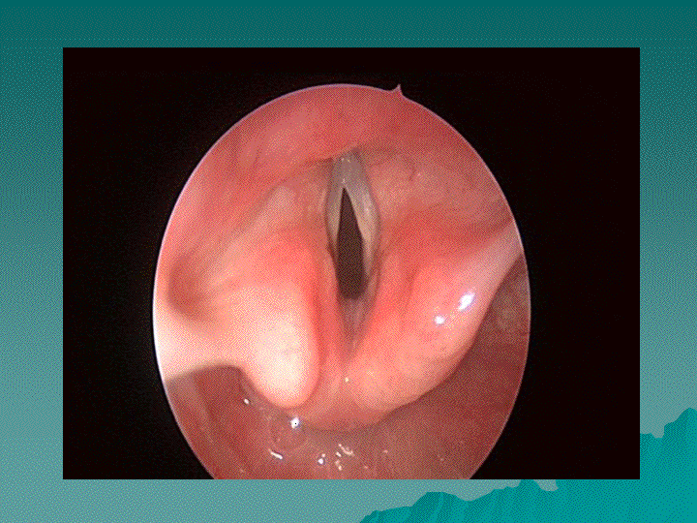
Glottic Anomalies

Slide 20
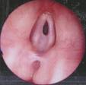
Laryngeal webs
  Failure of recanalization of larynx
  75% at glottic level
  Most anterior with subglottic involvement
  Four types– increasing severity
  May present at birth
  Diagnosis: flexible laryngoscopy

Slide 21
The presentation of laryngeal webs varies with the severity and type of the web.
Type I laryngeal webs involve 35% or less of the glottis.
  The true vocal cords are visible through the web and there is little or no subglottic extension.
  Symptoms include a mildly abnormal cry with some hoarseness.
  Respiratory distress is usually not a feature.
Type II webs are anterior webs involving 35-50% of the glottis.
  Subglottis involvement stems more from thick anterior webbing than from cricoid abnormalities.
  Airway symptoms are uncommon except during infection or after intubation trauma.

Slide 22
Type III webs involve 50-75% of the glottis.
  The web is thick anteriorly and the true vocal cords may not be visualized.
  There may be associated cricoid anomalies.
  Airway symptoms are often severe and marked vocal dysfunction may occur.
Type IV webs occlude 75-90% or more of the glottis.
  It is uniformly thick and the true vocal cord is not identifiable.
  The patient is aphonic and immediate airway management is required at birth.

Slide 23
Treatment
Thin membranous type I webs which produce only minimal symptoms can be observed until age 3-4 years and then divided with either the CO2 laser or cold knife.
Type II webs can be managed by incising the web along one vocal cord and then proceeding with staged dilations
Treatment of type III and IV webs is usually delayed until the child is 3-4 years old. Most infants will have a tracheotomy in place for airway control until definitive surgery is undertaken.
The standard treatment for these conditions entails a tracheotomy, laryngotomy, and keel insertion

Slide 24
Congenital Vocal fold paralysis
Vocal fold paralysis has long been recognized as a significant cause of stridor and hoarseness in infants and children.
It is the second most common cause of stridor in the newborn behind laryngomalacia. Laryngeal paralysis may be present at birth or may manifest itself in the first month or two of life.
The neurologic impairment reflects an injury to the vagus nerve.

Slide 25
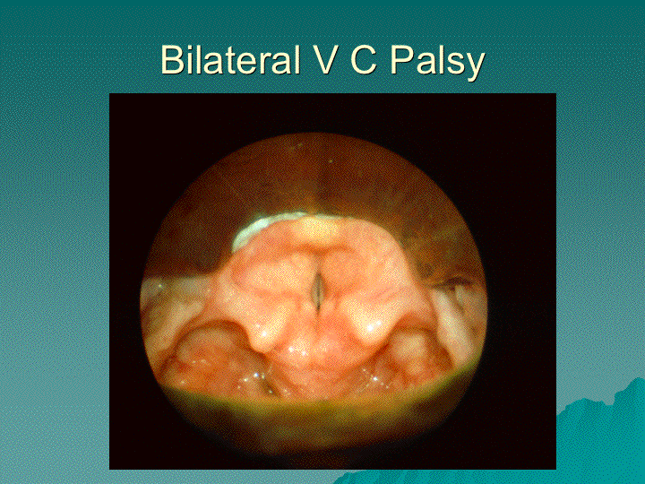

Slide 26
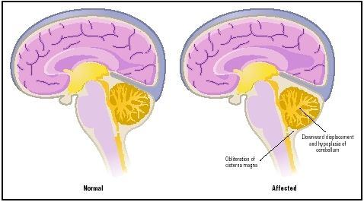
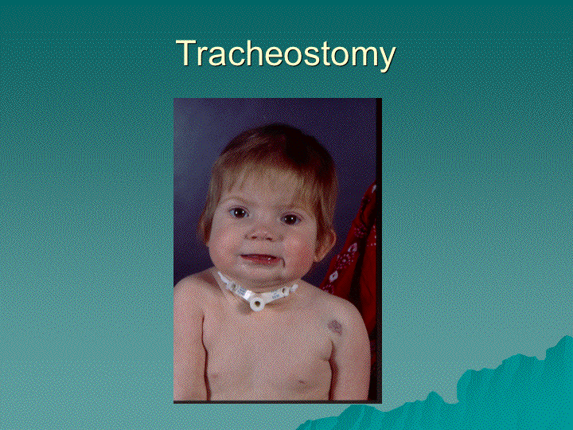
The lesion can occur anywhere from the brain through the neck into the chest and into the larynx.
Many paralyses are idiopathic in up to 47% of cases,
The most common causative factors:
  Arnold Chiari malformations,
  Hydrocephalus, neonatal hypotonia,
  Multiple peripheral paralysis (myasthenia gravis).
  Other causes include birth trauma and cardiac anomalies.
Associated laryngeal lesions such as clefts and stenosis are also commonly often found.

Slide 27
Symptoms
The most common symptom is stridor.
Ineffective cough, aspiration, recurrent pneumonia, and feeding difficulties are also commonly reported.
Consistent stridor, cyanosis, and apnea are frequent.
Voice and cry, however, may be normal particularly in cases of bilateral vocal cord paralysis.
Hoarseness and dysphonia are common in cases of unilateral vocal fold paralysis.

Slide 28
Management strategies depend on the child’s underlying condition.
Children with bilateral vocal fold paralysis frequently require surgical intervention.
The airway is often markedly compromised and in over 50% of cases a tracheotomy is required.
Multiple lateralization options include CO2 laser cordotomy and open arytenoidectomy, artenoidpexy, arytenoid separation with cartilage grafting or laser arytenoidectomy and cordectomy- glottic enlargement surgery [ Grade B ] to avoid tracheostomy/ achieve decannulaton.

Slide 29
The management of unilateral vocal cord paralysis in children is usually less urgent than that of bilateral paralysis.
Children adjust well to persistent unilateral vocal cord paralysis with few sequelae. A weakened cry may result but an adequate airway is the typically maintained.

Slide 30
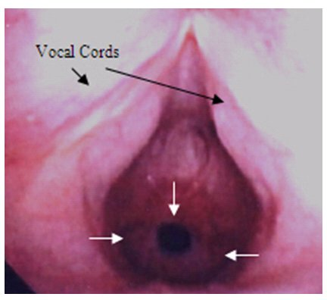
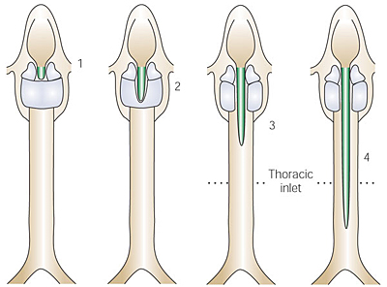
Subglottic anomalies

Slide 31
Subglottic Stenosis
May be classified as either acquired or congenital.
Although congenital subglottic stenosis is uncommon, accounting for 5% of all cases, it is the third most common congenital airway problem (after laryngomalacia and vocal cord paralysis).
Congenital SGS is thought to be secondary to failure of the laryngeal lumen to recanalize properly during embryogenesis
SGS is considered congenital if there is no history of endotracheal intubation or other forms of laryngeal trauma.

Slide 32
Subglottic stenosis is defined as a subglottic lumen 4.0 mm in diameter or less at the level of the cricoid in a full term infant.
The normal newborn subglottic diameter is 4.5 – 5.5 mm and in premature neonates around 3.5 mm.
Congenital SGS is divided histopathologically into membranous and cartilaginous types.
Membranous SGS is usually circumferential and consists of fibrous soft-tissue thickening.
The cartilaginous type usually results from a thickened or deformed cricoid cartilage

Slide 33
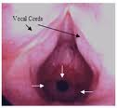
The severity of congenital subglottic stenosis depends on the degree of SG narrowing.
Children with subglottic stenosis usually present with stridor and/or respiratory distress.

Slide 34
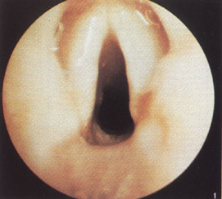
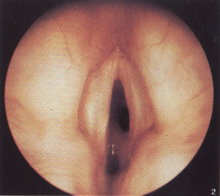
Classification
The McCaffrey system classifies laryngotracheal stenosis based on the subsites involved and the length of the stenosis.
Four stages are described:
  Stage I lesions are confined to the subglottis or trachea and are less than 1cm long
  Stage II lesions are isolated to the subglottis and are greater then 1 cm long

Slide 35
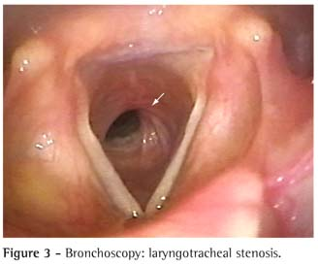
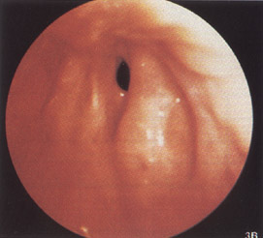
  Stage III are subglottic/tracheal lesions not involving the glottis
  Stage IV lesions involve the glottis

Slide 36
Treatment of congenital SGS is tailored to the symptoms and grade of the stenosis.
Symptoms are typically less severe in congenital SGS than in the acquired form & also improves as the child grows, and less than half of children with this disorder will require a tracheotomy.
Mild stenosis (Cotton-Myer grades I and II) can usually be treated conservatively with observation. In cases that do require surgery, endoscopic techniques such as CO2 laser resection of a membranous web can be performed.
Grade III or IV stenosis may require some form of open surgical procedure, as these typically are the result of a cartilaginous stenosis.

Slide 37
Laryngeal Cleft
Rare congenial anomaly
congenital laryngeal anomaly occurs in 1 in 2000 live births, less than 0.3% attributable to laryngeal cleft
Boys: girls with a ratio of 5:3
Contributing factors prematurity and hydraminos

Slide 38
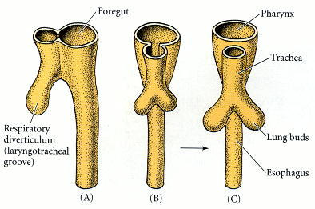
Cricoid cartilage begins forming at 5 weeks of gestation and is derived from 6th branchial arch. Chondrification completes by 6th week of gestation.
Incomplete fusion of tracheo-brachial septum or cricoid cartilage leads to laryngeal cleft or TE fistula

Slide 39
Classification of laryngeal cleft
Type I clefts as a supraglottic, interarytenoid clefts.
Type II clefts are a partial cricoid cleft.
Type III clefts are a complete cricoid cleft with or without extension into the esophagus
Type IV cleft are full laryngotrachealesophageal clefts.

Slide 40
Manifestations
Choking/aspiration with feeding
Regurgitation
Stridor
Recurrent pneumonia
Chronic Cough
Cyanosis

Slide 41
Treatment
Timing and approach for surgical repair depend upon severity of symptoms, associated abnormalities, type of cleft
In small cleft: conservative, positioning and thickened food, if failed surgical repair.
  Gel foam injection
  Open approach and graft interposition
  Endoscopic approach

Slide 42
Subglottic Haemangioma
 Benign vascular malformations
 Histological- endothelial hyperplasia
 Female predominance 2:1
 Asymptomatic at birth
 Stridor presents by 6 months (85%)
 Associated cutaneous hemangioma (50%)

Slide 43
Diagnosis
Direct laryngoscopy:
Compressible
Asymmetric, usually posterolateral
Bluish or reddish discoloration
CT/ MRI

Slide 44
Treatment:
Systemic steroids (principal)
 Partial regression in most patients (82-97%)
 Risk of growth retardation and increase susceptibility to infection
 Risk is reduced by alternate-day dosing regimen in the smallest doses
 Also intra lesion corticosteroids has been employed with successful avoidance of tracheotomy

Slide 45
Interferon alpha-2a - It requires prolonged therapy, blocks various steps of angiogenesis
Tracheostomy
Surgical excision

Slide 46
References
Jani P, Koltai P, Ochi JW. Surgical treatment of laryngomalacia. Journal of Laryngology & otology. 1991;105: 1040-5.
Shugar MA, Healy GB. Coexistent lesions of the paediatric airway. International journal of paediatrics otorhinolaryngology. 1980; 2: 323-7.
Beily CM, Froehlich P, Hoeve HLJ. Management of subglottic haemangioma. Journal of Laryngology & Otology. 1998; 112: 765-8.
Benjimin B, Inglis A. Minor congenital laryngeal clefts: Diagnosis & classification. Annals of ORL. 1989; 98: 417-20.

Slide 47
MCQ

Slide 48
1. Infant larynx lies at ___.
C2
C3
C4
C6

Slide 49
2. External laryngocoeles penetrate the ___________ membrane at the neurovascular bundle.
Crico thyroid
Thyrohyoid
Crico tracheal
None of the above

Slide 50
3.Brayce sign is seen ________.
Laryngomalacia
Laryngocele
Laeyngeal web
Subglottic stenosis

Slide 51
4. Which of the following is 2nd most common cause of stridor in new born?
Laryngomalacia
Laryngocele
Subglottic stenosis
Bilateral vocal cord paralysis

Slide 52
5. Epiglottis is derived from ________.
2nd arch
3rd arch
4th arch
Hypobranchial eminence

Slide 53
Thank you

Slide 54
C
B
A
D
D

