Slide 1
MYCOTIC CORNEAL
ULCER
BY DR. DHARMIL DOSHI

Slide 2
Etiology
Filamentous fungi (Aspergillus, fusarium)
Yeast (Candida & cryptococcus )
Mode of infection
Injury by vegetative material
Injury by animal tail.
Secondary fungal ulcers basically in immunocompromises patients.

Slide 3
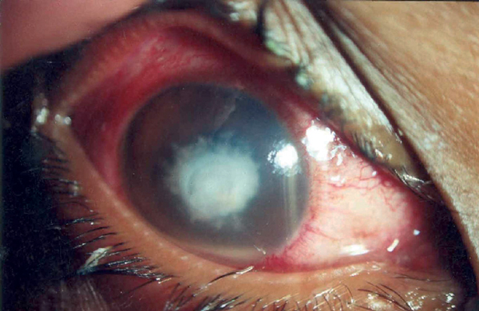

Slide 4
SIGNS.
Dry looking, Greyish white
Delicate feathery finger like projection.
A sterile immune ring (yellow line of demarcation)
Multiple small satellite lesion
Big hypopyon
Rarely perforation can occur.
NO CORNEAL VASCULARISATION. (5* point)

Slide 5
Diagnosis of MCU
Clinical manifestation
Laboratory investigations with wet KOH, and giemsa stain
Treatment:
Specific:
  Topical antifungal (fluconazole 2%, Nystatin 3.5 % ointment, variconazole 1%)
  Systemic tab fluconazole 2-3 wks

Slide 6
2. Non specific treatment
Cycloplegic drugs
1% atropine ointment
2% homatropine eye drops
Systemic analgesics & NSAIDS
Vitamin A,B,C

Slide 7
3. Physical & general measures
Dark goggles
Rest, good diet and fresh air
Hot fomentation

Slide 8
4. Therapeutic penetrating keratoplasty
Therapeutic penetrating keratoplasty in nonresponsive cases.

Slide 9
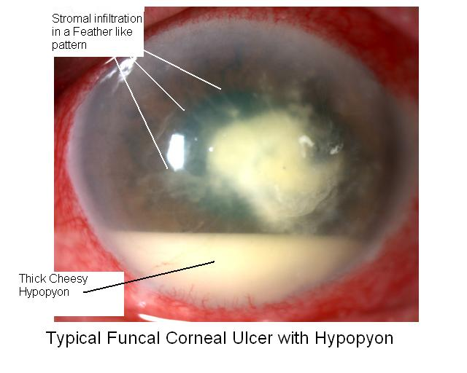

Slide 10
Citation | Author | Objective | Result
JAMA Ophthalmol. 2013 Apr;131(4):422-9. | Prajna NV¹, Krishnan T, Mascarenhas J, Rajaraman R, Prajna L, Srinivasan M | To compare topical natamycin vs voriconazole in the treatment of filamentous fungal keratitis. | A total of 940 patients were screened and 323 were enrolled. Causative organisms included Fusarium (128 patients [40%]), Aspergillus (54 patients [17%]), and other filamentous fungi (141 patients [43%]). Natamycintreated cases had significantly better 3-month best spectacle-corrected visual acuity than voriconazole-treated cases (regression coefficient=0.18 logMAR; 95% CI, 0.30 to 0.05; P=.006). Natamycin-treated cases were less likely to have perforation or require therapeutic penetrating keratoplasty (odds ratio=0.42; 95% CI, 0.22 to 0.80; P=.009). Fusarium cases fared better with natamycin than with voriconazole (regression coefficient=0.41 logMAR; 95% CI,0.61 to 0.20; P<.001; odds ratio for perforation=0.06; 95% CI, 0.01 to 0.28; P<.001), while non-Fusarium cases fared similarly (regression coefficient=0.02 logMAR; 95% CI, 0.17 to 0.13; P=.81; odds ratio for perforation=1.08; 95% CI, 0.48 to 2.43; P=.86).

Slide 11
OUTCOME
Natamycin treatment was associated with significantly better clinical and microbiological outcomes than voriconazole treatment for smear-positive filamentous fungal keratitis, with much of the difference attributable to improved results in Fusarium cases.

Slide 12
Citation | Author | Objective | Result | Outcome
Nepal Med Coll J. 2012 Sep;14(3):219-22. | Amatya R¹, Shrestha S, Khanal B, Gurung R, Poudyal N, Bhattacharya SK, Badu BP. | Etiological agents of corneal ulcer: five years prospective study . | Of 351 specimens examined, growth of etiological agents were obtained in 278 (79.20%). Of these, 113 (40.65%) had pure fungal growth, 108 (38.85%) had pure bacterial growth and 57 (20.50%) had mixed fungal and bacterial infection. The commonest fungal pathogen was Aspergillus spp 50 (33.33%) followed by Fusarium spp 19 (12.66%). Staphylococcal aureus 57 (44.53%) was isolated as commonest bacterial agent. Coagulase Negative Staphylococci 20 (15.6%) was second in the list. Pseudomonas spp 12 (9.40%) was the most common gram negative bacilli isolated. | Knowledge of both fungal and bacterial agents associated with this condition is of value for the prevention and management of corneal ulcers and their complications.

Slide 13
1 )fluconazole concentration?
2%
5%
7%
2.5%

Slide 14
2) Followin are true about fungal keratitis except:
Commoly blackish in color
Satellite lesions
Ciliary congestion
hypopyon

Slide 15
3) In fungal corneal ulcer, the most common agent is?
Mucor
Aspergillus
Candida
Lichen planus

Slide 16
4) Most active layer of cornea:
- epithelium
Descemets membrane
Lamina propia
endothelium

Slide 17
5 ) Which stain is used for acanthamoeba keratitis?
-gram stain
-Giesma stain
-calcofuor white
-Rose bengal

