Slide 1

REVISED NATIONAL TUBERCULOSIS CONTROL PROGRAMME
Dr Kusum Shah
Dept. Of Respiratory Medicine
PGIMS, Rohtak

Slide 2
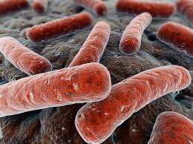
Introduction
Tuberculosis is one of the leading causes of mortality in India- killing -2 persons every three minute, nearly 1,000 every day.
Tuberculosis (TB) is an infectious disease caused by Mycobacterium tuberculosis
If left untreated, a person with sputum positive TB will infect an average of 10 to15 people in a year.
Multi Drug Resistance and co-infection with HIV has weakened our battle against the disease.

Slide 3
The global TB situation
Estimated incidence, 2014
Estimated number of deaths, 2014
9.6 million
1.1 million*
All forms of TB
1.2 million
390,000
HIV-associated TB
Multidrug-resistant TB
300,000
Source: WHO Global Tuberculosis Report 2015
* Excluding deaths attributed to HIV/TB

Slide 4
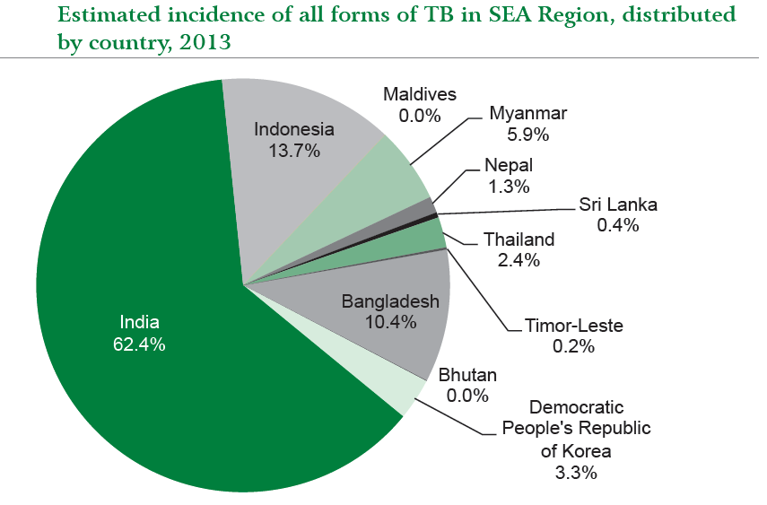
SEAR

Slide 5
India TB situation
Estimated incidence, 2014
Estimated number of deaths, 2014
2.2 million
0.22 million*
All forms of TB
HIV-associated TB
0.11 million
31,000
Multidrug-resistant TB
71,000
Source: WHO Global Tuberculosis Report 2015
* Excluding deaths attributed to HIV/TB
Notes:
.

Slide 6
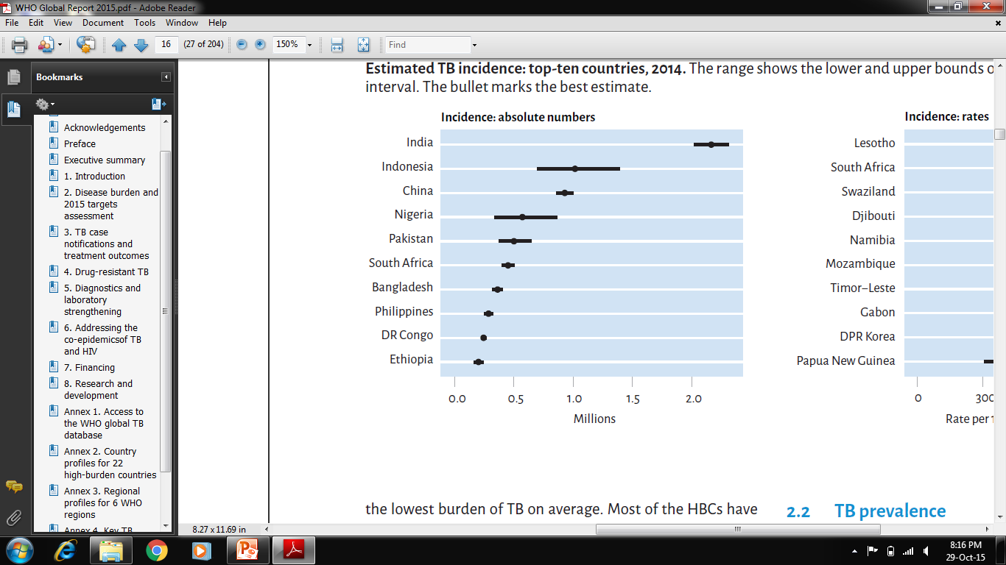
ESTIMATED INCIDENCE OF TB IN TOP 10 HIGH BURDEN COUNTRIES 2014

Slide 7
Evolution of TB Control in India
1950s-60s Important TB research at TRC and NTI
1962 National TB Programme (NTP)
1992 NTP Reviewed and concluded its failure
1993 RNTCP pilot began
1997-2006 RNTCP I
2006 -2011 RNTCP II
National Strategic Policy: 2012-17
Notes:
Formattiing required..TURN 450 INTO PERCENTAGE

Slide 8
RNTCP
Before the Revised National Tuberculosis Control Program (RNTCP) came into force the existing
National Tuberculosis program (NTP) had the following objectives:
  To identify and treat as large a number of TB patients as possible so that infectious cases are rendered non- infectious.
  To reduce the magnitude of TB problem in the country to a level where it ceases to be a public health problem.

Slide 9
FAILURE OF NTP
Results:
  low rates of case detection and treatment completion (30%),
  continuing high mortality (50 per 100,000)
  high rates of default (40–60%),
  REASONS:
  More emphasis on detection rather than cure
  Inadequate budget and insufficient managerial capacity
  Shortage and interrupted supply of drugs
  Emphasis on x-ray diagnosis resulting in inaccurate diagnosis
  Poor quality sputum microscopy
  Multiplicity of treatment regimens.

Slide 10
Revised National Tuberculosis Control Programme(1993)
              Goals
  - To reduce mortality and morbidity from tuberculosis
  - To interrupt chain of transmission.
  Objectives
  - Achievement of at least 85% cure rate of infectious cases of tuberculosis through DOTS involving peripheral health functionaries.
  - Augmentation of case finding activities through quality sputum microscopy to detect at least 70% of estimated cases.

Slide 11
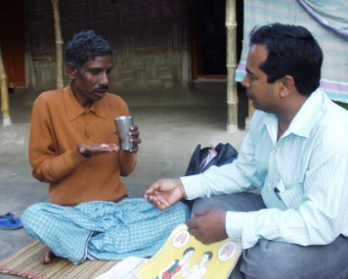
DOTS:
DOTS is a systematic strategy which
emphasizes on:
Political and administrative commitment.
Good quality diagnosis.
  Good quality microscopy is essential to identify the infectious patients who need treatment the most.
Good quality drugs.
  An uninterrupted supply of good quality anti-TB drugs must be available.
Directly observed treatment short-course chemotherapy
  The DOTS strategy along with the other components of the Stop TB strategy, implemented under the Revised National Tuberculosis Control Programme (RNTCP) in India, is a comprehensive package for TB control.
Systematic monitoring and accountability.

Slide 12
CENTRE
Organizational structure of RNTCP
Central TB Division, DGHS, MoH & FW
Deputy Director General-TB
Chief Medical Officers
National Lab Committee
National TWC for TB + HIV,
National DOTS Plus committee
NTF for medical colleges,
National OR committee
National institutes
(NTI, TRC, LRS, JALMA)
STATE TB CELL

Slide 13
ORGANISATION
STATE
Health Minister
Health Secretary
MD NHM
Director Health Services
Additional / Deputy / Joint Director
(State TB Officer)
State Training and Demonstration
Center (TB)
Director, IRL Microbiologist, MO,
Epidemiologist/statistician, IRL LTs etc.,
State TB Cell
Deputy STO, MO, Accountant,
IEC Officer, SA,
DEO, TB HIV Coordinator etc.,

Slide 14
ORGANISATION
DISTRICT
District Administration
District Magistrate/
District Collector
Chief Medical Officer and
other supporting staff
District Health Services
Nodal point for TB control
DTO, MO-DTC , LT, DEO,
Driver, Urban TB Coordinators,
TBHVs, Communication Facilitators
District TB Centre
One/ 500,000
(250,000 in hilly/
difficult/ tribal area)
Tuberculosis Unit
Medical officer-TB Control,
Senior Treatment supervisor(STS),
Senior TB Laboratory Supervisor(STLS)
One/ 100,000
(50,000 in hilly/ difficult/
tribal area)
Microscopy Centre
Medical Officer, paramedical staff
And Laboratory Technician (20-50%)
TB Health Visitors (TBHV),
DOT Provider
(MPW, NGO, PP, ASHA,
Community Volunteers)
DOT Centre

Slide 15
LAB STRUCTURE FUNCTIONS OF EQA
NRL
-OSE(On site evaluation) by NRL team – at least once a year.
-Panel testing of microbiologist & LTs of IRL
IRL
-OSE by IRL team – at least once a year.
-Panel testing of all STLS
DTC
-OSE by DTO team – at least once a month.
-OSE by IRL Team-During annual district visit.
-RBRC of routine slides
-OSE by DTO – at least once in quarter
- OSE by IRL Team (sample of DMCs)during OSE of DTC
-OSE by STLS at least once every month.
-Collection of RBRC of routine slides.
-Unblinded rechecking (5 +ves and 5 –ves)
TU
DMC

Slide 16
C-DST labs: 64
SL-DST: 24
RNTCP culture and DST labs network (October-2015)
Gurgaon
JALMA
IRL (Certified )
IRL (Under Process)
Med Col / NGO / Private Labs (Certified)
Med Col / NGO / Private Labs (Under Process)
National Reference Labs
CB-NAAT Sites
By technology
- Solid culture: 46
- LPA: 51
- Liquid culture: 28
- CB-NAAT: 121
NTI
TRC

Slide 17
STOP TB Strategy(2006)
■ In DOTS collaboration ,STOP TB strategy was started with additional six components-
1. Pursue high-quality DOTS expansion and enhancement
2. Address TB/HIV, MDR-TB, and the needs of poor and vulnerable populations
3. Contribute to health system strengthening based on primary health care
4. Engage all care providers
5. Empower people with TB, and communities through partnership
6. Enable and promote research
Notes:
VISION :A TB-free world
GOAL :To dramatically reduce the global burden of TB by 2015 in line with the Millennium Development Goals (MDGs)
and the Stop TB Partnership targets
OBJECTIVES ■ Achieve universal access to high-quality care for all people with TB
■ Reduce the human suffering and socioeconomic burden associated with TB
■ Protect vulnerable populations from TB, TB/HIV and drug-resistant TB
■ Support development of new tools and enable their timely and effective use
■ Protect and promote human rights in TB prevention, care and control

Slide 18
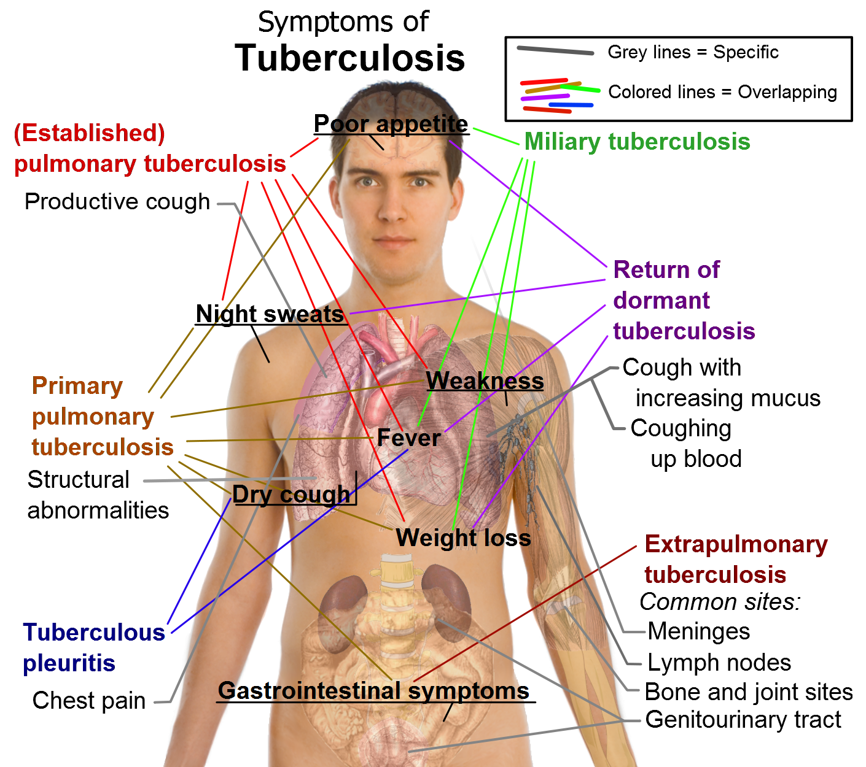
SYMPTOMATOLOGY OF T.B.

Slide 19
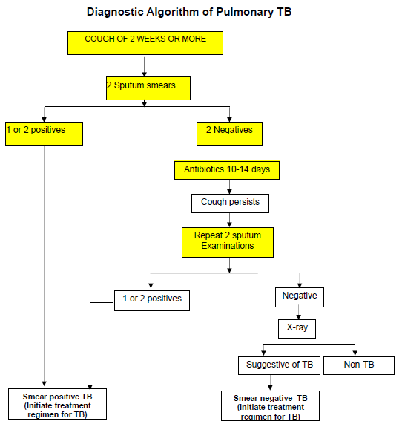

Slide 20
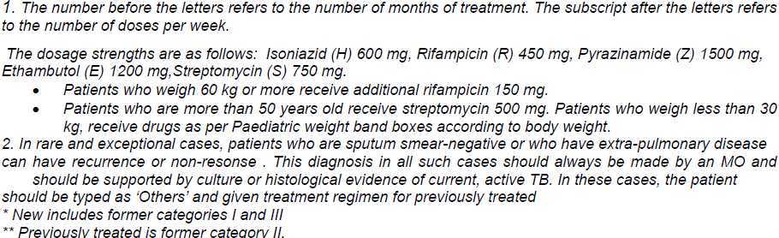
TREATMENT REGIMEN
Category | Type of Patient | Regimen | Duration in months
Category I Color of box: RED | New Sputum Positive Seriously ill sputum negative, Seriously ill extra pulmonary, | 2 (HRZE)₃, 4 (HR)₃ | 6
Category II Color of box: BLUE | Sputum Positive relapse Sputum Positive failure Sputum Positive treatment after default | 2 (HRZES)₃, 1 (HRZE)₃ 5 (HRE)₃ | 8

Slide 21
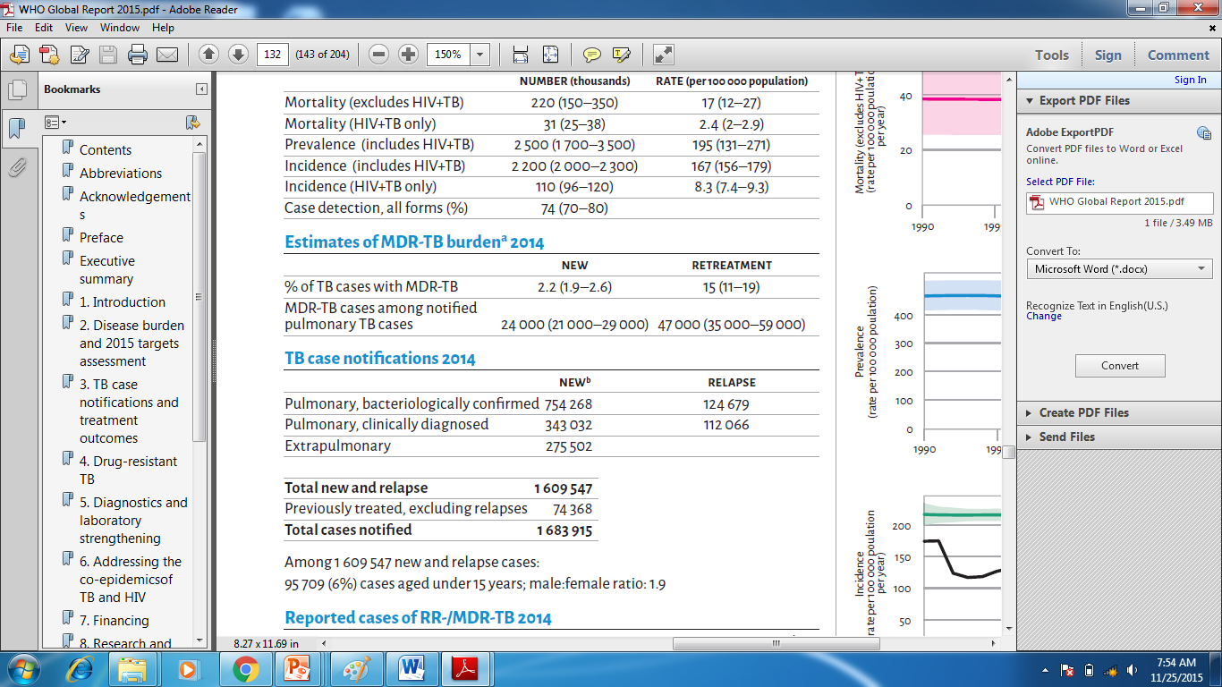
MDR-TB & XDR-TB
MDR-TB is defined as resistance to isoniazid and rifampicin, with or without resistance to other anti-TB drugs.
XDR-TB is defined as resistance to at least Isoniazid and Rifampicin (i.e. MDR-TB) plus resistance to any of the fluoro-quinolones and any one of the second line injectable drugs (amikacin, kanamycin or capreomycin).
Notes:
10 states???

Slide 22
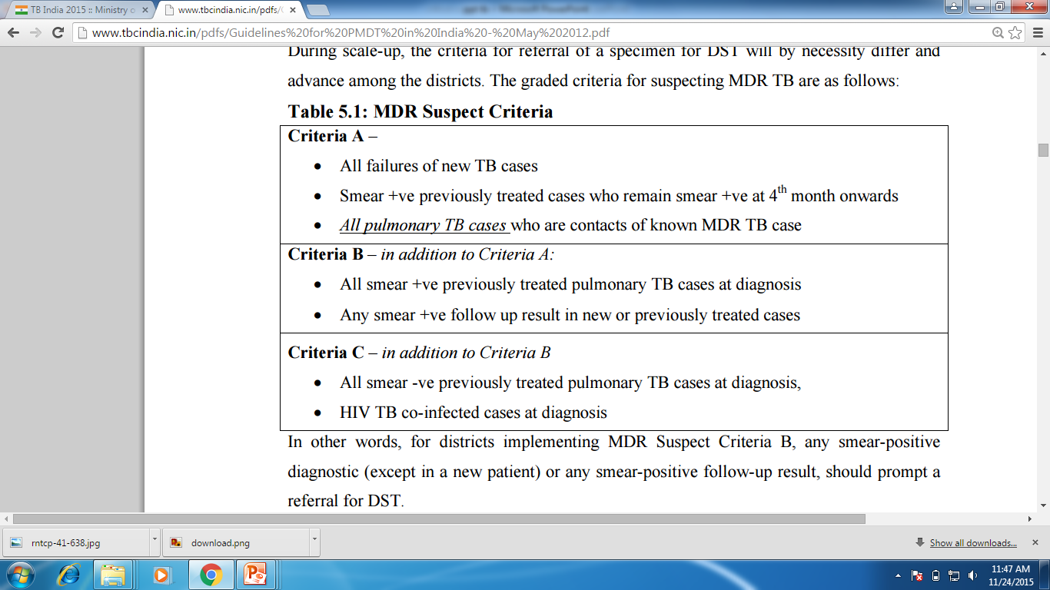

Slide 23
TREATEMENT OF MDR T.B.
RNTCP Regimen for MDR TB: 6 (9) Km Lvx Eto Cs Z E / 18 Lvx Eto Cs E [Reserve/Substitute drugs: PAS, Mfx, Cm]
TREATEMENT OF XDR T.B.
RNTCP Regimen for XDR TB: 6-12 Cm, PAS, Mfx, High dose-H, Cfz, Lzd, Amx/Clv / 18 PAS, Mfx, High dose-H, Cfz, Lzd, Amx/Clv [Reserve/Substitute drugs: Clarithromycin, Thiacetazone]

Slide 24
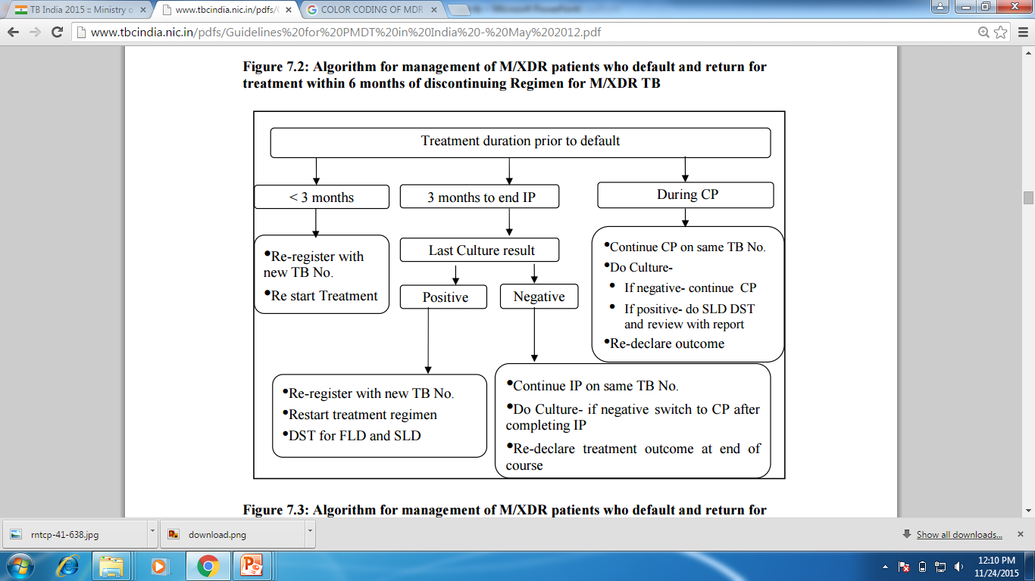

Slide 25
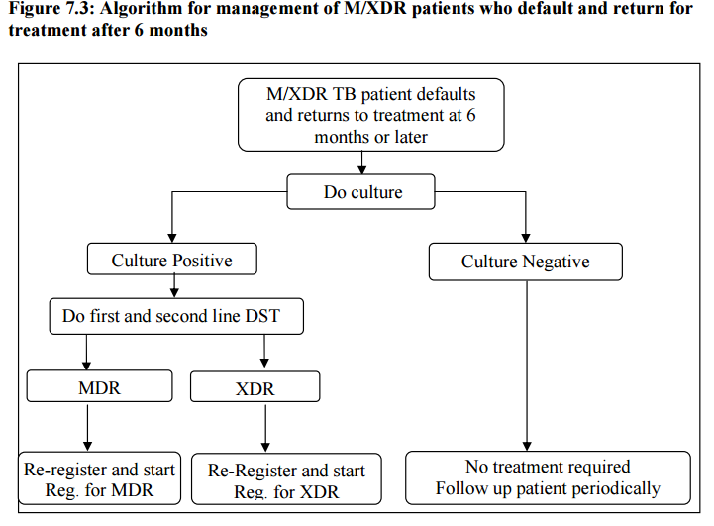

Slide 26
TB HIV Collaboration
In 2007, the first National Framework for joint TB-HIV collaborative activities was developed which endorsed a differential strategy reflective of the heterogeneity of TB-HIV epidemic.
Coordinated TB-HIV interventions were implemented including establishment of a coordinating body at national and state level, dedicated human resources, integration of surveillance, joint monitoring and evaluation, capacity building and operational research.
Interventions have focused on improving services for HIV-infected patients, with intensified TB case finding at HIV care settings and linking with TB treatment; and for TB patients with provider initiated HIV testing and counseling, provision of ART and decentralized CPT.

Slide 27
TB HIV Collaboration…
ESTIMATED HIV-POSTIVE INCIDENT TB CASES: 0.11 MILLION IN 2014
PERCENTAGE OF NOTIFIED TB PATIENTS WITH TESTING OF HIV : 72%
% OF TB PATIENTS WITH AN HIV TEST RESULT WHO WERE HIV-POSITIVE: 4.3%
% OF NOTIFIED HIV-POSITIVE TB PATIENTS STARTED ON ART: 91%
94% HIV INFECTED TB PATIENTS WERE INITIATED ON CPT.

Slide 28
Major challenges : RNTCP
Ineffective and delayed diagnosis of TB in both the private and public sector;
Practitioners do not stick to standard RNTCP treatment protocol.
Patients accessing private providers not linked or engaged with RNTCP;
Large-scale expansion of patient notification from the private sector;
Inadequate staffing at all levels, to be addressed through improved HRD, to reduce reliance on a limited pool of TB-dedicated staff.
Enforcement of regulations for prescribing and sale of anti-TB drugs; promoting rational use of first- and second-line anti-TB drugs outside the programme to prevent MDR and XDR TB;
Developing and implementing airborne infection control measures in health facilities.

Slide 29
Major Achievements:RNTCP
• Since its inception, the programme has initiated more than 19 million
patients on treatment, thus saving more than 3.1 million additional lives
• Since 2007, RNTCP has also achieved the new smear-positive case-detection rate of more than 70% in line with the global targets for TB control while maintaining the treatment success rate of >85%.
• Treatment services were decentralized through a network of more than
640 000 DOT centres/providers using patient-wise boxes both for adults
and paediatric patients.
• Successful involvement of 330 medical colleges, 2569 NGOs, 13 150 private
practitioners and over 150 corporate sector health units was achieved

Slide 30
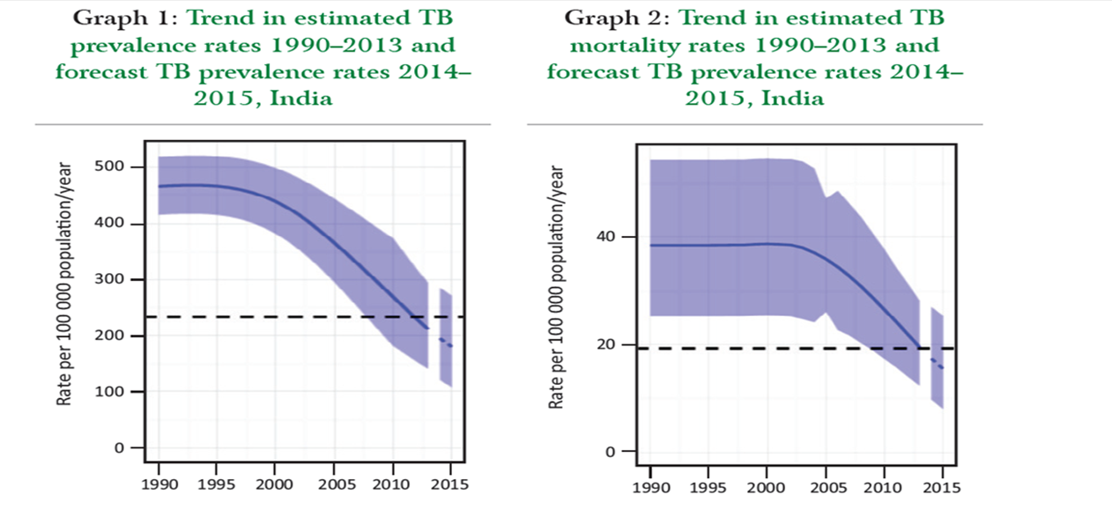
Major Achievements:RNTCP…
• By March 2013, all districts in the country were covered by PMDT services.
• In a workshop “TB-India Vision 2020”, RNTCP has developed strategies for
intensified TB control activities for achieving 2020 TB targets.

Slide 31
National Strategic Plan (NSP)(2012-17)
Vision
TB-free India
Goal
Decrease the morbidity and mortality by early diagnosis and treatment to all TB cases thereby cutting the chain of transmission.
RNTCP defined newer objectives of 'Universal Access to TB Care' for TB control in India in 2010.

Slide 32
Objectives
Case detection
NSP objective:
To Achieve 90% Notification rate for all cases
RNTCP Objective :
70% of estimated New Smear Positive TB cases
Treatment success
NSP Objective:
90% success rate amongst New & 85% amongst retreatment TB cases registered under RNTCP
RNTCP Objective:
85% of all New Smear positive TB cases
Drug resistant TB
NSP Objective:
Improve the successful outcome of treatment of MDR cases

Slide 33
Objectives
TB-HIV Collaboration
NSP Objective:
Decrease Mortality and morbidity of HIV associated TB
Private Sector
NSP Objective:
Improve the outcome of TB care in Private sector

Slide 34
RNTCP UPDATE
Single window services for TB HIV co infected patients
Introduction of Daily Regimen for drug sensitive TB under RNTCP
Scale up CBNAAT
Newer anti TB drug.

Slide 35
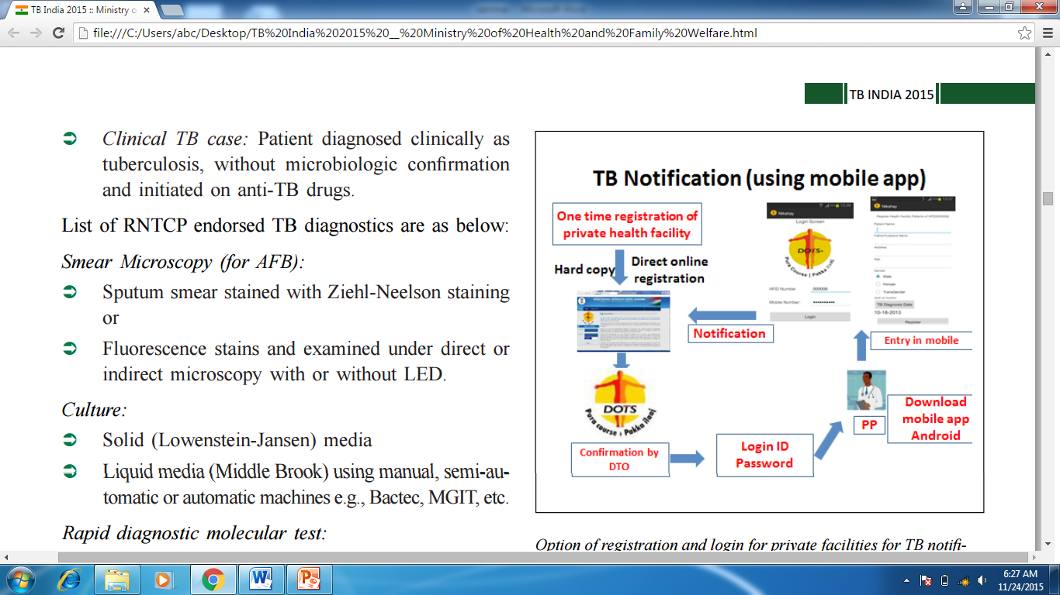
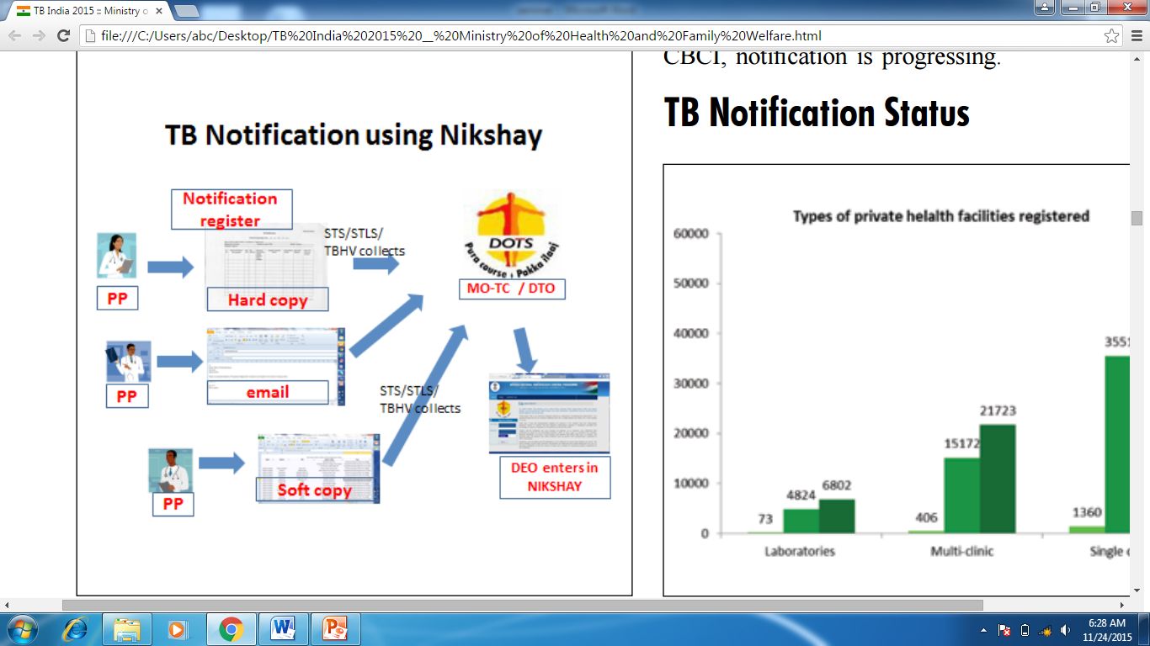
NIKSHAY
CASE BASED WEB BASED APPLICATION LAUNCHED ON MAY 2012

Slide 36
Till 18th March 2014
NIKSHAY
TB Patients Registered under RNTCP Till 18th March 2014 : 38,61,201
Peripheral Health Institutes (PHI) registered : 47,461
Patients notified : 20,8617
Culture & Drug Resistant Labs Patients registered : 1,20,717
Drug Resistant Tuberculosis Patients registered : 10,788
By end-2014, 82 309 private health facilities were registered for TB notification in Nikshay and cumulatively 1 643 521 TB patients were notified from the private sector through this tool.

Slide 37
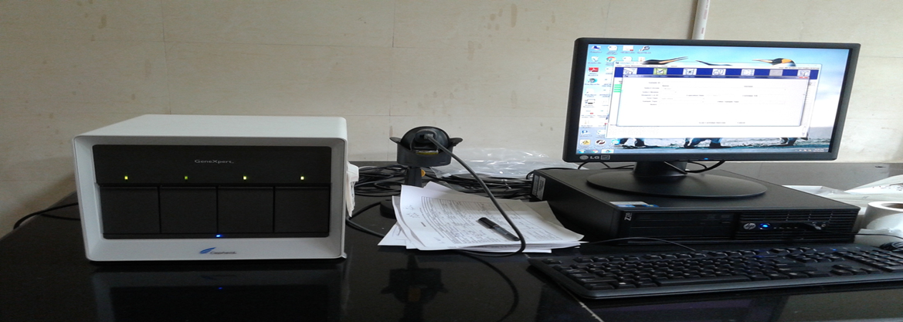
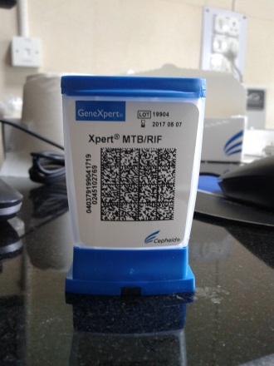
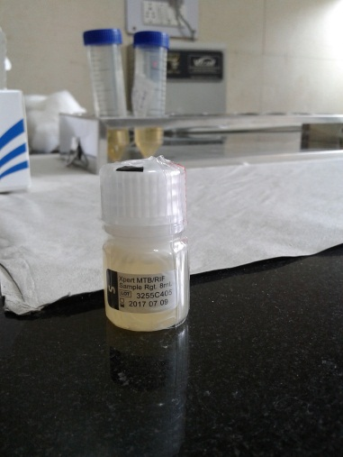
CB-NAAT MACHINE
FALCON TUBE
CARTRIDGE
SOLVENT
TEMP SHOULD BE < 20° C
4 SAMPLES AT A TIME, 12 SAMPLES IN A DAY
TIME 1 HR 50 MIN. SAMPLE: SOLVENT 1:2

Slide 38
RESEARCH & DEVELOPMENT
A diagnostic platform called the GeneXpert Omni® is in development.
A next-generation cartridge called Xpert UltraR is also in development.
Eight new or repurposed anti-TB drugs are in advanced phases of clinical development. An anti-TB drug candidate (TBA-354) is in Phase I.
testing.
Fifteen vaccine candidates are in clinical trials. Their emphasis has shifted from children to adolescents and adults.

Slide 39


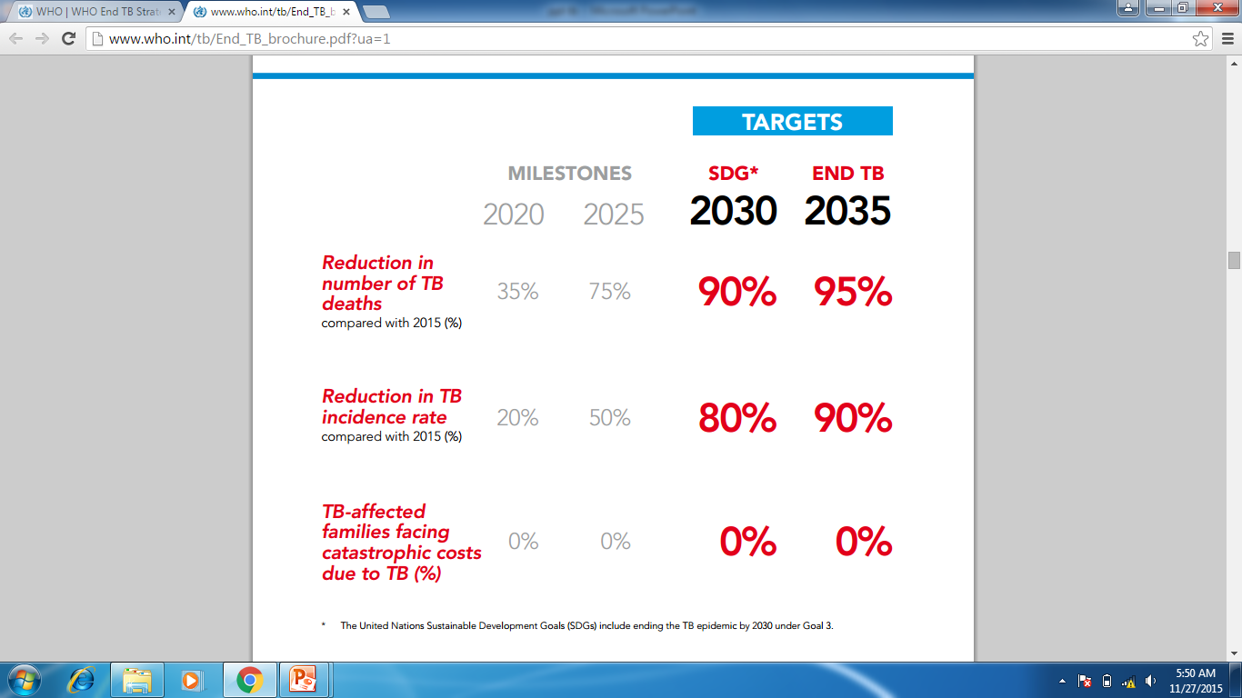

Slide 40
REFERENCES
TB India 2015 annual status report.
WHO Global Tuberculosis Report 2015.
Tuberculosis control in the South East Asia Region. Annual TB Report 2015.
Park’s Text Book of community medicine 23rd edition.
Revised National TB Programme Training Course for program managers

Slide 41
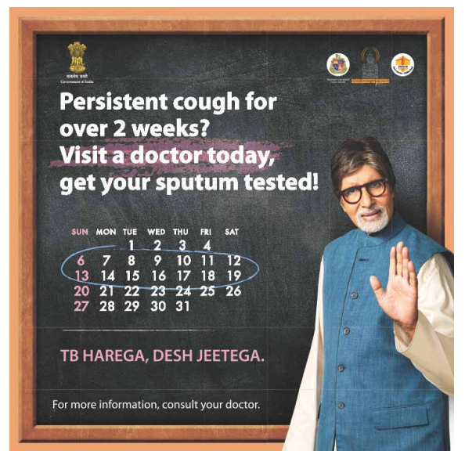
T
H
A
N
K
Y
O
U

Slide 42
1.In which Year was RNTCP pilot started?
a.1962
b.1984
c.1993
d.1990

Slide 43
2.What were the Objectives of the Revised National Tuberculosis Control Program?
(i)65% cure rate of infectious cases of tuberculosis
(ii)to detect at least 90% of estimated cases.
b. (i)95% cure rate of infectious cases of tuberculosis
(ii)to detect at least 100% of estimated cases.
c. (i)50% cure rate of infectious cases of tuberculosis
(ii)to detect at least 100% of estimated cases.
d. (i)85% cure rate of infectious cases of tuberculosis
(ii)to detect at least 70% of estimated cases.

Slide 44
3.What is the population for every Tuberculosis Unit in an urban area?
a.1,00,000
b.5,00,000
c,.40,000
d.2,00,000

Slide 45
4.Which of the following is a second line Antitubercular drug?
a.Rifampicin
b.Ethambutol
c.Isoniazid
d.Levofloxacin

Slide 46
5. MDR-TB is defined as resistance to?
Isoniazid and rifampicin, with or without resistance to other anti-TB drugs.
Isoniazid and ethambutol, with or without resistance to other anti-TB drugs.
Rifampicin and pyrazinamide, with or without resistance to other anti-TB drugs.
All first line antitubercular drugs.

