Slide 1
LABOUR ANALGESIA
Dr. Jayshri Desai,
Professor,
Dept.of Anaesthesia,
S.B.K.S.M.I.R.C,Piparia

Slide 2
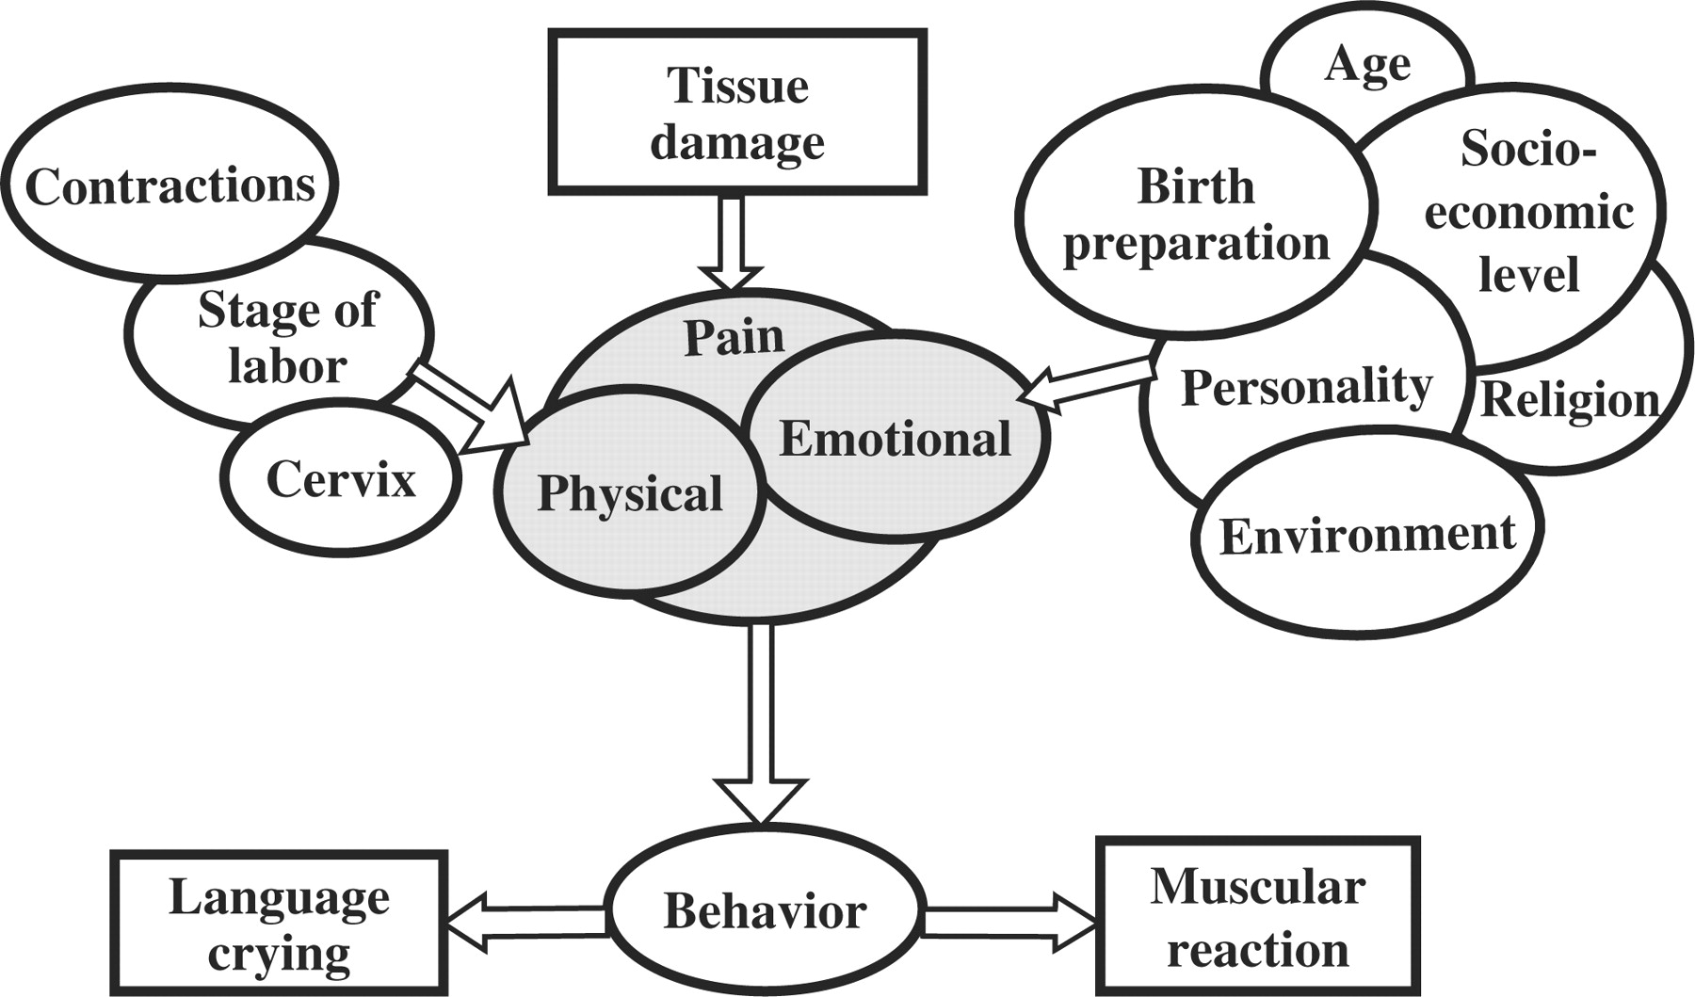
What defines labour pain?
Unique character
Escalating nature of pain
Varying with stage of labour
Multi-dimensional components

Slide 3
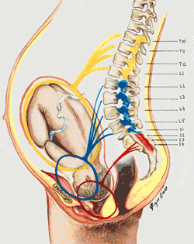
FIRST STAGE OF LABOUR
  Visceral, diffuse, poorly localized
  May be felt as back pain
  Results from uterine stretching , distortion, ischemia and cervical dilatation
  Visceral afferent travel with Aδ & C: uterine and cervical plexus → hypogastric and aortic plexus
  T₁₀ T₁₁ T₁₂ and L₁

Slide 4
SECOND STAGE OF LABOUR
Sharp localised pain in perineum
Somatic pain from streching of pain sensitive perineum (pelvic floor and vagina)
S 2,3, 4

Slide 5
To achieve the ideal labour analgesia...

Slide 6
Ideal labour analgesic
Provide good analgesia
Be safe for the mother and baby
Be predictable and constant in its effects
Be easy to administer
No loss of maternal consciousness
Should not Interfere with uterine contractions or progress of labour
Should not Interfere with mobility

Slide 7
Various modalities available
NON PHARMACOLOGICAL
PHARMACOLOGICAL

Slide 8
Application of non pharmacological methods of labor analgesia
Useful in primary set ups
Regional block facility not available
Safe
No side effects
Primarily 1st stage analgesia
However unsatisfactory in large no of patients

Slide 9
Non Pharmacological methods
Act by:
Psycho-prophylaxis: Altering the pain perception
Activating peripheral sensory perception

Slide 10
PSYCHOPROPHYLAXIS : patterned breathing and relaxation techniques
  physiologically by improving oxygenation and reducing muscle tension;
  cognitively by focusing on breathing and relaxation instead of pain.
  psychologically by reducing fear, anxiety
  and improving the sense of personal control
Most effective as a pain management strategy when learned and practiced in advance of the labor experience

Slide 11
Psycho-prophylaxis
Lamaze technique
Leboyer’s method
Hypnosis
Continuous labour Support
Yoga
Relaxation and Breathing
Music and Audioanalgesia

Slide 12
Techniques that activate peripheral sensory perception
Application of Heat and Cold
Transcutaneous Electrical Nerve Stimulation
Acupuncture and Acupressure
Intradermal Water Blocks
Water Baths in labour
Touch and Massage

Slide 13
Superficial applications of heat or cold
Easy to use, inexpensive
Minimal negative side effects when used properly
Heat application: back, lower abdomen, groin & perineum
Heat sources: hot water bottle, heated rice-filled sock, warm compress (wash clothes soaked in warm water and wrung out), electric heating pad, warm blanket, and warm bath or shower
Caution; protect mother from the possibility of skin damage or burns

Slide 14
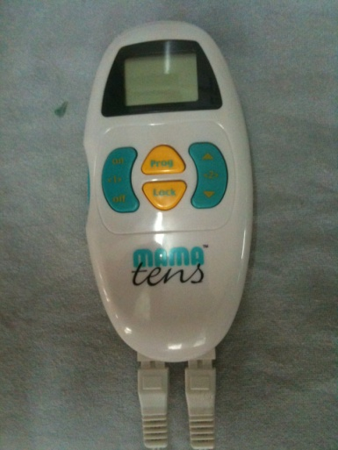
TRANS CUTANEOUS ELECTRICAL N. STIMULATION
Transmission of low voltage electrical current to skin via surface electrodes
Mechanism of Action:
Blockade of pain transmission through
stimulation of A-fibre transmission
(Gate theory)
Local release of ß-endorphins
However,
Latency (40 min to become effective)
Interference with fetal heart monitoring
Less effective in 2nd stage of labour
Mama TENS

Slide 15
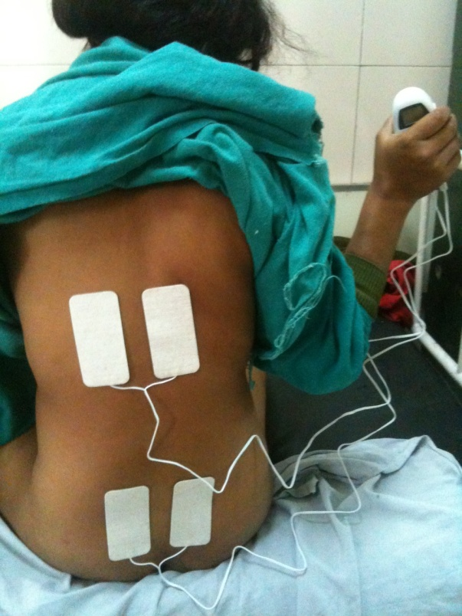
TRANS CUTANEOUS ELECTRICAL N. STIMULATION
Electrodes are placed
  1st Stage of labour: about 2 cm over the T10–L1 dermatomes on either side of the spinous process
  2nd Stage: over the S2–S4 dermatomes
  Amplitude & frequency of current are varied as the labour progresses

Slide 16
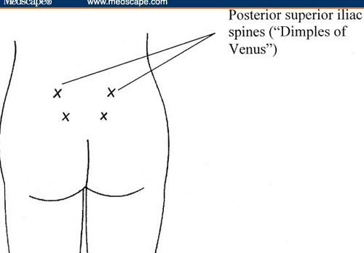
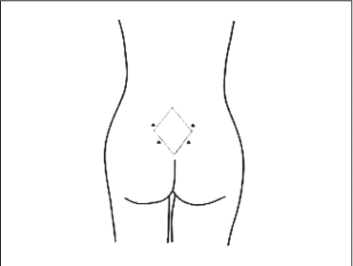
STERILE WATER BLOCK
It is used to treat lower back pain during labor without side effect on mom and fetus
Effective for first stage labour
Subcutaneous adminstration of dist H2O in the Michaelis Rhomboid

Slide 17
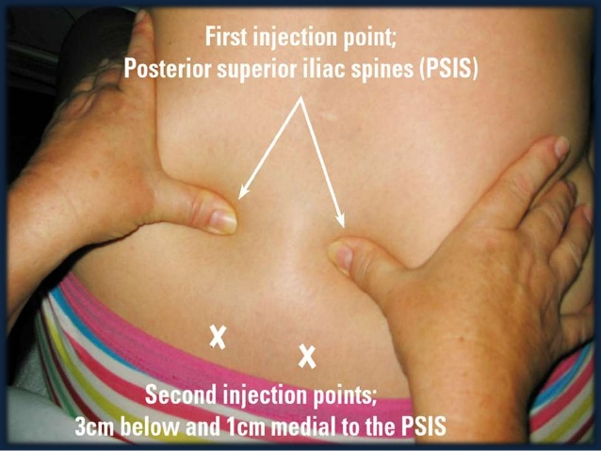
STERILE WATER
BLOCK
0.05 to 0.10 ml of Dist water is injected intracutaneously with insulin syringe over PSIS & 3cm inferior and 1cm medial to PSIS
Mechanism: osmotic distension of skin by salt free water stimulates nociceptor and inhibit pain transmission from uterus and Cx (gate theory)
Transiently painful for 30 sec
onset of pain relief : 2 min lasts till 45 to 120 min

Slide 18
Pharmacological techniques for labor analgesia

Slide 19
Pharmacological methods
Systemic analgesia
  Opioids
  Inhalational
  Recently, paracetamol
Regional analgesia
  Central neuraxial block (CNB)
  Paracervical and Pudendal nerve block
  Lumbar sympathetic block

Slide 20
Systemic Analgesia
Indications
  Regional contraindicated or technically difficult or not available
Disadvantages
  Poor efficacy
  Maternal/Neonatal effects of opioids
    Maternal side effects: sedation, resp depression , orthostatic hypotension, nausea, vomiting , gastric motility and delays emptying
    Fetal effects: FHR variability, resp depression, APGAR score, neurobehaviour changes

Slide 21
Parenteral Opioid Analgesia
Intermittent bolus
Patient-controlled opioid analgesia
  Superior analgesia with smaller drug doses
  Lower incidence of side effects
  Patient control of analgesia
Limitation: Small doses of opioid may not always be effective for the fluctuating intensity of labour pain.

Slide 22
OPIOIDS FOR LABOR ANALGESIA
DRUG | PCA dose | Lock out interval | BOLUS dose
Pethidine | 10-15mg | 8-20min | IM: 50-100mg IV: 25-50mg | Max fetal exposure at 2-3hrs nausea, vomiting and dysphoria
Fentanyl | 10-25mcg | 5-12min | IV:25-50mcg IM: 50-100mcg | highly lipophilic crosses placenta greater resp dep than equianalgesic dose of other opioids. Most suitable for PCA
Remifentanil (Bolus only) | 0.4-0.5mcg/kg | 2-3min |  | Less neonatal effects d/t rapid metabolism and redistribution To place epidural catheter in uncooperative patient Maternal sedation and apnea requires monitoring & careful titration
Remifentanil (Background infusion with bolus dose) | Infusion Rate: 0.05mcg/Kg/min Bolus: 0.25mcg/Kg | 2-3min

Slide 23
TRAMADOL:
  Synthetic opioid
  IM : 100 mg / 10-30 min(onset) / 3-4 hrs(duration)
  Moderate analgesia (effective in 1st stage)
  Mild resp depression
  Side effects : nausea, vomiting, sedation, dry mouth, sweating
  High placental permeability

Slide 24
KETAMINE
  Dose : 0.25 mg/kg, onset <30sec , duration 3-5 min.
  Infusion;0.25mg/Kg F/B 0.25mg/kg/hr
  Minimal maternal and fetal complications at low doses
  INDICATIONS:
  Analgesia just before vaginal delivery in parturient without regional anesthesia
  Adjunctive agent in parturients with unsatisfactory regional anesthesia
CAUTION : Repeated dosing compromise airway, Delirium.

Slide 25
INHALATIONAL AGENTS

Slide 26
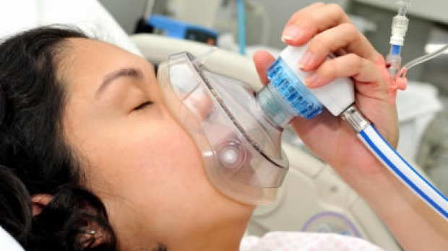
Inhalation analgesia
Sub-anesthetic concentrations of inhaled anesthetics
Mother remains awake with protective laryngeal reflexes
Either alone or as a supplement to regional or local anesthesia
Easy and rapid ( ↓FRC, ↑MV in pregnancy)
No effect on progress of labor
Make uterine contractions tolerable

Slide 27
Disadvantage:
  Incomplete pain relief and Unpleasant smell
  Specialized vaporizers
  Risk of over dosage & sedation
  Environmenatal Pollution hazard
  Need maternal monitoring & scavenging
  Post hyperventilation hypoxia

Slide 28
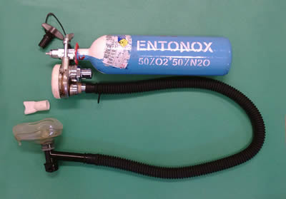
Entonox (O2:N2O 50:50)
Nitrous oxide : administered via facemask/mouth piece connected to a breathing circuit with a demand valve
Time from inhalation to peak analgesic effect - 50 seconds
Intermittent administration
First stage: Inhale 30 seconds before
the onset of contractions
Second stage: 2-3 breaths before each
expulsive force
continuous administration : increased sedation, loss of consciousness, and airway compromise
is being phased out from the UK in view of the poor analgesic efficacy and environmental pollution.

Slide 29
SEVOFLURANE/ SEVOX
  0.8% Sevoflurane with oxygen in Oxford Miniature Vaporiser
  Good analgesia with minimal sedation
  pleasant odour, Non irritant to the respiratory tract
  Useful pain relief during the first stage of labour
  Greater analgesia than Entonox
  Preferred over Entonox
  More sedation with sevoflurane

Slide 30
Regional Analgesia

Slide 31
Regional analgesia
Epidural analgesia
Combined spinal epidural analgesia
Spinal analgesia
Continuous spinal analgesia
Dural Puncture Epidural (DPE)
Paracervical block
Pudendal Nerve Block

Slide 32
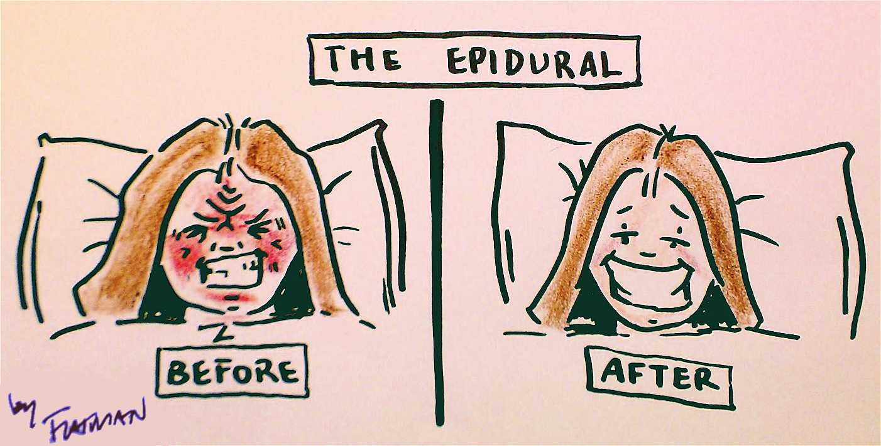
Epidural Labor Analgesia: Gold standard for pain relief in labor
Excellent pain relief & maternal satisfaction
Minimal fetal side effects and maternal adverse effects
Easily converts to surgical anesthetic, even in emergent/urgent situation

Slide 33
Which is the ideal Target population
Any parturient who demands analgesia is enough justification
High risk parturient
Marked obesity
Obstetric complications with potential for operative delivery (eg, placenta previa, high order multiple gestation)
Severe preeclampsia
Cardiopulmonary disorders
Controversial situations….
Notes:
First and foremost would be , which is the ideal target population for ELA. Obviously any……
In the high risk parturient, the obg needs to play a more proactive role by explaining the potential benefits of the epidural in improving maternal and neonatal outcome. These include…..
A controversial situation may arise when we have a parturient with a non reassuring FHR.

Slide 34
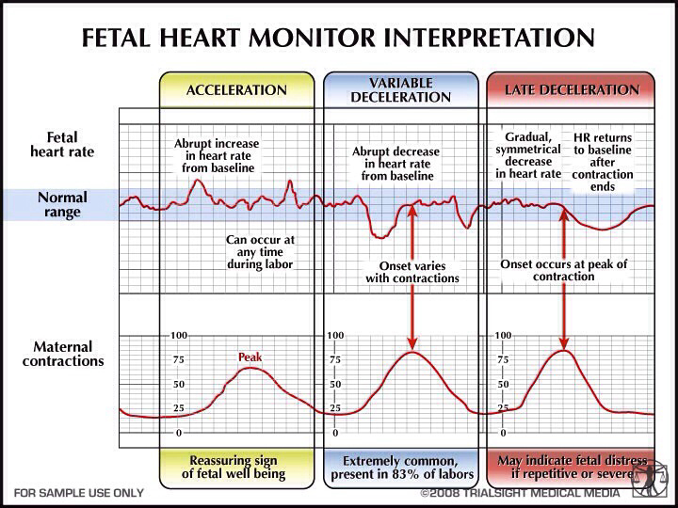
ELA in parturient with Non-reassuring fetal heart tone
Not a contraindication to regional analgesia
Rapid extension, should cesarean delivery be required for fetal distress
Notes:
As a matter of fact, should Cdelivery be rqd, a prior placed functioning epi wd allow a rapid extension of the block for cesarean csection

Slide 35
  PRE-REQUISITES
  Pre anaesthetic check up
  Consent
  IV access and monitor
  Facility of resuscitation equipment & drugs, oxygen, suction, intubation equipment, IPPV

Slide 36
Preparing the parturient for Epidural labor analgesia
Notes:
Once we have identified our target population,

Slide 37

Work up…
Early involvement of anesthesiologist
Antenatal counseling and evaluation by anesthesiologist
Routine PAC with relevant investigations
Written informed consent
NPO guidelines…
Notes:
Early involvement of the anesthesiologist in the antenatal period itself is desirable. Thorough evaluation with rouine PAC and all relevant investigations must be carried out. It is essntial tohave a written informd consent from the parturient. NPO guidelines in the laboring partuient are rather different keeping in mind the unpredicatable nature of labor and delivery

Slide 38
Fasting during labor and delivery
uncomplicated laboring patients:
modest amounts of clear liquids
water, fruit juices without pulp, carbonated beverages, clear tea, black coffee, and sports drinks.
Volume of liquids is less important than the presence of particulate matter
High risk Parturient: additional restriction of fluids
What all??
How much??
Solid foods should be avoided in laboring patients
Notes:
may be allowed for during labor

Slide 39

When to call the anesthesiologist to administer ELA?
Do I need to wait for a specific cervical dilatation to be reached ???
Cervical dilatation : 4-5 cm (primi) 3-4 cm (multi) ???
Frequent PVs to assess ideal cervical dilatation for epidural administration ???
Will the timing of administration affect the progress of labor or increase cesarean delivery rate or vaginal instrumental delivery???
Notes:
One of the major concerns of the obstetrician is what is the right time to call the anesthesiologist to adminster epidural?
Must she wait for a dilatation of 4-5cm before calling?
Would an advertent early administration of the epidural
Important to remember that the obs does not like to do frequent

Slide 40

Right time to Administer
Epidural Labor Analgesia
Ensure established labor
Withholding analgesia until an arbitrary cervical dilatation is unnecessary
Give the option of early neuraxial analgesia
Timing of epidural placement has no effect on cesarean rate, fetal malposition, or instrumental vaginal delivery
Best time to administer ELA: linked to parturient
demand not cervical dilatation*
*American College of Obstetricians and Gynecologists Committee on Obsteteric Practice. Analgesia and cesarean delivery rates. ACOG Committee Opinion No. 339, June 2006. Obstet Gynecol 2006;107:1487
Ohel et alEarly versus late initiation of epidural analgesia in labor: does it increase the risk of cesarean section? A randomized trial. Am J Obstet Gynecol.2006;194(3):600–605
Notes:
There is now clear consensus that the best time to adminster …….
initiation of neuraxial analgesia in the latent phase of labour (cervical dilation < 4 cm) does not increase the risk of Caesarean delivery..
Once we have ensured established labor,withholding

Slide 41
Epidural analgesia:
Mode of administration
Intermittent top ups
Continuous infusion
Patient controlled epidural analgesia
- With basal infusion
- Without basal infusion
- Computer integrated PCEA

Slide 42
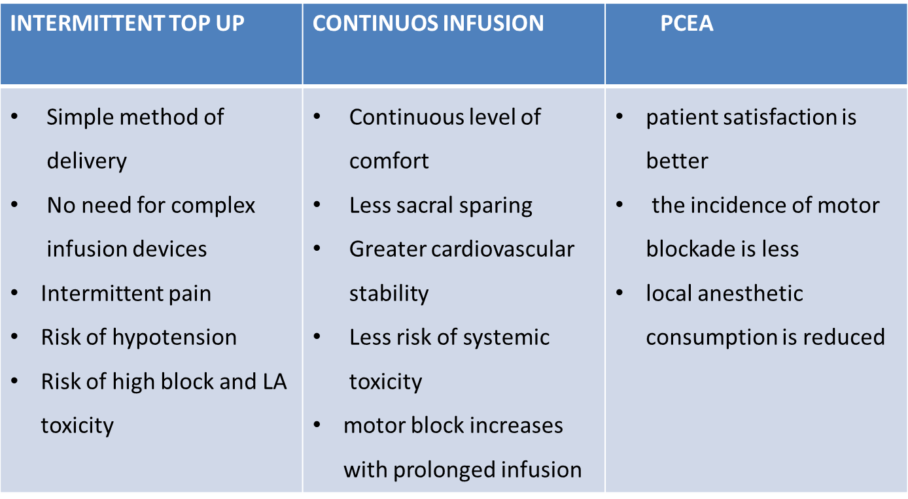
ELA Administration techniques

Slide 43
Test Dose for epidural labor analgesia
  Conventionally...
  30mg lignocaine + 15μg epinephrine given in uterine diastole
  Sudden , fast acceleration in maternal heart rate of at least 15-20bpm occurring within 1 min and duration 60 secs indicates intravascular injection
  Onset of motor blockade within 3-5 min indicates intrathecal injection.
  Role of test dose controversial...

Slide 44
DISADVANTAGE
A high incidence of false positives (intravascular)
Possible adverse effects on uterine blood flow and fetal well-being.
Causes exaggerated response in hypertensive patients.
  Intrathecal- greater motor & sensory block , undesirable
  RECENT:
    No test dose but careful aspiration before each top up
    Incremental dosage

Slide 45
Epidural regimen for labor analgesia
Low dose regimens: Combination of a local anesthetic with an opioid
reduced the total dose of local anaesthetic
Less motor blockade
Effective analgesia
DRUGS
Ropivacaine 0.1 -0.2 % (Recently 0.08%)
Bupivacaine 0.125-0.0625%
In combination with 0.002% fentanil/ sufentanil
Titrated to maintain
T10 level
      Bupivacaine 0.125% or 0.0625% + fentanyl 2 μg/ml

Slide 46
SUBSEQUENT ANALGESIA OPTIONS
Intermittent : 8-10ml bolus, repeat initial bolus as necessary to maintain maternal comfort
Continuous infusion 8-12 ml/hr:
1. Bupivacaine 0.0625 –0.125% + fentanyl 1-2 µg/ml
2. Bupivacaine 0.125% without opioid
  3. Ropivacaine 0.5- 2.0%
c. PCEA : Bupivacaine 0.05 - 0.125 % + Fentanyl 2 µg / ml
- 5 ml bolus
- Background infusion 3-6 ml / hr
- Hourly limit 30 ml
- lockout interval 5 - 15 mins
Titrated to maintain
T10 level

Slide 47
  MONITORING
Measure BP every 1-2 min for first 10 min, then every 5-15 min during the infusion & until the block wears off.
Monitoring: partogram – Uterine contractions, FHR, cervical dilatation, i/v fluids, urinary output.
Patient should turn from side to side every 30min to avoid a one-sided block.
Check regularly for Sensory level, adequacy of analgesia, & motor block.

Slide 48
Spinal analgesia
  Suitable in very early labour to enable epidural placement under more controlled conditions
  For instrumental deliveries in women who do not have an indwelling epidural catheter
  Opioid alone or low dose LA +opioid
 | DOSE | DURATION
Fentanyl | 15-25 µg | 85-95 min
Sufentanil | 5-10 µg | 105-115 min
Bupivacaine | 2.5 mg | 60 min
Continuous spinal analgesia with a “microcatheter” may be considered in cases of accidental dural puncture

Slide 49
Newer Techniques

Slide 50
Combined spinal epidural analgesia
Effective, rapid-onset analgesia with ability to prolong the duration of analgesia
Duration of the first stage of labour
Incidence of sacral sparing
Minimal motor block so ambulation possible
  Less chances of urinary retention
  ‘‘walking epidural’’
DISADVANTAGE ?

Slide 51
Criteria for Ambulation during Labor with Neuraxial Analgesia
Reassuring fetal status
Engagement of fetal presenting part and no obs C/I
Ability to perform bilateral straight-leg raises in bed against resistance
Ability to step up on a step stool with either leg taking
the first step, without assistance
Satisfactory trial of walking accompanied by a nurse
Patient must be accompanied by a companion at all
times
Intermittent fetal heart rate monitoring every 15min

Slide 52
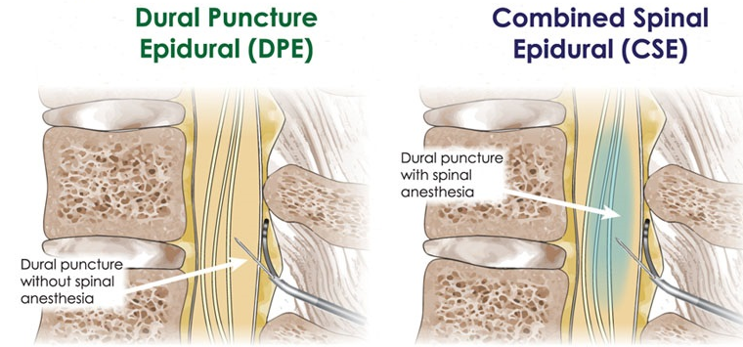
Dural puncture epidural (DPE)
Modification of CSE technique
Dural perforation is created from a spinal needle but intrathecal medication administration is withheld
Intrathecal transfer of injectate from the epidural space via the dural hole, allowing for more rapid onset and symmetrical analgesia.

Slide 53
Compared with epidural (EPL) & CSE technique
DPE technique has the advantage of :
Earlier onset
Lesser top ups
Improve caudal spread of analgesia
Less side effects like pruritis, hypotension etc

Slide 54
RECENT ADVANCES in Technology

Slide 55
USG & Reinforced catheters
Pre – procedural ultrasound:
Obstetric epidural technically difficult
Ease of performance and improved success rate
Especially useful in obese and in distorted lumbo sacral anatomy
Epidural flexible wire reinforced catheters:
easier threading and lesser complications such as kinking, intravascular threading and knotting

Slide 56
Recent Insights for Labor analgesia

Slide 57

Will ELA affect the:
1. Progress of labor?
2. Increase risk of Cesarean Delivery?
3. Incidence of instrumental delivery ?
Notes:
The administration of ELA has distinct effects in the 1st and 2nd stage of labor

Slide 58
First Stage of Labor
Prolongation of 1st stage
No ↑ in adverse maternal or neonatal outcomes d/t increased labor time
No prolongation of first stage
Or sometimes…..
Shortening of first stage due to reduction in maternal catecholamines and improved uterine contractility
Traditionally used doses
RECENTLY, Low dose LA with opioids
Schnider et al. Maternal catecholamines decrease during labor after lumbar epidural anesthesia. Am J Obstet Gynecol
Wong et al. The risk of cesarean delivery with neuraxial analgesia given early versus late in labor. N Engl J Med. 2005;352(7):655–665
Notes:
With the currently used low dose epidural, there is no prolongation of the first stage. On the contrary, some workers have even reported a shortening of the 1st stage…it has been my ersonal experience too and in our institution we too have observed a shortened 1st stage

Slide 59

Second stage of Labor
Effective neuraxial analgesia prolongs 2nd stage of labor
Relaxation of the abdominal wall musculature ↓↓effectiveness of maternal expulsive efforts.
Dense sensory blockade of uterus & birth canal: decrease maternal ability to coordinate expulsive efforts with uterine contractions.
Relief of pain leads to reduced bearing down efforts
Would this lead to an adverse maternal or neonatal outcome?
No adverse maternal of fetal outcome
Active management of second stage of labor is advocated
Notes:
The story changes a little in the second atage f labor
There is relaxation of ….
As a result of the effective neuraxial analgesia there is prolongation of the 2nd atage under Epidural LA

Slide 60
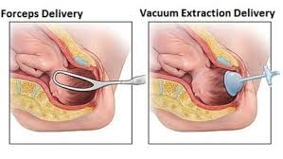
Active management of second stage
Effective neuraxial analgesia in the second stage of labor may result in an increased risk of instrumental vaginal delivery.
Application of ventouse or outlet forceps which are safe for both mother and fetus
Encourage mother to push with uterine contractions
Oxytocin augmentation
No statistically significant impact on the risk of caesarean section(cochrane Database 2012)
Laughon et al Neonatal and Maternal Outcomes With Prolonged Second Stage of Labor. Obstet Gynecol 2014: 124(1);57-67
Notes:
The points to be kept in mind are that the Obstetrician must resist the urge to go for an arbitrary termination of the second stage . Important to educate the mother to push only eith uterine contractions . Since she cannot feeel the pain of uterine contractions, she should be instructed oxytocin may be augmented in a parturient with weak contractions.
The other concern is that should the mother start pushing soon after the commencement of the 2nd atge or shpuld the pushing be delayed?
Aince the mother cannot perceive the pain tof the uterine contractions , she should be instructed to place her hands on her belly and push when there is appreciable tightening of the abdomen
Oxytocin only in parturient with weak uterine contractions Provided normal fetal position and FHS

Slide 61
Withholding the epidural top-up in the second stage
Traditionally, Epidural infuson stopped at full dilatation of Cx
Recently, continuation of the same epidural protocol until birth :
Reduction in the instrumental delivery rate was not statistically significant
Statistically significant increase in inadequate pain relief

Slide 62
RECENT INSIGHTS INTO COMPLICATIONS OF NEURAXIAL ANALGESIA SPECIFIC TO LABOR

Slide 63
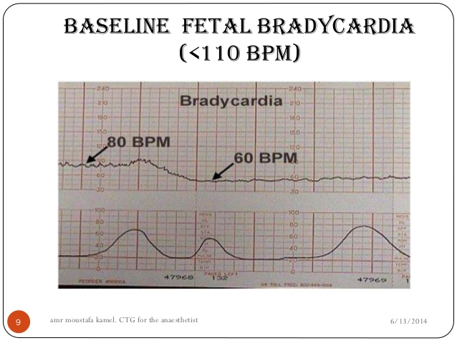
Fetal bradycardia with ELA
Incidence : 3-20%
Seen with both CSE and epidural
Cause
Abrupt relief of pain after ELA
Sudden disturbance in tocolytic/tocodynamic balance
Leads to uterine hypertonus and fetal bradycardia
No detrimental effect on fetus or outcome of labor
Does not increase Cesarean delivery rate
Rx:
Uterine displacement, oxygen, discontinue oxytocin, rapid IV fluids
Niroglycerine / terbutaline
Notes:
Fetal bradycardia soon after inititation of CSE or epidural if on eof the most freq FHR abnormalities observed with an incidence varying from 3-20%

Slide 64

Fever and epidural Labor analgesia..
Women in labor who receive epidural analgesia are more likely to experience hyperthermia and overt clinical fever
Average increase in temperature of approximately 1°C over 7 hours
little clinical significance – Not associated with neonatal infection
Cause : placental infection? Reactionary response? Alterations in temperature regulation induced by epidural analgesia?
More often seen in ELA lasting >6hrs
Notes:
women at risk for fever—due to longer duration of ruptured membranes, longer labor, more frequent cervical examinations, and other interventions—are also more likely to select epidural analgesia.

Slide 65

Backache & epidural labor analgesia
Local tenderness & transient backache at the site of epidural or spinal placement
Relatively common
Especially with difficult placement of the block
Usually clears within several days to 3 weeks
Superficial irritation of the skin or periosteal irritation or damage
Although short-term back pain is common, it does not appear to be related to the use of regional analgesia.
No causal relationship exists between the use of epidural analgesia and the development of long-term postpartum backache*.
*Anim-Somuah M et al Epidural versus non-epidural or no analgesia in labour
Cochrane Database Syst Rev. 2011;(12):CD000331....
Notes:
very often local…..Postpartum backache: Hormonal changes/Softening of maternal ligaments/ Mechanical changes (eg, exaggerated lumber lordosis, maternal weight gain). no significant association of Chronic back pain with epidural analgesia

Slide 66
Recently : Paracetamol for labor analgesia
1gm QID
First stage of labor
IV infusion paracetamol comparable to single-dose injection of intramuscular pethidine.
No significant drug complications, and Apgar scores of neonates were similarly normal in both groups of the study.

Slide 67
THANK YOU

