Slide 1
TACHYARRHYTHMIA
DR.DINESH CHAUHAN
PROF. &HEAD,
DEPT. OF ANAESTHESIA,
S.B.K.S.M.I.R.C.,PIPARIA

Slide 2
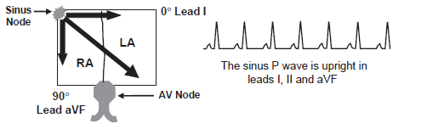
SINUS TACHYCARDIA
Def-Impulses that originate from the sinus node with a rate that exceeds 100 beats per minute (bpm)
ECG-
1. Sinus P waves are present with a rate >100 bpm.
2. The sinus P waves precede each QRS complex with a PR interval more than or equal to 0.12 seconds.
3. The morphology of the P wave should be upright in leads I,
II, and aVF and in V3 to V6.

Slide 3
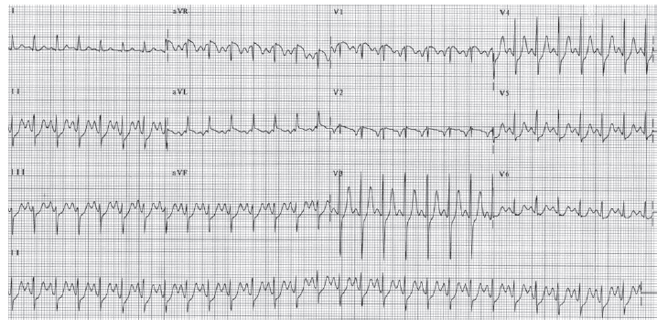
Upright P waves in leads I, II, and aVF and also in V3 to V6. The axis of the P wave is
closest to lead II,

Slide 4
Sinus tachycardia
accelerates and decelerates gradually and is a classic example of a tachycardia that is nonparoxysmal.
Has an identifiable cause
Physiologic- exercise, emotion, fear, or anxiety.
Pathologic- acute pulmonary embolism, acute pulmonary edema, thyrotoxicosis,infection, anemia, hypotension, shock, or hemorrhage.
Pharmacologic- atropine, hydralazine, epinephrine, norepinephrine and other catecholamines.
Pathologic sinus tachycardia
Sinus tachycardia without an identifiable cause
1.Inappropriate sinus tachycardia
2.POTS
3.Sinoatrial reentry

Slide 5
Inappropriate sinus tachycardia:
Not associated with any underlying condition and no definite causes can be identified.
rate of the tachycardia is inappropriately high at rest or during physical activity
Increase in sinus rate during exercise is out of proportion to the expected level of response.
due to --enhanced automaticity of the cells within the sinus node.
Postural orthostatic tachycardia syndrome(POTS):
Tachycardia is initiated by the upright posture and is relieved by recumbency.
In POTS, there should be no significant orthostatic hypotension or autonomic dysfunction because sinus tachycardia becomes appropriate when these entities are present.
Tilt table test- increase in heart rate 30 bpm from baseline or increase in heart rate
120 bpm without significant drop in blood pressure. The drop in blood pressure should not be 30 mm Hg systolic or 20 mm Hg mean blood pressure within 3 minutes of standing or tilt.
cause -multifactorial
half of patients have antecedent viral infection.

Slide 6
Presence of a limited autonomic neuropathy associated with postganglionic sympathetic denervation of the legs, resulting in abnormality in vasomotor tone and blood pooling.
Primary abnormality of the sinus node cells similar to inappropriate sinus tachycardia
Venous pooling in the splanchnic bed, hypovolemia, or failure to vasoconstrict
Sinoatrial reentry:
Type of SVT resulting from re-entry where the sinus node is part of the reentrant pathway.
P waves resemble that of sinus tachycardia.
It is paroxysmal in contrast to the other types of sinus tachycardia that are nonparoxysmal.
This tachycardia will be discussed in more detail under SVT from sinoatrial reentry

Slide 7
Treatment-
Sinus tachycardia:
Appropriate ST-No treatment
underlying cause of the tachycardia should be recognized and corrected.
Pericarditis, acute MI, congestive heart failure, or thyrotoxicosis-Beta blockers
Inappropriate sinus tachycardia:
Beta blockers Diltiazem and Verapamil sinus node modification using radiofrequency ablation
POTS:
1.Nonpharmacologic therapy:
Volume expansion with proper regular oral hydration
high-sodium intake of up to 10 to 15 g daily
compressive stockings
resistance training such as weight lifting.

Slide 8
2.Pharmacologic therapy-
Beta blockers:
Propranolol 20 to 30 mg three to four times daily
Calcium channel blockers:
Diltiazem or verapamil ( C/I-left ventricular systolic dysfunction)
Mineralocorticoids:
Fludrocortisone 0.1 to 0.3 mg orally once daily(hypovolemia)
considered only after nonpharmacologic therapy has been tried.
combined with hydration and high sodium intake.
Adrenoceptor agonists:
Midodrine 2.5 to 10 mg three times daily orally
3. Catheter ablation:
response to this type of therapy may be difficult to predict because the abnormality may be primarily in the sinus node but could also be due to secondary causes.

Slide 9
SUPRAVENTRICULAR TACHYCARDIA
Def- If the tachycardia originates above the bifurcation of the bundle of His, usually in the atria or atrioventricular (AV)junction(outside SA node) the tachycardia is supraventricular
Impulses follow the normal AV conduction system-activate the ventricles synchronously and will have narrow QRS complexes measuring 120 milliseconds.
SVT with Wide QRS- preexistent bundle branch block
ventricular aberration
bypass tract (Antidromic AVRT)
VT- impulses will spread to ventricles outside the AV conduction system-wide QRS
Tachycardias with narrow QRS complexes other than SVT=
1.Sinus tachycardia
2.Atrial flutter
3.Atrial fibrillation.
Treatment of these various arrhythmias is different.

Slide 10
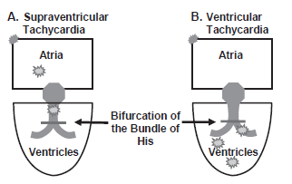

Slide 11
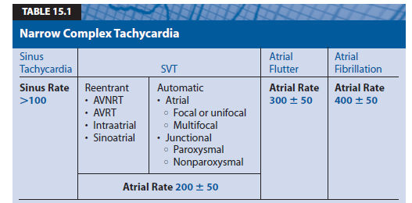

Slide 12
Three general mechanisms:
1.Reentry
2.Enhanced automaticity
3.Triggered activity.
1.Reentry:
M.C.
abnormality in the propagation of the electrical impulse
presence of two separate pathways with different electrophysiologic properties
2.Enhanced automaticity:
abnormality in initiation of the electrical impulse
Some cells in the atria or AV junction exhibit phase 4 diastolic depolarization spontaneously discharge faster than that of the sinus node
Phase 4-resting stage
3.Triggered activity:
abnormality in initiation of the electrical impulse
occurrence of afterdepolarizations. Afterdepolarizations are secondary depolarizations that are triggered by the initial impulse
digitalis toxicity, calcium excess, increased catecholamines.

Slide 13
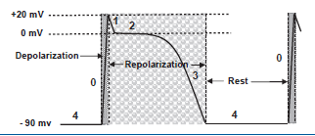
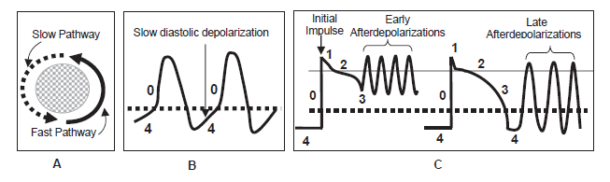

Slide 14
Reentry -in normal individuals
Enhanced automaticity –
structural cardiac diseases >normal individuals
abnormalities in electrolytes and blood gasses
Triggered activity –
digitalis excess
after cardiac surgery.

Slide 15
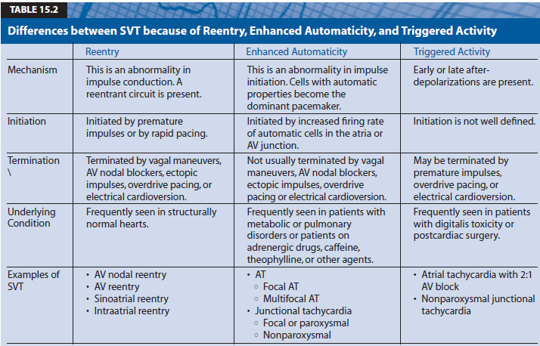

Slide 16
SVT DUE TO REENTRY
1.Atrioventricular nodal reentrant tachycardia(AVNRT):
M.C.
Slow and fast pathway that circles around the AV node
2. Atrioventricular reciprocating (or reentrant)tachycardia (AVRT):
bypass tract connecting the atrium directly to the ventricle
3. Sinoatrial reentrant tachycardia (SART):
sinus node and contiguous atrium
4. Intra-atrial reentrant tachycardia (IART):
small circuit within the atrium

Slide 17
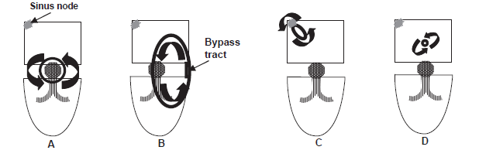

Slide 18
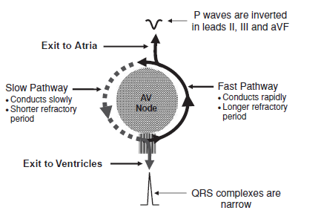
AVNRT
Young and healthy without structural heart disease
Female > Male
Rate-110-250(not helpful in distinguishing AVNRT from other SVT)

Slide 19
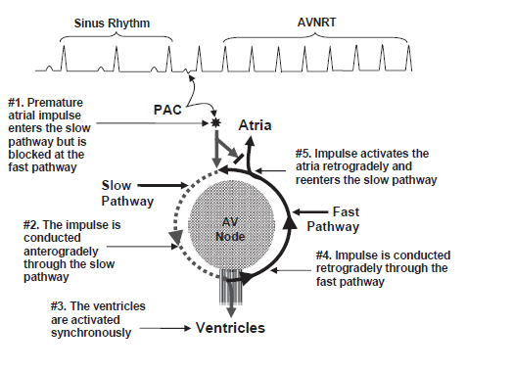

Slide 20
Electrocardiogram (ECG) findings:
1. narrow complex tachycardia with regular R-R intervals and no visible P waves
The P waves are retrograde and are inverted in leads II, III, and aVF,
not visible in the ECG because the atria and ventricles are activated simultaneously; hence, the P waves are buried within the QRS complexes.
most common presentation

Slide 21
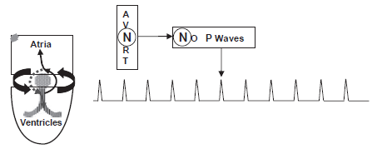
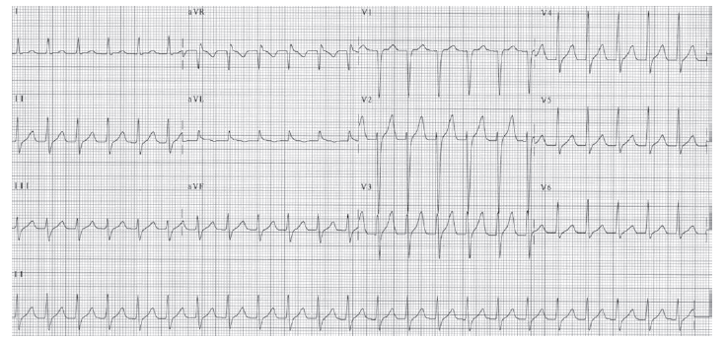

Slide 22
Other patterns
Activation of the atria and ventricles may not be perfectly synchronous.
1. retrograde P wave occurs immediately after the QRS complex, it is mistaken
for S wave in leads II, III, and aVF or r` in V1.
2. retrograde P wave occurs immediately before the QRS complex, it Is mistaken for q wave in lead II, III, or aVF
These pseudo-Q, pseudo-S, and pseudo-r ` waves should resolve on conversion of the tachycardia to normal sinus rhythm
3. retrograde P waves much further away from the QRS complexes. The retrograde P waves may distort the ST segment rather than the terminal portion of the QRS complex
Generally, when the P waves are no longer connected to the QRS complexes, the SVT is more commonly the result of AVRT rather than AVNRT

Slide 23
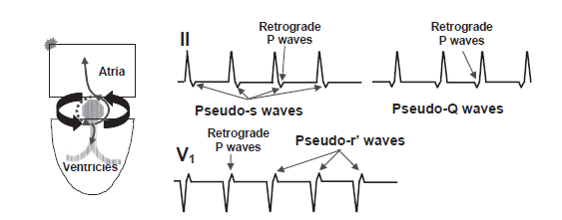
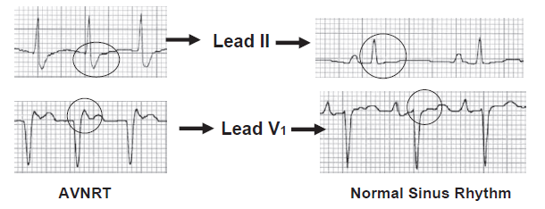

Slide 24
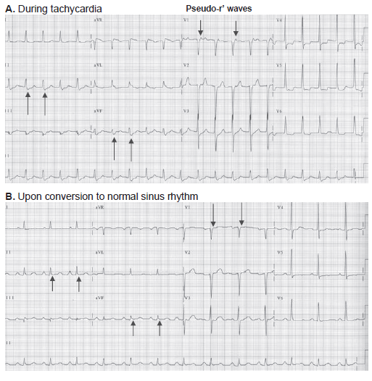

Slide 25
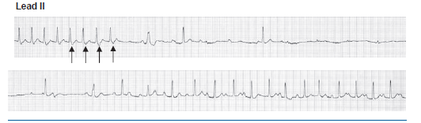
Disappearance of the pseudo-S waves on conversion to sinus rhythm.
Tachycardia terminated with a pseudo-S wave (last arrow) implying that the reentrant circuit was blocked at the slow pathway.

Slide 26
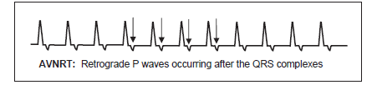

Retrograde P waves occur after the QRS complexes and distort the ST segment or T waves of the previous complex. Although this pattern is consistent with AVNRT, this is more commonly the result of atrioventricular reentrant tachycardia.

Slide 27
Atypical AVNRT:
retrograde P waves preceding each QRS complex
uncommon and occurs infrequently.
tachycardia is initiated by an ectopic ventricular (rather than atrial) impulse.
The impulse is retrogradely conducted to the atria through the slow pathway and anterogradely conducted to the ventricles through the fast pathway.
Retrograde P wave midway or almost midway between the QRS complexes
Difficult to differentiate from other narrow complex tachycardias, especially focal atrial tachycardia.

Slide 28
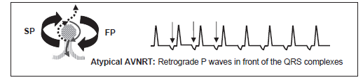
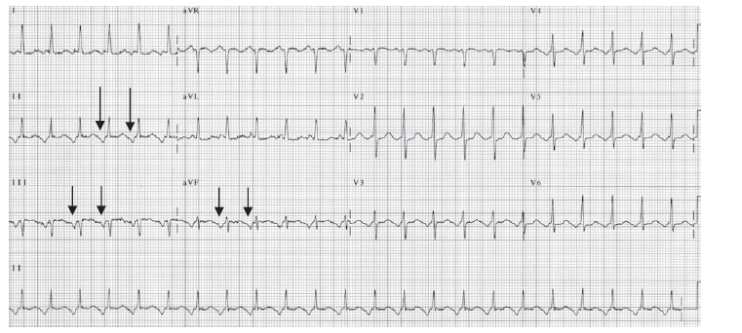

Slide 29
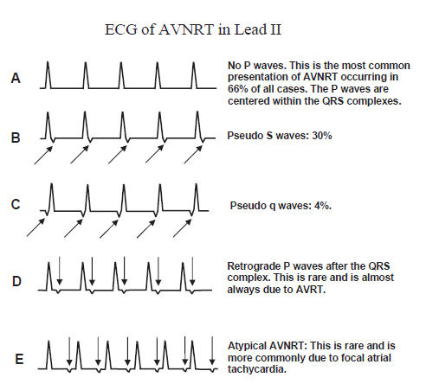

Slide 30
AVNRT therefore has many possible ECG presentations and should be considered in
any narrow complex tachycardia with regular R-R intervals
(whether or not retrograde P waves can be identified)

Slide 31
CLINICAL SIGNIFICANCE
AVNRT can occur suddenly and terminate abruptly and is therefore paroxysmal. sinus tachycardia -tachycardia is nonparoxysmal with gradual onset and gradual termination.
SVT from reentry are usually episodic occurring for a few minutes to a few hours and are recurrent.
SVT from enhanced automaticity -rarely persists for 12 hours a day
Generally tolerable except in patients with stenotic valves, ischemic heart disease, left ventricular (LV) dysfunction, or cardiomyopathy. In these patients, hypotension or symptoms of low cardiac output, myocardial ischemia, heart failure, or actual syncope may occur during tachycardia
healthy patients- If tachycardia is unusually rapid thus, syncope can occur when the tachycardia starts abruptly with a very fast rate or terminates with a very long pause because of overdrive suppression of the sinus node
Prominent neck vein pulsations-Cannon A wave (atrial contraction is simultaneous with ventricular contraction due to retrograde P waves occurring within or immediately after the QRS complex. )
Atrial stretch-Diuresis (atrial natriuretic peptide)

Slide 32
ACUTE TREATMENT
VAGAL MANEUVERS-
1.Carotid sinus pressure:
most commonly used and most effective vagal maneuver
under cardiac monitoring in the recumbent position. neck hyperextended
bifurcation
gentle but constant pressure
Initially only for a few seconds(5)
can be repeated several more times by pressing the artery at longer intervals if needed,
no need to rub or massage
Only one artery should be pressed at any time.
If there is no response, the same maneuver should be tried on the other carotid artery.
can also be repeated if the SVT persists after a pharmacologic agent has been given, but is not effective in terminating the tachycardia.
(carotid stenosis-carotid bruit, carotid sinus pressure should not be attempted)

Slide 33
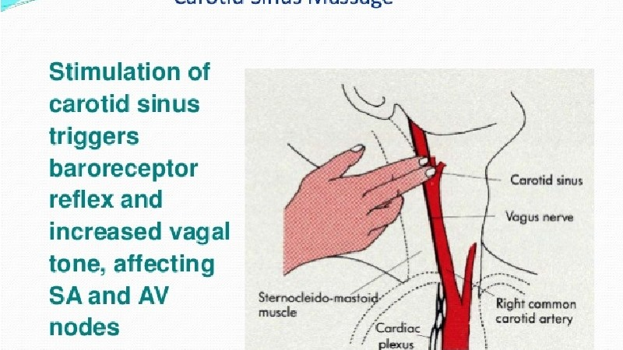

Slide 34
2. Pharyngeal stimulation:
The tongue blade is gently brushed to the pharynx to make the patient gag.
3. Valsalva maneuver:
tense the abdominal muscles by exhaling forcefully against a closed glottis.
Blowing forcefully through a spirometer, balloon
by straining, as if the patient is lifting a heavy object.
C/I-severely hypertensive, congestive failure, if an acute coronary event is suspected ,hemodynamically unstable.
4. Forceful coughing
5. Diving reflex:
face comes in contact with cold water- bradycardia
6. Ocular pressure:
not recommended since retinal detachment may occur

Slide 35
PHARMACOLOGIC THERAPY
ABCD-Adenosine,B-Blocker,CCB,Digoxin
ADENOSINE
C/I- bronchospastic pulmonary disease
Dose= 6mg-12mg-12mg
Dipyridamole Carbamazepine = 3mg
Theophylline =Higher dose
Diagnosis-
1.AVNRT&AVRT = termintes with retrograde P wave
2.FAT = terminates with QRS complex
3.Atrial flutter with 2:1 block= will not respond
slow the HR –allowing the diagnosis of AF by sawtooth

Slide 36
Verapamil
C/I- Hypotension,CHF,LV dysfunction(-ve inotropic)
Dose- 1. 2.5-5mg IV over 2 min
no response,stable
5-10mg IV every 15-30 min (total-20mg)
2. 5mg IV every 15 min (total-30mg)
Peak- within 3-5 min of bolus IV
Indication= PSVT with narrow complexes
SVT with wide QRS complexes
(with normal left ventricular function)
C/I = wide complex tachycardia and the diagnosis of the tachycardia is uncertain, verapamil should notbe given. If the wide complex tachycardia turns out to be ventricular, the administration of verapamil may cause severe hypotension or even death
Antidote-Calcium gluconate

Slide 37
Diltiazem
Dose= 0.25mg/kg Iv over 2 min (15-20 mg for 70kg)
after 15 min
0.35mg/kg(25mg)
maintenance5-15mg/hr IV
Shorter acting
Less hypotensive
Antidote-Calcium gluconate

Slide 38
B-Blockers
If not responded to above treatment
C/I= CHF,LV dysfunction,Hypotension,Bronchospastic pulm disease
1.Metoprolol- 5mg IV
repeated 2 more times every 5min (total-15mg i 15 min)
2.Atenolol- 5mg IV over 5 min
repeated once after 10 min
3.Propranolol- 0.1mg/kg IV not to exceed 1mg/min
repeated once after 2 min
4.Esmolol- 0.5mg/kg IV over 1min
maintenance of 0.05mg/kg/min for 4 min

Slide 39
Digoxin
Slow onset
Not much effective
Preferred- LV dysfunction,CHF,Hypotension
Dose-0.5mg IV over 5 min
0.25mg IV after 4hrs and repeated if needed for total dose max 1.5mg over 24hrs
Other
Procainamide
Propafenone
Amiodarone

Slide 40
Old Remedy- when there is hypotension
acute elevation of SBP by Phenylephrine
(reflex bradycardia by stimulation of baroreceptors)
Electrical cardioversion- last resort
Presence of LV dysfunction , CHF
Digoxin
Amiodarone
Electrical cardioversion

Slide 41
Long term Therapy
Minimal or no symptoms during tachy - no oral medication
Symptoms of hemodynamic instability/recurrent &prolonged arrythmia
Without LV dysfunction LV dysfunction
1.Verapamil,Diltiazem 1.Digoxin
2.B-Blockers-Aten,Meto,Prop 2.B-Blockers-Carvedilol,Metoprolol
3.Digoxin

Slide 42
See pt is stable or Unstable or not
C-ischemic Chest pain
H-Hypotension
A-altered sensorium Unstable= Synchronised Cardioversion
P-Pulmonary edema (CHF) (No vagal maneuver,no pharmac)
S-signs of Shock
Stable-Vagal,Pharmacotherapy

Slide 43
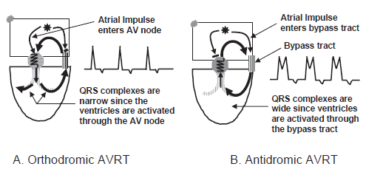
AVRT

Slide 44
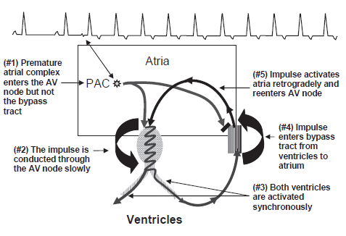
Narrow complex AVRT
The PAC finds the bypass tract still refractory because of its longer refractory period but is conducted through the AV node, which has a shorter refractory period
AV Node-slow pathway,short refractory period
Bypass tract-fast pathway,long refractory period

Slide 45
AVRT-reentrant circuit involves a large mass of tissue consisting of the atria, AV node, bundle of His, bundle branches and fascicles, ventricles, and bypass tract before returning to the atria. AVRT therefore is a form of macro-reentry.

Slide 46
Narrow complex (orthodromic) AVRT
Activation of the atria and ventricles cannot be simultaneous. The P wave, therefore, cannot be buried within the QRS complex. It should always be inscribed outside the QRS complexes
Atria are activated from the bypass tract, the P waves are inscribed retrogradely.
P waves inverted in II, III, and aVF
Retrograde P waves are inscribed immediately after the QRS complexes and deform the ST segments. Thus, the R-P interval is shorter than the PR interval
(m.c. Presentation)-Typical AVRT
AV block is not possible during AVRT because the atria and ventricles are essential components of the circuit; thus, every retrograde P wave is always followed by a QRS complex during tachycardia. When AV block occurs, the reentrant circuit (and therefore the tachycardia) will terminate.
(Conduction from V to A is faster than conduction from A to V= RP<PR)

Slide 47
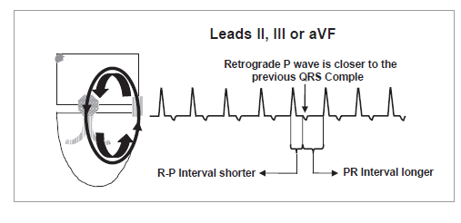

Slide 48
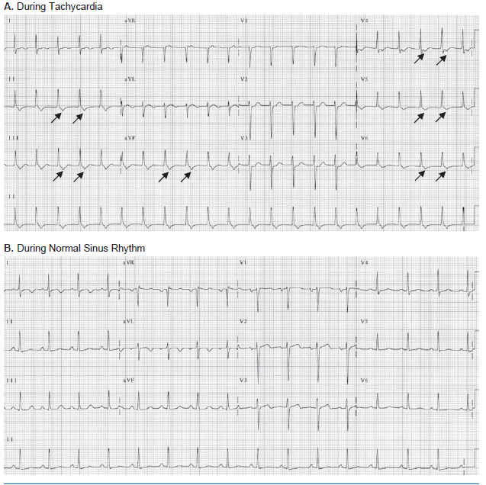

Slide 49
Orthodromic AVRT=
1.Typical AVRT- Retrograde P wave immediately after QRS complex
RP<PR
RP>80ms
2.Atypical AVRT-Retrograde P wave in front of QRS complex
RP>PR
ECG similar to Atypical AVNRT
Antidromic AVRT=
Classical example of Wide complex tachycardia due to SVT
Mistaken for VT

Slide 50
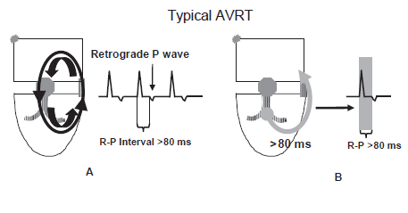
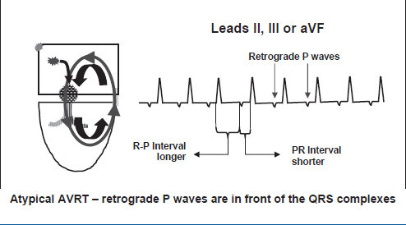

Slide 51
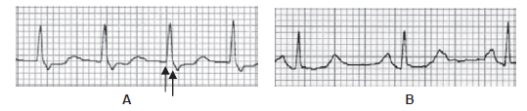
P waves are inscribed immediately behind the QRS complexes.
the R-P interval is 80 ms so it is AVNRT and not AVRT
AVRT-at least 80 ms is required for the impulse to travel from ventricle to atrium across the bypass tract in the surface electrocardiogram.
(B) Same patient on conversion to normal sinus rhythm with no retrograde P wave

Slide 52
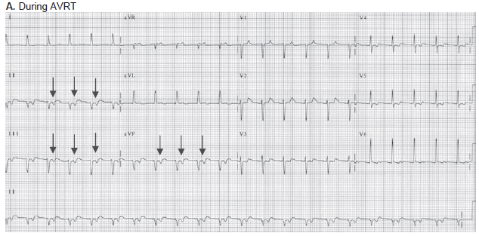
The retrograde P waves may be mistaken for inverted T waves in II, III, and aVF

Slide 53
Typical AVRT versus AVNRT-
When retrograde P waves are inscribed immediately after the QRS complexes during tachycardia,AVRT may be difficult to differentiate from AVNRT.
Clue-duration of the R-P interval
AVRT->80ms
AVNRT-<80ms
Because the R-P interval in AVRT measure 80 milliseconds, the retrograde P waves are usually inscribed separately from the QRS complexes, whereas in
AVNRT the retrograde P waves are usually connected to the terminal portion of the QRS complexes

Slide 54
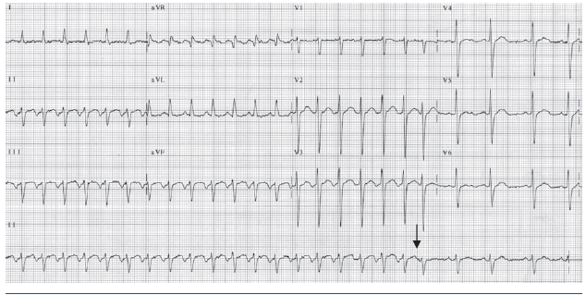
Atypical AVRT
retrograde P waves are in front of the QRS complex (R-P >PR interval)
The supraventricular tachycardia is terminated by a perfectly timed premature atrial complex (arrow)

Slide 55
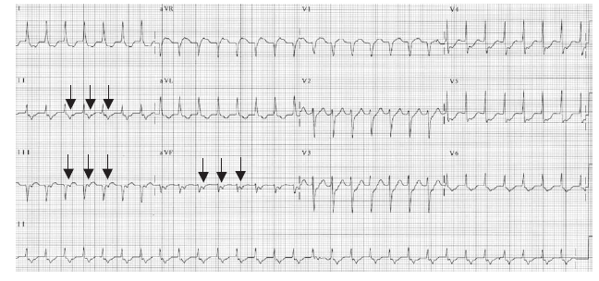
Typical AVRT

Slide 56
Concealed bypass tract-
Bypass tract is capable of conducting only in a retrograde fashion from ventricle to atrium but not from atrium to ventricle
Thus, the baseline ECG during normal sinus rhythm or upon conversion of the AVRT to normal sinus rhythm will not show any preexcitation (no delta wave or short PR interval). The presence of a bypass tract is suspected only when tachycardia from AVRT occur.
Manifest bypass tract-
Have preexcitation (delta waveand short PR interval) in baseline ECG during normal sinus rhythm.
These bypass tracts are capable of conducting from atrium to ventricle and also from ventricle to atrium. (Wolff-Parkinson-White Syndrom)

Slide 57
Electrical alternans-
Amplitude of the QRS complexes alternates by more than 1 mm.
more commonly seen in AVRT, can also occur with other types of SVT.

Slide 58
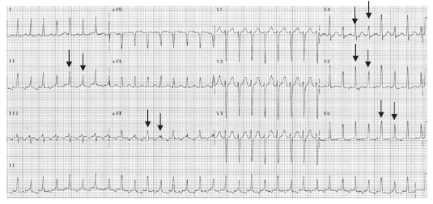

Slide 59
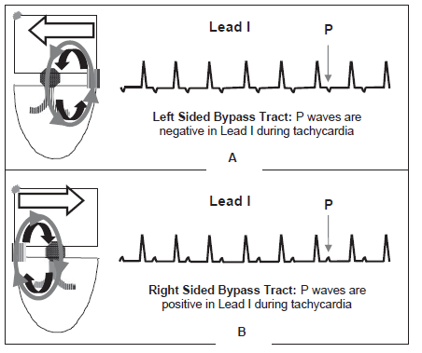
Localizing the bypass tract

Slide 60
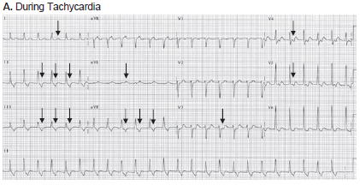
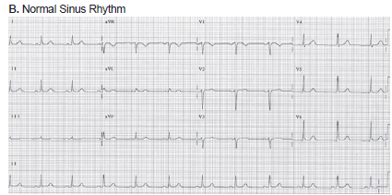
Right sided bypass tract
No evidence of pre-excitation is present-concealed bypass tract.

Slide 61
RBBB:
If a rate-related RBBB occurs during tachycardia and the ventricular rate becomes slower, the bypass tract is right sided
LBBB:
If a rate-related LBBB occurs and the ventricular rate becomes slower during the tachycardia, the bypass tract is left sided. Conversely, if the heart rate does not become slower, the bypass tract is at the opposite side

Slide 62
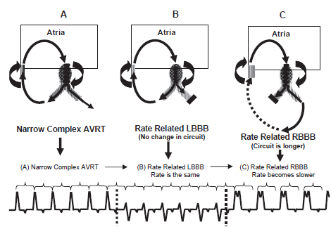
Bypass tract have to be activated from the left bundle branch, resulting in a longer and slower circuit

Slide 63
TREATMENT
Narrow complex AVRT-same as AVNRT
Adenosine in AVRT with Menifest bypass tract
Atrial Fibrillation
Very rapid Ventricular response
Collapse
So while treating AVRT,always Defebrillator should be available.

Slide 64
SART
Micro-reentrant tachycardia involving the sinus node and contiguous atrium.
Difficult to differentiate from sinus tachycardia because the sinus node is part of the reentrant circuit. During tachycardia, the P waves are identical to sinus P waves and easily mistaken for sinus tachycardia.
Precipitated and Terminated by Premature Atrial Impulse
paroxysmal with abrupt onset and abrupt termination
(Sinus Tachycardia- slow onset and gradual termination and is nonparoxysmal)

Slide 65
ECG Findings of SART
1. Identical to that of sinus tachycardia(P waves precede the QRS complexes and are upright in leads I, II, and aVF.)
2. Paroxysmal with abrupt onset and termination.
3. Precipitated and can be terminated by premature atrial complexes.
4. The atrial rate is usually not very rapid and is usually 120 to
150 bpm but can be 100 bpm.
SART can also be terminated by-
Vagal maneuvers
agents that block the AV node because AV nodal blocking agents also inhibit the sinus node-adenosine, beta blockers, calcium blockers, and digoxin
Only diff b/w ST and SART- abrupt onset and abrupt termination

Slide 66
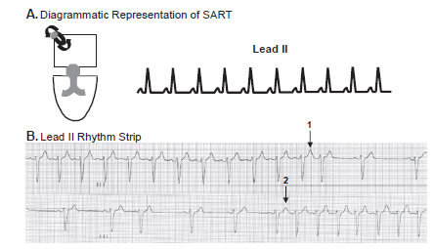
P waves resemble sinus tachycardia upright in leads II, III, and aVF.
SART can be terminated (1) or precipitated (2) by premature atrial complexes and is paroxysmal.

Slide 67
Clinical Implications
1.SART is uncommon
2.Associated with structural cardiac disease
3.Symptoms-lightheadedness but not syncope because the atrial rate 120-150 bpm, and can be slower than 100
( P waves precede each QRS complex; thus, atrial contribution to LV filling is preserved during tachycardia)

Slide 68
Acute Treatment
Therapy is usually not instituted early because the tachycardia is easily mistaken for sinus tachycardia
1.Vagal maneuvers
2. AV nodal blockers- Adenosine, beta blockers, CCB, digoxin
Prevention of recurrences-
1.Oral beta blockers
2.Diltiazem and Verapamil,
3. Digoxin.
Last Resort- Sinus node modification using radiofrequency ablation

Slide 69
IART
Micro-reentry
Larger if it circles around a scar tissue or around healed surgical incision(ASD repair)
ECG Findings of IART
1. The P waves are uniform in configuration and precede each QRS complex with a rate of 110 to 200 bpm.
2. The configuration of the P waves depends on the origin of the tachycardia and may be upright, biphasic or inverted in leads II, III, or aVF.
3. The atrial impulse is conducted to the ventricles through the normal AV conduction system; thus, the PR interval is usually 0.12 seconds.
4. Because the tachycardia is not dependent on the AV node, AV block can occur.
Reentrant ircuit is present in the atrium, which spreads circumferentially to activate the whole atria. So IART is an example of focal atrial tachycardia.

Slide 70
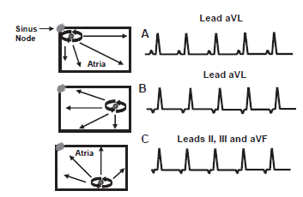
A -The P waves are upright or biphasic in lead aVL because the reentrant circuit originates from the right atrium close to the sinus node.
B -The P waves are inverted in lead aVL because the impulse originates from the left atrium.
C-The P waves are inverted in lead II, III, and aVF because the tachycardia originates from the bottom of the atria

Slide 71
Atrial tachycardia from IART is difficult to distinguish from atrial tachycardia resulting from enhanced or triggered automaticity using the surface ECG. Because these tachycardias all look alike electrocardiographically.
They are all included as examples of focal atrial tachycardia regardless of the mechanism

