Slide 1
A very probable case of dysplastic gangliocytoma of the cerebellum: MRI Findings
- Dr. Rajesh Rathore

Slide 2
Clinical Presentation
33-year-old woman presented with progressive headache and ataxia.
MR imaging examination on 1.5 T system, coil dedicated, on the axial, coronal and sagittal planes, using SE T1W, DWI, FSE T2W, FLAIR T1W/T2W, STIR, PROBE and PRESS sequences, were performed.

Slide 3
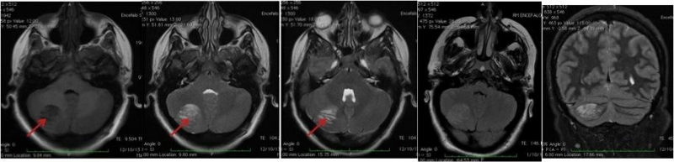
Axial FLAIR, FSE T2W, coronal STIR
'Tiger-striped' appearance (red arrow)

Slide 4
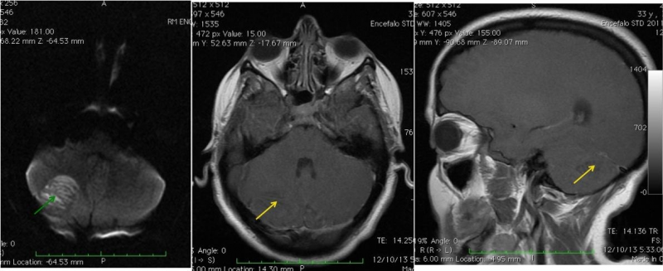
DWI and SE T1W with contrast
Bright signal on DWI (green arrow). No contrast enhancement (yellow arrow)

Slide 5
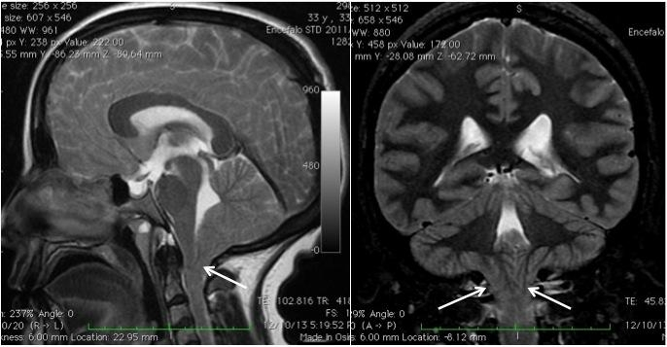
Coronal STIR and sagittal T2W
Tonsillar herniation (white arrow).

Slide 6
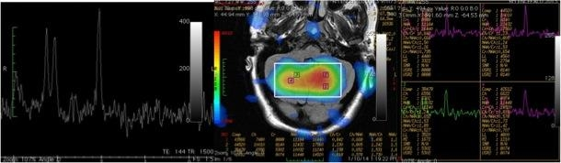
MR spectroscopy (PROBE-PRESS)
Reduced levels of metabolites

Slide 7
Differential Diagnosis
Cerebellitis
Infiltrating glioma with entrapped neurons

Slide 8
Conclusion
Magnetic resonance imaging (MRI) revealed an enlarged right cerebellum with alternate bands of hypo and hyper intensities ('tiger-striped' appearance) on T2 weighted images.
There was bright signal within the mass on diffusion-weighted images. There was no contrast enhancement and there was also tonsillar herniation.
MR spectroscopy showed slightly reduced levels of metabolites. This MRI findings are compatible with a very probable case of dysplastic gangliocytoma of the cerebellum

Slide 9
THANK YOU

