Slide 1

Radiological evaluation of Aneurysmal Bone Cyst
- Dr. Pallavi Shah

Slide 2
CLINICAL PRESENTATION
19 year old male came to our department with pain in the left shoulder.
No history of fever or any discharging sinus.

Slide 3
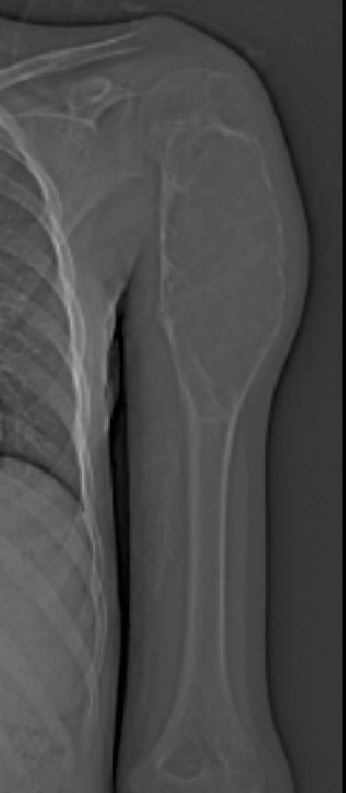
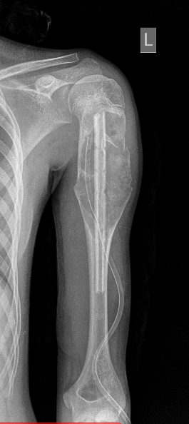
PLAIN X-RAY: showing an expansile lytic lesion eccentrically located in the metaphysis of the left humerus with thinned out sclerotic margins.
POST OPERATIVE X-RAY- Implant with a Surgical drain & post operative changes are seen insitu.

Slide 4
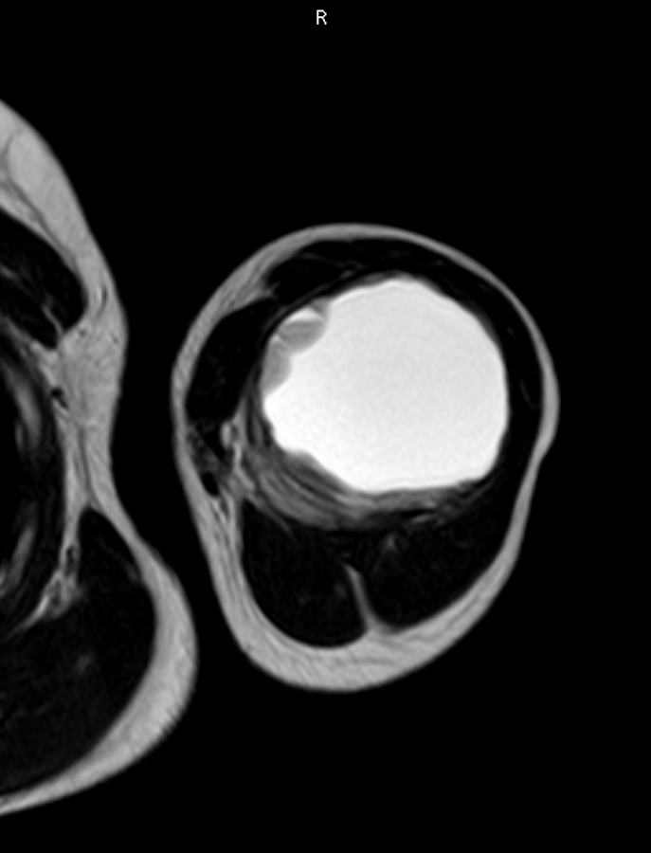
MRI SCAN : axial image show the characteristic fluid fluid levels which is suggestive of Aneurysmal Bone cyst

Slide 5
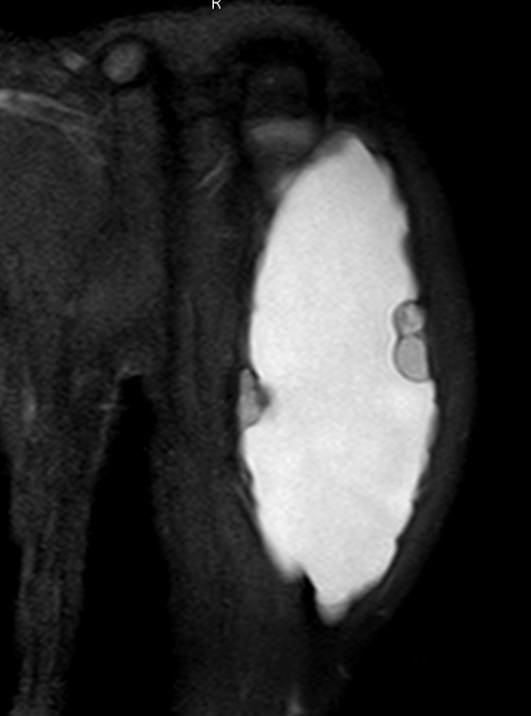
MRI SCAN : coronal image show the characteristic fluid fluid levels which is suggestive of Aneurysmal Bone cyst

Slide 6
Discussion
Radiological features of aneurysmal bone cyst
X-ray :
an area of bone resorption with slight or marked expansion.
Overlying cortex is thinned out.
The endosteal margin is relatively well defined against cortex.
An ill defined zone of transition is usual between the lesion and the medullary bone.
MRI :
T1 Weighted images show predominantly low to intermediate signal intensity with or without fluid levels. Acute hemorrhage in the cyst may have high signal intensity.
T2 weighted images show areas of of low to intermediate signal intensity or some areas of heterogeneous signal intensity, depending on the contents of the cyst. A rim of low signal intensity with internal septa may produce a multi-cystic appearances.

Slide 7
Thank You

