Slide 1
Congenital bilateral inguino-scrotal hernia with postoperative hydrocele formation
- Dr. Chandra Raychaudhari

Slide 2
Clinical History
The patient was admitted to the outpatient department of Paediatric Surgery clinic with bilateral
inguino-scrotal swelling which was more prominent on the right. On the right, the swelling was
permanent. On the left, the swelling was reducible, intermittent and induced by increase of
intra-abdominal pressure (i.e. coughing or crying).

Slide 3
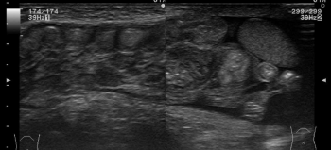
Imaging Findings
The hernia sac with its contents -non dilated enteric loops, mesentery and omentum- spreads into the right hemiscrotum, pushing the testis forward. The enlarged inguinal canal with its contents is demonstrated measuring approximately 2.1 cm.

Slide 4
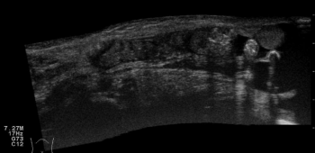
Extended-Field-of-view image showing the small bowel with mesentery herniating into the scrotum superiorly to the testis. The hernia is filled with fluid and echogenic air-filled intestinal loops. Dirty shadow artefacts arise from the air-filled loops.

Slide 5
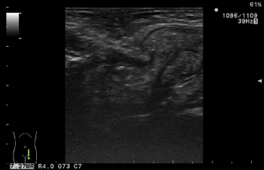
Peristalting bowel was seen in real time, entering through the deep inguinal ring into the inguinal canal during crying of the infant.

Slide 6
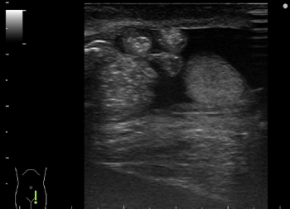
Scrotal hernia sac protruding through the superficial inguinal ring, containing fluid-filled bowel loops cranially to the testis along with hydrocele. The ipsilateral testis has normal echogenicity and size.

Slide 7
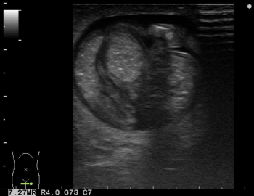
Transverse gray-scale view of the right hemiscrotum showing fluid encircling the herniating bowel loops with intestinal content. Transverse view of one air filled bowel loop (with dirty shadow).

Slide 8
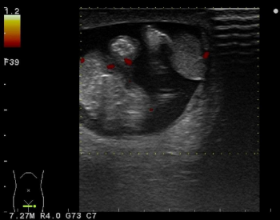
This transverse Power Doppler image depicts blood flow signals within the intestinal loops and the testis in the right hemiscrotum.

Slide 9
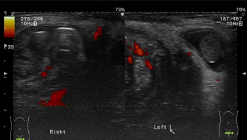
This bilateral comparative Power Doppler image demonstrates the scrotal hernia on the right and comunicating hydrocele on the left.

Slide 10
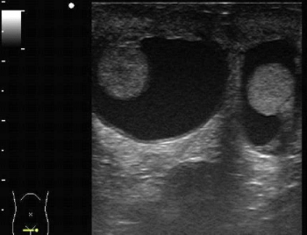
Bilateral reactive hydrocele with normal shape and echogenicity testes

Slide 11
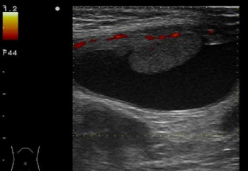
This postoperative long-axis Power Doppler image shows normal blood flow signals of the organs of the right hemiscrotum

Slide 12
Discussion
Hernias and hydroceles consist commonly encountered problems of routine paediatric practice.
Embryologically, these disorders stem from the inability of the processus vaginalis to fully
obliterate during the descent of testes. Inguinal hernias (IH) are usually indirect in neonates. [1, 2]
The incidence of IH is 4.4% but higher in premature infants and when intraabdominal pressure is
increased. [2] IH is located on the right in 60% of patients due to the fact that the right processus
vaginalis obliterates after the left. 10% of IH are bilateral while a reported 5-20% of patients with
clinically detected unilateral IH have a contralateral patent processus vaginalis, visible on
ultrasonography. Bilateral IHs affect more frequently high risk prematures and low birth-weight
neonates. [

Slide 13
Differential Diagnosis
Inguino-scrotal hernia,
Communicating hydrocele,
Cyst of the spermatic cord,
Cyst of the canal of
Nuck,
Complex hydrocele,
Undescended testis,
Haematoma, Haematocele, Scrotal abscesses,
Lipoma of the spermatic cord and inguinal canal, Inguinal lymph nodes

Slide 14
THANK YOU

