Slide 1
Extrapulmonary tuberculosis
- Dr. Pradeep Jhala
S.B.K.S medical college and research institute.
Sumandeep Vidhyapeeth.
Dhiraj General Hospital.
Vadodara ,Gujarat.

Slide 2
INTRODUCTION
EXTRA PULMONARY TUBERCULOSIS INVOLVES RELATIVELY INACCESIBLE SITES.
FEWER BACILLI CAN CAUSE MUCH GREATER DAMAGE.
MORE DIAGNOSTIC PROBLEM THAN PULMONARY TB.
INVASIVE PROCEDURES ARE FREQUENTLY REQUIRED TO ESTABLISH A DIAGNOSIS.

Slide 3
TUBERCULOUS MENINGITIS
IN CASE OF TB MENINGITIS HEMATOGENOUS SPREAD WILL LEAD TO INTRA MENINGEAL OR SUBMENINGEAL FOCI KNOWN AS RICH FOCI AND WITH ITS RUPTURE MENINGITIS OCCURS
CLINICAL PRESENTATION
SEIZURES
PHOTOSENSITIVITY
NECK STIFFNESS

Slide 4
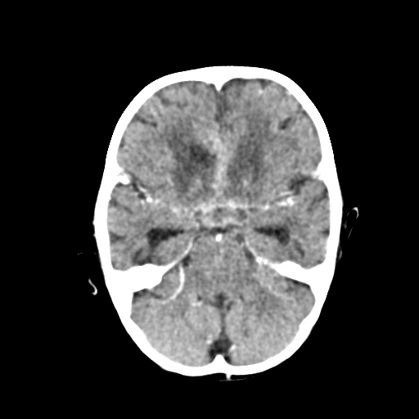
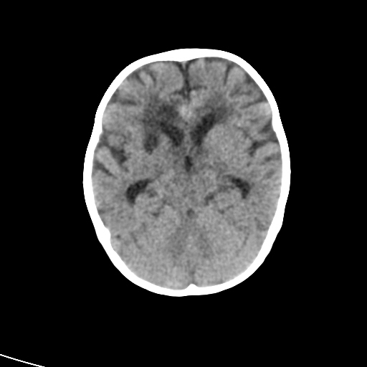
A PATIENT OF AGE 1 YEAR CAME TO THE DHIRAJ GENERAL HOSPITAL WITH COMPLAINTS OF CONVULSIONS AND NECK STIFFNESS. SHE HAD BEEN ON IRREGULAR TREATMENT OF AKT SINCE TWO MONTHS. SHE UNDERWENT CT SCAN FOR EVALUATION
THERE ARE MULTIPLE WELL DEFINED HYPODENSE LESIONS SEEN IN THE PERIVENTRICULAR REGION OF FRONTAL LOBE AND TEMPORAL LOBE NEAR SYLVIAN FISSURE WITH PERIPHERAL RIM ENHANCEMENT.
THERE IS PROMINENCE OF ALL VENTRICLES SUGGESTIVE OF COMMUNICATING HYDROCEPHALUS.
THERE IS EFFACEMENT OF SULCI AND GYRI ON PLAIN CT AND DIFFUSE MENINGEAL ENHANCEMENT ON POST CONTRAST STUDY SUGGESTIVE OF MENINGITIS

Slide 5
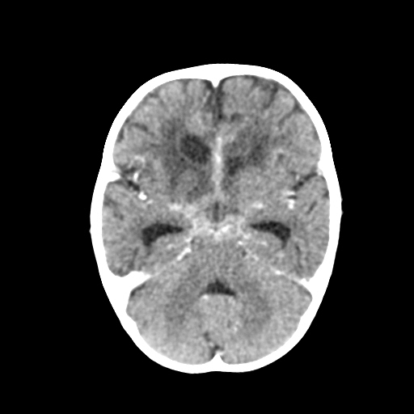
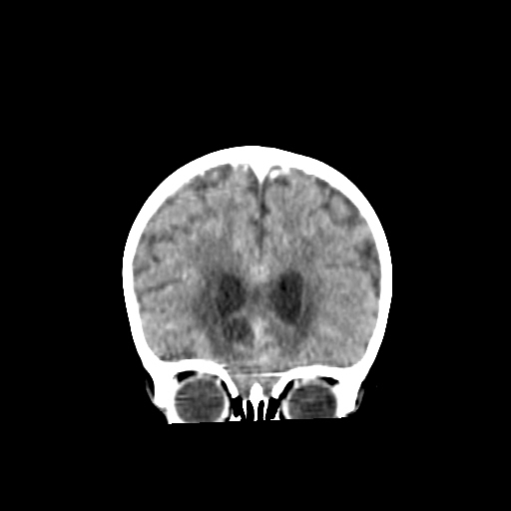

Slide 6
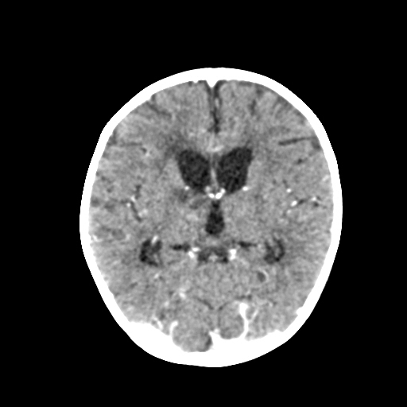
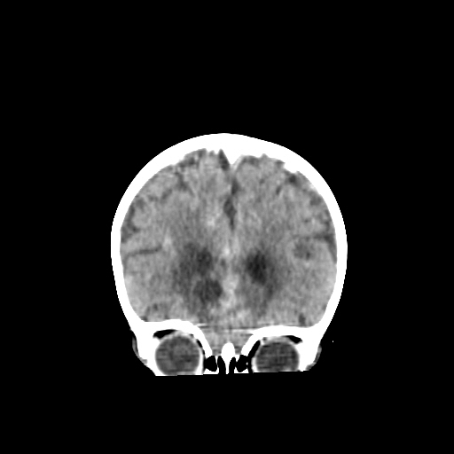

Slide 7
OSSEOUS TUBERCULOSIS
CLINICAL SYMPTOMS
INSIDOUS ONSET
PAIN AND SWELLING OF JOINT
JOINT CONTRACTURE AND LIMITED MOVEMENTS.
NIGHT SWEATS.

Slide 8
OSSEOUS TUBERCULOSIS
OSTEOARTICULAR TUBERCULOSIS STARTS WITH OSTEOMYELITIS IN THE GROWTH PLATES OF THE BONES.
IN THE LONG BONES TB ORIGINATES FROM THE EPIPHYSIS AND CAUSES TUBERCLE FORMATION IN THE MARROW WITH SECONDARY INFECTION OF THE TRABECULAE , THE JOINT SYNOVIUM WILL HAVE INFLAMMATORY REACTION FOLLOWED BY GRANULATION TISSUE.

Slide 9
THE PANNUS OF THE GRANULATION TISSUE FORMED THAN BEGINS TO ERODE AND DESTROY THE CARTILAGE AND EVENTUALLY BONE LEADING TO DEMINERALISATION.
PROTEOLYTIC ENZYMES ARE NOT FORMED AND THEREFORE THE JOINT SPACES ARE PRESERVED FOR CONSIDERABLE TIME BUT IF NO TREATMENT IS GIVEN ABSCESS FORMATION OCCURS.
SEQUESTRATION OF BONE IS RARE.

Slide 10
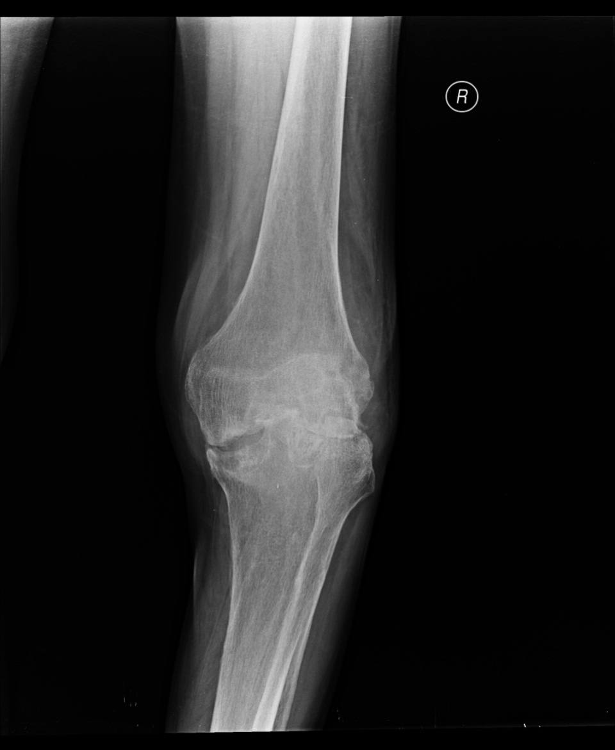
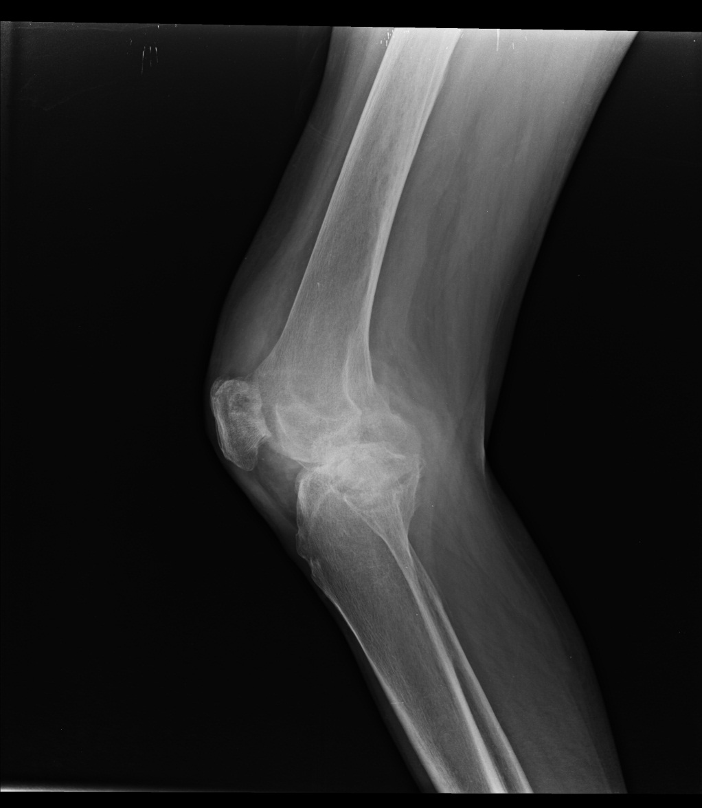
PATIENT CAME TO THE DHIRAJ GENERAL HOSPITAL WITH COMPLAINTS OF PAIN AND SWELLING IN THE RIGHT KNEE JOINT.PATIENT ALSO COMPLAINED OF FEVER AND WEIGHT LOSS SINCE PAST 3 MONTHS

Slide 11
X ray right knee joint
THERE IS EROSION OF THE ARTICULAR SURFACE WITH SOFT TISSUE SWELLING.
THERE IS COMPLETE LOSS OF JOINT SPACE WITH PERIARTICULAR BONY DEMINERALISATION .
THESE FINDINGS LEAD TO THE DIAGNOSIS OF TUBERCULOSIS KNEE JOINT

Slide 12
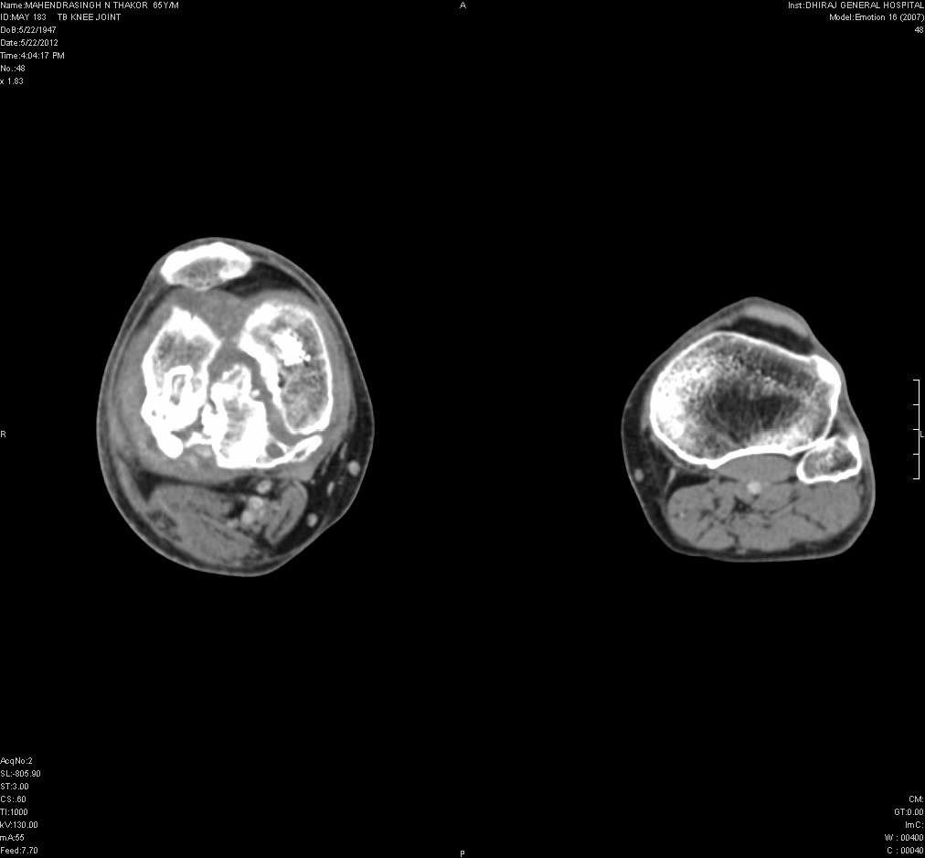
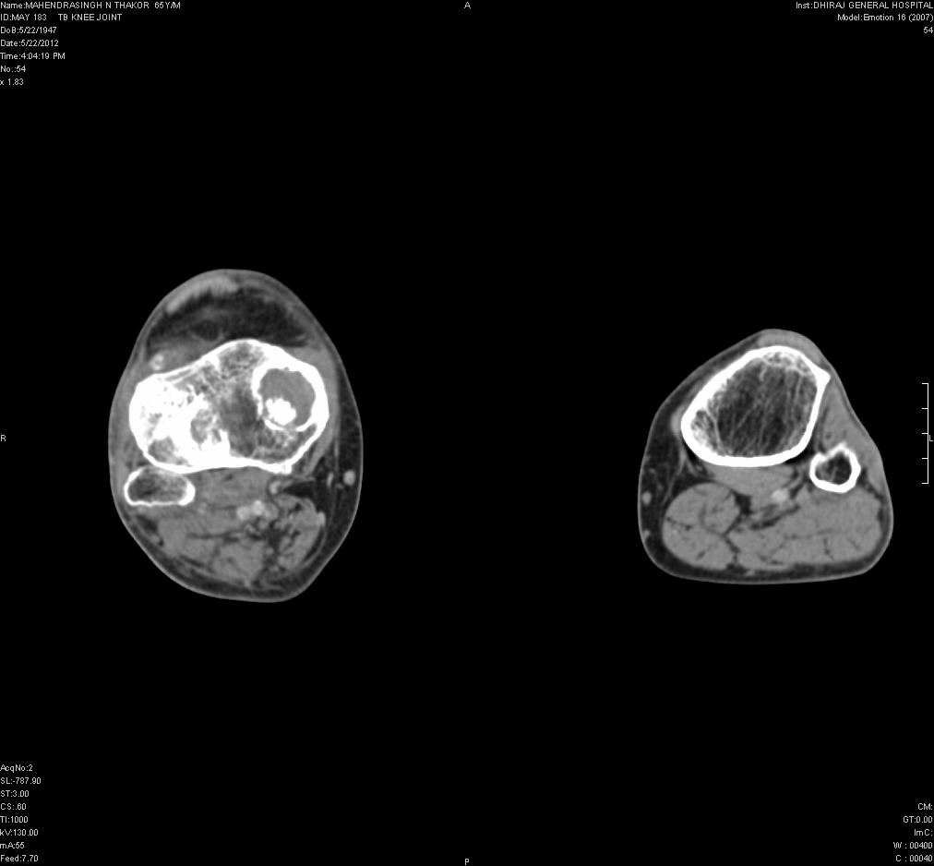
CT SCAN OF BOTH KNEES

Slide 13
CT SCAN OF BOTH KNEES
THERE IS EROSION INVOLVING THE CORTICAL SURFACE OF THE DISTAL END OF THE RIGHT FEMUR AND PROXIMAL END OF RIGHT TIBIA.
THERE IS ALSO REDUCTION IN THE JOINT SPACE INVOLVING BOTH THE MEDIAL AND LATERAL COMPARTMENTS OF THE RIGHT KNEE JOINT.
THERE IS ALSO SOFT TISSUE INVOLVEMENT WITH DEBRIS SEEN.

Slide 14
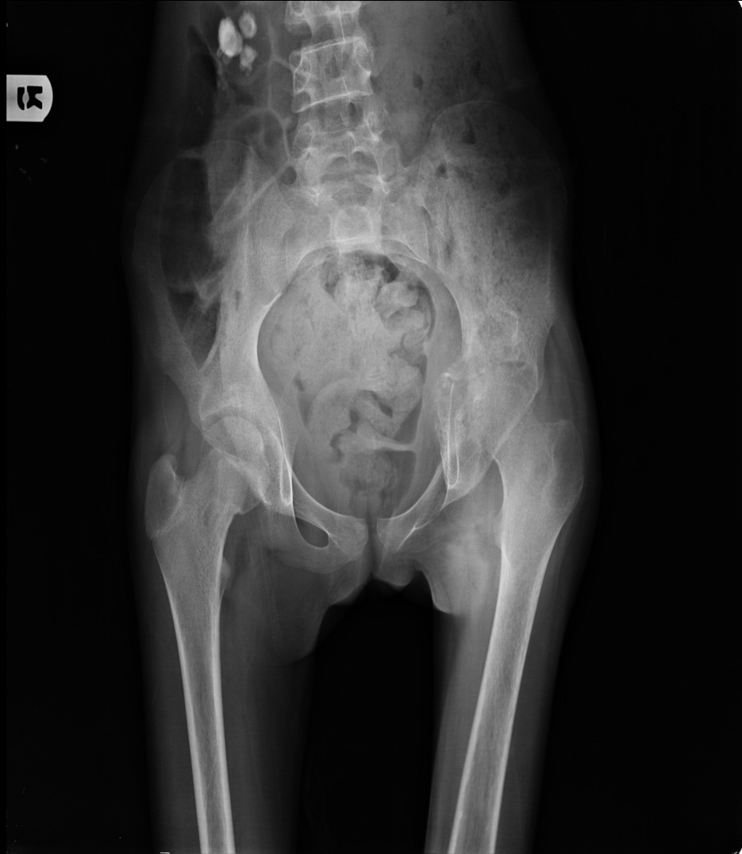
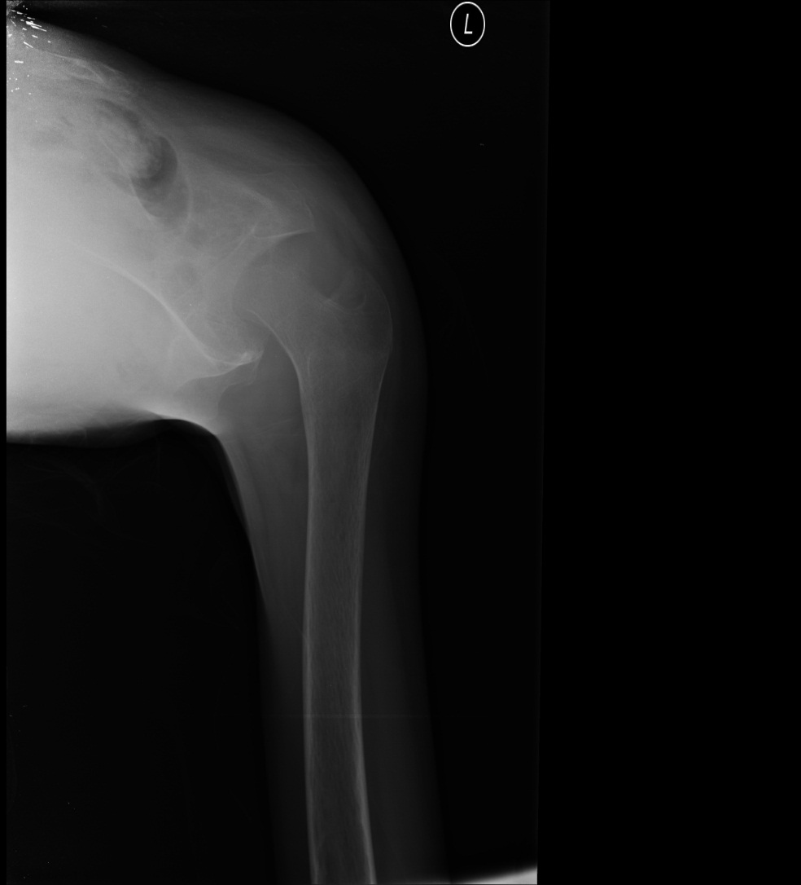
X-RAY HIP JOINT

Slide 15
X-RAY HIP JOINT
THERE IS COMPLETE LOSS OF THE JOINT SPACE WITH DESTRUCTION OF THE CARTILAGE AND ADJACENT JOINT SURFACES WITH SEVERE PERI-ARTICULAR OSTEOPOROSIS.

Slide 16
TUBERCULOSIS SPINE
THE INFECTION TRAVELS IN THE SPINE BY SUBLIGAMENTOUS SPREAD AND INTO THE PARA VERTEBRAL SPACES AND ADJACENT SOFT TISSUE.
IT CAUSES OSTEONECROSIS CHARACTERISED BY LOSS OF EXTRACELLULAR MATRIX AND COLLAPSE OF THE VERTEBRA.
SPINAL TB INVOLVING TWO OR THREE DIFFERENT SITES ARE REFERRED TO AS SKIPPED LESIONS.

Slide 17
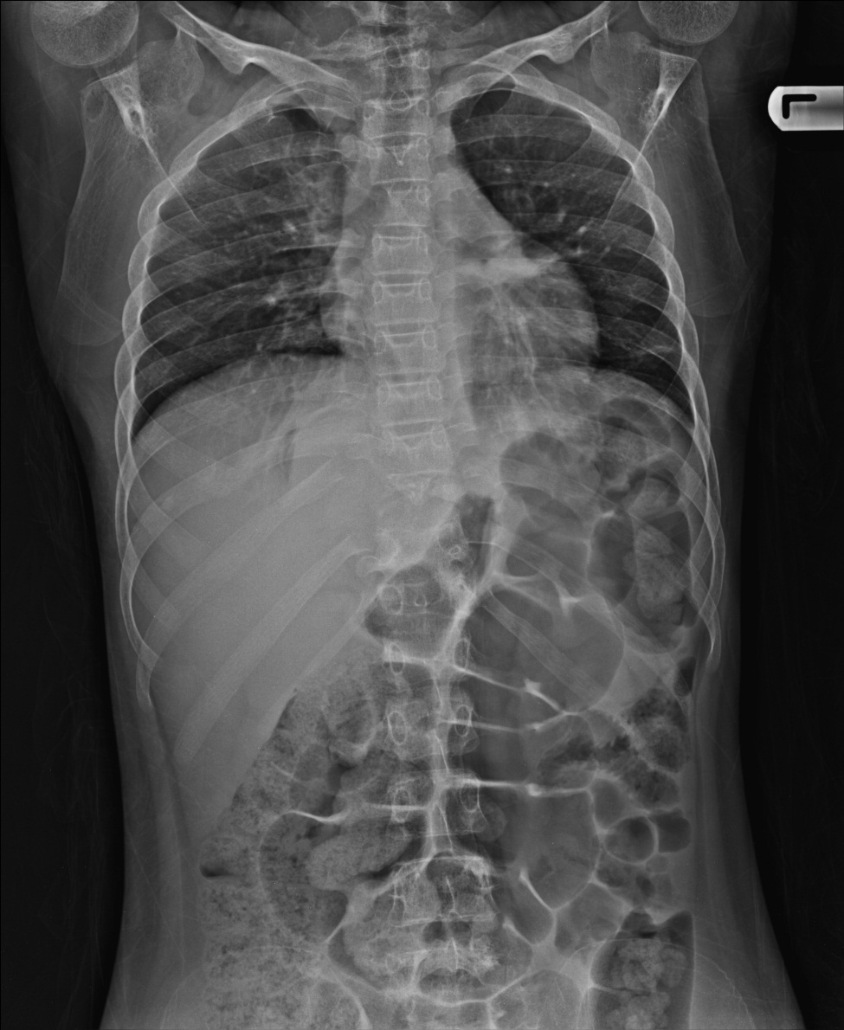
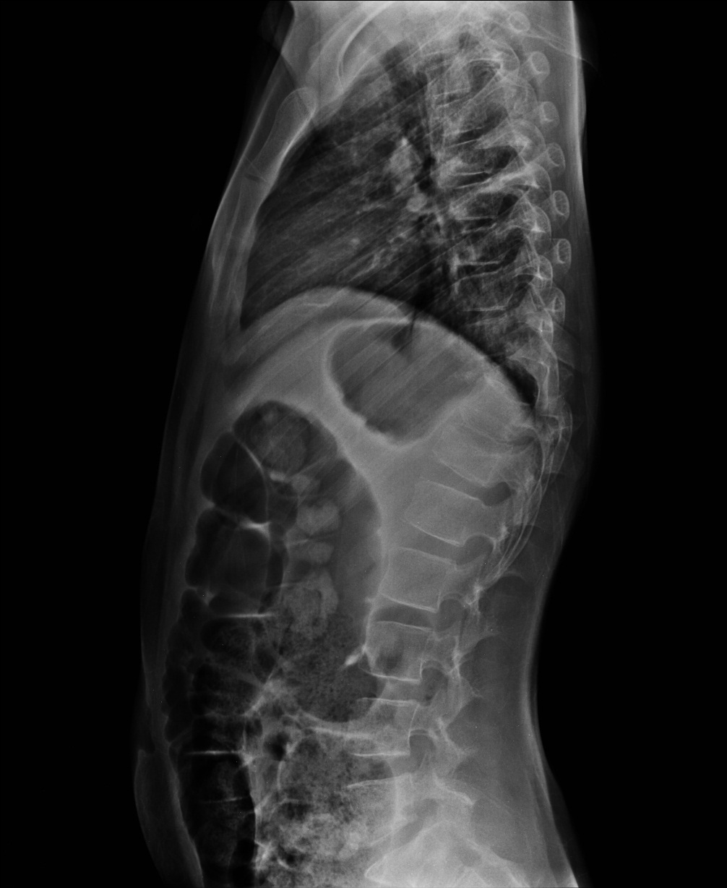
14 YEAR OLD FEMALE PATIENT CAME TO DHIRAJ GENERAL HOSPITAL WITH SUDDEN ONSET OF PARAPLEGIA AND SEVERE PAIN IN THE BACK.

Slide 18
X-RAY D.L.SPINE
THER IS PRESENCE OF EROSION OF THE ENDPLATES OF D10 –D11 VERTEBRA L BODIES WITH COLLAPSE WITH LOCALISED OSTEOPOROSIS
SOFT TISSUE SWELLING IS SEEN AT THE LEVEL OF D10-D11 VERTEBRAL BODIES.

Slide 19
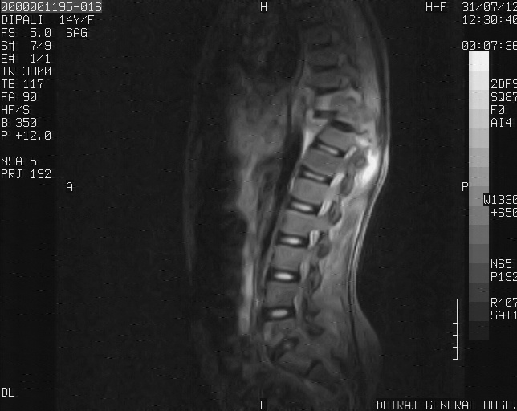
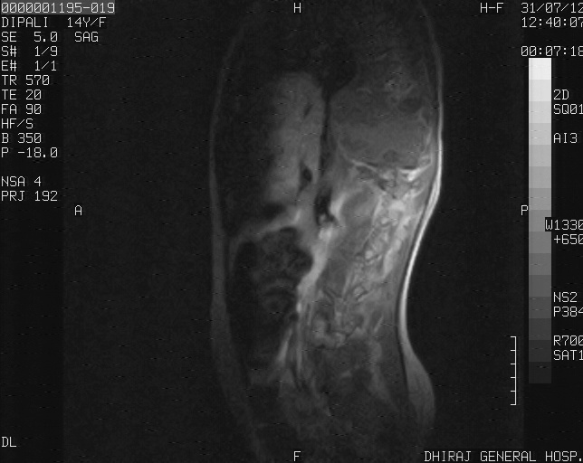
MRI WHOLE SPINE

Slide 20
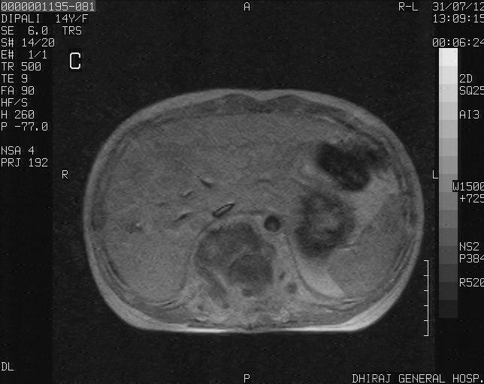
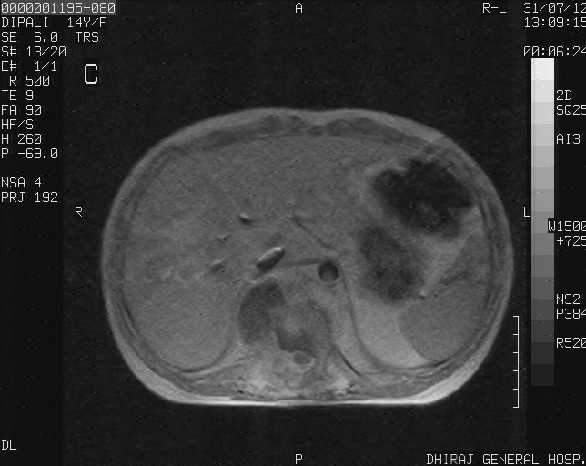
MRI WHOLE SPINE

Slide 21
MRI WHOLE SPINE
MRI SHOWED WEDGING AND LOSS OF HEIGHT OF D10-D11 VERTEBRAL BODIES WITH ALTERED SIGNAL INTENSITY ON T1 WI,T2 WI AND FLAIR SEQUENCES.
THERE IS ALSO INVOLVEMENT OF NEURAL FORAMINA.
FNAC WAS TAKEN FOR THIS PATIENT WHICH CONFIRMED THE DIAGNOSIS OF POTT’S SPINE.

Slide 22
CONCLUSION
RADIOLOGY PLAYS AN INTEGRAL PART IN THE DIAGNOSIS OF PULMONARY AS WELL AS EXTRAPULMONARY TUBERCULOSIS

