Slide 1
Lecture 8:
Casts, slab, splints, traction
Dr ADITYA K. AGRAWAL
ASSOCIATE PROFESSOR
DEPT OF ORTHOPAEDICS, DHIRAJ HOSPITAL
SBKS MIRC SUMANDEEP VIDYAPEETH

Slide 2
ACKNOWLEDGMENTS
SINGAPORE GENERAL HOSPITAL, SINGAPORE
SANCHETI HOSPITALS, PUNE, MAHARASHTRA
DR PREMAL NAIK, PEDIATRIC ORTHOPAEDIC SURGEON, AHMEDABAD

Slide 3
PLASTER TECHNIQUES

Slide 4
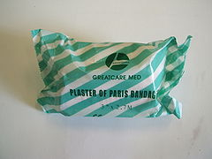
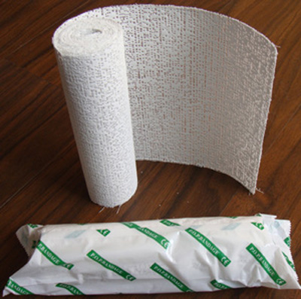
PLASTER OF PARIS
FORMULA
The POP bandage consists of a roll of muslin stiffened by dextrose or starch and impregnated with the hemihydrate of calcium sulfate.
When water is added, the calcium sulfate takes up its water of crystallization:
Gypsum + heat=> Plaster of Paris + steam
2CaSO₄·2H₂O + heat=> 2CaSO₄·½H₂O + 3H₂O

Slide 5
Setting time: time taken to change from powder form to crystalline form.
Average setting time: 3-9 minutes
Factors decreasing setting time:
1) Hot water
2) Salt
3) Borax
4) Resin
Factors increasing setting time:
1)Cold water
2)sugar

Slide 6
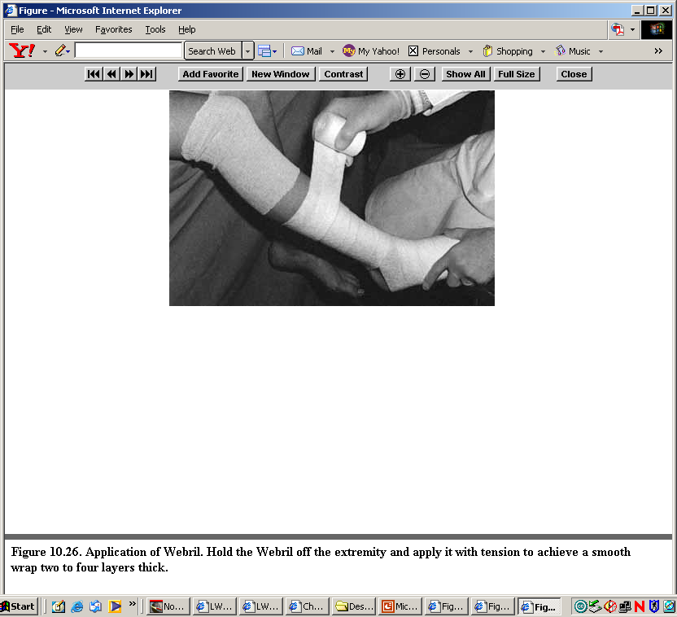
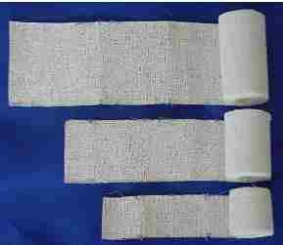
RULES FOR APPLICATION OF POP
  Padding: This is placed from distal to proximal with a 50% overlap, a minimum two layers, and extra padding at bony prominence like fibular head, malleoli, patella, and olecranon.
  Plaster: Cold water will maximize the molding time.
    8 inch width for thigh
    6 inch width for leg
    4 inch width for arm and forearm

Slide 7
One joint above and one joint below.
Mould with palm and not with fingers to avoid indentation.
Joints should be immobilized in functional position.
Not too tight or too loose i.e. adequate padding
Dip pop vertically in water till air bubble ceases to come
Uniform thickness of plaster is preferred.

Slide 8
TRIPLE SEQUENCE IN PLASTER TECHNIQUE
Phase 1: examination and rehearsal
Phase 2: plastering
Phase 3: reduction and holding

Slide 9
Examination and rehearsal
Examination of the displacement and assessment of the forces required to reduce and hold the reduction.
Need to assess
    Effect of gravity on the displacement
    Amount of force needed to correct the displacement
    Range of excursion from the position of greatest deformity to the position of apparent reduction

Slide 10
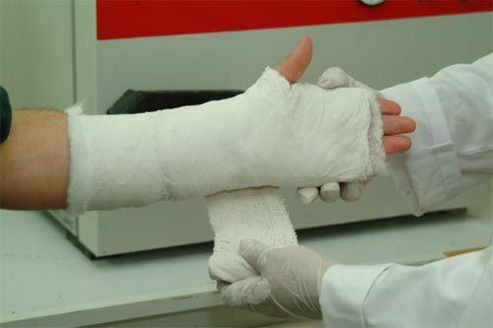
Plastering
Limb held by assistant in position of approximate reduction
Surgeon himself should apply
Quick application more important than holding precise reduction
Plaster should still be completely soft after application to allow final touches

Slide 11
Reduction and holding
After applying sufficient plaster, surgeon prepares to apply the rehearsed movement of reduction.
Should be able to clearly recognise sensation of reduction.
After applying rehearsed reduction, surgeon holds on, without further movement to allow the cast to set.
In the last few minutes, he should obliterate any abrupt impression that might invite pressure sore.

Slide 12
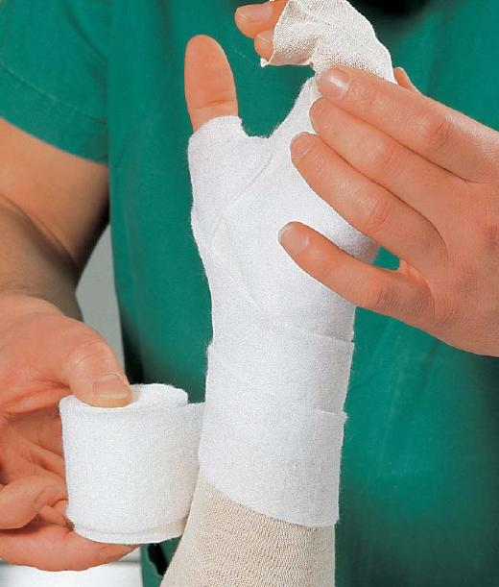
PLASTER TECHNIQUES
Plaster casts can be divided into 3 types:
Badly padded plaster
Unpadded plaster
Padded plaster

Slide 13
Badly padded plaster
It is loose on the limb and therefore cannot fix the fragments.
No padding is done in the bony prominences
Unpadded Plaster
Made by applying the turns of wet bandage directly to the skin without using any textile. (used by Böhler)
For practical purposes, if stockinette is used the resulting plaster can still be regarded as an unpadded cast.

Slide 14
The closeness of its application to the limb and actual adhesion to the skin, is believed to enhance fixation of a fracture.
Considerably easier to learn than padded plaster technique.
Bandage should never be pulled tight .
Bandage should be made to roll itself round the limb.
Should be applied by laying the wet roll of plaster on the skin and pushing it round the curves of limb with flat of hand.
The roll of plaster should not be lifted off the limb and pulled.
Recommended in 3 condition by Sir John Charnley:
1) Colles’ fracture
2) Scaphoid fracture
3) Bennett’s fracture

Slide 15
Padded plaster cast
A layer of cotton-wool is interposed between the skin and plaster,
The elastic pressure of the cotton enhances the fixation of limb by compensating for shrinkage in tissues .
The care with which cotton is applied is essential for success.
The cotton if not rolled already, should be carefully prepared in rolls before application. The roll of bandage remains in contact with surface of limb almost continuously.
Pressure is applied at the middle of width of bandage so that no excess of pressure can fall on either edge .

Slide 16
Each turn is applied slowly and is settled carefully in position.
At tapering parts of the limb, the turns are made to lie evenly by small tucks which are made with quick movement of index finger of left hand.
The durability of the cast depend on welding together of individual turns by smoothing movements of left hand.
Each layer must be applied with equal deliberation
The hall-mark of good plaster is that it should be of even thickness from end to end.
Never apply two turns in the same place except at the ends.
Have a progressive ‘backward and forward rhythm’ from top to bottom.

Slide 17
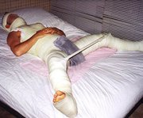
POP … various forms
Slab: only a part of circumference of limb is incorporated.
Cast: encircle whole circumference of the limb.
Spica
Brace

Slide 18
SLAB
Slab: only a part of circumference of limb is incorporated.
UPPER EXTREMITY
LOWER EXTREMITY
Below elbow
Above elbow
U-slab\ Coaptation splint
Sugar tong
Gutter splint
Below knee
Above knee
Cylindrical

Slide 19
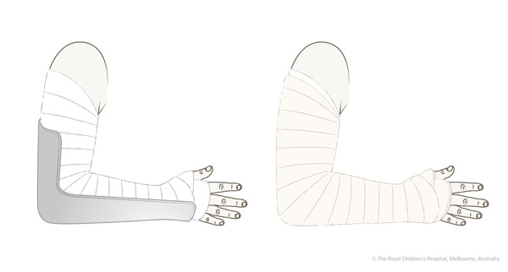
UPPER EXTREMITY
Used in
Colles fracture (above elbow in supination)
Smiths fracture (above elbow in supination)
Bartons fracture (above elbow in supination)
Fracture of metacarpals (Ball bandage)
Wrist drop (cock up slab)
Fracture of mid-shaft humerus(U – slab)
Fracture of both bone of forearm(above elbow in mid prone)

Slide 20
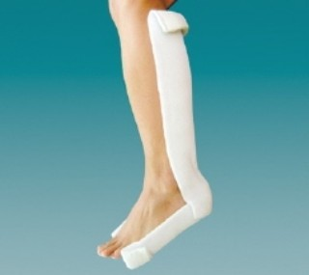
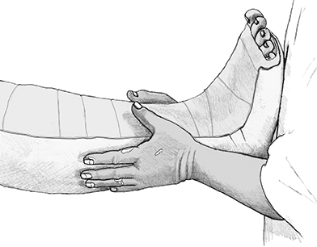
LOWER EXTREMITY
Undisplaced Patella fracture(Cylindrical slab)
Tibia plateau fractures (Above knee slab)
Undisplaced tibia shaft fractures (Above knee slab)
Ankle fractures\Foot injuries(Below knee slab)
Bimalleolar
Trimalleolar
Fracture calcaneum
Fracture metatarsals
Fracture toes

Slide 21
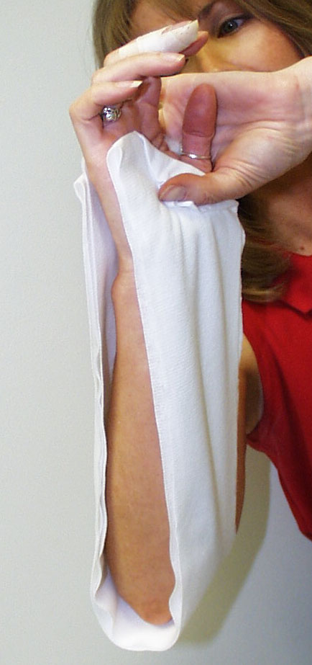
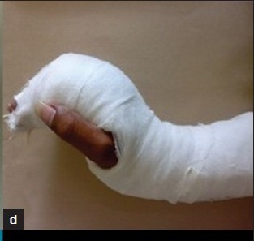
Sugar Tong Splint
Splint extends around the distal humerus to provide rotational control
Padding should be at least 3 - 4 layers thick with several extra layers at the elbow
COCK UP SLAB
In this type of slab the wrist is kept in extension and the slab is applied on the volar aspect of the forearm
Usually used in wrist drop (Radial nerve palsy)

Slide 22
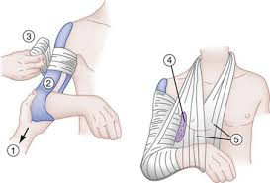
U-SLAB \ COAPTATION SPLINT
This type of splint is usually used in mid shaft humerus fractures
For the temporary relief
BALL BANDAGE
This type of bandage is used in fractures of metacarpals.
In this first the cock up slab is applied.
After that the ball made of pad is placed in the palm and after giving traction bandage is applied on it.

Slide 23
CASTING
Cast: encircle whole circumference of the limb
Goal of semi-rigid immobilization while avoiding pressure / skin complications
Often a poor choice in the treatment of acute fractures due to swelling and soft tissue complications
Good cast technique necessary to achieve predictable results

Slide 24
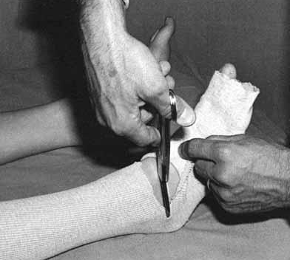
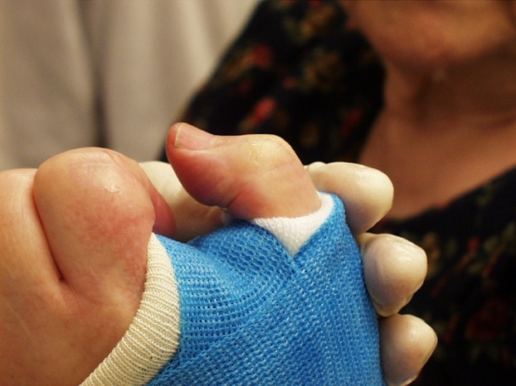
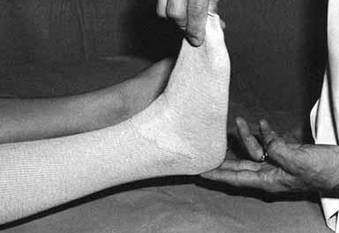
Casting Techniques
Stockinette - may require two different diameters to avoid overtight or loose material
Caution not to lift leg by stockinette – stretching the stockinette too tight around the heel may case high skin pressure
To avoid wrinkles in the stockinette, cut along the concave surface and overlap to produce a smooth contour

Slide 25
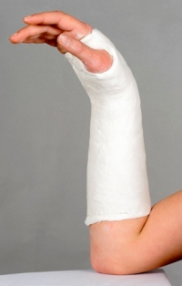
Forearm Casts & Splints
MCP joints should be free
  Do not go past proximal palmar crease
Thumb should be free to base of MC
  Opposition of thumb to little finger should be unobstructed

Slide 26
Below Knee Cast
Support metatarsal heads
Ankle in neutral – flex knee to relax gastroc
Ensure freedom of toes
Build up heel for walking casts - fiberglass much preferred for durability

Slide 27
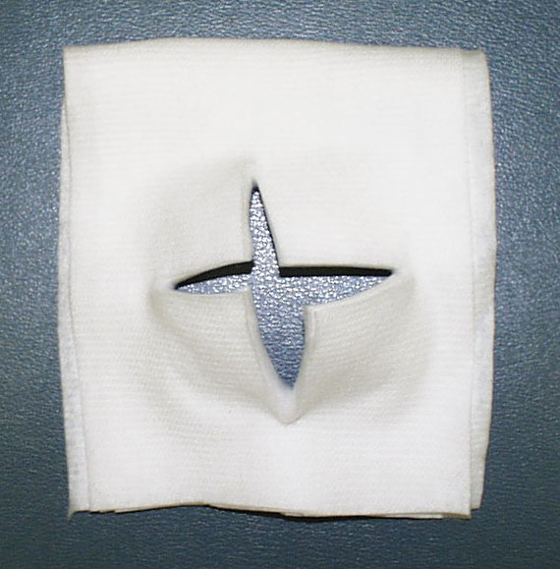
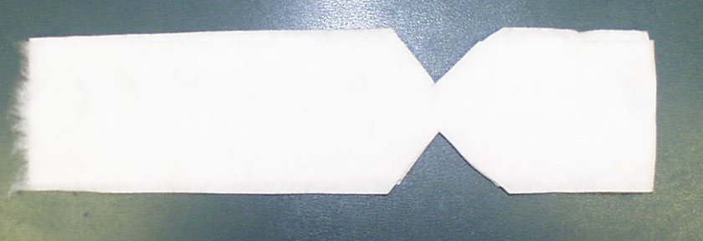
Padding for fibular head and plantar aspect of foot

Slide 28
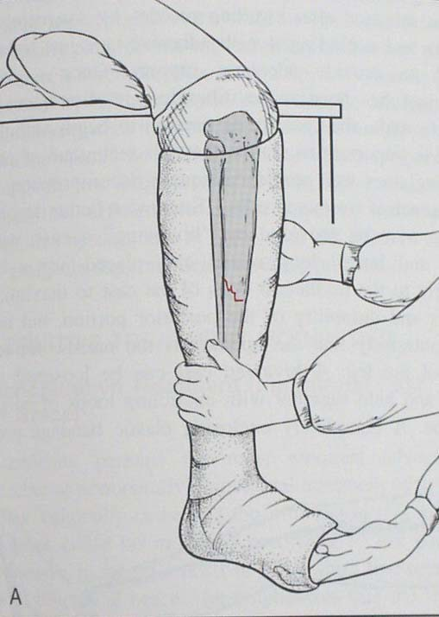
Flexed knee
Padded fibular
head
Neutral ankle
position
Toes free
Assistant or foot stand required to maintain ankle position
Notes:
Figure from:Figure from: Browner and Jupiter: Skeletal Trauma, 2nd ed, Saunders, p 2221 1998.

Slide 29
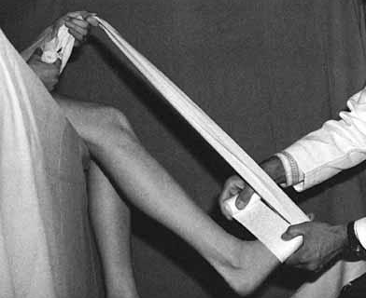
Short Leg Cast
When working alone, the patient can help maintain proper ankle position by holding onto a muslin bandage placed beneath the toes
Figure from Chapman’s Orthopaedic Surgery 3rd Ed.

Slide 30
Above Knee Cast
Apply below knee first (thin layer proximally)
Flex knee 5 - 20 degrees
Mould supra-condylar femur for improved rotational stability
Apply extra padding anterior to patella

Slide 31
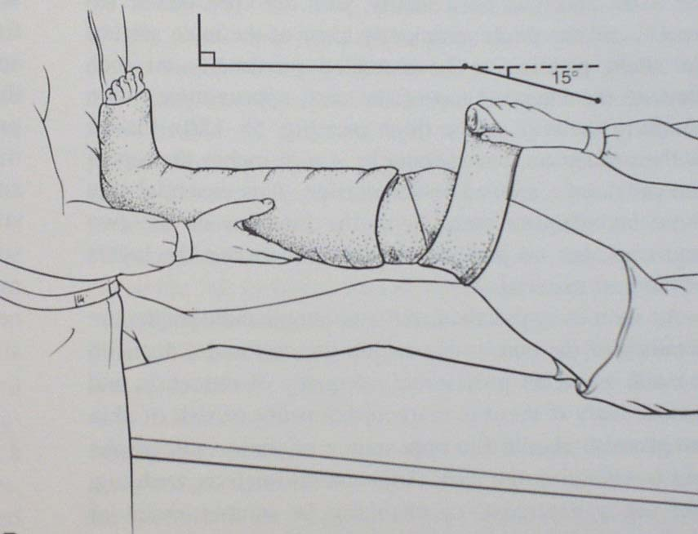
Anterior padding
Support lower
leg / cast
Extend to
gluteal crease
Figure from: Browner and Jupiter: Skeletal Trauma, 2nd ed, Saunders, 1998.
Notes:
Figure from:Figure from: Browner and Jupiter: Skeletal Trauma, 2nd ed, Saunders, p 2221, 1998.

Slide 32
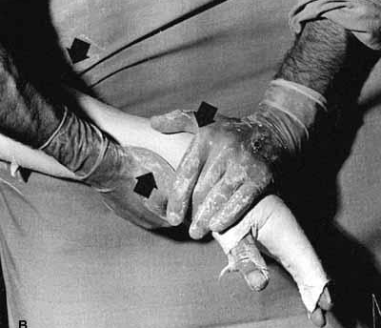
Cast Molding
Avoid molding with anything but the heels of the palm in order to avoid pressure points
Mold applied to produce three point fixation

Slide 33
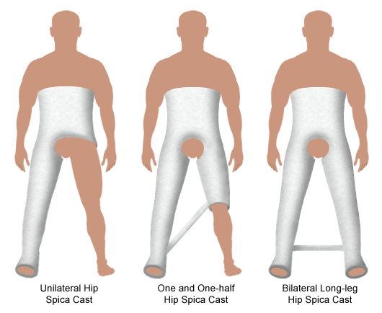
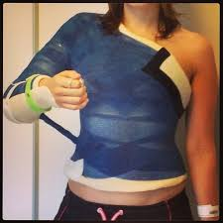
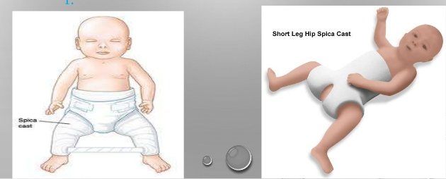
SPICA
Encircles one or both arms or legs and the chest or trunk
Uses- Fractures shaft of femur in children and in young adults
It generally is strengthened with a reinforcement bar

Slide 34
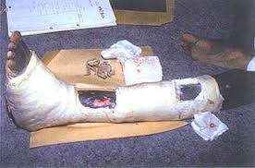
Windowed Plasters
Not usually encouraged
Danger of edematous tissue herniating through the window
Indicated in-
Compound fractures discharging copious pus
Compound fractures grafted with pinch graft

Slide 35
Errors in applying Padded Plasters
Attempting to plaster at the same time as attempting to hold a precise reduction.
Applying wool carelessly in shapeless lumps
Loose bandaging
Failing to recognise sensation of reduction through the plaster

Slide 36
After care of POP
Instructions to be given after applying POP:
Come immediately if any of following symptoms develops:
A) Exessive pain,
B) Exessive swelling,
C) Bluish or white discolouration of fingers or toes
2. Keep the plaster cast dry.
3. Mobilize all the joints which are not incorporated in the plaster to their full range of motion once plaster becomes dry.
4. Notice any cracks in the plaster.
5. Graduated weight bearing for lower limb fractures.
6. Physiotherapy of muscles within the plaster and joints outside the plaster is necessary to ensure early rehabilitation.

Slide 37
Advantages
Cost-effective
Non-allergic
Easily moulded to different forms
Disadvantages:
1) Radio-opaque so may occlude # lines
2) Heavy
3) Easily breaks when comes in contact with water

Slide 38
Complications of Casts & Splints
Loss of reduction
Pressure necrosis – may occur as early as 2 hours
Tight cast → compartment syndrome Univalving = 30% pressure drop Bivalving = 60% pressure drop
Also need to cut cast padding
Thermal Injury - avoid plaster > 10 ply, water >24°C, unusual with fiberglass
Cuts and burns during removal
Notes:
Loss of reduction is the most common complication of cast treatment as the swelling decreases and the padding compresses while the patient regains mobility. Careful casting technique can avoid this (careful molding, attention to detail—deforming forces:gravity and muscle). Appropriately time radiographic reevaluation and correction of problems will lead to a satisfactory outcome.

Slide 39
Complications of Casts & Splints
DVT - increased in lower extremity fracture
  Ask about prior history and family history
  Birth Control Pills are a risk factor
  Indications for prophylaxis controversial in patients without risk factors
Joint stiffness
  Leave joints free when possible (ie. thumb MCP for below elbow cast)
  Place joint in position of function

Slide 40
Complications of POP
Due to tight cast
-pain
-pressure sores
-compartment syndromes
-peripheral nerve injuries
c/o unrelenting pain,stretch pain, swelling over fingers, inability to move fingers, hypoaesthesia and bluish discolouration of the digits.

Slide 41
Complications of POP
Due to improper applications
-joint stiffness
-plaster blisters and sores
-breakage
Due to plaster allergy
-allergic dermatitis

Slide 42
Plaster vs. Fiberglass
Plaster
  Use cold water to maximize molding time
Fiberglass
  More difficult to mold but more durable and resistant to breakdown
  Generally 2 - 3 times stronger for any given thickness

Slide 43
Not to forget!!!
Check X Ray should be done after application of each cast to confirm the acceptability of reduction.

Slide 44
U.L. IMMOBILISATION
SIMPLE SLING : CUFF & COLLAR
SPLINTS : RIGID , SEMI-RIGID WITH ADEQUATE PADDING OF BONY PROMINENCES & BANDAGING
WOODEN , THERMOPLASTIC , FOOT-RULERS , BALL & BANDAGE , TIN SPLINTS,POP SLABS , THOMAS SPLINT.
FLEX ELBOW BEYOND 90 DEG.
ICE FOMENTATION

Slide 45
UPPER LIMBS
REMOVE RINGS , BANGLES , BRACELETS
ELEVATE IN A SLING.
FOMENT WITH ICE.
DON’T MASSAGE!!!
DON’T MANIPULATE!

Slide 46
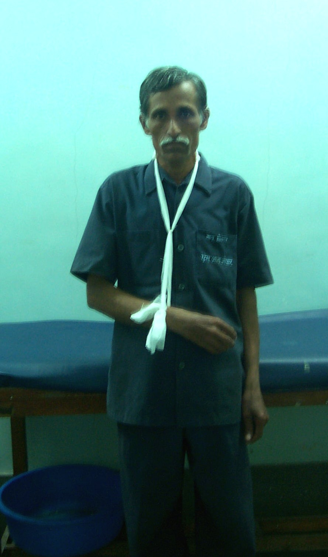
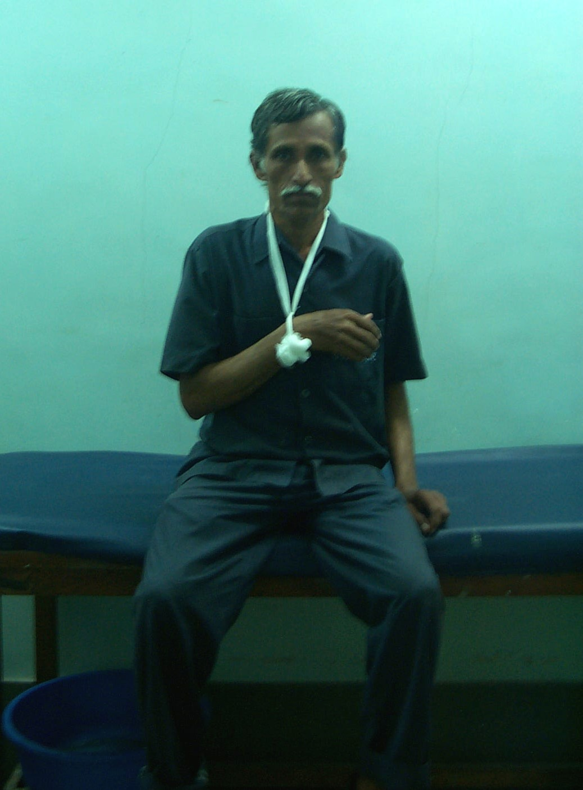
WRONG
RIGHT

Slide 47
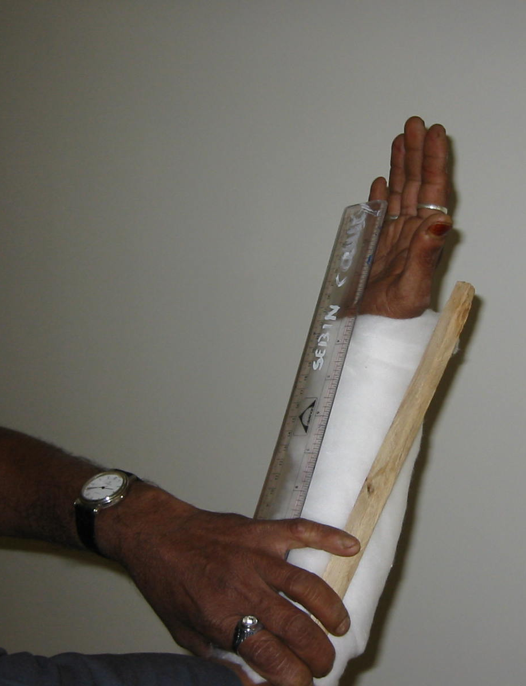
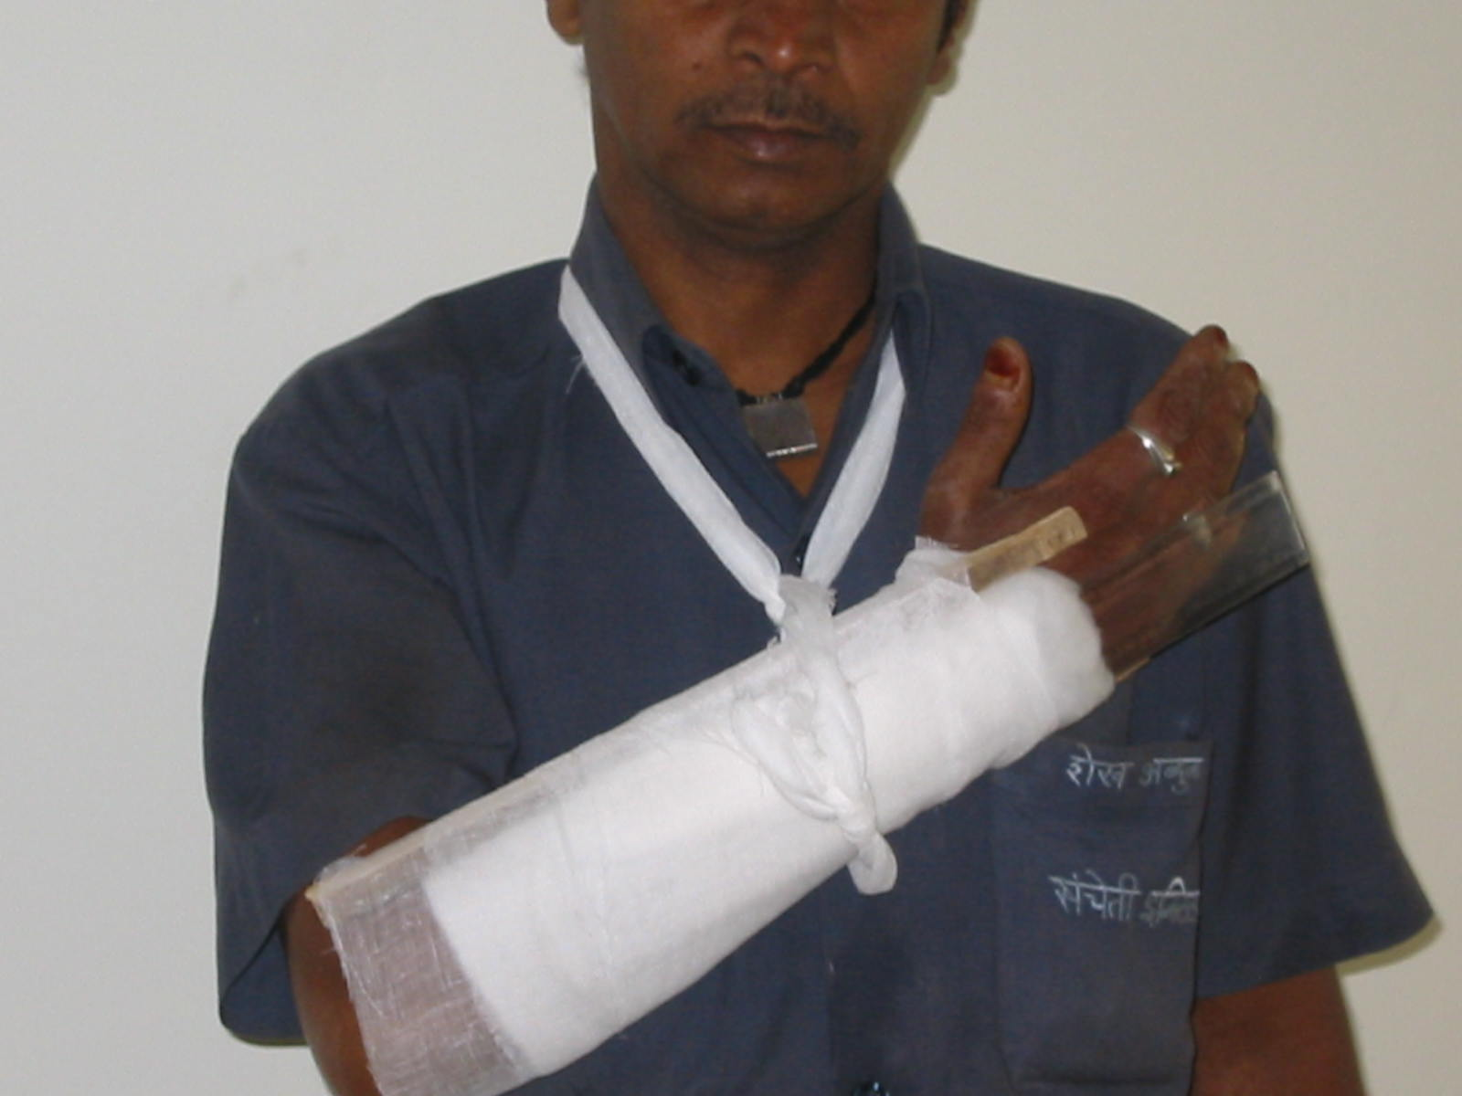
RULER SPLINTS FOR U.L.

Slide 48
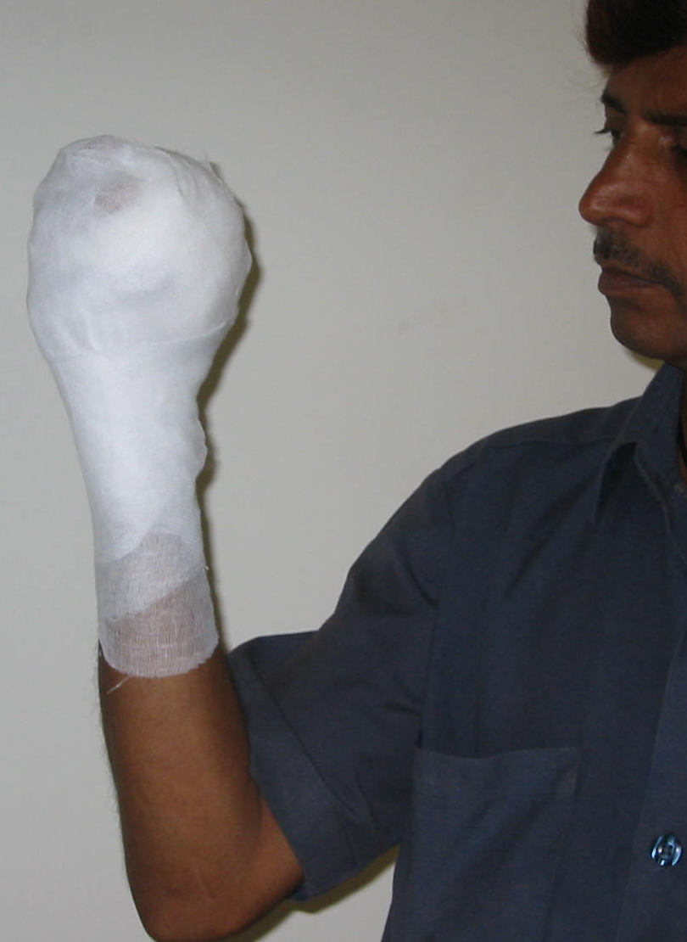
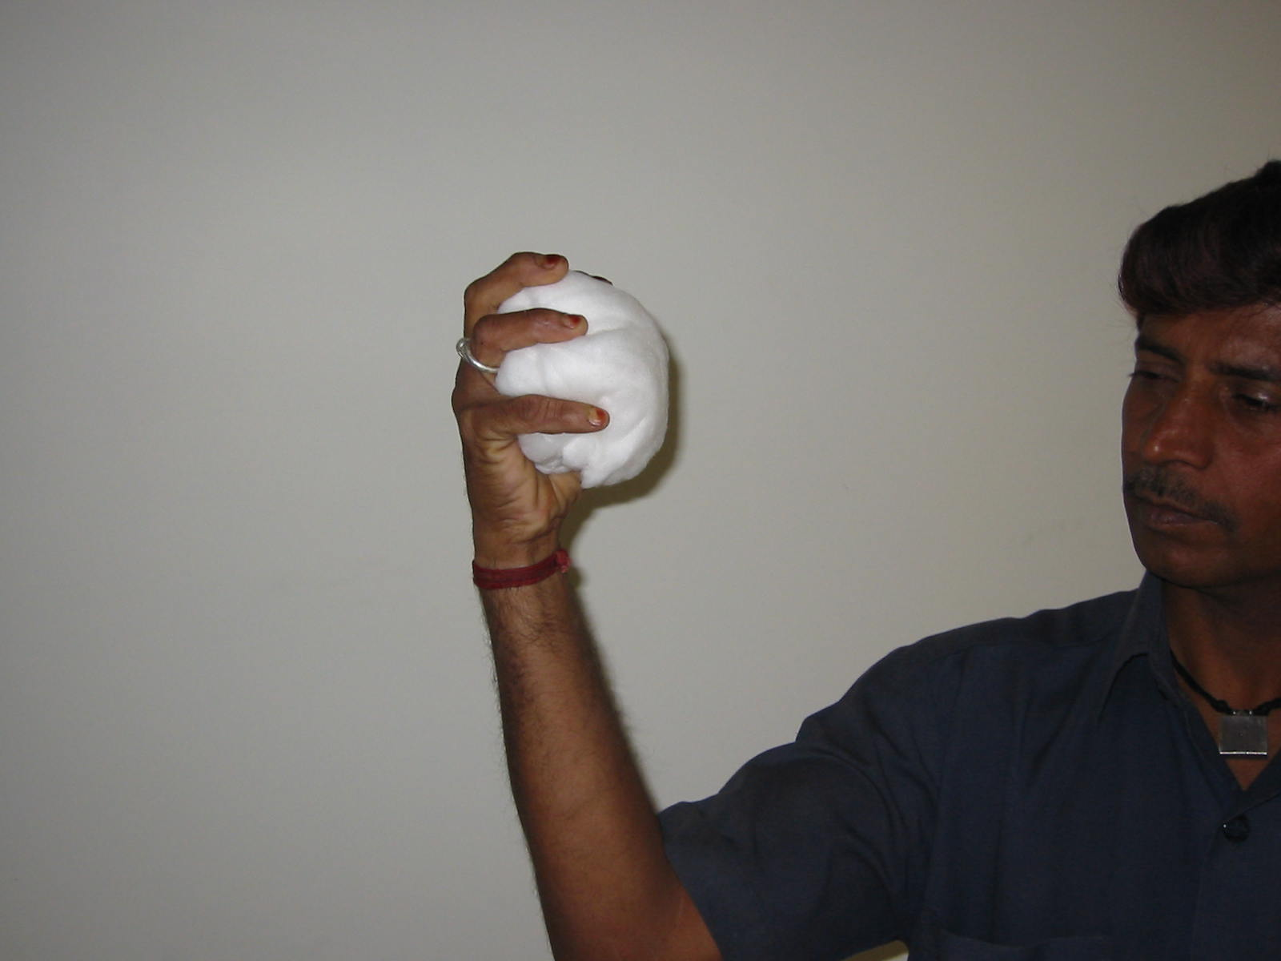
BALL - BANDAGE

Slide 49
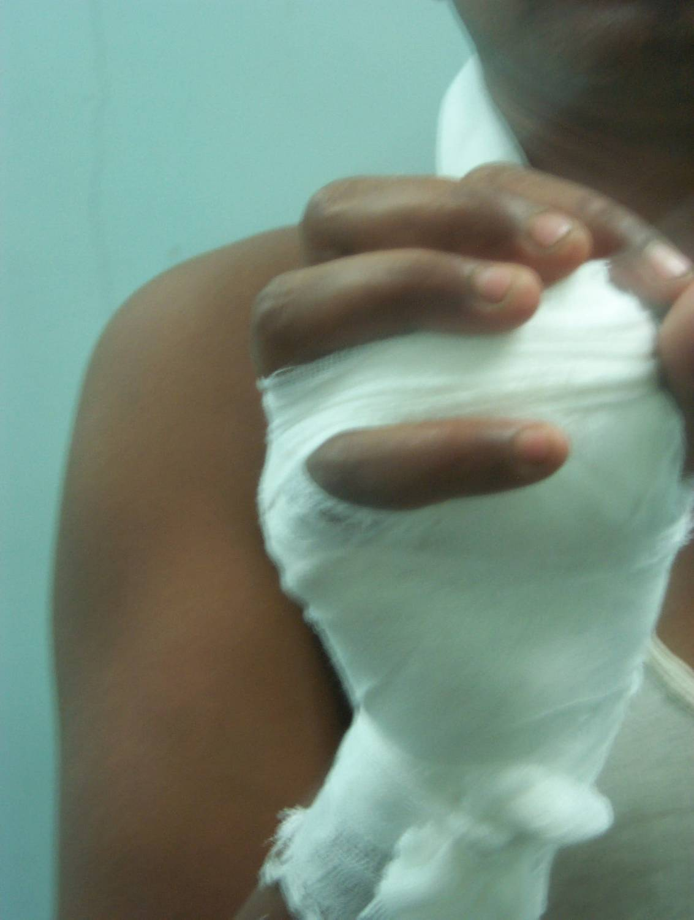
A BALL
BANDAGE
FOR
FINGER INJURIES

Slide 50
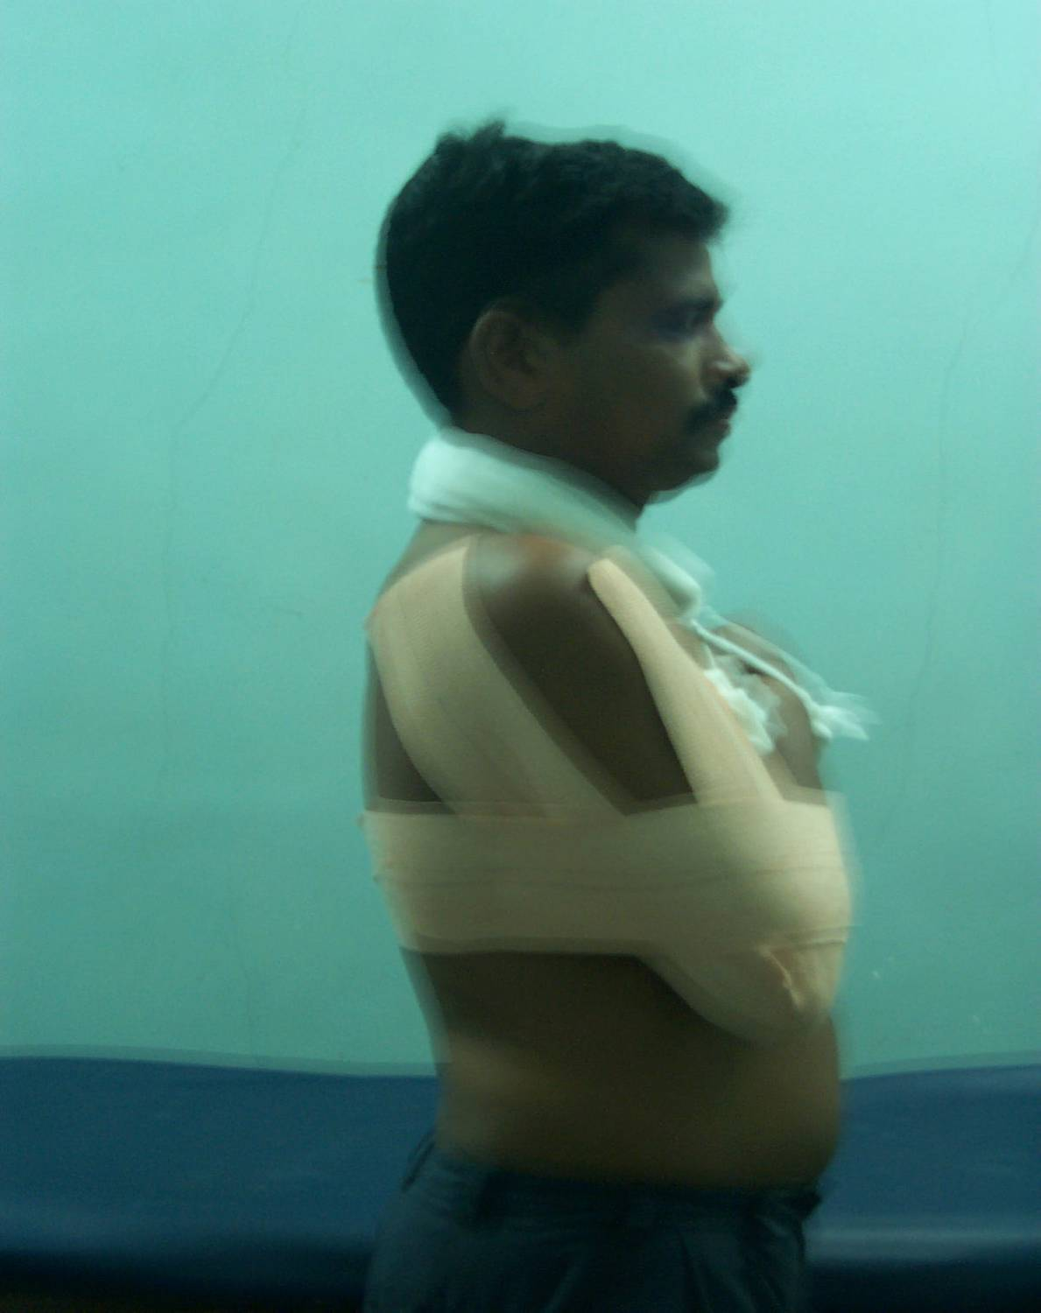
STRAPPING
THE ARM
TO THE
CHEST

Slide 51
Application of Collar & Cuff

Slide 52
Indication
Dislocation of shoulder joint
Fracture Humerus

Slide 53
Requisites
Collar & Cuff

Slide 54
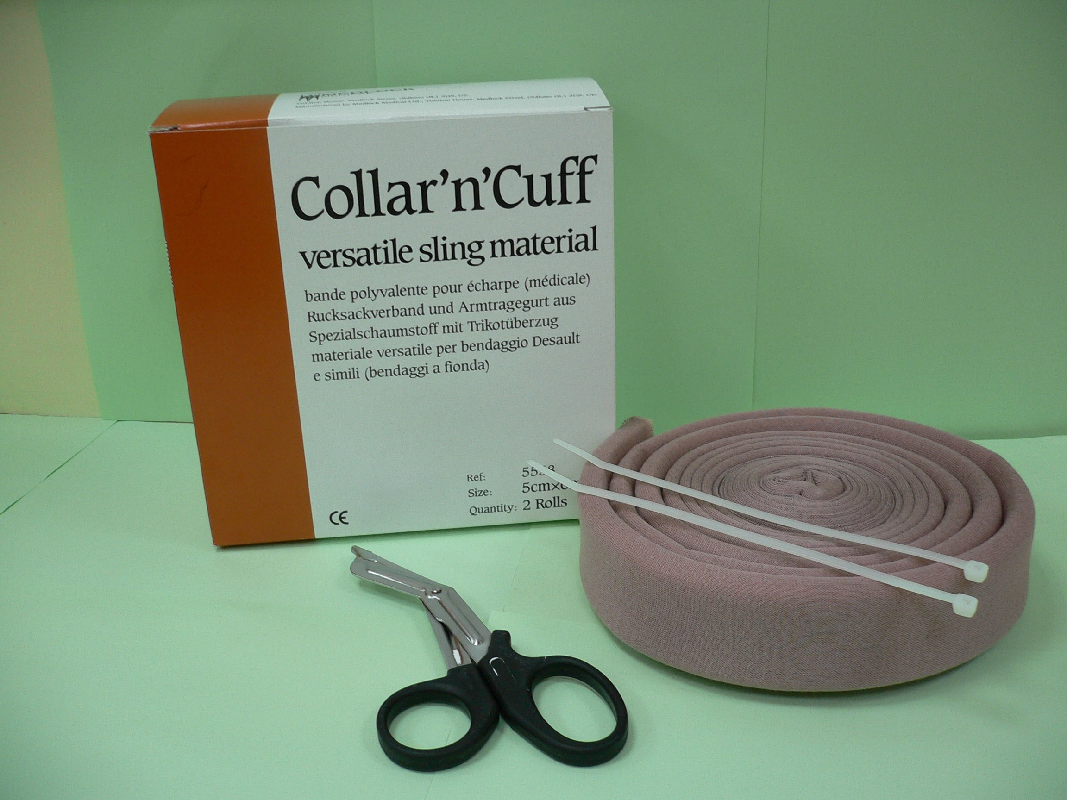
Padded Sling Material
Scissors
Cable Tie

Slide 55
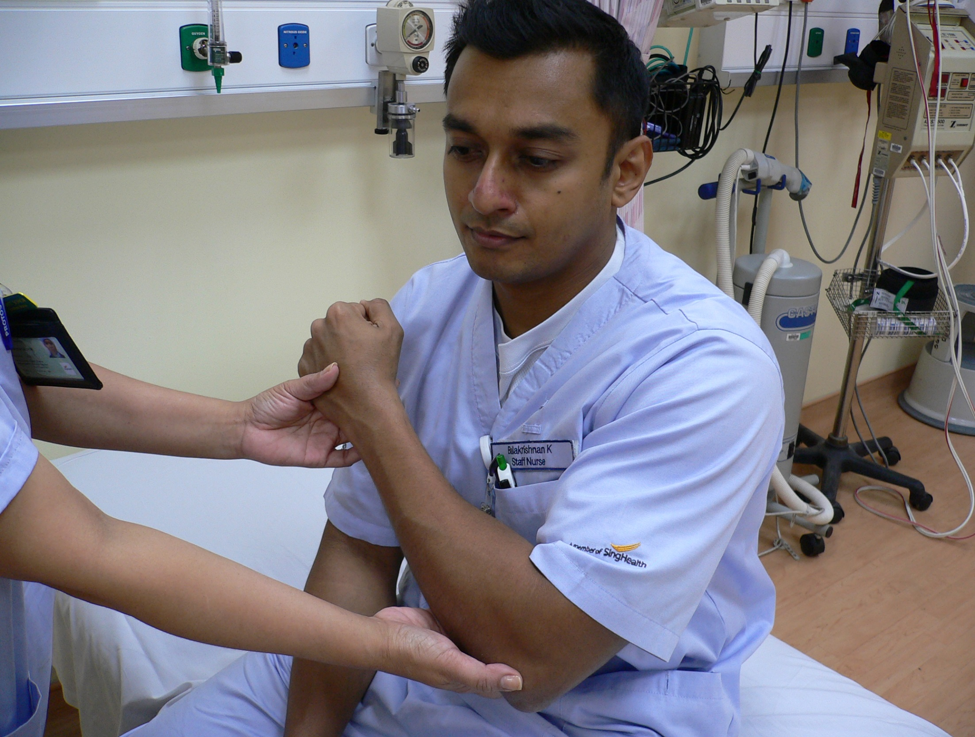
Step 1
Position the arm at least 45 °

Slide 56
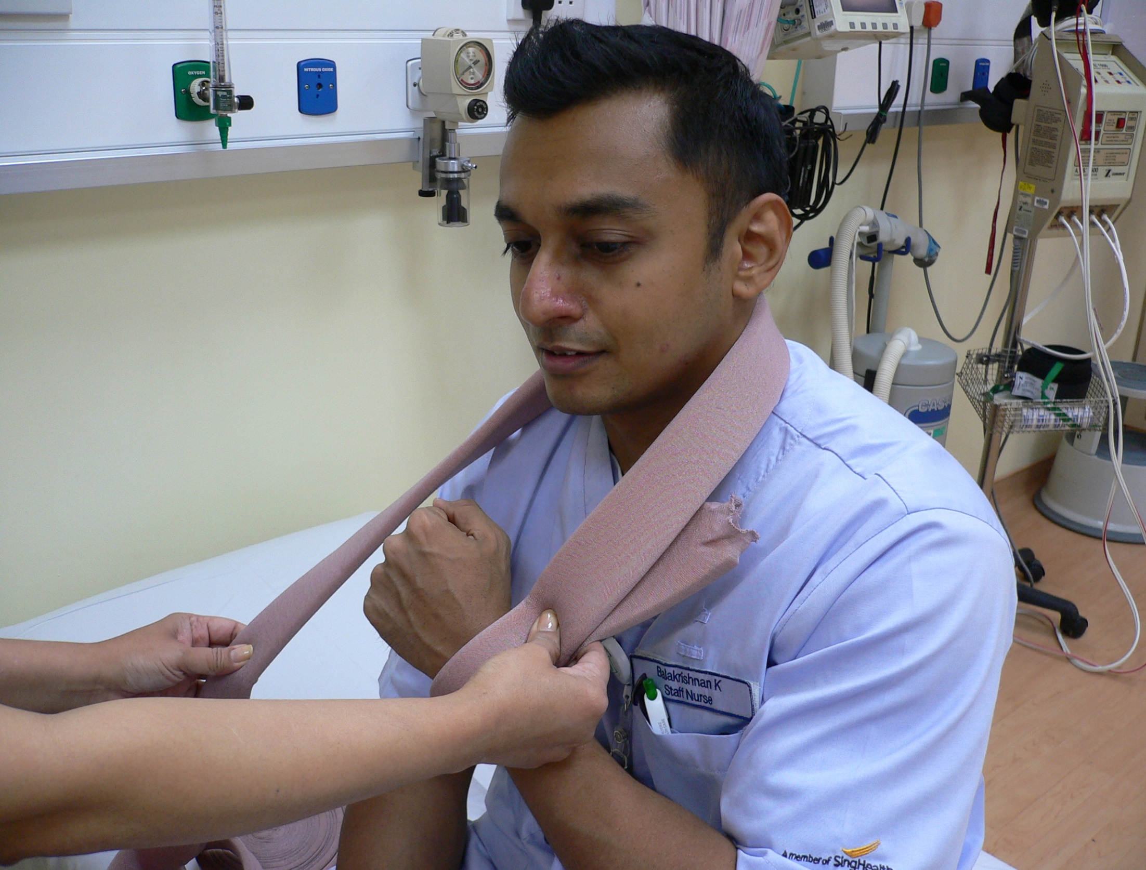
Over the neck
Step 2
Measure the appropriate length of sling for the patient according to size
Around the wrist with 2 fingers spacing

Slide 57
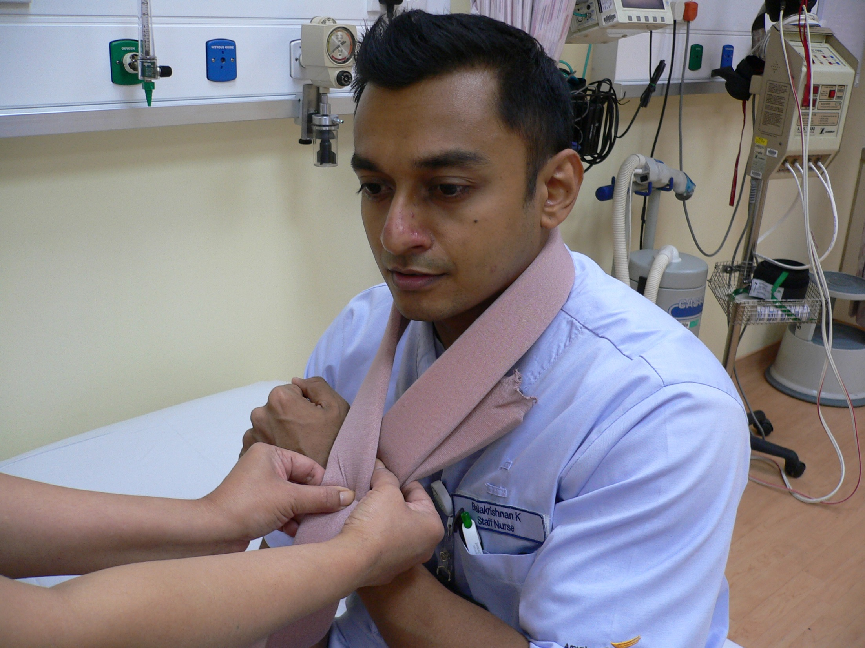
Step 3
Put the sling over the wrist to form the shape of a neck tie

Slide 58
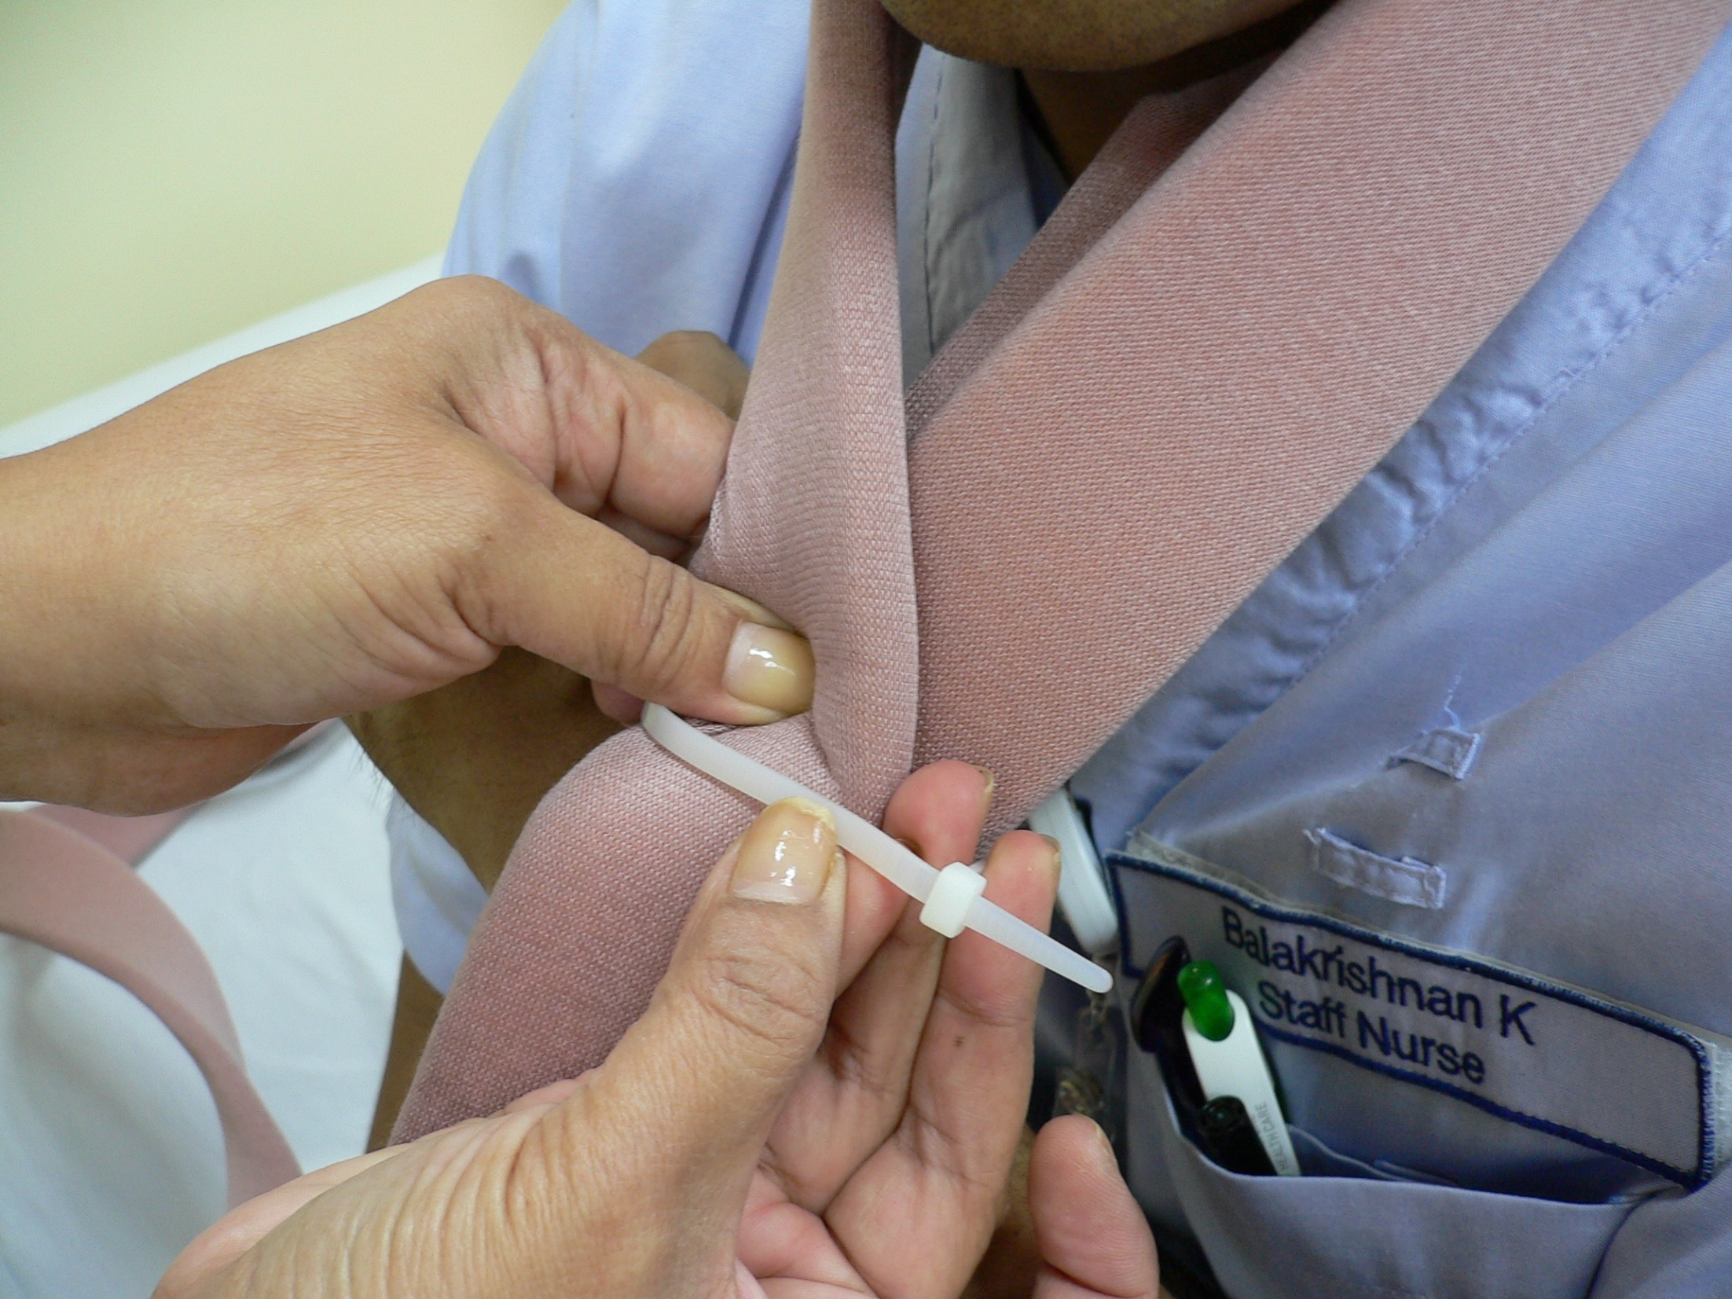
Step 4
Loop the cable tie around the neck tie
Ensure the cable tie joint faces inwards

Slide 59
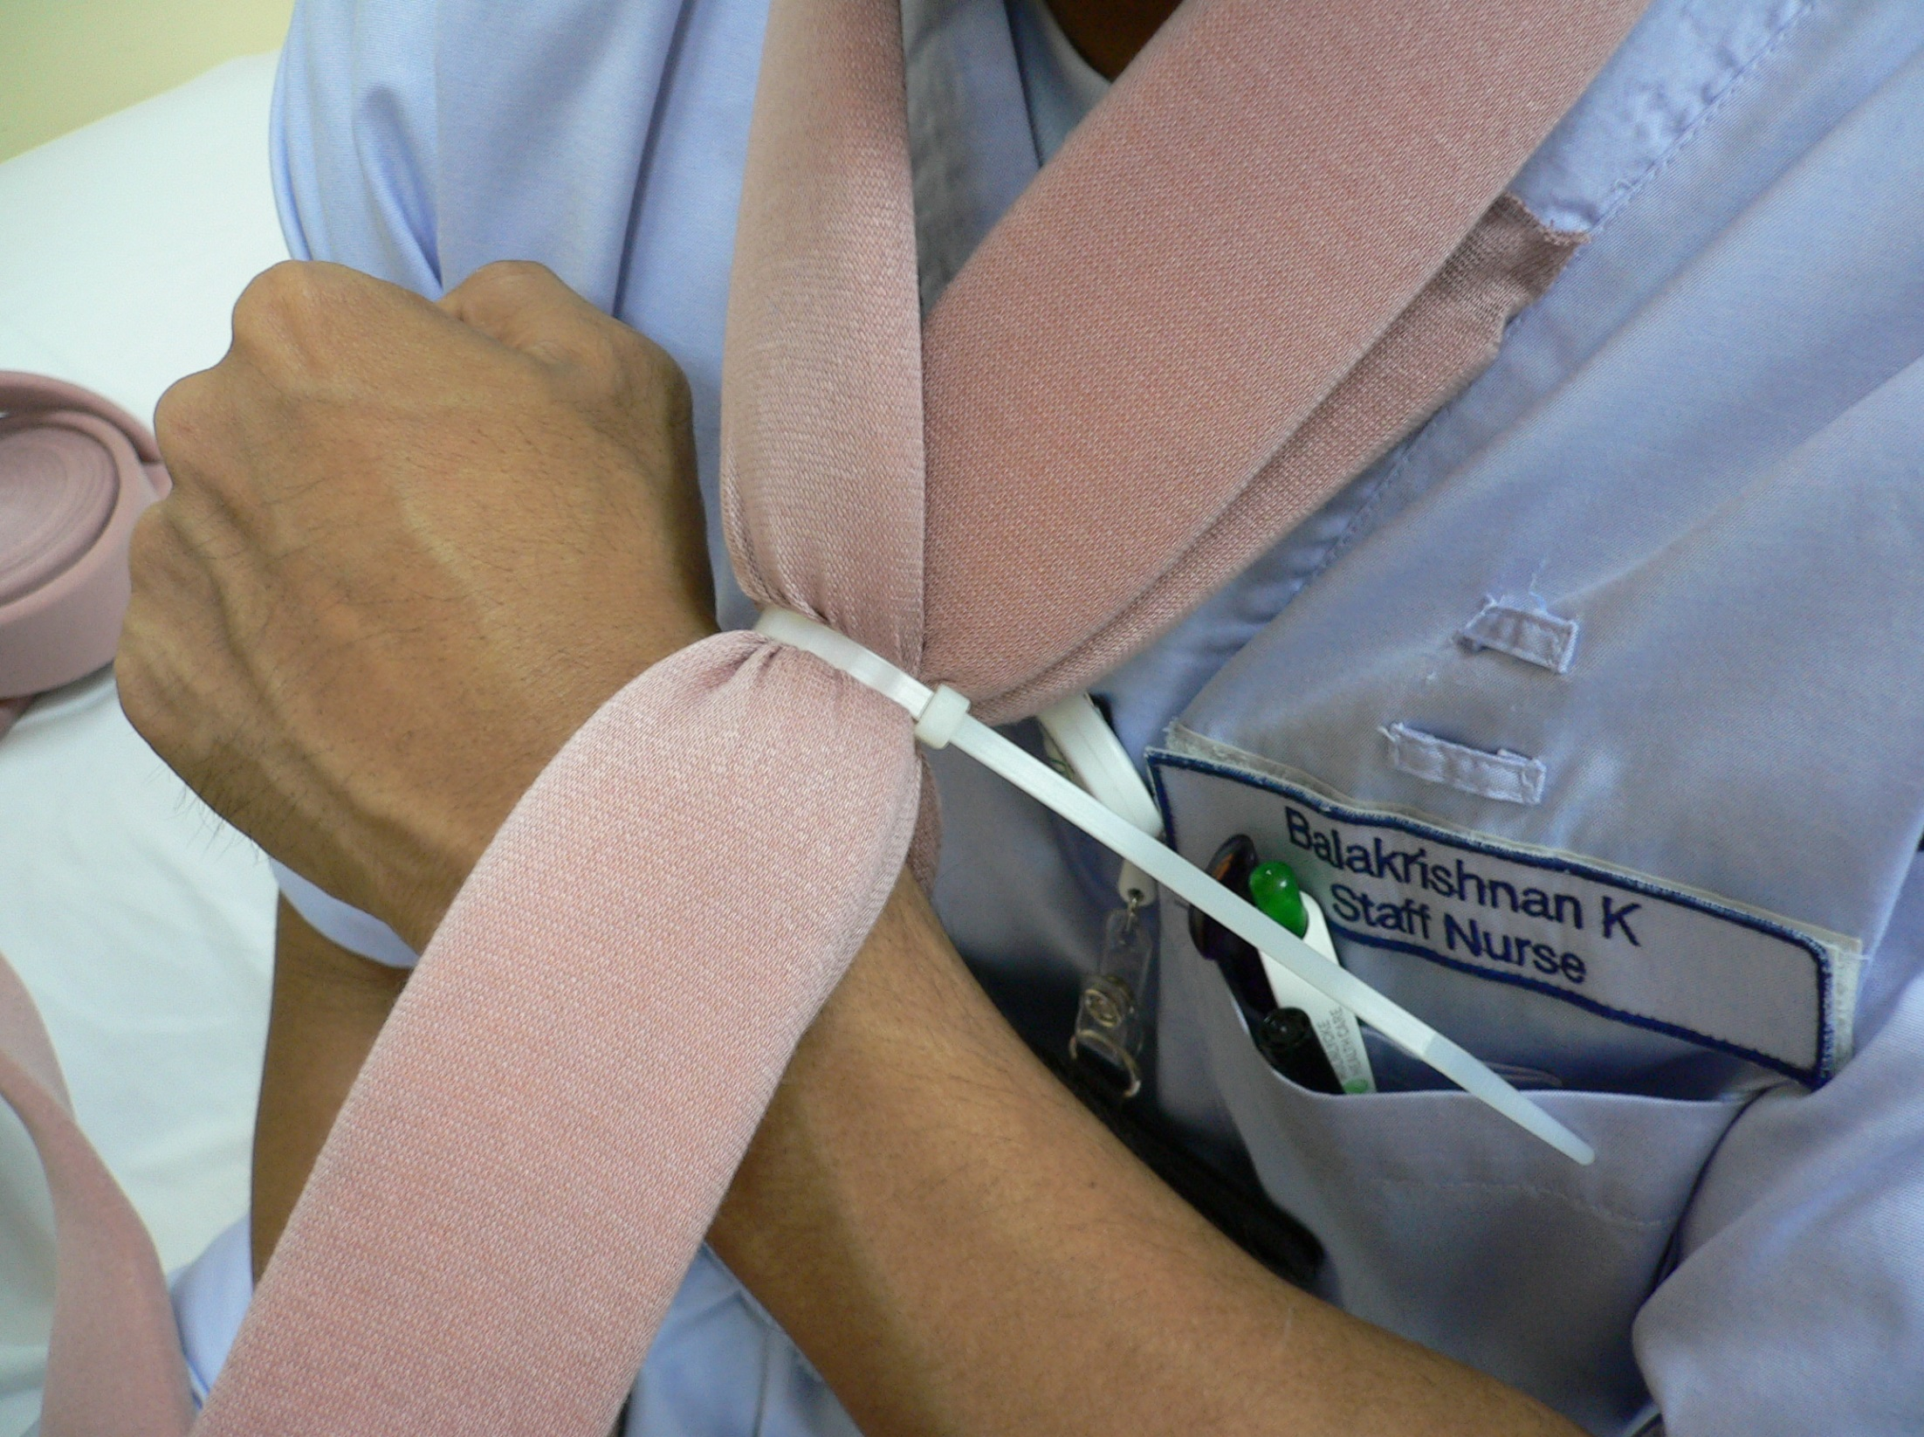
Step 5
Pull the cable tie tight enough to allow some adjustments to be made

Slide 60
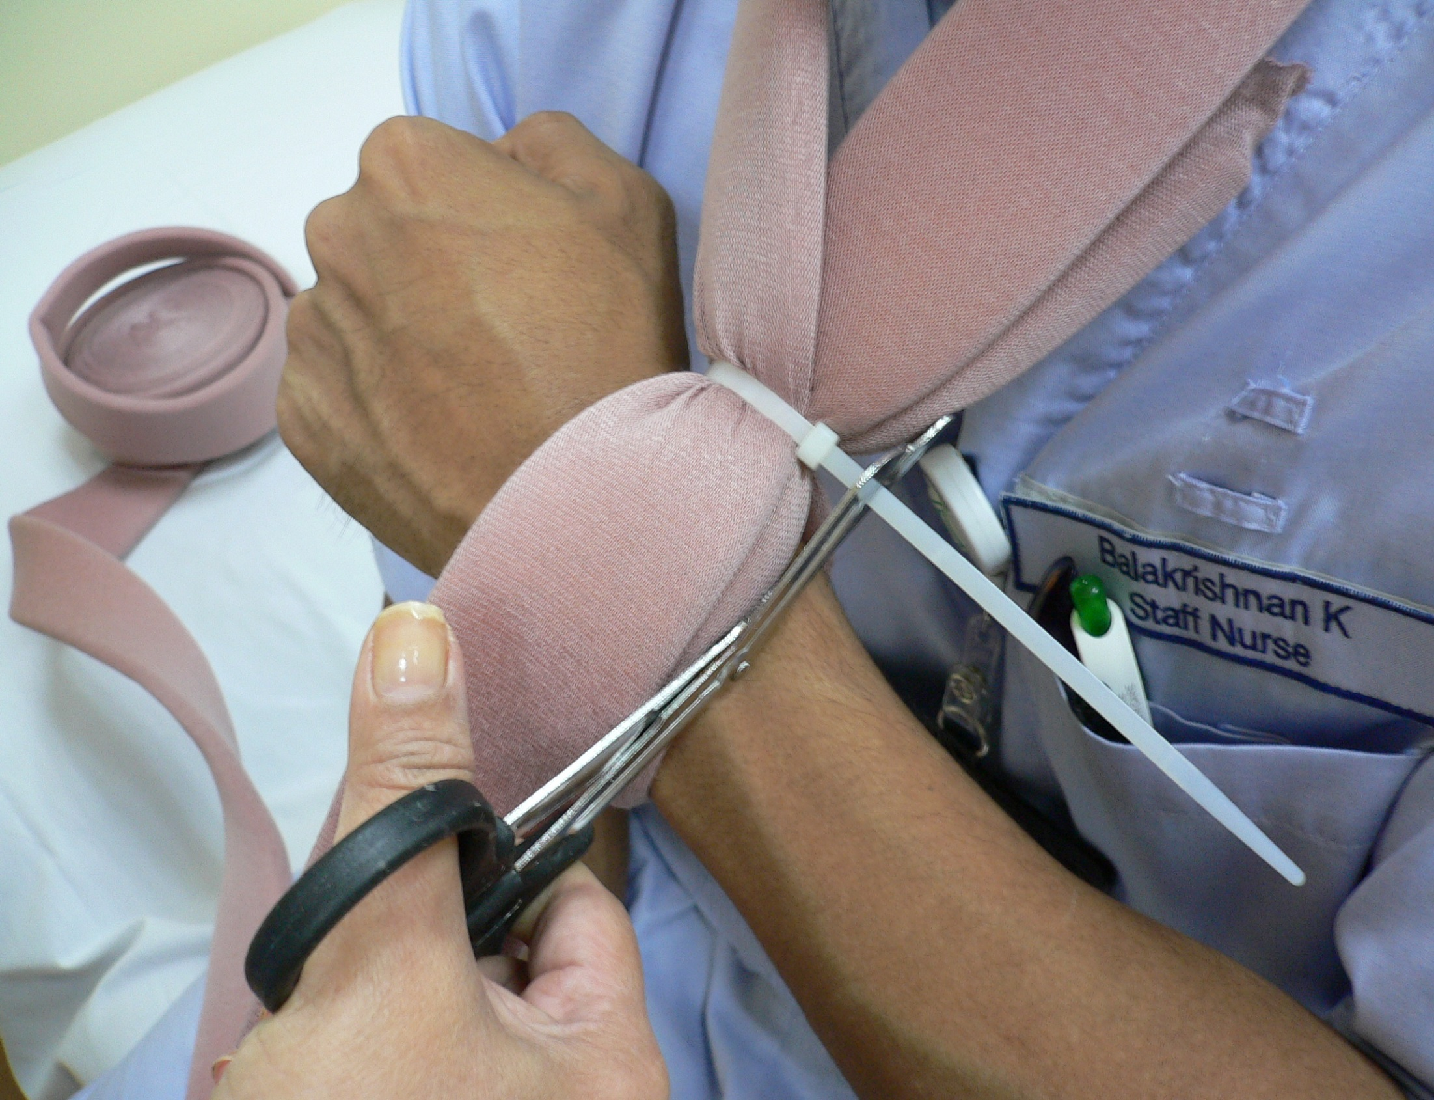
Step 6
Cut the balance of the cable tie

Slide 61
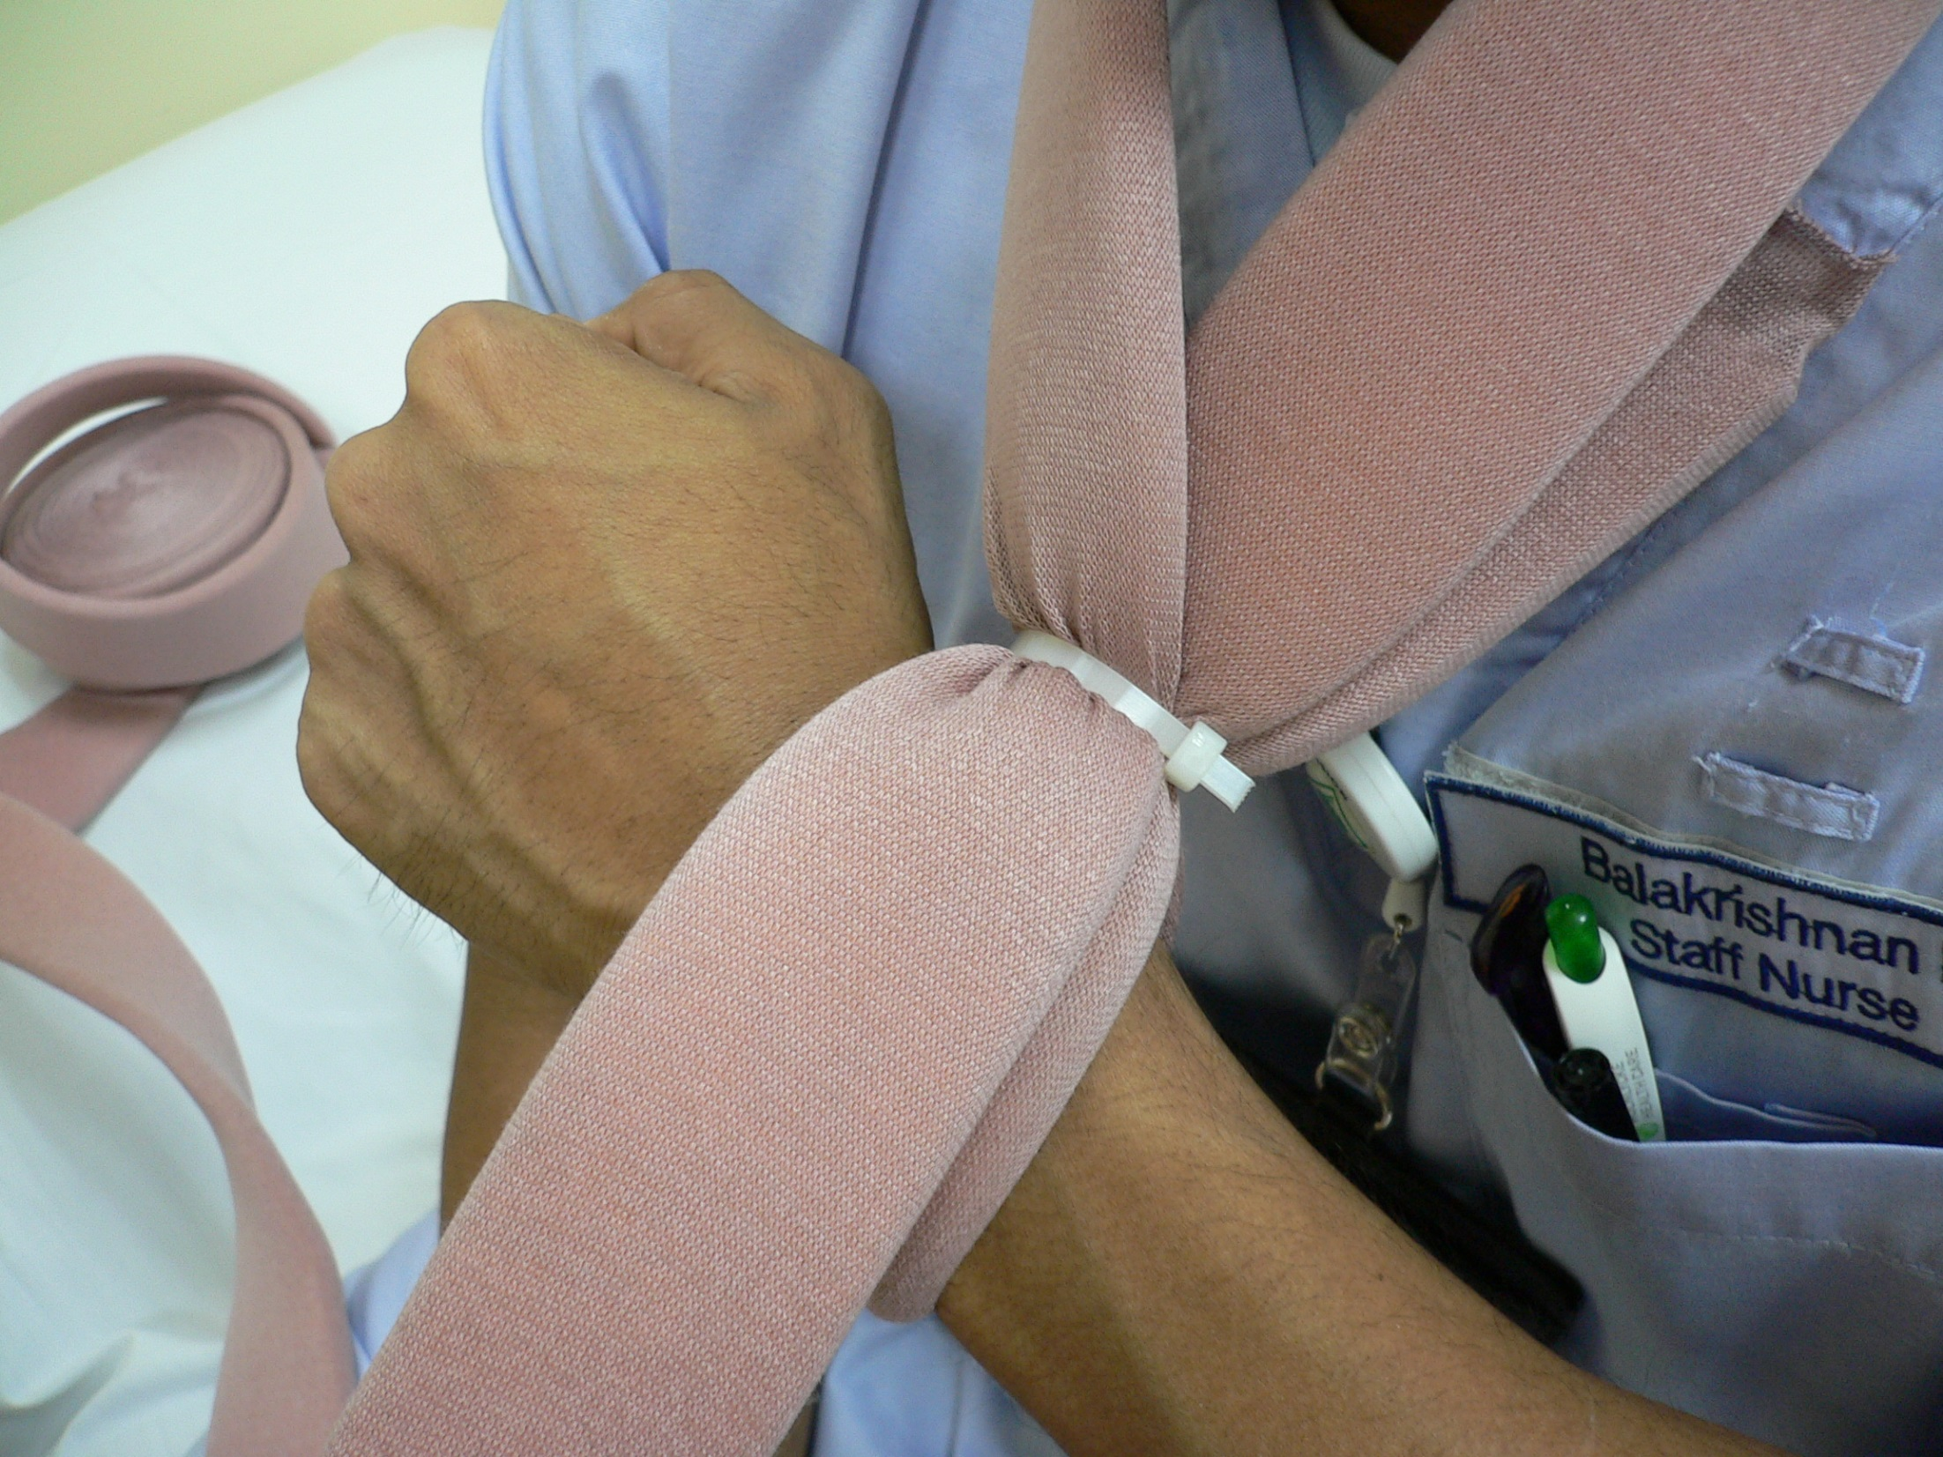
Finish look after cutting cable tie

Slide 62
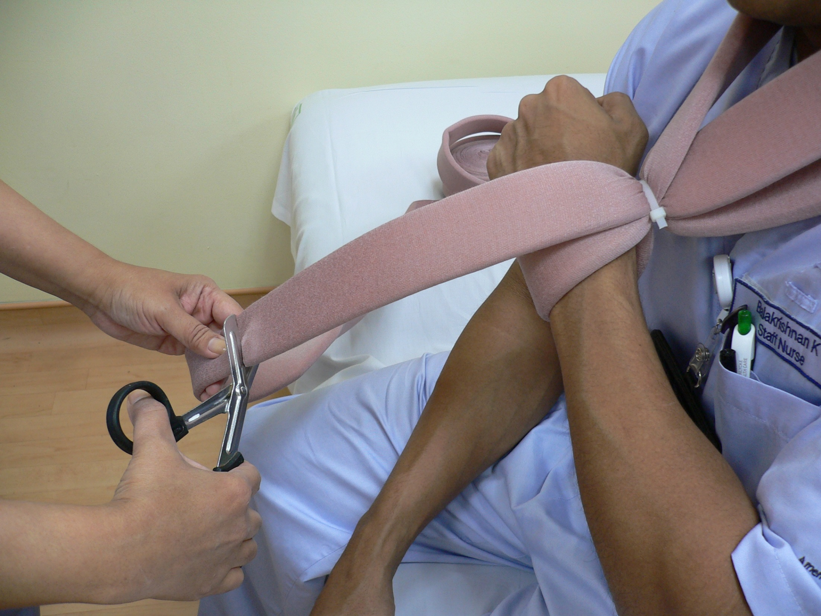
Step 7
Give an allowance for adjustment of sling height before cutting remainder of sling material

Slide 63
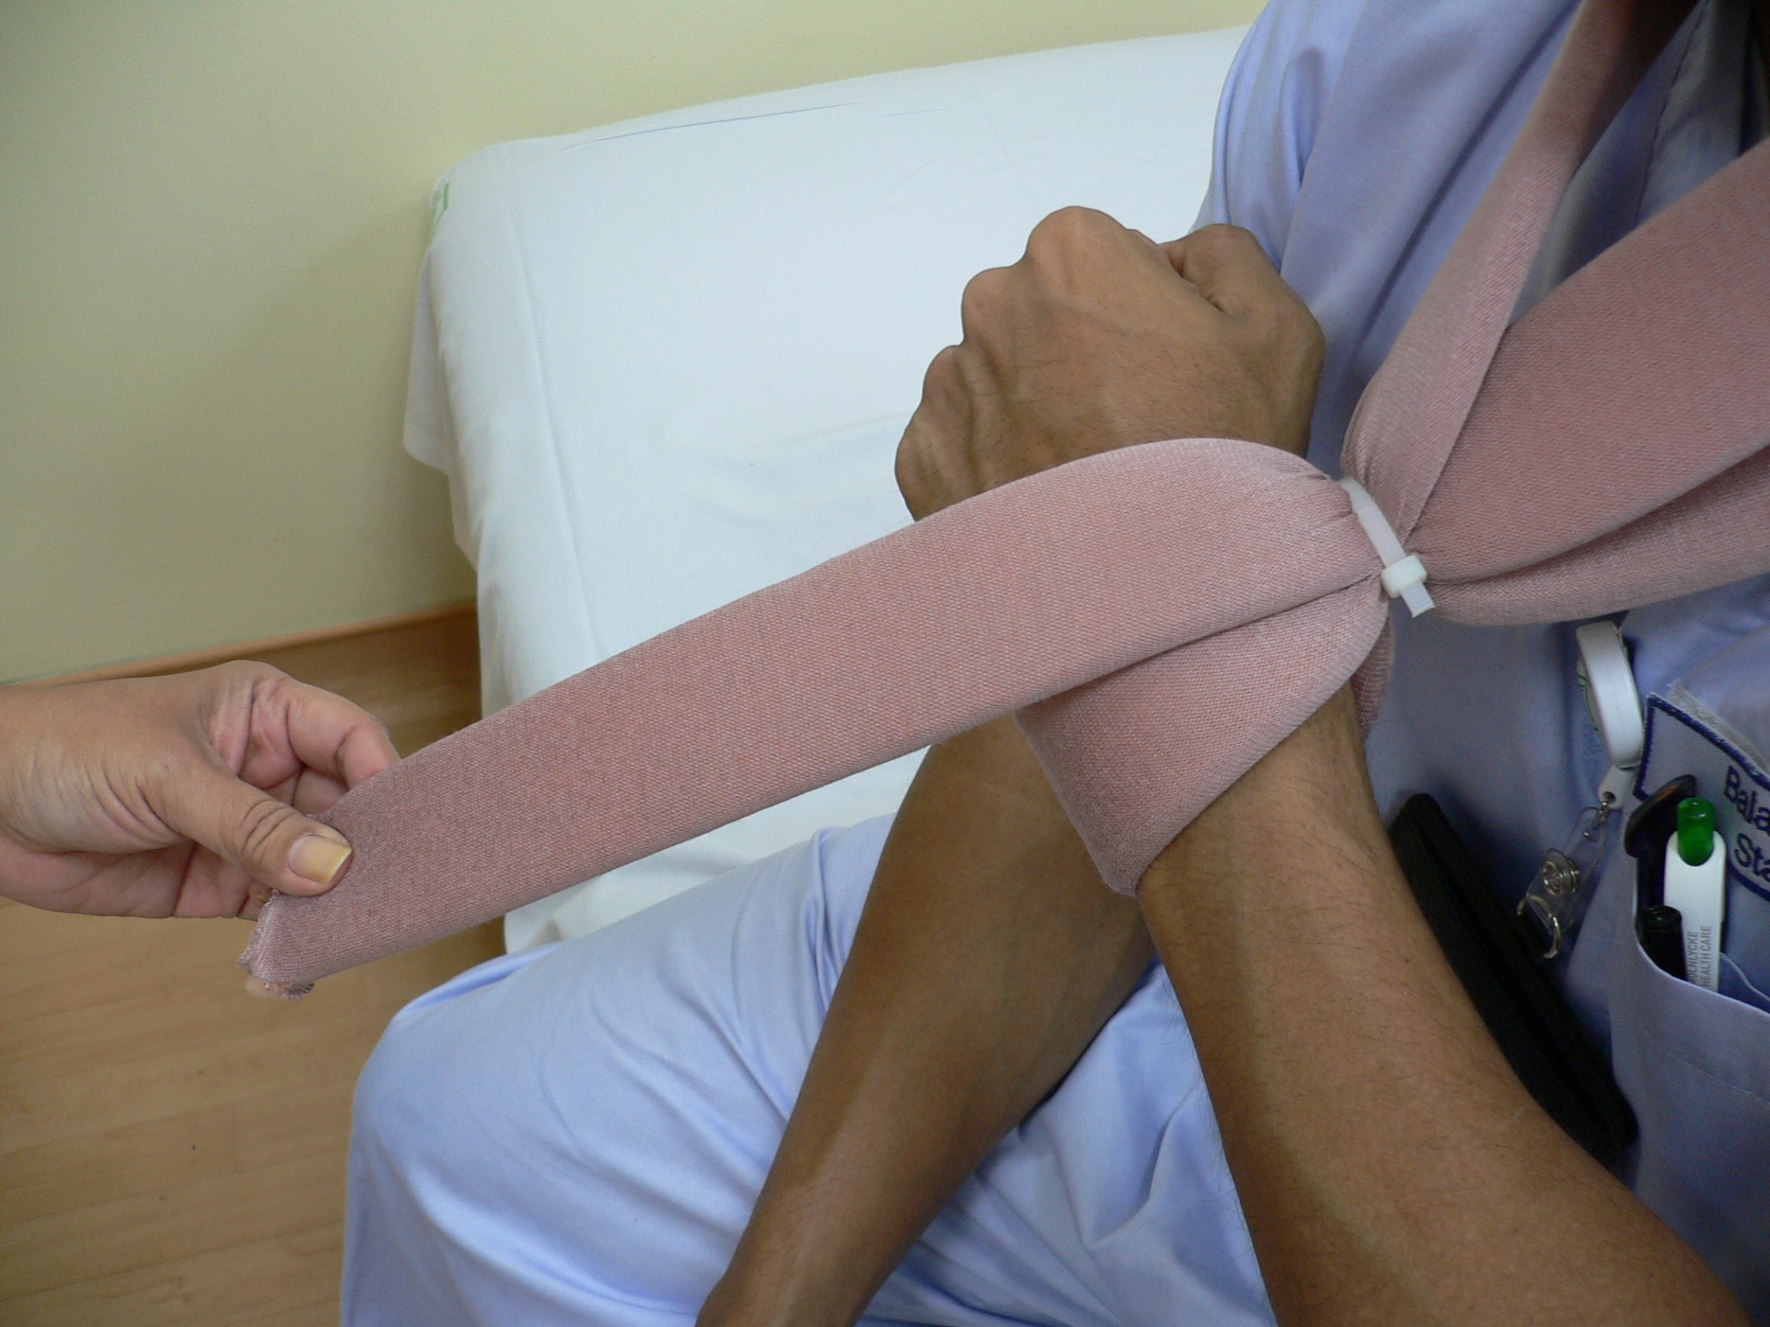
Finish look after cutting remainder sling material
Material has to be facing outwards

Slide 64
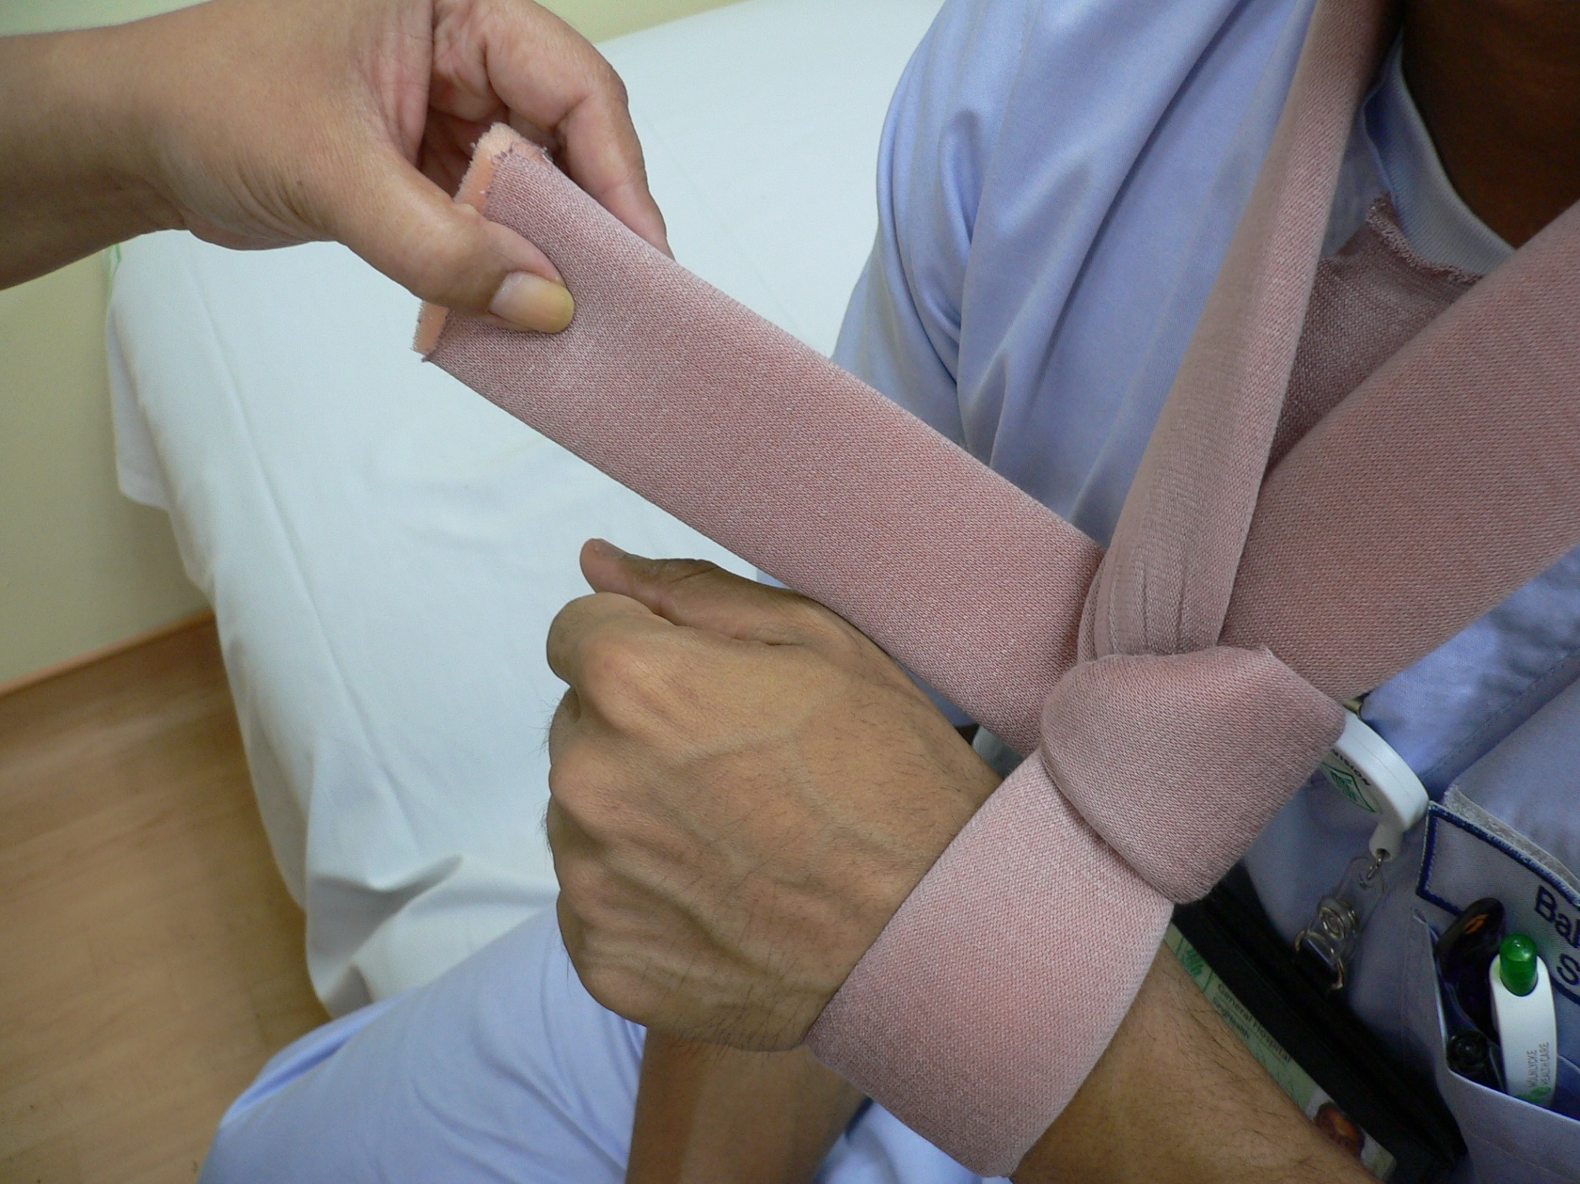
Step 8
Loop the arm sling remainder in an anti-clockwise direction facing the patient

Slide 65
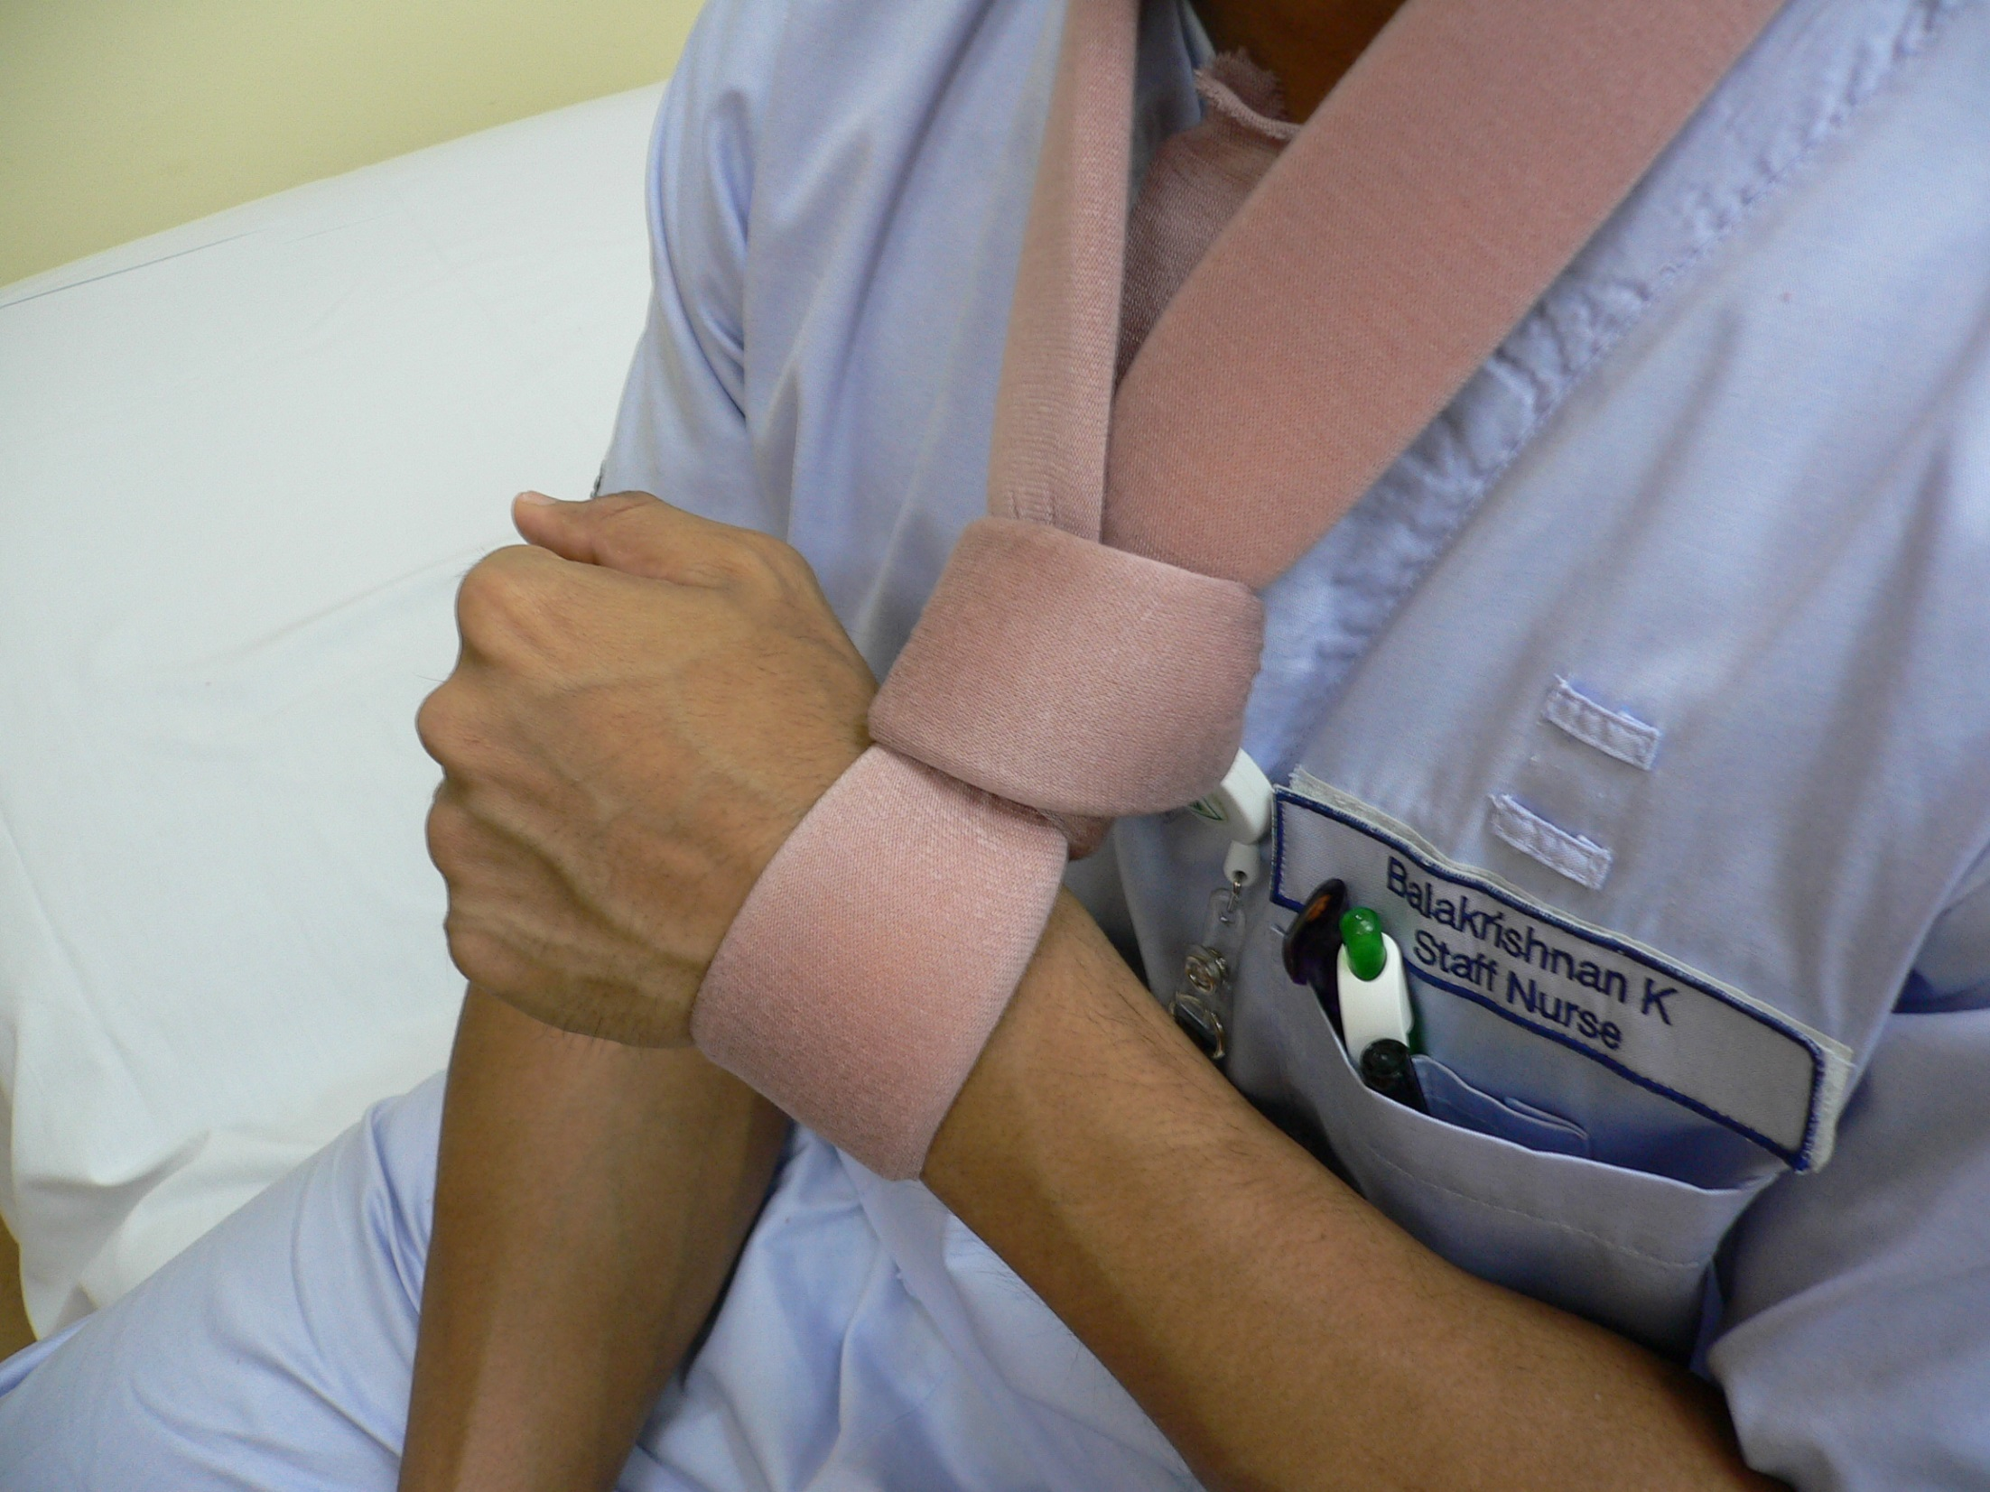
Step 9
Slot in the remainder of looped sling into the cable tie at the back

Slide 66
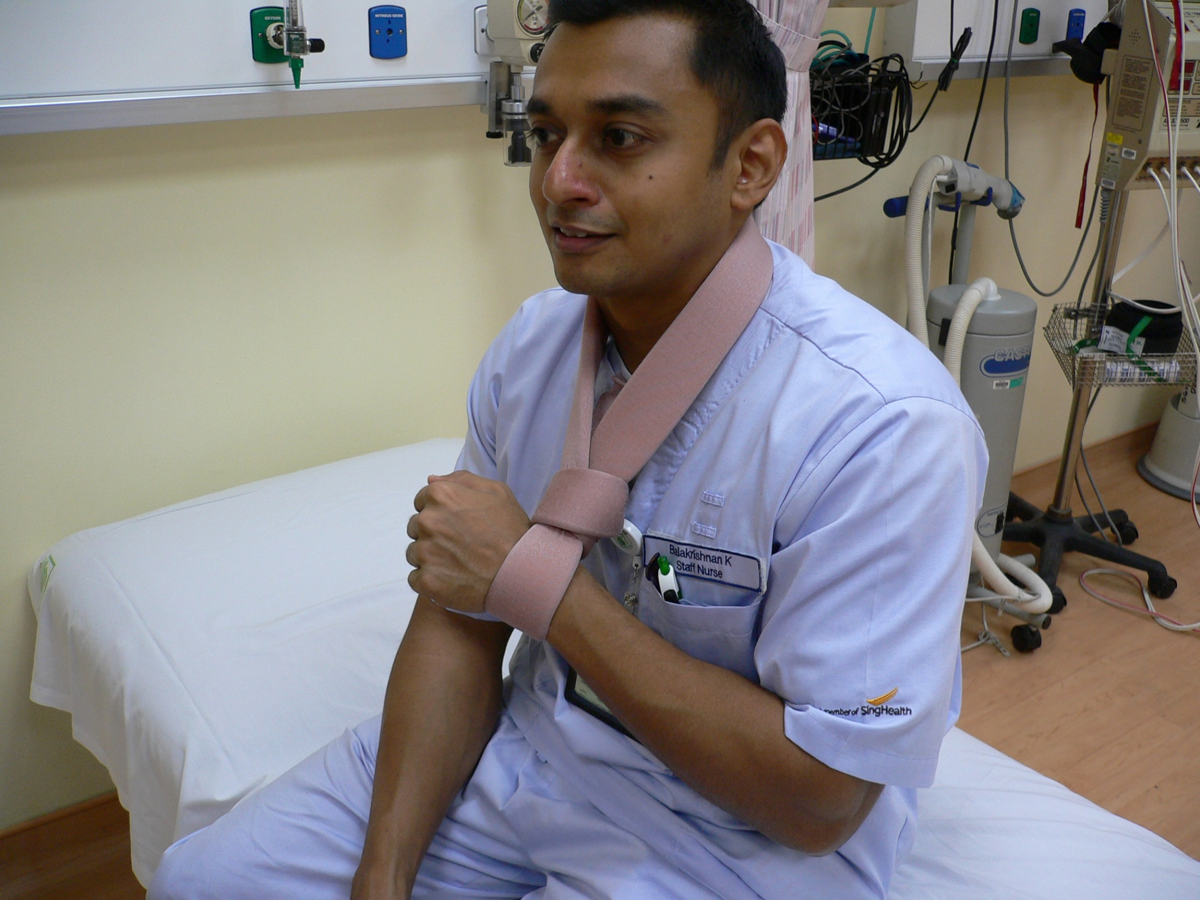
Finished look of Applying Collar & Cuff

Slide 67
Application of Zimmer Splint/ Buddy Splint to Digits of Upper Limb

Slide 68
Indication
Fracture of phalanx of hands
Support a mallet finger
Support finger due to cut tendon

Slide 69
Requisites

Slide 70
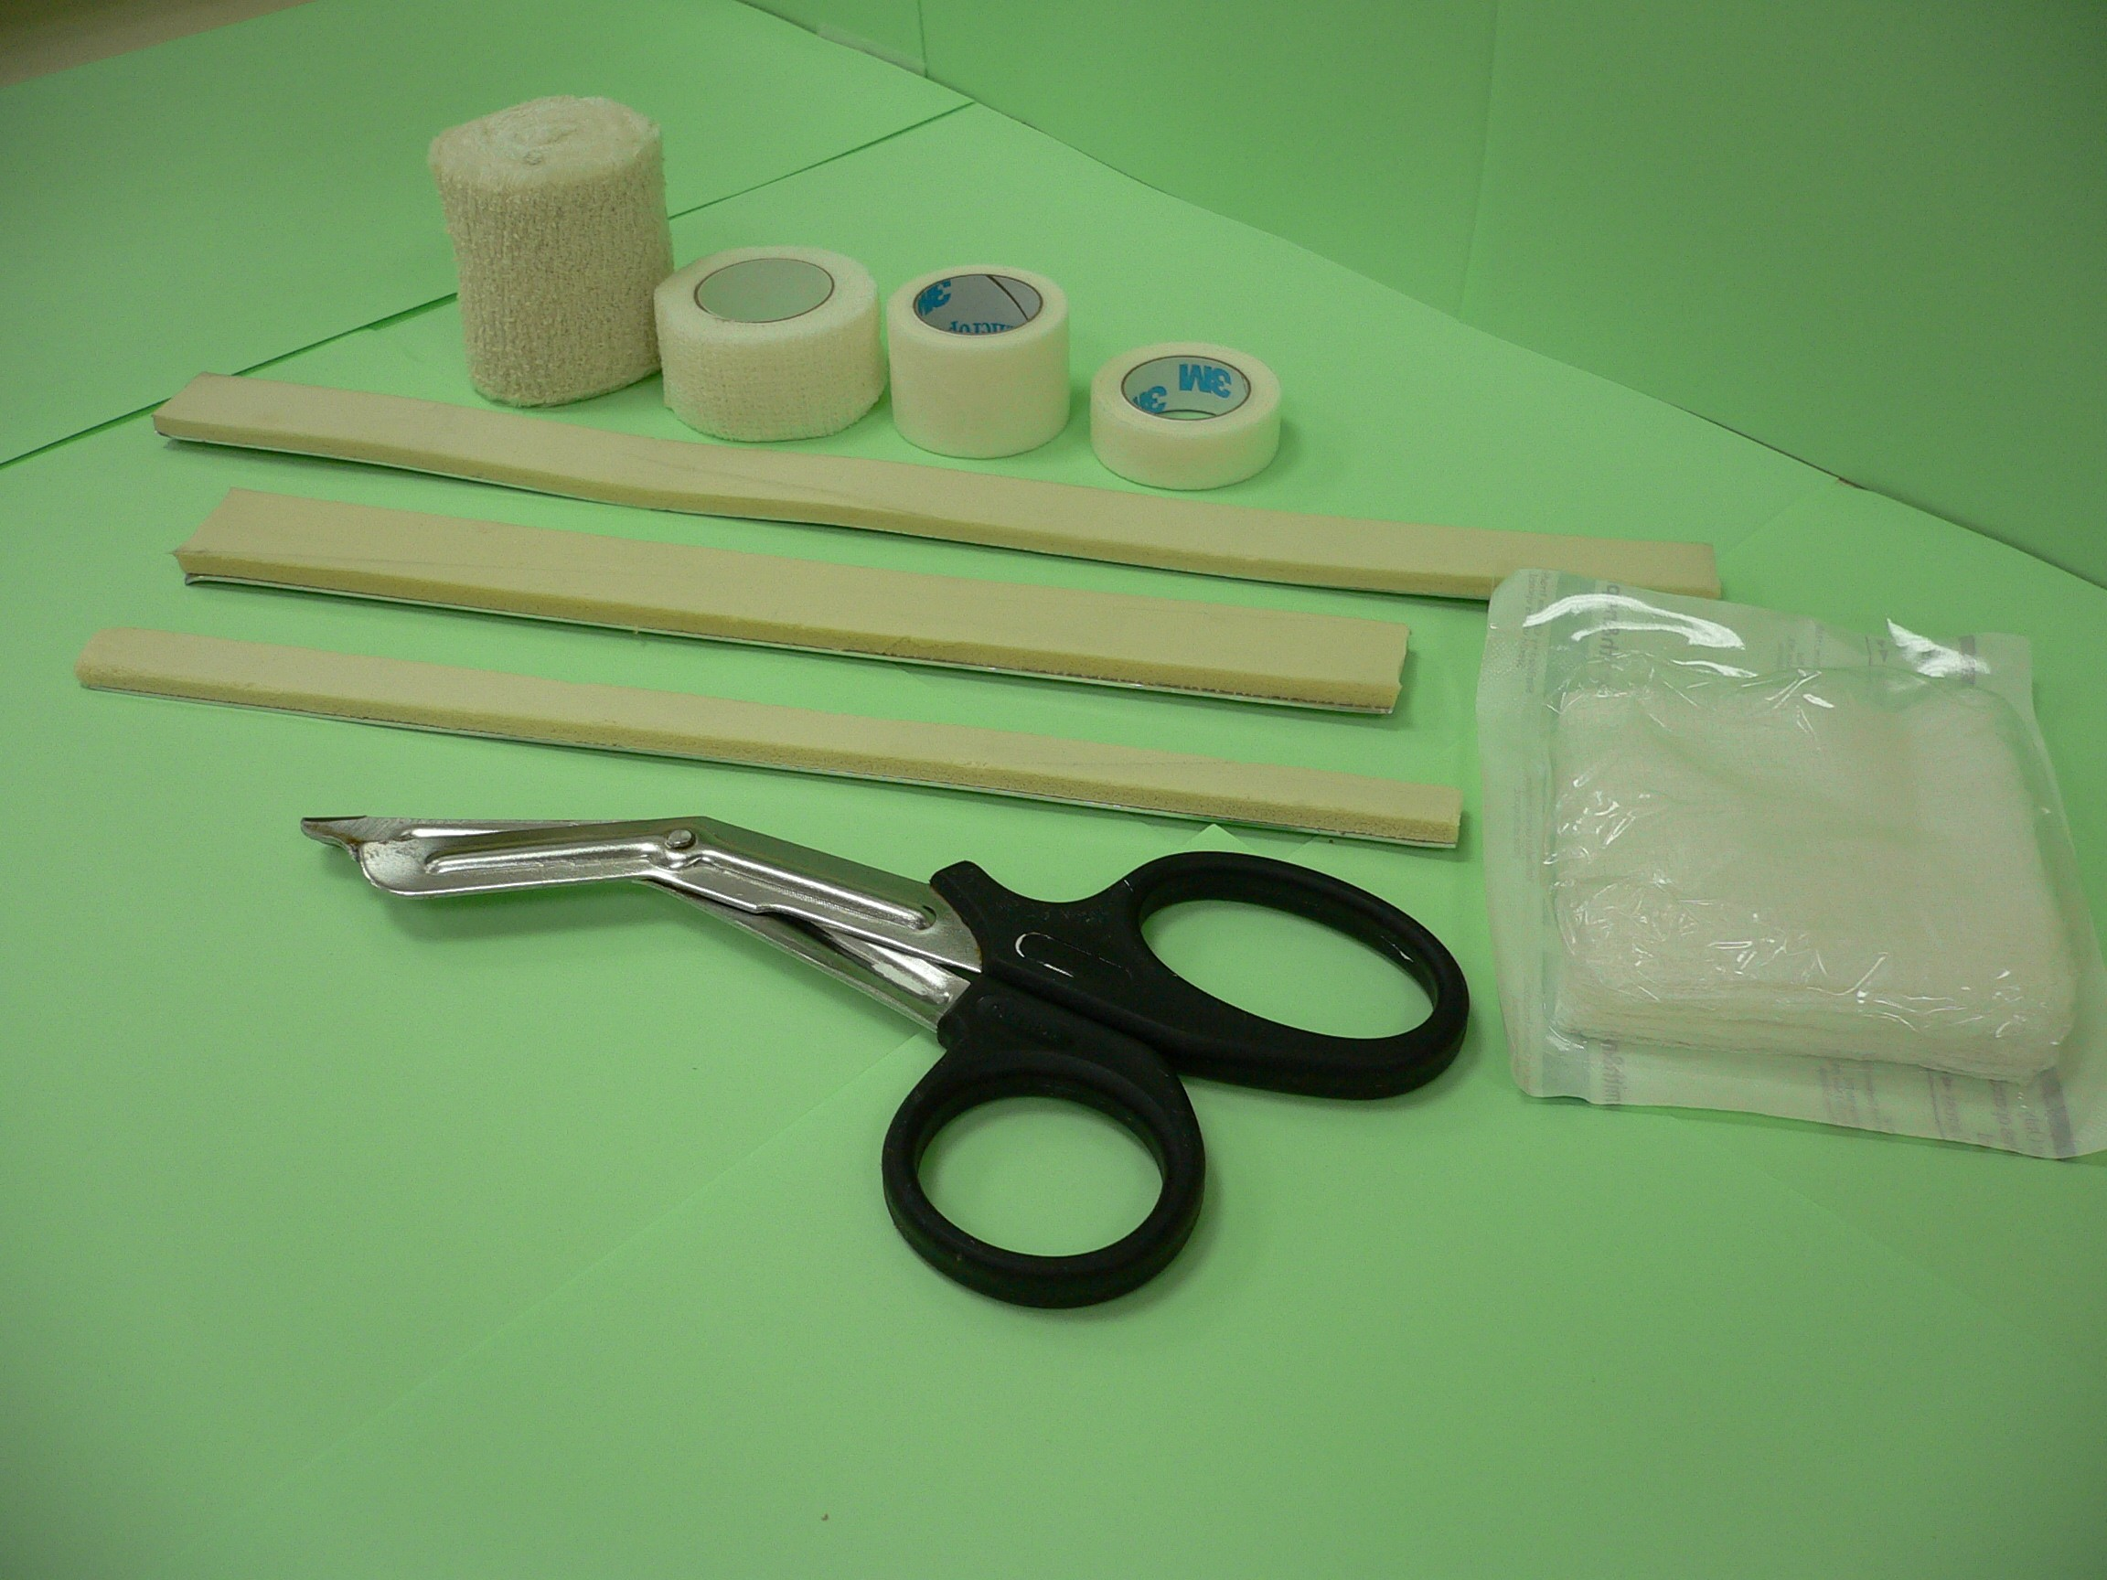
Crepe Bandage
Rinlkilastic Tape
Micropore Tape
Zimmer Splint
Gauze
Scissors

Slide 71
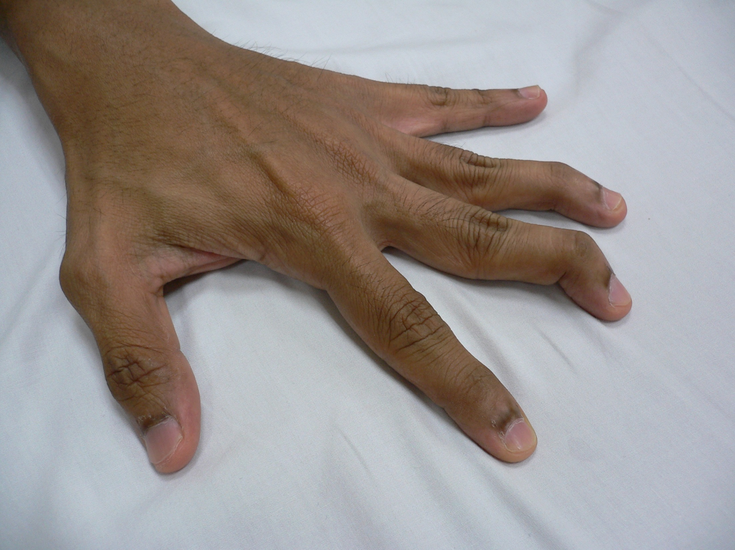
Buddy Splint Application
Step 1
Identify injured finger for splinting

Slide 72

i8
Why?
This prevents friction between them
Apply folded gauze in between the identified finger and the finger beside it

Slide 73

Use micropore to tape around the two fingers

Slide 74

Fold the edge of the tape to allow easy removal tape afterwards

Slide 75

Repeat the steps to tape the inner aspect of the finger again for more stability

Slide 76

Ensure the tape applied is not too tight to prevent constriction of fingers
Repeat the steps to tape the inner aspect of the finger again for more stability

Slide 77

Finished look after taping

Slide 78

Using 2-inch crepe bandage, bandage the 2 fingers together in a clockwise direction 2 rounds

Slide 79

Then cross diagonally to the back of the palm for another 2 rounds

Slide 80

Loop another 2 rounds around the fingers again for more support

Slide 81

The crepe should cross diagonally to the inner aspect of palm and the loop around the wrist 2 rounds

Slide 82

Fold the edge of the bandage before taping to have a neat look
The bandaging should end around the wrist

Slide 83

Tape the folded edge of the crepe bandage around the wrist

Slide 84

Finished Look

Slide 85
Buddy Splint of Lower Limb

Slide 86

Identify the injured toe

Slide 87

Place the folded gauze in between the identified toe and the toe beside it

Slide 88

Use the Rinkilastic bandage around the 2 toes

Slide 89

Loop the bandage in a clockwise direction 2 rounds

Slide 90

Ensure the bandaging is not too tight to prevent constriction and over extension of toes
Similar to the upper limb, cross the bandage diagonally to the area below the toes

Slide 91

Then loop the bandage around the foot and diagonally back to the toes

Slide 92

Finished Look

Slide 93
Application of Zimmer Splint

Slide 94


Slide 95


Slide 96


Slide 97


Slide 98


Slide 99


Slide 100


Slide 101


Slide 102


Slide 103


Slide 104


Slide 105


Slide 106


Slide 107


Slide 108


Slide 109
DANGER SIGNALS
GROSS DEFORMITY
ABSENT PULSATIONS
COLD LIMB , CYANOSIS AT FINGER NAILS
ABSENT MOVEMENTS / SENSATIONS.
COMPOUND FRACTURES , CRUSHED EXTREMITY , TRAUMATIC AMPUTATIONS

Slide 110
L.L. IMMOBILISATION
THOMAS SPLINT WITH / WITHOUT TRACTION.
WOODEN PLANKS , POP SLABS , KRAMER WIRE SPLINTS.
PILLOWS , SHEETS UNDER THE KNEE.
ALWAYS KEEP THE PATIENT SUPINE WITH EXREMITY ELEVATED
DONOT ASK TO BEAR WT.

Slide 111

LOWER LIMB IMMOBILISATION

Slide 112

PILLOWS UNDER THE KNEE & BANDAGE

Slide 113

DON’T FORGET ELEVATION!!!

Slide 114

THOMAS SPLINT

Slide 115

THE THOMAS SPLINT

Slide 116


Slide 117


Slide 118



SPINE BOARD

Slide 119

Statue of Liberty Splint

Slide 120
MCQ 1
Plaster of Paris is made up of
Borax
Resin
Calcium sulfate
Calcium carbonate

Slide 121

MCQ 2
What is the name of the splint on the palm?
Thomas splint
Bohler braun splint
Zimmer splint
Ilizarov

Slide 122

MCQ 3
What is the name of the splint?
Thomas splint
Bohler braun splint
Zimmer splint
Ilizarov

Slide 123
MCQ 4
Plaster and splints help in:
Reduce swelling
Immobilisation
Decrease pain
All of the above

Slide 124
MCQ 5
Plaster cast should be removed when
Cyanosed fingers
Pink fingers
Warm fingers
None of the above

Slide 125
THANK YOU

