Slide 1
Fibrocystic mastopathy with apocrine metaplasia.
- Dr. Tushar Vaishnav

Slide 2
Clinical History
A 52-year-old postmenopausal woman with a recent history of palpable subareolar lump in the left
breast came to our hospital for diagnostic mammography. The patient underwent mammography
and US examination.

Slide 3
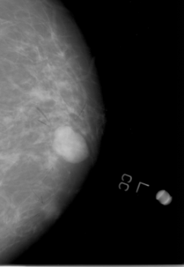
Imaging Findings
A subareolar solitary oval shaped circumscribed soft tissue density. No microcalcification noted.

Slide 4
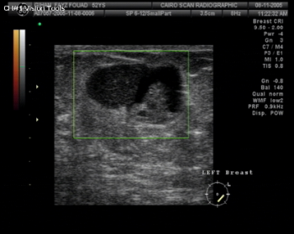
Cystic lesion with heterogenous internal echoes.

Slide 5
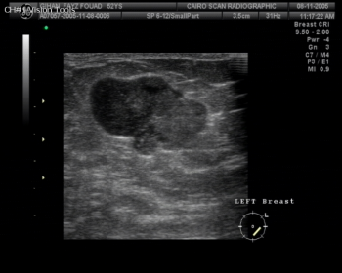
The internal echoe pattern is heterogenous

Slide 6
Discussion
Apocrine metaplasia is a very common finding in the female breast after the age of 25. It is so
common that many people regard it as a normal component of the breast. This, however, is only
really the case in apocrine sweat glands of the axilla and in the peri-areolar apocrine glands. The
apocrine cell does, however, contribute to a number of different breast lesions, some of which are
very taxing diagnostically; apocrine variants of both in-situ and invasive cancer are encountered.
This review considers the common apocrine metaplastic lesions seen in fibrocystic change as well
as apocrine adenoma, apocrine change within sclerosing adenosis, atypical apocrine lesions and
apocrine malignancies. Atypical apocrine adenosis confers an increased risk of developing breast
carcinoma in women older than age 60, and the risk in younger women is probably low.

Slide 7
THANK YOU

