Slide 1
Genetic counseling
Dr kinjal Jethva
Assistant Professor
Department of Anatomy
S.B.K.S.M.I. & R.C.

Slide 2


Slide 3
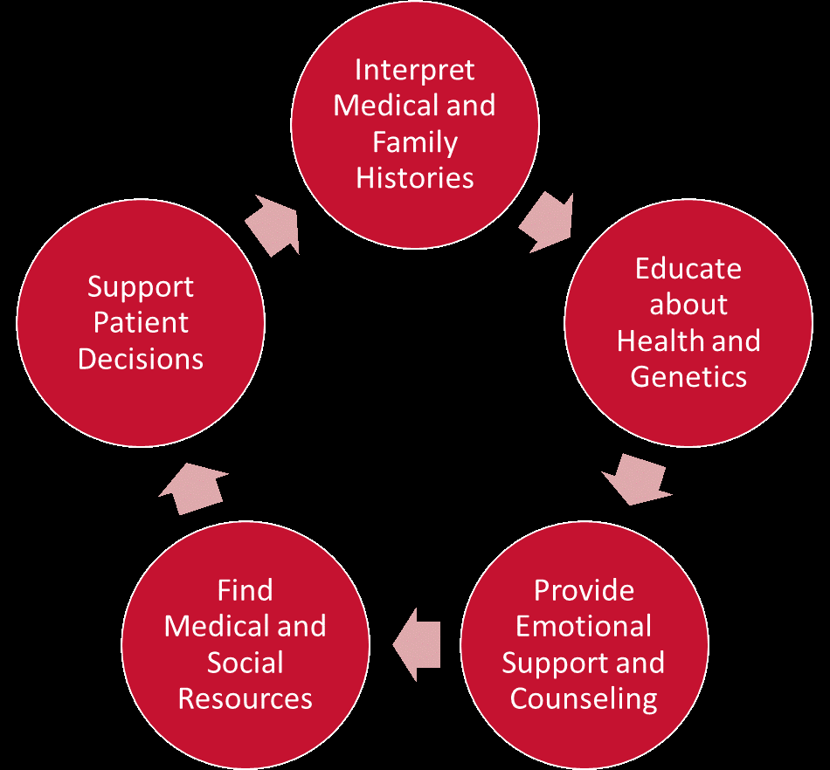

Slide 4
It is process by which patients or relatives who are at risk of an inherited disorder are advises about
Nature and result of the disorder
Chances of developing or transmitting that disorder
The options for the management of the disorder so as to prevent, avoid or improve the outcome of the disorder.

Slide 5
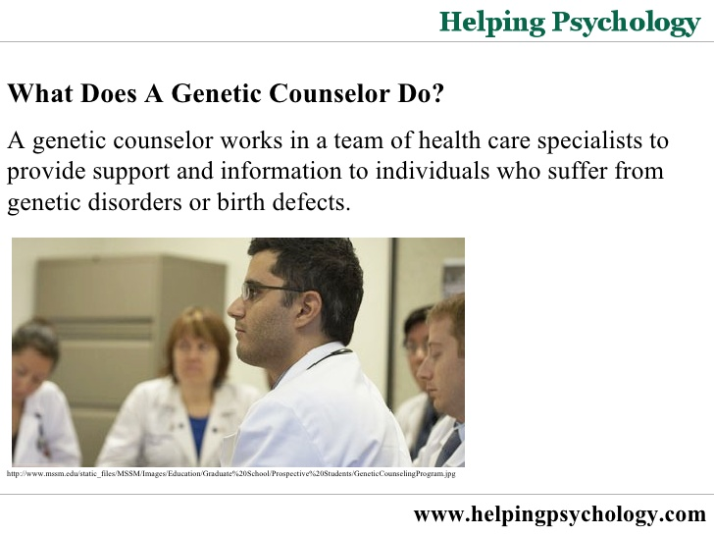
Genetic counselors

Slide 6
Role of genetic counselors
Provide information and support to family and patient about genetic disorder or birth defects
Identify family at risk of inherited disorder
Interpret the result of the test for genetic disorder, analyse the inheritance pattern and risk of recurrence.
They review the option available with the family

Slide 7
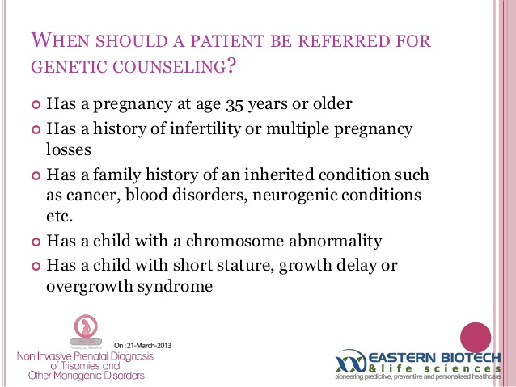

Slide 8
Time of genetic counseling
Before conception
When one or both the parents are carrier of certain traits.
For adult onset genetic conditions
Positive family history

Slide 9
In adulthood
For the adult onset genetic disease like Huntington's disease.
Any person may seek genetic counselling for a condition which they may have inherited from their biological parents.

Slide 10
After birth of the child with genetic disorder.
In this counsellor explain the condition of the child along with risk of this recurrence in future child

Slide 11
Benefits of genetic counselling
Parents can decide how the should proceed in their pregnancy after learning that foetus which the mother is carrying has a potential condition.
Families seek direction and suggestion from the counselors .

Slide 12
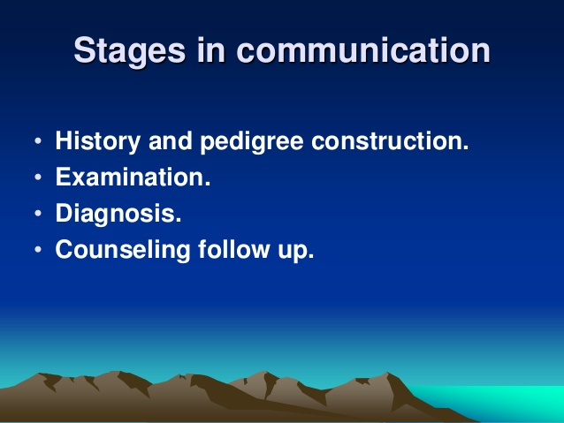

Slide 13
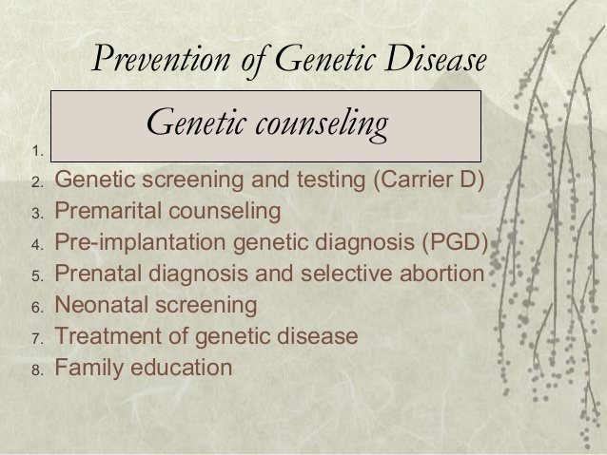

Slide 14
MCQ
1)Which of the condition is caused by monosomy of chromosome?
Turner’s syndrome
klinefelter’s syndrome
Down’s syndrome
Cri du chat syndrome

Slide 15
2)Incorrect statement about chromosome
Each chromosome presents primary constriction called cetromere
Number of chromosome is not constant in a species
Each somatic cell contain 23 pairs of chromosomes
Females have two x chromosome in each somatic cell

Slide 16
3)Clinical conditon caused by 21 chromosome triosomy.
Patau’s syndrome
Down’s syndrome
Kinefelter’s syndrome
Cri-du-chat syndrome

Slide 17
4)Select the incorrect statement about x linked recessive inheritance.
In usually affects the males
It usually affects the females
It may affect the females rarely
Females act as carrier

Slide 18
5)All are chromosome abnormality except
Microdeletions
Translocations
Polyploidy
metacentric

Slide 19
Jeeyae Choi¹ Hyeoneui Kim²
Volume 2014 (2014), Article ID 725968, 19 pages
http://dx.doi.org/10.1155/2014/725968
Author | Title | Method | Results | conclusion
Jeeyae Choi¹ Hyeoneui Kim² | Effectiveness of the Interventions Utilized in Genetic Counseling | We retrieved 126 papers from Medline and 19 from CINAHL. ) evaluated the effectiveness of different modes of communication or types of providers of genetic counseling (counselor, nurse, and physician). | Majority of the studies described the interventions related to genetic counseling on breast, ovarian, or colorectal cancers implemented in individual counseling sessions, and community-based group counseling | The methods and outcome variables evaluated varied across studies. We found that no single method was consistently reported bringing positive outcomes, partly due to the relatively small scale of the review.

