Slide 1
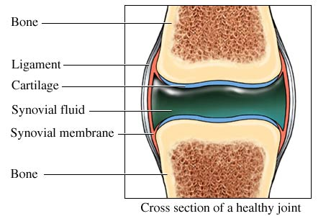
JOINT
DR.HETAL VAISHNANI
Associate Professor
Department of Anatomy
S.B.K.S.M.I. & R.C.

Slide 2
Joints
Definition
Introduction
Classification-
  Synarthoses (Immovable)
  Diarthroses (Movable)
Blood supply
Nerve supply
Lymphatic drainage
Clinical notes

Slide 3
Definition
It is a junction between two or more bones or cartilages
Related term: Arthron
Articulatio
Junctura
Syndesmology

Slide 4
Introduction
Joints are the weakest part of the skeleton
Joints are responsible for- movements
- weight bearing
- growth of bones
There are more joints in a child than in adult . E.g.-hip bone
Note: Long bones articulate by their ends
Flat bones by their margins
Short and irregular bones by surfaces

Slide 5
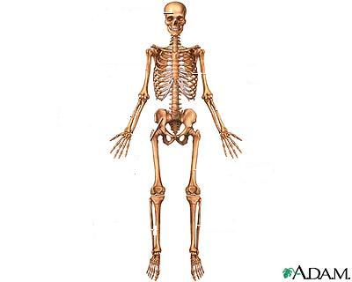
TEMPORO-MANDIBULAR JOINT
STERNO-CLAVICULAR JOINT
SHOULDER JOINT
1ST CHONDRO-STERNAL JOINT
ELBOW JOINT
INTERVERTEBRAL DISC
INTERCARPAL JOINT
WRIST JOINT
METACARPAL-
PHALANGEAL JOINT
HIP JOINT
PUBIC
SYMPHYSIS
KNEE JOINT
INFERIOR TIBIO-FIBULAR JOINT
INTERTARSAL JOINT
ANKLE JOINT

Slide 6
Classification
Functional: according to degree of mobility
  1). Synarthroses: Immovable joints,like fibrous joints
  2). Amphiarthroses: Slightly movable joint, like cartilaginous joint
  3). Diarthroses: Fully movable joints, like synovial joint

Slide 7
Classification
Structural- based on material binding the bone.
JOINTS
SYNARTHROSES
FIBROUS
CARTILA
GINOUS
DIARTHROSES
ACC. TO THE AXIS OF MOVEMENT
ACC. TO NO. OF BONES
SUTURES
SYNDESMOSES
GOMPHOSIS
SYNCHONDR-OSES
SYMPHYSES
SIMPLE
COMPOUND
COMPLEX
UNIAXIAL
HINGE
PIVOT
CONDYLAR
BIAXIAL
ELLIPSOID
SADDLE
POLYAXIAL
BALL & SOCKET
P
L
A
N
E

Slide 8
Immovable joints
Synarthroses (Immovable joints)
A. Fibrous joints
In these joints bones are united by fibrous tissue.
3 Types:
a. Suture-
1.serrate suture
2.denticulate suture
3.squamous suture
4.plane suture
5.wedge in groove suture
b. Syndesmoses
c. Gomphosis

Slide 9
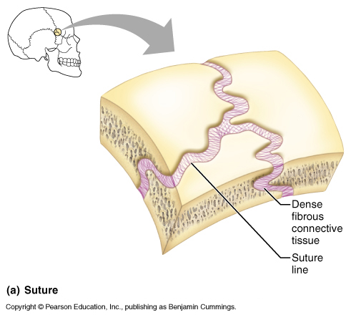
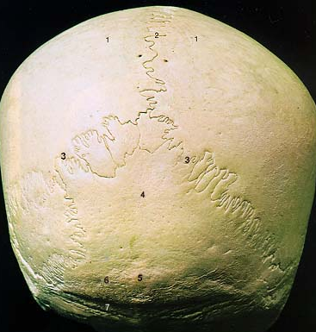
1.Serrate suture-
The edge of bones present saw tooth appearance. Exp.- sagittal suture of the skull

Slide 10
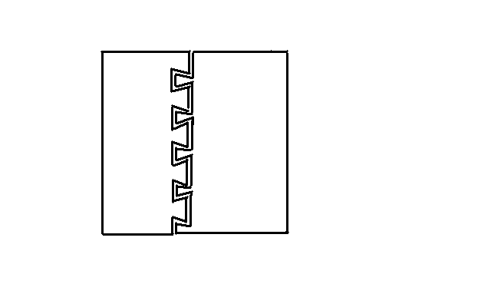
2.Denticulate suture-
The margins present teeth the tips being broader than the roots. Exp.- lamdoid suture
BONE
BONE

Slide 11
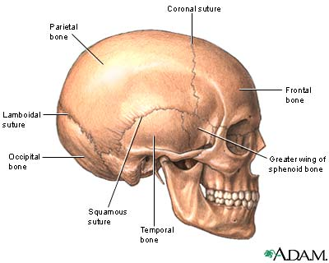
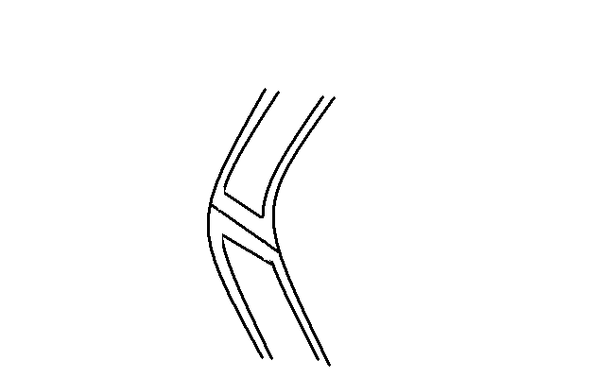
3. Squamous suture-
Here the edges of bone are united by overlapping.
Exp.-between parietal bone and squamous part of temporal bone.
BONE
SUTURAL
MEMBRANE
PERIOSTEUM

Slide 12
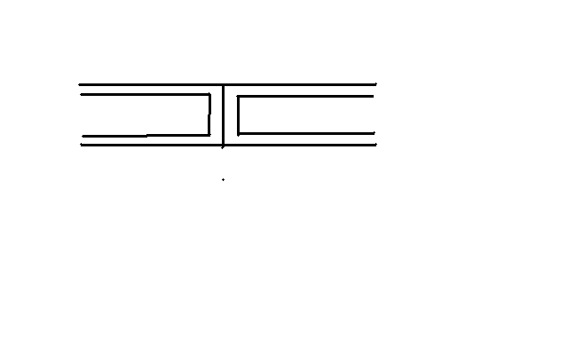
4. Plane suture-
The borders are plane and united by sutural ligament.
Exp.- articulation between palatine process of two maxillae.
PERIOSTEUM
BONE
BONE
SUTURAL
MEMBRANE

Slide 13
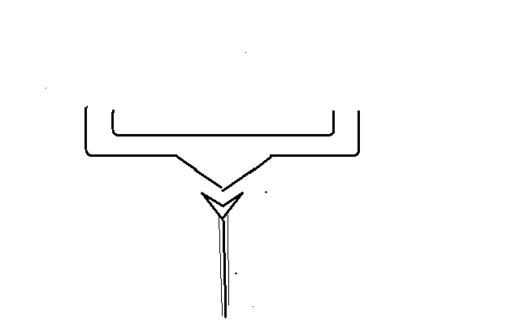
5. Wedge and groove suture-
The edge of one bone fits in the groove of the other bone.
Exp.-between the rostrum of sphenoid and the upper margin of vomer.
ROSTRUM OF
SPHENOID
VOMER

Slide 14
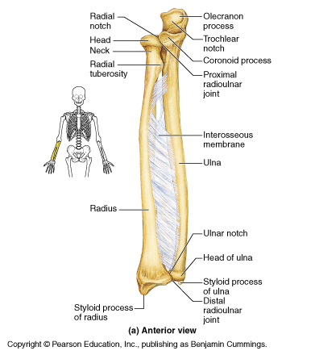
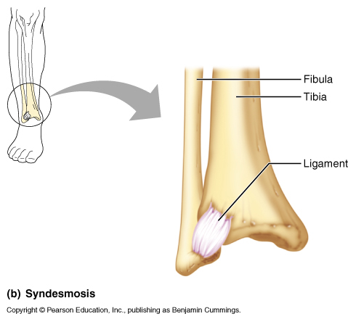
b. Syndemoses
  Bones are connected by ligaments, slight amount of movement is possible
  Such ligament persist throughout life
  E.g. tibiofibular ligament, interosseous membrane of radius/ulna, ligamenta flava

Slide 15
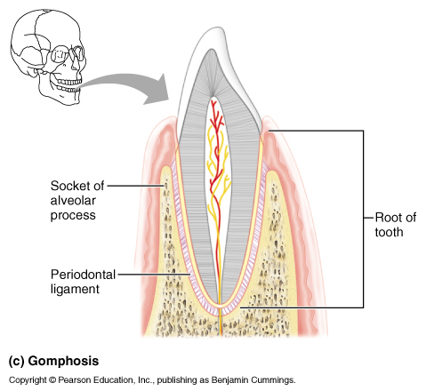
c. Gomphosis
  Peg in socket joint
  The root of teeth fit in the socket of the jaw & are united by fibrous tissue
  Only found in teeth/alveoli

Slide 16
a. suture
Fibrous joints
serrate
denticulate
squamous
plane
b.syndesmoses
c. gomphosis
Wedge in groove
eamcetzoology.blogspot.com/2008/08/joints-images_6908.html

Slide 17
Classification
Structural- based on material binding the bone.
JOINTS
SYNARTHROSES
FIBROUS
CARTILA-GINOUS
DIARTHROSES
ACC. TO THE AXIS OF MOVEMENT
ACC. TO NO. OF BONES
SUTURES
SYNDESMOSES
GOMPHOSIS
SYNCHONDR-OSES
SYMPHYSES
SIMPLE
COMPOUND
COMPLEX
UNIAXIAL
HINGE
PIVOT
CONDYLAR
BIAXIAL
ELLIPSOID
SADDLE
POLYAXIAL
BALL & SOCKET
P
L
A
N
E

Slide 18
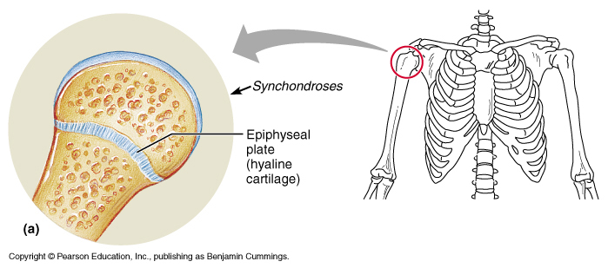
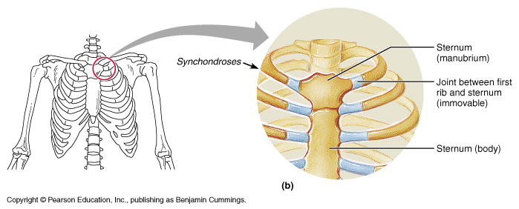
Cartilaginous Joints
a.Synchondroses (primary cartilaginous joint)
  Bones are united by a plate of hyaline cartilage
  Temporary in nature & replaced by bone
  No movement is possible
  Exp.:Epiphyseal growth plates, 1st chondro-sternal joint, Basi-occiput & Basi-sphenoid

Slide 19
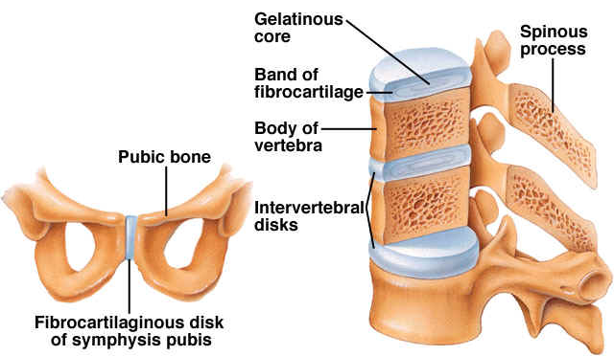
b.Symphyses (secondary cartilaginous joint)
  Bones are covered with hyaline cartilage & united by a plate of fibro-cartilage
  Persist throughout life and occupy median plane of the body
  Exp.-Pubic symphysis, Intervertebral disc, Sterno-manubrial joint

Slide 20
Synchondroses(Primary cartilaginous joint)
Cartilaginous joints
Symphyses(Secondary cartilaginous joint)
eamcetzoology.blogspot.com/2008/08/joints-images_6908.html

Slide 21
Diarthroses(Synovial Joints)
Most common joints in body
Most mobile joints
Characteristics of synovial joint:-
Articular surface of the bones are covered with articular cartilage.
Joint present a cavity which is filled with synovial fluid.
Joint cavity is covered by complete articular capsule Outer- fibrous capsule
Inner- synovial membrane

Slide 22
4. The articular bones are connected by a number of ligament which are additional to the fibrous capsule.
5. The joint cavity is divided completely or incompletely by articular disc or menisci.

Slide 23
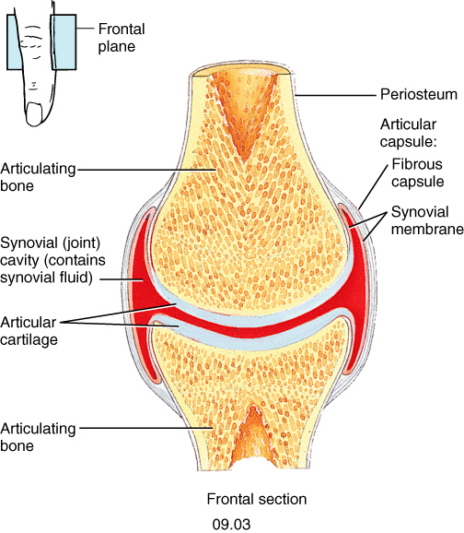
Articular cartilage
Hyaline in structure except which ossified in membrane
avascular, non-nervous and elastic
It has no covering of perichondrium so cartilage once damaged, can not replaced by hyaline tissue, it’s replaced by fibrous tissue.
It’s lubricated with synovial fluid, the cartilage provides slippery surfaces for free movements, like ‘ice on ice’.

Slide 24
Articular capsule
Outer -Fibrous capsule is sensitive to stretches imposed by movements.
Pierced by blood vessel and nerves.
Protect the joints from any sprain, this is called the “Watch –dog” action of capsule.
Binds the articulating bones together.
Supports the synovial membrane on the inner surface.

Slide 25
Articular capsule
Inner – synovial membrane lines whole of the interior the joint except the articular surfaces covered by hyaline cartilage.
Highly vascular and cellular
The membrane secretes a synovial fluid.
The viscosity of fluid is due to hyaluronic acid secreted by cells of the synovial membrane.

Slide 26
Synovial fluid
It is a viscous fluid, which fills up the joint cavity.
The synovial fluid is secreted by the synovial cells & by the mast cells of synovial membrane.
Maintains nutrition of the articular cartilage
Provides lubrication of the joint cavity to prevent wear and tear.

Slide 27
Ligament
Ligaments are fibrous band made up of collagen fibers which connect the adjacent bones
Capsular or true ligaments representing thickening of the fibrous capsule
Accessory ligaments which may be intra or extracapsular.
Maintain the stability of the joint

Slide 28
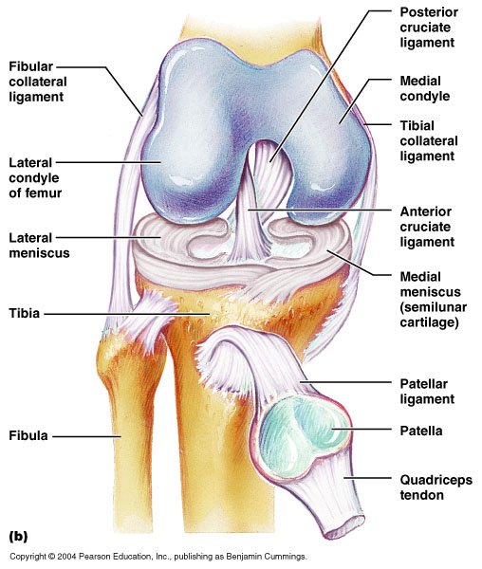
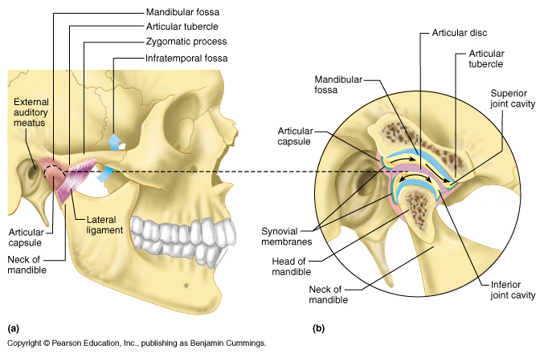
Articular disc or menisci
Joint cavity is divided completely into two compartments, is attached at the periphery to the fibrous capsule
Made up of fibro-cartilage
Provides different movement into upper and lower compartments.
Prevents wear & tear of the articular cartilage.

Slide 29
Classification
Structural- based on material binding the bone.
JOINTS
SYNARTHROSES
FIBROUS
CARTILA-
GINOUS
DIARTHROSES
ACC. TO THE AXIS OF MOVEMENT
ACC. TO NO. OF BONES
SUTURES
SYNDESMOSES
GOMPHOSIS
SYNCHONDR-OSES
SYMPHYSES
SIMPLE
COMPOUND
COMPLEX
UNIAXIAL
HINGE
PIVOT
CONDYLAR
BIAXIAL
ELLIPSOID
SADDLE
POLYAXIAL
BALL & SOCKET
P
L
A
N
E

Slide 30
Classification of synovial joint
Accordoing to the number of bones
Simple joint- when only two bones enter in the articulation. Exp.- inter-phalangeal joint of the fingers and toes.
Compound joint- more than two bones are involved in the joint. Exp.- ankle and radiocarpal joint.
Complex joint- joint is divided into two comparment by a articular disc or menisci. Exp.- knee joint, sterno-clavicular joint.

Slide 31
Classification
Structural- based on material binding the bone.
JOINTS
SYNARTHROSES
FIBROUS
CARTILA-
GINOUS
DIARTHROSES
ACC. TO THE AXIS OF MOVEMENT
ACC. TO NO. OF BONES
SUTURES
SYNDESMOSES
GOMPHOSIS
SYNCHONDR-OSES
SYMPHYSES
SIMPLE
COMPOUND
COMPLEX
UNIAXIAL
HINGE
PIVOT
CONDYLAR
BIAXIAL
ELLIPSOID
SADDLE
POLYAXIAL
BALL & SOCKET
P
L
A
N
E

Slide 32
Classification of synovial joint
According to the axis of movement and the shape of articular surface:
Uniaxial joint-has one degree freedom of movement
Hinge or ginglymus joint-
it moves around a transverse axis
One articular surface is convex and other is curved
Exp.- interphalangeal joint of finger & toes, ankle joint, elbow joint

Slide 33
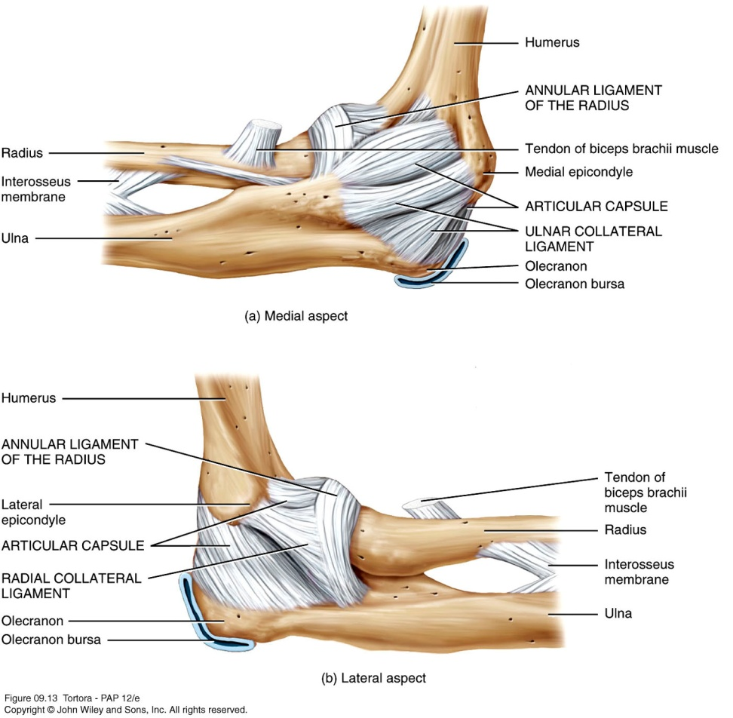
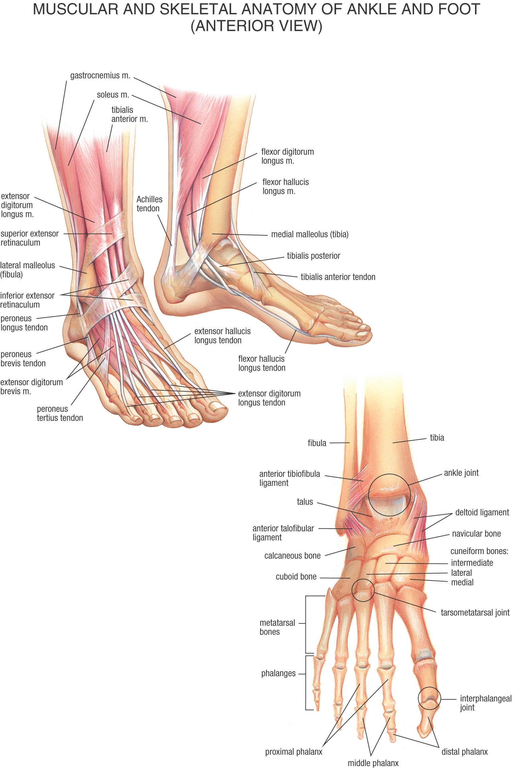

Slide 34
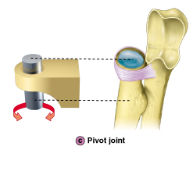
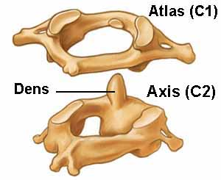
Pivot or trochoid joint- movement takes place on a vertical axis.
Exp.- atlanto- axial joint, radio-ulnar joint

Slide 35
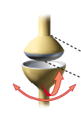
Condylar joint- moves mainly on the transverse axis and partly on a vertical axis.
It is a modified hinge joint.
Each bone consist of two distinct articular surfaces known as condyles.
Exp.- knee joint,temporo-madibular joint

Slide 36
Temporo-mandibular joint- condylar joint

Slide 37
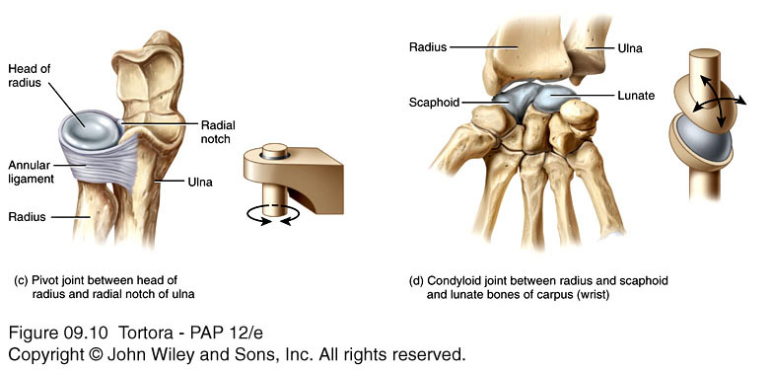
2. Biaxial joint-have two degree freedom of movement and present two varieties.
a) Ellipsiod joint
movement takes place around transverse & antero-posterior axis.
one articular surface is convex and elliptical ( oval ) in outline. The other articular surface is concave and reciprocally curved.
Exp.- radio-carpal, metacarpo-phalangeal, atlanto-occipital joint

Slide 38
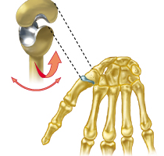
b) Saddle joint-movement takes place around transverse & antero-posterior axis. Movement same as ellispsoid joint.
Articular surfaces are saddle shaped and the other bone has the reciprocally concavo- convex surface.
Exp.-carpo-metacarpal joint of thumb, sterno-clavicular joint.

Slide 39
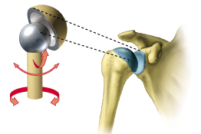
3. Polyaxial joint- have three degree freedom of movement
Ball & socket joint or spheroidal joint- movement take place around transverse, antero-posterior, vertical axis.
Articular surfaces include a globular head fitting into cup shaped socket
Exp.- shoulder & hip joint,talo-calcaneo-navicular joint.

Slide 40
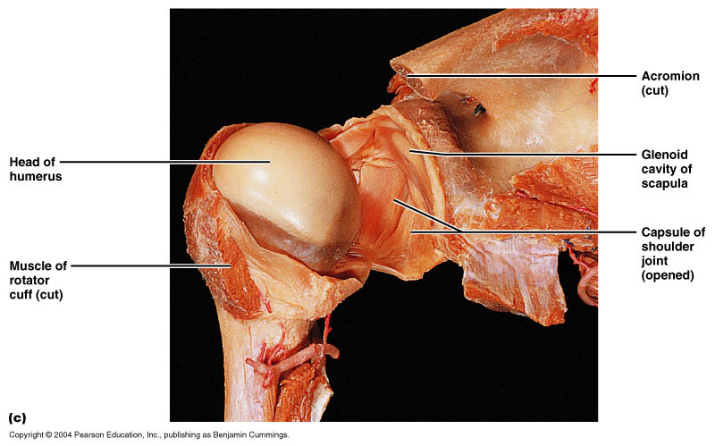
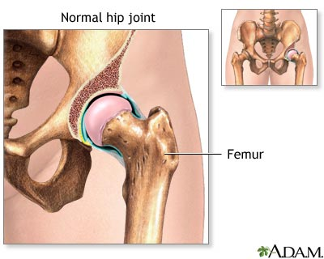

Slide 41
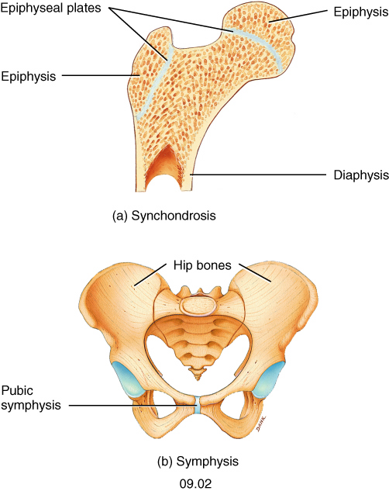
4.Plane joint-
Articular surface are flat & produce gliding movement in various direction is possible.
Exp.- intercarpal, intermetatarsal
Intercarpometacarpal
Chondrosrernal except 1st
Interchondral
Costoverterbral, costotransverse
acromioclavicular

Slide 42
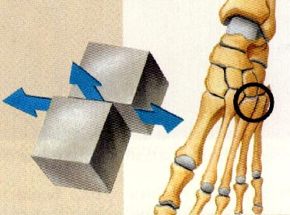
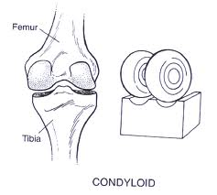
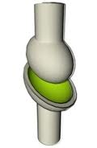
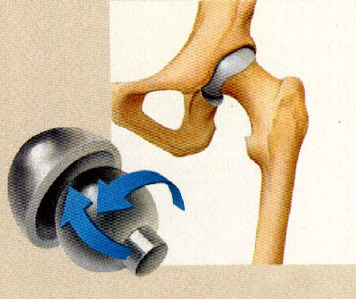
Uniaxial joint
Plane synovial joint
a.hinge variety
b.Pivot variety
c.Condyler variety
Biaxial joint
Polyaxial joint
a.Ellipsoid variety
b.Saddle variety
Ball & socket variety
eamcetzoology.blogspot.com/2008/08/joints-images_6908.html

Slide 43
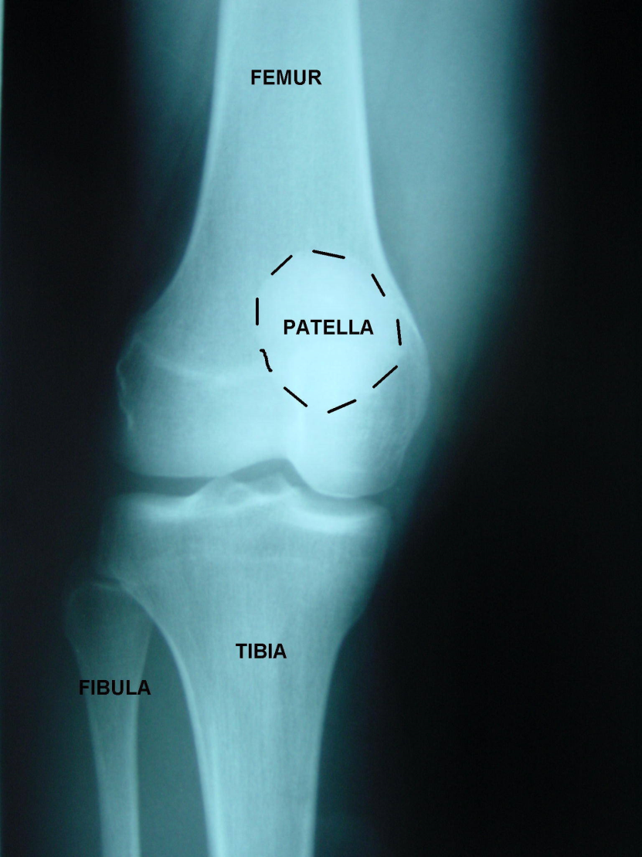
Peculiarities of synovial joint:-
Radiological joint space is larger than the actual one, because articular cartilage are not opaque to x-ray.
The pad of fat are intracapsular but extra-synovial and are known as harversian gland which is act as a vaccum filter.

Slide 44
Factors limiting the range of movement
1. shape of articulating bones:
disproportionate shape of glenoid cavity and head of humerus provides wider range of moment.
2. Tension of ligament:
e.g. over-extension of hip joint is prevented by tension of iliofemoral ligament
3. Tension of antagonist muscle
4. The approximation of soft part:
flexion at elbow joint

Slide 45
Factors maintaining stability of joint
1. Muscles:
tone of different muscle groups maintain the joint stability, important factor e.g. shoulder joint
2. Shape of articulating surfaces of bones:
e.g. hip joint, head of femur is completely received by acetabular socket
3. Ligaments:
permits desirable movements and prevents undesirable movements.

Slide 46
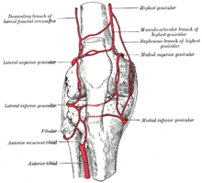
Blood supply
  Arterial branches from several different arteries merge around a joint, & form a rich plexus before penetrating the articular capsule
  Articular cartilage is avascular & gets nutrition by diffusion.

Slide 47
Nerve supply
Capsule and ligaments possess a rich nerve supply.
3 different types-
1. sensory nerves- convey pain sensation
2. sensory nerve conveying proprioceptive sensations.
3. autonomic nerves- vasomotor, vasosensory
∗ therefore, the joint pain is associated with, nausea, vomiting, slowing of pulse and blood pressure

Slide 48
Hilton’s law
The law states that the nerves supplying a joint, also suppy muscles regulating the movements of the joint & the skin over the joint
This mechanism of innervation helps to protect the joint.
The irritation of the nerves in joint disease causes reflex spasm of the muscles, the pain may be referred to the overlying skin.
Lymphatic drainage:
Form a plexus in the synovial membrane

Slide 49
Factors preventing friction during movement
1. synovial fluid
2. articular cartilage
3. bursae
4. sesamoid bone

Slide 50
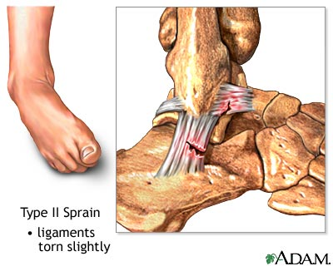
Clinical anatomy:
Sprains occur when ligaments are torn.

Slide 51
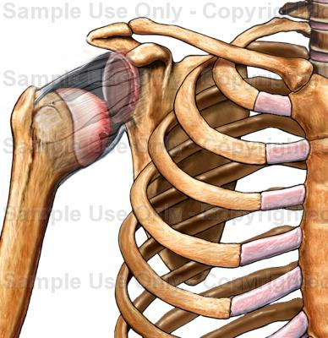
Dislocation of the joint
This is a condition in which the articular surfaces of the joint are abnormally displaced, so one surface loses its contact completely from the other.
If partial contact is still retained, it is better called subluxation.

Slide 52
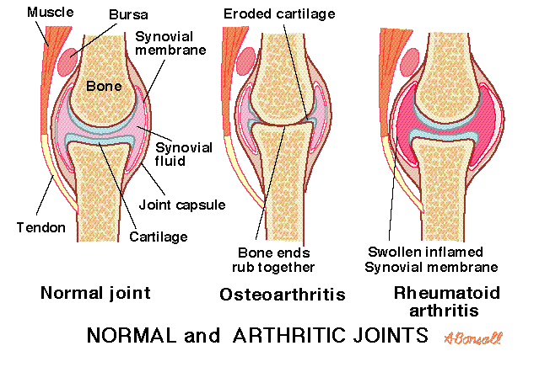
Osteoarthritis
Degenerative joint disease
  aging, wear & tear
  Affects large weight bearing joints
  Patient feels lots of pain due to rubbing of bones during movements.
visual.merriam-webster.com/human.../types-synovial-joints

Slide 53
injury
1. Tearing of – menisci
E.g. football players
2. Intraarticular fractures- can lead to collection of blood and broken particles in the joint cavity

Slide 54
Stiffness of joint
Related to weather with reduction in the temperature ( cold weather), viscosity of synovial fluid increses – leads to joint stiffness.

Slide 55
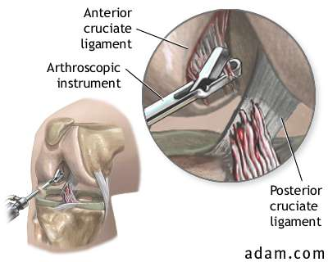
Arthroscopy- examination of joint
  By an instrument size of a pencil
  Requires small incisions only
  Diagnostic and therapeutic purpose
  remove torn knee cartilage

Slide 56
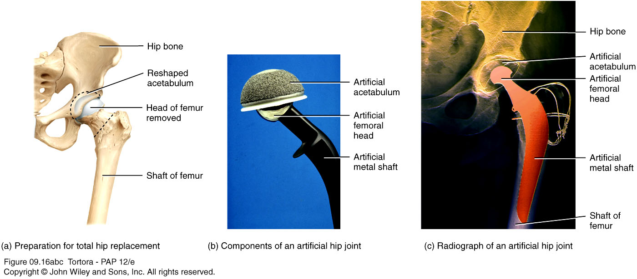
Arthroplasty- Replacement of joints

Slide 57
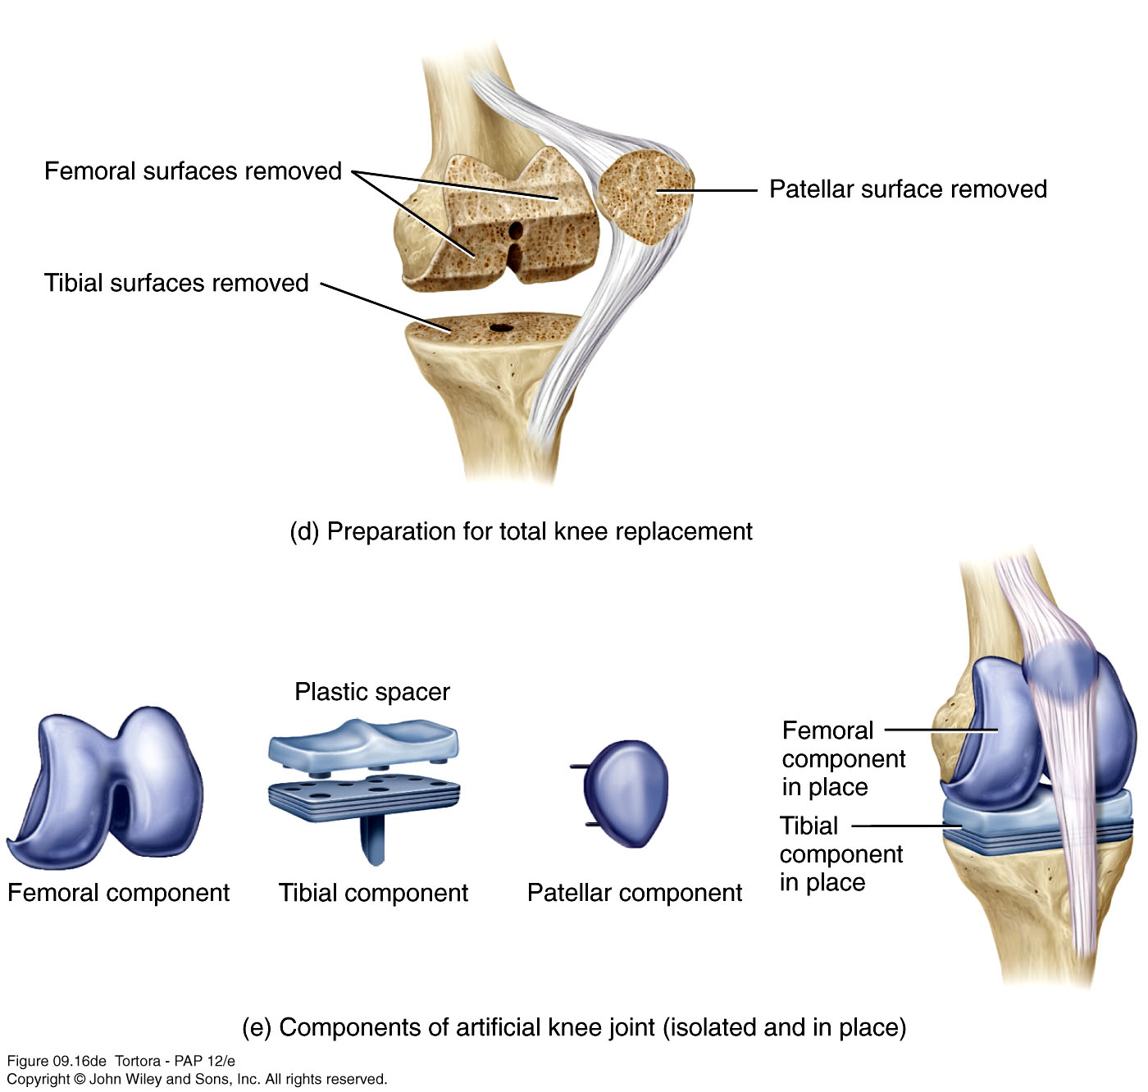
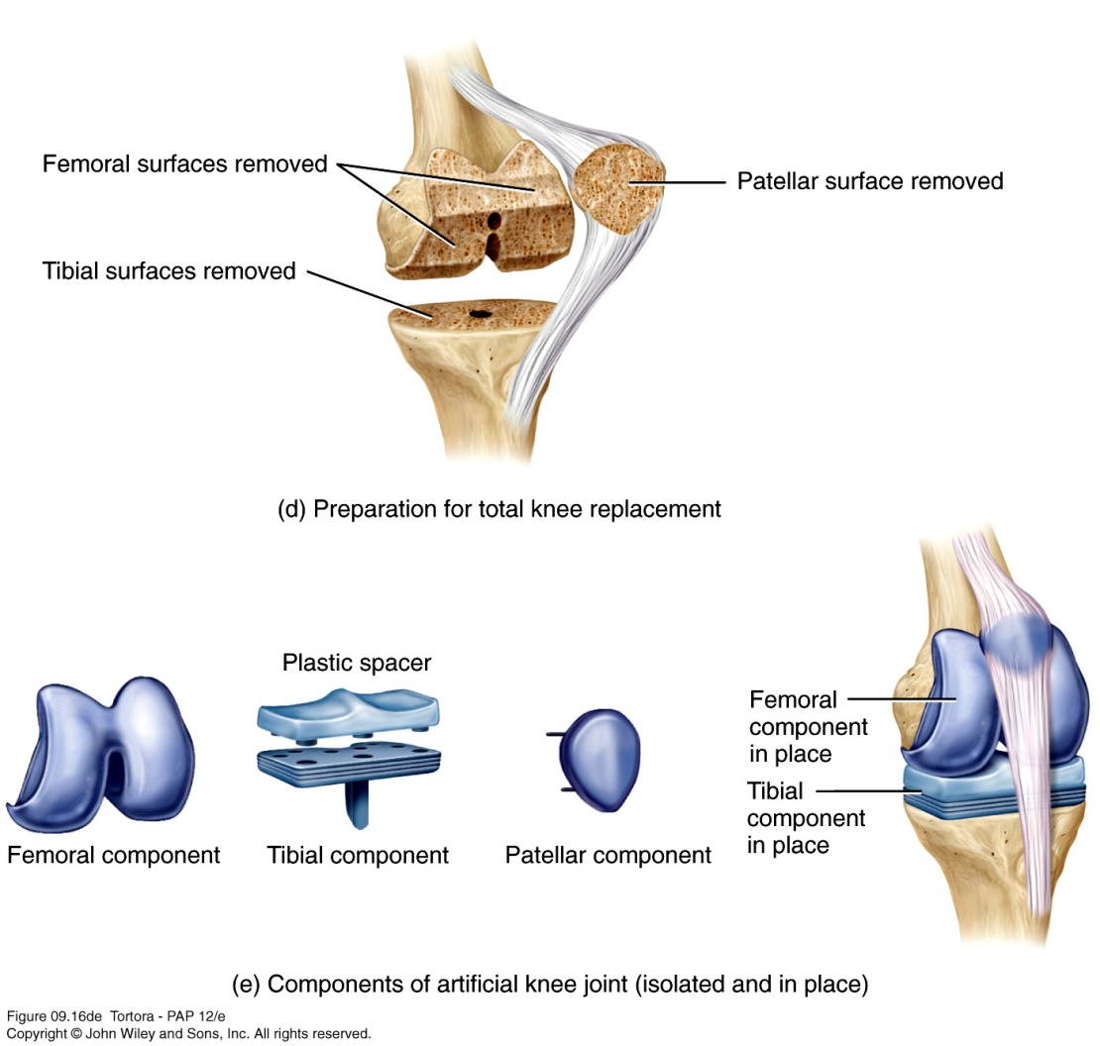

Slide 58
Questions

Slide 59
1. Write the type of joint:
Hip joint
Elbow joint
Sacroiliac joint
Knee joint

Slide 60
2. When the end of one bone gets out of its socket is known as-
A. arthritis
B. joint dislocation
C. paralysis
D. stiffness of a joint

Slide 61
3. The movable joint is-
A. serrate suture
B. denticulate suture
C. synovial joint
D. cartilaginous joint

Slide 62
4.Which of the following is not a fibrous joint-
A. serrate suture
B. denticulate suture
C. plane suture
D. primary cartilaginous joint

Slide 63
5. Which of the following is not a characteristic of a synovial joint-
A. immobile
B. possess a joint cavity
C. covered by an articular capsule
D. synovial fluid fills the joint cavity

Slide 64
Answers

Slide 65
1. Write the type of joint:
Hip joint - ball and socket variety of synovial joint
Elbow joint – hinge variety of synovial joint
Sacroiliac joint- plane variety of synovial joint
Knee joint- condyler variety of synovial joint

Slide 66
2. When the end of one bone gets out of its socket is known as-
A. arthritis
B. joint dislocation
C. paralysis
D. stiffness of a joint

Slide 67
3. The movable joint is-
A. serrate suture
B. denticulate suture
C. synovial joint
D. cartilaginous joint

Slide 68
4.Which of the following is not a fibrous joint-
A. serrate suture
B. denticulate suture
C. plane suture
D. primary cartilaginous joint

Slide 69
5. Which of the following is not a characteristic of a synovial joint-
A. immobile
B. possess a joint cavity
C. covered by an articular capsule
D. synovial fluid fills the joint cavity

Slide 70
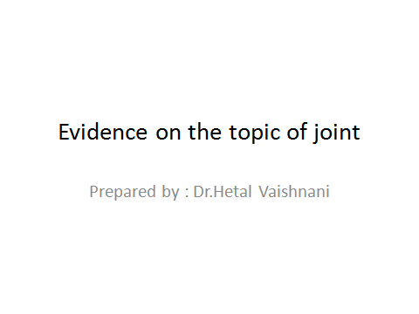

Slide 71
Frances Vaughn Wilder · Lissa Fahlman ·
Robert Donnelly
Received: 21 July 2009 / Accepted: 7 October 2009 / Published online: 29 October ,2009
Frances Vaughn Wilder Lissa Fahlman Robert Donnelly | Radiographic cervical spine osteoarthritis progression rates: a longitudinal assessment | we provide age-speciWc progression rates of radiographic cervical spine OA, by gender. Data from cohort subjects (ages 40+) from the Clearwater Osteoarthritis Study were analyzed (N = 707). All study subjects’ demonstrated radiographic cervical spine OA at baseline (2+). Lateral cervical spine radiographs were taken biennially. | The study outcome was radiographic disease progression. A grade increase of 1, or more, by the Lawrence and Kellgren ordinal scale was considered progression | We show that the progression rates for cervical spine OA increase with age. For all ages combined, men demonstrated higher rates of progression compared with women.

Slide 72
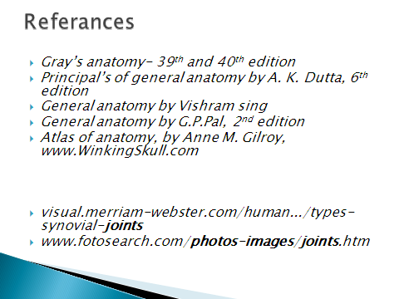

Slide 73
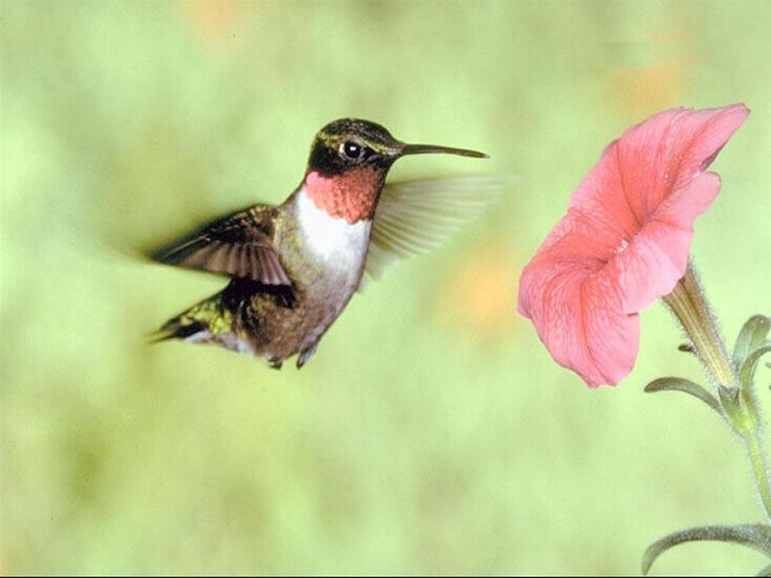
THANK YOU

