Slide 1
Spaces of the hand
Dr. Manoj Kulkarni
Associate Professor
S.B.K.S.M.I. & R.C.

Slide 2
Spaces are as follows:
A) Palmar spaces
Pulp space of the finger
Midpalmar space
Thenar space
B) Dorsal spaces
Dorsal subcutaneous spaces
Dorsal subaponeurotic spaces
C) The forearm space of Parona

Slide 3
Pulp space of the finger
The skin of the very tip of the finger is very firmly attached to the distal phalanx by numerous fibrous septa
They divide the soft tissue into a large number of virtually closed compartments
The middle and distal digital creases which overlie the joints are attached to the cruciate portions of the tendon sheath
The pulps therefore are relatively confined compartments
www.medceu.com/index/index.php?page=get_course

Slide 4
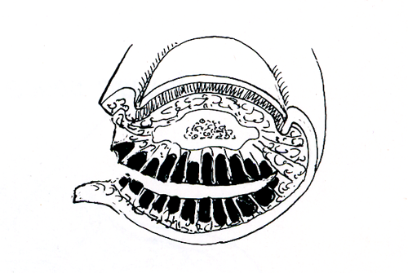
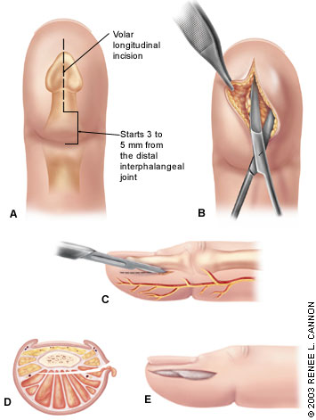
Applied of pulp space
Infections of the pulp thus remain localized rarely extending to adjacent spaces- known as a whitlow
Soft tissue necrosis and phalangeal osteitis will develop sooner
Drained by a lateral incision of the finger
www.medceu.com/index/index.php?page=get_course

Slide 5
Sassone LM, Fidel RA, Faveri M, Figueiredo L, Fidel SR, Feres M., J Endod. 2012 Jul;38(7):889-93. Epub 2012 May 4.
Sassone LM, Fidel RA, Faveri M, Figueiredo L, Fidel SR, Feres M., | A microbiological profile of unexposed and exposed pulp space of primary endodontic infections by checkerboard DNA-DNA hybridization. | Samples were collected by means of a #15 H-type file and 2 sterile paper points from 60 single-rooted teeth with necrotic pulp and periapical lesions. The presence, levels, and proportions of 40 bacterial species were determined by checkerboard DNA-DNA hybridization. | The species found in higher counts (×10(5)) in exposed pulp space cases were Eubacterium saburreum, Fusobacterium nucleatum ssp. vincentii, Tannerella forsythia, Enterococcus faecalis, Neisseria mucosa, Campylobacter gracilis, and Prevotella nigrescens, and in unexposed pulp space cases they were F. nucleatum ssp. vincentii, N. mucosa, E. faecalis, E. saburreum, C. gracilis, and Porphyromonas gingivalis. Counts of F. nucleatum ssp. vincentii, Campylobacter sputigena, Capnocytophaga showae, Treponema socrenskii, Porphyromonas endodontalis, Eikenella corrodens, and Capnocytophaga ochracea were significantly higher in unexposed pulp space cases (P < .05). | The data of the present investigation suggested specific differences between the composition of the microbiota in cases with exposed and unexposed pulp space and an association between higher levels of some specific species and unexposed pulp space cases.

Slide 6
Midpalmar space
Bounded by:
Ant: flexor tendons of med 3 fingers surrounded by synovial sheaths (ulnar bursa).
Post: 3,4,5, metacarpal bones with its interossei ms.
Med: Hypothenar muscles.
Lat: septum separating it from thenar space.
Distally: communicate with web spaces.
Proximally: Communicate with Parona space.
www.meduweb.com/showthread.php?t=9271 -

Slide 7
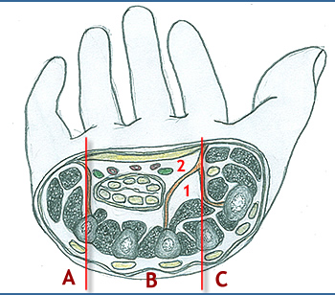
Midpalmar space
oganatomy.org

Slide 8
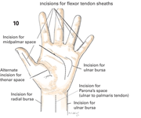
Applied of midpalmar space
The swelling obliterate the cup of the hand.
Infection also causes marked oedema of the dorsum of the hand.
Treatment:
Vertical incision extending from 3rd or 4th web space to distal palmar crease.
www.meduweb.com/showthread.php?t=9271 -

Slide 9
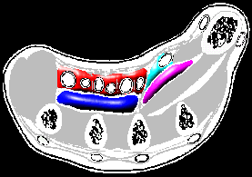
Thenar space
Boundaries:
Radial: thenar eminence, radial bursa
Ulnar: Middle metacarpal, ulnar bursa
Superficial: Carpal tunnel
Deep: Adductor pollicis
eatonhand.com

Slide 10
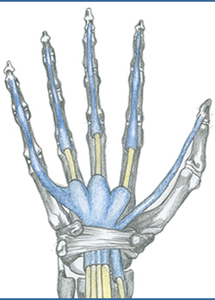
Synovial sheaths
Opposite each finger, the flexor tendons are enclosed in a digital synovial sheath, which in turn is covered by a fibrous flexor sheath.
www.medceu.com/index/index.php?page=get_course

Slide 11
Ulnar and radial bursa
The flexor pollicis longus has a separate synovial covering that is called the radial bursa.
The superficial and deep flexor tendons in the palm and forearm are enclosed in the ulnar bursa
www.medceu.com/index/index.php?page=get_course

