Slide 1
Gorham's disease.
- Dr. ParthivBrahmbhatt

Slide 2
Clinical History
A 73-year-old female patient presented with unremarkable history and progressive pain in her left hip.
A clinical examination was done, which revealed a decreased range of motions in her hip extension, abduction and external rotation.
Plain films of her hip were taken, which showed an extensive osteolysis of femoral head, neck and acetabulum, and soft tissue swelling. No collapse, fragmentation or sclerosis of the residual bone was noted.

Slide 3
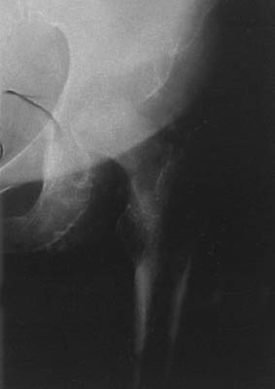
Imaging Findings
Extensive osteolysis and soft tissue swelling are noticed.

Slide 4
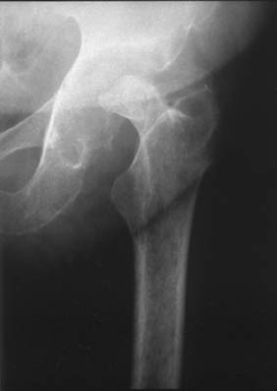
The characteristic tapering of the residual femoral neck is noticed.

Slide 5
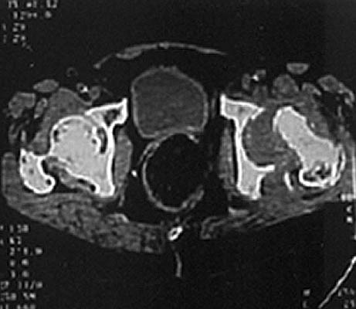
CT- Osteolysis and the intra-articular soft-tissue process are shown.

Slide 6
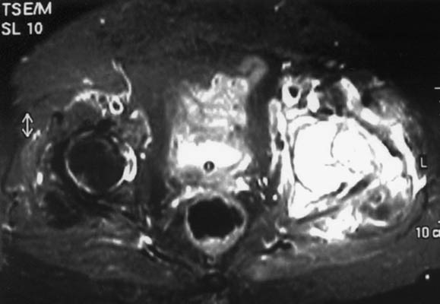
The lesions showing homogeneously high-signal intensity.

Slide 7
The lesions showing a homogeneously high-signal intensity.

Slide 8
Discussion
Our case refers to a unilateral rapid hip destruction in an old woman. The patient's age and history, as well as the initial X-ray findings were highly suggestive of a rapid destructive arthritis, which is an uncommon form of osteoarthritis.
Radiologically, there is a progressive and rapid destruction of the joint in the absence of osteophytes as is the case with the classic form of osteoarthritis.
Avascular necrosis of the femoral head was also a possible diagnosis, but the patient had no risk factors and the characteristic imaging features of the disease such as sclerotic or cystic lesions as well as the subchondral collapse were absent.

Slide 9
Arthritis of neuropathic disorders was also excluded based on the absence of neuropathy and the lack of the characteristic exuberant osteophytes and the free intra-articular bony fragments. Analgesics induced arthropathy was not considered possible because the patient used analgesics only occasionally.

Slide 10
THANK YOU

