Slide 1
Haematometrocolpos
- Dr. Jayesh Shah

Slide 2
Clinical History
A premenarche girl presented with a 3 day history of severe lower back pain. She had been experiencing milder, cyclical back pain for 8 months; this was occasionally felt in the abdomen.
On examination, lower back tenderness and an abdominal mass were noted. Previous medical history was unremarkable.

Slide 3
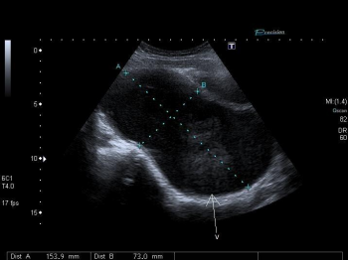
Longitudinal image illustrating a distended vaginal cavity (V) containing hypoechoic material.

Slide 4
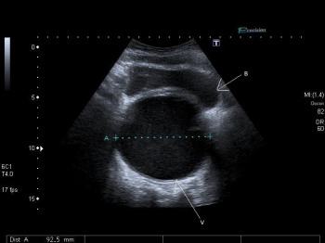
Transverse image illustrating a distended vaginal cavity (V) containing hypoechoic material, posterior to the bladder

Slide 5
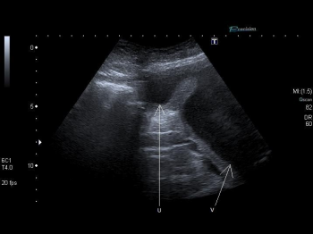
Longitudinal image illustrating the distended vaginal cavity (V) and distended uterus (U) superiorly

Slide 6
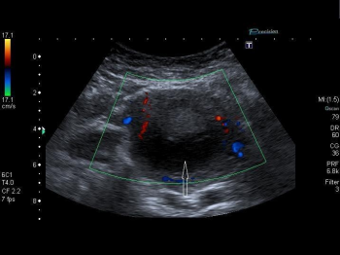
Transverse colour Doppler image of the uterus with distended uterine cavity (white arrow).

Slide 7
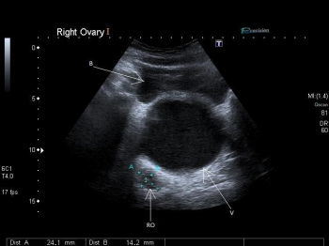
Transverse image illustrating the relation of the right ovary (RO) to the distended vaginal cavity (V) and bladder (B).

Slide 8
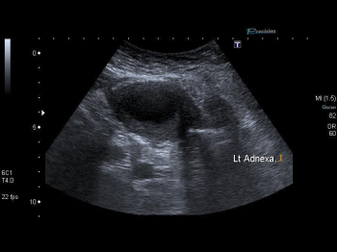
Normal left adnexa

Slide 9
Discussion
Haematometrocolpos is a rare diagnosis of a collection of blood in the vaginal cavity (haematocolpos) and uterus (haematometra) due to vaginal outflow obstruction .
The most common cause is an imperforate hymen; residual embryological mesodermal tissue that normally perforates during the later stages of development. This is an infrequent congenital abnormality occurring in approximately 1 in 2000 females .
A familial pattern has been reported with both dominant and recessive modes of inheritance suggested. Usually an imperforate hymen is an isolated abnormality but it is occasionally associated with other abnormalities such as
genitourinary malformations and renal agenesis

Slide 10
Ultrasound is the imaging modality of choice in these cases . Typical findings reveal a cystic mass of varying echogenicity, the diagnosis of which can normally be reached as long as care is taken to image all pelvic organs thoroughly [8]. Further imaging with CT or MRI is not necessary if no further pathology is suspected

Slide 11
Differential Diagnosis
Haematocolpos secondary to an imperforate hymen,
Haematometrocolpos secondary to a transverse vaginal septum,
Haematocolpos secondary to a transverse vaginal septum,
Haematometrocolpos secondary to other structural abnormalities,
Haematocolpos secondary to other structural abnormalities

