Slide 1
RARE CASE PRESENTATION OF HETEROTAXY SYNDROME
- Dr. Mayur Khandhedia

Slide 2
Abstract
In this case report , I present a rare case of Heterotaxy Syndrome in 1 day old baby child presented to radiology department with complain of difficulty in feeding diagnosed and by X-Ray radiographic procedure, Ultrasonography and CT Scan study.

Slide 3
Introduction
The beginning of the word (hetero-) means “different” and the end (–taxy) means “arrangement.” . Heterotaxy has been characterized by an abnormal syndrome of the viscera and veins . It is also known as ‘Situs Ambiguous’.
syndrome may be associated with complex cardiac anomalies, intestinal malrotation, hepatic involvement and very rarely splenic (asplenia or polysplenia) abnormalities.
Because of combined cardiac and GI abnormalities, infant mortality is very high, with 1-year mortality reaching up to the level of 32%.
Heterotaxy syndrome is equally common in boys and girls and can occur in all ethnic groups. For every 1,000,000 babies born, 4 of them will have Heterotaxy syndrome.

Slide 4
Case Report
A 1 day old baby came to Dhiraj Hospital with complaints of feeding intolerance and low birth weight 1.6 kg, other symptoms found are cyanosis is found on the lips and under the fingernails vomiting while feeding. Baby has normal anal patency and not passed the meconium.

Slide 5
Investigation:
Chest X-ray AP View,
Ultrasonography,
Radiographic meal and follow through study.
CT-Scan Thorax and abdomen.

Slide 6
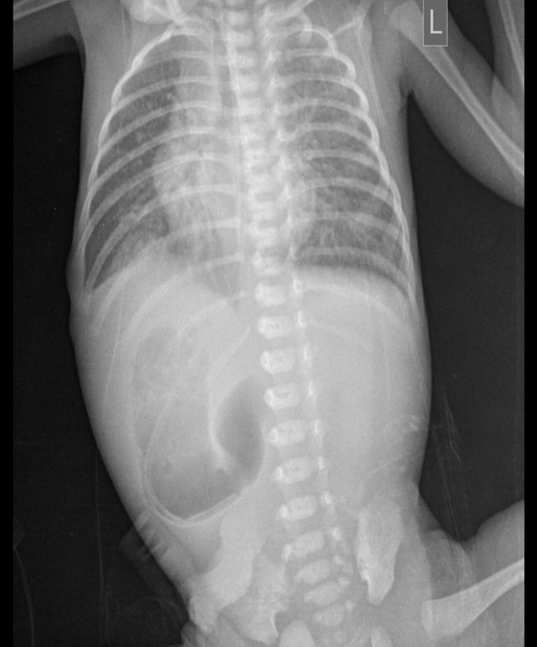
Chest X-Ray AP View
Chest x-ray shows gas shadow on the right side with distention of the stomach .
There is absence of the bowel gas in rest of the abdomen.

Slide 7
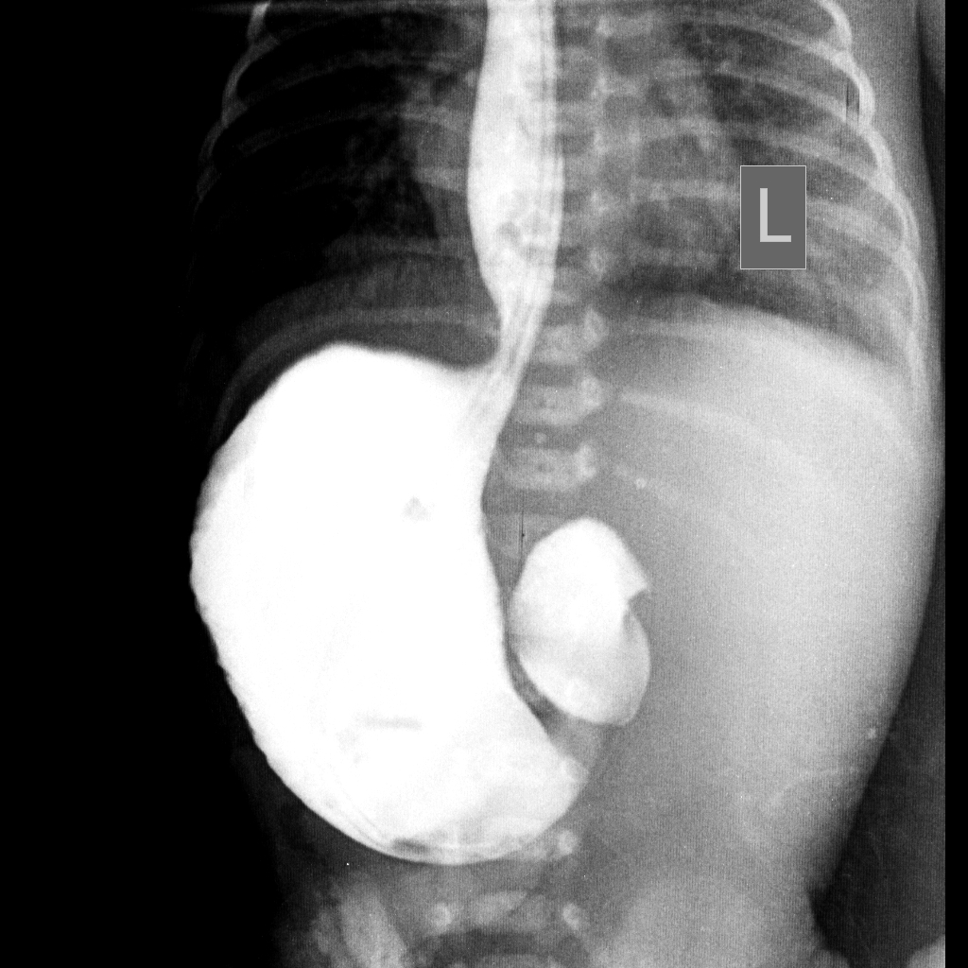
Radiographic Procedure
Radiographic meal and follow through study was done with Urograffin 60%.
Study shows stomach is on the right side and grossly distended.
Liver is seen on the left side.
Contrast is not passing to the duodenum with beak at the pylorus raised possibility of “Gastric Outlet Obstruction” or “Duodenal atresia”.

Slide 8
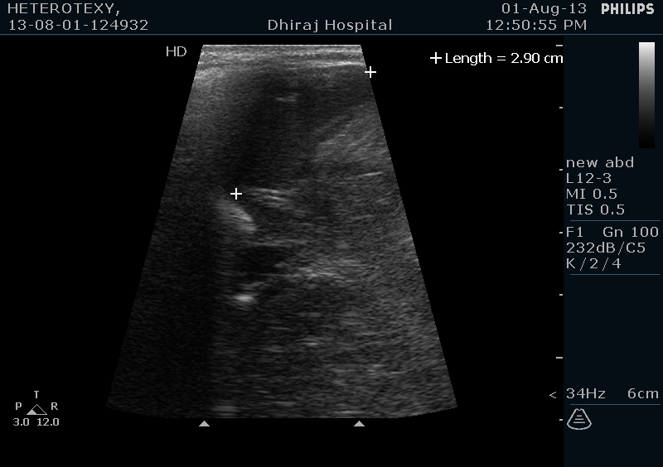
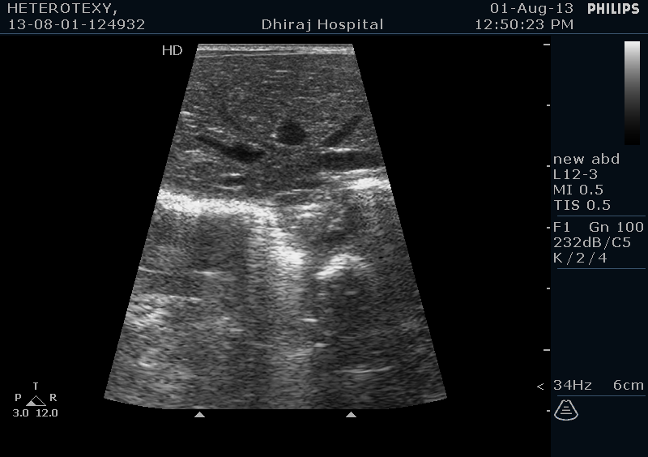
Ultrasonography
liver is on the left side with gall bladder is seen in midline position.
Spleen is on the right side.
Stomach is on the right side

Slide 9
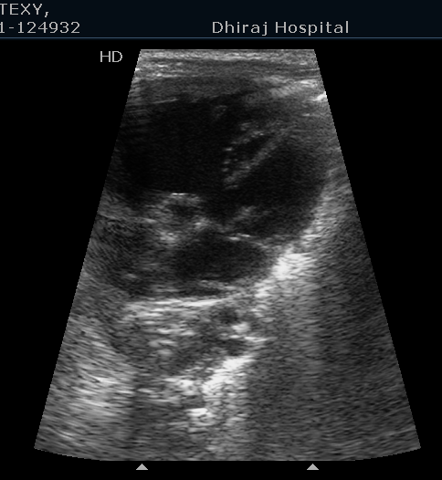
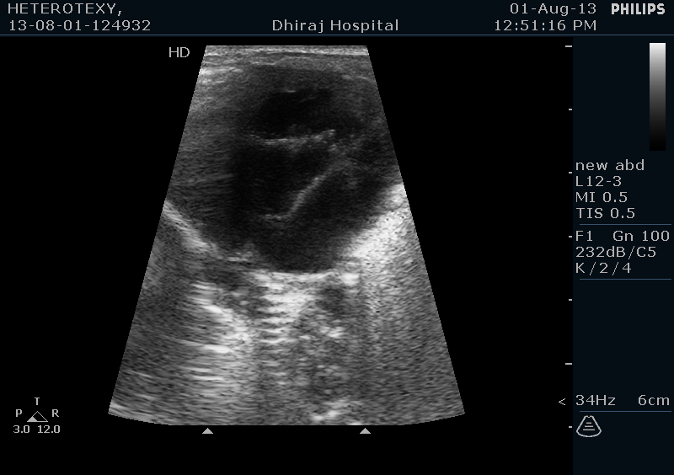
Atrial and ventricular septal defect noted.

Slide 10
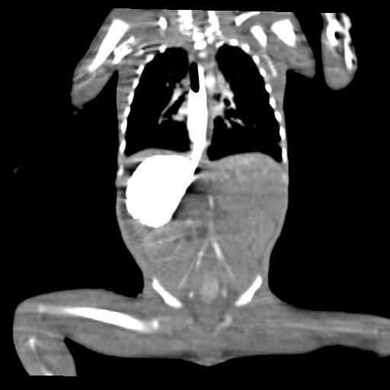
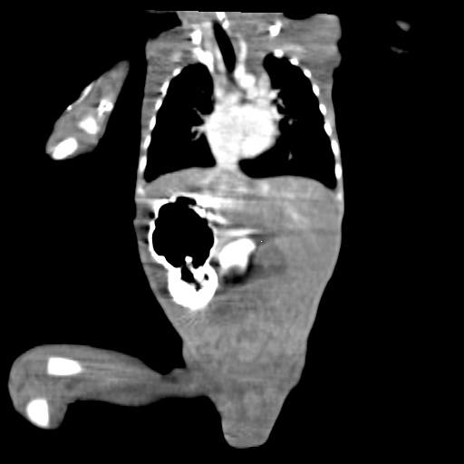
CT-Scan Thorax And Abdomen
Contrast is passed through esophagus to the stomach on the right side.
Contrast is not passed beyond the pylorus of the stomach.

Slide 11
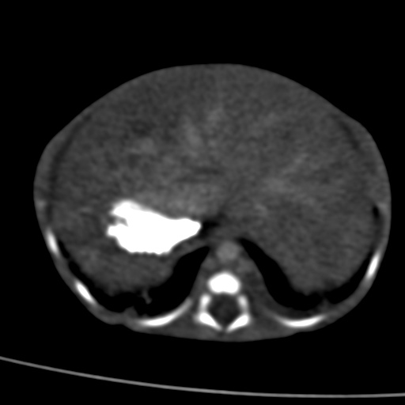
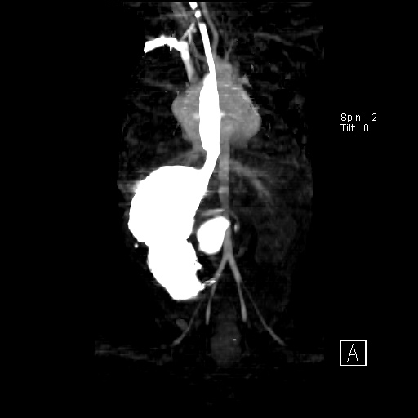
CT-Scan Thorax And Abdomen
Liver is on the left side with stomach is seen on the right side.
left

Slide 12
Discussion:
In this case report, we present an Heterotaxy Syndrome occurred in one day old female child who was born full term normal vaginal home delivery with low birth weight 1.6kg.
The patient was admitted with a history of difficulty in feeding, vomiting while feeding, meconium not passed. Also associated with cyanosis is found on the lips and under the fingernails.
Heterotaxy syndrome is a rare birth defect that is characterized by an abnormality where the internal thoraco-abdominal organs demonstrate abnormal arrangement across the left-right axis of the body.
There are different forms of Heterotaxy syndrome. All usually involve heart defects with other organs anomaly such as the stomach is on the right side, liver is either midline or on the

Slide 13
left side, gallbladder is midline, may be asplenia or polysplenia or spleen on the right side, may be associated with malrotation is in the form of intestinal obstruction or duodenal atresia.
The prognosis of each individual case depends mainly on the severity of the associated cardiac malformations, the occurrence of sepsis in case of asplenia, and acute abdominal complications due to malrotation of the intestine.
Treatment of Heterotaxy syndrome is done by surgery to correct the abnormalities. The type of heart surgery performed will be based on each child's particular heart problems like Fontan-type procedure Biventricular repair surgery will be needed to place the intestines into the proper position to prevent any blockage.

Slide 14
Conclusion
Any combination of abnormal position of abdominal and thoracic organs or venous anomalies should raise the suspicion of a Heterotaxy syndrome. Recent advances in investigation and management improvements in cardiac surgical skills and techniques occurring around the world, are likely to result in improvements in survival of these patients although still today there is high morbidity and mortality.

