Slide 1
Lateral pelvic wall
Dr. Kinjal Jethva
Assistant Professor
Department of Anatomy
S.B.K.S.M.I. & R.C.

Slide 2
The pelvis is divided by the plane of the pelvic inlet or pelvic brim, or superior aperture of the pelvis into two parts :
The upper part is known as the greater or false pelvis
The lower part is known as the lesser or true pelvis

Slide 3
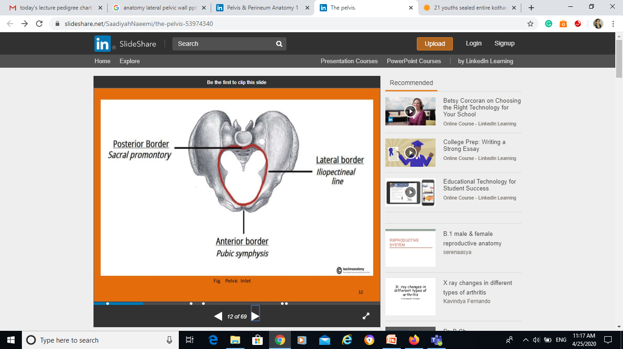
Division of pelvis

Slide 4
Pelvic walls
Anterior wall
Posterior wall
Inferior wall
Lateral wall

Slide 5
1. Anterior pelvic wall
Shallowest wall
Formed by posterior surface of:
Pubic rami
Symphysis pubis
Pubis bone

Slide 6
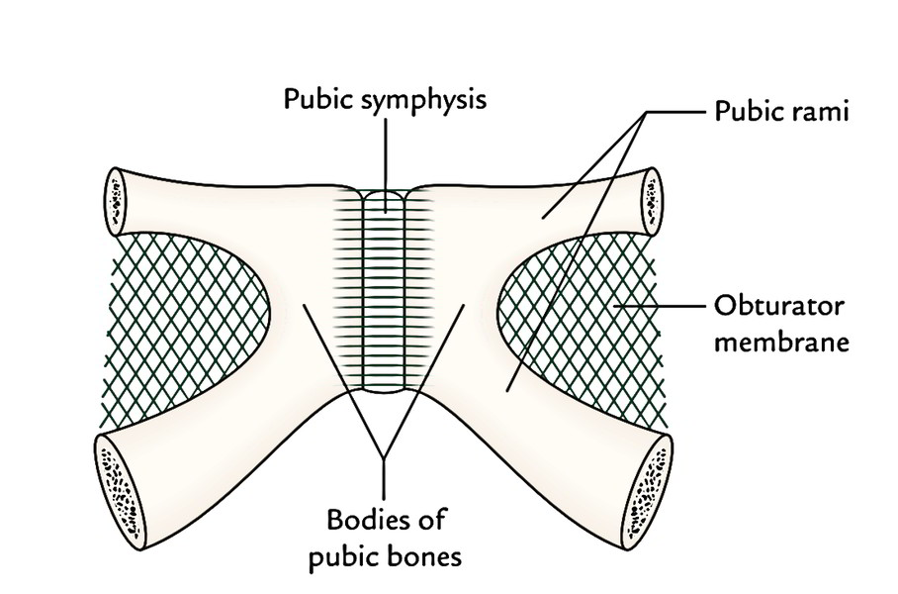
1. Anterior pelvic wall

Slide 7
2. Posterior pelvic wall
Formed by:
Sacrum
Coccyx
Piriformis muscle

Slide 8
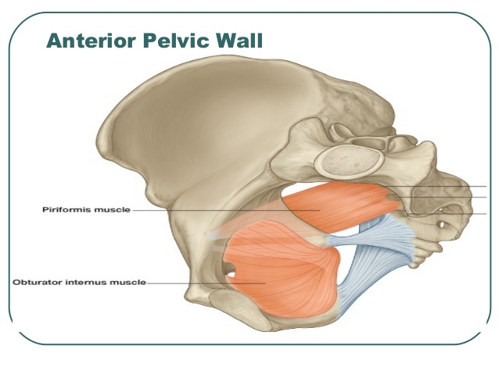
2. Posterior pelvic wall
Sacrum
Coccyx

Slide 9
3. Inferior wall (Pelvic floor)
Supports the pelvic viscera
Formed by pelvic diaphragm
In order to allow for urination, parturition(in female), and defecation

Slide 10
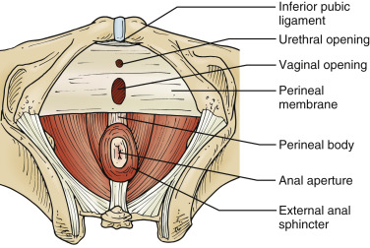
3. Inferior wall (Pelvic floor)

Slide 11
4. Lateral pelvic wall
Formed by:
Bones – sacrum and coccyx
Pelvic inlet below linea terminalis
Ligaments- Sacrotuberous ligament, Sacrospinous ligament, Obturator internaus ligament, Obturator membrane
Muscle- piriformis and obturator internus

Slide 12
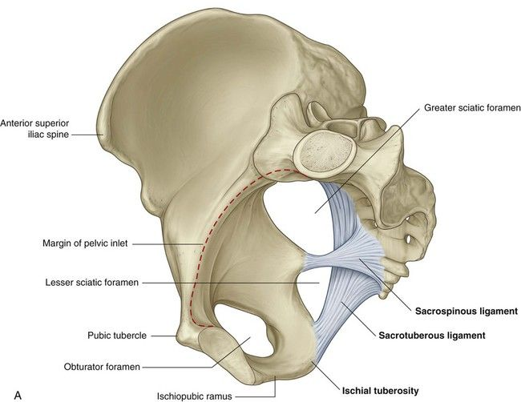
Ligaments
Sacrotuberous lig.
Sacrospinous lig.
Both will form the greater and lesser sciatic foramina

Slide 13
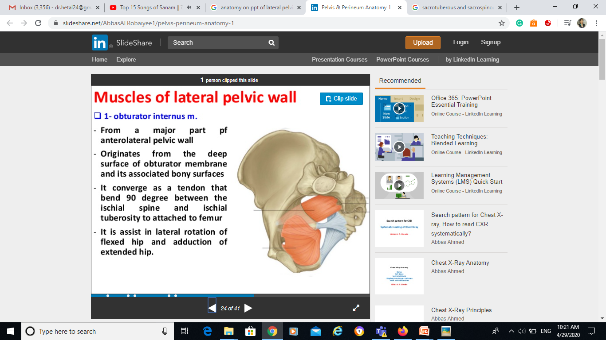
Muscle of lateral pelvic wall

Slide 14
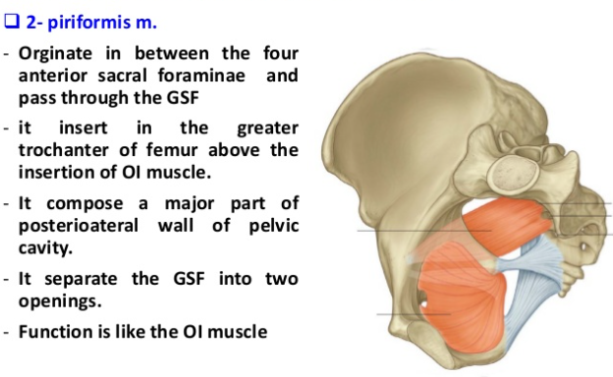
Muscle of lateral pelvic wall

Slide 15
Fascia of the Lateral Pelvic Wall
1. The fascia covering the muscles of the lateral pelvic wall is condensed to form thick and strong membranes.
2. The fascia covering the obturator internus is called the obturator fascia.
3. The fascia covering the piriformis is thin.

Slide 16
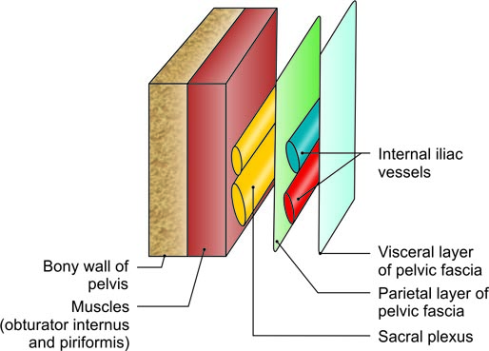
Arrangement of structures on the walls of true pelvis

Slide 17
Importance of lateral pelvic wall
Each ovary lies in the ovarian fossa on the lateral pelvic wall.
The ovarian fossa is bounded:
1. Anteriorly by the obliterated umbilical artery.
2. Posteriorly by the ureter and the internal iliac artery.

Slide 18
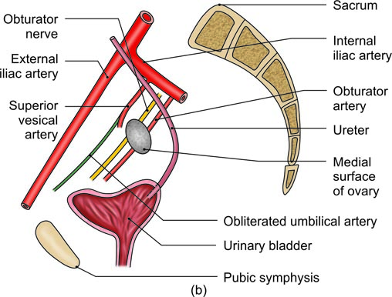
(b) Medial view of boundaries of the ovarian fossa as seen in a sagittal section

Slide 19
Common iliac artery
These are common terminal branches of the abdominal aorta
Beginning in front of L4 and end at the level of the lumbosacral intervertebral disc by dividing into the:
External iliac artery
Internal iliac artery

Slide 20
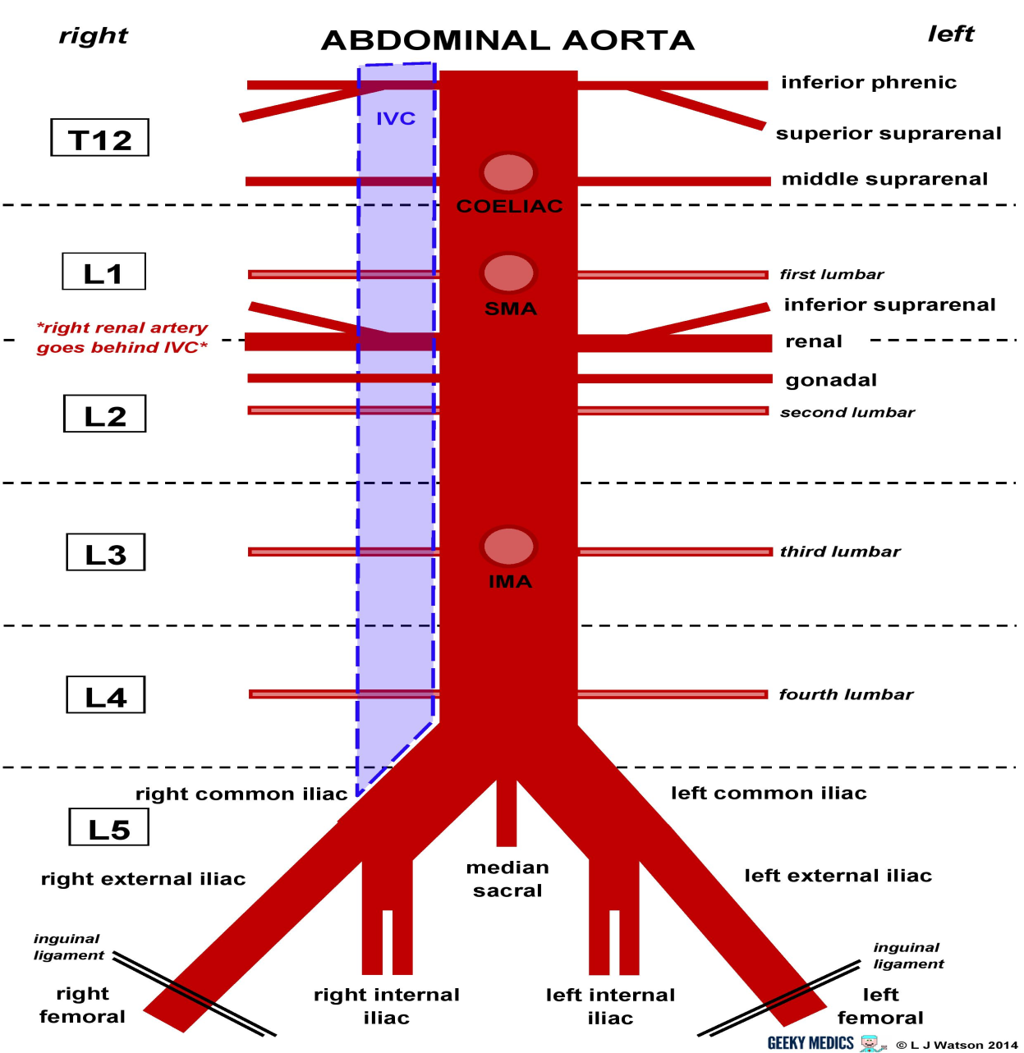
Branches of abdominal aorta

Slide 21
Internal iliac artery(IIA)
The internal iliac artery is the smaller terminal branch of the common iliac artery.
It is 3.75 cm long
It supplies:
The pelvic organs except those supplied by the superior rectal, ovarian and median sacral arteries
The perineum
The greater part of the gluteal region
The iliac fossa.

Slide 22
Course of IIA
Course:
Begins in front of the sacroiliac joint, it lies medial to the psoas major
Ends near the upper margin of the greater sciatic notch by dividing into:
Anterior division
Posterior division

Slide 23
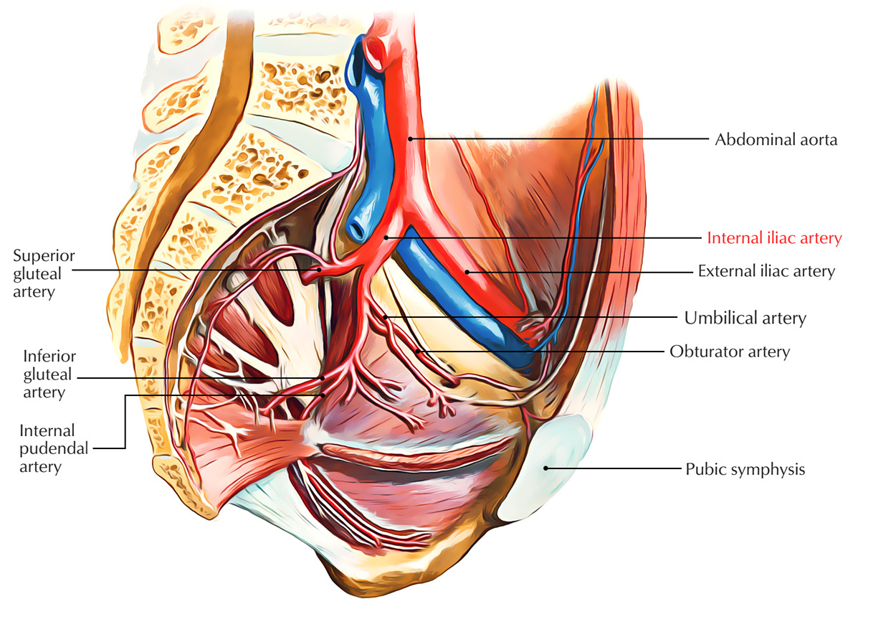
Course and relation of IIA

Slide 24
Relation of IIA
Anteriorly- to the ureter
Posteriorly- to the internal iliac vein, lumbosacral trunk, and sacroiliac joint
Laterally- to the external iliac vein and obturator nerve
Medially- to the peritoneum and tributaries of the internal iliac vein

Slide 25
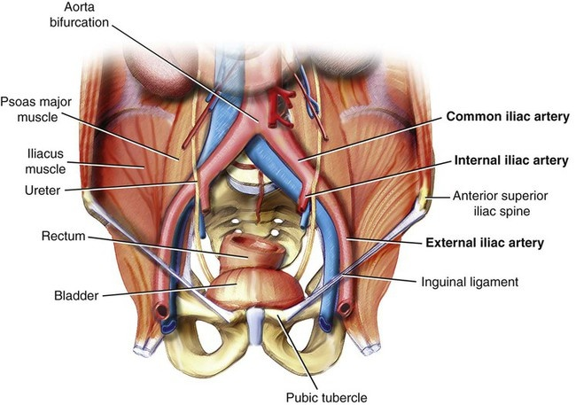
Relation of IIA

Slide 26
Branches
From anterior division:
Superior vesical artery
Obturator artery
Middle rectal artery
Inferior vesical artery in male(vaginal in female)
Inferior gluteal artery
Internal pudendal artery
Uterine artery in female only

Slide 27
Branches
From posterior division:
Iliolumbar artery
2 lateral sacral artery
Superior gluteal artery

Slide 28
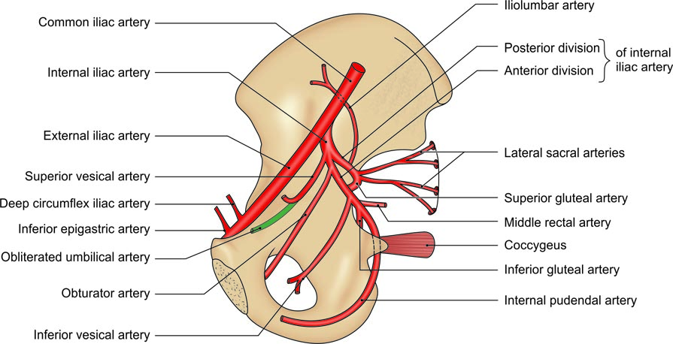
Branches of the right internal iliac artery in a male

Slide 29
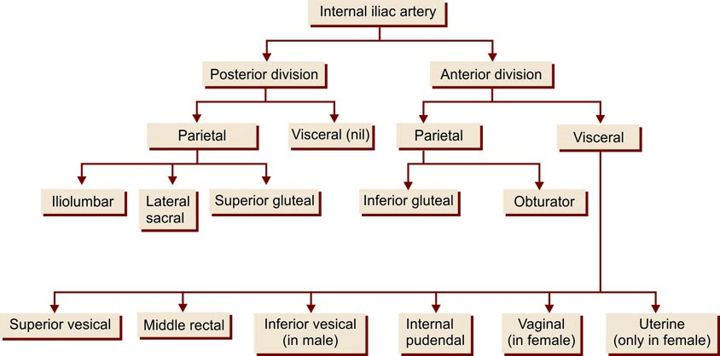
Branches of internal iliac artery

Slide 30
Branches from anterior division of IIA
Superior vesical artery- supplies superior surface of urinary bladder and muscular wall of vas deference
Obturator artery- gives branch to the obturator internus and iliacus muscle and also to adductor group of the thigh
Middle rectal artery- supplies muscles coat of prostate, seminal vesicals and rectum

Slide 31
Branches from anterior division of IIA
4. Inferior vesical artery in male- supplies prostate, seminal vesicals, urinary bladder and lower part of ureter(vaginal in female- supplies vagina and base of bladder)
5. Inferior gluteal artery- braches to gluteal region in lower limb
6. Internal pudendal artery- supplies the perineum and external genitalia
7. Uterine artery in female – supplies the vagina, uterus and medial 2/3rd part of oviduct

Slide 32
Branches from posterior division of IIA
Iliolumbar artery- iliac branch supplies iliacus muscle and lumbar branch supplies psoas, quadratus lumborum and erector spinae
Lateral sacral artery- supplies cauda equina and muscle of back of sacrum
Superior gluteal artery- supplies muscles of gluteal region(gluteus medius and minimus)

Slide 33
SACRAL PLEXUS
Formation
The sacral plexus is formed by the lumbosacral trunk and the ventral rami of the first to third sacral nerves, and part of the fourth sacral nerve.

Slide 34
Lumbosacral trunk- is formed by the descending branch of the ventral ramus of nerve L4 and the whole of L5
Lumbosacral trunk in front of sacroiliac joint joins with nerve S1

Slide 35
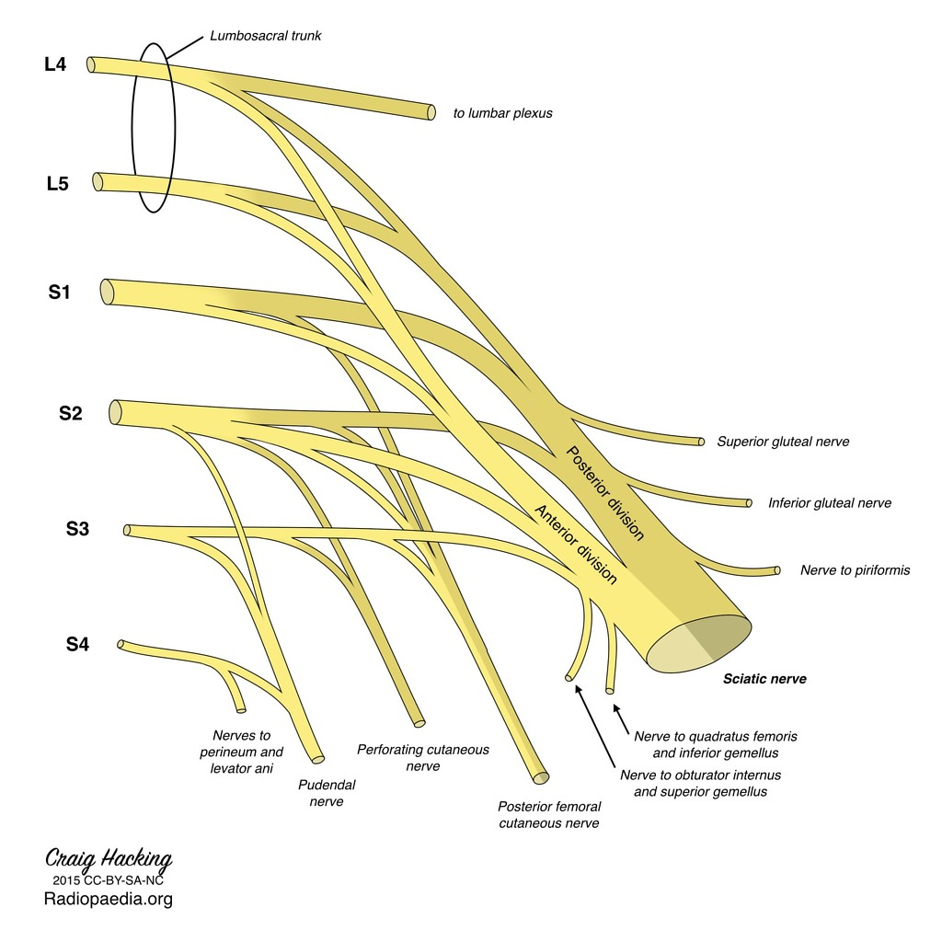
Sacral plexus

Slide 36
Branches
Branches derived from both dorsal and ventral divisions are as follows:
1. Sciatic nerve: 2 components
Common peroneal nerve - arises from dorsal divisions of L4, L5, S1, S2. It supplies evertors of foot and dorsiflexors of ankle joint.
Tibial nerve- arises from ventral divisions of L4, L5, S1, S2, S3. It supplies the hamstring muscles, all muscles of calf and intrinsic muscles of the sole.
2. Posterior cutaneous nerve of thigh: Dorsal divisions of S1, S2 and ventral divisions of S2, S3.

Slide 37
Branches from Dorsal Divisions
1. Superior gluteal nerve: L4, L5, S1.
2. Inferior gluteal nerve: L5, S1, S2.
3. Nerve to piriformis: S1, S2.
4. Perforating cutaneous nerve: S2, S3.

Slide 38
Branches from Ventral Division
1. Nerve to quadratus femoris: L4, L5, S1.
2. Nerve to obturator internus: L5, S1, S2.
3. Pudendal nerve: S2, S3, S4: Supplies sphincter ani externus and all muscles in urogenital triangles.
4. Muscular branches to the levator ani, the coccygeus and the sphincter ani externus, including perineal branch of nerve S4.
5. Pelvic splanchnic nerves: S2, S3, S4.

Slide 39
Muscular branches
Nerve S4- supplies to the levator ani or iliococcygeus part and the coccygeus or ischiococcygeus
Perineal branch of the S4- supplies to middle part of the sphincter ani externus, it also supplies the skin between the anus and the coccyx.

Slide 40
THANK YOU

