Slide 1
Sphenoid lateral spontaneous cephalocele
- Dr. Vishal Bharadava

Slide 2
Clinical Presentation
A 80 years-old female, with clinical history of hypertension and diabetes, was brought to our hospital after suffering a facial injury after falling while cleaning her bathtub.
No episode of unconsciousness or any other neurological symptom was referred.
Physical examination demonstrated Glasgow 15/15, orbital edema and a left frontal hematoma.

Slide 3
Non-enhanced computer tomography (CT) demonstrated no traumatic craniofacial complications, beyond a periorbital hematoma. Incidentally a skull defect was found in the grater wing of the left sphenoid bone, with a posterior cortical rupture and protrusion of intracranial through the defect. [Fig. 1 a, b]
Magnetic Resonance (MR) was made to confirm CT findings. MR showed an skull expansive defect in the left grater wing sphenoid bone, with a posterior cortical discontinuity through which cerebrospinal fluid, hyperintense in T2-weigthed images and hypointense in FLAIR and T1-w images, and the anterior pole of the temporal lobe, isointense to cerebral parenchyma in all sequence, herniates.

Slide 4
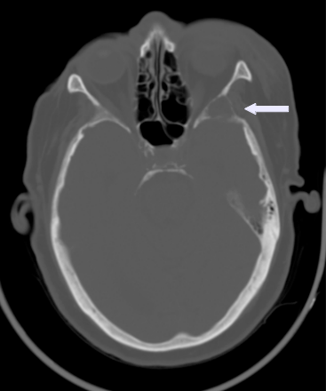
Non-enhanced CT
Bone window. skull lytic expansive defect in the grater wing of the left shenoid bone with posterior cortical rupture.

Slide 5
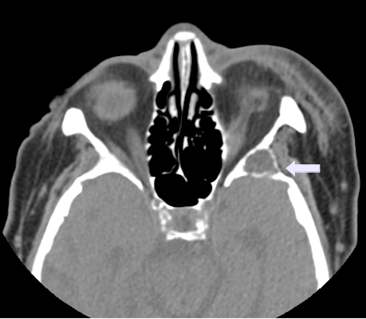
Non-enhanced CT.
Soft tissue window. (black arrow) skull lytic expansive defect in the grater wing of the left shenoid bone with heterogeneous center and posterior cortical rupture.

Slide 6
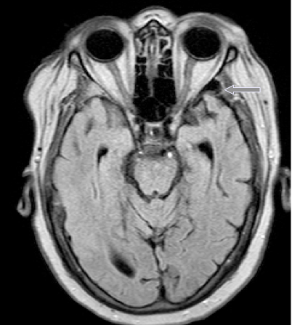
Magnetic resonance
FLAIR, Axial. Isointense anterior temporal lobe, surrounded by CSF, protrudes through the cortical defect in the grater wing of the let sphenoid bone.

Slide 7
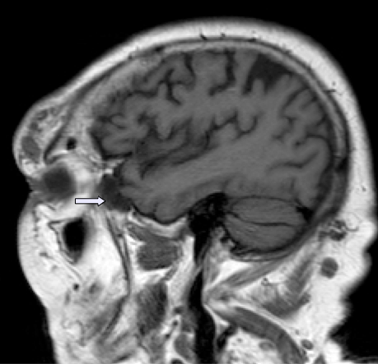
Magnetic resonance
T1-w images. Sagital. Hypointense CSF, and isointense brain parenchyma protrudes through the skull defect.

Slide 8
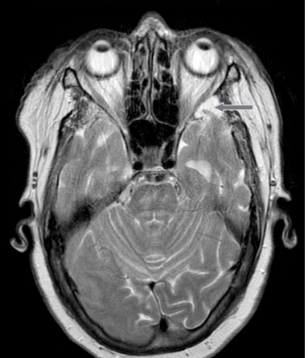
Magnetic resonance
T2-weighted images. Axial. Isointense anterior temporal lobe, surrounded by hyperintense CSF, protrudes through the cortical defect in the grater wing of the let sphenoid bone.

Slide 9
Differential Diagnosis
Sphenoid defect in neurofibromatosis type 1
Sphenoid lateral spontaneous cephalocele type 1

Slide 10
Conclusion
CT and MR are complementary imaging technic and is recommended to use both for presurgical evaluation. CT angiography is needed to demonstrate relationship of dural sinuses to bony defect. Untreated lesions can associate to headache and seizures, and increase risk for meningitis, SLSC type 2 can be treated medical o surgical if symptoms are present, since it can also be an incidental finding with no treatment needed as our case.

Slide 11
THANK YOU

