Slide 1
Ganglion, De Quervain’s Tenosynovitis, Trigger Finger
Dr Dhruv Sharma
Associate Professor
Dept of Orthopaedics
Dhiraj Hospital, SBKS MIRC
SUMANDEEP VIDYAPEETH

Slide 2
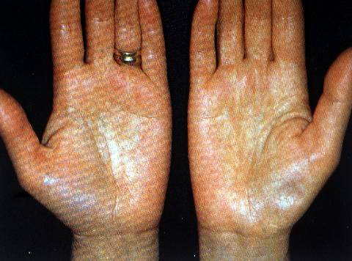
INTRODUCTION
Common hand problems

Slide 3
Function of the hand
Motor
grasp
pinch - tip pressure
- pulp pressure
- lateral pressure
hook

Slide 4
Function of hand sensory
stereognosis (position ,size, shape,etc.)
Pinprick
light touch

Slide 5
Rapid assessment of hand function
space and stability
open and close
pinch and touch

Slide 6
Muscles of the hand
Three group of muscles act on the fingers
long flexors
long extensors
intrinsic muscles

Slide 7
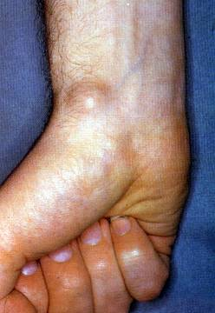
Ganglion
        cystic swelling in the neighbourhood of
        tendon or joint

Slide 8
Ganglion pathology
wall
lining
content
uni.. or multilocular cyst

Slide 9
Ganglion formation
large no. of closely packed cells
formation of cavity
mucoid degeneration ? ischemia

Slide 10
Ganglion site
60-70% dorsal wrist ganglion
(scapholunate joint)
18 -20% volar ganglion
10 - 20% in the flexor sheath

Slide 11
Ganglion treatment
conservative
surgical

Slide 12
Carpal Tunnel Syndrome (CTS)
        The entrapment of the median
        nerve at the fibro osseous
        tunnel of the carpus.

Slide 13
CTS
Aetiology
Decrease in the size of the canal
osteoarthritis
trauma
acromegaly

Slide 14
CTS
Aetiology 2
increase in the size of its contents
pregnancy
rheumatoid arthritis
alcoholism
tumour
idiopathic

Slide 15
CTS
Clinical Picture
patients in their 40s
female > male
pain (nocturnal)
numbness
clumsiness

Slide 16
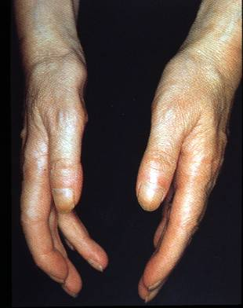
CTS signs
wasting of thener eminence
numbness
weakness
Tinnel sign
Phalen sign

Slide 17
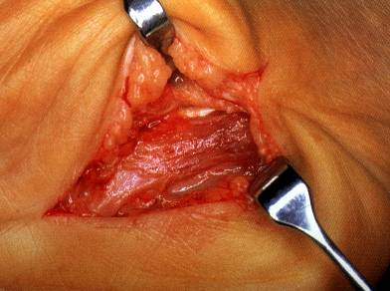
CTS
Treatment
non operative
splint
steroid injection
surgical decompression
arthroscopic
open

Slide 18
De Quervains Disease
Stenosing tenovaginitis of the first dorsal extensor compartment

Slide 19
de Quervain’s Tenosynovitis
de Quervain’s Tenosynovitis occur when there is inflammation and/or entrapment of extensor pollicis brevis (EPB) and abductor pollicis longus (APL) tendon.
It is precipitated by repetitive wrist motion, especially thumb flexion combined with ulnar deviation of the wrist.

Slide 20
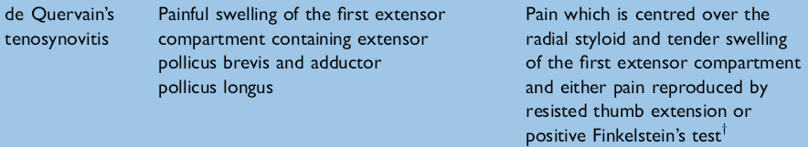


Slide 21
SYMPTOMS & SIGN
Pain and swelling about the region of the radial styloid,especially during grasping movement with the thumb.
Finkelstein’s test involves actively flexing the thumb into the palm while making a closed fist, while having the examiner passively deviate the wrist in an ulnar direction.

Slide 22
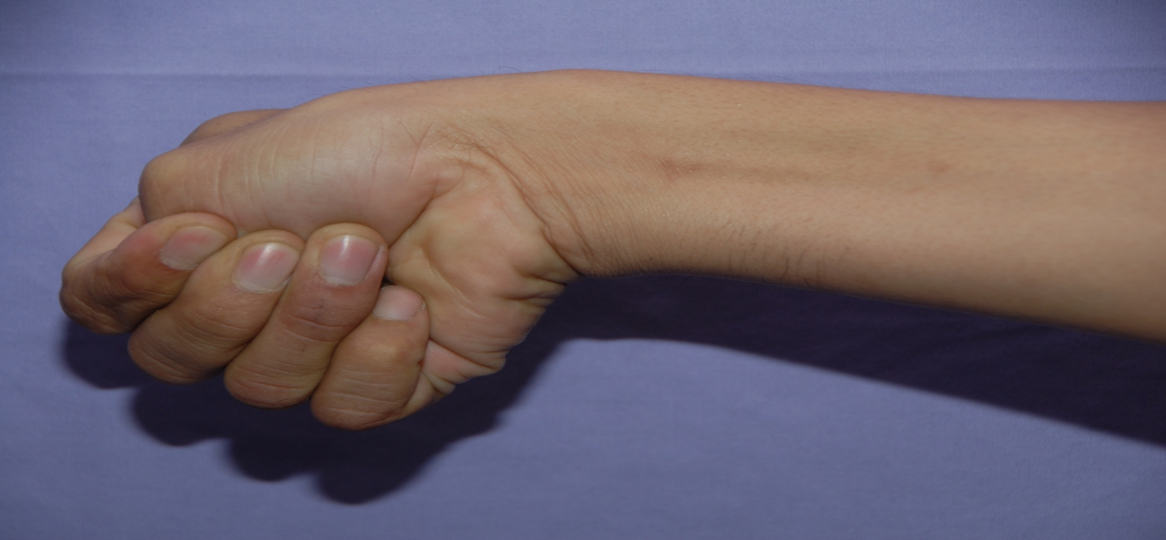
Demonstration of Finkelstein’s test with the thumb in the palm and the wrist ulnarly deviated.

Slide 23
De Quervain’s
Treatment
non operative
rest
steroid injection
anti-inflamatory
operative

Slide 24
TREATMENT
Acute therapies can involve ice applicaion for 15 minutes every 6 hours or NSAIDS.
Rest.
Modalities.
Thumb spica splint or buddy taping thumb to index finger for resting APL and EPB tendon.
Analgesics.
Steroid injection.

Slide 25
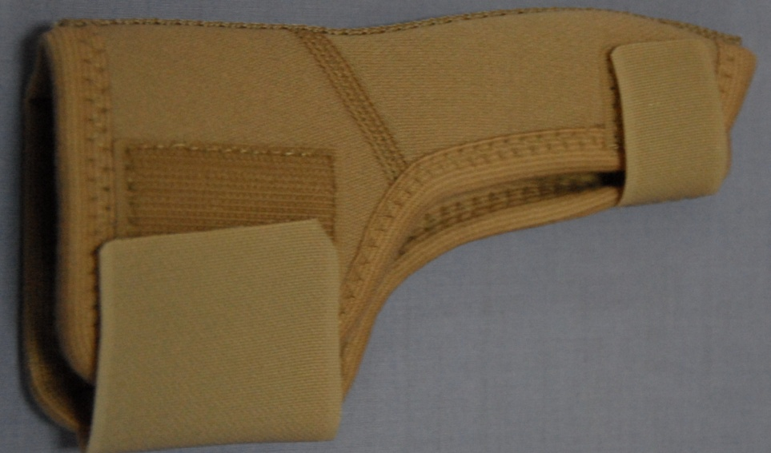
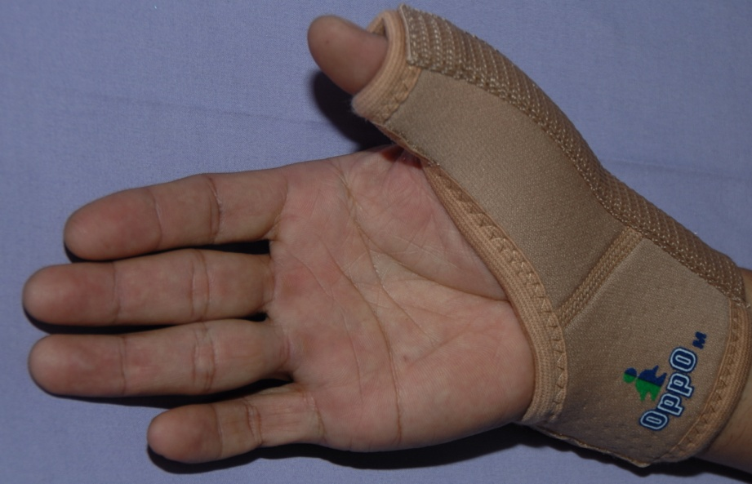
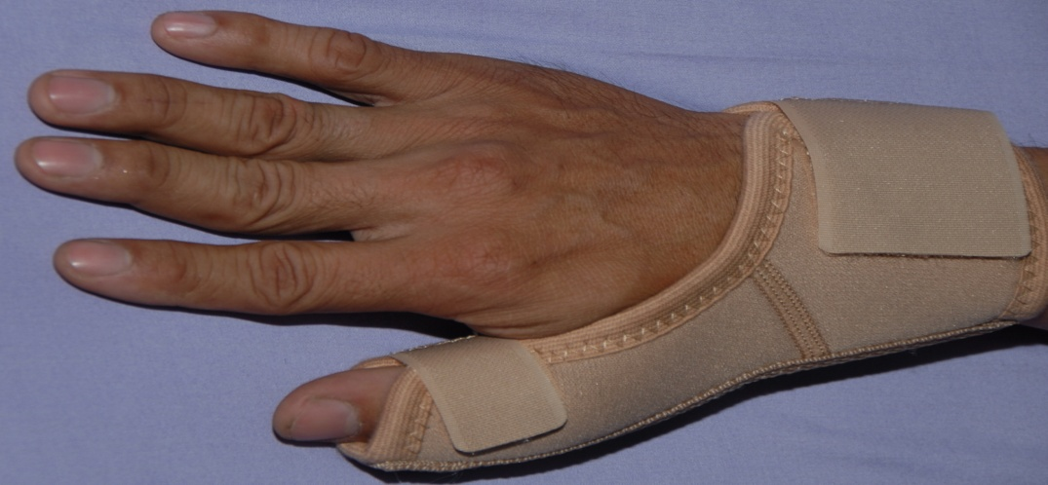

Slide 26
Author / Year | Study | Level | Results | Conclusion
Alexander Scheller, Ralph Schuh, [...], and Alexander Schuh /2009 October ; 33(5) ; 1301-1303 | Retrospective | III | There were six perioperative complications, including one superficial wound infection, one delayed wound healing, and four transient lesions of the sensory branch of the radial nerve. A successful outcome defined as absence of triggering and pain, both subjectively and on examination, was achieved in all cases. All patients had complete relief of symptoms and returned to their normal daily activities. Finkelstein’s test was negative in all cases. There were no sensory deficits of the superficial radial nerve. Four patients had mild pain but normal function of the hand not related to the operative procedure. In all cases a cosmetically acceptable scar could be found. | The evaluation and treatment of de Quervain’s tenosynovitis has evolved since the description by de Quervain in 1895. Nonoperative treatment was felt early on to be unsuccessful, with surgical operative decompression of the first dorsal compartment being uniformly recommended.Meanwhile, several authors published anatomical variations of the first extensor compartment. The accurate injection of triamcinolone into the sheath of both the extensor pollicis brevis and abductor pollicis longus tendon was considered very effective for DD in a recent study.

Slide 27
Trigger Fingers
stenosing tenovaginitis of the
flexor tendon sheath(A1 pulley)

Slide 28
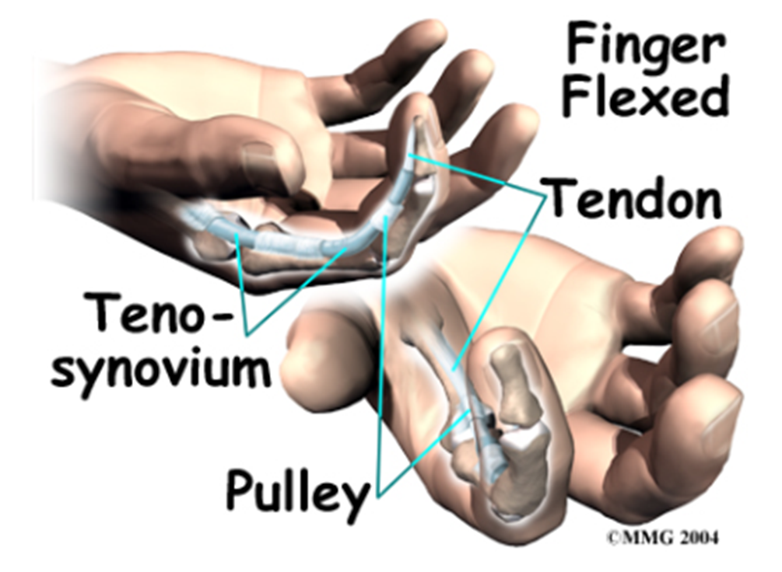
Trigger Finger
Notes:
Trigger finger and trigger thumb, also known as “stenosing tenosynovitis,” are conditions affecting the movement of the tendons as they bend the fingers or thumb toward the palm of the hand. Triggering is usually the result of a thickening in the tendon that forms a nodule, or knob. The pulley ligament may thicken as well. The constant irritation from the tendon repeatedly sliding through the pulley causes the tendon to swell in this area and create the nodule. Rheumatoid arthritis, partial tendon lacerations, repeated trauma from pistol-gripped power tools, or long hours grasping a steering wheel can contribute to the development of trigger finger. Infection or damage to the synovium causes a rounded swelling (nodule) to form in the tendon.

Slide 29
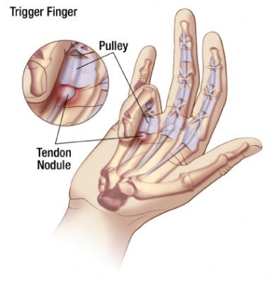
Trigger Finger
Notes:
Trigger finger may be caused by highly repetitive or forceful use of a finger or thumb. Medical conditions that cause changes in tissues -- such as rheumatoid arthritis, gout, or diabetes -- also may result in trigger finger. Prolonged, strenuous grasping, such as with power tools, also may aggravate the condition. Farmers, industrial workers, and musicians can be affected by trigger finger since they rely on their fingers or thumbs for multiple repetitive movements. Trigger finger is more common in women than in men and tends to occur most frequently in people who are between 40 and 60 years of age.

Slide 30
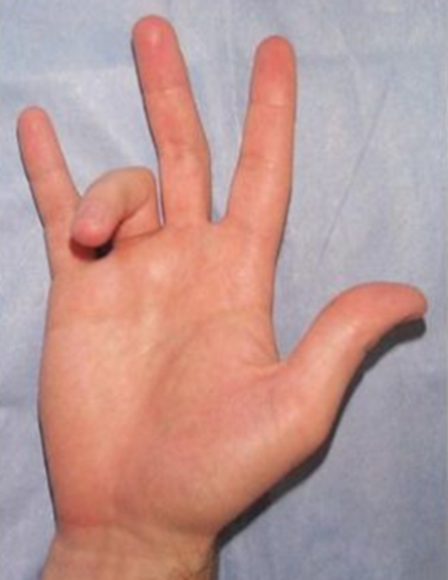
Trigger Finger Symptoms
Notes:
Here is a photograph of illustrating the posture that the finger is stuck in with trigger finger. As you can see, the finger is stuck in a flexed position. The nodule has been pulled through

Slide 31
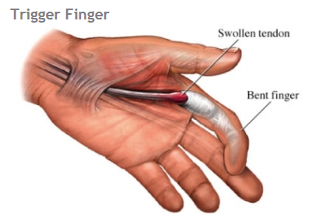
Notes:
Symptoms occur when there is a size mismatch between the flexor tendons of the fingers or thumb and the sheath which surrounds the tendons. Instead of gliding smoothly through the sheath, the tendons can meet resistance within the tight sheath, which can be painful. Some patients report “catching” or “clicking” of the finger with attempts at motion. Some people may feel a tender nodule or "bump" in the palm at the base of the finger/thumb where a portion of the tendons and sheath are thickened and firm. In severe cases, the finger can become stuck or "locked" in flexion, requiring the person the straighten the finger with the other hand. The affected tendons are tough, fibrous bands of tissue that connect the muscles of the forearm to your finger and thumb bones. Together, the tendons and muscles allow you to bend and extend your fingers and thumb, for example, as in making a fist.

Slide 32
Trigger Finger aetiology
congenital (thumb)
    often not recognised until toddlers
    30% resolve spontaneously
acquired (middle aged)
    idiopathic
    traumatic
    diabetes
    rheumatoid

Slide 33
Trigger Finger treatment
non operative
    steroid injection
operative
    release of A1 pulley

Slide 34
MCQ 1
DeQuervain’s Tenosynovitis is due to inflammation of tendons:
EPB & APL
EPL & APB
EPL & EPB
APL & APB
None of the above

Slide 35
MCQ 2
Which test is diagnostic for DeQuervain’s Tenosynovitis?
Watson’s test
Finkelstein’s test
Tinel’s test
Jobe’s test
Neer’s test

Slide 36
MCQ 3
Which are the treatment modalities for DeQuervain’s tenosynovitis?
Steroid injection
Surgical excision
All of the above
None of the above
Thumb brace

Slide 37
MCQ 4
For DeQuervain’s tenosynovitis, Steroid injection can be given maximum
Once
Twice
Thrice
Four times
Five times

Slide 38
MCQ 5
Which nerve is in relation to DeQuervain’s release
Superficial radial nerve
Median nerve
Ulnar nerve
Posterior interosseous nerve
Radial nerve

