Slide 1
Pediatric fractures
Lateral condylar fractures of the humerus
Dr. Manish Shah
Associate Professor
Dept of Orthopaedics, Dhiraj Hospital
SBKS MIRC, Sumandeep Vidyapeeth
Vadodara

Slide 2
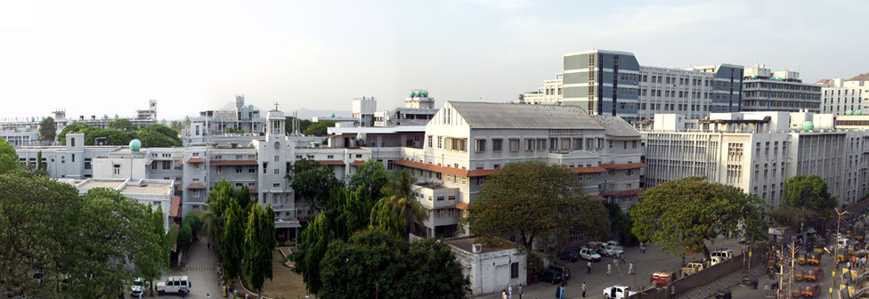
ACKNOWLEGMENTS
Dr. Vrisha Madhuri
Prof and Head
Paediatric Orthopaedic Unit
Christian Medical College Vellore

Slide 3
Lateral condyle fractures
Peak at 6 years of age
Nearly 17% of all distal humerus fractures and 10-15% of elbow injuries

Slide 4
Easily missed
Why?
Minimal symptoms
Bonesetters

Slide 5
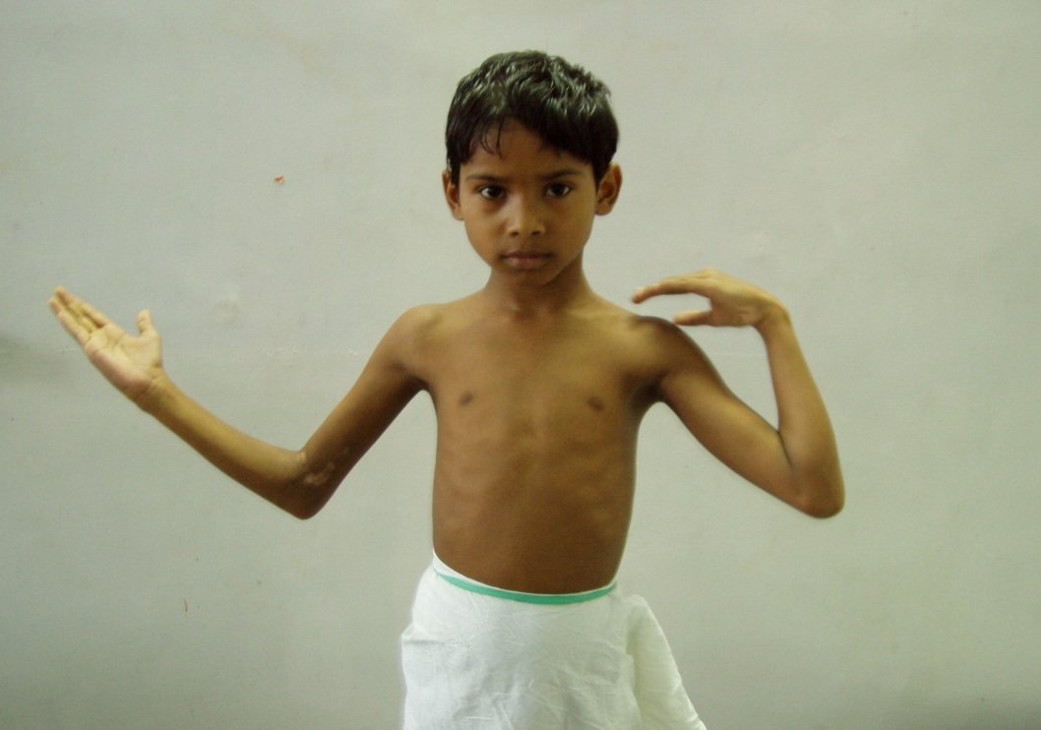
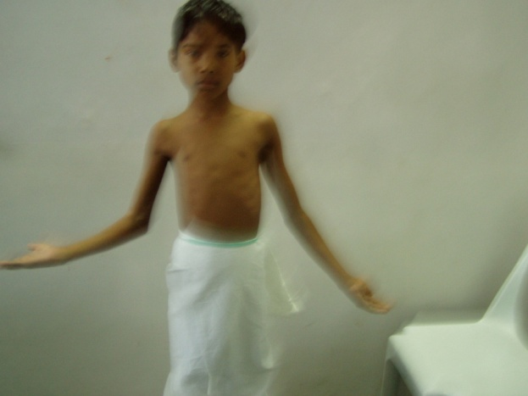
Does it really matter?
Late or improper reduction
stiffness and deformity with loss of function which is not surgically correctable

Slide 6
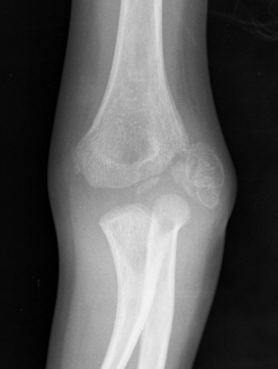
Anatomical Classification
Milch 1
Milch 1

Slide 7
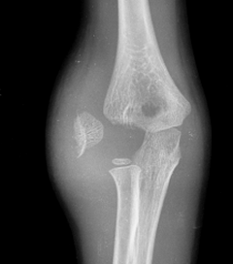
Milch 2

Slide 8
Does elbow stability correspond to classification Mirsky et al
Milch classifcation did not correspond to operative findings in 52%
Milch type 1 may exit medial to capitellum
Milch type 2 may be extraarticular exiting medial to trochlear physis
Notes:
Mirsky et al found that in 52% of their cases Milch classification did not correspond to the operative findings Some of the Milch I exited lmedial to capitellum and were unstable and some of type 2 were extraarticular exitinf medial to trochlear epiphysis
Mirsky et al found that in 52% of their cases Milch classification did not correspond to the operative findings Some of the Milch I exited lmedial to capitellum and were unstable and some of type 2 were extraarticular exitinf medial to trochlear epiphysis

Slide 9
Stages of displacement
Minimally displaced, articular surface intact seen in 1 or both view
Fracture complete, displaced more than 2 mm (2-4 mm), shift of olecranon
Rotation and displaced proximal and lateral, shift of olecranon and radial head
Jakob, Fowles and Rang JBJS 975
What makes these stable?
Notes:
Jakob, Fowles and Rang in JBJS 1975
Badelon further divided in to with less than 2 mm displacement
Seen in 1 view and seen in both views
Kamegaya soowed on mRI studies that 5 out of 12 minimally displaced had crossed the physis and entered in to joint space

Slide 10
Role of Soft tissues in stability
Stable
Soft tissue swelling minimal, localised to lateral side
Unstable
Extensive soft tissue swelling, pain, crepitus on movement
Even if radiologically undisplaced can displace later
Notes:
In unstable tear between the brachiradialis and ECRL and capsule also torn

Slide 11
MRI-
  OCCULT FRACTURES REVEALED (7/9 WITH EFFUSION ON XRAY - #)
  Acta Radiol. 2005 Pudas T, Hurme T, Mattila K, Svedstrom E.
  stability in minimally displaced lateral humeral condyle fracture can be assessed by MRI.
  Kamegaya M et al, J Pediatr Orthop. 1999
  Fractures of the lateral humeral condyle: lateral cartilage hinge central to fracture stability.
  J Pediatr Orthop. 2002 Horn BD, et al

Slide 12
Undisplaced or up to 2 mm displacement /soft tissue stable
Treat conservatively with posterior slab for 3 weeks
X-rays at 3 days to 1 week interval mandatory

Slide 13
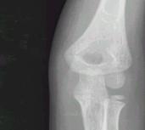
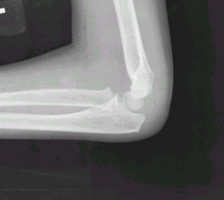
Undisplaced- Fracture line seen in 1 view

Slide 14
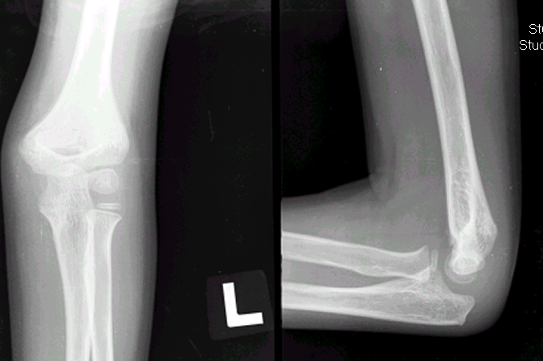
3 weeks later

Slide 15
Seen in both views but no shift of olecranon

Slide 16
6 weeks later
Notes:
4 sets of xrays done

Slide 17
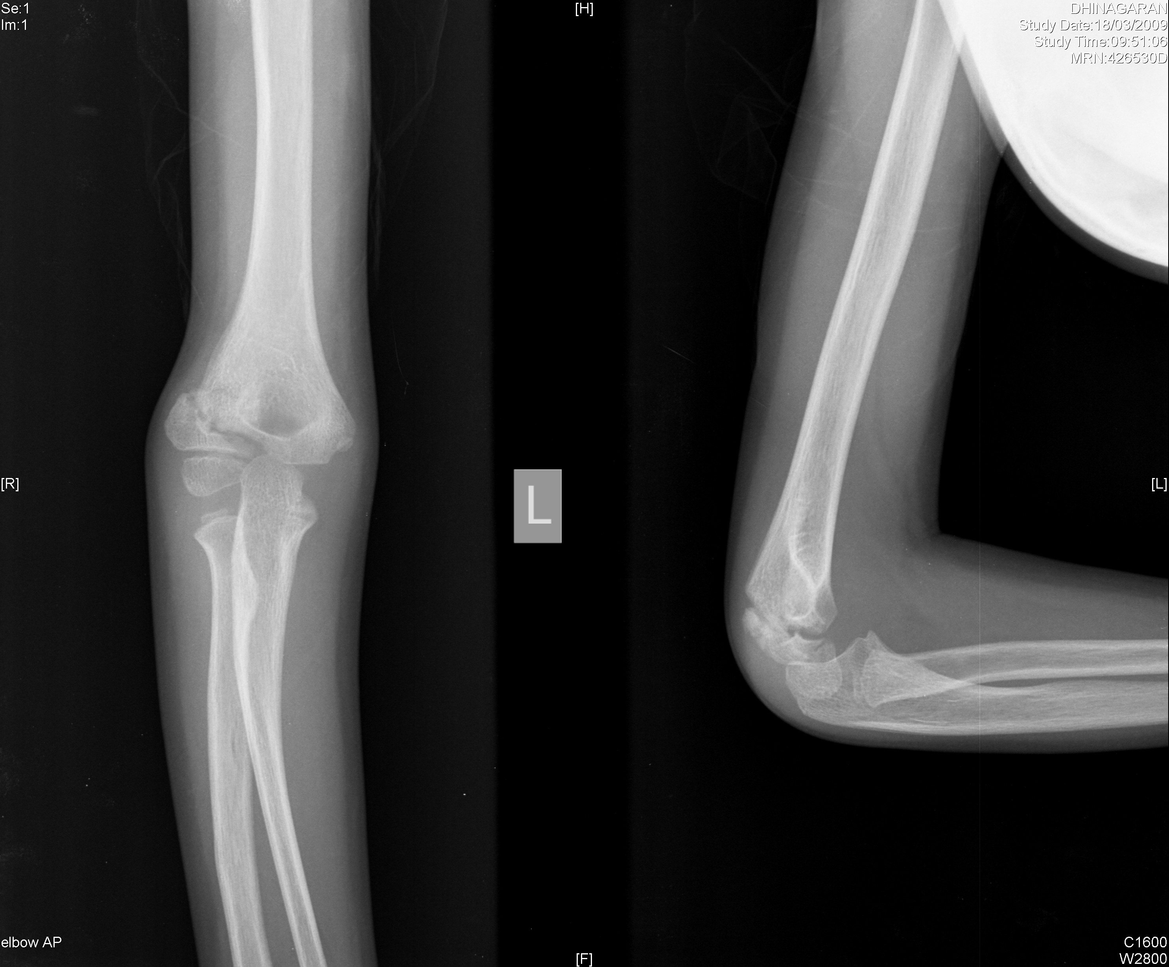
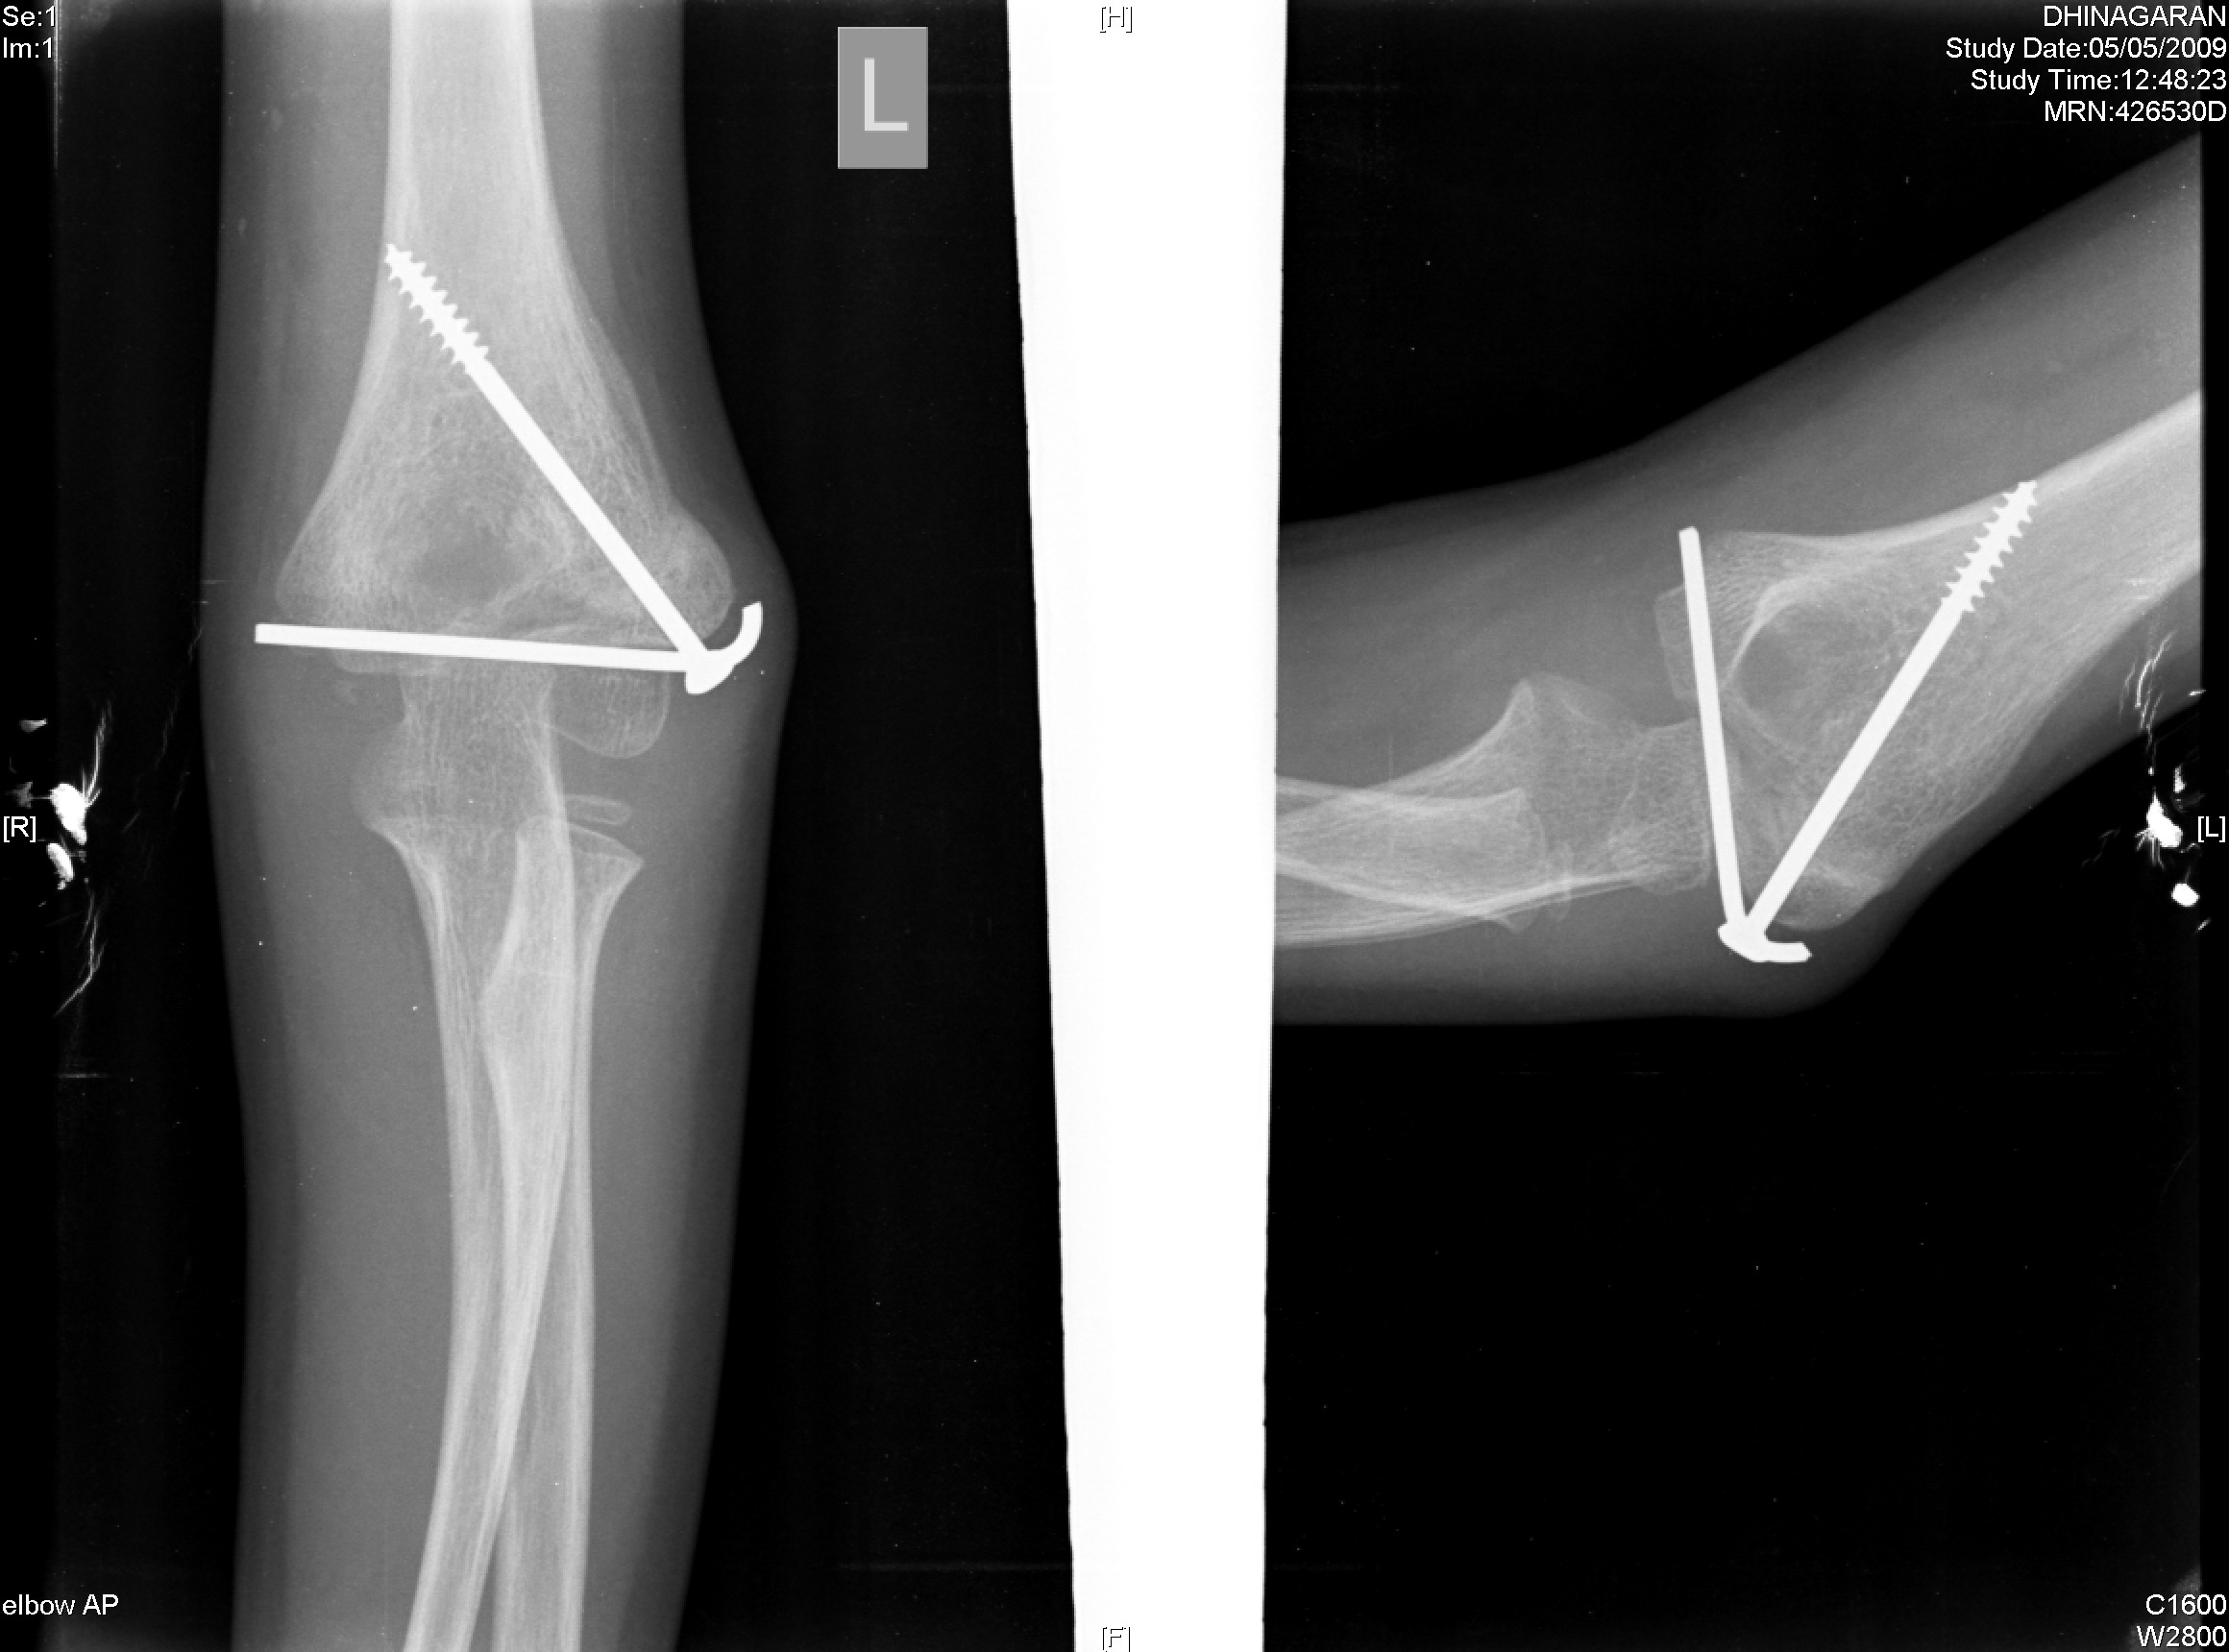
Type 2

Slide 18
Closed reduction and pinning
In stage 2 only if closed reduction possible and joint is congruous

Slide 19
Closed reduction and pinning
An arthrogram may be required
Closed reduction achieved by supination and extension of elbow, valgus stress may be required

Slide 20
Approach
Lateral
Open capsule and assess reduction
anteriorly
Posterolateral
Posterior

Slide 21
Method of fixation
Smooth pins
2 pins
Placement in metaphyseal fragment crossing at the lateral edge
If metaphyseal fragment small, place Screw across the physis
Older child
Notes:
Recommended by Jeffery 1958, problems of screw backing out, limitation of elbow movement

Slide 22
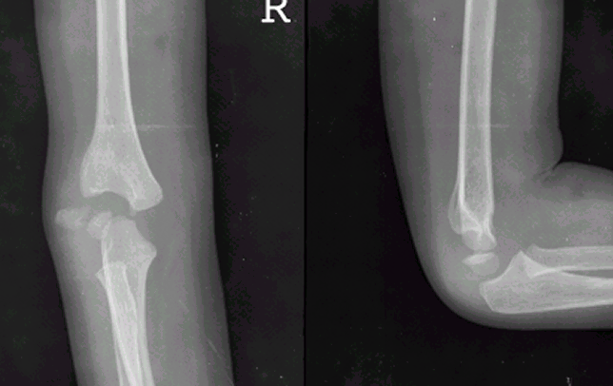
Displaced and rotated

Slide 23
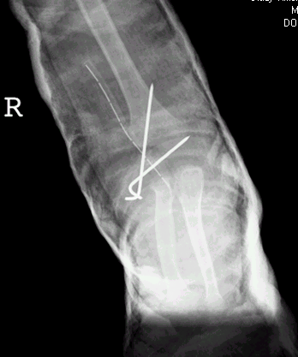
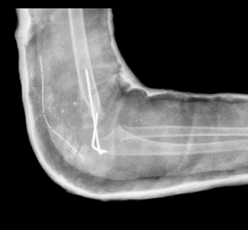
Open reduction and pinning

Slide 25
Timing of pin removal
3 weeks
Or
After bony union

Slide 26
Nonunions

Slide 27
Challenges in children
Growth
Deformity
Differential growth of the fragments
Vascularity
Avascular necrosis of epiphyseal fragments
Hyperemia adjacent to growth plates
Size

Slide 28
Clinical features
Good ROM
Flexion deformity
Cubitus valgus deformity

Slide 29
Non union of lateral condyle
Mild loss of range of motion but function well
Many documented cases over 50 years with good function
84 year follow up -- Smith JBJS 1973
50 year follow up -- Kalenak Clin Orthop 1977

Slide 30
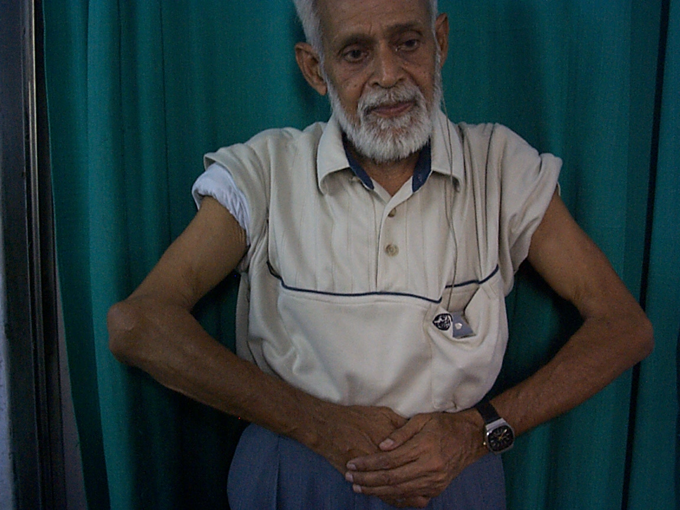
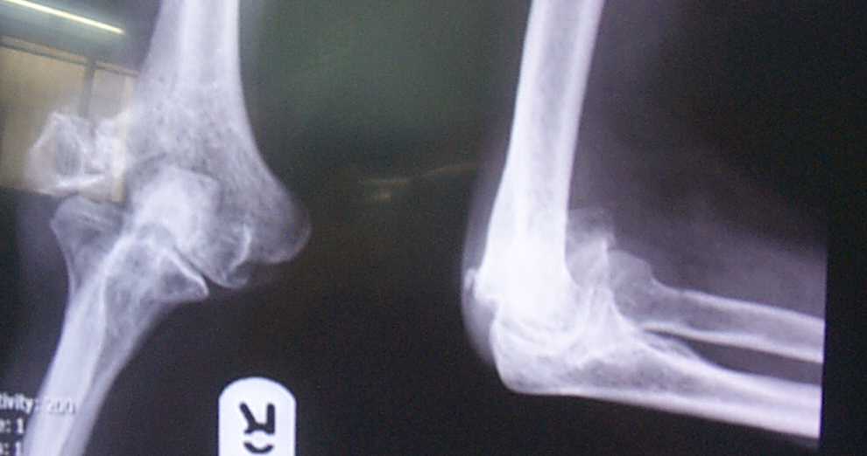
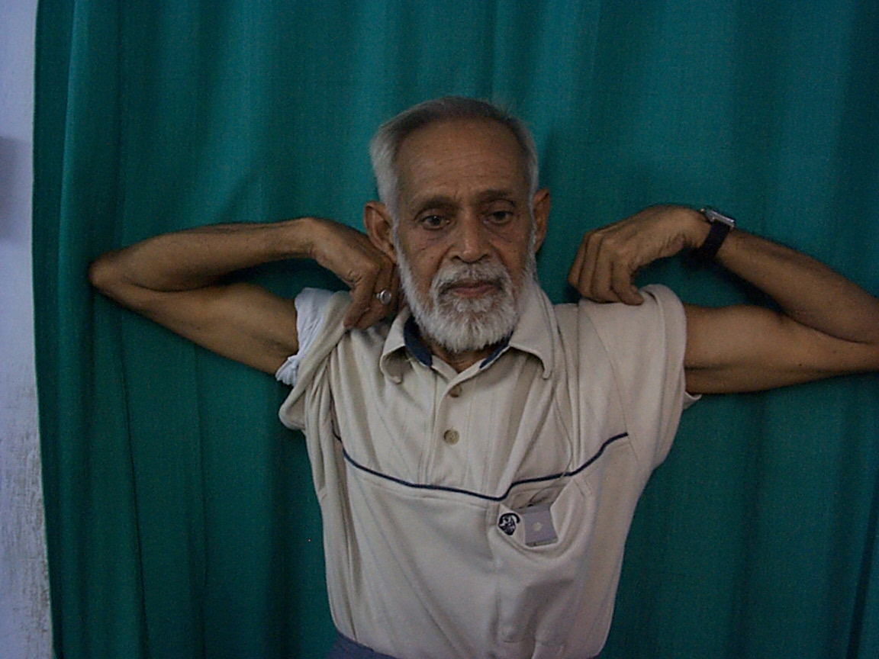
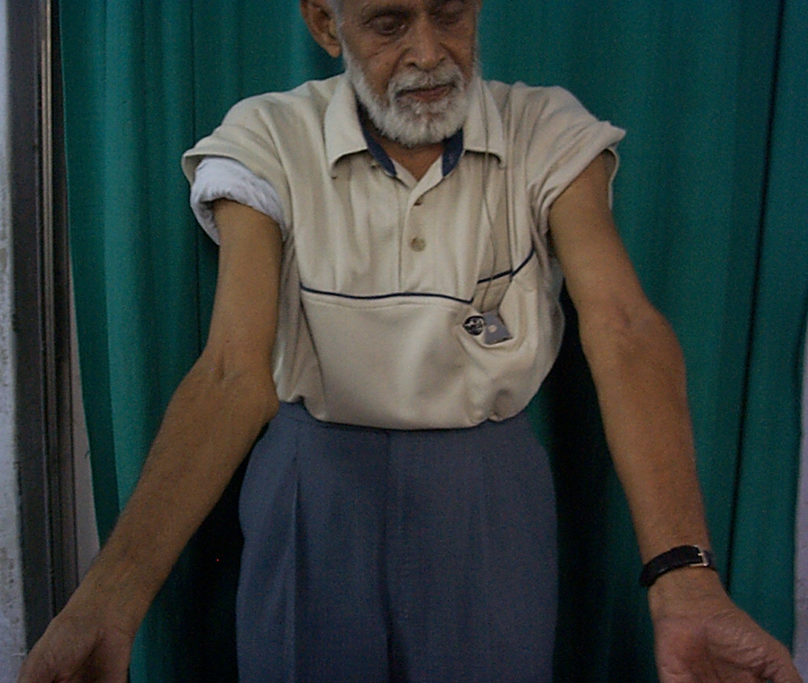

Slide 31
Nonunion of lateral condyle - sequelae
Cubitus valgus
More in Milch type 2 - type 1 the lateral crista of trochlea is intact
Fragment migrates proximally and laterally with lateral translocation of proximal radius and ulna

Slide 32
Nonunion of lateral condyle - sequelae
Tardy ulnar palsy
Takes many years to develop.
Mean interval 22 years in Gay and Love’s series. 30 to 40 years in Miller’s series

Slide 33
Long term follow up
Milch Type 1 – have more pain
Milch Type 2 - have more ulnar nerve symptoms
  Toh et al 2002

Slide 34
Management options
Treat tardy ulnar nerve palsy if functional limitations of elbow not severe
No treatment or treatment after skeletal maturity
      Beaty 1985
      Blount et al 1954
      Canale et al 1968
      Conn and Wade 1961

Slide 35
Management options
Corrective osteotomy and ORIF
16 out of 17 good and excellent result following ORIF +/- supracondylar osteotomy
Shimada 2002

Slide 36
Role of osteotomy Kim et al 2005

Slide 37
Dome
Osteotomy
Tien 2005

Slide 38
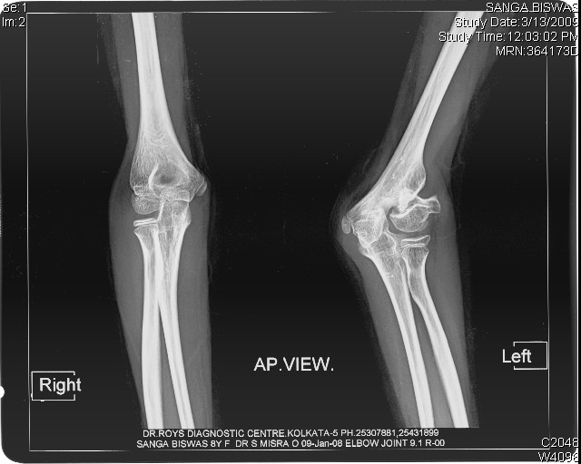
ORIF with osteotomy

Slide 39
ORIF with osteotomy

Slide 40
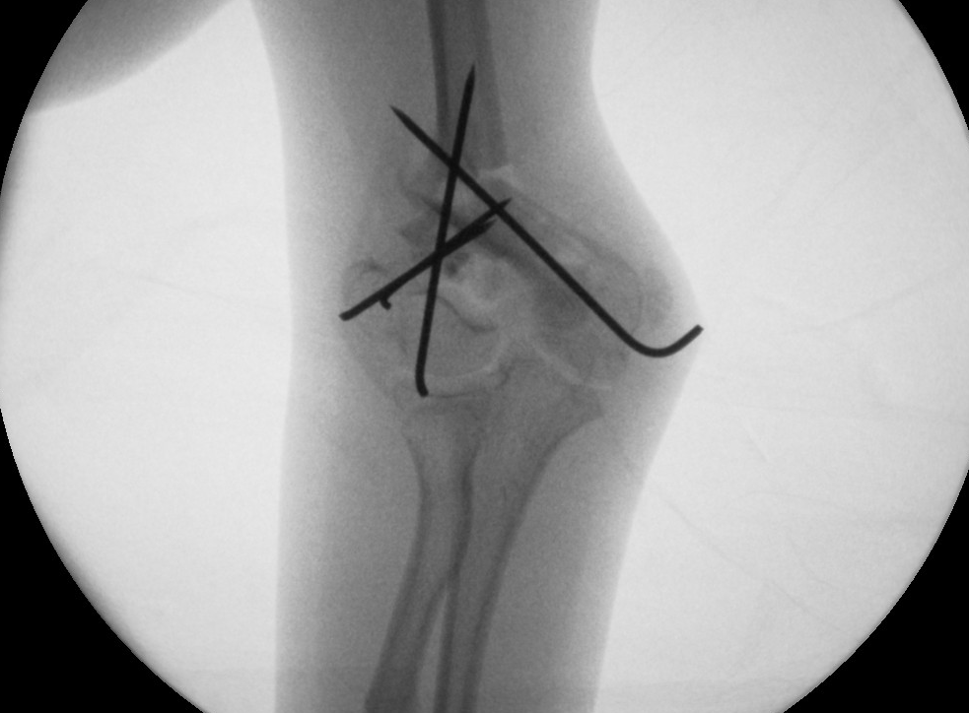

Slide 41
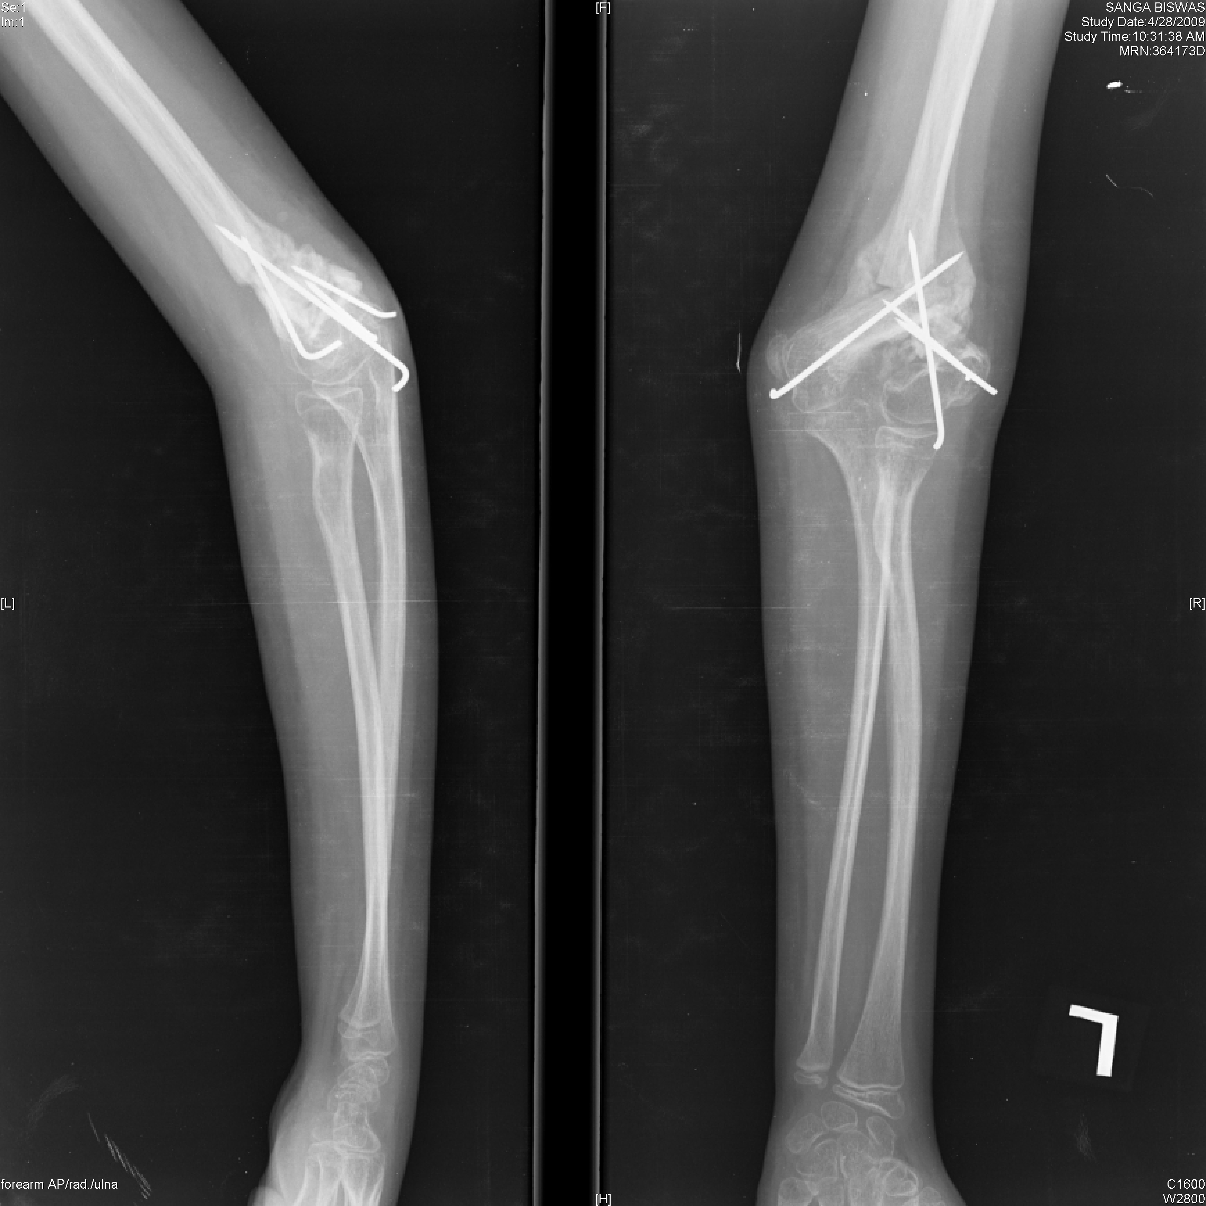
2 months postop

Slide 42
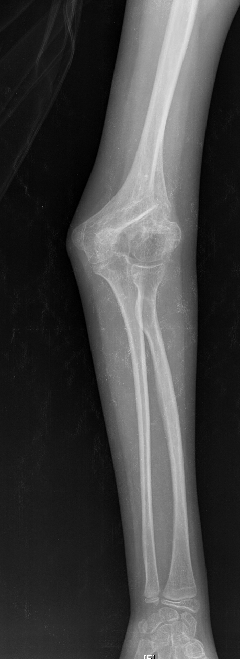
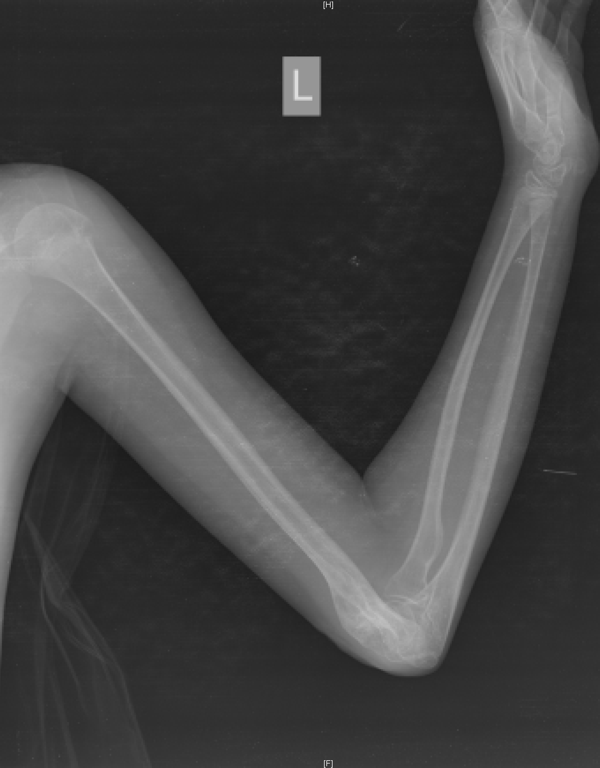
Good option when dealing with severe cubitus valgus & instability

Slide 43
Minimal displacement
No valgus deformity and no angulation
Asymptomatic or weakness of the elbow during high performance activity
Metaphyseal part can be fixed with extrarticular dissection and metaphyseal bone graft and screw fixation.
Articular part is not dissected

Slide 44
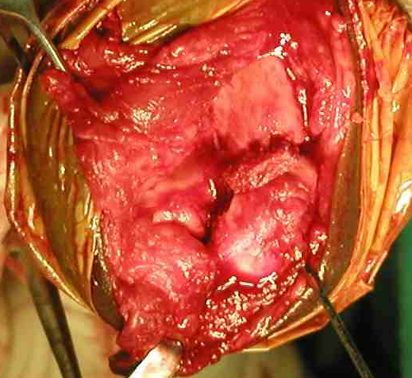
Non union of mildly displaced condyle
Treatment of (minimally displaced) nonunions in childhood 9 months to 3 years after the fracture
Flynn and Richards JBJS 1971

Slide 45
Moderate to severe displacement
With proximal migration
Distal fragment is displaced enough to allow cartilaginous surface to oppose bony surface of the humeral metaphysis
Valgus deformity of the elbow

Slide 46
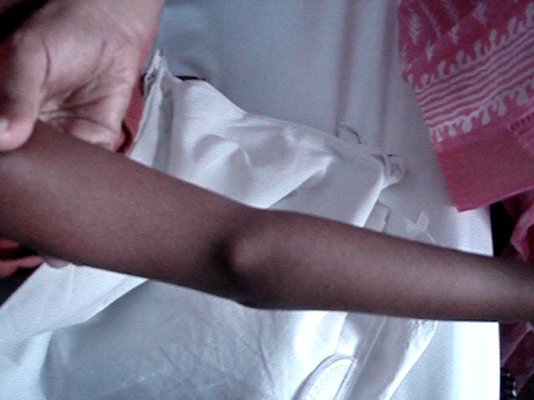
Rotating condyle test

Slide 47
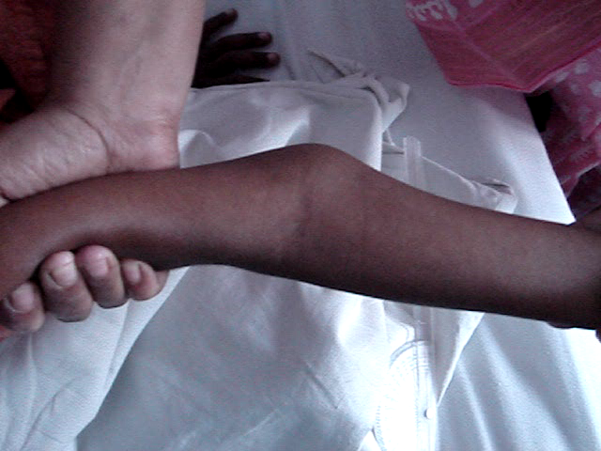
Instability

Slide 48
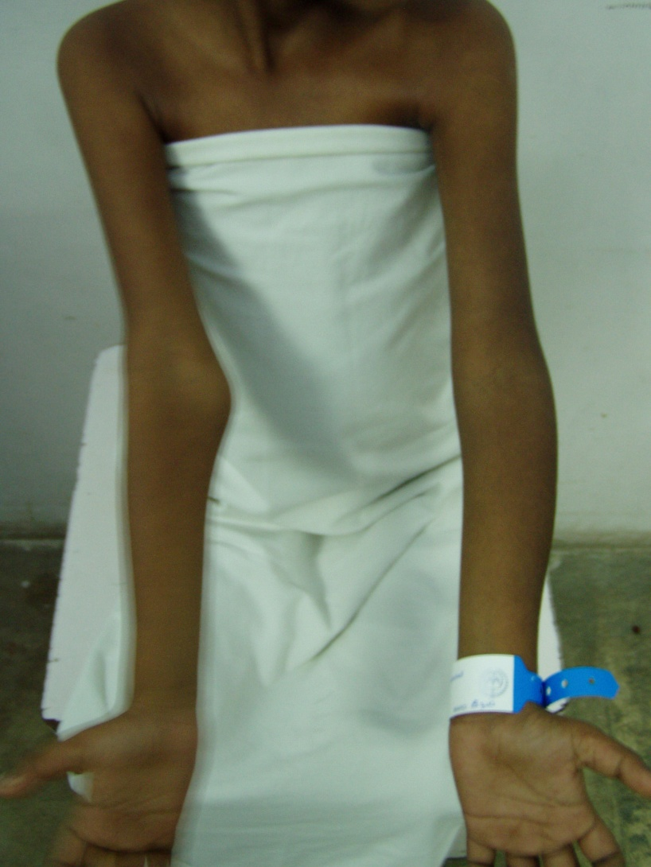
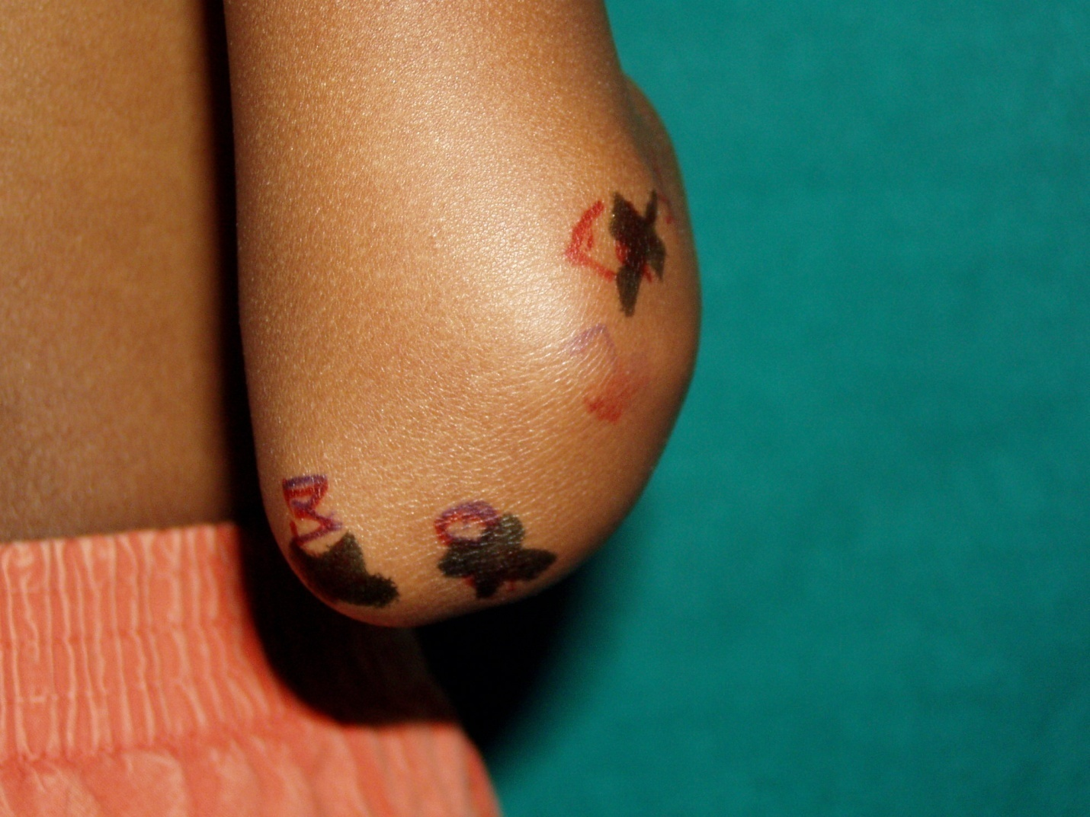

Slide 49
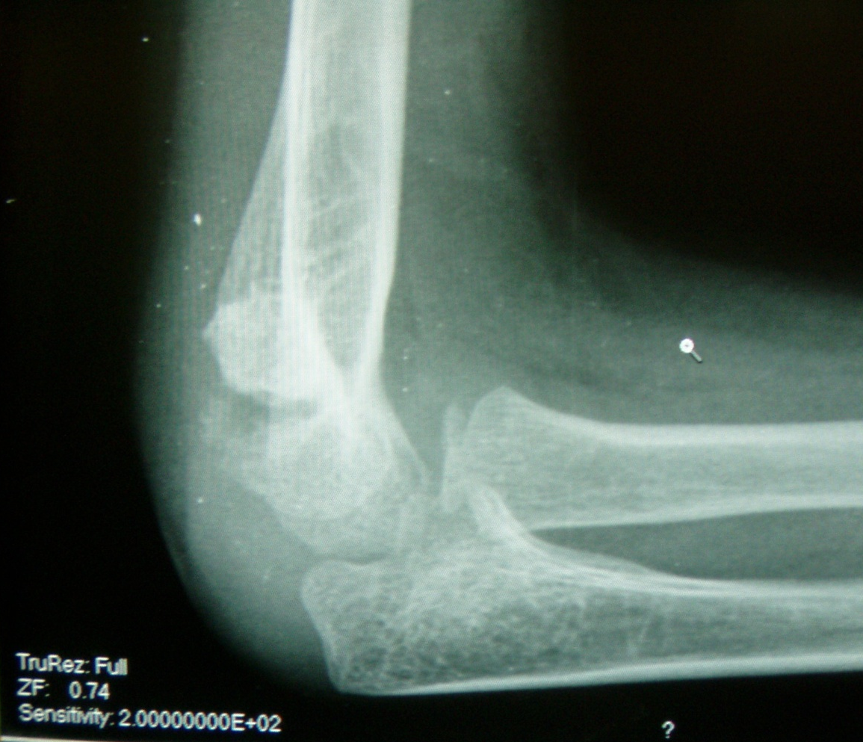
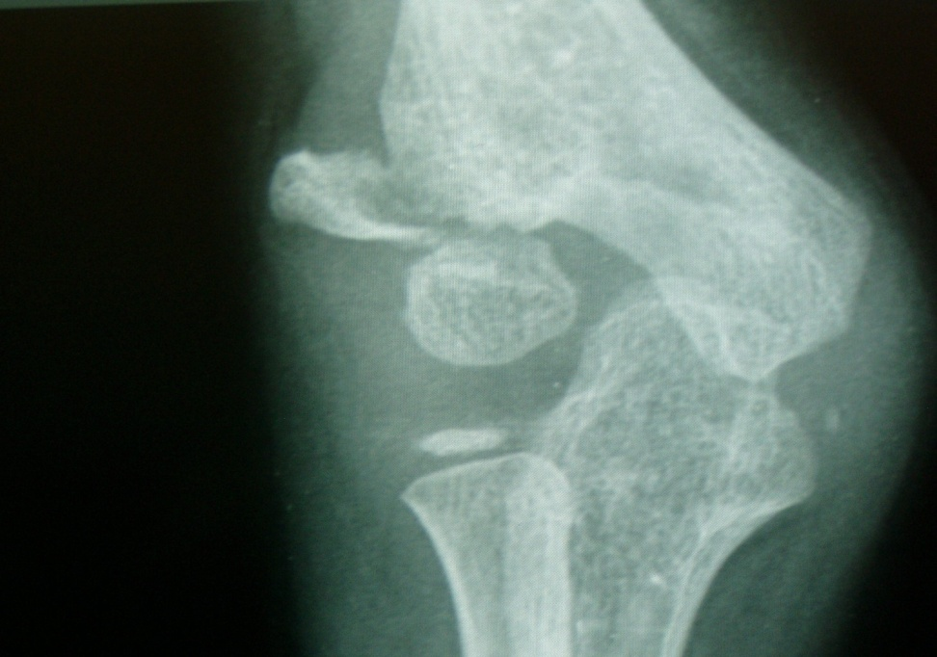

Slide 50
Surgical technique for grossly displaced but not rotated

Slide 51
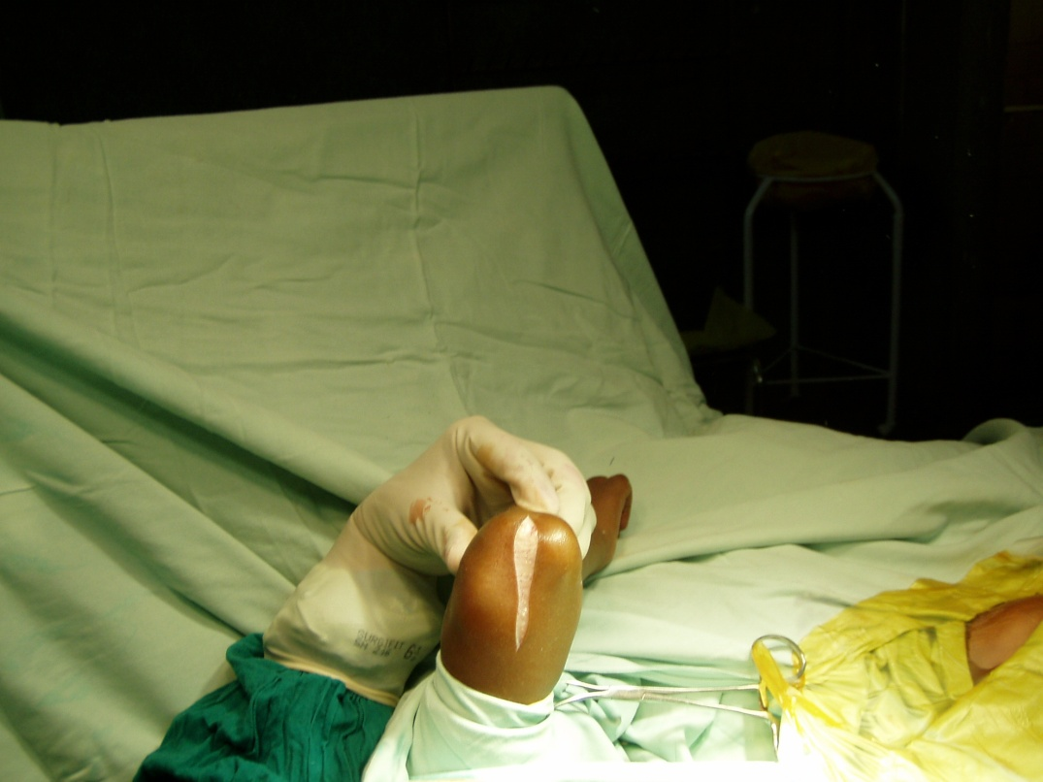
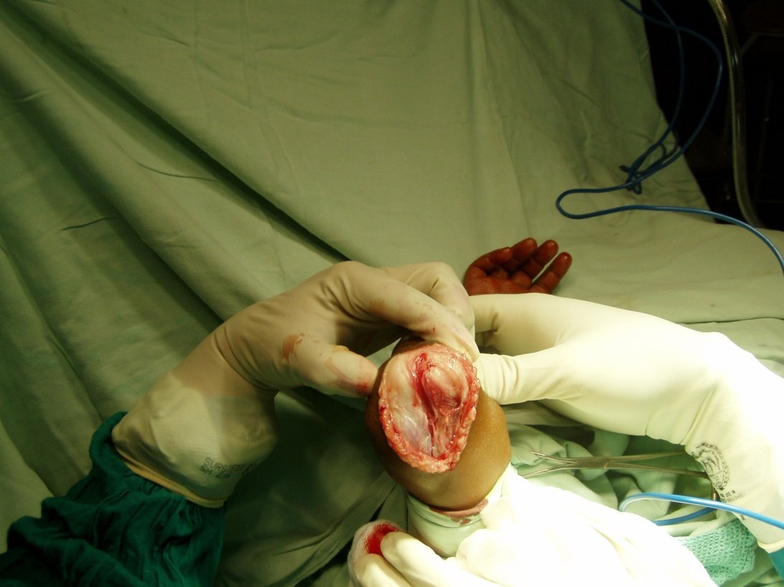
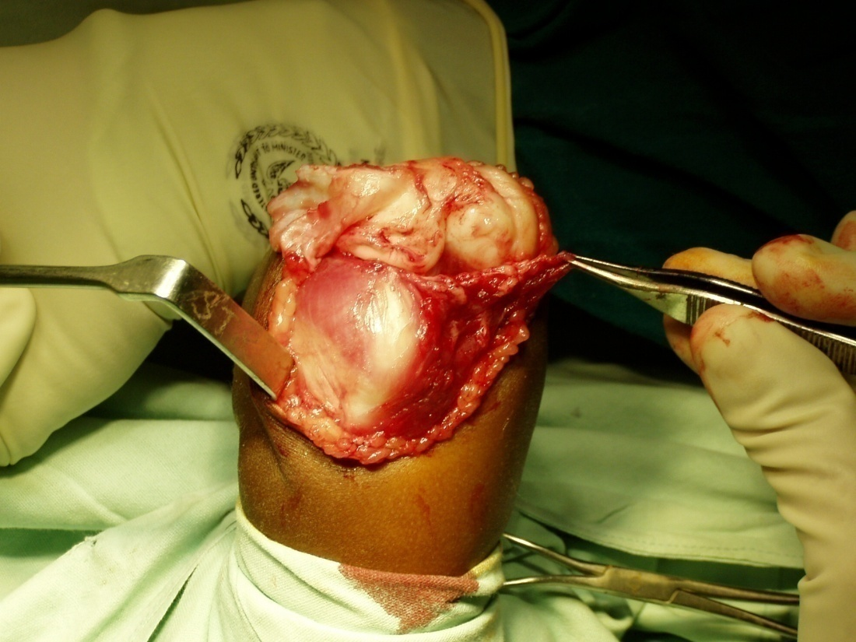
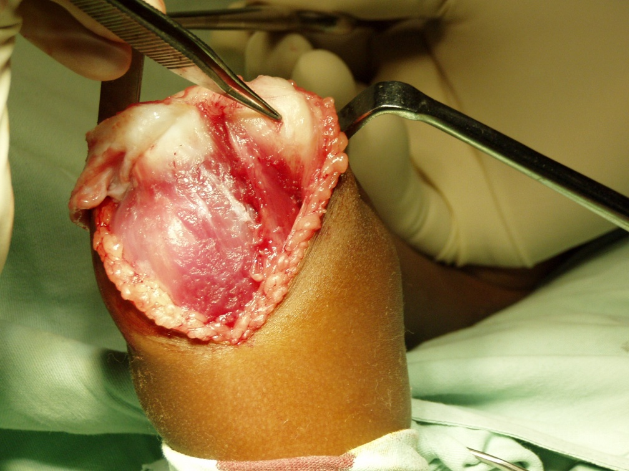

Slide 52
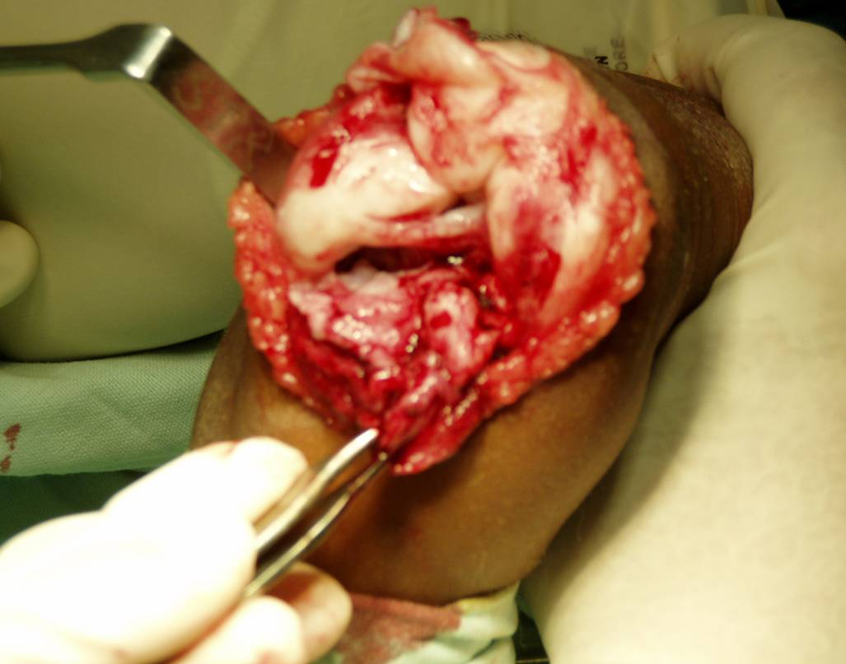
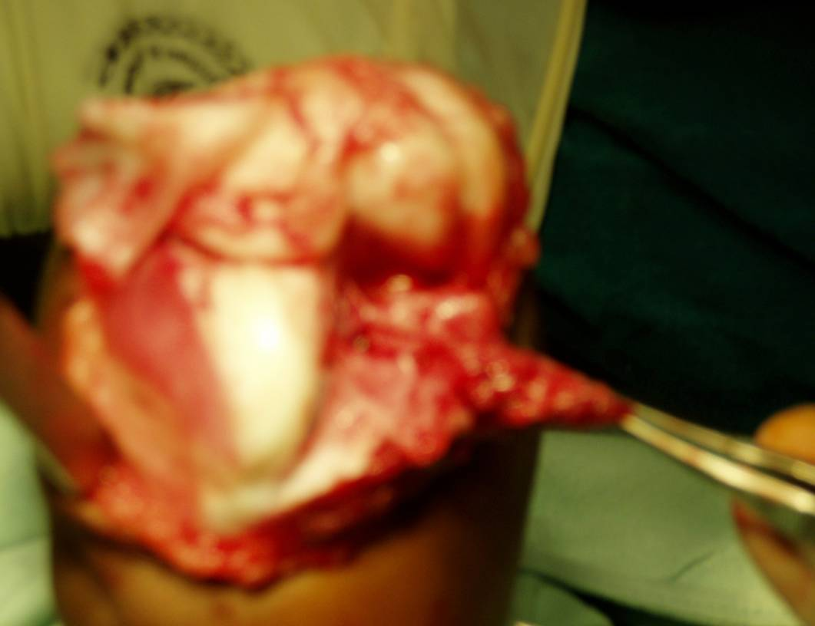
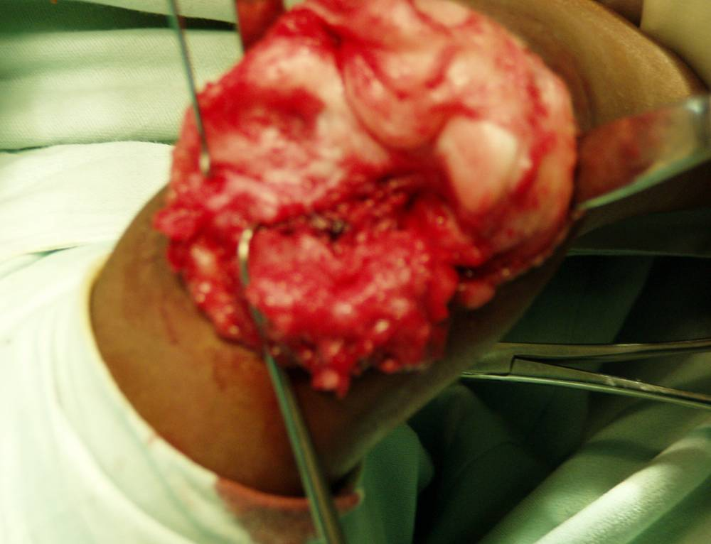
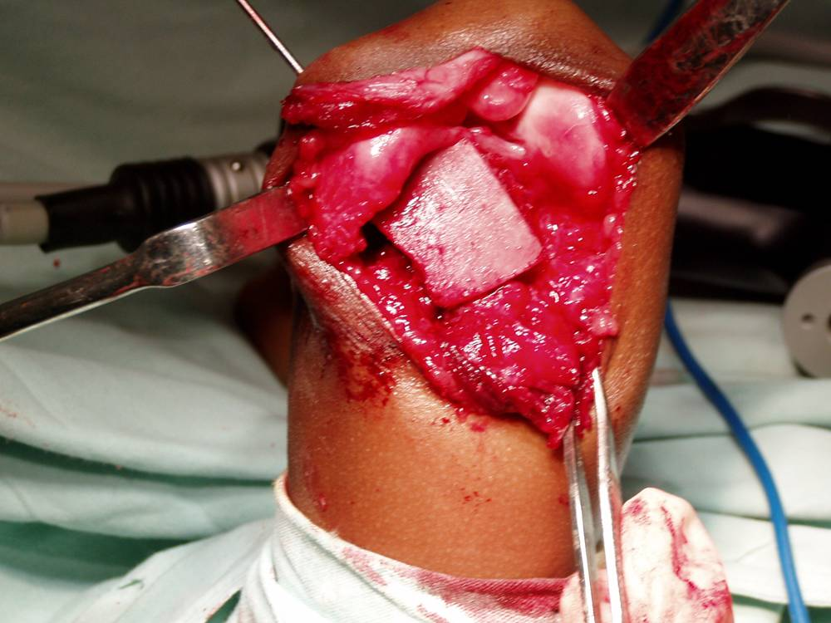

Slide 53
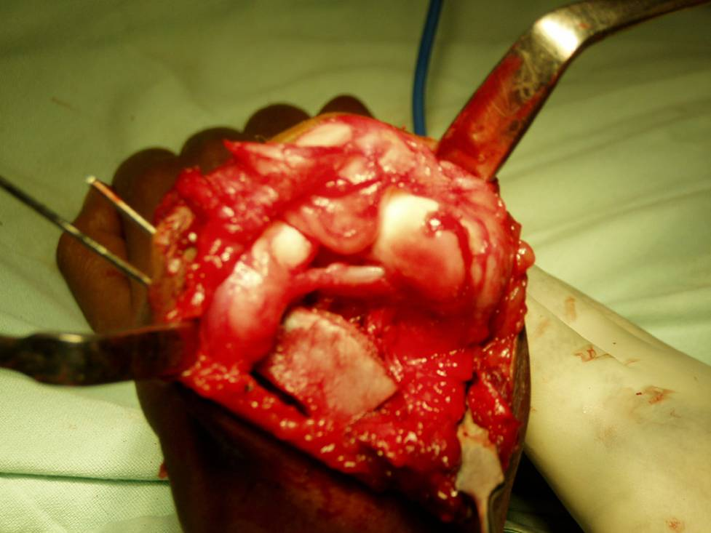
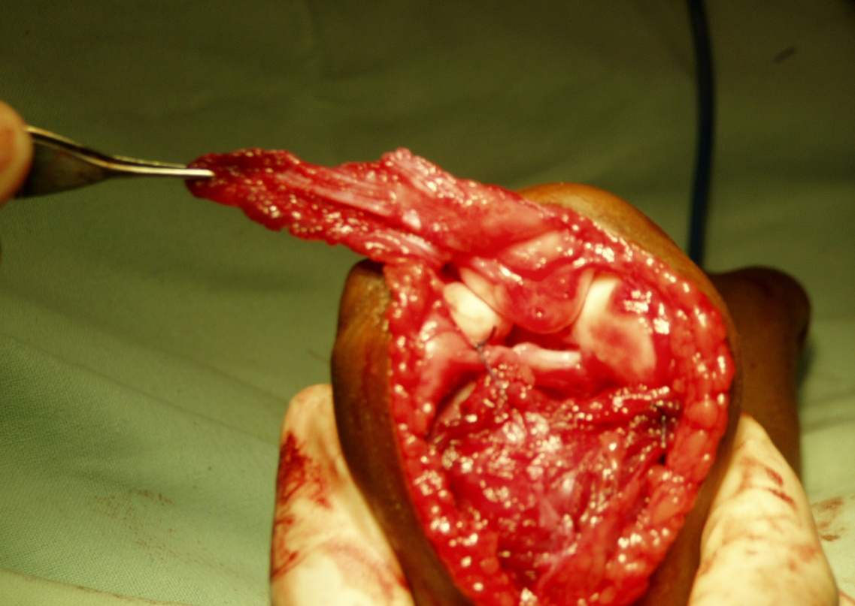
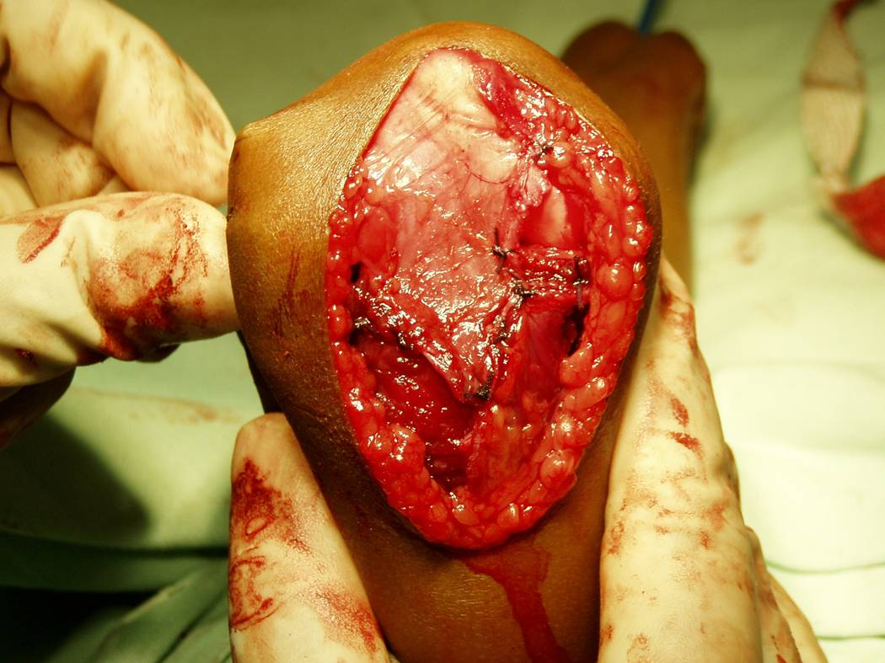
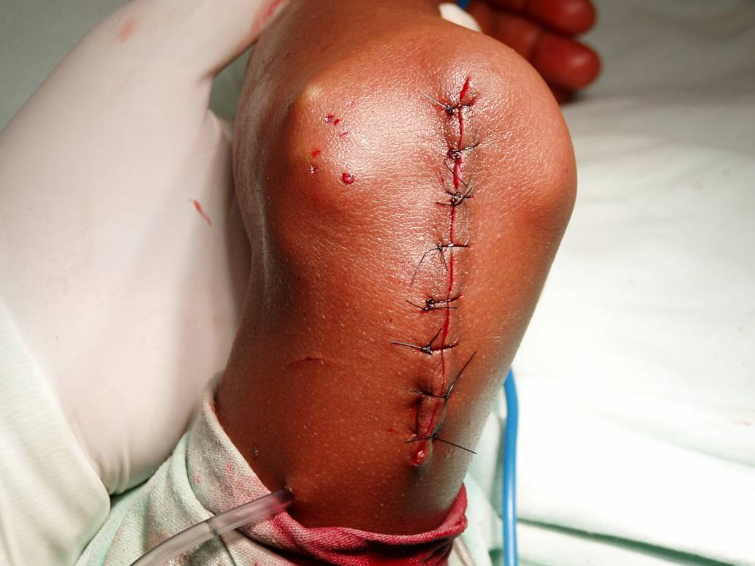

Slide 54
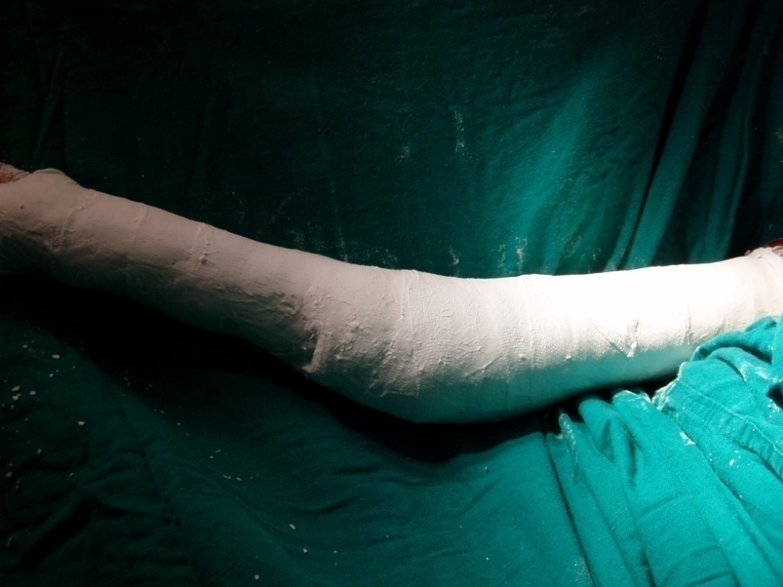
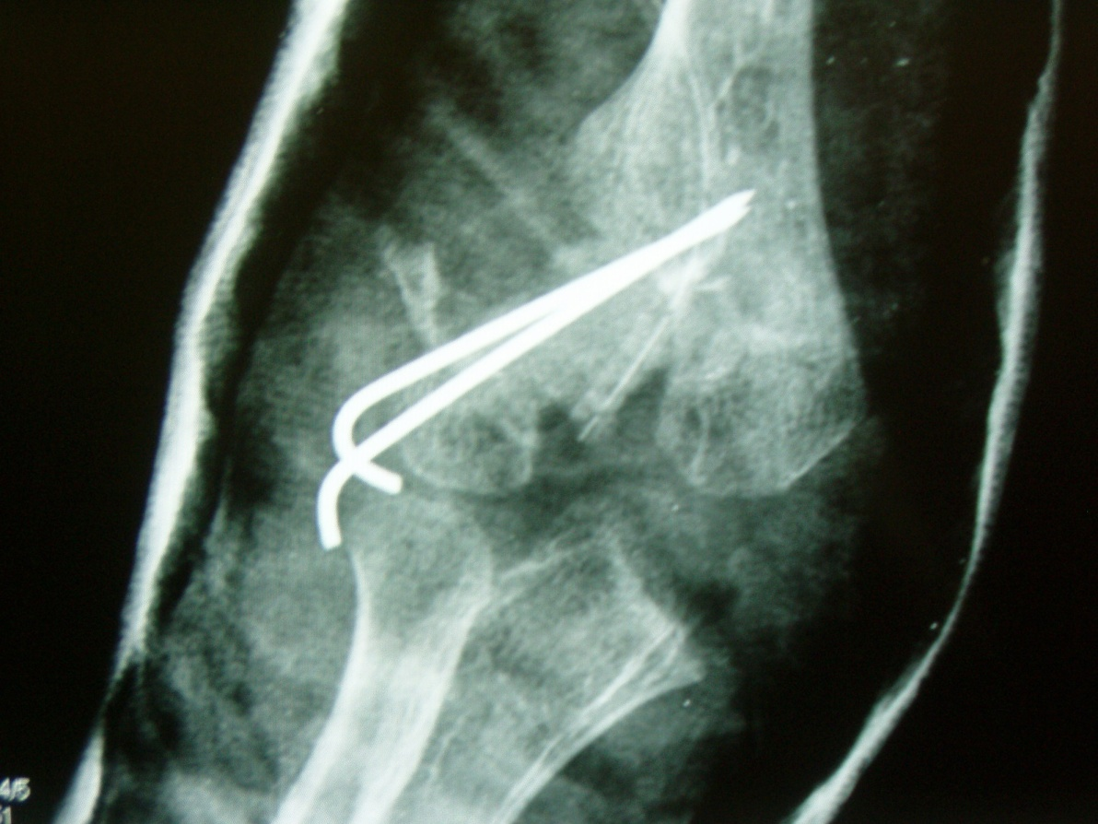
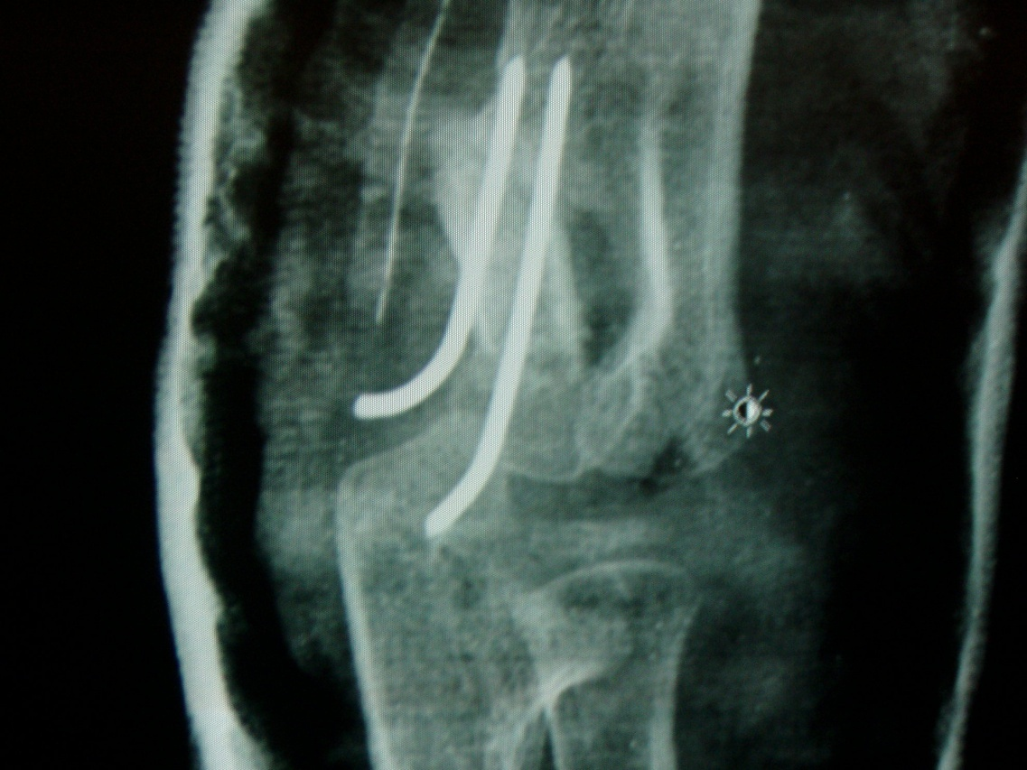

Slide 55
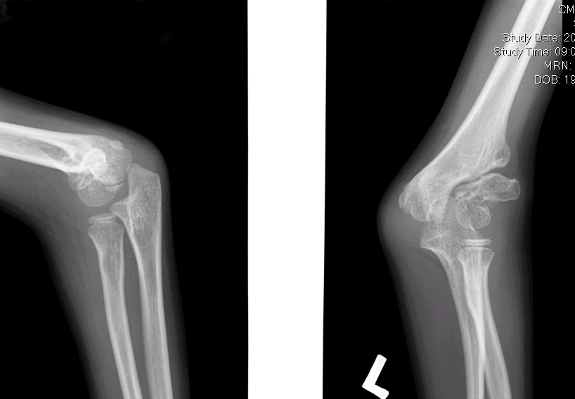
7 year old boy, injury 3 years ago deformity and weakness of the elbow

Slide 56
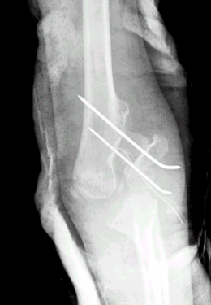
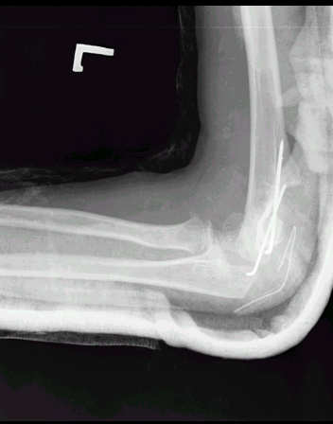
POST OP

Slide 57
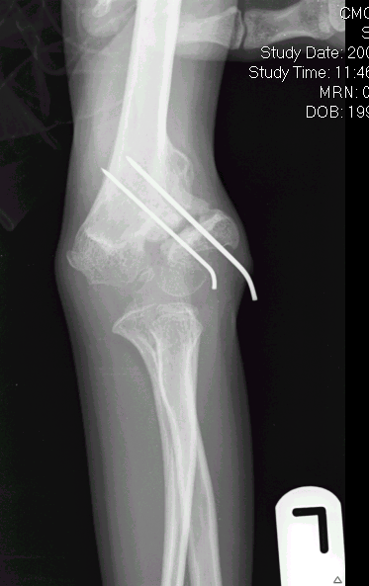
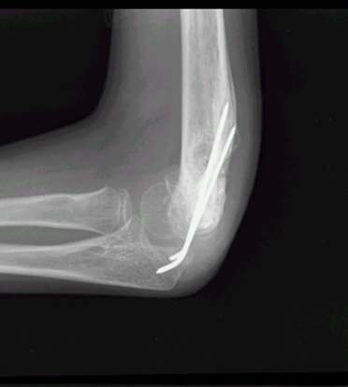
4 months postop

Slide 58
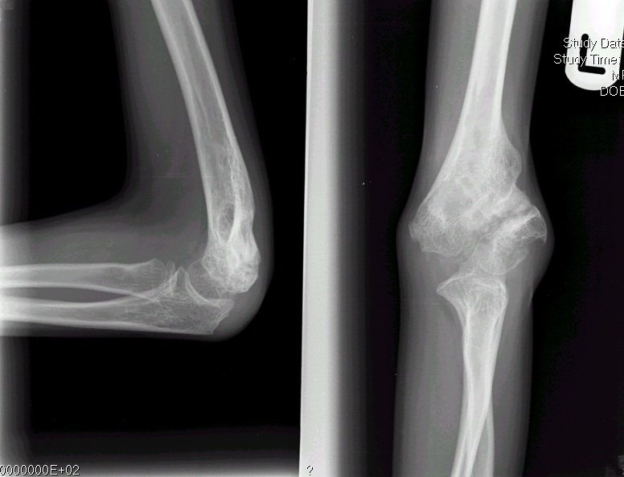
8 months postop

Slide 59

2 years postop

Slide 60


11 year old boy with 40 degree cubitus valgus deformity, no definite history of injury

Slide 61

2 months postop

Slide 62

4 months post op

Slide 63
Message
Mild displacement / severe proximal migration
Restore length by bone graft and reduce and fix metaphyseal portion

Slide 64
Surgical technique for grossly displaced and rotated lateral condyle nonunion

Slide 65

Posterior approach
Dissect and move the triceps laterally
The fracture approached through the gap between fracture fragments

Slide 66


10 year old boy with injury to elbow 6 months back

Slide 67


Slide 68


Slide 69


Slide 70

2 year 3 months follow up
ROM 10 -120 degree
Physeal arrest
10 degree FFD ROM 10 – 120 degree

Slide 71

4 year old boy, 4 months post trauma
ROM 70 -100 degrees

Slide 72


Slide 73

2 months post op

Slide 74



Slide 75
Those with significant rotation requiring extensive dissection
-Corrective supracondylar osteotomy. Leave the fracture alone/fix fracture
Transposition of the nerve if tardy palsy

Slide 76
Late presentation with ipsilateral injury
Elbow dislocation, medial epicondyle and ulnar shaft injury - reported
Myositis – esp. in a late presenting lesion
A true elbow dislocation can be made out preoperatively because of proximal migration of radius and ulna

Slide 77


Slide 78

8 year old girl with fall on the outstretched hand 3 months ago –ROM- 10 degrees
Clinical features suggestive of elbow dislocation

Slide 79



Slide 80


Slide 81


Slide 82


Slide 83
Message
Even in neglected cases a good reduction can be obtained
Posterior approach is invaluable as it allows good reduction for these cases

Slide 84
Thank you

Slide 85
Malunion
3 types
Cubitus valgus due to malunion
Bifid lateral condyle due to malunion of Milch Type 1 injury
Cubitus varus due to rotation of lateral condyle in the coronal plane

Slide 86

Cubitus varus following coronal rotation of type 2 injury

