Slide 1
CAROTID TRIANGLE
Mrs. Priyanka Sharma
Assistant Professor
Department of Anatomy
S.B.K.S.M.I. & R.C.

Slide 2
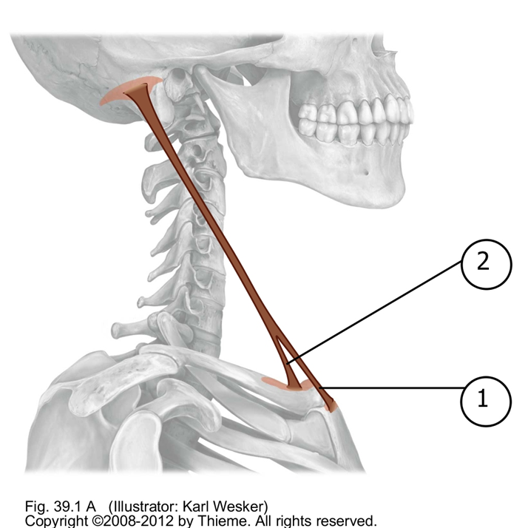
STERNOCLIEDOMASTOID
CLAVICULAR HEAD
STERNAL HEAD

Slide 3
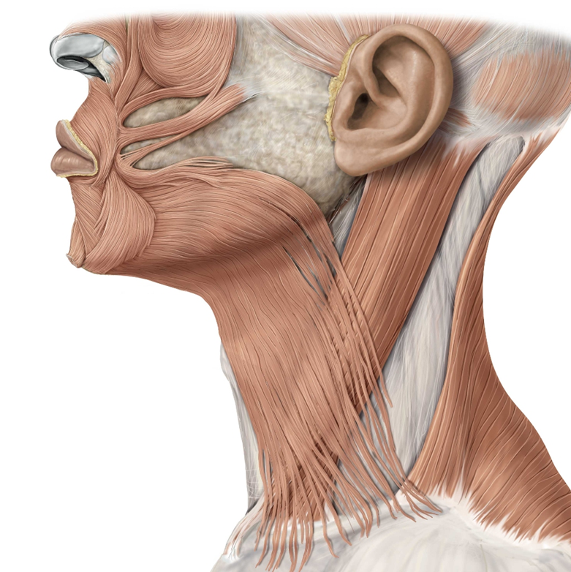

Slide 4
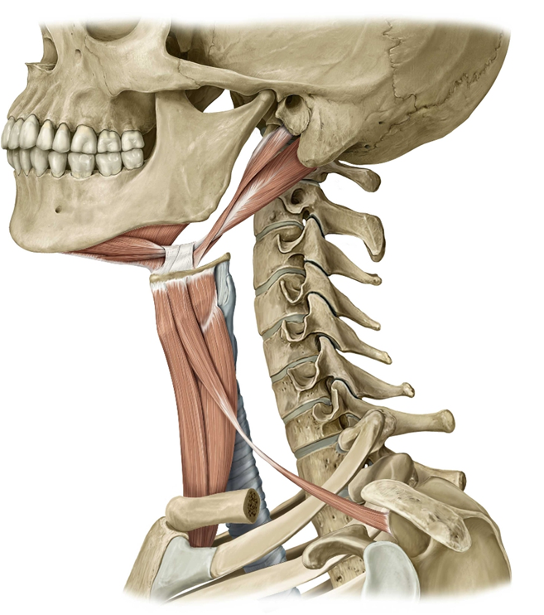

Slide 5
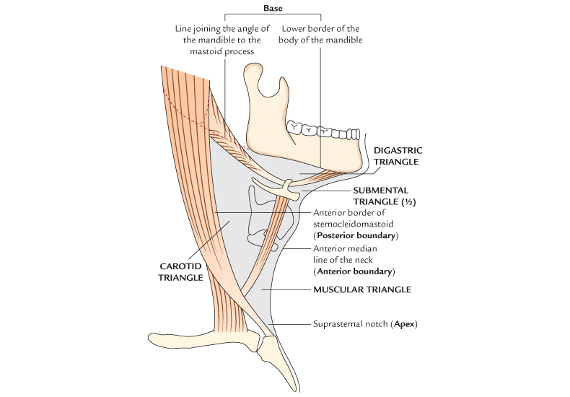

Slide 6
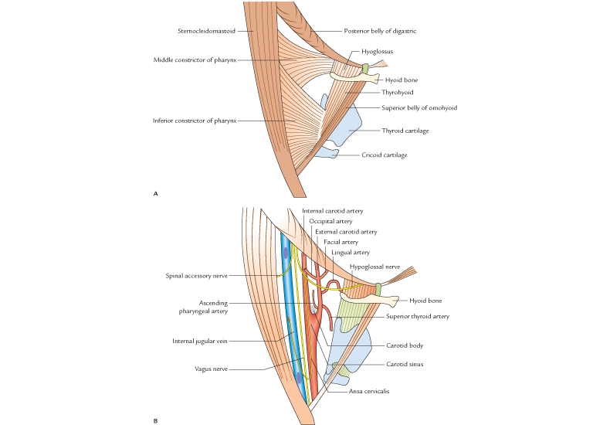

Slide 7
CAROTID TRIANGLE
Boundaries:
Posterior: Anterior margin sternocleidomastoid
Antero-superior: Posterior belly digastric, Stylohyoid
Antero-inferior: Superior belly omohyoid
Roof: Skin, superficial fascia(platysma, cutaneous N.)
Deep cervical fascia
Floor: Thyrohyoid, Hyoglossus, Middle and inferior
constrictors of pharynx

Slide 8
CONTENTS
1. Common carotid artery with carotid sinus and body
2. Internal carotid artery
3. External carotid artery
Superior thyroid, lingual, facial, Ascending
Pharyngeal and occipital artery
4. Internal jugular vein
5. Vagus nerve and superior laryngeal nerve

Slide 9
6. Spinal accessory nerve
7. Hypoglossal nerve and the upper root of ansa
cervicalis
8. Sympathetic trunk
9. Lymph nodes

Slide 14
Common carotid artery:
- enters neck behind sternoclavicular joint
- runs upwards laterally to upper border of
thyroid cartilage where it divides
- enclosed in carotid sheath
- gives no branches

Slide 15
2. Internal carotid artery:
- begins at upper border of thyroid cartilage,
ascends to reach the base of skull and enters
carotid canal
- medially related to pharynx
- at the upper end IJV lies posterior to the artery
- between IJV & ICA lies 9, 10, 11 and 12 nerves
- laterally crossed by styloid apparatus

Slide 16
3. External carotid artery:
- arises from CCA at the level of C3-4 disc
- terminates behind the neck of mandible within
parotid
- in lower part lies antero-medial to ICA, in upper
part lies lateral to ICA
- lower part of the artery lies in carotid triangle

Slide 17
Branches in carotid triangle:
a) Ascending pharyngeal:
- only medial branch
b) Superior thyroid:
- runs infero-medially accompanied by external
laryngeal nerve to reach upper pole of thyroid
- it gives off superior laryngeal branch which is
accompanied by internal laryngeal nerve

Slide 18
c) Lingual artery:
- arises opposite the tip of greater cornu of hyoid
- hyoglossus divides it into three parts- 1,2,3.
- first part lies in carotid triangle superficial
to middle constrictor of pharynx
- it forms a characteristic upward loop which is
crossed by hypoglossal nerve

Slide 19
d) Facial artery:
- arises just above hyoid and leaves the triangle
by passing deep to posterior belly of digastric
and stylohyoid
e) Occipital artery:
- from posterior aspect of ECA opposite facial
- runs backwards parallel to digastric and leaves
the triangle deep to sternocliedomastoid

Slide 20
4. Internal jugular vein:
- continuation of sigmoid sinus in the posterior
compartment of jugular foramen
- descends within carotid sheath and leaves the
neck behind the sternal end of clavicle

Slide 21
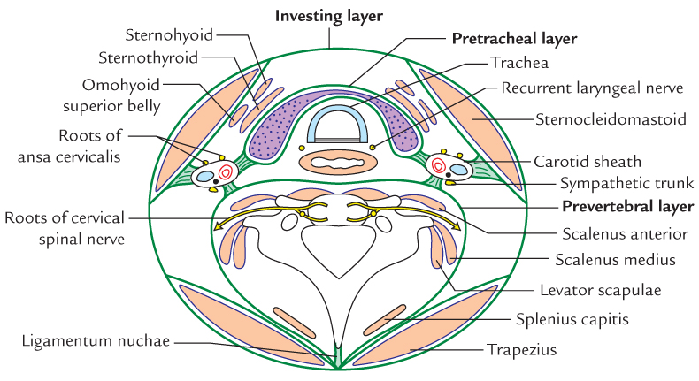

Slide 22
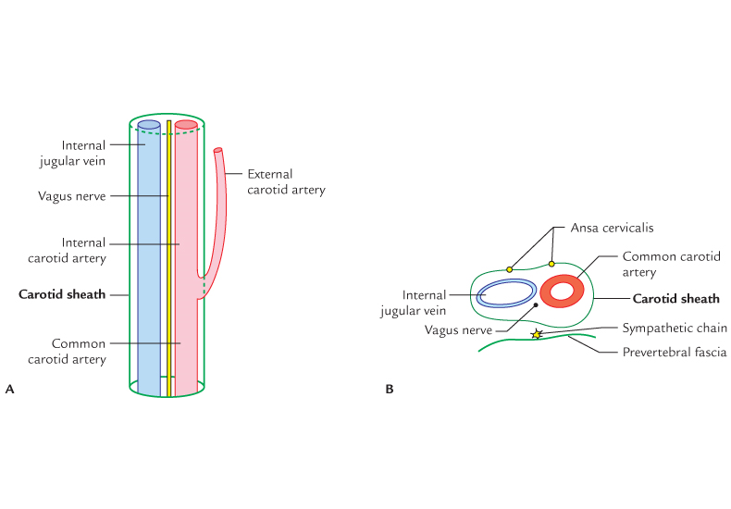

Slide 23
CAROTID SHEATH
- it is a tubular investment of deep cervical fascia
around neurovascular bundle of neck
Extent: from arch of aorta to base of skull
Formation: anterior wall – Pretracheal fascia, attached to
sternocleidomastoid
- rami of ansa cervicalis are embedded in it
: posterior wall – pre vertebral fascia

Slide 24
Contents:
1) Common and internal carotid arteries medially
2) Internal jugular vein laterally
3) Vagus lies between and behind artery and vein
The sheath is thick over artery and ill defined over the vein to allow its expansion
Cervical part of the sympathetic trunk lies behind the
sheath

Slide 25
Structures that pierce carotid sheath:
1) External carotid artery
2) Tributaries of IJV
3) Branches of vagus nerve
: Glossopharyngeal
: Accessory
: Hypoglossal
: Cervical

Slide 26
TITLE | AUTHOR/ JOURNAL | MATERIAL | RESULT | CONCLUSION
Symptomatic and asymptomatic carotid artery plaque | Majid M Mughal,¹ Mohsin K Khan,² J Kevin DeMarco,³ Arshad Majid,⁴ Fadi Shamoun,⁵ and George S Abela Expert Rev Cardiovasc Ther. 2011 Oct; 9(10): 1315–1330. | The pathophysiology, clinical imaging, and management of symptomatic and asymptomatic carotid artery stenosis. | Men tend to have more frequent strokes at a younger age (<75 years) but overall, women have more strokes than men. At least 15–20% of all ischemic strokes are attributed to carotid artery atherosclerosis . Furthermore, it is estimated that 5–10% of individuals over 65 years of age have asymptomatic carotid artery atherosclerosis with at least 50% artery stenosis | Men tend to have more frequent strokes at a younger age (<75 years) but overall, women have more strokes than men. At least 15–20% of all ischemic strokes are attributed to carotid artery atherosclerosis [3]. Furthermore, it is estimated that 5–10% of individuals over 65 years of age have asymptomatic carotid artery atherosclerosis with at least 50% artery stenosis

Slide 27
MCQ
Q. 1 Which structure is not a content of carotid sheath?
Internal jugular vein
Internal carotid artery
External carotid artery
Vagus

Slide 28
MCQ
Q. 2 How many arteries from external carotid artery in
carotid triangle?
5
4
3
2

Slide 29
MCQ
Q. 3 All muscles form the floor of carotid triangle except
Thyrohyoid
Omohyoid
Hyoglossus
Inferior constrictor

Slide 30
MCQ
Q. 4 How many cranial nerves cross carotid triangle?
6
5
4
3

Slide 31
MCQ
Q. 5 Superior laryngeal artery is accompanied by
Recurrent laryngeal nerve
Internal laryngeal nerve
External laryngeal nerve
Ansa cervicalis

Slide 32
MCQ ANSWERS
Q. 1 c
Q. 2 a
Q. 3 b
Q. 4 d
Q. 5 b

