Slide 1
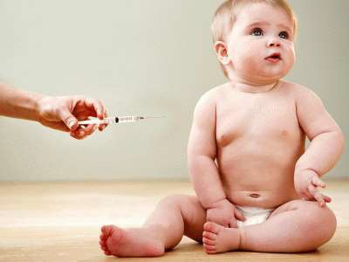
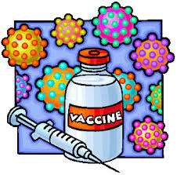
IMMUNIZATION
Dr.Sunil Pathak
Associate Professor
Department of Paediatrics
SBKS MIRC

Slide 2
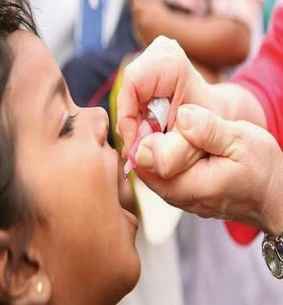
OBJECTIVES
To study what is Immunization,history, various schdedules and programmes .
To study about passive immunization in VPD
TO study how to describe a vaccine
How to calculate vaccine requirement

Slide 3
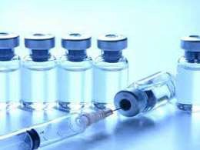
IMMUNISATION
Immunization is the
process inducing providing
of artificially
immunity or
protection
from disease.

Slide 4
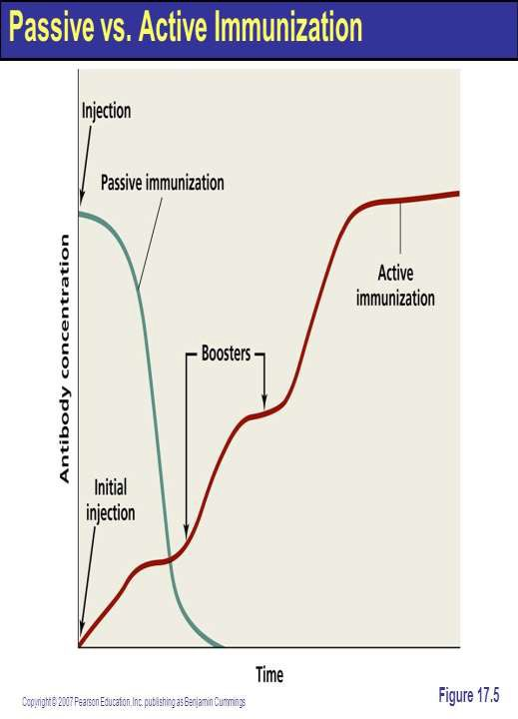
Active is the
immunization process of
stimulating the body to produce antibody
and other immune
through
responses
administration of a vaccine or toxoid.
.

Slide 5

Passive immunization is provision of temporary immunity by administration of preformed antibodies derived from humans or animals

Slide 6
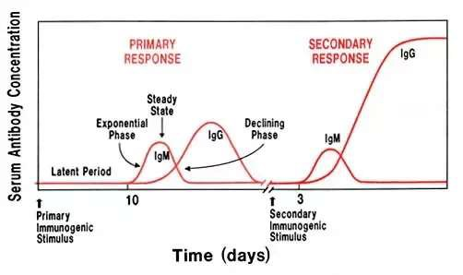
Process of generation of immunity after vaccination
PRIMARY RESPONSE-
When an antigen is administered for the first
time to
an animal or human who has never
been exposed to it, there is a latent period of induction of 3 to 10 days before antibodies appear in the blood.

Slide 7
Process of generation of immunity after vaccination
PRIMARY RESPONSE-
The antibody that is elicited first is entirely of the IgM type. The IgM antibody titre rises steadily during the next 2-3 days or more, reaches a peak level and then declines almost as fast as it developed.

Slide 8

Process of generation of immunity after vaccination
PRIMARY RESPONSE-
Meanwhile, if the antigenic
stimulus
was sufficient, IgG antibody appears in a few days. IgG reaches a peak in 7-10 days and then gradually falls over a period of weeks or months

Slide 9
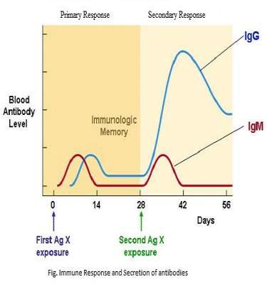
Process of generation of immunity after vaccination
PRIMARY RESPONSE-
The nature and extent of primary response to an antigen is determined by a number of factors, e.g., dose of antigen, nature of antigen, route of administration, adjuvants, nutritional status of the host, etc

Slide 10
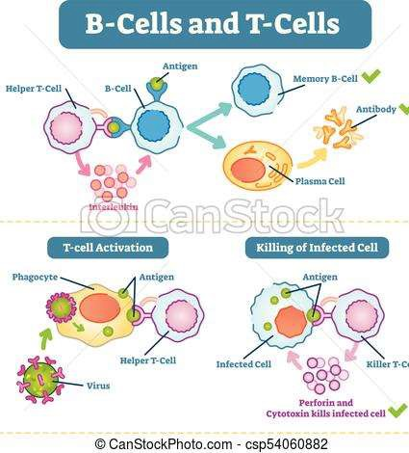
Process of generation of immunity after vaccination
PRIMARY RESPONSE-
An important outcome of primary antigenic challenge is education of the reticulo-endothelial system of the body. There is production of what are known as "memory cells" or "primed cells" by both B and T lymphocytes.

Slide 11
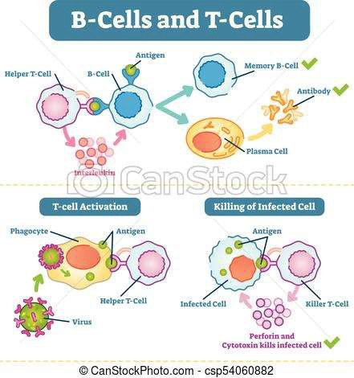
These cells
are responsible for the
"immunological memory"
which
becomes established
after fact,
immunization. In
of to
the purpose
immunization
is
develop memory.
immunological

Slide 12

SECONDARY (BOOSTER) RESPONSE-
The response to a booster dose differs in a number of ways from the primary response: 1 shorter latent period.
production of antibody is more rapid
antibodies are more abundant.

Slide 13
SECONDARY (BOOSTER) RESPONSE-
antibody response maintained at higher levels for a longer period of time and
the antibody elicited tends to have a greater avidity or capacity to bind to the antigen.

Slide 14
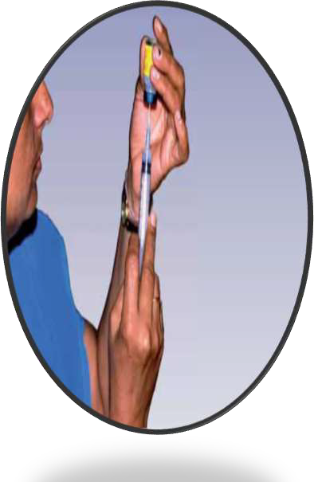
Vaccine
Term derive from “vaccae=cow”.
So immunization agent is known as vaccine.
Vaccine is biological designed specific
a immuno- substance
to produce protection
against a given disease.

Slide 15
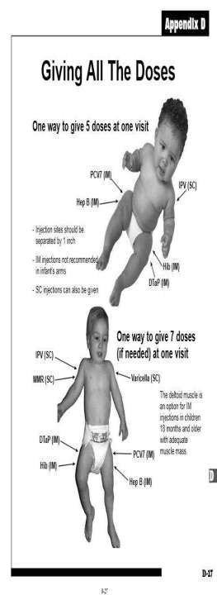
Type of vaccine
Live vaccine.
Inactivated or killed vaccine. 3.SUB UNIT VACCINES
  Toxoids .
  Protein vaccine
C.RECOMBINANT protein vaccin D.Polysaccharide-based vaccines E.Conjugated vaccine 4.Combination
e

Slide 16
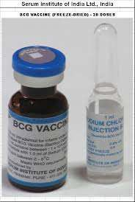
LIVE VACCINE-
Antigen in vaccine is live but attenuated.
Since antigen are live,they multiply in body after administration so stimulus is more.
Generally given in single dose. E.g.-BCG, OPV,MMR, YELLOW FEVER

Slide 17
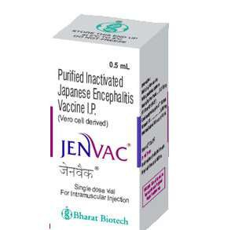
KILLED VACCINE-
Organism are inactivated or killed by heat or chemical.
They are given by multiple doses.
Immunity last shorter than live vaccine.
E.g.-JE VACCINE, ANTIRABIES VACCINE, INFLUENZA KILLED VACCINE

Slide 18
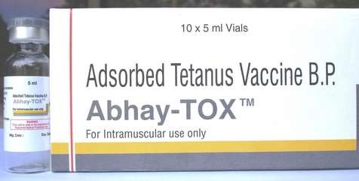
TOXOID-
They are modified toxins.
Toxins are detoxicated They are required in multiple doses.
E.g.- tetanus toxoid, diptheria toxoid

Slide 19
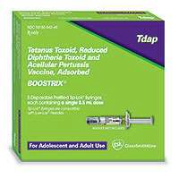
Protein vaccine
Proteins can be purified from in vitro culture of a Pathogenic micro-organism

Slide 20
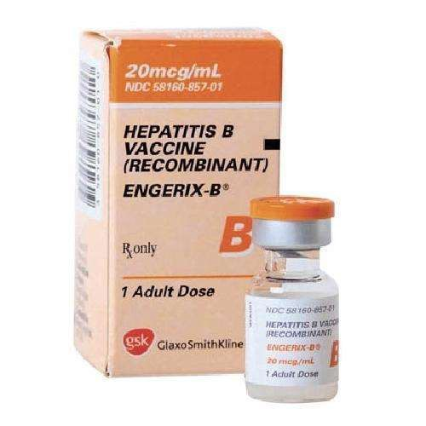
RECOMBINANT PROTEIN VACCINE

Slide 21
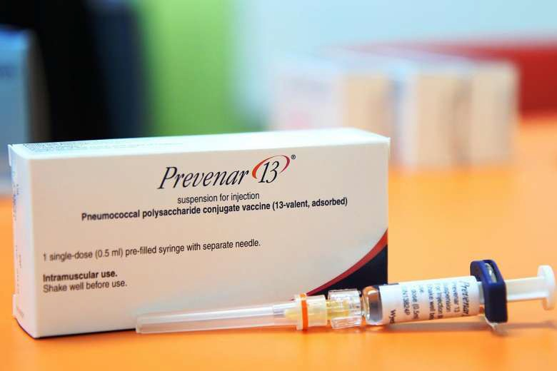
POLYSACCHARIDE-BASED VACCINES

Slide 22
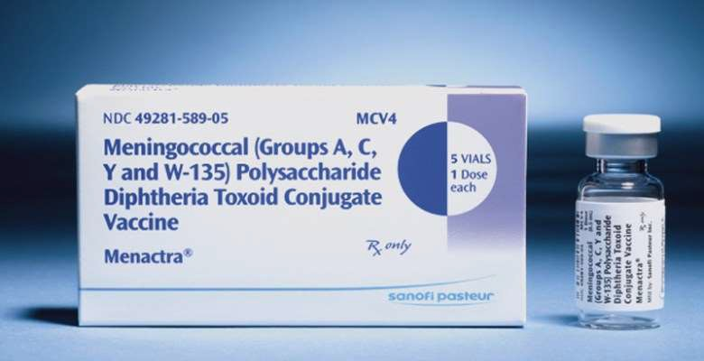
CONJUGATED VACCINE

Slide 23
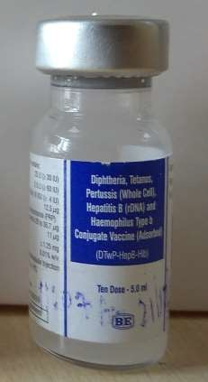
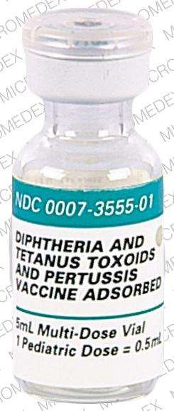
COMBINATION VACCINE-
They are so called because the preparation contains more than one antigen.
They also called mixed vaccine.
E.g.- Easy Five ( penta valent ), DPT
, DT, MMR

Slide 24
Milstone in vaccination
1798 - Smallpox vaccine 1885 - Rabies vaccine 1897 - Cholera vaccine 1921 - BCG

Slide 25
Milstone in vaccination
1923 - Diphtheria Toxoid 1926 - Pertussis vaccine 1927 - Tetanus toxoid 1937 - Influenza vaccine

Slide 26
Milstone in vaccination
1935 - Yellow fever vaccine (17 D) 1949 - Mumps vaccine
1954 - Salk's Polio vaccine
1957 - Sabin live oral Polio vaccine

Slide 27
Milstone in vaccination
1960 - Measles vaccine 1962 - Rubella vaccine
1968 - Type C meningococcus vaccine 1971 - Type A meningococcus vaccine

Slide 28
Milstone in vaccination
1980- smallpox declared eradicated from the world.
1981- meningococcal polysaccharide vaccine, group A,C,Y W135 combined ( Menomune ).
1982- hepatitis B vaccine.
1983- pneumococcal vaccine 23 valent. 1988- worldwide polio eradication initiative launched.

Slide 29
Milstone in vaccination
1990- the vaccine adverse reporting system ( VAERS ), a national programme monitoring the safety of vaccine established.
1991- hepatitis B vaccine recommended for all infant.
1991- acellular pertusis vaccine licensed for use in older children aged 15 month to 6 year.
1993- JE vaccine.
2003- first adult immunisation schedule introduced.

Slide 30
Milstone in vaccination
2004- Pediarix, a vaccine that combines the DTaP, IPV & Hep B vaccines, into one shot , is approved.
2006- Gardasil, the first HPV vaccine is approved.
2008- Rotarix, a two dose rotavirus vaccine is approved.
2009- influenza- A ( H1N1 ) Vaccine approved.

Slide 31
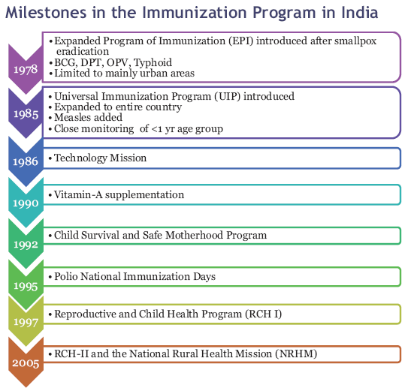

Slide 32
Expanded Program on Immunisation
WHO launch a global immunization program, known as Expanded Program on Immunization (EPI) in May 1974.
To protect all children of the world against six vaccine-preventable diseases, namely - diphtheria, whooping cough, tetanus, polio, tuberculosis and measles by the year 2000.
EPI was launched in India in January 1978 .

Slide 33
Universal Immunisation Programme
The Indian version, the Universal Immunization Programme, was launched on November 19, 1985.
The National Health Policy aimed at achieving universal immunization coverage of the eligible population by 1990.

Slide 34
NATIONAL IMMUNISATION SCHEDULE VACCINE WHEN TO GIVE
For infants
BCG
At birth or as early as possible till one year of age
Hepatitis B
At birth or as early as possible within 24 hour
OPV 0
At birth or as early as possible within the first 15 days

Slide 35
NATIONAL IMMUNIZATION SCHEDULE
OPV 1,2 & 3 | At 6 weeks , 10 weeks & 14 week
ROTA VIRUS 1,2&3 | At 6 weeks , 10 weeks & 14 week
PENTAVALENT 1,2 & 3 | At 6 weeks , 10 weeks & 14 week
FRACTIONAL- IPV 1&2 | At 6 weeks & 14 week
MEASLES AND RUBELLA 1 | 9 completed months -12 month ( given up to 5 years if not received at 9-12 month age)
JAPENESE ENCEPHALITIS 1 | 9-12months
Vitamin A ( 1st dose ) | At 9 month with measles

Slide 36
NATIONAL IMMUNISATION SCHEDULE
For children | When to given
DPT booster | 16-24 month
OPV Booster | 16-24 month
Measles and Rubella 2 | 16-24 month
Japanese Encephalitis 2 | 16-24 month with DPT / OPV Booster
Vitamin A | 16 month with DPT/OPV booster. Then one dose every 6 month up to the age of 5 year
DPT booster | 5-6 years
TT | 10 years & 16 years

Slide 37
NATIONAL IMMUNISATION SCHEDULE
FOR PREGNANT WOMEN TT-1
TT-2
TT- Booster
Early in pregnancy 4 weeks after TT-1
If received 2 TT doses in a pregnancy within the last years

Slide 38
IAP SCHEDULE
Birth - 15 days
BCG + OPV (zero dose) +HepB1
6 weeks - 8 weeks
OPV1 +IPV1 + DPT1+ HepB2 + Hib1 +
Rotavirus1 + PCV1
OPV2 + IPV2 + DPT2+ Hib2 + Rotavirus2 + PCV2
OPV3 + IPV3 + DPT3 + Hib3 + Rotavirus3# + PCV3
HepB3 + OPV1
Measles+OPV2
10 weeks- 12 weeks
14 weeks - 16 weeks
6 months
9months (complete d)

Slide 39
IAP SCHEDULE
12 months
15 months
18 months
Hepatitis A1
MMR1 + Varicella + PCV booster
OPV4 + IPV booster1 + DPT*booster1 + Hib booster1 + Hepatitis A2
Typhoid1 (give repeat shots every 3 years)
OPV5 + DPT* booster2
+MMR2^ + Varicella2$$
Tdap/Td (Every 10 years then
give Td)+ HPV**
2 years
5 years
10 - 12 years

Slide 40
Passive immunization in VPD
Passive immunization is a short-term expedient useful only when exposure to infection has just occurred or is imminent within the next few days. The duration of immunity induced is short and variable (1-6 weeks).

Slide 41
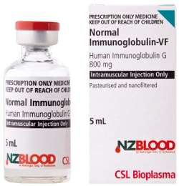
Passive immunization in VPD
Three types of preparations are available for passive immunity-
Normal human immunoglobulin.
Specific (hyperimmune) human immunoglobulin. Antisera or anti-toxins.

Slide 42
Passive immunization is applied in following vaccine preventable disease-
Diphtheria,
Tetanus, Hepatitis B Rabies
& Measles.

Slide 43
DIPTHERIA ANTITIOXIN-
DOSE:
Prophylactic: 500 to 2000 units by subcutaneous or intramuscular injection;
Therapeutic: 10,000 to 30,000 units by
intramuscular injection or 40,000 to 100,000 units by intravenous injection in 2 divided doses with an interval of 12 to 24 hours.

Slide 44
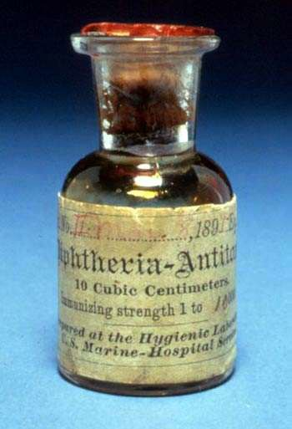
Passive Immunisation – Immunoglobulins
1. ADS of horse origin.
2. ADS of human origin.

Slide 45
Dosage of antitoxin (equine)
Duration of disease | 48 hours
Lesions | Throat | Larynx
Dose | 20 000 | 20 000
(I.U.) | – 40000 | – 40000
Must be used only after sensitivity test.

Slide 46
Dosage of antitoxin (equine)
Duration of disease | Over 48 hours
Lesions | Membrane in naso- pharynx | Swelling in neck | Extensive disease > 3 days
Dose | 40000 | 80000 | 80000
(I.U.) | – 60000 | – 120000 | – 120000
Must be used only after sensitivity test.

Slide 47
Antitoxin Treatment – human
Dose: 0.6 ml/kg body weight Intramuscular (Available as 2ml vial with 300 mg Globulins).
Advantage over ADS (horse origin):
  Hypersensitivity absent.
  Longer protection.

Slide 48
MEASLES IMMUNOGLOBULIN (HUMAN )
DOSE- recommended by WHO is 0.25 ml per kg of body weight. It should be given within 3-4 days of exposure.
The person passively immunized should be given live measles vaccine 8-12 weeks later.

Slide 49
HEPATITIS B IMMUNOGLOBIN-
The recommended dose is 0.05 to 0.07 ml/kg of body weight ; two doses should be given 30 days apart . HBIG provides short-term passive protection which lasts approximately 3 months . Since the median incubation period is said to be lower than 100 days , two doses of HBIG given one month apart should suffice.

Slide 50
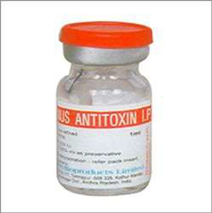
TETANUS IMMUNOGLOBIN
Dose – 250 unit for prophylaxis
3000-6000 for therapeutic

Slide 51
HOW TO DESCRIBE A VACCINE
whenever one describe a vaccine it must be done under the following heads
Type
Content Dose
Time of administration
No of doses including boosters
53

Slide 52
HOW TO DESCRIBE A VACCINE
Diluent if any
Time after reconstitution Efficacy
Storage
Side effects contraindications
54

Slide 53
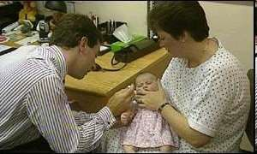
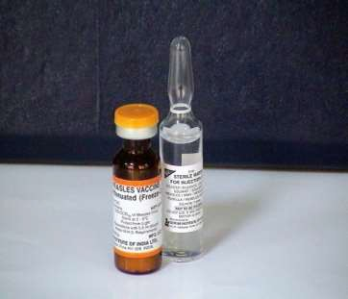
MEASLES VACCINE
Freezed dried vaccine contains live attenuated virus 1000 T.C.I.D.₅₀;
Stored at 2-8ºC.
Dose → 0.5 ml; Route → Subcutaneous.
55

Slide 54
MEASLES VACCINE
Time of administration → 9 months in India.
According to W.H.O if child is malnourished,
1st dose is b/w 6-8 months; 2nd dose after 1 year.
Efficacy of Vaccine – 95%if given after one year. At nine months -85%
Duration of immunity– Lifelong.
56

Slide 55
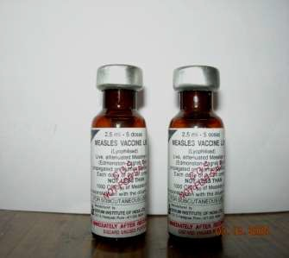
Measles vaccine
It is freezed dried vaccine
Has to be reconstituted with
distilled water 8.Reconstituted vaccine
must be
used as early as possible

Slide 56
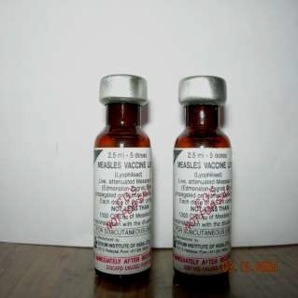
Measles vaccine
It has shell life for 2 years
Must be stored between
2-8 degree centirgade

Slide 57
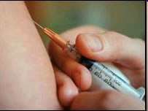
MEASLES VACCINE
Recent W.H.O. recommendation – 1st dose of measles 9 months.
2nd dose of M.M.R. – 15 months.
This vaccine may also be given to contacting person.
59

Slide 58
Complications of vaccine
Fever
Rash
Rarely S.S.P.E
T.S.S

Slide 59

CONTRAINDICATIONS TO MEASLES VACCINE
1.Impaired cell-mediated immunity. 2.Convulsions.
3.Patient on steroids. 4.Pregnancy.
61

Slide 60
CONTRAINDICATIONS TO MEASLES VACCINE
Active T.B.
Acute infectious disease. 7.Generalized allergy.
62

Slide 61
How to calculate vaccine requirement
There are two ways to calculate vaccine requirement-
based on real number of beneficiaries in community.
based on , Birth Rate and IMR.
63

Slide 62
Method 1-
count the total number of beneficiaries, like infant, pregnant mother etc.
multiply it with total number of dose of vaccine to be given.
now multiply it with wastage factor for different vaccines
64

Slide 63
Eg- if there are 100 infant. Number of doses of BCG require will be
100× 1 × 1.33= 133 doses
Since vial of BCG come in doses of 10.
So needed vial will be= 133/10= 13.3 i.e. 14
65

Slide 64
Method 2- if we know the Birth Rate & IMR.
Example- if birth rate is 22/1000 population & calculation is required for sub centre which cater 5000 population.
total number of pregnant women = 22×5
=110
10% wastage factor will be added for abortion so total number of pregnant lady will be-
= 110+ 11=121
66

Slide 65
Now for infant we will have to consider BR as live birth. So number of infant = 110
Since IMR = 34 /1000 live birth
So total infant will be= 110-4= 106
If we want to calculate dose of penta =
= 106×3×1.18(wf)
=376
So total number of vial for Penta- 376/10= 38
67

Slide 66
WASTAGE MULTIPLICATION FACTOR
 | NO. OF DOSES | WMF
HEP B | 1 | 1.11
BCG | 1 | 2
DPT | 2 | 1.11
OPV | 3+2 BOOSTER | 1.11
ROTA VIRUS | 3 | 1.33
IPV | 2 | 1.11
PENTAVALENT | 3 | 1.11
MR | 2 | 1.33
PCV | 3 | 1.11
TT | 2 | 1.11
JE | 2 | 1.33
SYRINGES | AS PER REQUIREMENT | 1.11
68

Slide 67
MCQ
Q. 1. Name the vaccine which was first discovered In the world
Rabies
Plaque
Small pox
Chicken pox
3
69

Slide 68
MCQ
Q.2.in which year small pox vaccine was discovered
1. 1798
2. 1898
3. 1998
4. 1800
1
70

Slide 69
MCQ
Q.3 While calculating vaccine requirement, The wastage multiplication factor is
1. 1
2. 1.33
3. 1.5
4. Is different for different vaccines
4
71

Slide 70
Q.4 the total number of pregnant women in calculation of vaccine requirement by enumration is found out by using a mutiplication factor of
1. 1.33
2. 1.5
3. 2
4. 0.1
3
72

Slide 71
MCQ
q.5 the dose of immunoglobulin in the prevention of measles is
1 ml/kg
1.5ml/kg
0.5ml/kg
4. 0.25ml/kg
4
73

Slide 72

74

