Slide 1





Dr. Pathik Thakkar
Assistant Professor
Department of Paediatrics
SBKS MIRC
1

Slide 2




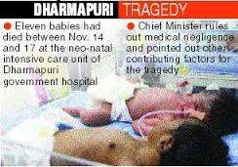
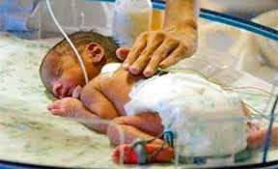
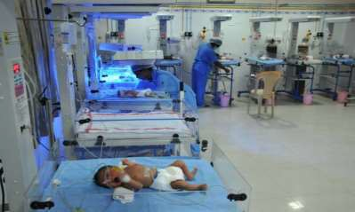

Slide 3

During the third week of November 2014 a series of neonatal deaths, unusually higher than expected, were reported to have taken place in the Dharmpuri government district hospital, Tamilnadu.
The Health Department looked at the performance of ICDS, the primary health centre, CHC.
Is medical negligence, the cause ????

Slide 4


OVERVIEW
Introduction
IMNC
What is IMNCI
  Rationale for an integrated evidence
  Components of the integrated approach
  Principles of integrated care
  IMNCI case management process
  F-IMNCI
Current status of IMNCI
4

Slide 5

INTRODUCTION
Developments related to child health
-- 1978- EPI
-- 1984- UIP
-- 1985- ORAL REHYDRATION THERAPY
-- 1990- UIP AND ORT UNIVERSALIZED
-- 1992- CSSM
-- 1997- RCH –I
-- 2005- NRHM AND RCH - II
-- 2013 - RMNCH + A
5

Slide 6

HISTORY
Over the past quarter century, child mortality has more than halved, dropping from 91 to 43 deaths per 1000 live births between 1990 and 2015. Yet in 2015 an estimated 5.9 million children still died before reaching their fifth birthday.
IMCI was first developed in 1992 by UNICEF and the World Health Organization (WHO) with the aim of prevention, or early detection and treatment of the leading childhood killers.

Slide 7

IMCI seeks to reduce childhood mortality and morbidity by improving family and community practices for the home management of illness, and improving case management of skills of health workers in the wider health system.
Key factors in the child’s immediate environment – nutrition, hygiene, immunization, ORT, breastfeeding.

Slide 8

IMCI
Premier strategy to provide prevention, treatment and care for
sick children and improve child survival.
To improve survival in countries with more than 40 deaths per 1000 live births.
Care for sick newborns.
Under one week of age was added in 2003, after which many countries renamed it as IMNCI.
Over 100 countries have adopted IMNCI and implemented it.
8

Slide 9

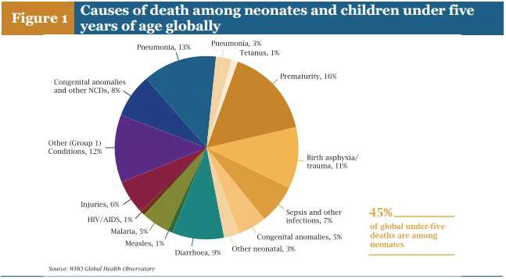
Source: UNICEF report 2015
9

Slide 10

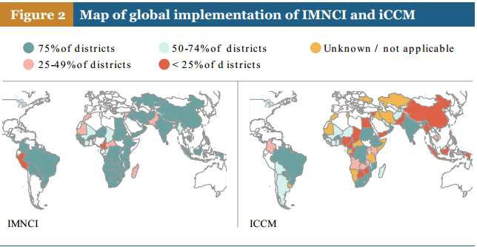
Source: UNICEF report 2015
10

Slide 11

NATIONAL GOALS
1990 |  | MDG 2015 | SDG
Infant Mortality Rate | 80 | <27 | -
Neonatal Mort rate | 53 | <20 | <12
U5M Rate | 107 | <42 | <25
Source:Health in 2015: from MDGs to SDGs- WHO
11

Slide 12

WHAT IS IMCI
IMCI is an integrated approach to child health that focuses on the well-being of the whole child. IMCI aims to reduce death, illness and disability, and to promote improved growth and development among children under five years of age.
IMCI includes both preventive and curative elements that are implemented by families and communities as well as by health facilities.

Slide 13

MAJOR ILLNESS
Strategy encompasses a range of interventions to
prevent and manage five major childhood illnesses
Acute Respiratory Infections
Diarrhoea
Measles
Malaria
Malnutrition
The major cases of neonatal mortality such as prematurity and
sepsis.

Slide 14

WHY INTEGRATED MANAGEMENT
First-level facilities do not have many diagnostic tools. Providing quality care to sick children is a serious challenge.
Integrates case management of most common childhood problems by -
Universal immunization , essential new born care, exclusive breastfeeding during first 6 months of life, appropriate complementary feeding , ORT, and timely appropriate use of antibiotics in pneumonia have proven to be effective.
14

Slide 15

IMCI Vs SINGLE - CONDITION APPROACHES?
The IMCI initiative adopted a broad, cross-cutting approach recognizing that in most cases, more than one underlying cause contributes to the illness of the child.
Children often suffering from more than one condition, so making a single diagnosis impossible.
Emphasizes prevention of disease through immunization and improved nutrition.
IMCI attempts to combine the lessons learned into an effective approach for managing the sick child.
15

Slide 16

WHY IMNCI
Focus on the most common causes of mortality.
Nutrition assessment and counselling for all sick infants and children.
Home care for newborns to promote exclusive breastfeeding.
Prevent hypothermia.
Improve illness recognition & timely care seeking.
Reduce infant and child mortality rates.
16

Slide 17

Features | Generic IMCI | India- IMNCI
Coverage of 0-6 days(early newborn period) | No | Yes
Basic health worker module | No | Yes
Home visit module by provider for care of newborn and young infant | No | Yes
Home based training | No | Yes
Duration of training on young infant | 2 Out of 11 Days | 4 out of 8 days
Sequence | Child first ,then young infant | Newborn/ young infant first then child.
IMCI t
o IMNCI in
INDIA
17

Slide 18
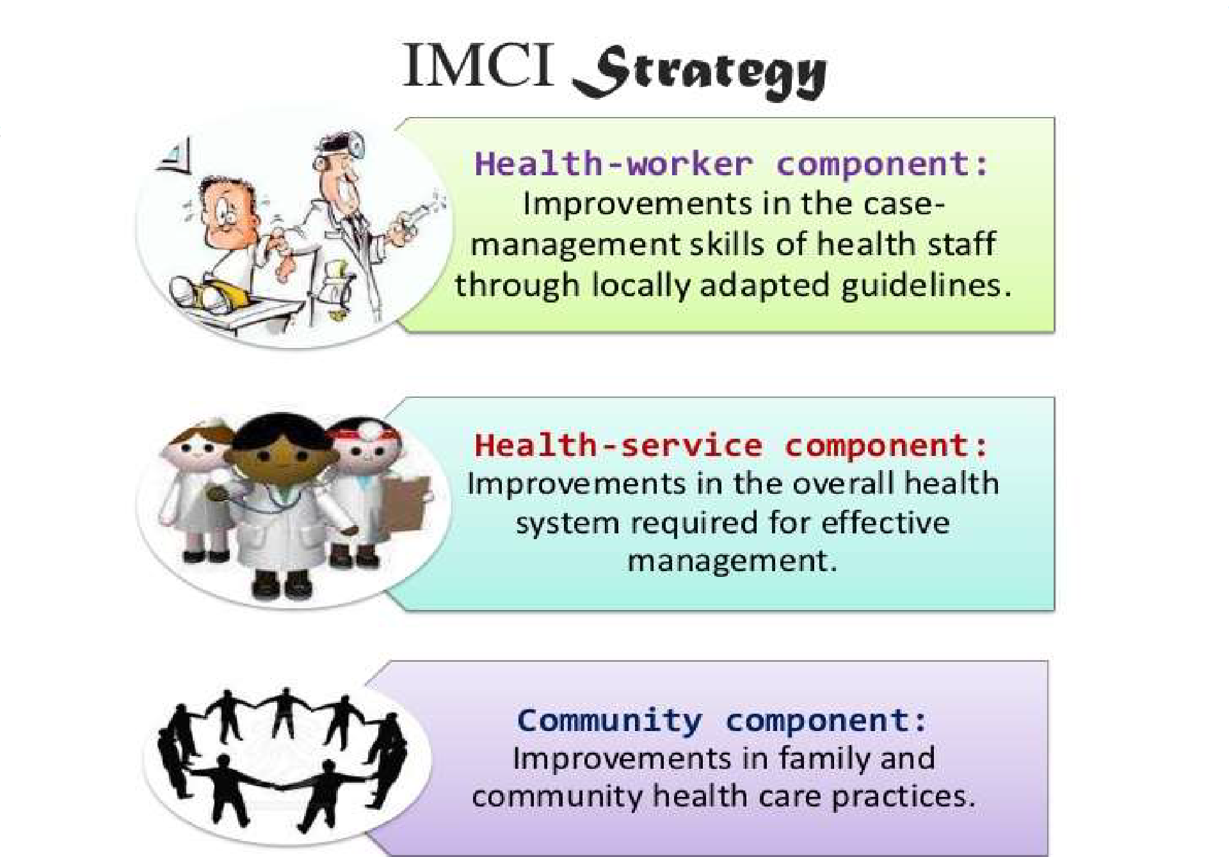

18

Slide 19

IMNCI COMPONENTS AND INTERVENTION
Improve health worker skills | Improve health systems | Improve family and community practices
Case management standards and guidelines | District and block planning management | Appropriate Care seeking
Training of facility- based public health care providers | Availability of IMNCI drugs | Nutrition
IMNCI roles for private | Quality improvement and | Home case management and
providers | supervision at health facilities – public and private | adherence to recommended treatment
Maintenance of competence among trained health workers | Referral pathways and services | Community services planning and monitoring
 |  | 19

Slide 20

IMNCI APPROACH
Syndromic approach
Holistic approach
Triage
Standardized Case Management
Primary Health Care Model
Community Participation
20

Slide 21



EVIDENCE BASED SYNDROMIC APPROACH
Reduced Child Death Individually
Vaccination | Oral Rehydration Therapy | Antibiotics
Fever
Overlapping Symptoms
Need For Integrated Approach
Difficulty Breathing
Diarrhoea
Cough
21

Slide 22

CASE MANAGEMENT PROCESS
TWO AGE CATEGORIES :
Young infants: From birth up to 2 months
Older children : From 2 months up to 5 years.
22

Slide 23

CORE INTERVENTIONS TO IMPROVE CHILD SURVIVAL
Combating pneumonia/ Sepsis
Combating diarrhoea
Nurturing newborns Infant feeding
Immunization
Combating malaria
23

Slide 24

PRINCIPLES OF IMNCI
Examine all sick children aged upto 5 years.
Assess for main symptoms.
Routinely check for nutrition, immunization, HIV status in
high HIV settings & other potential problems.
Classify the problem.
Use of limited drugs & active participation of caregiver.
Counselling of caregiver.

Slide 25

CLASSIFICATIONS
PINK : Patient requires URGENT hospitalization.
Give pre-referral treatment and Refer URGENTLY to hospital
YELLOW: Specific medical treatment and advice, as you do in
your OPD or Clinic.
GREEN : Simple advice on home management . May require
some home made safe remedy.

Slide 26












STEPS IN CASE MANAGEMENT
The basic steps in the management of the sick children are as
under:-
Assess the child for group of symptoms
Classify the severity of disease Identify treatment
Treat as per the plan. Counsel the mother.
Follow up care.
26

Slide 27

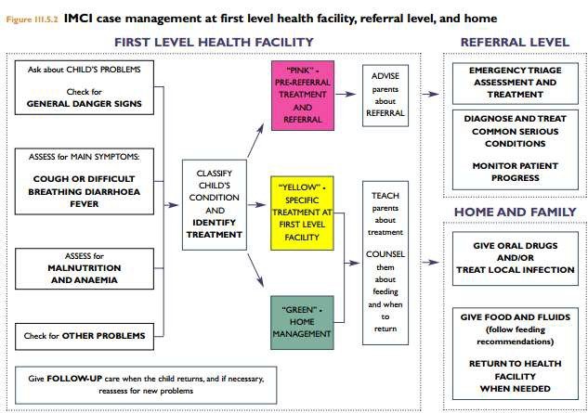
Source: Students’ Handbook for IMNCI Integrated Management of Neonatal and Childhood Illness
27

Slide 28

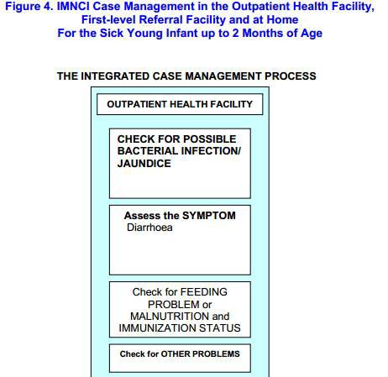
Source: Students’ Handbook for IMNCI Integrated Management of
Neonatal and Childhood Illness
28

Slide 29

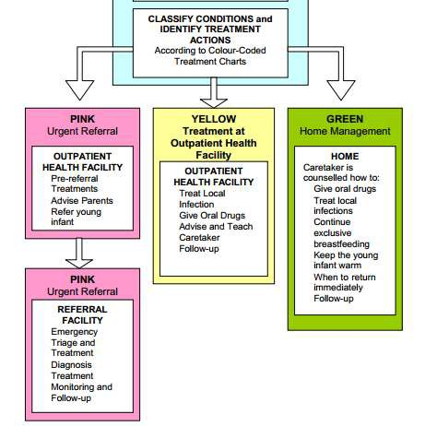
Source : Students’ Handbook for IMNCI Integrated Management of
Neonatal and Childhood Illness
29

Slide 30

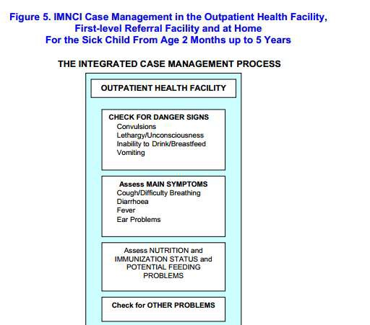
Source: Students’ Handbook for IMNCI Integrated Management of Neonatal and Childhood Illness
30

Slide 31

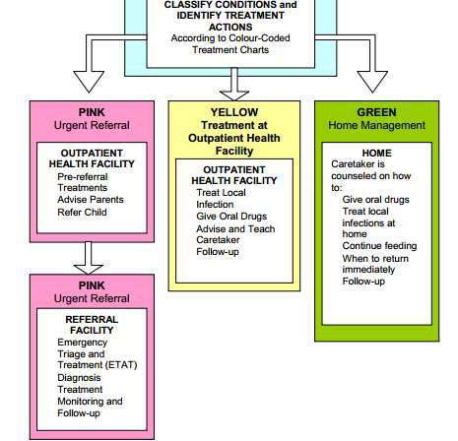
Source: Students’ Handbook for IMNCI Integrated Management of Neonatal and Childhood Illness
31

Slide 32

CARE OF NEWBORNS AND YOUNG
INFANTS (infants under 2 months)
Keeping the child warm
Initiation of breast feeding
Counselling for exclusive breast feeding
Cord , skin and eye care
Recognition of illness in newborn ,management and referral
Immunization
Home visits in the postnatal period

Slide 33

CARE OF INFANTS
(2 months to 5 years)
Management of diarrhoea, ARI , malaria and anaemia
Recognition of illness and at risk conditions
Prevention and management of Iron and Vitamin A deficiency
Counselling on feeding for all children below 2 years
Counselling on feeding for malnourished
Immunization

Slide 34

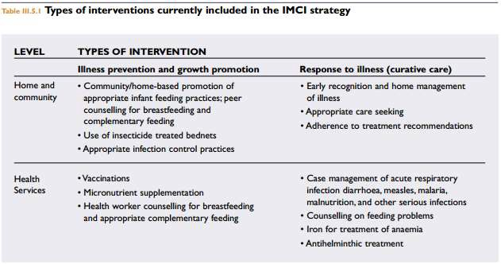
Source: Students’ Handbook for IMNCI Integrated Management of Neonatal and Childhood Illness
34

Slide 35

EVALUATION OF IMCI
Multi-Country Evaluation (MCE) to evaluate the impact, cost
and effectiveness of the IMCI strategy.
The results of the MCE indicate that:
IMCI improves health worker performance and their quality of care.
IMCI can reduce under-five mortality and improve nutritional status, if implemented well.

Slide 36

EVALUATION OF IMCI
IMCI is worth the investment, as it costs up to six times less per child correctly managed than current care.
Child survival programmes require more attention to activities that improve family and community behaviour.
The implementation of child survival interventions needs to be complemented by activities that strengthen system support.

Slide 37

PRE- SERVICE IMNCI
Adding IMNCI to the medical curriculum.
In medical colleges the need to include training on F-IMNCI in the training schedules –
Trained manpower in the public and private sector.
Undergraduate students and interns, during their postings in the Departments of Paediatrics and Preventive & Social Medicine.
Staff Nurse training on F-IMNCI in their training schedules.
37

Slide 38

C-IMNCI
Community IMCI meant to empower communities and households to adopt healthy and safe practices to protect the health of children under 5 years of age.
In 2011 WHO and UNICEF further developed Caring for newborns and children in the community, guidance that includes home visits for newborn care and for children’s healthy growth and development, and integrated community case management (iCCM) by community health workers (CHWs).
To diagnose and treat diarrhoea, malaria, and pneumonia among children 2-59 months, and to detect severe acute malnutrition in children 6-59 months, in communities where access to facility- based health services is poor.
38

Slide 39

F-IMNCI
IMNCI + the Facility Based Care Package.
It provides a continuum of quality care for severely ill newborns and children from the community level to the facility.
From 10th November 2009 IMNCI has been re- structured as
F- IMNCI with added component of :
-Asphyxia Management
-Sepsis, Pneumonia
- Meningitis, Severe Malnutrition

Slide 40






F-IMNCI
Skill building of the medical officers and staff nurses & ANM at 24/7 PHCs, CHCs and DH.
F-IMNCI
Master trainers at state level and district level are
Paediatricians from Tertiary hospital and medical colleges.

Slide 41

F-IMNCI PACKAGE
Developed by a committee of experts constituted by the Ministry of health and welfare, India.
Members from professional bodies like the IAP
Members from National Neonatology Forum
HOD’s of Paediatrics from Medical colleges
Field level experts.
41

Slide 42

ETAT
IMNCI Plus ETAT
(Emergency Triage Assessment and Treatment)
Triage
Maintain temperature
Check & Treat hypoglycaemia
Airway & Breathing
Give oxygen
Circulation
Coma and convulsions
Dehydration

Slide 43

FACILITY BASED NEWBORN CARE
Facility based care of sick young infants -
Care at birth including neonatal resuscitation
Care of newborn in postnatal ward
Management of sick newborn
Management of low birth weight babies
Neonatal transport

Slide 44

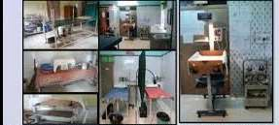
NEWBORN CARE CORNER (NBCC)
Space within the delivery room, to provide immediate care.
In India as of 2015- 16,968 NBCC are operational.
44

Slide 45

NEWBORN STABILIZATION UNIT (NBSU)
Facility within or in close proximity to maternity ward.
Care for sick, low birth weight babies.
Should be present in all FRU/CHC.
4 bedded unit, with 2 beds in postnatal ward.
As of 2015- 2228 NBSU are functional.
45

Slide 46
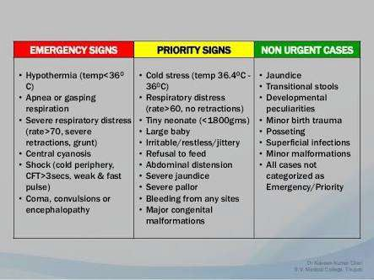
CRITERIA TO ADMIT IN NBSU
46

Slide 47


SPECIAL NEWBORN CARE UNIT
It’s a neonatal unit.
Hospitals with more than 3000 deliveries a year will have a SNCU.
Equipped with 12 beds.
As of 2015 – 602 SNCU are functional.

Slide 48

NAVJAT SISHU SURAKSHA KARYAKRAM
[NSSK] training has been incorporated in the F-IMNCI training programme itself.
Train health personnel in basic newborn care at birth issue.

Slide 49

HOME BASED NEWBORN CARE
Objective is to reduce neonatal mortality and morbidity-
By provision of essential newborn care ,and complications.
Early detection and special care for LBW babies.
Early identification of illness and prompt referral.
Support family to adopt healthy practices.
prevent

Slide 50

IMNCI STATUS- INDIA
Operationalised in more than 500 districts.
Physicians, nurses, AWWs, and ASHAs trained under IMNCI.
26,800 medical officers and specialists are trained.
CHCs/FRUs staffs trained under F-IMNCI.
50

Slide 51

IMNCI STATUS- TAMILNADU
As per the Government of India (GOI) operational guidelines, NHM has initiated IMNCI training in a phased manner based on IMR.
IMNCI training was initiated in 2007-08 and at present all 31
districts have been covered.
The Institute of Child Health, Chennai is the nodal centre for IMNCI training.
Health and nutrition field functionaries are being trained for 8 days in IMNCI, addition to the supervisory staffs who are being additionally trained for 3 more days on issues and solutions pertaining to the implementation of the programme at the grass root level.
51

Slide 52

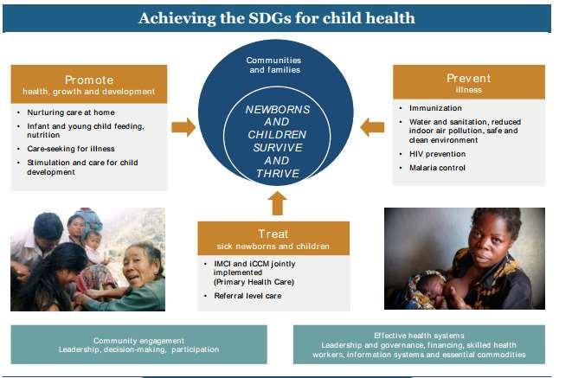
IMNCI -SDG
Source: Towards a Grand Convergence for Child Survival and Health November 2016 ,WHO
52

Slide 53

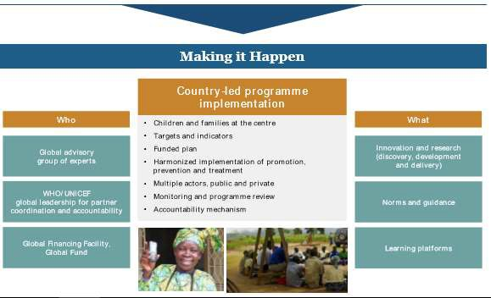
Source: Towards a Grand Convergence for Child Survival and Health November 2016 ,WHO
53

Slide 54

CONCLUSION
IMNCI was better implemented when:
The health system context was favourable.
A systematic approach to planning and implementation was used.
Political commitment and community involvement.

Slide 55

SUMMARY

Slide 56

REFERENCE
Park’s Textbook of preventive and social medicine 24th edition
National health programs of India J.Kishore 11th edition
Towards a Grand Convergence for Child Survival and Health November 2016 ,WHO
http://www.nrhmtn.gov.in/rchtrglist.html
Students’ Handbook for IMNCI Integrated Management of Neonatal and Childhood Illness
WORLD HEALTH ORGANIZATION Country office for India, Ministry of Health & Family Welfare Government of India 2003
Facility Based IMNCI (F-IMNCI) Facilitators Guide, Ministry of Health &
Family Welfare Government of India New Delhi 2009
Operational Guidelines for Implementation of Integrated Management of Neonatal and Childhood Illness (IMNCI)
India Newborn_Action_Plan_(INAP),NHM 2014

Slide 57

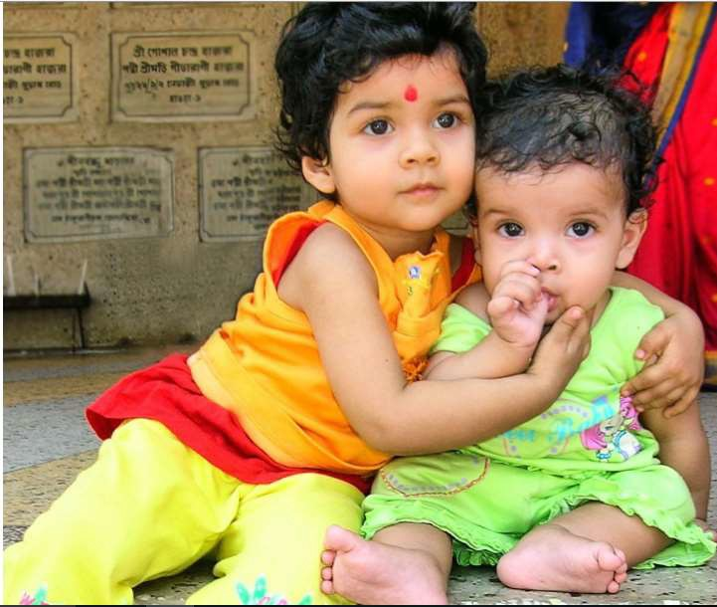
THANKYOU

