Slide 1
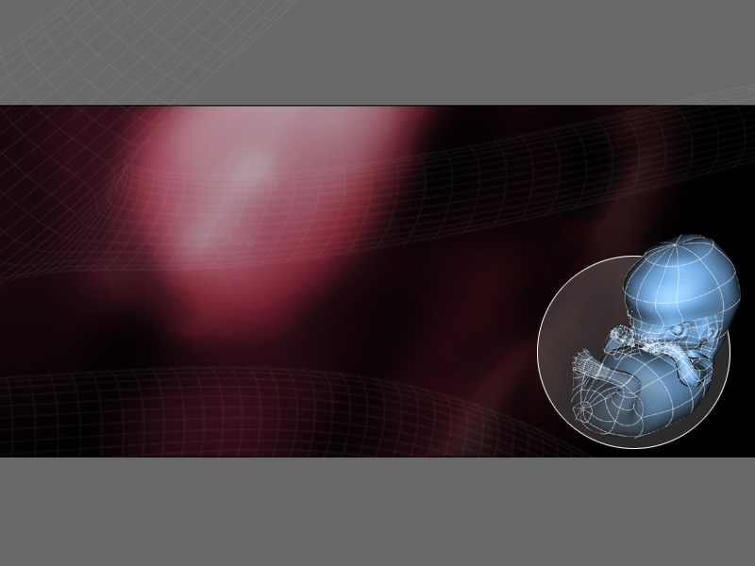
EMBRYOLOGY
OOGENESIS
Dr. Manoj Kulkarni
Associate Professor
Department of Anatomy
S.B.K.S.M.I. & R.C.

Slide 2
  REPRODUCTIVE ORGANS/ GLANDS
  Primary reproductive organ
  Ovary :
  Produces oocytes, estrogens and progesterone
  Accessory reproductive organs/ glands –
    Fallopian tubes: Transport of Gametes & Fertilization
    Uterus: Implatation & Growth of fetus
    Vagina : external genitalia
    Mammary glands: Feeding of newborn

Slide 3
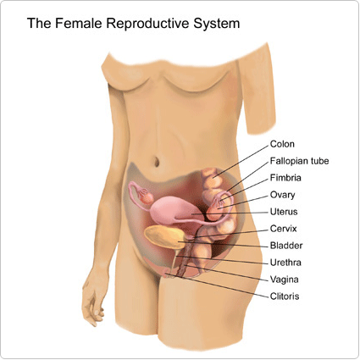

Slide 4
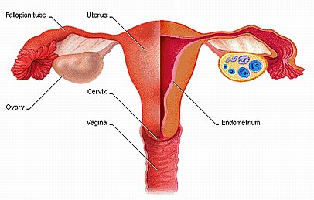

Slide 5
OOGENESIS
Defination:Sequence of events by which oogonia are transformed into mature oocytes.
Begins before birth and is completed after puberty and continues till menopause.
1)Prenatal maturation of oocytes.
2)Postnatal maturation of oocytes.

Slide 6
Prenatal Maturation of Oocyte
Primordial germ cells differentiate into oogonia
The oogonia undergo a number of mitotic divisions to form a cluster of cells (3rd month intra uterine life)
Oogonia enlarged to from primary oocyte before birth
Primary oocyte get surrounded by flattened cell– primordial follicle
These primary oocyte enter meiosis I and arrest their cell division in prophase

Slide 7
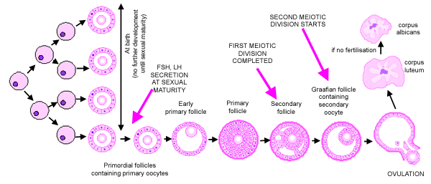

Slide 8
Oogenesis
      At the time of birth all primary oocytes have started prophase but stop at diplotene stage called resting stage.
      Total number of primary oocytes at birth are 600000—800000.
      At puberty only 400000 are present, rest degenerate.
      During reproductive phase approx. 500 will be ovulated
      Each month approx. 15 -20 primordial follicles begin to mature.

Slide 9
Postnatal maturation of oocyte
No primary oocytes form after birth in females
Further maturation of primordial follicles begins during puberty
A group of follicles begins to develop, one follicle ovulation will ovulate each month
Primary oocyte completes first meiotic division just before ovulation,cytoplasm division unequal

Slide 10
Maturation of Primordial Follicle
There are three phases of maturation –
1) Primary follicle
2) Secondary follicle
3) Graffian follicle

Slide 11
Primary Follicle
      - Primary oocyte is surrounded by flat follicular cells.
      - These cells are separated from ovarian stroma by basement membrane
      - Flat follicular cells become cuboidal and then stratified
      - These stratified cells are called granulosa cells.
- The granulosa cells and oocyte secrete a glycoprotein which forms a layer called zona pellucida

Slide 12
Primary Follicle
      Zona pellucida is separated from oocyte by previtelline space.
      Granulosa cells and oocyte form microvilli which penetrate and interdigitate within the zona pellucida
      Thus a primary follicle is formed.
      Therefore a primary follicle has following structure inside out--
a) Primary oocyte
b) Previtelline space
c) Zona Pellucida
d) Granulosa cells.

Slide 13
Primary Follicle
The ovarian stroma cells around primary follicle differentiate to form theca folliculi (box) which has two layers --
a) Inner – Secretory called theca interna which is vascular and produces follicular fluid, estrogen and progesterone.
b) Outer –Fibrous capsule called theca externa which merges with ovarian stroma

Slide 14
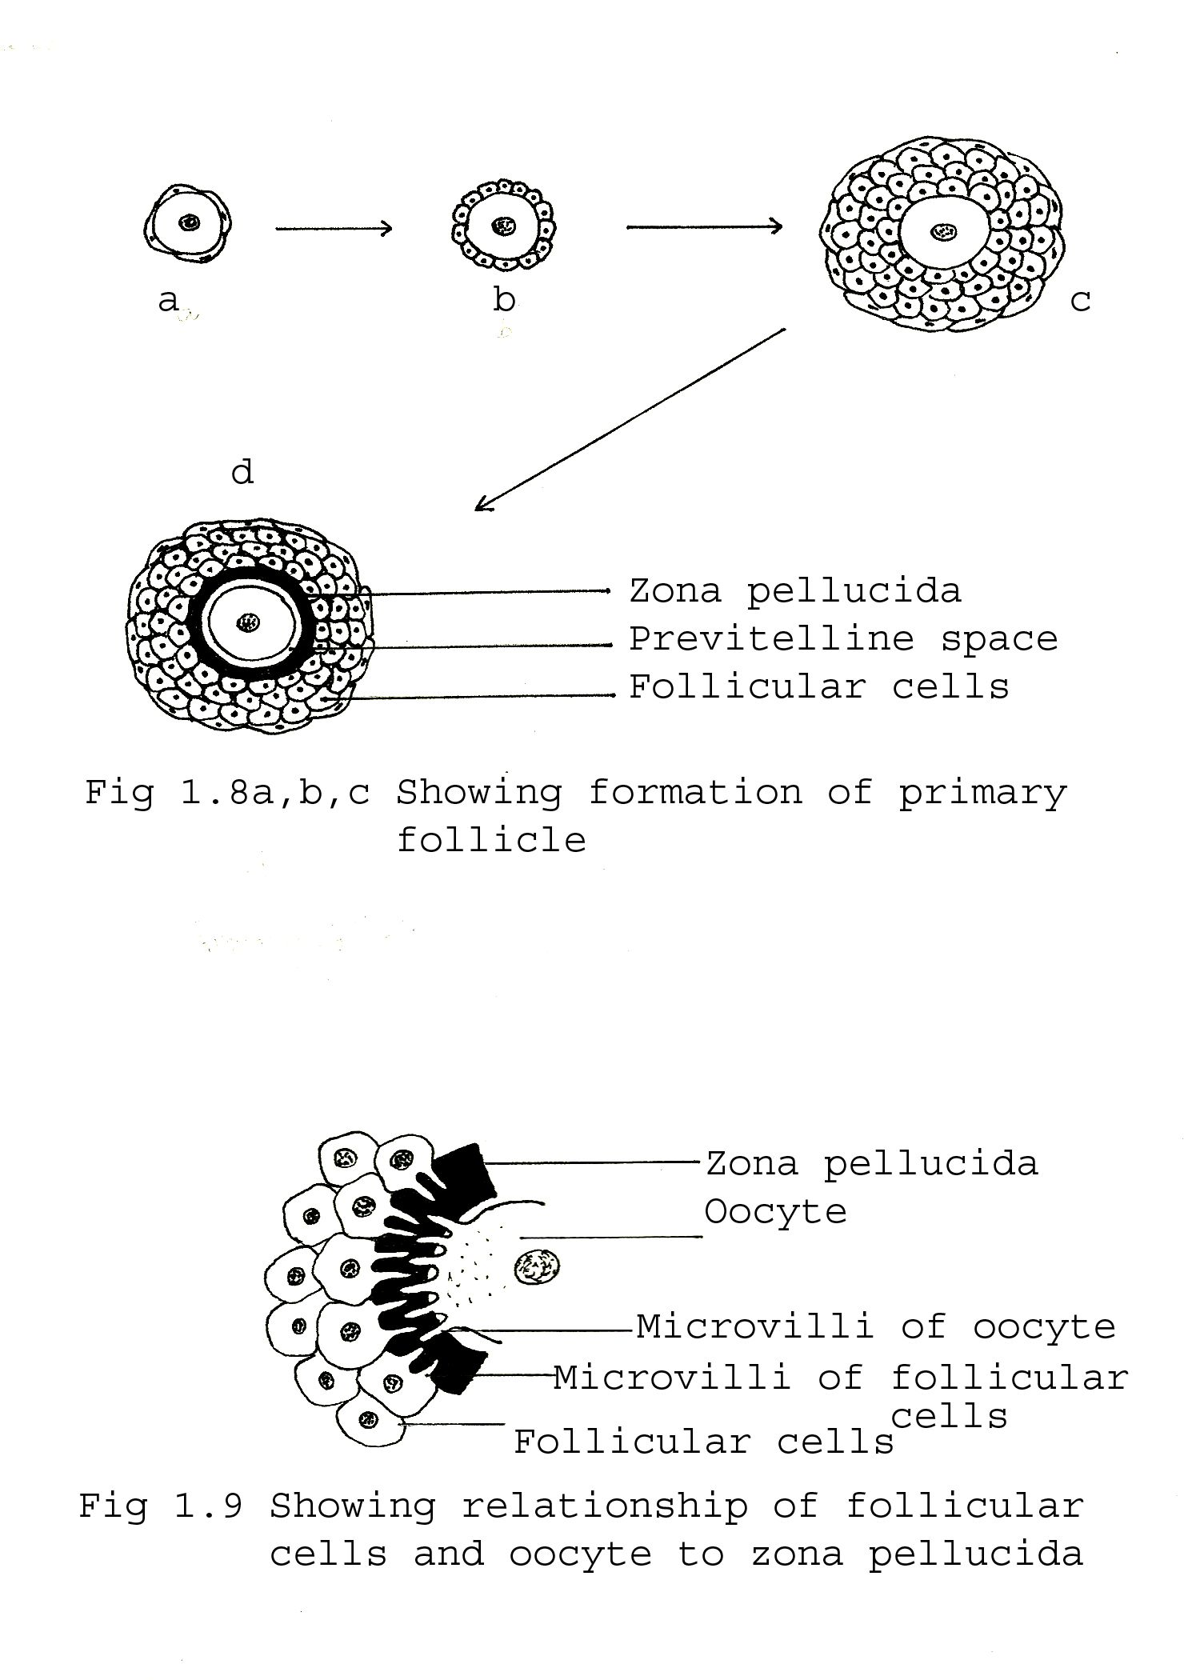
Primary Follicle

Slide 15
Primary Follicle

Slide 16
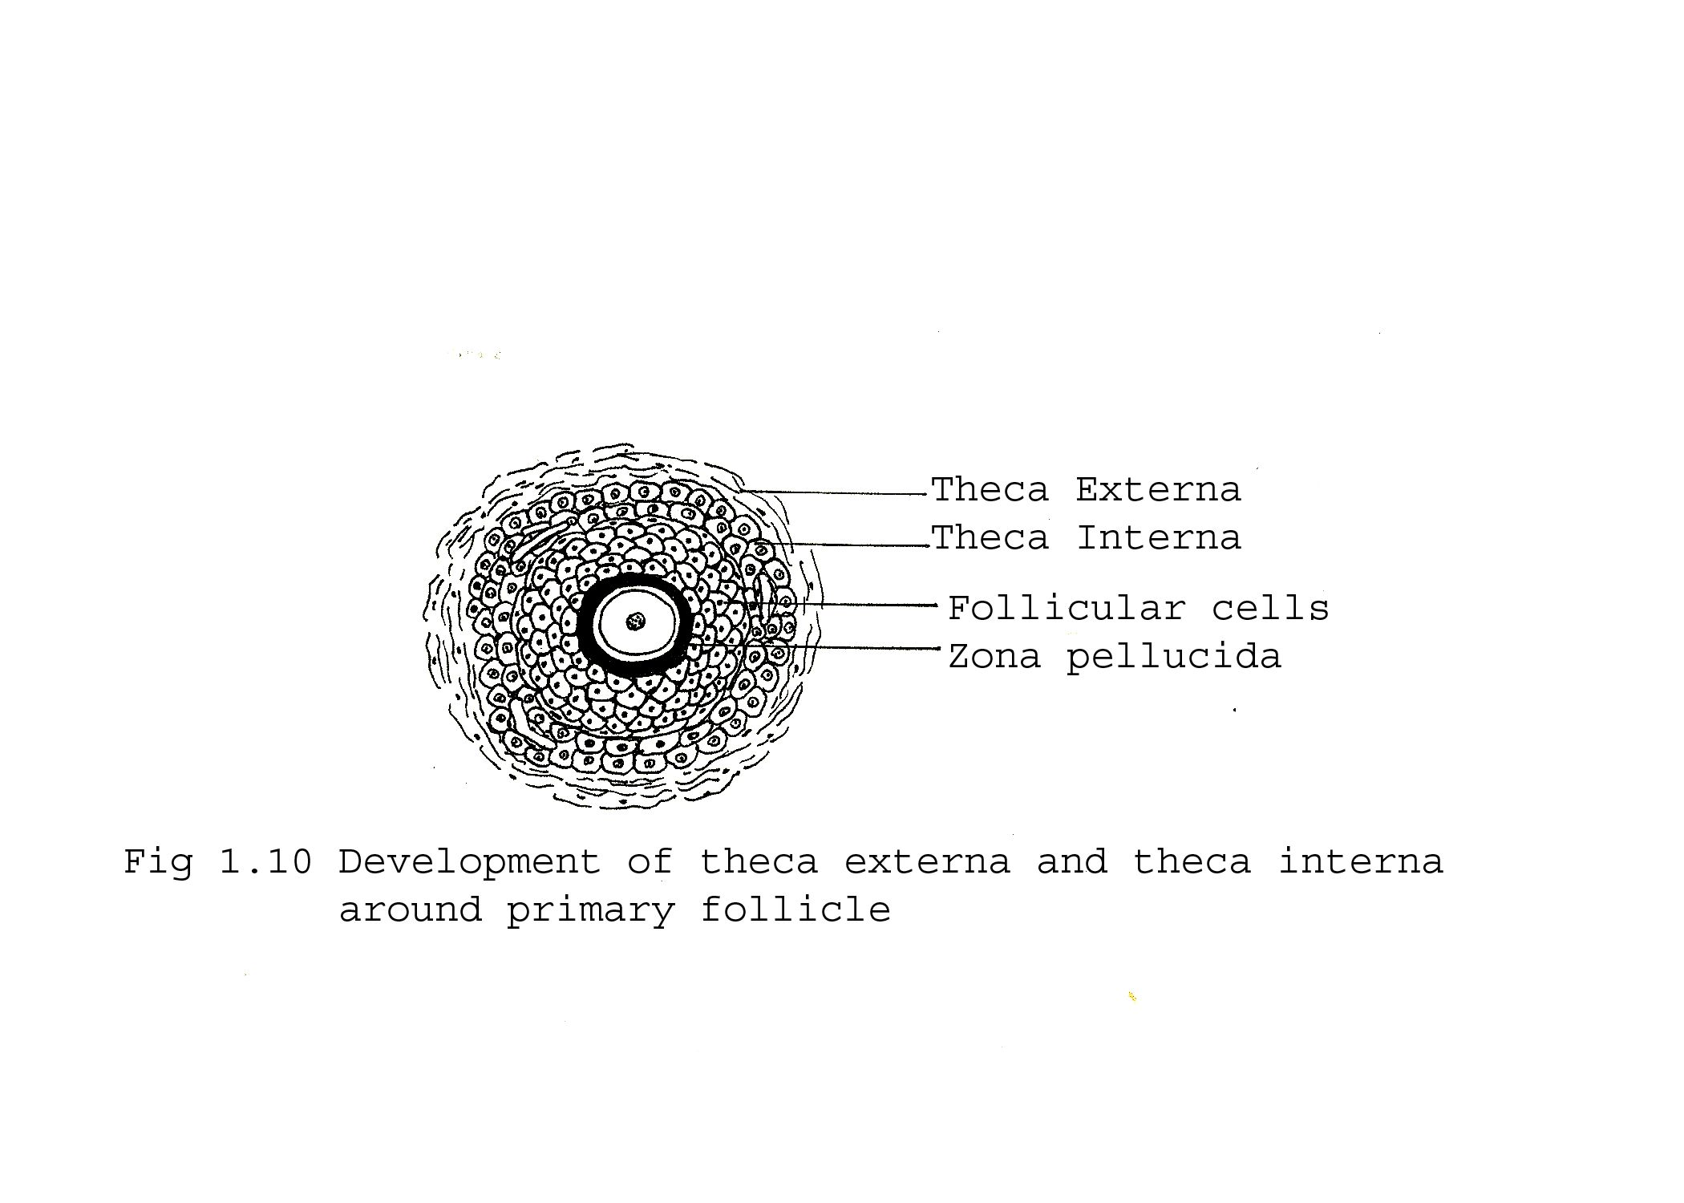
Development of Theca

Slide 17
Secondary follicle
        Fluid filled spaces appear in granulosa cells (a)
        These spaces fuse to form follicular antrum containing follicular fluid. (b)
        As the follicular antrum enlarges, the primary oocyte is pushed to one side.
        The granulosa cells surround the oocyte and project into follicular antrum
These granulosa cells form cumulus oophorus

Slide 18
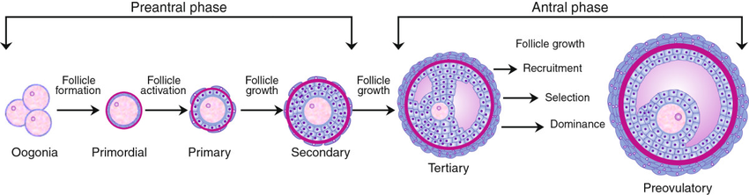

Slide 19
Graffian follicle
        Under the effect of increased LH the mature secondary follicle undergoes Pre-ovulatory growth period.
        Meiosis I is completed, one daughter cell is big (1n) and is called secondary oocyte.
        The other daughter cell is shed in previtelline space as first Polar body
        The secondary oocyte then enters meiosis II but before ovulation is arrested (metaphase II).
        It is completed only if fertilization occurs.
        With each ovarian cycle only one Graffian follicle reaches full maturity, rest degenerate.

Slide 20
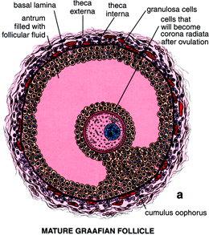

Slide 21
OVULATION
- Sudden increase in growth of Graffian follicle
- Results in swelling and stigma on the surface of
ovary
- Smooth muscle in theca externa contract which increases intra follicular pressure
- This causes the separation of secondary oocyte along with cumulus oophorus and floats in follicular fluid
- Enzymatic digestion of follicular wall causes stigma to rupture

Slide 22
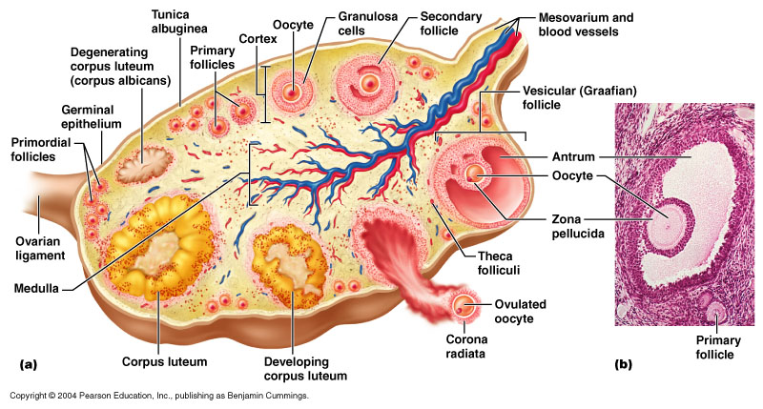

Slide 23
Thus the secondary oocyte surrounded by cumulus cells is expelled out with follicular fluid
After ovulation the follicular (cumulus) cells get radially arranged and are called corona radiata

Slide 24
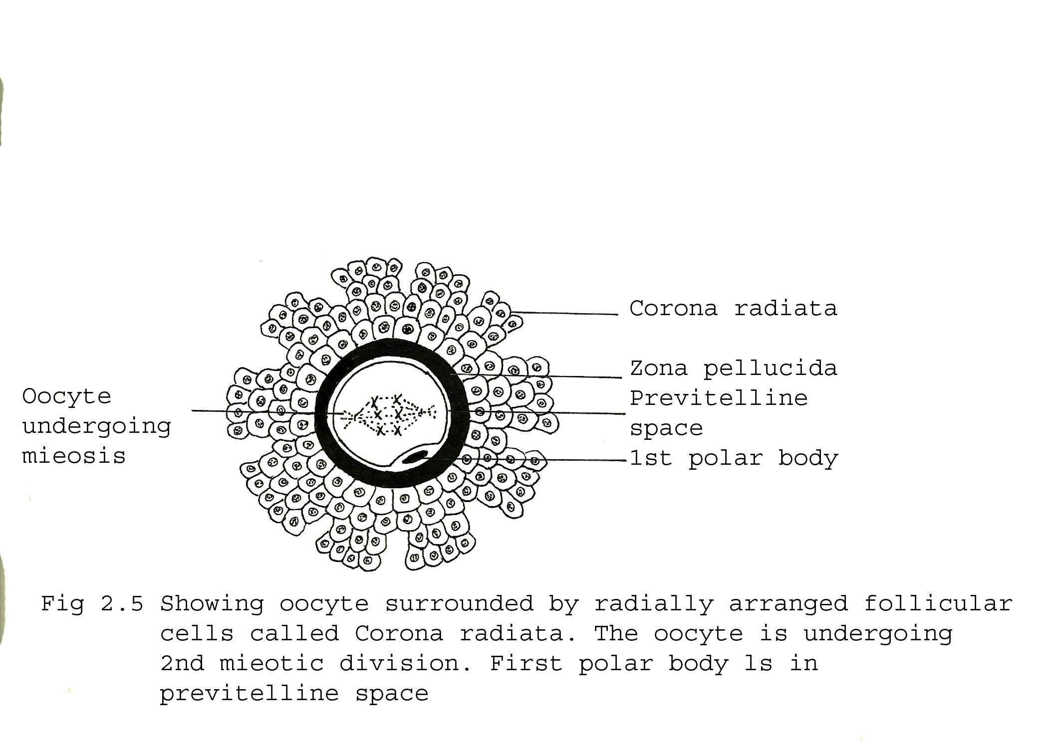
OOCYTE WITH CORONA RADIATA

Slide 25
Atretic follicle
Several ovarian follicles start maturing during each ovarian cycle, but only one attains full maturity and undergoes ovulation.
The other follicles degenerate and form atretic follicles

Slide 27
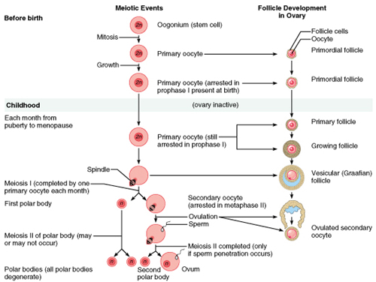

Slide 28
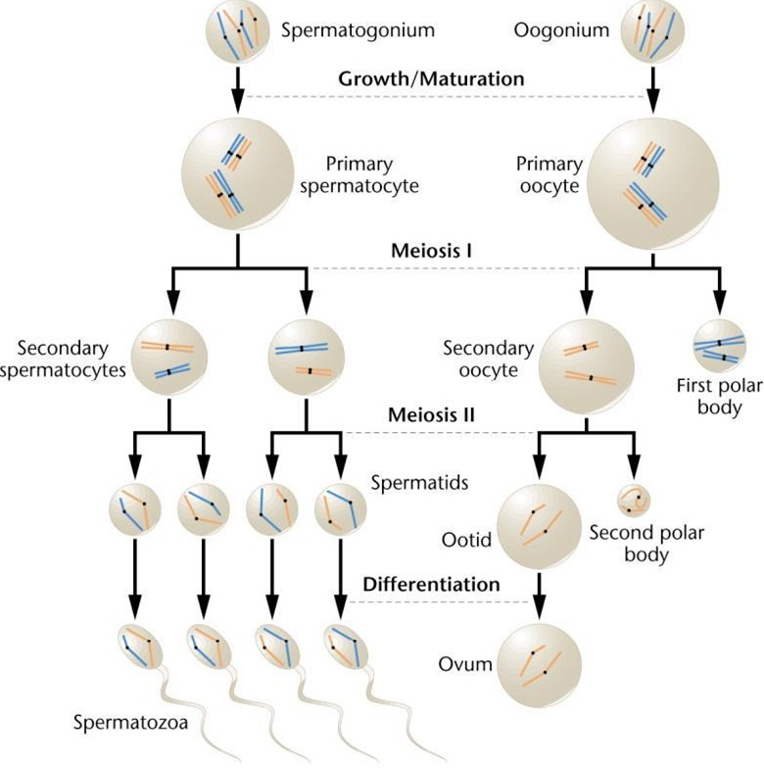

Slide 29
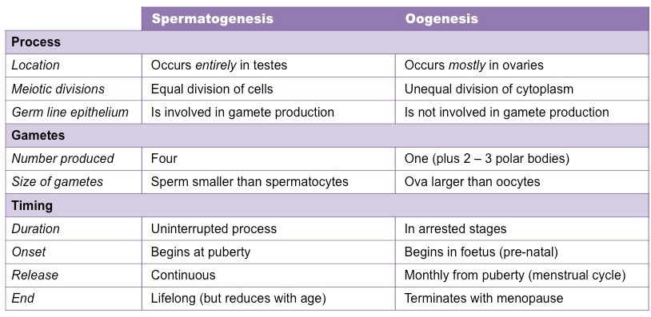

Slide 30
MCQ
Q. 1 Follicular cells are derived from
Surface epithelium of ovary
Fibroblast
By division of oocyte
From capillaries

Slide 31
MCQ
Q. 2 Zona pellucida is produced by
Oocyte
Follicular cells
Oocyte and Follicular cells
d) None of the above

Slide 32
MCQ
Q. 3 First polar body lies in
Oocyte
Previtelline space
Zona pellucida
Follicular cells

Slide 33
MCQ
Q. 4 The ovum released during ovulation is
Primary Oocyte arrested in meiosis
Secondary oocyte arrested in meiosis
Primary oocyte which has complete first meiotic division
secondary oocyte which has complete second meiotic division

Slide 34
MCQ
Q. 5 False about oogenesis is
First polar body receives little cytoplasm
Secondary oocyte will complete second meiotic division only if ovum is fertilized
Oogeneisi begins at puberty
No oogenesis after menopause

Slide 37
Corpus Luteum
After ovulation the wall of the follicle collapses and gets thrown into folds.
The follicular cells enlarge and become polyhedral in shape. The cytoplasm is filled with yellow pigment and are now called lutein cells.
The corpus luteum secretes progesterone

Slide 38
Corpus luteum of Menstruation
The fate of the corpus luteum depends on whether the ovum is fertilized or not.
The corpus luteum persists for 12-14 days if there is no fertilization and secretes progesterone. (the corpus luteum of menstruation)
It then degenerates and becomes a mass of fibrous tissue called the corpus albicans.

Slide 39
Corpus luteum of preganancy
It the ovum is fertilized and pregnancy occurs then for four months it is called the corpus luteum of pregnancy.
The progesterone secreted is essential to maintain the pregnancy during the first few months till the placenta takes over the function of secretion of progesterone.
After that it degenerates to form corpus albicans.

Slide 40
Symptoms of ovulation –
1) Mittelschmerz – Sudden constant pain in inferolateral part of abdomen caused by slight bleeding in the peritoneal cavity during ovulation.
2) Basal body temperature slightly falls followed by sustained rise after ovulation.

Slide 41
Comparison of Gametes
Secondary Oocyte
Large in size
Immotile
Large amount of cytoplasm
Contains yolk granules
Regular shape of cell with cell organelles
Sex chromosomes only of one kind
22 X
Spermatozoa
Small in size
Highly motile
Very little cytoplasm
No yolk granules
Has a specific shape having head and tail with limited organelles
Sex chromosomes of two kinds
22X/22Y

Slide 42
FEMALE REPRODUCTIVE CYCLE
Commencing at puberty & continuing throughout the reproductive years , monthly reproductive cycles
These monthly cycles prepare the reproductive system for pregnancy.
Consists of 1)Ovarian cycle
2)Endometrial (menstrual) cycle

Slide 43
Ovarian Cycle
Each cycle-FSH, LH
Follicular development
One will mature and ruptures through the surface of the ovary ( Ovulation)
Copus luteum

Slide 44
Follicular Development
Growth and differentiation of primary oocyte
Proliferation of follicular cells
Formation of zona pellucida
Development of the theca folliculi

Slide 45
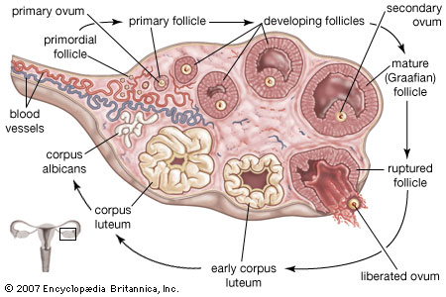

Slide 46
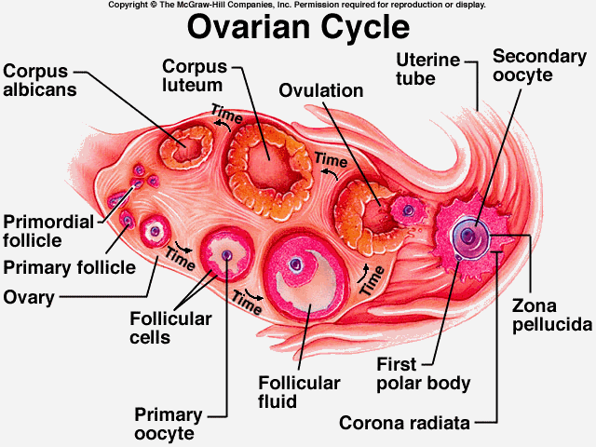

Slide 47
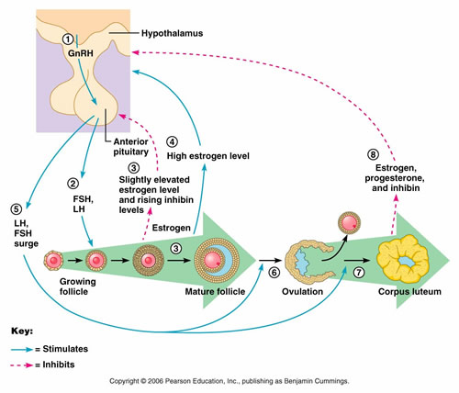

Slide 48
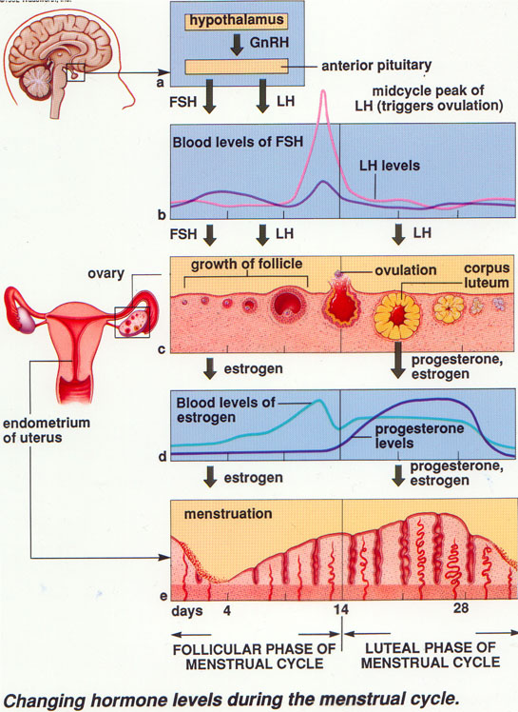

Slide 49
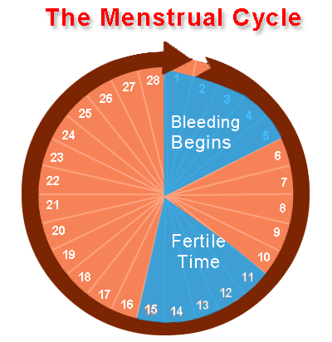

Slide 50
ANSWERS
1. a
2. c
3. d
4. b
5. d

Slide 51
Title | Author/ Journal | Material | Result | Summary
The bottleneck: mitochondrial imperatives in oogenesis and ovarian follicular fate | Robert P.S Jansen, Kylie de Boer Molecular and Cellular Endocrinology Volume 145, Issues 1–2, 25 October 1998, Pages 81–88 | We review here in detail the passage of mitochondria through the female germ cell line. | maintaining the integrity of mitochondrial inheritance is such a strong evolutionary imperative that we should expect at least some features of ovarian follicular formation, function and loss to be primarily adapted to this specific purpose. | that to prevent accumulation of mild mitochondrial genomes in the population there is a need for physiological female sterility prior to total depletion of ovarian oocytes, a phenomenon for which there is empirical evidence and which we term the oöpause.

Slide 53
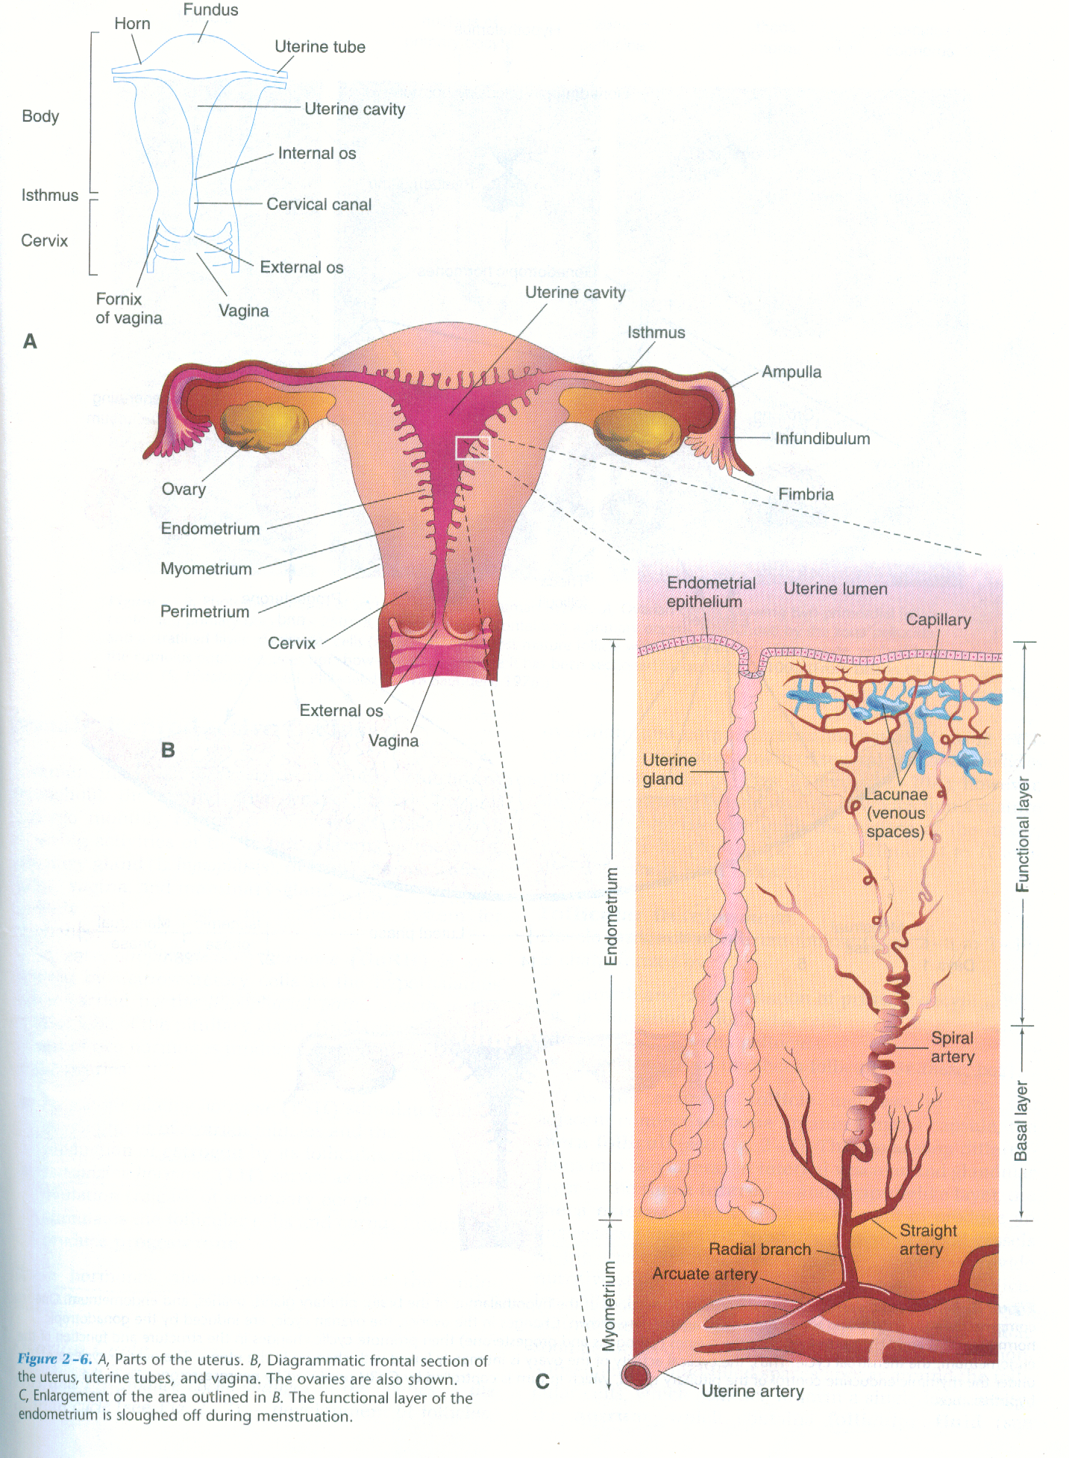

Slide 54
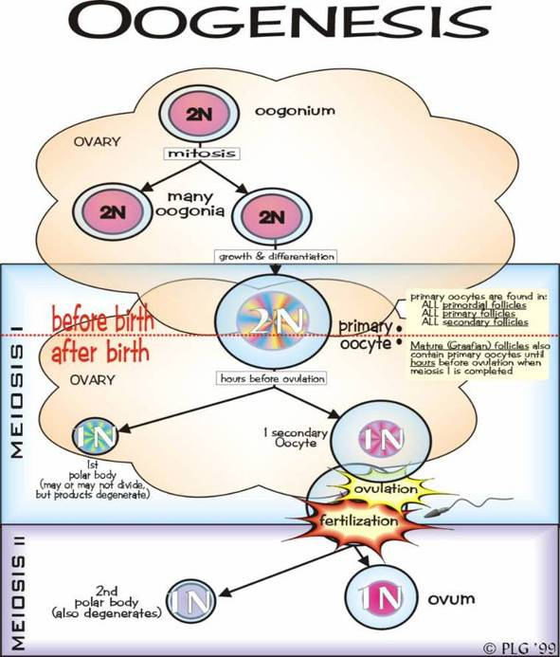

Slide 55
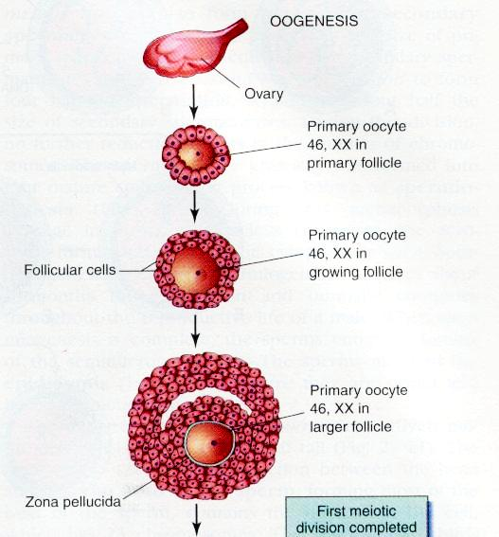

Slide 56
