Slide 1
MACRONUTRIENTS
AND
DIET IN MEDICAL ILLNESS
Dr Pathik Thakkar.
SBKS MIRC

Slide 2
NUTRITION-DEFINITION
It is defined as the process by which the organism utilizes food.
It signifies the dynamic process in which the food that is consumed is absorbed ,metabolized and used for nourishing the body

Slide 3
TYPES OF NUTRIENTS
DEFINITION-Nutrients are the chemical substances in the food that the body uses for functions that supports growth ,tissue maintenance and repair.
TYPES OF NUTRIENTS-
1.Carbohydrates
2.Proteins
3.Fats
4.Vitamins
5.Minerals
6.Water

Slide 4
ESSENTIAL NUTRIENTS | NON-ESSENTIAL NUTRIENTS
Not synthesized in the body or not synthesized adequately | Can be synthesized by the body
They need to be provided by the diet and include- Carbohydrates Essential amino acids Vitamins Minerals Water | They include Glucose Cholesterol Non-essential amino acids

Slide 5
CARBOHYDRATES
They are the major source of energy
Carbohydrates Simple Sugars Complex Carbohydrates Polysaccharides
Monosaccharides Disaccharides

Slide 6
MONOSACCHARIDES-Glucose
-Galactose
-Fructose
DISACCHARIDES-Sucrose=Glucose+Fructose
-Lactose=Glucose+Galactose
POLYSACCHARIDES-Maltodextrin-It is a glucose polymer obtaines by partial hydrolysis of cornstarch
-Starch ,glycogen and fibre are examples of complex carbohydrates
45-65% of the calories in food are from carbohydrates

Slide 7
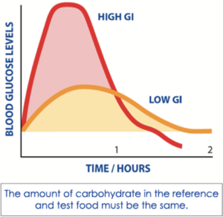
GLYCEMIC INDEX
It is the measure of the extent to which blood glucose is raised by 50gm portion of a carbohydratecontaining food and compared to 50gm of glucose or white bread
The Glycemic Index (GI) is a relative ranking of carbohydrate in foods according to how they affect blood glucose levels. Carbohydrates with a low GI value (55 or less) are more slowly digested, absorbed and metabolised and cause a lower and slower rise in blood glucose and, therefore usually, insulin levels

Slide 8
LOW GLYCEMIC INDEX-55 or LOWER | MEDIUM GLYCEMIC INDEX-55 to 69 | HIGH GLYCEMIC INDEX-70 or HIGHER
Apple | Sugar | Glucose
Orange | Brown rice | French bread
Mango | Chapati | Baked Potato
Banana | Sweet Potato | Cake
Grapefruit | Cherry | Cornflakes
Milk |  | White rice
Milk Chocolate |  | Watermelon
Carrot(raw) |  | Carrot(cooked)

Slide 9
PROTEINS
Protein means of prime importance
FUNCTIONS-
Help in body building and tissue repair
Form enzymes, hormones ,antibodies and also help in transporting other nutrients
Specific Dynamic action[SDA] or
Thermic effect of food[TEF] for protein (29%) is much higher than that of carbohydrate and fat(5%)-This is the energy used during digestion.

Slide 10
AMINO ACIDS-BUILDING BLOCKS OF PROTEIN
24 AMINO ACIDS 8 ESSENTIAL 16 NON-ESSENTIAL
Valine,leucine,isoleucine,lysine,tryptophan,methionine,
threonine and phenylalanine are esssential amino acids.
Histidine is essential in infants.
In Low Birth Weight Babies-Arginine ,cysteine and taurine are also essential.
Glutamate-An ANTISTRESS NUTRIENTpresent in largest amount in plasma.It is a neuroregulator and precursor for GABA.

Slide 11
Egg and Breast milk are the best quality of protein
REFERENCE PROTEIN-Egg protein for the ease of making it available for laboratory reference.
-The quality of dietary protein is basedon the extent to which it deviates from the reference protein.
-The chemical score of a food item is the precentage of the limiting amino acids in the food item compared to the level of same amino acid in the refernce protein.eg-lysine is limiting incereals ,whereas methionine is limiting in legumes(pulses).
GLUCOGENIC AMINO ACIDS
Amino acids which can be converted to glucose are glucogenic amino acids.Eg-Lysine and Threonine.

Slide 12
MEASURES OF PROTEIN QUALITY:
1.DIGESTIBILITY COEFFICIENT:Amount of absorbed nitrogen compared to the total nitrogen present in the food.
-Cooking improves digestibility as Trypsin inhibitor present in soyabean and egg white ,which decreases digestibility ,gets destroyed on cooking.
DC=Absorbed nitrogen ×100
Food nitrogen
2.BIOLOGICAL VALUE:BV=Retained nitrogen ×100
Absorbed nitrogen

Slide 13
3.NET PROTEIN UTILIZATION:
NPU=Retained nitrogen × 100
Food nitrogen
Egg has the highest NPU
4.PROTEIN EFFICIENCY RATIO(PER):Refers to gain in weight in experimental animalsper unit weight of protein consumed.

Slide 14
PROTEIN QUALITY OF FOOD ITEMS
EGG has the highest BV ,NPU and PER and is considered as the best protein.
ITEM | BV | NPU | PER
Egg | 96 | 96 | 3.8
Cow milk | 90 | 85 | 2.8
Meat | 74 | 76 | 3.2
Fish | 80 | 74 | 3.5
Rice | 80 | 77 | 1.7
Wheat | 66 | 61 | 1.3
Bengal gram | 74 | 61 | 1.1

Slide 15
FATS(LIPIDS)
Fats provide Essential Fatty Acids(EFA)
EFA are Polyunsaturated fatty acids(PUFA)
EFA used to be termed the “Queen Of Vitamins” and then it was designated as Vitamin F.
EFA-Linoleic acid and Linolenic acid ,present in ratio of 5:1 to 10:1.
Among PUFA,omega-6 to omega-3 ratio of 5:1 is desirable.High omega-6 and low omega-3 content as in groundnut ,sunflower and safflower oils-leads to
-Free radical disease,angiotoxicity ,impaired immune function,reduced glucose tolerance ,increased platelet
Aggregation and albuminuria.

Slide 16
LONG CHAIN POLYUNSATURATED FATs Derived From
Linoleic Acid Alfa Linolenic Acid
-Archidonic acid -Eicosa pentaenoic acid
-Adrenic acid -Docosa hexaenoic acid
DHA are the building blocks of brain lipids
EPA is cardioprotective
Deficiency of LCPs may lead to co-morbid conditions like dyslexia ,dyspraxia and hyperactivity.

Slide 17
DIETARY FATS
Visible Fats Invisble Fats
-Oil ,Ghee ,Butter -Present in food items
Average Indian diet supplies 25-30% of calories as fats,maximum permitted is upto 45%.
1-3% of calories should come from EFA.
Phrynoderma(toad skin) responds to EFA.
MEDIUM CHAIN TRIGLYCERIDES(MCT):They can be absorbed directly into portal vein even during fat malabsorption.Eg-Coconut oil.
Monounsaturated fatty acids raise HDL cholesterol.

Slide 18
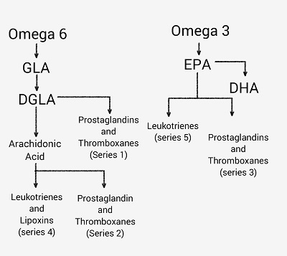

Slide 19
EPA compete with ARA in in the cyclo-oxygenase pathway.Normally ,ARA is converted to prostacyclin and thromboxane A2.Prostacyclin is potent vasodilator and platelet deaggregator whereas thromboxane A2 is potent vasoconstrictor and platelet aggregator.
High ARA/EPA ratio is an important risk factor for coronary artery disease.
TRANS FATS:Are unsaturated fats which are uncommon in nature but can be created artificially.In food production ,liquid cis-unsaturated fats such as vegetable oils are hydrogenated to produce saturated fats.There is increased risk of coronary artery disease as Trans fats raises LDL,decreases HDL and increases Triglyceride level.

Slide 20
VITAMINS:
These are chemical substances in the food that perform specific function in the body.
Water Soluble Vitamins:Viamin B complex and Vitamin C.
Fat Soluble Vitamins:Vitamin A ,D ,E , K.
Stores of water soluble vitamins are limited in our body ,exception is Vitamin B12.
Fat soluble vitamins are stored in fatty tissue and liver.These stores can last for months and years even when the stores are low

Slide 21
MINERALS
MACROELEMENTS/ TRACE ELEMENTS/
MACROMINERALS MICROMINERALS
>0.01% of body weight <0.01% of body weight
-Calcium -Iron ,Iodine ,Zinc
-Phosphorus -Copper ,Chromium,
-Sodium -Selenium ,Cobalt,
-Potassium
-Magnesium
Both vitamins and minerals form protective foods and are also called FUNCTIONAL FOODS.

Slide 22
DIET IN COMMON DISEASES:
DIET IN MALABSORPTION AND OTHER GI DISORDERS:
MALABSORPTION DISORDERS:3 TYPES:
1.CARBOHYDARTE MALABSORPTION:Disaccharidase deficiency is the most common ,eg ,Lactose Intolerance.
Diagnosis by: -Watery diarrhoea and perianal excoriation due to acidic stool.
-More than 2% reducing substance in the motion at 2 separate testings.
-pH less than 5.6

Slide 23
Treatment:
1.Restriction of dietary lactose.
2.Substitution with alternative nutritive sources
3.Provision of adequate calcium intake
4.Use of lactase enzyme substitutes
5.Giving Curd or Yoghurt-as these contain endogenous beta-galactosidase which is activated in the intestine, thus auto-digesting the lactose it contains.
6.Soya milk may be started if necessary in very young infants.
7.In older children ,cereals ,pulses ,etc can be continued along with family pot feeding.

Slide 24
2.PROTEIN MALABSORPTION:
-It is called as Creatorrhoea
-Chicken when given is found to be passed out as such.
-These patients need supplementation of protease enzyme.
-In general ,patient with protein malabsorption require specific therapy foe the underlying disease ,in addition to protein and calorie supplementation.
-Coeliac disease-Gluten free diet+lactose free diet until mucosa healing occurs
-Crohn’s disease-Aminosalicylates+high calorie+high protein diet+multivitamin supplementation.
-Giardia infection:Treated with metronidazole.

Slide 25
3.FAT MALABSORPTION:
-It is also called as Steatorrhoea.
-These patients have symptomatic relief when put on a low fat diet.
-Supplemetation with MCT is helpful as they can be directly absorbed into the blood stream.
-They should be given fat soluble vitamins.
-Pancreatic enzyme supplements are required in those with exocrine pancreatic insufficiency.
-Dose of pancreatic enzymes is calculated based on the dose of lipase;upto 1500IU/Kg/meal may be given along with meals and snacks.
-If steatorrhoea does not improve ,give antacids and ranitidine to prevent digestion of enzyme in drug by HCl.Drug should be given mixed with a meal.

Slide 26
  3.DIET IN BOWEL RESECTION OR SHORT BOWEL SYNDROME:
  -Short bowel syndrome results when more than 20% of the intestine is resected.
  -1st stage:3-4 weeks:profuse watery diarrhoea
  -2nd stage:Upto 6 months:Reduction in diarrhoea and adaptation.
  -3rd stage:After 6 months:Patient becomes stable and tolerates many food items.
  -Carbohydrate that is passed unabsorbed into the colon gets fermented and gives rise to short chain fatty acids that are absorbed easily in the colon.
  -In ileal atresia or resection , B12 deficiency can occur.

Slide 27
DIET IN DIABETES MELLITUS:
-Insulin dependent diabetes(Type 1)is most common.
-Non-insulin dependent diabetes(Type 2)is extremely rare.
-Malnutrition realted diabetes(secondary diabetes) is also reported.
-Maintain adequate carbohydrate ,fat and protein ratio
-Carbohydrate:50-60% ;Protein:10-15% and Fat:20-30%
-Avoid fasting and feasting.
-High fibre ,low fat diet with adequate carbohydrate and protein is ideal for diabetic children.
-BRITTLE DIABETES:Is a term used to describe hard-to-control diabetes.It is characterized by wide variation or swings in blood glucose level that can move quickly from too high to too low.

Slide 28
Diet for Diabetic patients is planned considering following headings:
1.Meal Planning.
2.Model diet.
3.Exchange system.
4.Glycaemic index of foods.
5.Exercise
6.Insulin
7.Sweetners

Slide 29
1.MEAL PLANNING:
GOALS:
-Ensure normal growth
-FBS<115mg/dl
-PPBS<126-140mg/dl
-Sr Cholesterol<200mg/dl
-LDL cholesterol<130mg/dl
-HDL cholesterol>50mg/dl
-Sr Triglycerides<160mg/dl
-Glycated Hb-6-8gm% within normal limits.
Avoid rapidly absorbed mono and disaccharides and refined sugars like glucose ,sugar ,honey ,swets and sweet drinks,Whole wheat is better than rice as contains acarbose which allows slow carbohydrate absorption.

Slide 30
Fibre delays carbohydrate absorption and decreases hyperglycemia ,increases insulin receptors and decreases insulin requirement.
-1-3% Fibre present in: Whole wheat ,coriander ,carrot ,brinjal ,cauliflower ,mango.
-3-5% of fibre present in: Ragi ,pulses ,ground nut ,peas ,guava.
Low Fat increases insulin binding and reduces LDL and VLDL cholesterol.
-Polyunsaturated: 1.2 Better to give vegetable fat that
Saturated 1 contain PUFA.
-Avoid animal fat and hydrogenated oil(Dalda)

Slide 31
Fruits:When blood sugar is well controlled ,half to one fruit can be allowed at the expense of a snack or after exercise.
2.Model diet:
-Calories should be spread over as breakfast-20%
lunch-20%
dinner-30%
snacks-3times-10%each.
-One snack may be om;itted and 10% may be added to the lunch.
3.EXCHANGE SYSTEM:It is useful to ensure fixed energy intake and to avoid monotony.1 exchange will supply 10gm carbohydrate.

Slide 32
CARBOHYDRATE EXCHANGES
1 exchange=10 gm of carbohydrate
½ slice of bread | 1 glass curd(yogurt)
2 cream crackers | 2/3 cup unsweetened orange juice
1 apple or orange | 2/3 cup cornflakes
1 small potato | 1 glass milk
½ banana

Slide 33
4.GLYCEMIC INDEX OF FOODS:
-Glycemic index of:-Glucose-100%
Rice-72% Wheat-65% Ice cream-42% Potato-90%
Soyabean and peanut-20%
Apple-40%
-This may vary from time to time depending on empty stomach or full stomach and hence is not of much practical significance.

Slide 34
5.EXERCISE:-Reduce the insulin requirement
-Reduce LDL cholesterol
-Increase HDL cholesterol
-Avoids obesity.
6.INSULIN:
-Requirement-1IU/Kg/day
-It can be given as 2 rations:2/3 in morning and 1/3 in evening,20min before food.
-Each ration should be 2/3 of intermediate acting and 1/3 plain insulin.
-When requirement is >2U/Kg/day ,it indicates insulin antibodies and switch over to human insulin.
-Human insulin is the best ,it does not evoke insulin antibodies

Slide 35
7.SWEETNERS:
-Non-nutritive swetners (saccharin ,aspartame ,suchramate and acesulphame K) are used in diabetic diet for improving palatability without increasing energy intake.
-Nutritive swetners (sorbitol and fructose) are useful in baking.
-They increase the energy intake and tend to have GI side-effects when >50gm/day is consumed.
-Fructose in excess may be channelled to glucose pathway.
-Saccharin in very high doses is thought to produce hepatic malignancy.

Slide 36
3.DIET IN INBORN ERROR OF METABOLISM:
Diagnosis is suspected when infant normal at birth,presents with
-Failure to thrive
-Acidosis
-Persistent vomiting
-Developmental abnormalities
-Organomegaly
-Convulsions
-Peculiar smell of urine
A history of similar deterioration in a previous sibling normal at birth should suggest th diagnosis of IEM.

Slide 37
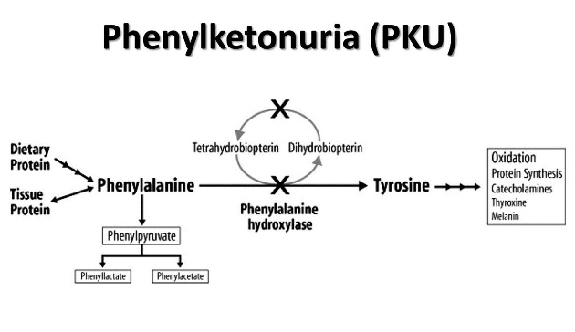
A.AMINO ACIDS:
I.PHENYLKETONURIA:
-Most common IEM.

Slide 38
Clinical Features:
-Infants present with “blue eyed blondes” due to decreased melanin as a result of decreased tyrosine
-Mental retardation is due to elevated phenylalanine.
-Seborrhoea/eczema ,hypertonia and seizures.
-Mother with PKU taking high phenylalanine diet can have abortions , babies with microcephaly and congenital heart disease.
Requirement:25-50mg/kg body weight as it is an essential amino acid.

Slide 39
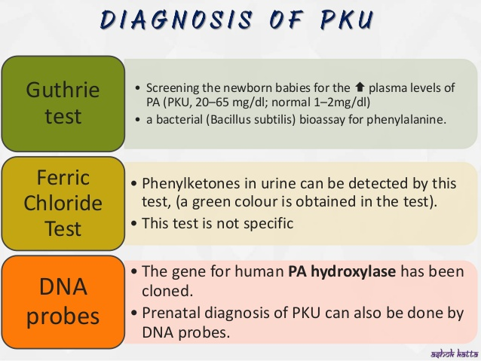

Slide 40
DIET:
1.LOW PHENYLALANINE FORMULA(LPF):LPF like Lofenalac(Mead Johnson) is the diet of choice.
-Tyrosine should be provided livberally as it is synthesized from phenylalanine.
-Overtreatment can lead to Phenylalanine deficiency.The goal is to maintain serum phenylalanine level between 3 and 15mg%.
-Rigid diet can be released after 6years of age.
-Dietary restriction should be reintroduced during pregnancy.
2.MODEL DIET IN PKU:
-Avoid high protein items like fish ,egg ,meat ,cheese.
-Limit medium-protein items like cereals ,pulses ,bread
-Liberally use low PA items like Tubers ,vegetables ,fruit ,eg.,Tapioca ,cucumber ,apple ,grapes ,guava ,mango ,papaya.
3. Tetrahydrobipterin(THBP) and neurotransmitter precurssors like 5-OH tryptophan and L-dopa may be beneficial.

Slide 41
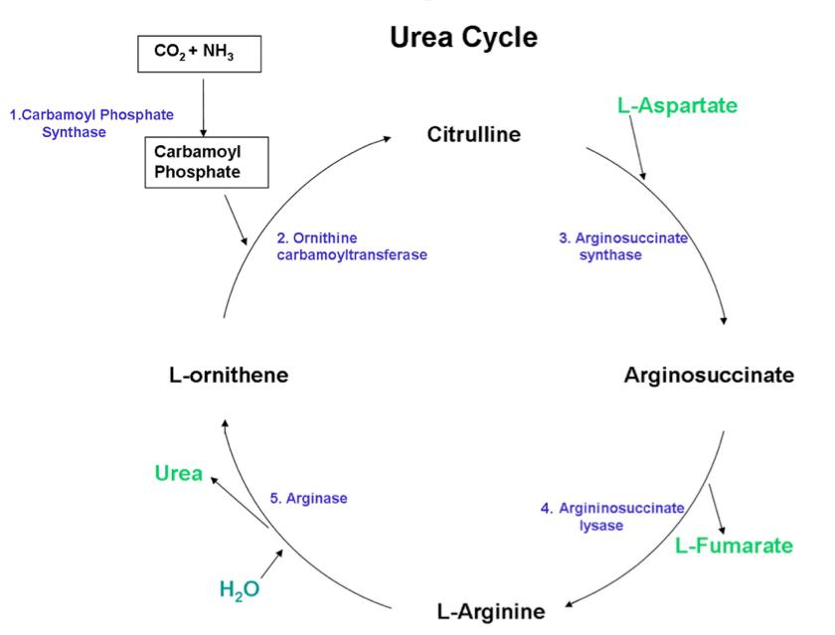
UREA CYCLE DISORDERS AND HYPERAMMONEMIA

Slide 42
UREA CYCLE DISORDERS WITH HYPERAMMONEMIA:
-Disorders of arginine ,citrulline ,ornithine metabolism are included here.
-Hyperammonemia produces –Vomiting ,refusal to feed ,tachypnea and coma.
-Older children-agitation ,confusion and ataxia.
-Endogenous breakdown of proteins should be avoided by adequate calorie intake.
-Essential amino acid can be supplied intravenously(0.25gm/kg/day).
-I.V. lipids (1gm/kg/day) is found beneficial to supply calories.
-Restriction of protein to 0.5-1gm/kg/day.

Slide 43
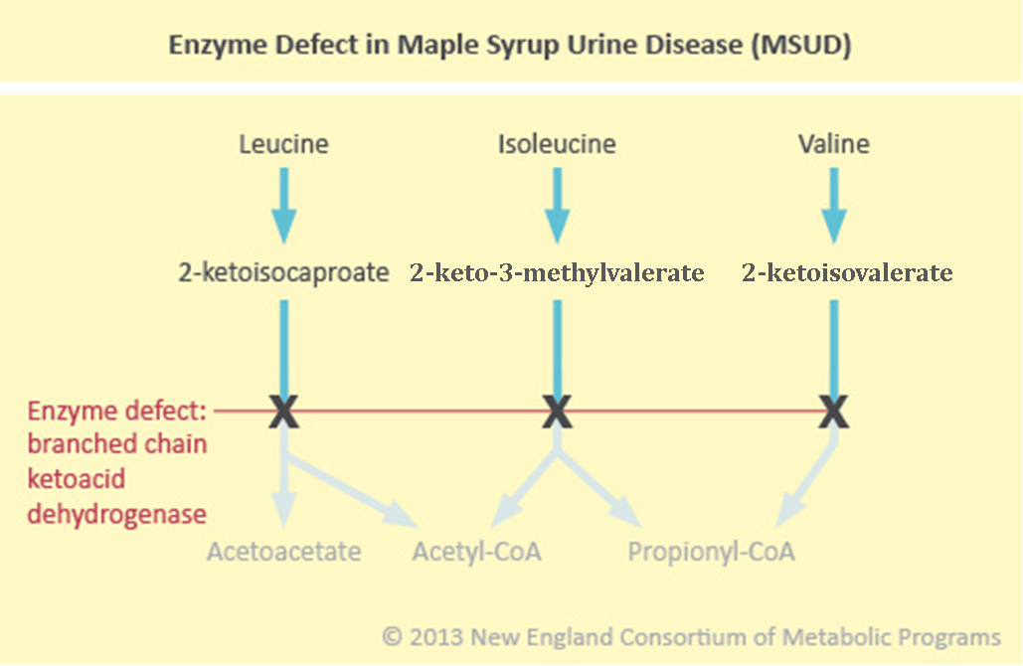
MAPLE SYRUP URINE DISEASE:

Slide 44
Defect in branched chain keto acid dehydrogenase.
Sweet odour of maple syrup (burnt sugar) in body fluids and urine.
Elevation of branched chain amino acids in the blood.
C/F: Feeding difficulty ,shrill cry ,alternate hyperactivity and flaccidity ,semi-coma and convulsion.
DIET:
-Small amount of branched chain amino acids should be provided as they cannot be synthesized in the body.
-This diet should be continued till myelination is complete.
-Large doses of thiamine can be added as it is co-factor for the enzyme and beneficial in patients with thiamine –responsive MSUD.

Slide 45
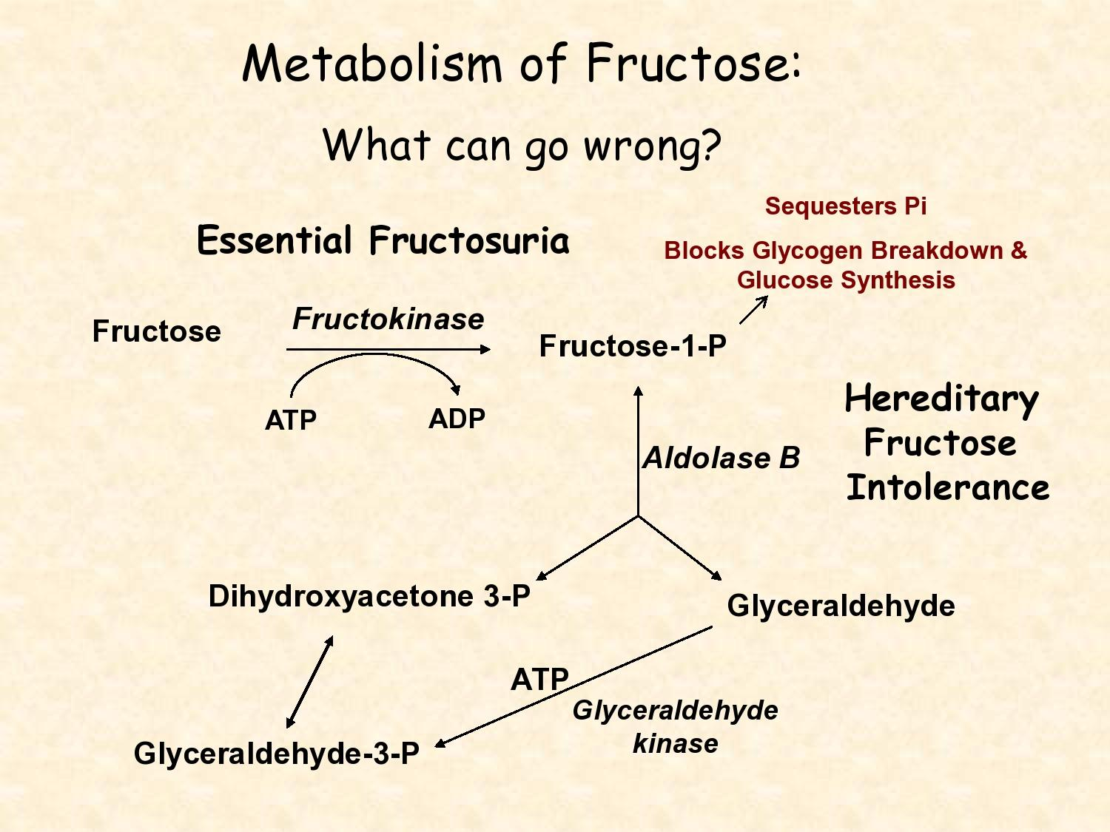
CARBOHYDRATE METABOLISM:
1.FRUCTOSE:

Slide 46
-Dietary source of fructose is sucrose.
-Fruits and honey are other sources of fructose.
-Absorption is not dependent on insulin.
-It gets absorbed by GLUT 2 and GLUT 5 receptors.
-Fructose is metabolized separately in Liver and Muscle.
-In fructose metabolism ,defects like benign fructosuria and hereditary fructose intolerance ,honey and sugar should be avoided.
-Too much of fructose leads to hyperlipidemia.
-Progressive liver disease may occur.

Slide 47
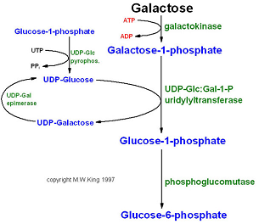
GALACTOSEMIA:

Slide 48
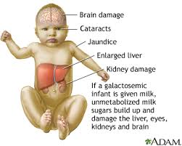
Clinical Features Of
Galactosemia
Persistent vomiting
-FTT,Jaundice,
-Hepatospleenomegaly
-Cirrhosis,Cataract,
-Mental retardation
Cataract may be the only
sign in galactokinase deficiency
Urine Benedict’s test:Positive
Glucose oxidase test:Negative
Guthrie’s microbiological
assay is positive d/t galactose.

Slide 49
DIET:
Avoid all milk and milk products as it contains lactose which is 50% galactose.
Non dairy creams prepared from soya protein may be used.
Avoid baked products as it also contains non-fat milk solids and lactose.
Galactose is present in some complex starches in peas ,soyabeans ,vegetables.Hence ,ormula prepared frpm soya protein isolate can be given whereas whole soya flour preparations are avoided.
Among fleshy foods ,avoid organ meat like liver.
Strict dietary restriction is necessary in early years

Slide 50
FOOD GROUP | TO INCLUDE IN GALACTOSEMIA | TO EXCLUDE IN GALACTOSEMIA
1.MILK GROUP | Soya protein milk, Non dairy cream of soya protein(avoid whole soya flour), | All milk and milk products including breast milk and sodium caseinate
2.Cereals-Pulse group | Cereals ,Pulses sparingly | All pulses if erythrocyte enzyme is low
3.Fats | Oil ,nut | Butter,cream,cheese ,ghee
4.Fruits and Vegetables | Fresh fruits and vegetables | Peas ,vegetables canned or processed with lactose.
5.Meat group | Muscle ,egg ,fish | Liver.

Slide 51
KETOGENIC DIET FOR MYOCLONIC SEIZURES
It is found beneficial in infants and children with myoclonic seizures.
Myoclonic epilepsies of childhood include:
-Benign myoclonus of infancy with normal EEG.
-Typical myoclonic epilepsy of early childhood
-Complex myoclonic epilepsies(CME) like Lennox Gustaut Syndrome with myoclonic and tonic seizures.
-West syndrome with infantiles myoclonus.
-Hypsarrythmia and mental retardation
-Juvenile Myoclonic epilepsy(JME)
-Progressive myoclonic epilepsies(PME) with CNS Degenration.

Slide 52
Ketogenic diet produces its effect by increasing inhibitory neurotansmitter GABA.
80% of the calories is supplied by fat and rest as carbohydrates , protein is restricted.
60% of fat can be as MCT.
Ketogenic diet is unpalatable and not liked by children above 2-3years.
MCT is present in coconut oil and cotton seed oil.
The child is fed on fat and oil and urine is tested for ketone bodies,child should be under strict observation.
Adequate vitamins and minerals especially calcium should be supplied.

Slide 53
DIET IN HEPATIC DISEASES:
Goal is to provide adequate calories and electrolytes and to prevent hypoglycaemia ,hypoalbuminemia ,hypokalemia.
Liberal carbohydrates and fruits ,adequate protein and fats according to tolerance are given.
High fat decreases gastric emptying and may aggravate the nausea.
Phospholipid extracts from soyabeans is found to help in liver regeneration and to improve appetite.

Slide 54
1.HEPATITIS:
-Most patients prefer a high carbohydrate ,low fat diet with sufficient salt which is palatable to the anorexic patient.
-Fat can induce an early satiety even in normal children and hence a child can eat only small amount of fatty food.
-besides the secretion of bile acids may be decreased in hepatitis.
-Apart from this ,there isno benefit in insisting a fat free diet
-Supplementary vitamins ,minerals and lithotropic agents are not necessary.

Slide 55
2.CHRONIC LIVER DISEASE:
-Ensure RDA pul10-20% extra calories for malabsorption and altered liver function.
-Protein enough to meet the RDA can be given unless in hepatic coma.
-MCT and fat soluble vitamins are given in view of decreased bile flow.
-Fat restriction needs to be done if there is cholestasis.
-Prolonged cholestasis with fat malabsorption leads to deficiency of fat soluble vitamins and calcium.
-High doses of vitamins A ,D ,E ,K should be supplemented.

Slide 56
SPECIAL NUTRITIONAL DEMANDS IN CHRONIC LIVER DISEASE:
DEFICIENCY | MANAGEMNET
Fat Malabsorption | MCT as coconut oil/MCT formula
FAT SOLUBLE VITAMINS
VITAMIN A | 10000-15000 IU/day
VITAMIN E | 50-400 IU/day as tocopherol or Tocopherol polyethylene glycol-1000 succinate. Maintain Vitamin E:Serum lipid ratio of 6mg/g in children and 8mg/g in adults
VITAMIN D | 5000-8000 IU/day of D3 or 3-5mg/kg/day of 25-oh cholecalciferol or 1-2mg /day of 1,25-Di-OH cholecalciferol(Calcitriol)
VITAMIN K | 2.5-5mg on alternate day as water soluble menadione orally or Inj Vit K 5mg twice a month.
WATER SOLUBLE VITAMINS | Twice the requirement daily

Slide 57
Choleretics are substances that increase the volume of secretion of bile from the liver as well as the amount of solids secreted
Choleretics/UDCA(Ursodeoxycholic acid)-
15-20mg/kg/day or Cholestyramine 8-16g/day.
-Retention of cholesterol and bile acids leads to itching and xanthoma.
-Vitamin E deficiency is associated with neurological symptoms like ataxia and neuropathy.

Slide 58
HEPATIC ENCEPHALOPATHY:
Aim is to reduce ammonia level and to support the liver.
1.Avoid protein by mouth.
-Protein restriction is important. In acute HE ,protein may be reduced to 0.5-1g/kg. As Hepatic encephalopathy subsides ,protein intake should be increased.
-Vegetable proteins are better tolerated than animal proteins bcoz they:-Are less aminogenic
-Contains smaller amount of methionine
and aromatic amino acids.
-Have laxative action
-Contain more fibres which help in incorporation and elimination of nitrogen in faecal bacteria

Slide 59
2.Lactulose 1-2ml/kg/day in divided doses or till there is diarrhoea(upto 30ml/dose).
3.Lactisyn or lactobacilli may be given orally.
4.Ryle’s tube aspiration and bowel wash.
5.Calorie requirement is RDA for age plus 10-20% extra calories.As much calories as possible should be given as 10% glucose enriched with 25% dextrose.
-Upto 12% glucose can be given through peripheral vein
6.Supplement Vitamin K and FFP.
7.Glucagon-0.03mg/kg/day upto 1mg/dose for 3 days helps in liver regeneration and to prevent hypoglycemia.
8.Supplement branched chain amino acids valine,leucine ,isoleucine which help in liver regeneration.

Slide 60
9.HEPATIC DRIP:Composition of Hepatic Drip-
ITEM | QUANTITY
NS | 100ml
10% Dextrose | 400ml
KCl | 5ml
Ca gluconate | 5ml
MVI | 2ml

Slide 61
RECOVERING HEPATIC ENCEPHALOPATHY:
-Add protein 10g/day and gradually increase upto 1-1.5g/kg/day.
-Branched chain amino acids like valine,leucine ,isoleucine are metabolized in the muscle and kidney unlike non-branched chain amino acids that are metabolized in the liver
-Protein of vegetable origin should be given.
-MCT can be given in children with decreased bile flow and fat malabsorption.
LIVER DISEASE WITH ASCITES AND OEDEMA:
-Ascites is due to hypoalbuminemia, secondary aldosteronism and/or portal hypertension.
-Salt and fluid should be restricted and NS may be avoided in hepatic drip.
-Plasma and albumin infusion are beneficial.

Slide 62
DIET IN RENAL DISEASES:
A.ACUTE GLOMERULONEPHRITIS-
1.NUTRITION:
A . Fluid-Restrict fluid to insensible loss plus last day’s output when oliguria is present.
Oilguria -Urine output <1ml/kg/hour or 25ml/kg/day.
Insensible water loss-400ml/m2/day
Bedside calculation of insensible water loss:
-Newborn-30ml/kg ->5years=15ml/kg
-Infant-25ml/kg -Adult=10ml/kg
-1-5years-20ml/kg
Formula to calculate GFR
-Preterm=0.35×length+SrCreatinine
-Infant=0.45×length+Sr Creatinine
-Child=0.55×length+Sr Creatinine

Slide 63
b.Calories:RDA for age plus 10% extra for infection/illness.
c. Protein : Give RDA for age if blood urea is normal.
d. Sodium : Restrict sodium during oliguria
-Gradually add 1-2g/day during diuretic phase and slowly increase to 10g/day.
e. Potassium :It is avoided.
2.Peritoneal Dialysis:
Indications-
1.Symptomatic uremia
2.Circulatory overload
3.Hyperkalemia.
4.Hypertension not responding to medical treatent

Slide 64
3.Diuretic Phase:During the diuretic phase ,slowly release fluid ,protein and salt restriction.
4.Food items that can be given in Acute Nephritis:
Fluids that can be given-Kanji water ,butter milk,diluted milk(50-100ml of milk made upto 1 glass)
Food items that can be given are salt-restricted items like
-Rice -Honey
-kanji -Glucose
- Idli -oil/ghee
- Dosa -Unsalted butter and vegetables
-Rice flakes -Avoid high proteins ,salt and fruits.
-Sugar
-Jaggery

Slide 65
B.DIET IN ACUTE RENAL FAILURE:
a.Fluid challenge:20ml/kg NS or RL or more till central venous pressure is normal.
b.Diuretic challenge:1-2mg/kg furosemide if well hydrated or 2ml/kg 20% mannitol if underhydrated.If oligo-anuria persists ,treat as ARF.
c.Fluids in ARF:
IVF if oral is not tolerated
Quantity-Insensisble water loss + last day’s output
Type of fluid-Insensible loss as 10% dextrose
-Output-50% as NS and 50% as 10% dextrose
d.Sodium: No extra sodium when there is oligo-anuria and hypertension.
e.Sodium bicarbonate-Acidosis is corrected by 1-2ml/kg 7.5% soda bicarb. This may be given 12hourly.
f.Tackle hyperkalemia

Slide 66
g.Phosphate-To control hyperphosphatemia ,prevent absorption by giving aluminium hydroxide and supplement calcium.
Avoid calcium phosphate(Osteocalcium) and give calcium carbonate(shelcal).
Avoid protein rich food which tends to have high phosphate.
h.Protein:Restrict protein intake to 0.5-1.25g/kg/day.
-Provide essential amino acids.
-Non essential pool tends to be high due to contribution by urea and other nitrogen wastes.
i.Others: Treat anemia ,hypertension ,Infection and coagulopathy. Antibiotics as per renal dose.

Slide 67
NUTRITIONAL GUIDELINES FOR THE CHILD WITH AKI:
Adequate nutrition will help
-Prevent catabolism
-Control metabolic abnormalities
-Recovery
-It may delay or prevent need for dialysis.
BOYS AND GIRLS | ENERGY(Estimated Average Requirement) | Protein
0-6 months | 95-115 kcal/kg | 1.5-2.1g/kg
6-12months | 95 kacl/kg | 1.5-1.6g/kg
1-3 years | 95 kcal/kg | 1.1g/kg
4-6 years | 90 kcal/kg | 1.1g/kg
7-10 years | 1740(F)-1970(M) kcal/day | 28g/day
11-14 years | 1845(F)-2220(M) kcal/day | 42g/day
15-18 years | 2110(F)-2755(M) kcal/day | 55g/day(M),45g/day(F)

Slide 68
C.DIET IN CHRONIC RENAL FAILURE:
The goals are:
a.To reduce nitrogen intake
b.To maintain nitrogen balance.
c.To cover essential amino acid requirement
d.To supply eneough calories.
Energy:Infant-100-120kcal/kg/day
Children-80-100kcal/kg/day
In stunted children ,RDA for height age is given rather than
for chronological age

Slide 69
PROETIN: High protein-will aggravate acidosis ,hyperkaelemia , hyperphosphataemia
-Low protein: Reduce BUN ,improve renal function and reduce GI and neurological symptoms like nausea ,vomiting ,muscle cramps ,convulsion and neuropathy.
-Milk is rich in phosphate ,meat is rich in potassium
-Protein allowance in CRF according to GFR:
Protein (gm/kg)
TYPE OF CRF | 0-1 years | 1-5 years | 5-10 years
Mild(GFR:20-40) | 1.8 | 1.4 | 1
Moderate(GFR:5-20) | 1.4 | 1 | 0.8
Severe(GFR<5) | 1 | 0.8 | 0.6

Slide 70
Sodium: Sodium excretion is almost constant in CRF.
-Excess intake will lead to hypertension and fluid
retention.
-Restrict salt intake to 300-600mg/day in infants
And to 1-2g/day in older children.
Potassium:Restrict potassium intake.
2.Acidosis:Give 0.5-2ml/kg of soda bicarb in divided doses.
3.Hyperphosphatemia and renal rickets:These may develop in 3months period after onset of CRF.
-Hence Xray wrist should be taken after 3 months
-Restrict phosphate intake(high protein diet)
-Give aluminium hydroxide(1ml/kg/day)
-Calcium(1g/day) and alphaD3 0.25mg/day or upto 0.05mg/kg/day.

Slide 71
DIET IN NEPHROTIC SYNDROME:
Patients often present with anasarca ,either initially or during relapses.They may show evidence of prolonged ,severe protein deficiency such as a greatly reduced muscle mass and infection.
An adequate protein intake (2-3g/kg/day) is recommended.
High protein intake and rise in Sr albumin leads to increased proteinuria ,but there is no evidence that all ingested protein is lost.
Conversely ,severe reduction of dietary protein decreases proteinuria ,but at the expense of marked hypoalbuminemia and loss of muscle mass.While in MCNS ,the preoteinuria resolves within 14 days ,an adequate protein intake allows repletion of body protein.

Slide 72
During daily administration of prednisolone ,dietary salt should be restricted to decrease the tendency of hypertension.Also prednisolone can lead to weight gain ,so ,fat should be restricted.
In non-minimal lesions ,steroid resistant nephrotic syndrome with heavy proteinuria ,dietary protein is restricted to 1.5-2 gm/kg/day ,with aim of reducing proteinuria.
Calcium and vitamin D supplements are required in patients with persistent heavy proteinuria ,especially due to steroid resistant nephrotic syndrome.
Diuretic induced potassium loss needs to be replaced.

Slide 73
OBESITY
Obesity can present early(Starting obesity) or it may be around puberty(Creeping obesity).
Causes of obesity are:-Hereditary ,lifestyle related , syndromic ,constitutional ,neuropsychiatric ,endocrine.
BMI value indicates risk for obesity or overweight in pubertal children.
BMI FOR AGE | NUTRITIONAL STATUS
<5th percentile | Underweight
5th-84th percentile | Normal
85th-94th percentile | Overweight
≥95th percentile | Obese

Slide 74
DIET:
Diet 1:By avoiding ghee ,butter ,oil ,gravy ,milk cream
,sugar ,jaggery ,chocolates ,bakery items and choosing low-
calorie dense items like idli instaed of high-calorie dense
items like upma(eg.,2 idlies=100 cal instead of
1 cup upma=250 cal ) can induce a deficit of approximately
1/3rd of calorie intake.
This is most practicable and acceptable to the family.
Avoid eating in between the meals
Diet 2:This is highly restrictive diet rich in protein called
“Protein Modified Fast(PMF)” with or without added
carbohydrate.PMF is associated with ketonuria within 2
days and requires close monitoring.It is also associated with
nitrogen loss ,lymphopenia and low transferrin levels.

Slide 75
Addition of little carbohydrate leads to increase in insulin ,reduction in lipolysis and fat utilization and leads to protein catabolism and negative nitrogen balance.
But ,addition of carbohydrate will prevent ketosis and monitoring will become difficult.
PMF leads to weight loss of 3 Kg in first week followed by 1 Kg/week thereafter.
Renal ,Hepatic ,cardiovascular functions should be monitored.
Hypotension ,cardiac arrythmia and alopecia have been noted.

Slide 76
1.PRECAUTIONS WITH PMF DIET:
-PMF should supply 1.5-2.5g/kg protein/day according to ideal weight.
-Protein should be derived from lean meat ,fish ,eggs.
SupplementKCl(25mEq),Calcium(800mg),multivitamins
and minerals.
-Include salted and low calorie vegetables without oil.
2.PMF WITH ADDED CARBOHYDRATE:To the above
PMF diet ,add two plaintains(100gm) that supplies 100
calories and 1.2g protein extra or 100 gm potatoes that
supplies 100 calories and 1.6gm protein.

Slide 77
Diet 2-Protein modified Fast(PMF)-1000 kcal diet for a 10
year old obese child.
Ideal weight 30kg,protein 1.5-2.5g/kg=45gm ,energy<50%
of the RDA=1000kcal
FOOD ITEMS | Raw(gm) | Cooked quantity | Energy(kcal) | Protein(gm)
Rice | 100 | 2 cups | 375 | 7
Dhal | 25 | 10 tsp | 95 | 5
Milk | 300 | 1.5 cups | 200 | 9
Egg | 80 | 2 | 160 | 12
Soya | 25 | 10tsp | 110 | 11
Greens | 50 | 5 tsp | - | 1
Idli | - | 1 | 50 | 1
TOTAL |  |  | 990 | 46

Slide 78
COLEIAC DISEASE:
Also known as gluten sensitive enteropathy.
It is define as permanent intolerance to the prolamines of some cereals like gliadin of wheat ,hordeins of barley and secalins of rye ,associated with mucosal disease of proximal small bowel.
It is characterized by:
-Malabsorption
-Histologic abnormalities of the small bowel mucosa.
-Clinical and histolgic improvement on a gluten-free diet
-Relapse on a gluten-containing diet.

Slide 79
GLUTEN-FREE DIET:
-There is usually dramatic response to GFD.
-Foods to be excluded and included in coeliac disease.
ITEM | FOOD TO BE EXCLUDED | FOOD TO BE INCLUDED
CEREALS | Wheat ,barley ,rye ,oats in any form.Thickening agents containing wheat flour ,sauces ,jelly ,ice-creams ,pastries ,prepared meat ,sausages. | Rice ,corn ,bajra ,ragi ,arrowroot ,sago
BEVERAGES | All malted drinks | Plain milk ,soy milk ,fresh fruit juice
SOUPS | Cream soup containing wheat as thickening agent. | Plain vegetable ,meat and chicken soup
Desserts and dairy products | Milk sweets or puddings with wheat flour base. | Home-made ice-creams ,yoghurt
Miscellaneous | Chocolates ,pickles containing rye ,mustard powder ,grounded spices ,baking soda | Tapioca,sorghum Pulses,fruits,vegetables

Slide 80
Iif the child does not improve on gluten free diet ,it is possible that he is getting small quantities of gluten inadvertently.Gluten containing diet should be avoided lifelong.
DISACCHARIDE-FREE DIET:
-Disaccharidase activity ,especially that of lactase ,is very much decreased in Coeliac disease.Hence it is advisable to avoid milk and milk products for a few weeks

Slide 81
INFLAMMATORY BOWEL DISEASE:
There is no curative therapy for Ulcerative colitis and Chrons disease.
The aim of the therapy is relief of symptoms and improvement of quality of life.
The normalization of laboratory parameters is not esssential.
Nutritional therapy is extremely important in the management of IBD.
Enteral nutrition is the preferred route for nutritional therapy because of its advantages:
-Ease of administration -Direct stimulatory effect on
-Low cost gut mucosa.
-Minimal side effects

Slide 82
Recently ,specific nutrients added to formulas and complementary therapy have been tried.These nutrients include:
-Arginine
-Structured lipids
-Fish oil
-Fructo-oligosaccharides
-Carnitine
-Taurine
-Antioxidants (Vitamin E and C and beta carotene)
-Nucleotides
-Glutamine ,probiotics and growth factors.

Slide 83
Parenteral nutrition is reserved for patients with
-Severe colitis
-Those in perioperative period.
-Those with short bowel syndrome
-Severe malabsorption who have failed enteral feeding

Slide 84
DIET IN GASTRO OESOPHAGEAL REFLUX:
GOR subsides spontaneously in most healthy infants,usually when the baby is able to sit or walk.
Supine position is avoided
Right lateral position is preferred as:
-It increases the gastric emptying and
-Separates the gastric contents from the gastro oesophageal junvtion.
Ideal positioning:
-While awake:Standing or sitting upright
-While sleeping: Prone position ,with head end of bed elevated.

Slide 85
DIET:
-Thickening of infant formula with rice cereal.
-Small and frequent feeds.
FOODS TO BE AVOIDED:
-Fatty foods
-Acidic foods like citrus juice ,carbonated beverages and tomato products.
-Coffee.
Weight reduction in obese children is very important to reduce reflux
Certain drugs can precipitate or aggravate the reflux:
-Salbutamol ,Theophylline ,Diazepam ,Barbiturates.

Slide 86
NUTRIONAL MANAGEMENT IN DAIRRHOEA:
ORS and continued feding
Breast feeding should never be stopped.
The child should continue to receive normal diet,milled cereals are better than whole cereals.
Food should be easily digestible and given in small quantities ,at short intervals.
Complex carbohydrates (rice ,wheat ,potatoes ,bread and cereals) ,lean meat ,yoghurt ,and boiled bananas are well tolerated.
Food high in simple sugars including soft drinks ,tea and juices should be avoided.
80% of the dietary fat can be absorbed in spite of diarrhoea,they can increase the calorie content of diet without increasing the bulk.

Slide 87
Transient lactose intolerance is part and parcel of diarrhoea.It should never be an indication for stopping breast milk or giving lactose free milk.
During convalescence ,dietary intake should be increased to at least 125% of normal RDA ,using nutrient dense foods to compensate for the losses and promote rapid nutrional recovery.
Cow’s milk should be avoided in children with diarrhoea and severe PEM:
There is damage to villous epithelium in acute diarrhoea
Macromolecules of cow’s protein are absorbed intact
Into the bloodstream ,through the breached mucosa.

Slide 88
These proteins are highly antigenic and so the body produces antibodies against them
This leads to the formation of circulating antigen-antibody complexes,whuch are deposited in normal mucosa as well as already damaged mucosa.
This may lead to chronic diarrhoea especially in children with severe PEM.

Slide 89
DIETARY MANAGEMENT OF PERSISTENT
DIARRHOEA:
Avoid all feeds till diarrhoea is at least partially controlled which may be by the 2nd day of treatment.
Small frequent feeds should be given to reduce the gastrocolic reflex.
It is better to start with high carbohydrate ,low protein
and no fat regimen.
Always avoid the food substances ,which may be responsible for persistent diarrhoea,.eg:milk and milk product in cow’s milk allergy ,gluten containing food in coeliac disease.
Provide adequate micronutrients and vitamins.
Diet should not be hyperosmolar.

Slide 90
DIETARY MANAGEMENT-Different diets:
DIET A / LEVEL 1 DIET LOW LACTOSE DIET CEREAL BASED DIET WITH LITTLE MILK | Low milk diet (50 ml/kg/day) Curd ,rice/sooji,gruel with milk,Suji or broken wheat(dalia),jaggery,green leafy vegetables can be used.
DIET B /LEVEL 2 DIET LACTOSE FREE DIET MILK FREE CEREAL BASED DIET | Milk free diet-Cereal-pulse mix/gruel,amylase rich food,rice ,cooked moong dal,sugar ,coconut oil
DIET C /LEVEL 3 DIET LACTOSE AND SUCROSE FREE DIET | Lactose-sucrose/starch free diet/soya based,chicken based ,egg

Slide 91
DIET IN CONSTIPATION:
-Encourage high fibre diet like
-vegetables and fruits like guava ,papaya ,and mangoes
-plenty of fluids.
-Cow’s milk-fed babies tend to be more constipated compared to breast fed babies.
-Avoid iron and calcium supplements.

Slide 92
REFERENCES
Nutrition and Child development-KE Elizabeth-5th Edition
Piyush Gupta Volume 1
Paediatric Gastroenterolgy and Hepatology-A Riyaz-3rd edition
Oxford Specialist Handbook in Paediatric Nephrology-2nd edition

