Slide 1
SICKLE CELL DISEASE
BY :
DR.PUTUN PATEL

Slide 2
Sickle Cell Disease/Anaemia
Sickle cell disease (SCD) is a life threatening autosomal recessive genetic disorder resulting from inheritance of abnormal genes from both parents.

Slide 3
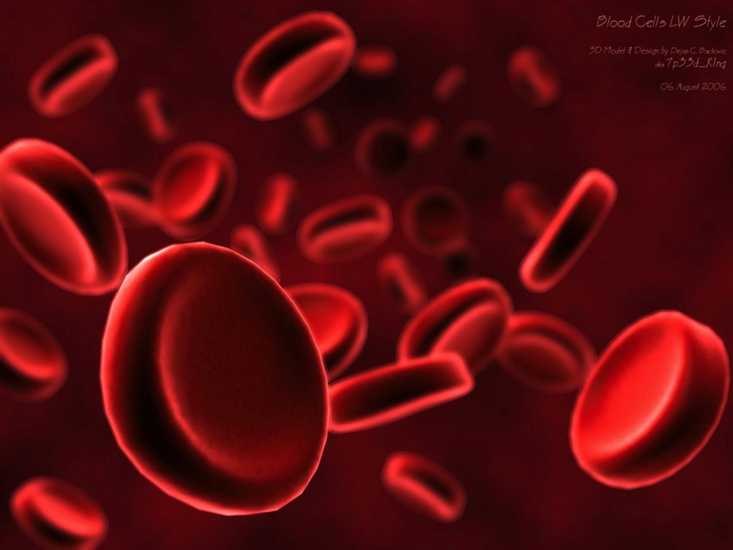
The RBCs are produced in bone marrow and average life of normal RBCs is about 120 days.
Normal red blood cells (RBCs) are biconcave disc shaped and move smoothly through the blood capillaries.

Slide 4
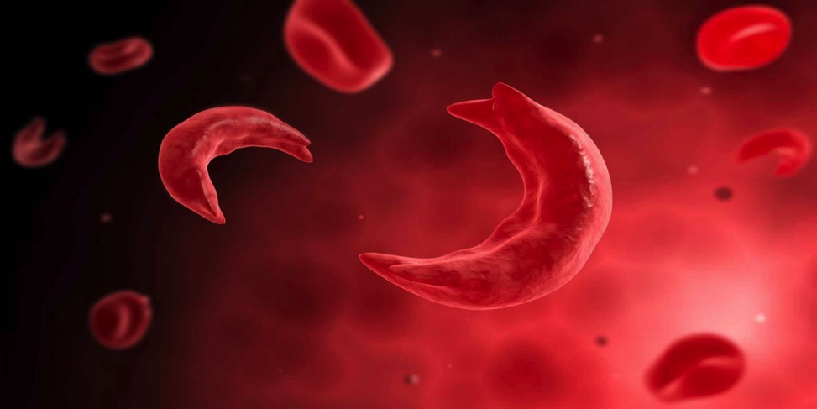
Biconcave disc shape of RBCs changes to sickle shape under low oxygen tension due to polymerization of faulty haemoglobin called HbS arising out of a point mutation in beta globin gene.
The life span of RBCs in SCD patients is only about 10 to 20 days and the bone marrow can't replace them fast enough. As a result there is decrease in number of RBCs in the body and the RBCs don’t contain sufficient amount of haemoglobin (hypochromia).

Slide 5
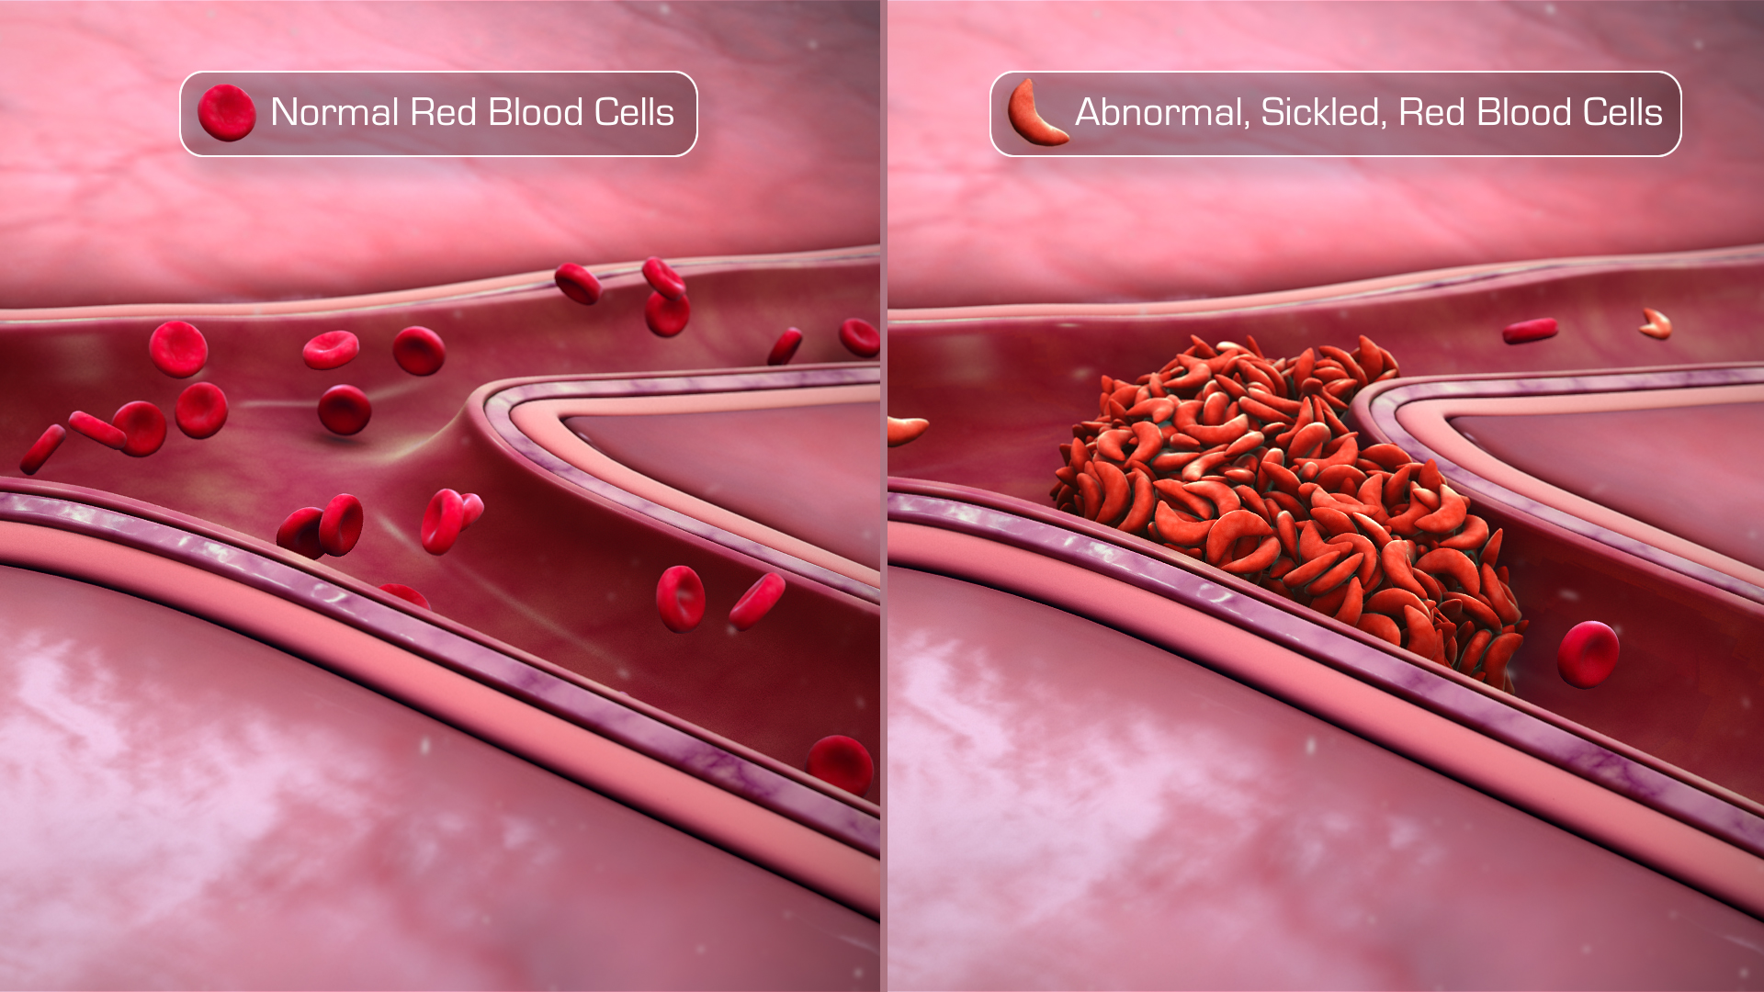
In SCD the RBCs become sickle or crescent shaped which are stiff & sticky and tend to block the blood flow in small capillaries. Blocked blood flow causes ischemia leading to severe pain and gradual damage to organs.

Slide 6
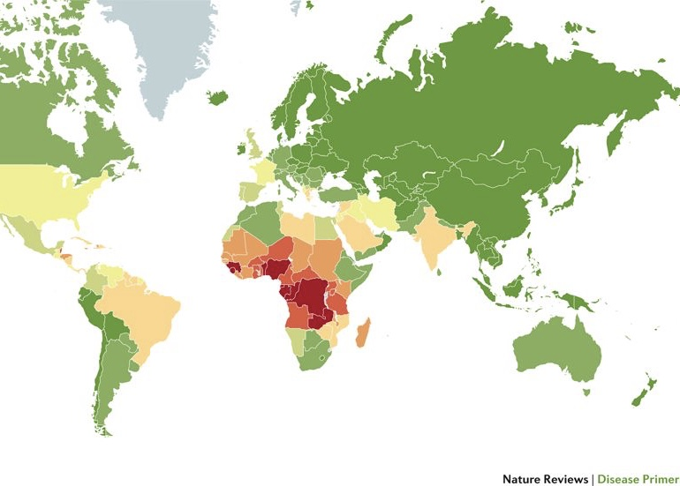
PREVELANCE
Sickle cell gene is commonly believed to be associated with African ancestry and malaria endemic areas. Besides Africa, it is found around Mediterranean, Middle-East and India.
The disease gene has spread also to Europe, America & Caribbean through migration of human populations.
The frequency of sickle cell carriers is up to 1 in 4 in West Africans and 1 in 10 in Afro Caribbean’s.

Slide 7
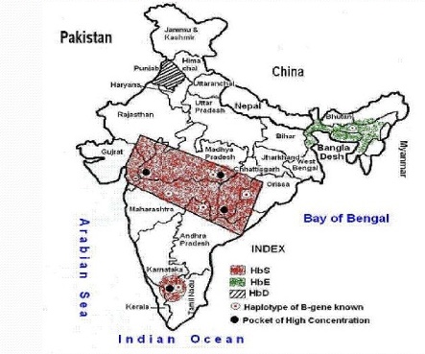
In India, it is prevalent in Chhattisgarh, Odisha, Maharashtra, Gujarat, Madhya Pradesh, Telangana, Andhra Pradesh and some parts of Tamil Nadu & Kerala.

Slide 8
The highest prevalence has been recorded in the state of Orissa (1-44.4%),
followed by Madhya Pradesh (1-40.0%; including Chhattisgarh)
Tamil Nadu (1-40.0%),
Andhra Pradesh (1-35.7%)
Assam (1-35.5%)
Maharashtra (0.8-35.0%)
Gujarat (1-31.4%)
Kerala (1-30.0%)
Uttar Pradesh (1.5-18.5%)
Karnataka (1-8.0%)
Rajasthan (1-5.7%)
West Bengal (1-1.7%)
Bihar (0.8%; including Jharkhand)
in the decreasing order.
The sickle cell disorder is most common in scheduled tribes.

Slide 9
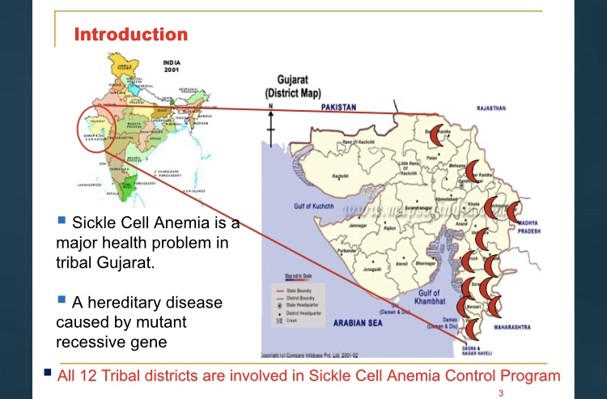

Slide 10
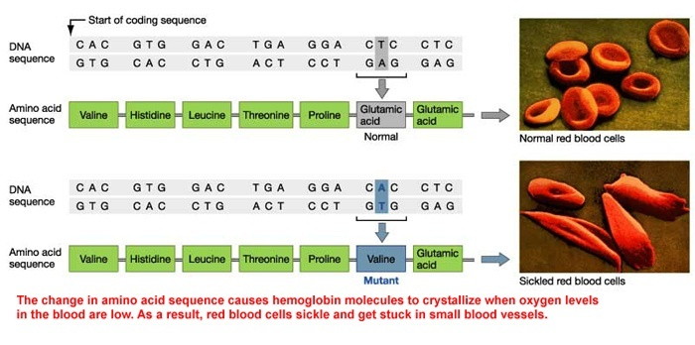
Pathophysiology

Slide 11
Two essential pathological processes
Vaso-occlusion.
Haemolysis
Results in - anaemia & functional deficiency of nitric oxide
  results in vascular endothelial damage
  Responsible for complications such as pulmonary hypertension, priapism and stroke.
causes acute and chronic ischaemia
responsible for acute pain and organ damage.

Slide 12
Deoxygenation
Polymerization of Hemoglobin
Sickling of red cell
Endothelial Damage
RBC & leukocyte adhesion to endothelium , vasoconstriction
Vascular Occlusion organ ischemia & end organ damage

Slide 13
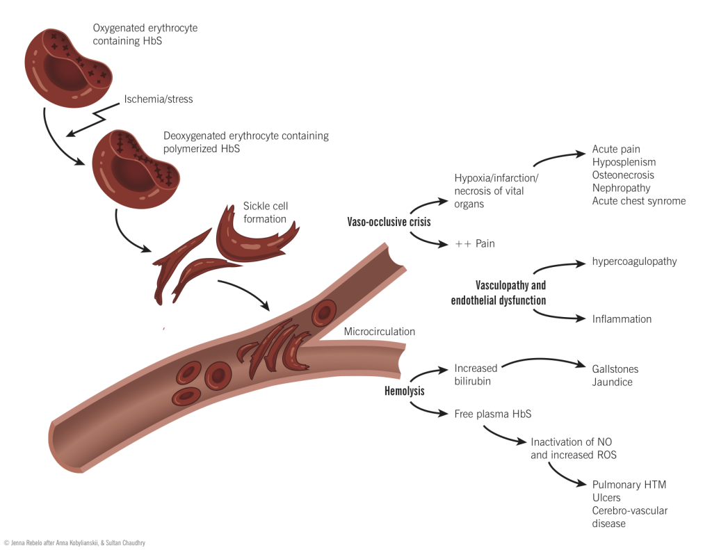

Slide 14
Inheritance

Slide 15
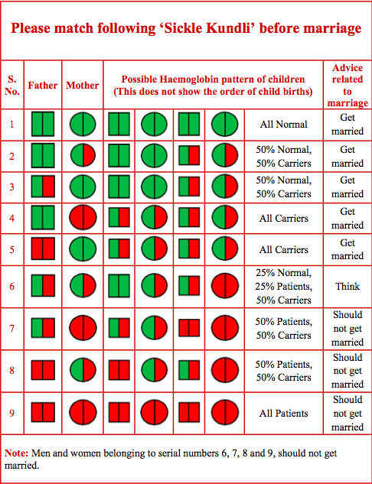

Slide 16
Growth & Development

Slide 17
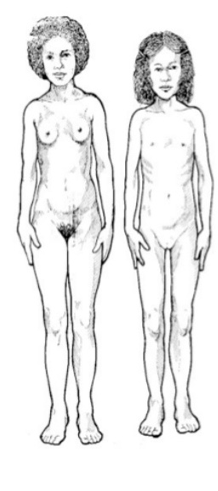
Females :
Females with sickle cell anaemia maintain a lower average height and weight than those females with normal haemoglobin.
This lower than average height and weight continues until late adolescence.
Puberty is usually delayed by several years.
Menarche (beginning of the menstrual period) is also delayed.

Slide 18
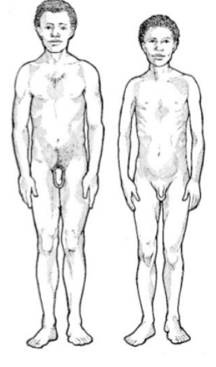
Males
Males with sickle cell anaemia maintain a lower average height and weight than those males with normal haemoglobin.
This lower than average height and weight continues until late adolescence.
Puberty is usually delayed by several years.
^{It is}
important to reassure the adolescent that he/she will eventually catch up with his/her peers.

Slide 19
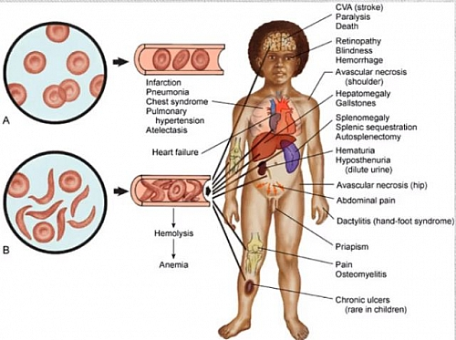
Clinical Manifestations

Slide 20
Abnormal immune function & functional asplenia – 6 month
Greatest causes for morbidity and mortality - Bacterial sepsis
By 5 yr of age, most of have - functional asplenia.
An additional risk factor - deficiency of alternative complement pathway serum opsonins against pneumococci.
Increased risk of infection and death from bacterial infection - encapsulated organisms such as Streptococcus pneumoniae & Haemophilus influenzae type b.

Slide 21
CRITICAL HEALTH CONDITIONS

Slide 22
Dactylitis or Hand-Foot Syndrome
Dactylitis - hand-foot syndrome
first manifestation of pain in children
occurring in 50% of children - age of 2 years.
Symmetric or unilateral swelling of the hands and/or feet.
Requires palliation with pain medications - acetaminophen with codeine.

Slide 23
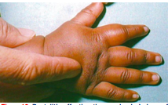

Slide 24
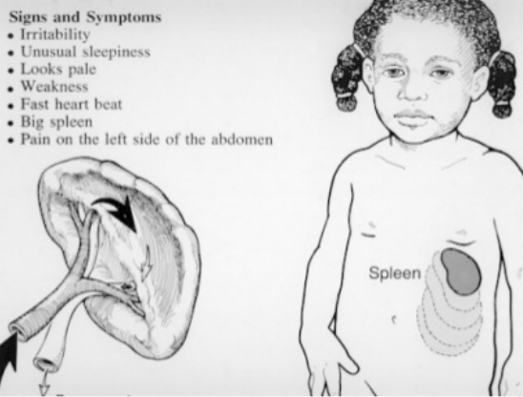
Splenic Sequestration
Acute splenic sequestration is a life-threatening complication occurring primarily in infants and can occur as early as 5 wk of age which is indicated by rapid increase in the size of spleen in a short period of time.
Approximately 30% of children have a severe splenic sequestration episode & a significant percentage of these episodes are fatal.

Slide 25
Teaching parents and primary caregivers how to palpate the spleen to determine if the spleen is enlarging.
The etiology of splenic sequestration is unknown.
Diagnostic Testing and Laboratory Monitoring
Engorgement and increase of the spleen size .
Evidence of hypovolemia
Decline in haemoglobin of ≥2g/dL from the patient’s baseline haemoglobin
Reticulocytosis
Decrease in the platelet count may be present. These events can be accompanied by upper respiratory tract infections, bacteremia, or viral infection.

Slide 26
Treatment
Early intervention / hemodynamic stability -isotonic fluid or blood transfusions.
Blood - 5 ml/kg of packed red blood cells (RBCs)
Prophylactic splenectomy performed after an acute episode has resolved for preventing future life-threatening episodes.
Repeated episodes - common occurrs ~50% of patients
Most recurrent episodes - within 6 months of the previous one
Blood transfusion therapy- to prevent subsequent episodes but does not reduce the risk of recurrent splenic sequestration when compared to no transfusion therapy.

Slide 27
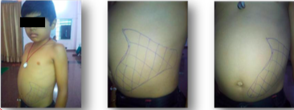

Slide 28
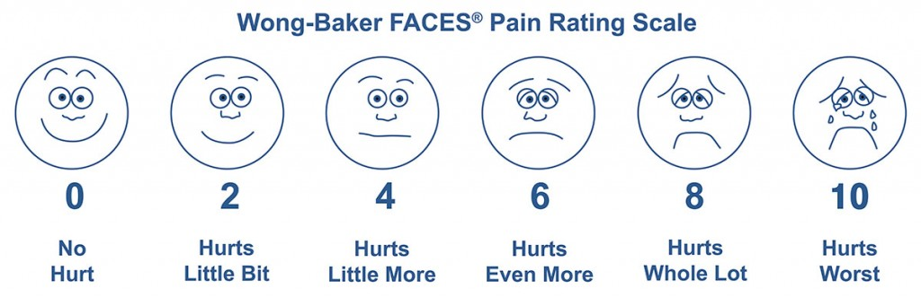
PAIN
The chief clinical feature of sickle cell anaemia is pain.
Precipitating causes - physical stress, infection, dehydration, hypoxia, local or systemic acidosis, exposure to cold & swimming for prolonged periods

Slide 29
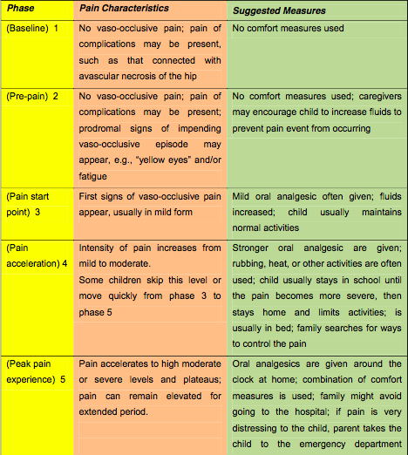
CHARACTERISTICS OF PAIN IN SICKLE CELL DISEASE

Slide 30
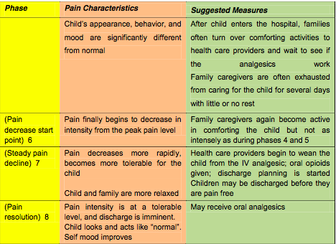

Slide 31

TREATMENT OF PAIN

Slide 32
Patient who has ~1 painful episode per year that requires medical attention.
Specific therapy for pain - acetaminophen or a non-steroidal agent .
Followed by acetaminophen with codeine /short- or long- acting oral opioid.
Hospitalization for -IV morphine or it’s derivatives.

Slide 33
BT – for decrease in Hb resulting in hemodynamic compromise, respiratory distress, or a falling Hb concentration.
IV hydration does not relieve or prevent pain
Given when patient is unable to drink as a result of the severe pain or is dehydrated.
Opioid dependency in children with SCD is rare and should never be used as a reason to withhold pain medication.

Slide 34
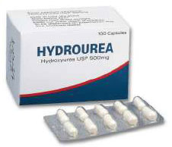
The primary toxicities - myelosuppression that reversed upon cessation of the drug.
The long-term toxicity associated with hydroxyurea in children has not been established; but all evidence to that suggests that the benefits far outweigh the risks.
The dose of hydroxyurea - 15 mg/kg body weight daily.
If required, dose can be increased upto 20-30 mg/kg per day gradually, if tolerated by patient.
Monitoring children on hydroxyurea is rigorous, with initial visits every 2 weeks to monitor for hematologic toxicity with dose escalations and then monthly after a therapeutic dose has been identified.
Hydroxyurea - decrease the rate of painful episodes by 50% and the rate of ACS episodes and blood transfusions by ~50%. Hydroxyurea is safe and well tolerated in children >5 yr of age.

Slide 35
It decreases the production of deoxyribonucleotides via inhibition of the enzyme ribonucleotide reductase by scavenging tyrsol free radicals as they are involved in the reduction of nucleoside diphosphates(NDPs)
It increases the concerntration of HbF and increase the levels of nitric oxide , having more oxygen binding capacity .

Slide 36

FEVER AND BACTEREMIA

Slide 37
Clinical Factors Associated with Increased Risk of Bacteremia Requiring Admission in Febrile Children with Sickle Cell Disease
^{Seriously ill appearance}
Hypotension: systolic BP <70 mm Hg at 1 year of age or <70 mm Hg + (2 × tage in years) for older children
Poor perfusion: capillary-refill time >4 seconds
^{Temperature >40.0°C}
A corrected white-cell count >30,000/cubic mm or <500/cubic mm
Platelet count <100,000/cubic mm
^{History of pneumococcal sepsis}
^{Severe pain}
Dehydration: poor skin turgor, dry mucous membranes, history of poor fluid intake, or decreased output of urine
Infiltration of a segment or a larger portion of the lung
^{Haemoglobin level <5.0 g/dl}

Slide 38
^{Infectious Risk Management}
1. Penicillin V orally from 2 months to at least 5 years of age
• 125 mg twice a day up to age 3 yr, and then 250 mg twice a day
2. Prompt administration of broad spectrum or pneumococcal specific antibiotics in case of possible bacterial infection
3. Malarial prophylaxis when appropriate
^{4. Immunization}
^{• Streptococcus pneumoniae}
^{• Haemophilus influenzae}
^{• Meningococcus}
^{• Influenzae}
• Salmonella typhi (for at risk individuals)
5. Elimination of recurrent focal infection(dental infection, sinusitis, acute recurrent tonsillitis,
Cholecystitis, urinary infections)

Slide 39
Acute Chest Syndrome
Commonest cause of hospitalization with SCD.
It can be fatal.
Result of sickling in the lungs.
It is believed that sickled cells clump up in the small blood vessels in the lungs or move there from some place in the body .
This may triggered by a lung infection like pneumonia .
It may develop right before , during or after an episode of pain in the abdomen or bones .

Slide 40
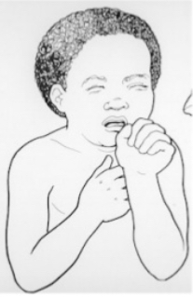
Signs & Symptoms
Chest Pain
Fast breathing &/or retractions
Congested Pneumonia Like Cough
Abdominal pain
Fever
Trouble breathing

Slide 41
PREVENTION
1. Incentive spirometry and periodic ambulation in patients admitted for vaso-occlusive crises, surgery, or febrile episodes
2. Watchful waiting in any hospitalized child or adult with sickle cell disease (pulse oximetry monitoring and frequent respiratory assessments)
3. Avoidance of overhydration
4. Intense education and optimum care of patients who have sickle cell anaemia and asthma
Diagnostic Testing & Laboratory Monitoring
Blood culture
Nasopharyngeal samples for viral culture (respiratory syncytial virus, influenza)
Blood counts every day and appropriate chemistry
Continuous pulse oximetry
Chest radiograph

Slide 42
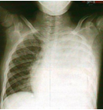
Treatment
Blood transfusion (simple or exchange)
Supplemental O2 for drop in pulse oximetry by 4% over baseline, or values <90%
Empirical antibiotics (cephalosporin and macrolide)
Continued respiratory therapy (incentive spirometry and chest physiotherapy as necessary)
Bronchodilators and steroids for patients with asthma
Optimum pain control and fluid management

Slide 43
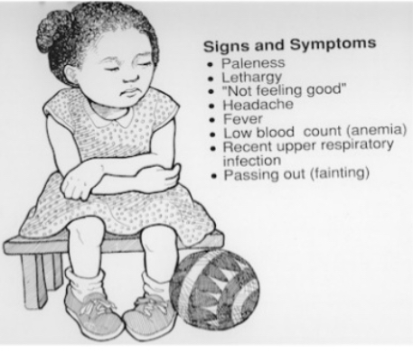
Aplastic Crisis
Aplastic crisis is a temporary cessation of bone marrow activity affecting predominantly the red cell precursors .
The destruction of red cell precursors by
human parvovirus B19 is the main etiology.
Bone marrow aplasia, predominantly affects red cell series but also lowers platelets and whitecells, lasting 7-10days. The bone marrow always recovers with the development of viral immunity but because of shortened red cell survival in SS disease may be fatal.

Slide 44
^{Prevention}
Human parvovirus vaccine is under development but not yet available. SS siblings of affected case have over a 50% chance of aplasia simultaneously or within 3 weeks.
^{Diagnosis}
Marked lowering of Hb – usually to 2-4 g/dl over a few days.
Reticulocytes 0% or if present, a daily marked increase consistent with the recovery phase.
^{Treatment}
Blood Transfusion (BT) as emergency if reticulocytes 0% and Hb > 2g/dl below steady state level; transfusion may be performed in day care centre if uncomplicated aplasia (no features other than pallor).
Review after 3-4 days to ensure reticulocytosis of recovery phase has occurred.
Patients may be closely monitored without transfusion if they are already in recovery phase - daily marked increase in reticulocytes count and rising Hb.
Monitor urine for proteinuria; watch for signs of stroke.

Slide 45

NEUROLOGICAL COMPLICATIONS

Slide 46
^{Features & Diagnosis:}
1. Focal neurologic deficit that lasts for >24 hr and/or increased signal intensity with a T2- weighted MRI of the brain indicating a cerebral infarct.
2. Absence of a focal neurologic deficit lasting >24 hr in the presence of a lesion on T2- weighted MRI indicating a cerebral infarct indicates silent cerebral infarct.
3. Evidence of a stroke can be found as early as 1 yr of age.
4. Other complications include headaches, anaemia, seizures, cerebral venous thrombosis, and Reversible Posterior Leukoencephalopathy Syndrome (RPLS).
5. CT brain to exclude cerebral hemorrhage.
6. MRI of brain with diffusion-weighted imaging to distinguish between ischemic infarcts & RPLS.
7. MR venography to evaluate the possibility of Cerebral Venous Thrombosis.

Slide 47
^{Treatment:}
^{Focal Neurologic Deficit}
Oxygen administration to keep SPO2>96%.
Simple BT within 1 hr of presentation with goal of Hb maximum 10 g/dl.
^{Excess Hb might limit O}₂ delivery to Brain due to hyper-viscosity of blood can decrease O₂ ^{delivery.}
IV hydration does not relieve or prevent pain. Give iv. hydration only when the patient is unable to drink due to the severe pain or dehydration.
Opioid dependency in children with SCD is rare and should never be used as a reason to withhold pain medication.
Hydroxyurea, a myelosuppressive agent, to reduce the frequency of painful episodes.

Slide 48
Primary Prevention :
Transcranial Doppler (TCD) assessment of the blood velocity in the terminal portion of the internal carotid artery (ICA) and the proximal portion of the middle cerebral artery (MCA). Two methods are used viz.,. non-imaging and imaging techniques.
The TAMM (Time Averaged Maximal Mean ) blood velocities used as cut-offs to define the risk limits are as follows:
Normal velocity - 'standard risk’ ^{<170 cm/s}
Borderline velocity - 'conditional’ ^{170 to 199 cm/s}
^{High velocity - 'high risk’} ^{>200 cm/s}

Slide 49
^{TCD scanning decision}
Inadequate scan/ low velocities - Rescanning or alternative technique is suggested.
Normal scan <170 cm/sec - Repeat TCD in 1 year.
^{Conditional 170 to 199 cm/sec-}
Rescan between 1 & 4 months. Children <10 years & those with higher velocities are considered to be at higher risk & should be scanned earlier
^{Abnormal >200 cm/sec -}
Discuss risk of stroke & consider chronic transfusion. A rescan might be considered appropriate depending on the blood velocity & individual clinical circumstances.

Slide 50
^{Excessive Iron Stores}
Biopsy of the liver - gold standard
commonly - serum ferritin levels
MRI of the liver - alternative to biopsy and more accurate than serum ferritin in measuring iron content in heart and liver
Erythrocytapheresis - preferred method
Despite being the preferred method, erythrocytapheresis is less commonly performed

Slide 51
Loss of Vision
The loss of vision may occur when blood vessels in the eye become blocked with sickle cells and the retina (the thin layer of tissue inside the back of the eye) gets damaged.
Some patients grow extra blood vessels in the eye from the lack of oxygen.
Prevention
The eyes should be checked every year
Primarily it should be done by an ophthalmologist who specializes in diseases of the retina.
Treatment
If there is retinal damage by undue blood vessel growth, laser treatment often can prevent further vision loss.

Slide 52
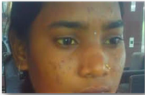
^{Deep Jaundice}
^{main cause which is because} of increased bilirubin production due to hemolysis.
causes stone in gall bladder and bile duct .

Slide 53
Laboratory Diagnosis

Slide 54
Solubility Test
Further an anemic individual with Hb of < 7.0 g/dL may give a false negative result.
Use of packed erythrocytes (0.01 mL) for solubility test will correct for this error.
In infants younger than 6 months and individuals with history of recent transfusion with normal erythrocytes, false negatives may occur due to low concentration of HbS.
Based on the relative insolubility of haemoglobin S in the reduced state in high phosphate buffer solution .
Reducing agent –Metabisulfite
Solubility test is a qualitative test and does not distinguish the difference between haemoglobin S disease (SS) and haemoglobin S trait (AS).
Erythrocytosis, hyperglobulinemia, extreme leukocytosis, or hyperlipidemia may cause false positive results.

Slide 55
Sickling Test
In the Sickling test we create the conditions at which oxygen tension decline to induce the Sickling process of HbS in RBCs.
When a drop of blood is sealed between a cover slip and a slide, the decline in oxygen tension due to oxidative processes in the blood cells leads to sickling.
In this method blood drop is added with sodium metabisulfite, a chemical reducing agents which rapidly reduces oxyhaemoglobin to reduced haemoglobin to accelerate sickling. In positive samples the typical sickle-shaped red blood cells will appear.

Slide 56
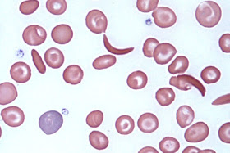
^{steps of Sickling Test}
• Fresh blood in any anticoagulant.
• Mix 1 drop of blood with 1 drop of 2% sodium metabisulphite solution on a
^{microscope slide.}
• Cover with a cover slip and seal the edge with wax/vaseline mixture or with nail varnish.
• Incubate at room temperature for 1 to 4 hours.
• Examine under a microscope with the dry objective.

Slide 57
False negative results may be obtained if the metabilsulphite has deteriorated or if the cover slip is not sealed properly.
A positive test does not distinguish the sickle cell trait from sickle cell disease.
Sensitivity 99.9% and Specificity 97%

Slide 58
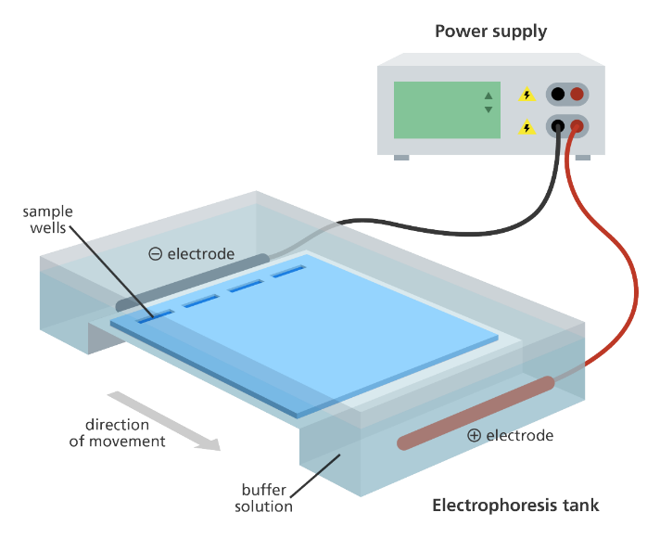
^{Electrophoresis}
The electrophoresis process work on the fact that different haemoglobin types have different electrical charges and move at different speeds in an electric field.
In an electrical field proteins that have a net negative charge will migrate from the cathode ("black," "negative") to the anode ("red", "positive") of the field.
The positions of the protein products are detected either directly by staining, or by coupled enzymatic reactions.
It has 100% of sensitivity and specificity.

Slide 59
Genotype : SS = Hb S >90%
Hb A 0 %
Hb F <10%
AS = Hb S < 40%
Hb A >60%
Hb F <0.1%

Slide 60
Newborn Screening
Early diagnosis -------- reduce morbidity, premature death, intellectual disability & other developmental disabilities
Newborn screening for sickle cell can be performed via the more sensitive haemoglobin HPLC fractionation or automated capillary electrophoresis and identifies the specific types of haemoglobin present.
This test uses a few drops of blood from pricking the baby's heel.
These drops are absorbed on a screening card (Guthrie Cards) that is taken to a laboratory for testing.
Newborn dried blood spot samples are screened for the presence of normal haemoglobins (F and A) and common haemoglobin variants to include S, C, D, E, and Bart's.
A fully automated instrument is fast and can analyze 96 samples in few hours.

Slide 61
Management of Newborn Screening
Confirm Diagnosis on capillary sample at age 1 month
^{Regular immunization schedules}
including Haemophilus influenzae type b vaccine.
Teach parents how to feel for the spleen which should be done daily; or more often if ^{child is sick.}
Advice purchase of thermometer and teach its use.
Start regular pneumococcal prophylaxis form 4 months to 4 years.
Oral penicillin-V 125 mg twice a day up to age of 3 years, and then 250 mg twice a day; or erythromycin 125 mg bd upto age of 3 years and then 250 mg bd if allergic to penicillin.
Explain about delayed physical and sexual development and slim build: advice plenty of ^{fresh fruit and vegetables}
Arrange regular review of child every 3 months or immediately if sick.

Slide 62
General Health Maintenance
Environmental
• Altitude: less than 1500 meters • Avoid cold exposure
• Avoid hot exposure
Way of Llife
• Regular hydration
• Avoidance of strenuous exercise
• Adoption of a quiet way life
Nutrition
• Folic acid supplementation 5 mg/day
• Zinc supplementation until puberty

Slide 63
Education
• Health education for the patient and relatives
• Information on symptoms requiring
medical advice
• Genetic counseling
• Appropriate use of analgesia at home
Psycho-Social Management
• Implementation of care pathways
• Easy access to social workers
• Open access to psychologist
• Avoidance of stress

Slide 64
Models of Management
Early Diagnosis and Follow-up
Newborn diagnosis essential to prevent many early deaths.
Regular follow-up .
Establish baseline for patients‟ clinical state and hematology by review when well.
Provide programme of management including pneumococcal prophylaxis and education on splenic palpation.
Diet
Folate supplementation when there is evidence of megaloblastic change or poor diet.

Slide 65
Haematology
Monitor hematology profile with reticulocytes and red cell indices every 3 monthly.
Monitor renal function every 6 monthly in patients to detect renal failure.
Gallstones
Common in SS disease (50% by 25 year) but rarely cause trouble no indication for removal of asymptomatic stones. Remove if evidence of acute or chronic Cholecystitis or blockage of the cystic or common bile duct.
Fever
Investigate febrile patients urgently and assume septicemic until proved otherwise,
Acute chest syndrome is common cause of fever.

Slide 66
Stroke
It is a catastrophic complication in childhood. Chronic transfusion programs may prevent recurrence but many difficulties with such programs in the Caribbean.
Bone Pain
Find out precipitating factors. Provide day care facilities for management of uncomplicated painful crises, remember pain in the ribs and sternum may precede acute chest syndrome. Investigate pain in hip with limp as possible avascular necrosis of femoral head.
Leg Ulcers -------- Avoid trauma around the ankles if possible, Treat ulcer actively with bed rest.
Acute Chest Syndrome ------- It is a major cause of morbidity and mortality in sickle cell disease. Chronic transfusion programmes may delay onset of respiratory failure.
Pripism ----- Ask about priapism because it is commonly treatable.
Renal Failure --------- Progressive glomerular damage associated with failing haemoglobin lever increasingly common in patients over 30 years.

Slide 67
IMMUNIZATION

Slide 68
PNEUMOCOCCAL VACCINE | PCV 13 & PPSV 23 | PCV 13 F/BY PPSV23 IN INTERVAL OF 8 WEEKS APART
TYPHOID VACCINE | Vi-PS (polysaccharide) Vi-PS conjugate | Vi-PS (polysaccharide) vaccines: Single dose at 2 years; revaccination every 3 years Vi-PS conjugate (Typbar-TCV®): Single dose at 9–12 months and a booster during second year of life.
Meningococcal VACCINE | conjugate vaccines & polysaccharide vaccines | For children 2 years and above
INFLUENZA VACCINE | Trivalent inactivated influenzavaccine (TIV) | 6 months to below 9 years: Two doses 1 month apart; 9 years and above: Single dose Annual revaccination with single dose

Slide 69
Councelling

Slide 70
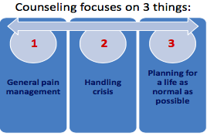

Slide 71
The patient should know:
What Sickle Cell is?
The difference between sickle cell Trait and sickle cell disease
That the Severity of pain & frequency of crisis are unpredictable.
That this is incurable.
That Only amelioration of conditions can be done.
That this is a genetic disorder.

Slide 72
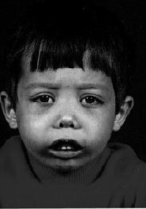
Identification of Patient

Slide 73
Delayed growth
Weight & height sub-normal
General complains of weakness
Highly anemic appearance
Severe anaemia
Pale skin
Colorless nails
Yellow skin & eyes
Long time jaundice
Flat bones
Continuous mild fever,
Short breaths/breathlessness
Laborious breathing

Slide 74
Loss of appetite
More tired than usual
Frequent urination dark urine
Pain in bones & ribs
Irritability & prominent mood swings
Swelling in hands & legs
Priapism
Infertility
Frequent viral & bacterial infections
Swollen spleen

Slide 75
Parent’s Role in Adolescents & Young Adults
Discuss nature of the disease/trait & its affect on them
Learn to identify onset of pain/crisis by self
Discuss & review ways to manage pain/crisis
Counsel them about adverse effects of tobacco, smoking, alcohol & drugs
Review school & work-place performance, watch out for drops in performance Parents to give praise frequently.

Slide 76
Pregnancy Phase/Pre-natal
Planning & early pre-natal care is the key
Pre-natal care should be done by an Obstetrician, who is an expert in high-risk pregnancy
Avoid infections
high protein & fibrous diet
Pre-natal vitamins & folic acid supplements
Preventing dehydration

Slide 77
Neonatal/Early Infancy
High possibility of premature/pre-term baby
Newborn screening for SCA/SCD: HPLC test and other tests
Test for sepsis
High risk of infections
Vaccinations– penicillin, anti-tetanus, pneumococcal, meningococcal , H.influenza B and typhoid vaccination till age 5
Childhood and School Going Children
Should have affection, safe environment at home and in school
Should be allowed to drink water frequently in school

Slide 78
No strenuous exercise
Should be exempt from outdoor activities when temperatures are very high
Should be given Moderate work load in schools desirable
At the hint of fever/ pain/ change in complexion or pallor/ breathing difficulty/
dizziness/ differential palpitation/ swelling/ muscular weakness –refer to a doctor
Counseling for Diet Management
Take a high fibre diet, plenty of roughage
Take large amount of proteins in diet
Choose diet rich in anti-oxidants
Avoid oily and fatty foods (masala)
Take plenty of water

Slide 79
Outlook
Current Treatment modalities available for sickle cell disease are as follows:
Hydroxyurea -- reduces painful crises & ACS in selected seriously affected patients but must be monitored carefully with frequent blood tests.
Bone marrow transplantation -- cure symptoms but is expensive requiring high expertise, only applicable to approximately 15% of Patients with HLA matched siblings, and has a 10% short-term mortality longer term effects on reproduction.
Chronic transfusion programmers -- reduce recurrent strokes but there are potentially serious complications.

Slide 80
Conclusions
In malarious areas, malaria continues to be a major cause of early death and complications in sickle cell disease patients. Control of malaria in the Caribbean has been associated with better survival.
Education and supportive services should empower the patient to cope with their disease.
With good care many patients with SS disease are living productive live and surviving to 70 years and beyond. Median survival currently estimated at 45- 55 years.

Slide 81


