Slide 1
BNP AND ANP

Slide 2
INTRODUCTION

Slide 3
Natriuretic peptides
  harmones
  secreted from heart
  important natriuretic and kaliuretic properties.

Slide 4
The family of natriuretic peptides
  at least eight structurally related amino acid peptides
  stored as three different pro hormones
    ANP 126 amino acid pro hormone
    BNP 108 amino acid pro hormone
    CNP 126 amino acid pro hormone.

Slide 5
Dendroaspis natriuretic peptide
  a D-type natriuretic peptide (DNP)
  the most recent addition to the family of natriuretic peptide.

Slide 6
Atrial Natriuretic Peptide

Slide 7
In 1950 studies conducted revealed→ that dilatation of the cardiac atria could induce natriuresis
In 1964, electron microscopy revealed → the presence of secretory granules in atrial monocyte

Slide 8
In 1981 De Bold and his colleagues demonstrated → that extracts from atrial monocytes injected into rats led to brisk natriuresis and diuresis
These atrial harmones were subsequently named as atrial natriuretic peptides(ANP).
This established heart as an endocrine organ.

Slide 9
  28 amino acid polypeptide
  is secreted in response to atrial stretching, angiotensin II stimulation, endothelin and symapathetic stimulation.
  Normal levels 25-60pg/ml
  Elevated levels are found in patients with LVH and mitral valve disease.

Slide 10
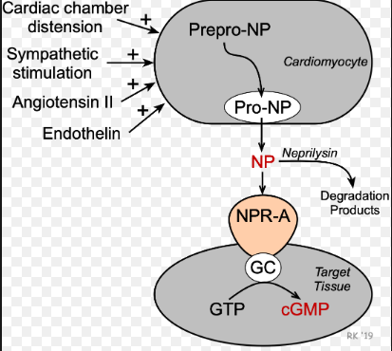
The GCMP serves as second messenger for the cellular actions of natriuretic peptides

Slide 11
B-type Natriuretic Peptide and Pro-BNP

Slide 12
BNP
  discovered in porcine brain in 1988
  where it was thought to be a neurotransmitter, hence its original name → brain natriuretic peptide.

Slide 13
  Subsequently, it was shown to be 10 fold more abundant in the heart than in brain
  hence the current term B-type natriuretic peptide, there is storage of BNP in ventricles which is incidentally the main source.
  Pro –BNP is processed within the human heart to form BNP

Slide 14
Before its activation, BNP is stored as a 108 amino acid polypeptide precursor
Pro-BNP→ secreted by secretory granules in both ventricles and lesser extent in atria.
After Pro-BNP is secreted in response to volume overload and myocardial stretch

Slide 15
cleaved to biologically inert molecule NT –pro BNP and the biologically active harmone BNP
Once released, BNP binds to and activates the atrial natriuretic factor receptor NPRA and to lesser extent NPRB.

Slide 16
Although ANP was identified first, concentration of BNP in myocardial tissue were found to be higher than those of ANP
therefore BNP is used as marker of increased ventricular filling pressure and LV dysfunction.

Slide 17
PATHOPHYSIOLOGY

Slide 18
  Natriuretic peptides (NPs) → involved in the long-term regulation of sodium and water balance, blood volume and arterial pressure.
    There are two major pathways of natriuretic peptide actions:
    vasodilator effects
    2) renal effects that leads to natriuresis and diuresis.

Slide 19
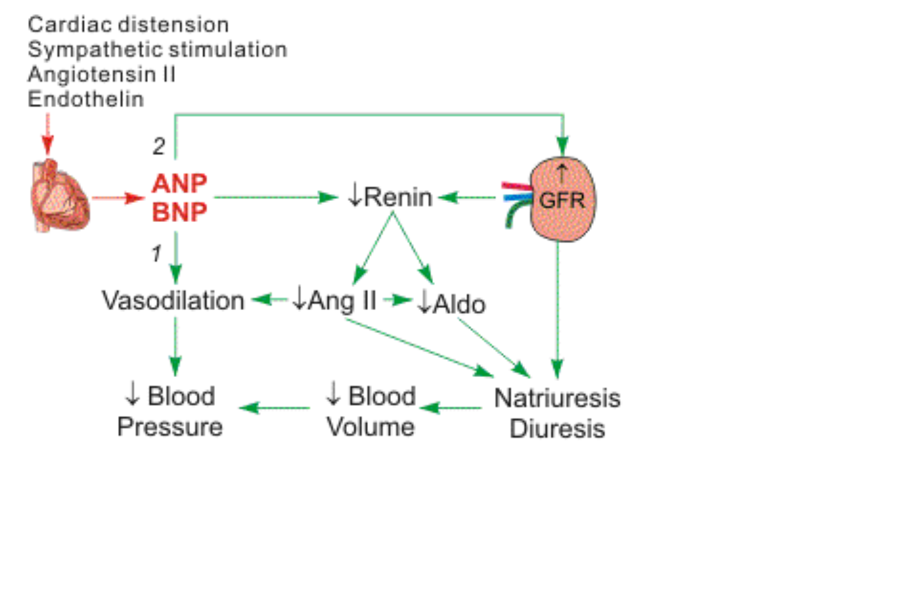

Slide 20
High ventricular filling pressure stimulate the release of ANP and BNP.
Both peptides have diuretic, natriuretic and antihypertensive effects which they exert by inhibiting the renin angiotensin aldosterone system.
They also have systemic and renal sympathetic activity.

Slide 21
decrease in systemic vascular resistance and central venous pressure.
The net efffect is to decrease blood pressure and thus afterload..
Additionally decrease in cardiac output due to decrease in central venous pressure and preload as result of reduction in blood volume resulting in natriuresis .
BNP may provide a protective effect against the detrimental fibrosis and remodelling that occurs in heart failure.

Slide 22
NPs affect the kidneys → increasing glomerular filtration rate (GFR) and filtration fraction
  which produces natriuresis (increased sodium excretion) and diuresis (increased fluid excretion).
  These renal effects of NPs are potassium sparing unlike most diuretic drugs that are used to induce natriuresis and diuresis in patients.

Slide 23
A second renal action of NPs is:
they decrease renin release
thereby decreasing circulating levels of angiotensin II and aldosterone.
This leads to further natriuresis and diuresis.
Decreased angiotensin II also contributes to systemic vasodilation and decreased systemic vascular resistance.

Slide 24
Cardio and renal effects
Cardiovascular and Renal Actions of Natriuretic Peptide
Natriuresis
Diuresis
Improve glomerular filtration rate & filtration fraction
Inhibit renin release
  ↓ circulating angiotensin II
  ↓ circulating aldosterone
Systemic vasodilation
Arterial hypotension
Reduced venous pressure
Reduced pulmonary capillary wedge pressure

Slide 25
Natriuretic peptide receptors and plasma endopeptidases actively clear BNP from the circulation thus the plasma half life is short around 20 mins.
No receptor mediated clearance of NT pro BNP is known to occur, and NT – pro BNP has longer half life of 60-120 mins as a result plasma levels of NT- pro BNP is 3-5 times higher then BNP levels.

Slide 26
NT pro BNP is more stable during storage than BNP.
Clearance of NT pro BNP is primarily renal hence its diagnostic utility is confounded in patients with renal insufficiency.

Slide 27
BNP and NT-pro BNP Assay methods

Slide 28
First generations assays for BNP
    - competetive immunoassays that required extraction and purification of the plasma sample .
Second generation assays
    - based on monoclonal antibodies and radio-isotope labels which was available in 1994 and required 12-36 hours to complete test.

Slide 29
Third generation assays
  available in the year 2000
  uses immunoflourescent methods
  provided results in 15minutes.

Slide 30
Role of NATRIURETIC PEPETIDES

Slide 31
Natriuretic peptides
  Helps to establish the diagnosis of heart failure .
  These values also depend on age and gender
  higher in elderly person and women.
The single most validated and established use of natriuretic peptides remains the diagnosis of CHF

Slide 32
BNP:
<100pg/ml –HF unlikely
>100pg/ml – HF likely
100-400pg/ml –use clinical judgement

Slide 33
NT-pro BNP
<300pg/ml- HF unlikely
Age <50years, NT-pro BNP >450pg/ml –HF likely
Age 50-75 years, NT-pro BNP >900pg/ml-HF likely
Age >75years, NT-pro BNP >1800pg/ml –HF likely.
Patients with chronic congestive heart failure may have elevated natriuretic peptide levels from the baseline

Slide 34
AHA RECOMMENDATIONS
The ACC/AHA guidelines for managing heart failure have incorporated using natriuretic peptides levels in establishing
  The prognosis
  The disease severity of chronic heart failure and acutely decompensated heart failure .

Slide 35
Guidelines from AHA
  Class A/B :
  As biomarker of prevention and prognosis.
  recommends to the use of BNP or NT-pro BNP in determining the patients at risk of heart failure
  To prevent the development of LV dysfunction or new onset heart failure

Slide 36
  CLASS C/D:
  In ambulatory patients presenting with new onset dyspnea, especially when the diagnosis is uncertain.
  use of BNP or NT-pro BNP values in the diagnosis of heart failure or exclusion of heart failure
  Have higher sensitivity than specificity

Slide 37
To exclude ADHF :
To identify ADHF:
PEPTIDE | CUT OFF | SENSITIVITY
BNP | 30-50pg/ml | 97
NT-proBNP | <300pg/ml | 99
ANP | <57pmol/L | 98
BNP | >100pg/ml | 90
NT-proBNP | >900pg/ml | 90
ANP | >127pmol/L | 87

Slide 38
Clinical Significance
  other conditions have also been recognized in which natriuretic peptides have a role

Slide 39
Elevated levels of natriuretic peptides are associated with coronary heart dissease/MI and atrial fibrillation
  poor long term prognosis
  adverse impact on long term mortality
natriuretic peptides may be predictor of sudden cardiac death and also response to cardiac resynchronization therapy.
Natriuretic peptides are also being used to evaluate valvular heart disease

Slide 40
Conditions associated with elevated of BNP are
Acute renal failure.
Hypertension .
Pulmonary disease such as pulmonary hypertension, severe COPD, Pneumonia, pulmonary embolism, ARDS .
d) Older age
e) Female sex

Slide 41
f) Liver cirrhosis
g) Sepsis
h) Chemotherapy
Conditions associated with lower than expected BNP are obesity(BMI >30kg/m2), flash pulmonary edema, pericardial constriction.

Slide 42
Falsely high levels of BNP and NT-proBNP may seen in
Females : due to higher estrogen levels causing higher BNP levels or the effect of testosterone on lowering the levels of BNP.
2. Advancing age : With advancing age , the levels of both the natriuretic peptides increase due to alterations in multiple levels in synthesis, secretion and ,metabolism .

Slide 43
3. Renal failure : are elevated in CKD (GFR<60ml/min) even in the absence of heart failure. This makes both BNP and NT-proBNP less accurate for diagnosing heart failure as the cause symptoms in patients with CKD .
  The values of natriuretic peptides also fluctuate with dialysis.
4. High cardiac output states such as sepsis, cirrhosis and hyperthyroidism may cause elevated levels of natriuretic peptides.

Slide 44
PROGNOSTIC VALUE

Slide 45
Natriuretic peptides are independent predictors of mortality of CHF.
Increased or persistent elevation of natriuretic peptide levels despite treatment suggests progression of disease or resistance to treatment.
In acute setting, failure of BNP or NT-pro BNP levels to decrease with treatment is a poor prognostic factor that requires intensification of treatment.

Slide 46
Natriuretic peptide levels should not be measured daily, should be measured on day of admission , after 24 hours of treatment and at discharge.
Decreased levels are predictive of excellent outcome.
  Elevated levels have prognostic value in CKD because patients with high levels of natriuretic peptide levels do worse than those with lower levels.

Slide 47
Recombinant BNP
Recombinant human BNP or Nesiritide
  - Acts by decreasing pulmonary capillary wedge pressure and improving dyspnea
  - Approved for the treatment of acute decompensated congestive heart failure caused by systolic dysfunction

Slide 48
Neutral endopeptidase or Neprilysin inhibitors (ex sacubitril)
  - a new drug that increase the concentration of circulating natriuretic peptides by inhibiting their degradation.
  -Sacubitril when combined with ARB inhibitors(valsartan) has shown to be safe and effective in treating acute decompensated heart failure.

Slide 49
Acts by blocking both angiotensin receptors and degradation of natriuretic peptides
enhances the RAAS counter regulatory effects of natriuretic peptides and block the actions of elevated circulating angiotensin II.

Slide 50
THANK YOU

