Slide 1
Eeg
(electroencephalogram)

Slide 2
ELECTROENCEPHALOGRAPHY
Technique which records electrical waveforms from the surface of the scalp
Non invasive
Hans Berger recorded the first human EEG in 1924.
  also invented the apparatus, the electroencephalogram.
In India, the first EEG machine was manufactured by Dr. Anil D Desai in the King Edward Memorial Hospital, Mumbai.
EEG is the investigation of choice in patients with epilepsy.

Slide 3
HOW EEG IS RECORDED ?
EEG is the graphical representation of cerebral electrical activity recorded by applying electrodes over the scalp.
It records the voltage difference between 2 scalp areas.
Action potential decays exponentially as distance from the source increases and is further attenuated by resistance from CSF, dura and bone. Hence the surface EEG inherently has some distortions and limitations of waveforms.

Slide 4
The electrodes are small metallic discs that provide the conduction of electro cortical potential by wires towards the amplification device and a recording machine.
Each site has a letter to identify the lobe and a number to identify the hemisphere.
The letters F, T, P, C, and O stand for frontal, temporal, parietal, central and occipital.
Z refers to an electrode placed in the midline.

Slide 5
Even numbers refer to electrode positions on the right hemisphere, whereas odd numbers refer to those on the left hemisphere.
Letters A and Fp denote the earlobes and frontal polar sites.
EEG is recorded by employing the internationally preferred method for application of the scalp electrodes, the 10-20 system.
The 10 and 20 refer to the actual distances between the adjacent electrodes are either 10% or 20% of the total front-back or right-left distance of the skull.
Nasion and Inion are the 2 anatomical landmarks used for positioning the electrodes.

Slide 6
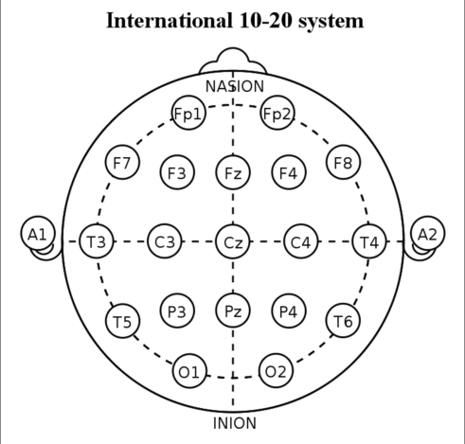

Slide 7
In the 10-20 system, standardized montages are used for analysis of the waveforms.
There are 2 types of montages – bipolar and referential.
Montage means the placement of the electrodes.
The referential type of recording is useful in measuring the elevation with reference to a particular point.
Bipolar recording measures the difference of elevation between nearby points, going serially in a particular direction.

Slide 8
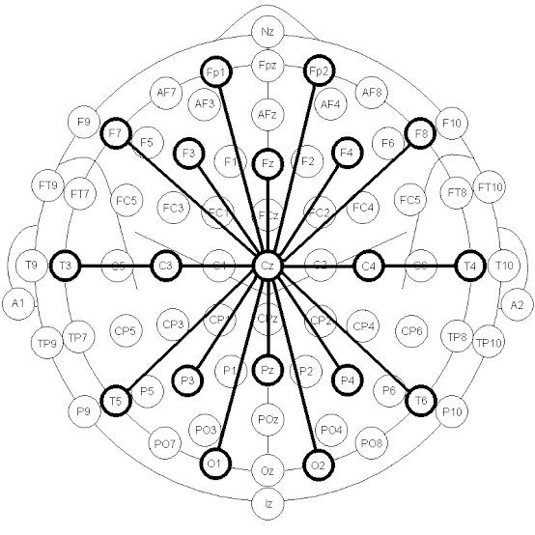
Referential Montage

Slide 9
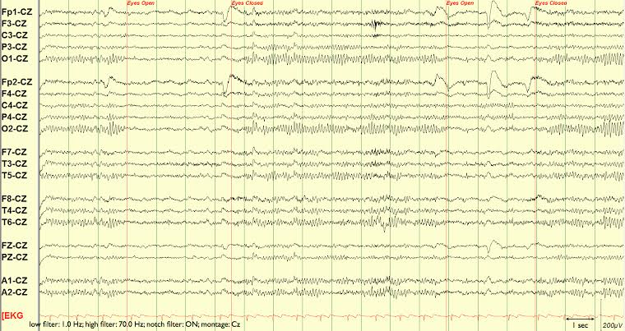

Slide 10
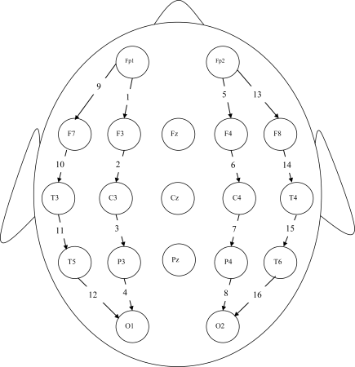
Bipolar Montage

Slide 11
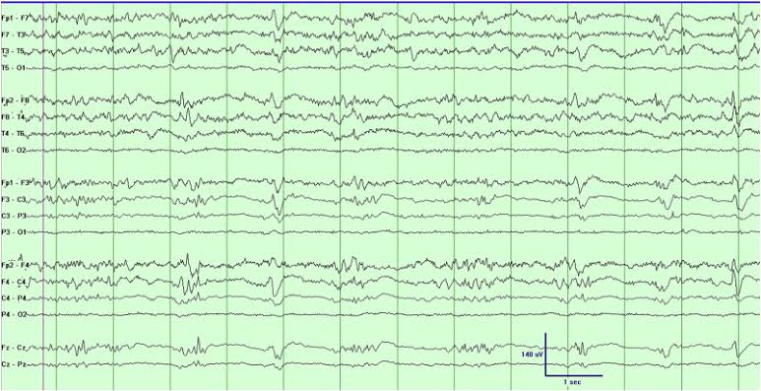

Slide 12
WHEN EEG IS HELPFUL ?
Important in distinguishing epileptic seizures from other types of spells, such as psychogenic non epileptic seizures, syncope, movement disorders.
Useful in the diagnosis, classification and management of epilepsy.
Only in 50% of the patients, initial inter ictal EEG shows abnormality. With subsequent serial EEGs, sensitivity increases.

Slide 13
Normal EEG during an attack indicates psychogenic nature.
EEG is employed for the determination of cerebral death in patients with irreversible coma, particularly when organs have to be salvaged for transplantation.
EEG is useful for the detection of changes in the brain activities and in quantifying changes in brain degeneration in dementia.

Slide 14
Role of EEG in epilepsy
Diagnosis of epilepsy
Distinction between focal and generalized seizure disorder
Identification of syndrome specific changes
Recognition of photosensitive elements in epilepsy
Predicting chances of seizure relapse, if medication is withdrawn
Localization of epileptogenic area before epilepsy surgery
Detection of non convulsive status epilepticus
Monitoring of convulsive status epilepticus

Slide 15
INDICATION OF cEEG monitoring in ICU
1) Established seizures/status epilepticus – to guide titration of anticonvulsive therapy
2) Screen for non convulsive seizures – who are at high risk like hypoxic ischemic encephalopathy, stroke, meningitis, IVH
3) Screen for seizures among patients who are paralyzed
4) Characterization of “ spells” : suspected to represent seizures
5) Cerebral ischemia detection : delayed cerebral ischemia due to vasospasm following SAH
6) Prognostication (by monitoring evolution of EEG background)

Slide 16
EEG waves
EEG wave | Amplitude (uV) | Frequency (Hz)
Beta | 1-5 | >14
Alpha | 20-100 | 8-14
Theta | 30-50 | 4-8
Delta | >100 | <4

Slide 17
Beta waves are predominant when the person is wake and is performing mental activity.
Alpha waves are predominant when the person is awake and resting.
Theta waves are present when the person is sleeping.
Delta waves are seen in deep sleep.

Slide 18
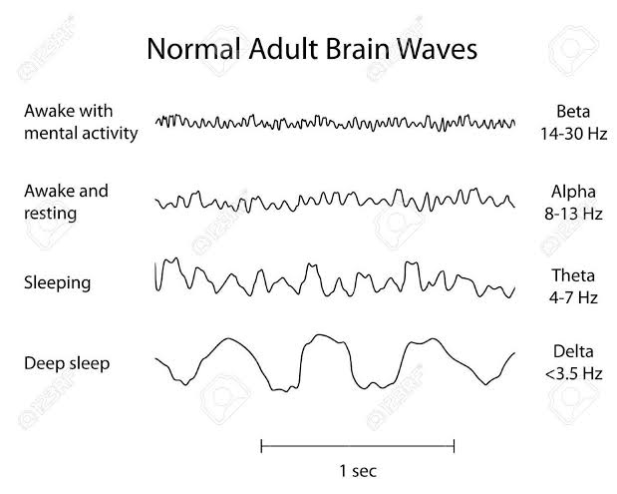

Slide 19
Delta wave
Slowest waveform.
Normally seen in adults during sleep.
Activity is resistant to external stimuli and is usually polymorphic and arrhythmic.
In elderly, delta activity is sometimes seen in the temporal area during wakefulness.
Delta activity is considered abnormal under other circumstances.

Slide 20
Theta wave
4-8 Hz
Activity is often present diffusely in children during wakefulness, whereas in adults, it occurs predominantly during drowsiness.
Theta activity may occur in the temporal area in elderly.

Slide 21
Persistent focal slowing, particularly of delta frequency, is often associated with a structural lesion.
Arrhythmic slowing is classically seen with lesions affecting the white matter, whereas rhythmic slowing is more suggestive of cortical dysfunction.
Generalized theta delta slowing usually points to diffuse dysfunction of the brain.

Slide 22
Alpha wave
8-13Hz
Lower limit of alpha activity is reached by 3 years of age and progressively increases to normal level by adulthood.
Frequency of alpha wave remains stable with difference on both sides of upto 0.5 Hz. Difference of more than 1 Hz is considered abnormal.
Also known as posterior dominant rhythm.
Occurrence is during wakefulness, especially when the person is relaxed and has both eyes closed.

Slide 23
Seen maximally over occipital areas, with spread to parieto temporal areas.
Failure of alpha rhythm attenuation with eye opening/mental activity indicates abnormality on that side.

Slide 24
Alpha variants
Mu rhythm
Frontal alpha
Paradoxical alpha: Seen in sedated patients.
Bancaud’s phenomenon: Unilateral blocking of alpha activity with eye opening/mental activity. The side lacking the blocking response is abnormal.
Alpha coma: Most often caused by HIE or destructive process in pons. Alpha waves distributed uniformly in patients who are unresponsive to stimuli/comatose.

Slide 25
Beta wave
>14 Hz
Generalized beta activity is induced/ enhanced by benzodiazepenes, barbiturates and in hyperthyroidism.
Significant attenuation of beta activity or loss of faster frequencies suggest cortical dysfunction or a collection between the cortex and the recording electrodes ( SDH, epidural hematoma)
Breach rhythm: Variant of beta activity seen in central or mid temporal region when there is a skull defect.

Slide 26
SLEEP CYCLE
Sleep is divided into NREM and REM sleep.
NREM sleep includes stages I, II and slow wave sleep (formerly stages III and IV).

Slide 27
EEG changes during sleep
Stage I: Alpha dropout, roving eye artefacts vertex waves. POSTS ( positive occipital sharp transients of sleep)
Stage II: Sleep spindles and K complexes
Stage III & IV: Delta predominance

Slide 28
POSTS
Sharp contoured surface positive transients over occipital area.
Often mistaken for sharp epileptiform discharges
Features distinguishing POSTS from sharp epileptiform activity:
Bilateral occurrence
Occurrence in runs of 4-5 Hz
Monophasic appearance of waves

Slide 29
Sleep Spindle & K complex
Sleep spindles are paroxysmal, sinusoidal, low-medium amplitude activity lasting about a second, occurring at 5-15 second intervals.
They are associated with rhythmic discharge of neurons fro the thalamo-cortical system.
K complexes are high voltage, slow waves which are less sharply contoured. They are related to the arousal process, being maximal at the vertex and can occur spontaneously or in response to sudden sensory stimuli.

Slide 30
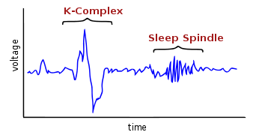

Slide 31
Significance of K complex
In patients with idiopathic generalised epilepsy, K complex induced synchronization can trigger spike and wave discharges.
In autosomal dominant nocturnal frontal lobe epilepsy, K complexes are present at the start of the seizure activity.
Restless leg syndrome is associated with increased numbers of K complexes and often precede leg movements.

Slide 32
ACTIVATION PROCEDURES
Activation procedures are performed during an EEG to induce or enhance abnormal EEG patterns.
The most commonly used ones are hyperventilation, photic stimulation, sleep deprivation and drug withdrawal.
Hyperventilation usually triggers absence seizures.

Slide 33
Hyperventilation
Patient asked to breathe deeply at the rate of 18-20 per minute for 3 minutes.
This leads to hypocapnia, which causes constriction of the cerebral arteries, resulting in decreased activity of mesencephalic reticular formation.
The normal response is characterized by an increase in amplitude and diffuse bilateral theta and delta activity.
The EEG return to baseline usually within a minute.

Slide 34
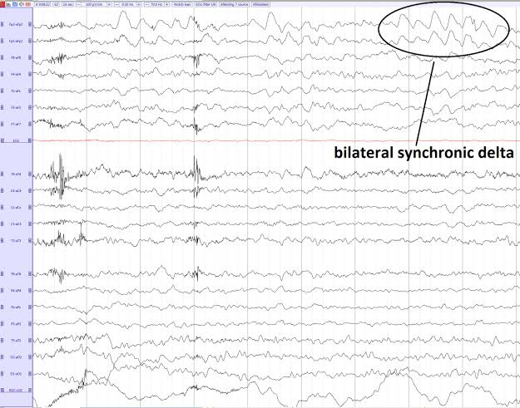

Slide 35
Abnormal response
HV is very effective in activating generalized 3 Hz spike and wave discharge/clinical absence seizure
HV enhances generalized polyspike discharge in JME patients
A build up that persists for several minutes after HV is suggestive of moya moya disease

Slide 36
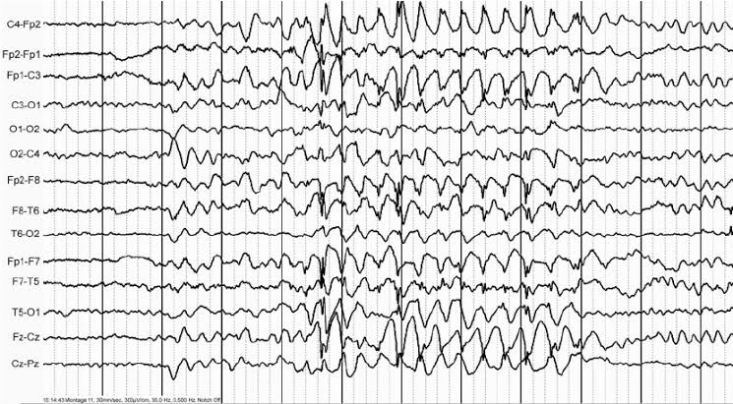
Hyperventilation induced absence seizure

Slide 37
Photic stimulation
Flashing of lights is called photic drive.
Due to continuous flashing of light, there will be eyelid closure, which will present as artefact in the EEG. This is phototmyogenic response.
Continuous photic drive will elicit a photoparoxysmal response, which is charecterized by generalized spikes, polyspikes and wave.

Slide 38
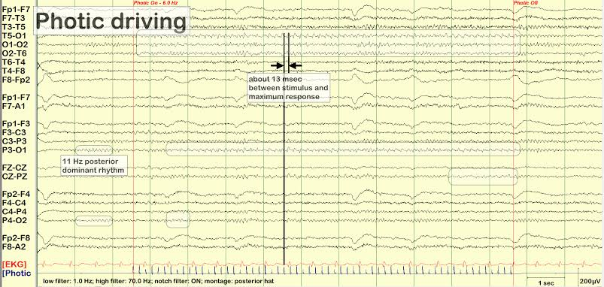

Slide 39
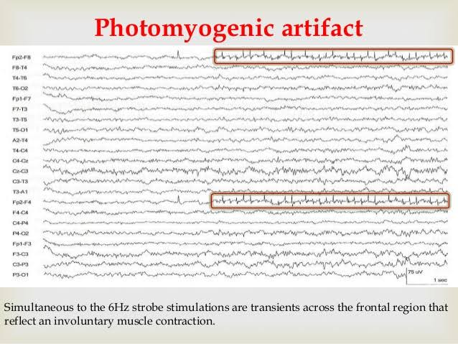

Slide 40
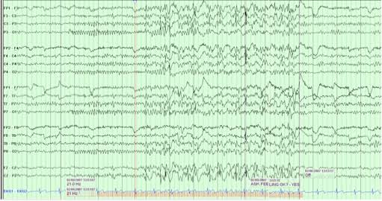

Slide 41
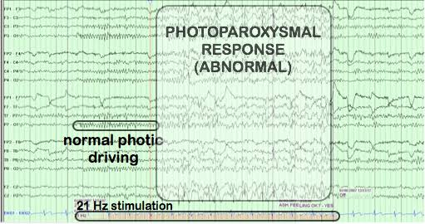

Slide 42
Conditions associated with PPR
Juvenile myoclonic epilepsy
Absence Seizures
Occipital lobe epilepsy
Diffuse encephalopathies: Lafora body disease, MELAS (mitochondrial encephalopathy with lactic acidosis and stroke like episodes)
CJD, Epilepsy with GTCS on awakening

Slide 43
ARTEFACT
An artefact in an EEG refers to any electrical signal which is not directly generated from the brain.
They may interfere with the interpretation by masking normal patterns or mimicking abnormal discharges.
Types: Occular
Cardiac
Muscle
Electrode

Slide 44
Ocular artefacts
Blink
Flutter: Usually occurs in bifrontal region and us if low amplitude and high frequency
Lateral gaze: Recognized by phase reversal in opposite directions on the side on which gaze is directed.
Slow/Roving eye movements: Seen in drowsiness.

Slide 45
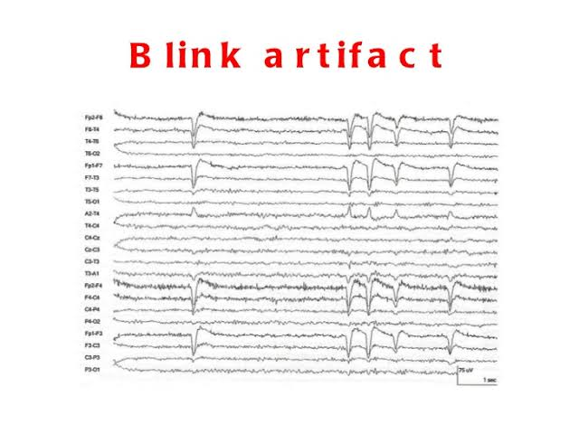

Slide 46
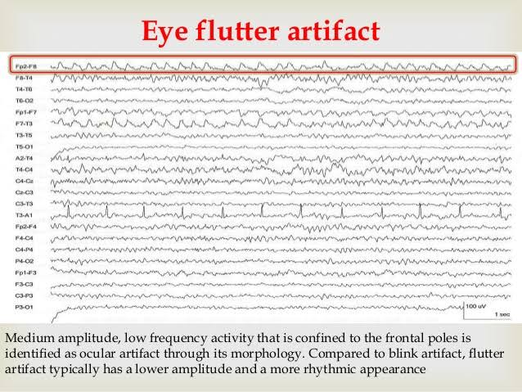

Slide 47
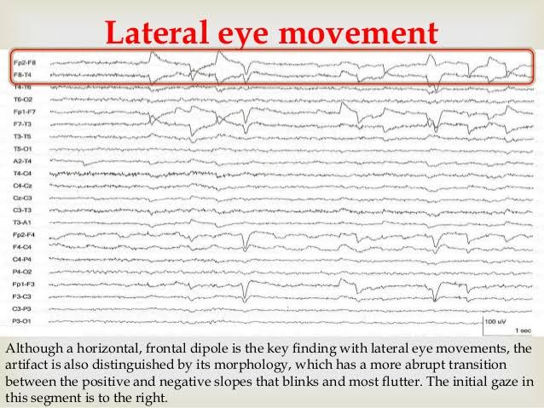

Slide 48
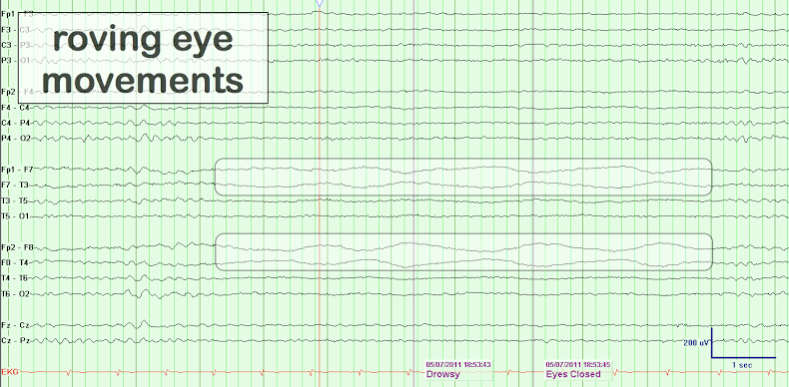

Slide 49
Cardiac artefacts
Electrocardiographic
Pulse artefact: Occurs when the electrode rests over a scalp blood vessel

Slide 50
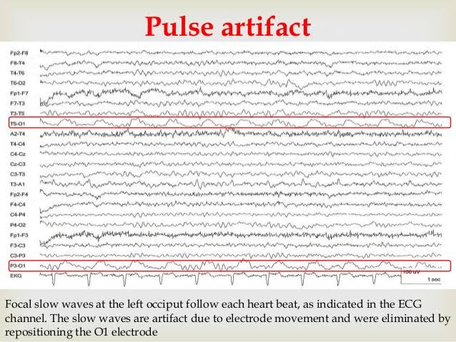

Slide 51
Muscle artefact
EMG: Occur in regions with underlying muscles.
Glossokinetic: Tongue tip acts as an inherent negative dipole and along with muscular activity from pharyngeal muscles, give rise to glossokinetic effect.

Slide 52
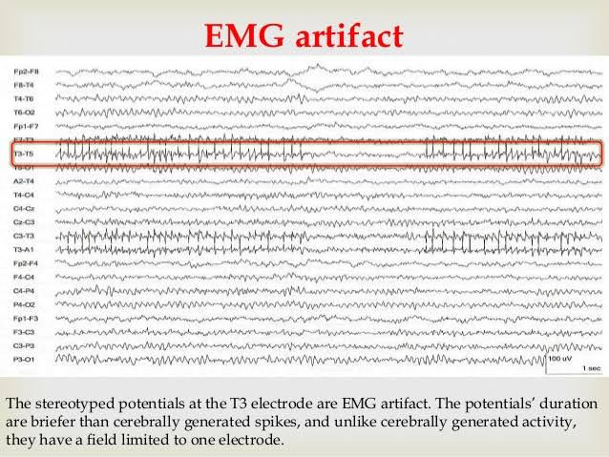

Slide 53
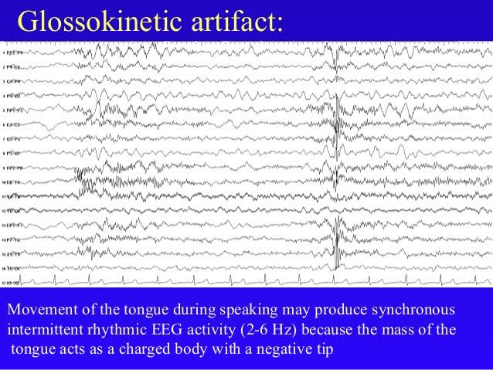

Slide 54
Electrode artefact
Pop: Electrode paste between skin and electrode works as a capacitor and stores electrical charge. Due to change in impedance, sudden potential appears in all channels that include the electrode.
Poor electrode contact: Produces instability in impedance.
Salt bride: Unwanted connection between electrodes.

Slide 55
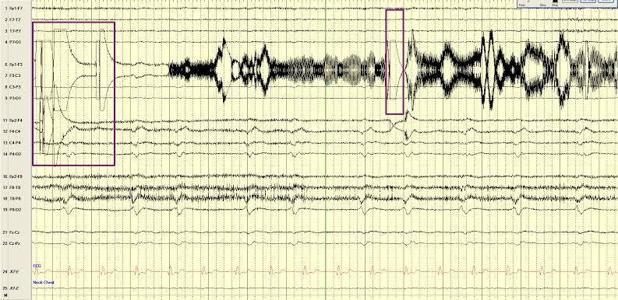

Slide 56
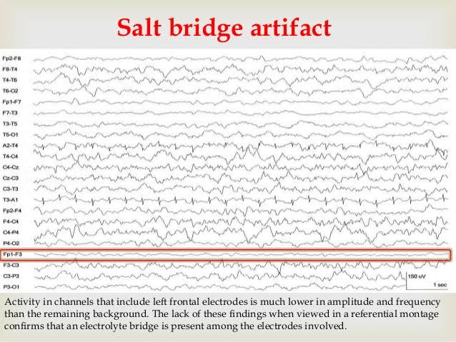

Slide 57
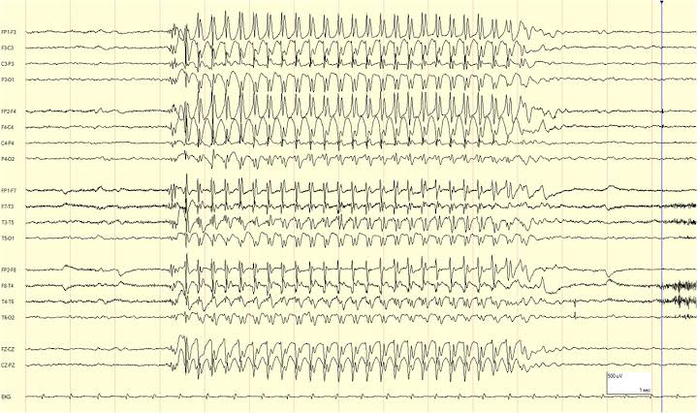
Absence seizure

Slide 58
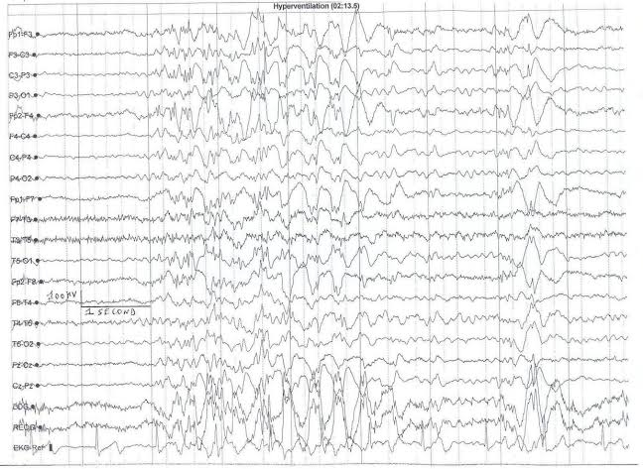
JME

Slide 59
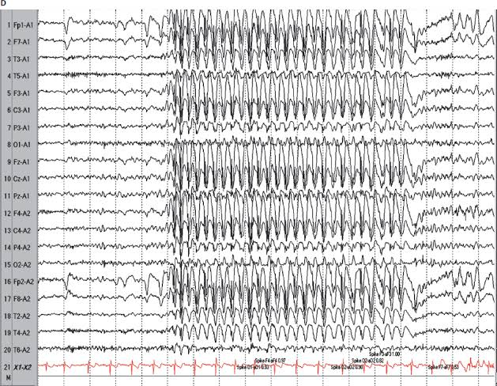
GTCS

Slide 60
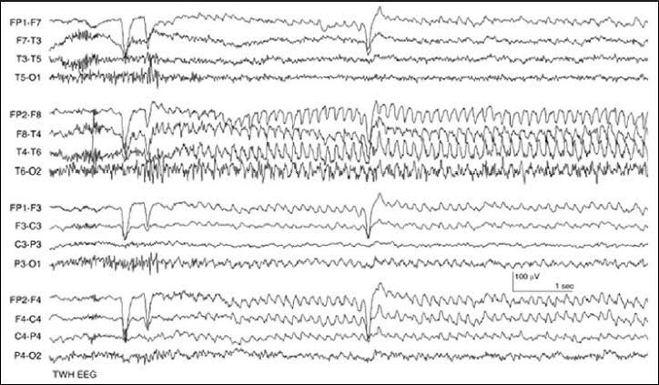
Temporal Lobe Epilepsy

Slide 61
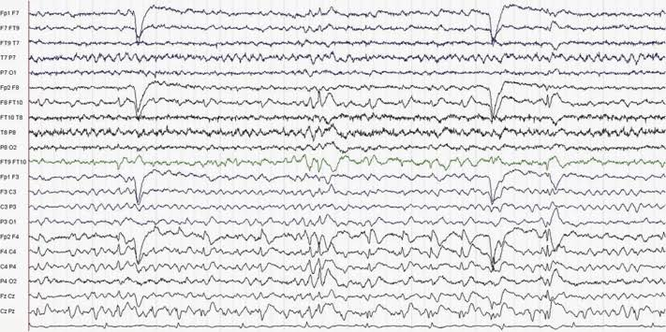
Frontal lobe epilepsy

Slide 62
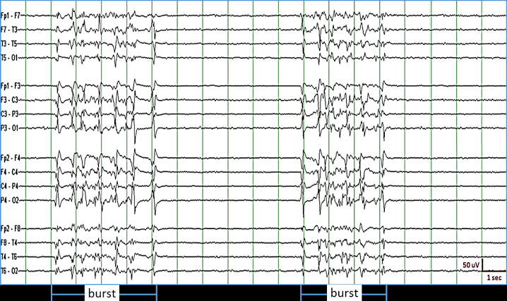
Burst suppression

Slide 63
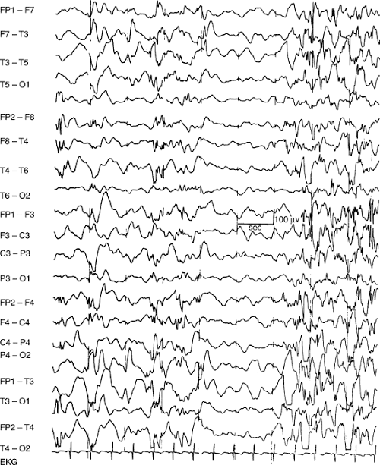
Hypsarrhythmia

Slide 64
Thank You

