Slide 1
FEBRILE ENCEPHALOPATHY

Slide 2
OVERVIEW
Levels of consciousness
Definition of terms
Points from history/epidemiology
Investigations
Supportive management
Specific management
Sepsis Associated encephalopathy
HIV Encephalopathy
Malaria Encephalopathy
Autoimmune encephalitis

Slide 3
LEVELS OF CONSCIOUSNESS
ALERT: Fully conscious
LETHARGIC: Appear somnolent, but may be able to maintain arousal.
OBTUNDED: Requires touch or voice to maintain arousal.
STUPOROUS: Unresponsiveness from which the individual can be aroused only by painful stimulus.
COMATOSE: State in which patient is unable to arouse or respond to noxious stimuli and is completely unaware of self and surroundings.

Slide 4
DEFINITION
ENCEPHALOPATHY
Diffuse disturbance of brain function without inflammation
ENCEPHALITIS
Dysfunction of brain associated with inflammation
FEBRILE ENCEPHALOPATHY
Acute onset of fever (<1 WEEK) + alteration of consciousness for >12 hours

Slide 5
ACUTE FEBRILE ENCEPHALOPATHY
It is defined as altered mental state that either accompanies or follows short febrile illness that is characterised by a diffuse and nonspecific brain insult manifested by a combination of coma, seizures, and decerebration.
Central nervous system (CNS) infections are the most common causes of altered mental status in patients with nontraumatic coma.

Slide 6
ENCEPHALITIS
FEBRILE ENCEPHALOPATHY
INFLAMMATION
Temp >38 degree C
Cellular CSF
Seizures
Alteration of cerebral function
Focal neurological signs
Imaging /EEG suggestive of inflammation

Slide 7
ACUTE ENCEPHALITIS SYNDROME (AES)
Clinically, a case of Acute Encephalitis Syndrome (AES) is defined as a person of any age, at any time of year with the acute onset of fever and at least one of the following:
a) change in mental status (including symptoms such as confusion, disorientation, coma, or inability to talk);
b) New onset of seizures (excluding simple febrile seizures).

Slide 8
INFECTIOUS CAUSES
Age old enemies:
Cerebral Malaria
Enteric Fever
Japanese Encephalitis
Bacterial Meningitis
Fulminant Hepatic failure
VIRAL ENCEPHALITIS
Herpes simplex type 1 and type 2
Varicella zoster
HHV6
Epstein Barr virus
Arboviruses – JE, West Nile, Dengue, Chikungunya
Rhabdoviruses-rabies
Orthomyxovirus – H1N1
Paramyxovirus – measles
HIV

Slide 9
INFECTIOUS CAUSES
Bacterial
Meningitis
Brain abscess
Sepsis associated encephalopathy
Leptospirosis
Typhoid
M. tuberculosis
Rickettsial (scrub typhus)
Parasitic
Cerebral malaria
Toxoplasma

Slide 10
NON- INFECTIOUS CAUSES OF FEVER
Over production of heat
Impaired heat dissipation
Neuroleptic malignant syndrome
Malignant Hyperthermia
Drugs- Cocaine, Salicylate
Thyrotoxic encephalopathy
Convulsive status epilepticus
Catatonic schizophrenia
Anticholinergic toxicity, e.g. Amitriptyline
Heat Stroke

Slide 11
Structural lesions (Impaired thermoregulatory mechanism)
Hypothalamic lesion
Brain stem lesions (stroke)
Intraventricular and subarachnoid haemorrhage

Slide 12
Misc. causes
Infectious or post infectious demyelination (ADEM)
Cerebral fat embolism
Altered sensorium with secondary cause of fever: e.g. Stroke with aspiration pneumonia

Slide 13

HOW TO APPROACH?
HISTORY:
Most important
Sometimes only clue to correct diagnosis.
Careful and systematic clinical assessment is key to management of a patient of febrile encephalopathy.
Imp to differentiate infective vs non infective causes.
Temporal course is also imp – whether fever preceded or followed altered sensorium or simultaneous.
Classical triad of CNS inf – fever, neck rigidity, altered mental status. (present in majority of patients)

Slide 14
IMPORTANT POINTS FOR HISTORY:
Fever, Headache, Vomiting, Altered Sensorium
Geographic and Seasonal factor
Immune status, Drug intake
Contact with animals, Dog bite, Insect bite
Foreign travel
Occupation

Slide 15
PHYSICAL EXAMINATION:
Thorough physical examination & neurological examination can provide imp clues to underlying etiology.
Skin rashes are common in meningococcal infection, rickettsia fever, VZV, Colorado tick fever
Parotitis in mumps
Erythema nodosum may be a/w TB & histoplasmosis
Mucous membrane lesions common in Herpes virus infection
Upper resp tract infection favor Influenzae or Mycoplasma
Look for lymphadenopathy, hepatosplenomegaly.
Kernig’s sign, Brudzinski’s sign, Jolt accentuation

Slide 16
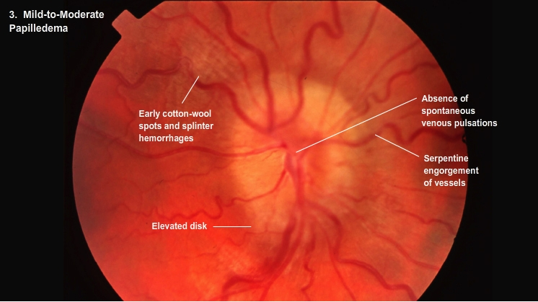
Detailed neurological examination including:
Pupillary size(anisocoria) & reaction(loss)
Forced eye deviation,
Cranial nerve involvement,
Decerebrate rigidity,
Focal neuro deficit, and
Fundus examination for papilledema help in diagnosis & planning investigations.
Common focal abnormalities are:
Hemiparesis, Aphasia, Ataxia,
Pyramidal Signs, Cranial Nerve Deficits,
Involuntary Movements (Myoclonus & Tremors),
Partial Seizures & Papilledema.

Slide 17
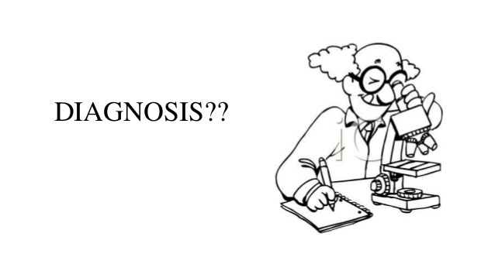
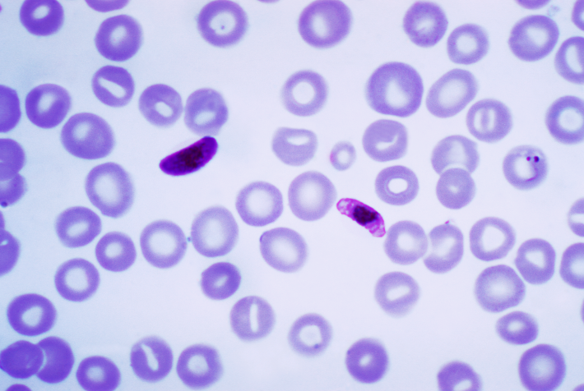
INVESTIGATIONS:
BLOOD INVESTIGATIONS:
TC, DC - CBC
Coagulation profile
Blood culture: positive in 30-80% cases of bacterial meningitis.
Serum CRP & Procalcitonin
Blood biochemistry
Arterial blood gases
Peripheral Blood Smear:
Relative lymphocytosis in viral meningitis.
Leukopenia & thrombocytopenia – in rickettsial infection & viral haemorrhagic fevers.
“For definitive diagnosis of malarial infection: P.falciparum gamet.”

Slide 18
CHEST X-RAY:
May reveal changes suggestive of infection such as Mycoplasma, Legionella, Tuberculosis
Lumbar Puncture:
Always indicated when meningitis or meningoencephalitis is suspected. Includes:
CSF pressure
Gross examination for turbidity, cob web coagulum
Color
Chemical examination: sugar, protein
Cell count & cell types
Microbiological examination: gram stain, India ink preparation, cultures
PCR for tuberculosis, viral infection
Latex agglutination
Limulus lysate assay

Slide 19
HISTORY
Fever with rash
Maculopapular
Petechiae/purpura
Vesicles
Eschar
Herpes labialis
RESPIRATORY SYMPTOMS
H1N1
Diarrhoea, vomiting
Enteroviruses
Polio

Slide 20
PAROTITIS
Mumps
EB virus
HIV
MYALGIA, ARTHRALGIA
Dengue
Leptospirosis

Slide 21
Lower cranial nerve palsies:
TBM
VASCULITIS
Brainstem encephalitis
JE, West Nile
Abnormal behaviour/psychosis:
HSV
Limbic encephalitis
NCSE
Opisthotonic posture Choreoathetosis :
JE, autoimmune
Visual loss:
Optic neuritis
Hypertensive encephalopathy
Meningeal signs:
MENINGITIS
ADEM
Meningoencephalitis
Papilledema:
ICSOL
Hydrocephalus –TBM
Hypertensive encephalopathy

Slide 22
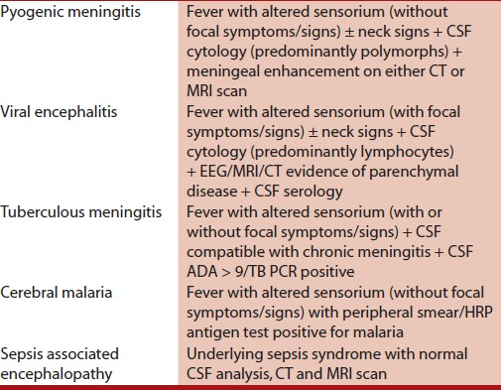
Diagnostic criteria used for different etiologies of acute febrile encephalopathy

Slide 23
IMPORTANT POINTS
Presence of fever alone is not sufficient to make a diagnosis of an infectious etiology ( e.g. Meningitis or encephalitis)
Encephalopathy may be precipitated by systemic infections or sepsis without cerebral inflammation (septic encephalopathy)
Sepsis can lead to altered sensorium secondary to metabolic alterations like hypoglycemia, hyperpyrexia, hypovolemia, hepatic or renal failure.

Slide 24
Even in absence of infection there can be high rise of temp due to mechanisms such as overproduction or impaired dissipation of heat, non infectious CNS diseases, hypothalamic lesion.
Patients of NMS may have fever, neck stiffness, delirium, generalized rigidity, even after the offending drug has been withdrawn.
WORLDWIDE , infection of the CNS is the commonest cause of Fever with altered sensorium.

Slide 25
NEUROLOGICAL INVESTIGATIONS
CSF STUDY
ELECTROENCEPHALOGRAM (EEG)
IMAGING

Slide 26
A) LUMBAR PUNCTURE
CONTRAINDICATIONS:
Lumbar puncture should not be performed as part of initial acute management if patient has following:
GCS <8
Deteriorating GCS
Focal neurological signs
Abnormal breathing pattern
Abnormal Doll’s eye response
Abnormal posture
Shock
Bradycardia ( heart rate <60)
Clinical evidence of systemic meningococcal disease
Pupillary dilatation (unilateral or bilateral) and Pupillary reaction to light impaired or lost
Signs of Raised ICP
IMAGING BEFORE LP IN RAISED ICT

Slide 27
BACTERIAL MENINGITIS
PMN
• High protein, low sugar, gram stain
ASEPTIC MENINGITIS
Few lymphocytes
• Normal protein
• Normal sugar
VIRAL ENCEPHALITIS
Lymphocytic
Normal sugar, normal to slightly raised protein
TUBERCULOUS MENINGITIS
• Opalescent, cob web
• Lymphocytic
• High protein, Low sugar

Slide 28
CSF findings | NORMAL | VIRAL | BACTERIAL | TUBERCULAR | FUNGAL
OPENING PRESSURE | 60-180 mm of H2O | Normal | Elevated | Elevated/ Variable | Elevated/ Variable
COLOUR | Clear | Usually clear | Turbid/ xanthochromic | Xanthochromic/variable | Clear/ Variable
TOTAL COUNT | <5 cells/cmm | <100 cells/cmm | >1000/cmm | Variable (100-500/cmm) | Variable
DIFFERENTIAL COUNT | Lymphocytes | Lymphocytes | PMN’s | Lymphocytes | Lymphocytes
PROTEIN | 20-40mg/dl | Normal/ Increased | Elevated | Elevated | Elevated
GLUCOSE | 40-80mg/dl | Usually normal | Decreased | Decreased | Decreased
MICROSCOPY |  | Usually normal | Gm stain +ve/variable | AFB +ve | India ink preparation

Slide 29
PCR IN CSF
Take at least 5 ml of CSF
Be sure that it is not mixed with blood
Sensitivity and specificity are relatively good
Can be negative very early in HSV and after 10 days of treatment
Paired samples – 4 fold rise in titre

Slide 30
NEUROIMAGING
MRI
CT SCAN
Characteristic neuroimaging changes:
Fronto temporal changes in HSV.
Thalamic & midbrain changes in Japanese encephalitis.
Basal exudates after contrast admission in TB Meningitis.
Basal ganglia ring enhancing lesion in Toxoplasmosis.
Multiple ring enhancing lesions in tuberculoma.

Slide 31
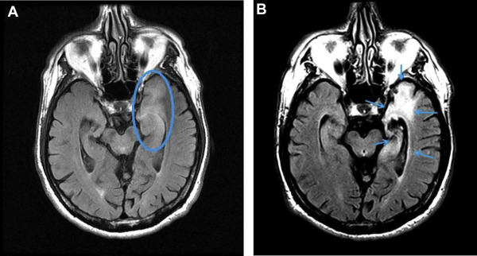
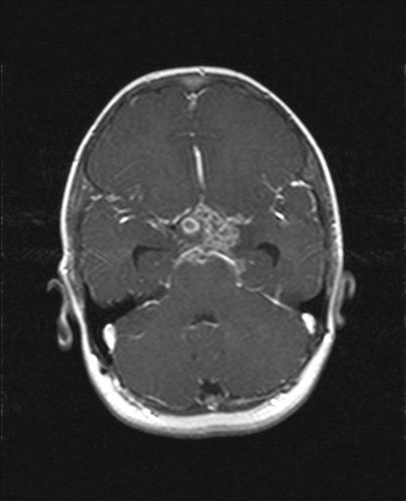
HSV encephalitis
TB Meningitis

Slide 32
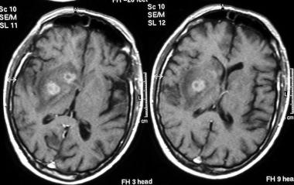
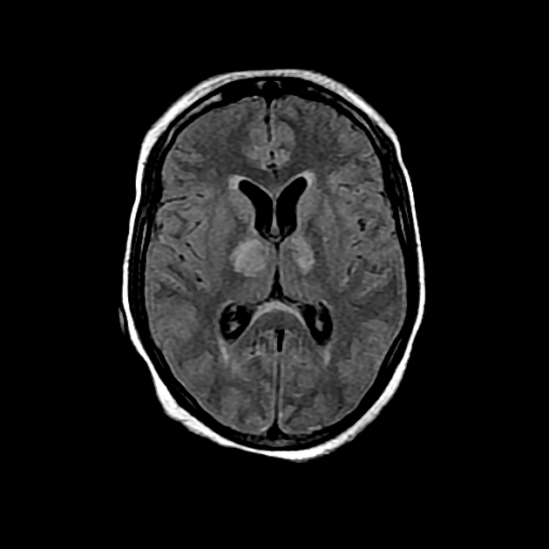
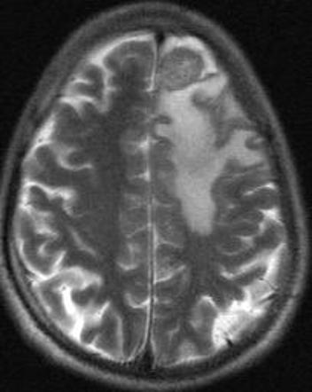
Toxoplasmosis
JAPANESE ENCEPHALITIS
TUBERCULOMA

Slide 33
EEG
EEG is important in a patient with febrile encephalopathy to rule out non-convulsive status.
EEG is strongly recommended in any suspected case of acute encephalitis since it may help in distinguishing focal encephalitis from generalized encephalopathy.
In the latter, EEG may show diffuse, bihemispheric slowing for example, triphasic slow waves in hepatic encephalopathy.
EEG is invariably abnormal in HSE and evolve from a nonspecific slowing to a more characteristic change of 2–3 Hz, periodic lateralized epileptiform discharges originating from the temporal lobes limited to about half the cases in the later stages.

Slide 34
NON CONVULSIVE STATUS EPILEPTICUS (NCSE)
Should be suspected in confusion, stupor, unarousable coma
Subtle features like eye blinking, nystagmus, perioral twitching, automatisms may be seen
May follow convulsive seizures
EEG is the only diagnostic clue
Response to diazepam can be demonstrated in simultaneous EEG recording
Generalised/complex partial

Slide 35
GENERAL MANAGEMENT
Maintain:
Normothermia
Normoglycemia
Normal electrolyte balance
Normotension
Management of raised ICT:
Minimal stimulation
Head end elevation
Avoid hypotonic fluids
3% saline
Mannitol 20% solution
Hyperventilation

Slide 36
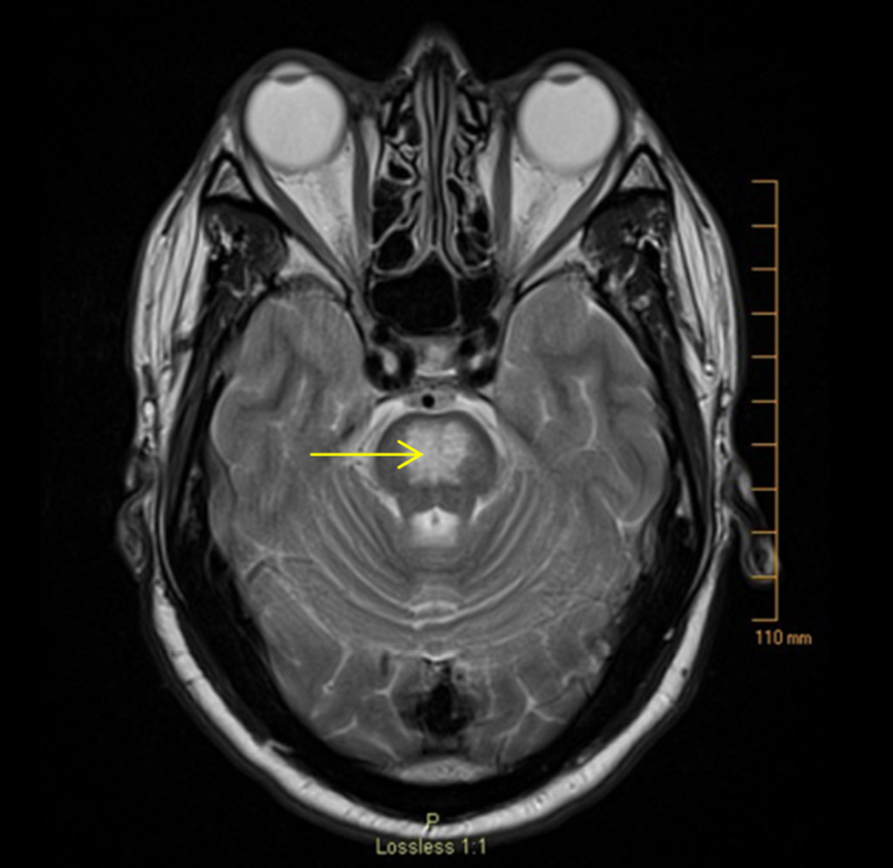
SUPPORTIVE MANAGEMENT
Management of seizures/status epilepticus
Identify SIADH and manage
Rapid correction of hyponatremia may lead to central pontine myelinolysis
central pontine myelinolysis

Slide 37
SYMPTOMATIC TREATMENT
Abnormal /psychotic behaviour – Haloperidol+ Phenergan
Choreoathetosis – Dopa blockers
Dystonia - Tetrabenazine, Anticholinergics, Muscle relaxants

Slide 38
SPECIFIC TREATMENT
Specific treatment according to cause.

Slide 39
SEPSIS ASSOCIATED ENCEPHALOPATHY
Poorly understood CNS condition
Defined as a diffuse brain dysfunction secondary to infection elsewhere in the body without overt CNS infection
Manifests lethargy –delirium
Pathogenesis:
bacterial invasion of brain
endotoxins
derangement of neurotransmitter and
amino acid and microvascular changes
Prognosis- poor
May be seen in patient with
1. mechanical ventilation
2.critical ill patient in icu.

Slide 40
HIV ENCEPHALOPATHY
MANIFESTATION:
MAY BE HIV VIRUS ITSELF OR ITS NEUROLOGICAL COMPLICATION D/T OPPORTUNISTIC INFECTION LIKE:
1. CNS tuberculosis
2. cytomegalo virus encephalitis
3. toxoplasmosis
4. cryptococcal meningitis
5.syphilis
6.tumours (primary CNS lymphoma )or drug related complications

Slide 41
MALARIA ENCEPHALOPATHY
The potentially fatal complication of falciparum malaria ( most important cause of unarousable coma in febrile patients in endemic area ).
SUSCEPTIBILITY
children
pregnant women
non – immune adults
20 % all severe falciparum malaria requires ICU admission.

Slide 42
MALARIA
Selective cytoadherence and sequestration of parasitized RBC’S in cerebral venules and toxin release at schizont rupture are possible pathological mechanism.
Systemic complications like hypoglycaemia may contribute to development of coma.
Diagnosis – PS for MP
Treatment – artesunate (2.4 mg/kg IV at 0, 12 and 24 hours; then once daily) is better than quinine (IV loading dose of 20 mg salt/kg; then 10 mg/kg 8 hourly).

Slide 43
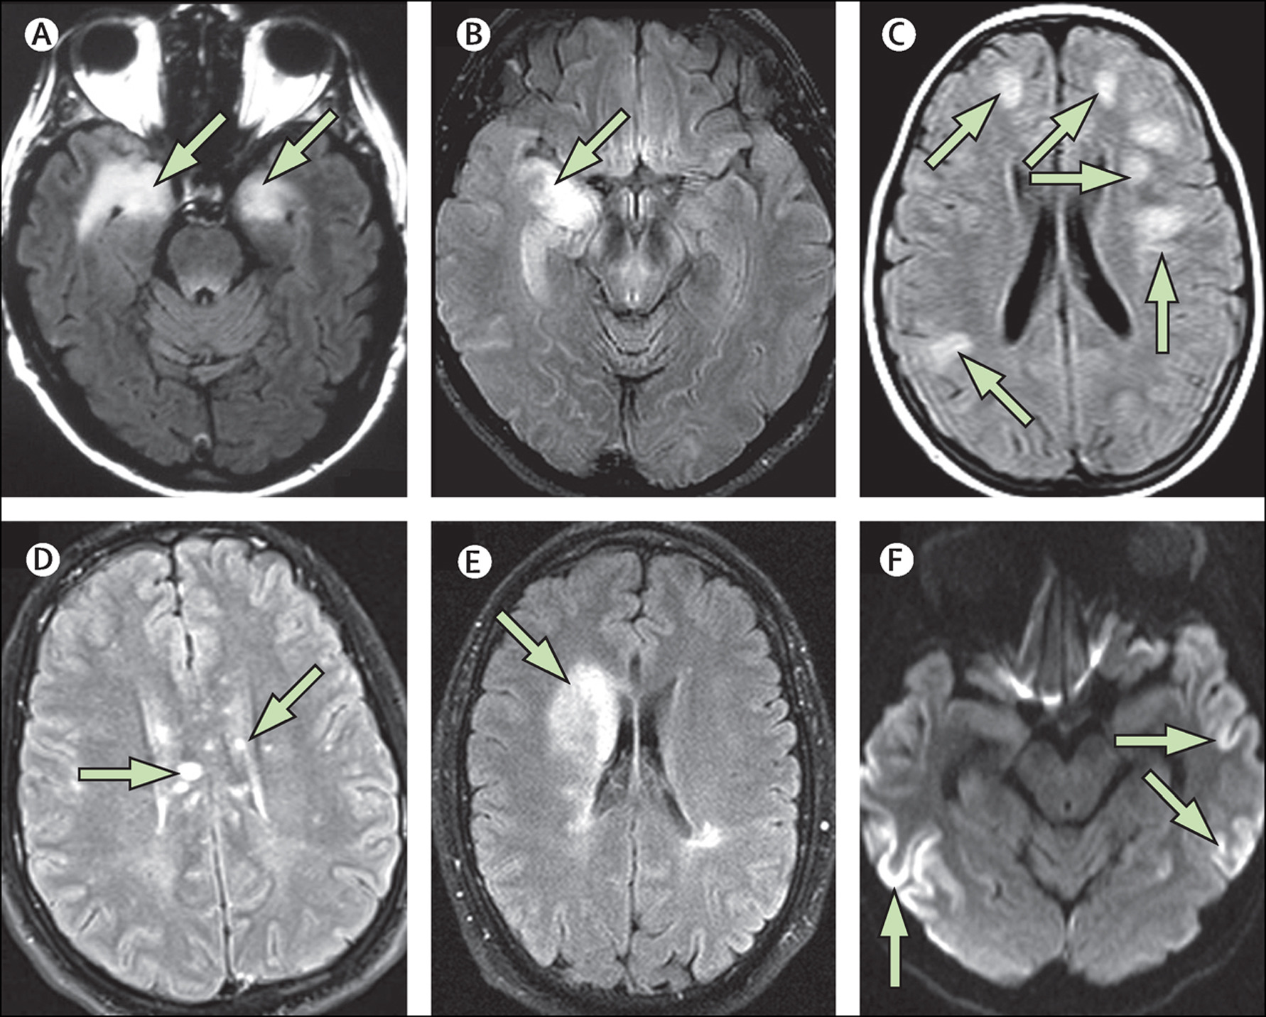
AUTOIMMUNE ENCEPHALITIS
Often presents with fever
Behavioural abnormalities
Psychosis
Movement disorders
Seizures/status epilepticus
May be paraneoplastic – teratoma ovary in young females
Often no tumour is identified
Antibodies to NMDA (N-methy- D- aspartate) ,VGKC/LGI-1 (voltage gated potassium channels/ leucine-rich glioma inactivated protein-1) receptors
Treatment – IVIG, plasmapheresis

Slide 44
OTHER STUDY
J Emerg Trauma Shock. 2010 Jul;3(3):220-4. Acute febrile encephalopathy in adults from Northwest India.
Bhalla A, Suri V, Varma S, Sharma Department of Internal Medicine, PGIMER
A total of 127 patients with fever of less than 2 weeks duration along with alteration in mentation were studied prospectively over a period of 12 months.
A total of 33% patients had pyogenic meningitis, 29.9% had evidence of meningoencephalitis, and 12.7% were diagnosed as sepsis-associated encephalopathy. These were followed by cerebral malaria, leptospirosis, and brain abscess as the cause of febrile encephalopathy in adults.

Slide 45


