Slide 1
HYPERKALEMIA

Slide 2
NORMAL POTASSIUM BALANCE
The dietary intake of potassium ranges from less than 35 to more than 110 mmol/day in adults.
Despite this widespread variation in intake, homeostatic mechanisms serve to maintain plasma K+ precisely between 3.5 and 5.0 mmol/L.
In a healthy individual at steady state, the entire daily intake of potassium is excreted, approximately 90% in the urine and 10% in the stool.

Slide 3
More than 98% of total body potassium is intracellular, chiefly in muscle. Buffering of extracellular K+ by this large intracellular pool plays a crucial role in the regulation of plasma K+.

Slide 4
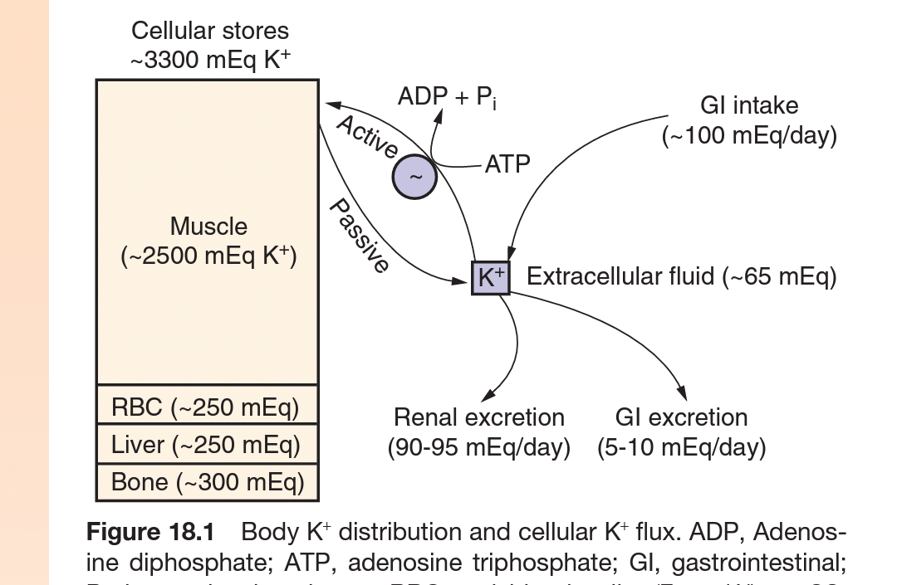
POTASSIUM TRANSPORT MECHANISMS

Slide 5
The intracellular accumulation of K+ against its electrochemical gradient is an energy-consuming process, mediated by Na+-K+-ATPase enzyme.
The Na+-K+-ATPase functions as an electrogenic pump, since the stoichiometry of transport is three intracellular Na+ ions to two extracellular K+ ions.
The enzyme complex is made up of a tissue-specific combination of multiple α-, β-, and γ-subunits, which are further subject to tissue-specific patterns of regulation.
Skeletal muscle contains as much as 75% of body potassium, and exerts considerable influence on extracellular K+.

Slide 6
Changes in skeletal muscle Na+-K+-ATPase activity and abundance are major determinants of the capacity for extrarenal K+ homeostasis.
Hypokalemia induces a marked decrease in muscle K+ content and Na+-K+-ATPase activity, an apparently altruistic mechanism to regulate plasma K+.
This is primarily due to dramatic decreases in the protein abundance of the α2-subunit of Na+/K+-ATPase.
In contrast, hyperkalemia due to potassium loading is associated with adaptive increases in muscle K+ content and Na+-K+-ATPase activity.

Slide 7
Potassium can also accumulate in cells by coupling to the gradient for Na+ entry, entering via the electroneutral Na+- K+-2Cl− cotransporters NKCC1 and NKCC2.
The NKCC2 protein is found only at the apical membrane of the thick ascending limb (TAL) and macula densa cells, where it functions in transepithelial salt transport and tubular regulation of renin release.
In contrast, NKCC1 is widely expressed in multiple tissues, including muscle.

Slide 8
The cotransport of K+-Cl− by the four K+-Cl− cotransporters (KCC1-4) can also function in the transfer of K+ across membranes; although the KCCs typically function as efflux pathways, they can mediate influx when extracellular K+ increases.
The efflux of K+ out of cells is largely accomplished by K+ channels.
There are three major subclasses of mammalian K+ channels: the six-transmembrane domain (TMD) family, which encompasses the voltage-sensitive and Ca2+-activated K+ channels; the two-pore, four-TMD family; and the two-TMD family of inward rectifying K+ (Kir) channels.

Slide 9
FACTORS AFFECTING INTERNAL DISTRIBUTION OF POTSSIUM
Insulin : Enhances cell uptake of K+ by activating several K+ transport pathways particularly Na+-K+-ATPase . It also activates Na+-H+ exchange and Na+-K+-2Cl- ccotransport. Most prominently K+ uptake increases in liver, skeletal muscles, cardiac muscles and fat, due to insulin.

Slide 10
2. β-2 adrenergic receptor stimulation enhances uptake of K+ by liver and muscle by activation of Na+-K+-ATPase via increase in cyclic adenosine monophosphate. Also, in the skeletal muscles they activate inwardly directed Na+-K+-2Cl- cotransporter NKCC1 which accounts for as much as 1/3rd of uptake response by catecholamines.
3. α adrenergic agonists on the other hand impair the ability to buffer increases in K+. It is thought that it is so, to blunt the β adrenegic stimulation induced increased K+ uptake during exercise.

Slide 11
4. Acid base balance : Acute disturbances in acid-base equilibrium result in changes in serum K+, such that alkalemia shifts K+ into cells, whereas acidemia is associated with K+ release.

Slide 12
RENAL POTASSIUM EXCRETION
POTASSIUM TRANSPORT IN THE DISTAL NEPHRON
The proximal tubule and loop of Henle mediate the bulk of potassium reabsorption, such that a considerable fraction of filtered potassium is reabsorbed prior to entry into the superficial distal tubules.
Renal potassium excretion is primarily determined by regulated secretion in the distal nephron, specifically within the connecting segment (CNT) and cortical collecting duct (CCD).

Slide 13
Apical Na+ entry via the amiloride-sensitive epithelial Na+ channel (ENaC) results in the generation of a lumen-negative potential difference in the CNT and CCD, which drives passive K+ exit through apical K+ channels.
Thus, K+ secretion is dependent on delivery of adequate luminal Na+ to the CNT and CCD; K+ secretion by the CCD essentially ceases as luminal Na+ drops below 8 mmol/L.
Dietary Na+ intake also influences K+ excretion, such that excretion is enhanced by excess Na+ intake and reduced by Na+ restriction.

Slide 14
CONTROL OF POTASSIUM SECRETION
ALDOSTERONE
Aldosterone is an important regulatory factor in K+ excretion, and an increase in plasma K+ is an important stimulus for aldosterone secretion.
Aldosterone has no effect on the density of apical SK channels in the CCD or CNT; rather, the hormone induces a marked increase in the density of apical Na+ channels, thus increasing the driving force for apical K+ excretion.

Slide 15
The apical, amiloride-sensitive ENaC is comprised of three subunits, α-, β-, and γ-, that assemble together to mediate Na+ transport.
Aldosterone activates ENaC channel complexes by multiple mechanisms.
First, it induces transcription of the α-ENaC subunit, increasing the availability for co-assembly with the more abundant β- and γ-subunits.

Slide 16
Second, aldosterone and dietary Na+-Cl− restriction stimulate a significant redistribution of ENaC subunits in the CNT and early CCD, from a largely cytoplasmic location during dietary Na+-Cl− excess to a purely apical distribution after aldosterone or Na+-Cl− restriction.
Third, aldosterone induces the expression of a serine-threonine kinase called SGK-1 (serum and glucocorticoid-induced kinase-1); coexpression of SGK-1 with ENaC subunits results in increased expression at the plasma membrane.

Slide 17
EFFECT OF POTASSIUM INTAKE
Changes in K+ intake strongly modulate K+ channel activity in the CNT and CCD (secretory capacity), in addition to H+-K+-ATPase activity in the OMCD (reabsorptive capacity).
Increased dietary K+ rapidly increases the activity of SK channels in the CCD and CNT, along with a modest increase in Na+ channel (ENaC) activity.
The increase in ENaC and SK channel density in the CCD occurs within hours of intake of a high-K+ diet, with a minimal associated increase in circulating aldosterone.

Slide 18
REGULATION OF RENAL RENIN AND ADRENAL ALDOSTERONE
Renin secretion by juxtaglomerular cells within the afferent arteriole is initiated in response to a signal from the macula densa, specifically a decrease in luminal chloride transported through the Na+-K+-2Cl− cotransporter (NKCC2) at the apical membrane of macula densa cells.
In addition to this macula densa signal, decreased renal perfusion pressure and renal sympathetic tone stimulate renal renin secretion.

Slide 19
Renin released from the kidney ultimately stimulates aldosterone release from the adrenal via Ang II.
Hyperkalemia per se is also an independent and synergistic stimulus for aldosterone release from the adrenal gland, although dietary K+ loading is less potent than dietary Na+-Cl− restriction in increasing circulating aldosterone.

Slide 20
HYPERKALEMIA
EPIDEMIOLOGY
Hyperkalemia is usually defined as a potassium level of 5.5 mmol/L or higher.
In most hospitalized patients, the pathophysiology of hyperkalemia is multifactorial, with reduced renal function, medications, older age (≥60 years), and hyperglycemia being the most common contributing factors.
In patients with ESKD, the prevalence of hyperkalemia is 5% to 10%.

Slide 21
CAUSES OF HYPERKALEMIA
Pseudohyperkalemia –
Cellular efflux; thrombocytosis, erythrocytosis, leukocytosis, in vitro hemolysis.
Hereditary defects in red cell membrane transport.
Intra to extracellular shift –
Acidosis
Hyperosmolality, radiocontrast, hypertonic dextrose, mannitol.
Β2-Adrenergic antagonists (noncardioselective agents)

Slide 22
4. Digoxin and related glycosides
5. Hyperkalemic periodic paralysis
6. Succinylcholine, thermal trauma, neuromuscular injury, disuse atrophy, mucositis, prolonged immobilisation.
7. Rapid tumour lysis
Inadequate excretion –
A. Inhibition of renin-angiotensin-aldosterone axis :
ACE inhibitors
Renin inhibitors (in combination with ACE inhibitors or ARBs)
ARBs

Slide 23
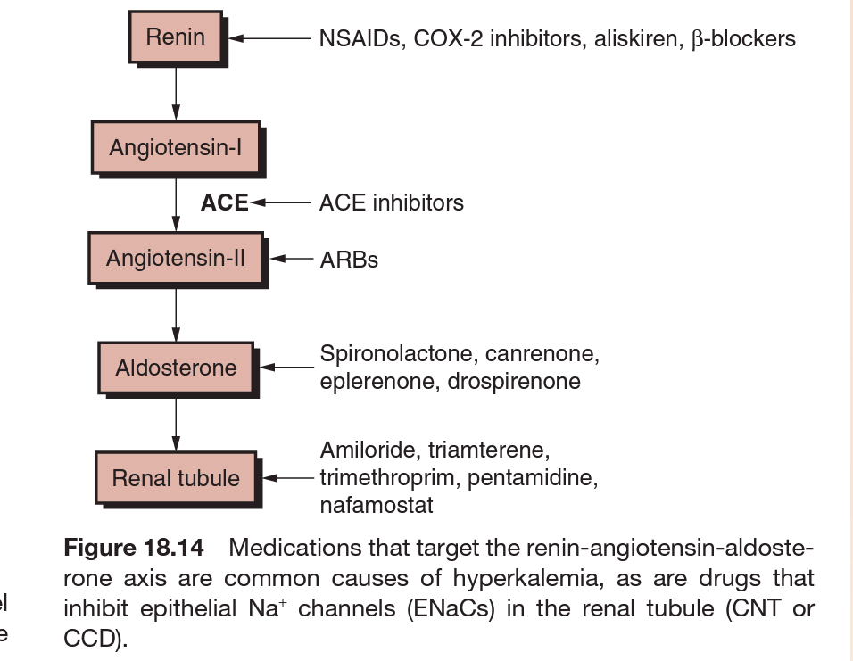
4. Blockade of mineralocorticoid receptors – spironolactone, eplerenone, drosperinone.
5. Blockade of the epithelial sodium channels (ENaC) – amiloride, triamterene, trimethoprim, pentamidine.

Slide 24
B. Decreased Distal Delivery –
Congestive Heart Failure
Volume depletion
Hyporeninemic hypoaldosternism –
Tubulointestitial diseases : SLE, Sickle cell anemia, obstructive uropathy.
Diabetes, diabetic nephropathy
Drugs – NSAIDs, COX2 inhibitors, β-blockers, cyclosporine, tacrolimus
Chronic kidney disease, advanced age
Pseudohypoaldosteronism type 2

Slide 25
Renal resistance to mineralocorticoid –
Tubulointerstitial diseases – SLE,amyloidosis, sickle cell anemia, obstructive uropathy, post acute tubular necrosis.
Hereditary – Pseudohypoaldosteronism type 1, defects in mineralocorticoid receptors or the epithelial sodium channel (ENaC)
Advanced renal insufficency –
CKD
ESRD
Acute oliguric kidney injury

Slide 26
Primary adrenal insufficiency –
Autoimmune – Addisons disease, polyglandular endocrinpathy
Infectious – HIV, CMV, TB, disseminated fungal infection
Infiltrative – amyloidosis, malignancy, metastatic cancer
Drug associated – heparin, LMWH
Hereditary – adrenal hypoplasia congenita, congenital lipoid adrenal hyperplasia, aldosterone synthase deficiency
Adrenal hemorrhage or infarction, including in antiphospholipid syndrome

Slide 27
CLINICAL FEATURES
Hyperkalemia is a medical emergency due to its effects on the heart.
Cardiac arrhythmias associated with hyperkalemia include sinus bradycardia, sinus arrest, slow idioventricular rhythms, ventricular tachycardia, ventricular fibrillation, and asystole.
Mild increases in extracellular K+ affect the repolarization phase of the cardiac action potential, resulting in changes in T-wave morphology; further increase in plasma K+ concentration depresses intracardiac conduction, with progressive prolongation of the PR and QRS intervals.

Slide 28
Severe hyperkalemia results in loss of the P wave and a progressive widening of the QRS complex; development of a sine-wave sinoventricular rhythm suggests impending ventricular fibrillation or asystole.

Slide 29
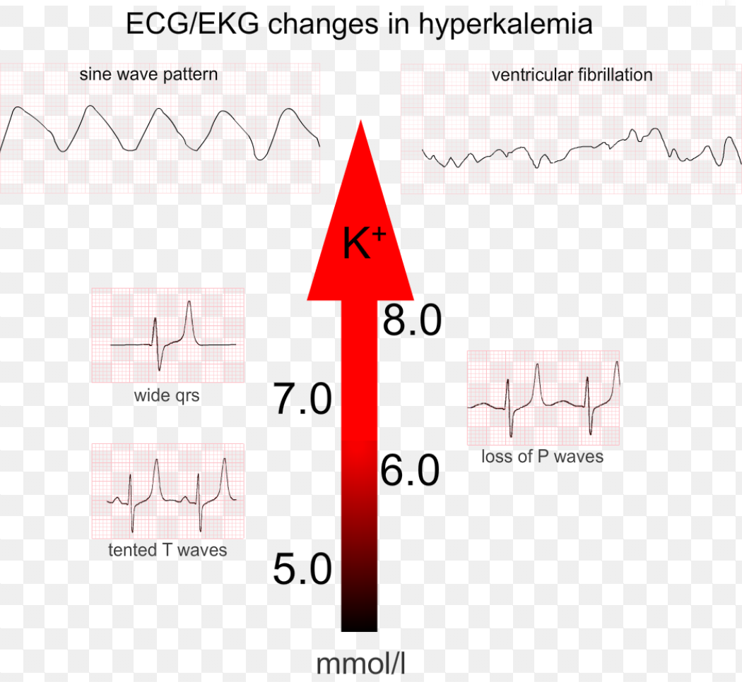

Slide 30
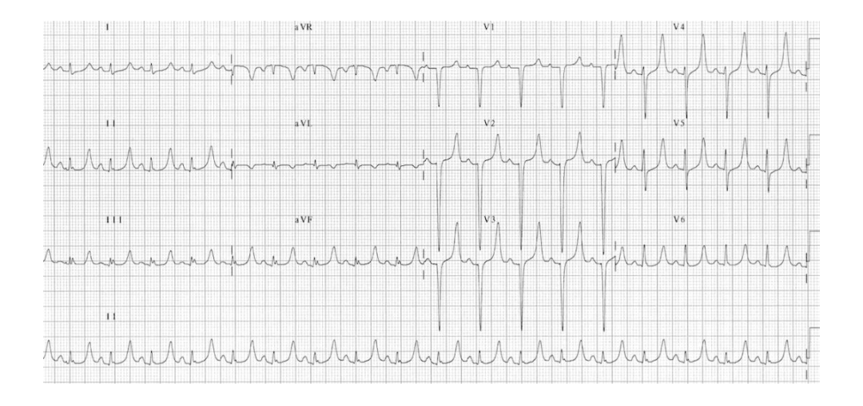
This ECG shows Tall, symmetrical peaked T waves.

Slide 31
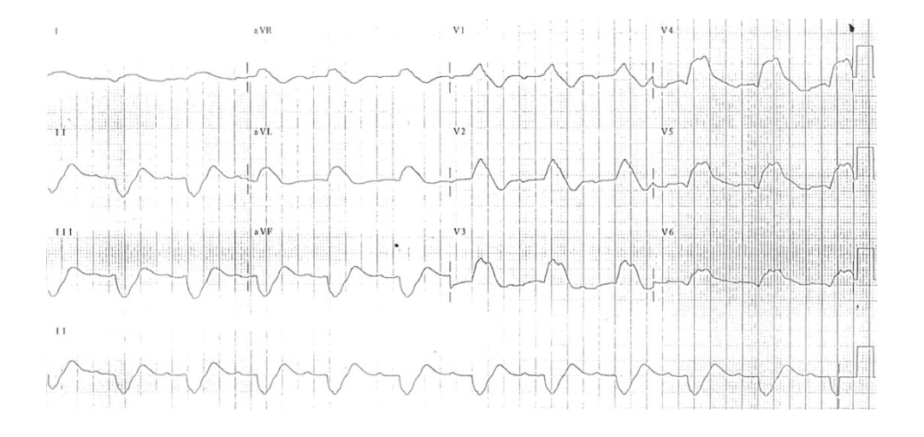
Here the ECG shows wide, bizzare QRS complexes

Slide 32
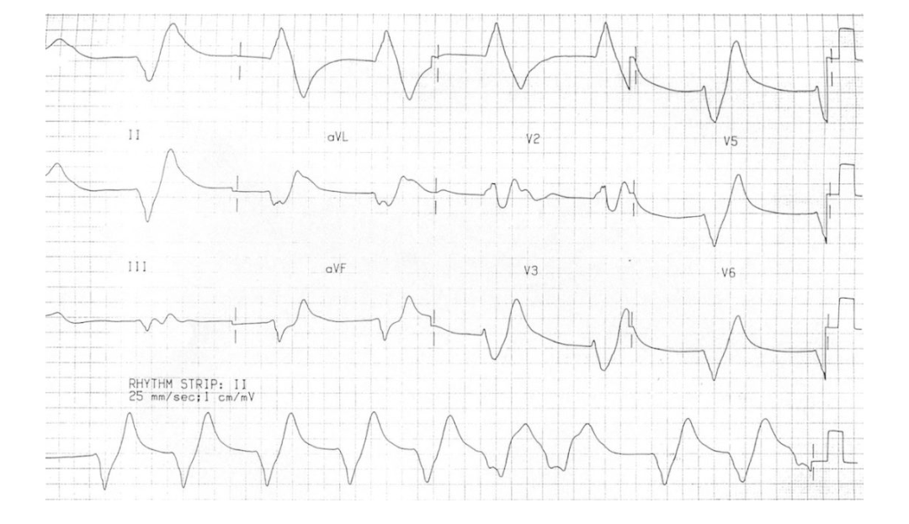
Here there is sine wave appearance in the ECG

Slide 33
Hyperkalemia from a variety of causes can also present with ascending paralysis, denoted secondary hyperkalemic paralysis. The presentation may include diaphragmatic paralysis and respiratory failure.

Slide 34
CLINICAL APPROACH TO HYPERKALEMIA
The first priority in the management of hyperkalemia is to assess the need for emergency treatment (electrocardiographic changes; K+ ≥ 6.5 mmol/L).
This should be followed by workup to determine the cause.
The history and physical examination should focus on medications (e.g., ACE inhibitors, NSAIDs, TMP-SMX), diet and dietary supplements (e.g., salt substitute), risk factors for kidney failure, reduction in urine output, blood pressure, and volume status.

Slide 35
Initial laboratory tests should include electrolytes, BUN, creatinine, plasma osmolality, Mg2+, and Ca2+, and complete blood count and urinary pH, osmolality, creatinine, and electrolytes.
Plasma and urine osmolality are required for calculation of the transtubular K+ gradient.
Plasma renin activity, plasma aldosterone, and the response in TTKG to fludrocortisone may be necessary to determine the specific cause of an inappropriately low TTKG in hyperkalemia.

Slide 36
TREATMENT OF HYPERKALEMIA
Immediate antagonism of cardiac effects of hyperkalemia –
Intravenous Calcium : Ca raises the action potential threshold and reduces excitibility, without changing the RMP.
Thus it reduces the depolarisation blockade due to hyperkalemia.
Dose : 10 ml of 10% calcium gluconate i.v. over 2-3 mins with cardiac monitoring.
Dose to be repeated if no changes in ECG or if they reoccur.

Slide 37
Rapid reduction in plasma K+ concenteration by redistribution into cells –
1.Insulin lowers plasma K+ by shifting K+ into cells.
Dose : 10 units of i.v. regular insulin followed immediately by 50 ml of 50% Dextrose.
2. Β2-agonist, Albuterol, is effective but underused as about 20% of ESRD patients are found to be resistant to it.
Dose : 10-20 mg of nebulized albuterol in 4 ml of normal saline inhaled over 10 mins.
Albuterol and insulin with glucose have an additive effect.
3. I.V. Bicarbonate has no role in acute treatment but can be effective in hyperkalemia with sustained administration over several hours.
It should be infused in an isotonic or hypotonic fluid.

Slide 38
Removal of Potassium –
It can be done with cation exchange resins, diuretics and/or dialysis.
Cation exchange resin sodium polysterene sulfonate (SPS) exchanges Na+ for K+ in GIT and increases fecal excretion of K+.
Calcium based resins are also available.
Dose : 15-30 g of powder given in preade suspension of 33% sorbitol.
The effect is slow and may take about 24 hours and usually requires repeated doses at every 4-6 hours.
Intestinal necrosis is a rare but fatal complication.

Slide 39
7. Novel intestinal potassium binders which appear to lack the intestinal toxicity of SPS are available for management of hyperklemia, these are –
Patiromer, it is a non-absorbed polymer provided as a powder for suspension, which binds K+ in exchange of Ca+.
ZS-9 is an inorganic nonabsorbable crystalline compound that exchanges both Na+ and H+ in exchange for K+ and NH4+ in intestine.
8. I.V. saline can be beneficial in hypovolemic patients, patients with oliguria.
9. Loop or thiazide diuretics can be used to reduce plasma K+ in volume replete or hypervolemic patients with sufficient renal function for diuretic response.

Slide 40
10. Hemodialysis is the most effective and reliable method to reduce plasma K+ concentertion.

