Slide 1
IRON DEFICIENCY ANEMIA

Slide 2
INTRODUCTION
Iron deficiency is one of the most prevalent form of malnutrition.
Globally, 50% of anemia is attributable to iron deficiency and accounts of 841,000 deaths annually worldwide.
Africa and parts of Asia bear 71% of the global mortality burden; North America represents only 1.4% of the total morbidity and mortality associated with iron deficiency.

Slide 3
Sources of iron-
Your body needs to make hemoglobin, found in red blood cells, and myoglobin, found in muscles.
The best sources of iron are found in lean beef,eggs,salmon,tuna,
liver ,oysters , poultry(dark meat),dried fruits and beans,and whole
grains.
Small amounts of iron can also be found in almonds and brazil nuts, as well as dark leafy greens such as spinach , kale ,collard and dandelion greens.
However it is harder for your body to absorb iron from vegetables, nuts, dried fruits, and whole grains.
By pairing them with meat or fish, your body will be better able to get the full benefit of the iron vegetables, nuts and whole grains contain.

Slide 4
Iron metabolism-
Iron is a critical element in the function of all cells, although the amount of iron required by individual tissues varies during development.
At the same time ,the body must protect itself from free iron, which is highly toxic in that it participates in chemical reactions that generate free radicals such as o₂ or oH^{- .}
The major role of iron in mammals is to carry o₂ as a part of hemoglobin.O2 is also bound by myoglobulin in muscle.
Iron is a critical element in iron containing enzymes, including the cytochrome system in mitochondria.
With out iron, cells lose their capacity for electron transport and energy metabolism, in erythroid cells, hemoglobin synthesis is impaired, resulting in anemia and reduced oxygen delivery to tissue.

Slide 5
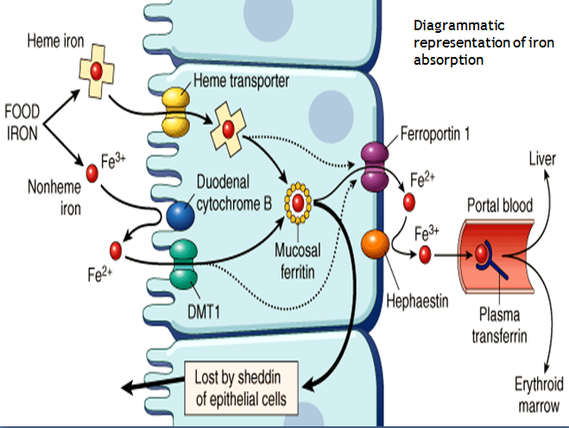

Slide 6
Most iron in the food that we ingested is in the ferric form(fe3+),
but iron can only be reabsorbed by the bowel in bivalent form
( i.e as Fe2+)
For this reason reducing agents in food such as ascorbate( vitamin-c)
promote iron uptake.
In this case, when we ingest heme iron it will be absorbed quickly because of the appearance of hemoglobin carrier protein(HCP) in the apical part of enterocyte.

Slide 7
In case of ingest non heme iron, firstly it should be transfer from Fe+3 to Fe+2 by reductase agent (Ascorbic acid or ferric reductase Dcytb1)
After that it will be transport to inside the enterocyte by divalent material transport (Dmt1).
Iron enter the enterocyte.
1.Some will be storage in the enterocyte as ferritin.
2.Some will transport through the basolateral surface of enterocyte by
ferroprotein.

Slide 8
Hephaestin is membrane bound-ferri oxidase enzyme, which contain copper , converts Fe2+ to Fe3+ at the basal surface prior to binding apo transferrin.
Hepcidin controls iron body status by affecting ferroportin-1 concentration.
Ceruloplasmin-circulated ferri oxidase(copper containing protein), convert Fe2+ into Fe3+ in circulation for binding apo transferrin.

Slide 9
Storage form of iron in body.
Transferrin (protein carrier ) of iron in the circulation.
Apotransferrin (transferrin not bind to iron )
Ferritin (storage form of iron in the hepatocytes and enterocytes.
Note: Iron is absorbed specifically in the duodenum.

Slide 10
Iron overload-
Disturbances resulting from raised iron concentration are less frequent. Known as hemochromatosis,
These conditions can have generic causes or may be due to repeated administration of blood transfusions.
As the body has practically no means of iron, more and more stored iron stored iron is deposited in the organs over time in patients with
under treated hemochromatosis , ultimately leading to severe
disturbances.

Slide 11
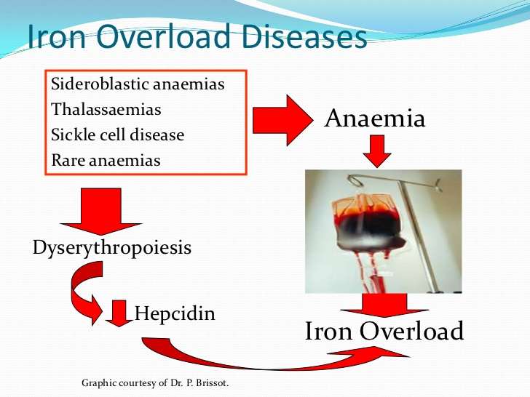

Slide 12
STAGES OF IRON DEFICIENCY
The progression to iron deficiency can be divided into three stages
Negative iron balance
Iron deficient erythropoiesis
Iron deficiency anemia
1.Negative iron balance- Here demand for iron exceed body ability to absorb iron from the diet.
it result from number of physiological mechanisms include
1.blood loss
2.pregnancy
3.rapid growth spurts in adolescents
4.inadequate dietary iron intake.

Slide 13
As long as iron stores are present and can be mobilized, the serum iron, TIBC AND red cell protoporphyrin levels remain with in normal range, at this stage, red cell morphology and indices are normal.
2.Iron deficiency erythropoiesis- Once the transferrin saturation falls to 15-20%, hemoglobin synthesis becomes impaired.
From this stage marrow iron stores are absent and the serum ferritin level is < 15micro grams /liter.
Careful evaluation of peripheral blood smear reveals the first appearance of microcytic cells and if laboratory technology is available, one finds hypochromic reticulocytes in circulation.

Slide 14
3.Stage of iron deficiency anemia- Gradually the hemoglobin and hematocrit begin to fall, reflecting iron deficiency anemia.
The transferrin saturation at this point is 10-15%.
When moderate anemia is present (Hb-10 to 13 g/dl),the bone marrow remains hypo proliferative.
With more severe anemia (Hb- 7 to 8 g/dl),hypochromia and microcytosis become more prominent, target cells and poikilocytosis
appears.
Consequently, with severe prolonged iron deficiency anemia, erythroid
hyperplasia of the marrow develops , rather than hypo proliferation.

Slide 15
Causes of iron deficiency anemia-
1.Increased demand for iron-
a.Rapid growth in infancy or adolescence
b.Pregnancy
c.Erythropoietin therapy
2. Increased blood loss-
a.chronic blood loss
b.Menses
c.Acute blood loss
d.Blood donation
e.Phlebotomy as treatment for polycythemia vera
3.Decreased iron intake or absorption
a.inadequate diet
b.Malabsorbtion from disease (sprue, Crohn’s disease)
c.Malabsorbtion from surgery(gastrectomy and some forms of bariatric
surgery
d.Acute or chronic inflammation.

Slide 16
Clinical features
Chief complaints- Easy fatigability , generalized weakness, lassitude and palpitations, pica(compulsive eating of non food items).
History- Chronic blood loss , deficient diet.
Signs- Pallor
koilonychia(brittle, spoon shaped nails) these are the signs
cheilosis(fissures at the corners of mouth) of advanced tissue
Iron deficiency
The diagnosis of IDA is typically based on laboratory results.

Slide 17
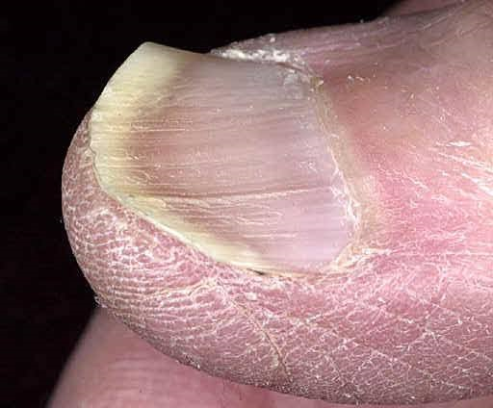
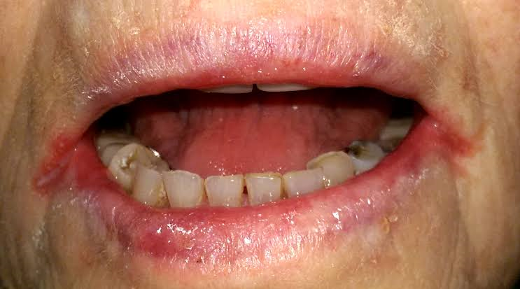

Slide 18
LABORATORY EVALUATION
Complete blood count(CBC),Peripheral smear
Serum iron profile
Bone marrow study( if needed)
Investigations to determine other causes of IDA
(e.g-fecal occult blood test , colonoscopy , urine examination.)

Slide 19
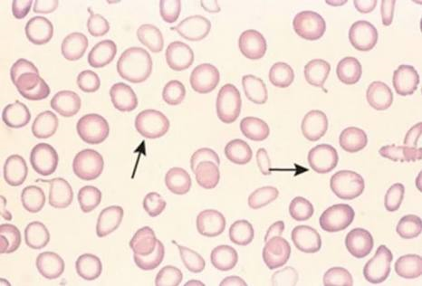

Slide 20
LABORATORY IRON STUDIES
Serum iron(50-150mcg/dl)-
-It is the concentration bound to transferrin.
-Approximately one-third transferrin bound to iron
(Normal transferrin saturation-25 to 50%).
-Levels are decreased by infection and inflammation.
-Best interpreted in conjunction with TIBC.
Total iron binding capacity(300 to 360mcg/dl)-
-Indirect measurement of the iron-binding capacity of serum
transferrin.
-Levels don’t fluctuate over hours or days unlike serum iron

Slide 21
Serum ferritin-
average around 30mcg/l in females and 100mcg/l in males.
ferritin(storage iron) is proportional to total iron stores.
Best indicator of iron deficiency or overload.
Infection or inflammation can increase the concentration,
independent of iron status.
Transferrin saturation-
Normal value >20%
Ratio of serum iron level to TIBC in percentage.
Reflects the extent to which iron-binding sites are occupied on transferrin and indicates the availability of iron for erythropoiesis.
Less sensitive and specific for IDA than ferritin

Slide 22
Marrow iron stores-
Although RE iron stores can be estimated from iron stain of a bone
marrow aspirate or biopsy, the measurement of serum ferritin has
largely supplanted these procedures for determination of storage
iron.
However in addition to storage iron, the marrow iron stain provides
information about the effective delivery of iron to the developing
erythroblasts.
Red cell protoporphyrin level-
Normal values <30mcg/dl & IDA the values are >100mcg/dl.
The most common causes of increased red cell protoporphyrin levels
are absolute or relative iron deficiency and lead poisoning.

Slide 23
Transferrin receptor protein-
Serum level of TRP reflect the total erythroid marrow mass and
another condition in which they are elevated is IDA.
Normal values are 4-9mcg/L.
This laboratory test is becoming increasingly available and along with
serum ferritin , has proposed to distinguish between iron deficiency
and the anemia of inflammation.

Slide 24
Differential diagnosis-
Other than iron deficiency, only three conditions need to be
considered in the differential diagnosis of a hypochromic microcytic
anemia they are-
1.Thalassemias.
2.Anemia of inflammation/chronic disease.
3.Myelodysplastic syndromes.
1.Thalassemias-They are differentiated from iron deficiency most
readily by serum iron values i.e normal or increased serum iron levels
and transferrin saturation and are characteristic of the
thalassemia’s.
(RDW) index is generally normal in thalassemia and elevated in iron
deficiency.

Slide 25
2. Anemia of inflammation/chronic disease-
The iron values usually make the differential diagnosis clear
as the ferritin level is normal or increased and the transferrin
saturation and TIBC are typically below normal in anemia of chronic
disease.
Anemia of chronic disease is normocytic normochromic most of the
the times from which we can differentiate it from IDA.
3.Myelodysplastic syndromes-
Least common condition
The iron values again reveal normal stores and more than an adequate supply to the marrow, despite the microcytosis and hypochromia.

Slide 26
Treatment-
The severity and cause of IDA will determine the appropriate
approach to treatment.
For majority of cases of IDA(pregnant woman, growing children and
adolescents , patients with infrequent episodes of breathing and
those with inadequate intake of iron.) oral iron therapy will suffice.
For patients with unusual blood loss or malabsorption, specific
diagnostic tests and appropriate therapy take priority.

Slide 27
ORAL IRON THERAPY-
In asymptomatic patient with established iron-deficiency anemia,
treatment with oral iron is usually adequate.
Typically, for iron replacement therapy, up to 200mg of elemental
iron per day is given, usually as three or four iron tablets each
containing (50-65mg elemental iron) given over a course a day.
Ideally, oral iron preparations should be taken on an empty stomach,
since food may inhibit the absorption.

Slide 28
Some patients with gastric disease or prior gastric surgery require
special treatments with iron solutions, because the retention capacity
of the stomach may be reduced.
A dose of 200mg of elemental iron per day should result in absorption
of iron up to 50mg/day.
The goal of therapy in individuals with IDA is not only to repair the anemia
but also to provide the stores of at least 0.5 to 1g of iron, sustained
treatment for a period of 6-12 months after correction of anemia will be
necessary to achieve this.

Slide 29
Side effects and response to treatment-
In the complications of oral iron therapy, gastrointestinal distress
is most prominent and seen in 15-20% of patients.
Abdominal pain , nausea , vomiting or constipation may leads to
noncompliance.
The response to iron therapy varies , depending on the erythropoietin
stimulus and the rate of absorption.
Typically ,the reticuloendothelial cell count should begin to increase
with in 4-7 days after initiation of therapy and peak at 7-10 days.
The absence of response may be due to poor absorption , non
compliance(which is common) or confounding diagnosis.

Slide 30
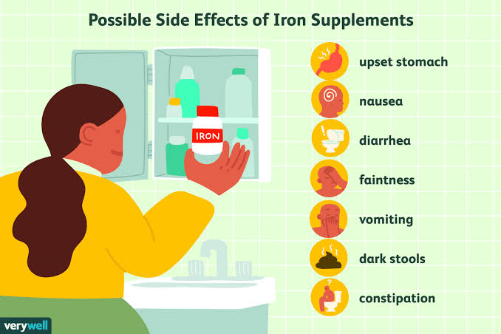

Slide 31
Parenteral iron therapy
Intravenous can be given to patient who are unable to tolerate oral iron, whose needs are relatively acute who needs iron on ongoing basis.
Parenteral iron use has been increasing rapidly in the last several years that recombinant erythropoietin(Epo) therapy induces a large demand for iron-a demand that frequently cannot be met through the physiological release of iron from RE sources or oral iron absorption.
The safety of parenteral iron particularly iron dextran-has been a concern. The serious adverse reaction to intravenous high molecular weight iron dextran is 0.7%.
Fortunately, newer iron complexes are available in united states, such as ferumoxytol (Feraheme), sodium ferric gluconate (Ferriecit),iron sucrose (Venofer) and ferric carboxy maltose(Injectafer) that have much lower rates of adverse effects.

Slide 32
Ferumoxytol delivers 510mg of iron per injection, ferric gluconate 120mg per injection, ferric carboxy maltose 750 mg per injection.
Parenteral iron is used in two ways; one is to administer the total dose of iron required to correct the hemoglobin deficit and provide the patient with at least 500mg of iron stores; the second is to give repeated small doses of parenteral iron over a protracted period.
The latter approach is common in dialysis centers, where it is not unusual for 100mg of elemental iron to be given weekly for 10 weeks to augment the response to Epo therapy.
The amount of iron needed by an individual patient is calculated by the following formula:
Body weight(kg) x 2.3 x(15- patient’s hemoglobin g/dl)
+ 500 or 1000mg (for stores).

Slide 33
In administering intravenous iron dextran , anaphylaxis is a concern.
Anaphylaxis is much rarer with the newer preparations.
The factors that have corelated with an anaphylactic –like reaction include a history of multiple allergies or a prior allergic reaction to dextran(in case of iron dextran).
Generalized symptoms appearing several days after the infusion of a large dose of iron can include arthralgias ,skin rash and low grade fever.
These may be dose related, but they do not preclude the further use of parenteral iron in the patient.
For example,If a large dose of iron dextran is to be given (100mg), the iron preparation should be diluted in 5% dextrose in water or 0.9% Nacl solution.

Slide 34
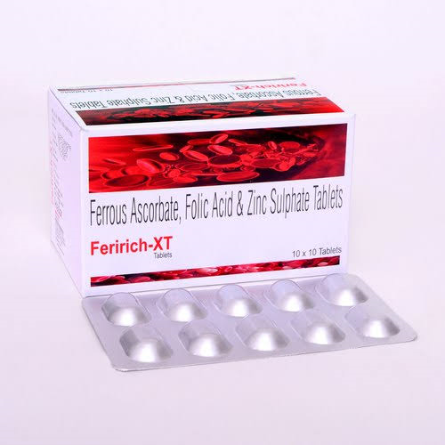
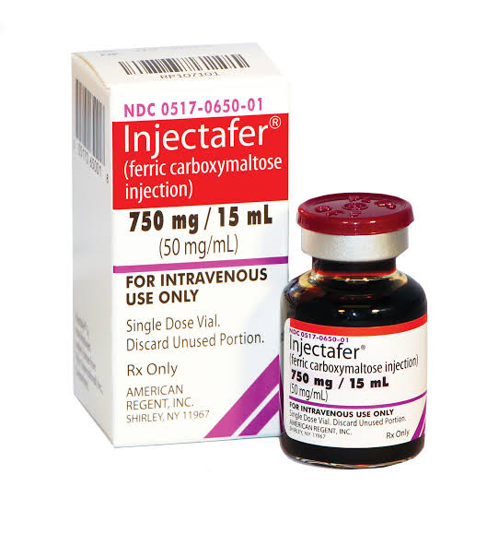
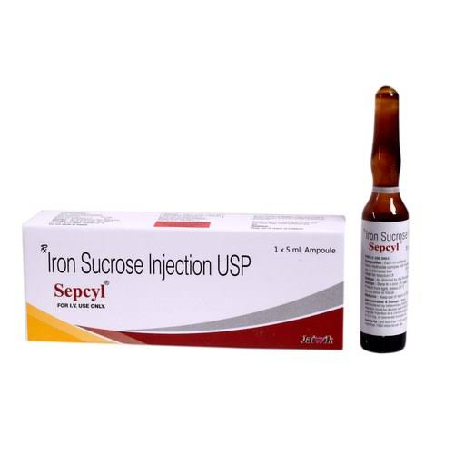

Slide 35
The iron solution can then be infused over a 60-90 min period(for larger doses) or at a rate convenient for the attending nurse or physician.
Although a test dose (25mg) of parenteral iron dextran is recommended, in reality a slow infusion of a larger dose of parenteral iron solution will afford the same kind of early warning as a separate injected test dose.
Early in the infusion of iron, if the chest pain, wheezing, a fall in blood pressure, or other systemic symptoms occur, the infusion of iron should be stopped immediately.

Slide 36
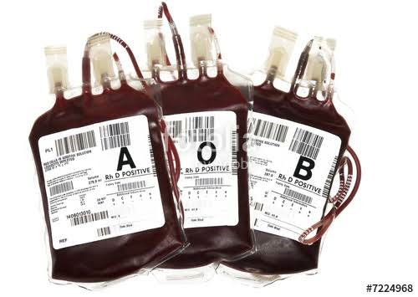
Red cell transfusion-
Transfusion therapy is reserved for
1.individuals who have symptoms of anemia,
2.cardiovascular instability,
3.continued and excessive blood loss
from whatever source and who require immediate intervention.

Slide 37
The management of these patients is less related to the iron deficiency than it is to the consequences of the severe anemia.
Not only do transfusions correct the anemia acutely, but the transfused red cells provide a source of iron for reutilization, assuming they are not lost through continued bleeding.
Transfusion therapy will stabilize the patient while other options are reviewed.

Slide 38
References-
slide1-Iron deficiency anemia,Harrison 20th edition page-684.
slide 3,6,7,8,9-Iron metabolism,Harrison 20th edition page-683.
slide 12,13,14-Stages of iron deficiency anemia 20th edition-684 &685
slide 15,16-causes& clinical features of IDA Harrison20th edition-685
slide 20,21,22,23-Laboratory iron studies Harrison 20th edition685,686
slide 24,25-differential diagnosis of IDA Harrison 20th edition 686
slide 27,28,29-Oral iron therapy Harrison 20th edition 686,687
slide 31,32,33,35-Parenteral iron therapy Harrison 20th edition 687
slide 36,37-Red cell transfusion Harrison 20th edition 686

Slide 39
THANK YOU

