Slide 1
MEGALOBLASTIC ANEMIA

Slide 2
Review
Introduction
Causes
Cobalamin and Folic Acid – Dietary Sources, Absorption, Transport
Biochemical functions
Clinical Features
Hematological Findings
Diagnosis
Treatment

Slide 3
Megaloblastic Anaemias characterised by the presence of distinctive morphologic appearances of the developing red cells in the marrow.
Marrow is usually hypercellular and the anemia is based on ineffective erythropoeisis
Due to impaired DNA synthesis
Affects cells primarily having rapid turnover,
  specially hematopoietic precursors
  gastrointestinal epithelial cells
Cell division is sluggish
Cytoplasmic development progresses normally, so megaloblastic cells tend to be large
With an increased ratio of RNA to DNA.

Slide 4
Causes
Cobalamin deficiency or abnormalities of cobalamin metabolism
Folate deficiency or abnormalities of folate metabolism
Therapy with antifolate drugs (methotrexate)
Independent of either cobalamin or folate deficiency and refractory to cobalamin and folate therapy
AML, Myelodysplasia,
Drugs interfering DNA synthesis – Hydroxyurea,
6-Mercaptopurine

Slide 5
Cobalamin
Cobalamin (vitamin B12) exists in a number of different chemical forms. All have a cobalt atom at the center of a corrin ring is mainly located in mitochondria. It is the cofactor for the enzyme L-methyl malonyl coenzyme A (CoA) mutase.
The other major natural cobalamin is methylcobalamin, the form in human plasma and in cell cytoplasm. It is the cofactor for methionine synthase.
There are also minor amounts of hydroxycobalamin to which methyl and adocobalamin are converted rapidly by exposure to light.

Slide 6
Dietary Sources And Requirements
Cobalamin is synthesized by microorganisms. Ruminants obtain cobalamin from the foregut, but the only source for humans is food of animal origin, for example, meat, fish, and dairy products.
Vegetables, fruits, and other foods of non animal origin are free from cobalamin unless they are contaminated by bacteria. A normal diet contains 5–30 μg of cobalamin daily.
Adult daily losses (mainly in the urine and feces) are 1–3 μg (~0.1% of body stores), and because the body does not have the ability to degrade cobalamin, daily requirements are also about 1–3 μg.
Body stores are of the order of 2–3 mg, sufficient for 3–4 years if supplies are completely cut off.

Slide 7
Absorption
Two mechanisms exist for cobalamin absorption. One is passive, occurring equally through buccal, duodenal, and ileal mucosa; it is rapid but extremely inefficient, with <1% of an oral dose being absorbed by this process.
The normal physiologic mechanism is active; occurs through the ileum and is efficient for small oral doses of cobalamin, and mediated by gastric intrinsic factor (IF).
Dietary cobalamin is released from protein complexes by enzymes in the stomach, duodenum, and jejunum; combines rapidly with a salivary glycoprotein known as haptocorrins (HCs). In the intestine, the HC is digested by pancreatic trypsin and the cobalamin is transferred to IF.
IF is produced in the gastric parietal cells of the fundus and body of the stomach, and its secretion parallels that of hydrochloric acid.

Slide 8
The IF-cobalamin complex passes to the ileum, where IF attaches to a specific receptor (cubilin) on the microvillus membrane of the enterocytes. Cubilin is also present in yolk sac and renal proximal tubular epithelium.
The cobalamin-IF complex enters the ileal cell, where IF is destroyed.
Between 0.5 and 5 μg of cobalamin enter the bile each day. This binds to IF, and a major portion of biliary cobalamin normally reabsorbed together with cobalamin derived from intestinal cells.
Because of the appreciable amount of cobalamin undergoing enterohepatic circulation, cobalamin deficiency develops more rapidly in individuals who malabsorb cobalamin than it does in vegans, in whom reabsorption of biliary cobalamin is intact.

Slide 9
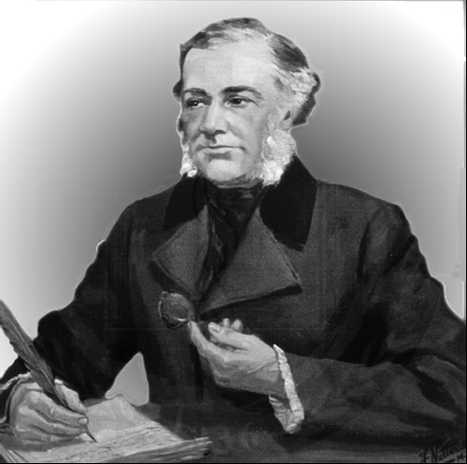
Pernicious anemia
history
In the 1850s the English physician
Thomas Addison described a lethal (pernicious) form of
Anaemia
  to pathological gastric mucosa
  and associated with the absence of acid in
  the stomach.
In 1926, at a meeting in Atlantic City, Georges
Minot and William Murphy cured patients by ingestion of large quantities of raw liver.
3 years later William Castle postulated an
“intrinsic factor”
THOMAS ADDISON

Slide 10
Pernicious Anemia
Caused by the absence of IF
  Atrophy of the mucosa
  Autoimmune destruction of parietal cells
Seen in individuals of northern European descent and African Americans
Men and women are equally affected
Disease of the elderly, the average patient presenting near age 60
Often associated with other immune diseases
(eg Hashimoto's thyroiditis)

Slide 11
Transport
Two main cobalamin transport proteins exist in human plasma; both bind cobalamin—one molecule for one. One HC, also known as TC I, is closely related to other cobalamin-binding HCs in milk, gastric juice, bile, saliva, and other fluids.
The gene TCNL is at chromosome 11q11-q12.3. These HCs differ from each other only in the carbohydrate element of the molecule.
TC I is derived primarily from the specific granules in neutrophils. Normally, it is about two-thirds saturated with cobalamin, which it binds tightly.
TC I does not enhance cobalamin entry into tissues. Glycoprotein receptors on liver cells are involved in the removal of TC I from plasma, and may play a role in the transport of cobalamin analogues to the liver for excretion in bile.

Slide 12
The other major cobalamin transport protein in plasma is transcobalamin, also known as TC II is synthesized by liver and by other tissues, including macrophages, ileum, and vascular endothelium.
It normally carries only 20–60 ng of cobalamin per liter of plasma and gives up cobalamin to marrow, placenta, and other tissues, which enters by receptor-mediated endocytosis involving the TC II receptor and megalin.
Export of “free” cobalamin is via the ATP-binding drug transporter multidrug resistance protein 1.

Slide 13
Folic Acid
DIETARY FOLATE
Folic (pteroylglutamic) acid is a yellow, crystalline, water-soluble substance. It is the parent compound of a large family of natural folate compounds, which differ from it in three respects:
(1) Partly or completely reduced to dihydrofolate (DHF) or tetrahydrofolate (THF) derivatives
(2) Usually contain a single carbon unit
(3) 70–90% of natural folates are polyglutamates.

Slide 14
The highest concentrations of folate found in liver, yeast, spinach, other greens, and nuts (>100 μg/100 g). The total folate content of an average varies widely according to the type of food eaten and the method of cooking.
Folate is easily destroyed by heating, particularly in large volumes of water.
Total body folate in the adult is ~10 mg, with the liver containing the largest store.
Daily adult requirements are ~100 μg, and so stores are sufficient for only 3–4 months in normal adults and severe folate deficiency may develop rapidly.

Slide 15
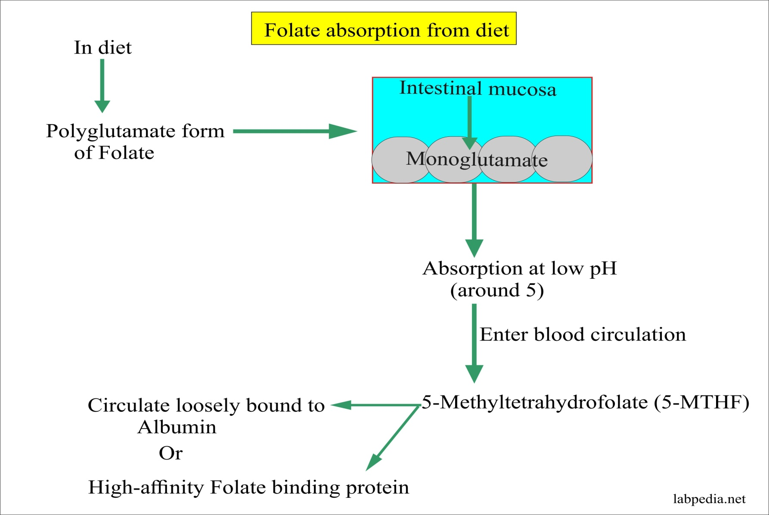
ABSORPTION OF FOLIC ACID

Slide 16
Absorption
Folates are absorbed rapidly from the upper small intestine. The absorption of folate polyglutamates is less efficient than that of monoglutamates; on average, ~50% of food folate is absorbed.
Polyglutamates are hydrolyzed to the monoglutamates derivatives either in the lumen of the intestine or within the mucosa. All dietary folates are converted to 5- methylTHF (5-MTHF) within the small intestinal mucosa before entering portal plasma.
The monoglutamates are actively transported across the enterocyte by a proton-coupled folate transporter (PCFT) situated at the apical brush border and is most active at pH 5.5.

Slide 17
Folic Acid at doses >400 μg is absorbed largely unchanged and converted to natural folates in the liver.
Lower doses are converted to 5-MTHF during absorption through the intestine. About 60–90 μg of folate enters the bile each day and is excreted into the small intestine.
Loss of this folate, together with the folate of intestinal cells, accelerates the speed with which folate deficiency develops in malabsorption conditions.

Slide 18
Transport
Folate is transported in plasma; about one-third is loosely bound to albumin, and two-thirds is unbound. In all body fluids (plasma, cerebrospinal fluid, milk, bile) folate is largely present in the monoglutamates form.
Three types of folate-binding protein are involved. A reduced folate transporter (RFC) is the major route of delivery of plasma folate (5-MTHF) to cells.
Two folate receptors, FR2 and FR3 fixed in the cell membrane by a glycosyl phosphatidylinositol anchor, transport folate into the cell via receptor mediated endocytosis.
The third protein, transports folate at low pH from the vesicle to the cell cytoplasm. The reduced folate transporter also mediates uptake of methotrexate by cells.

Slide 19
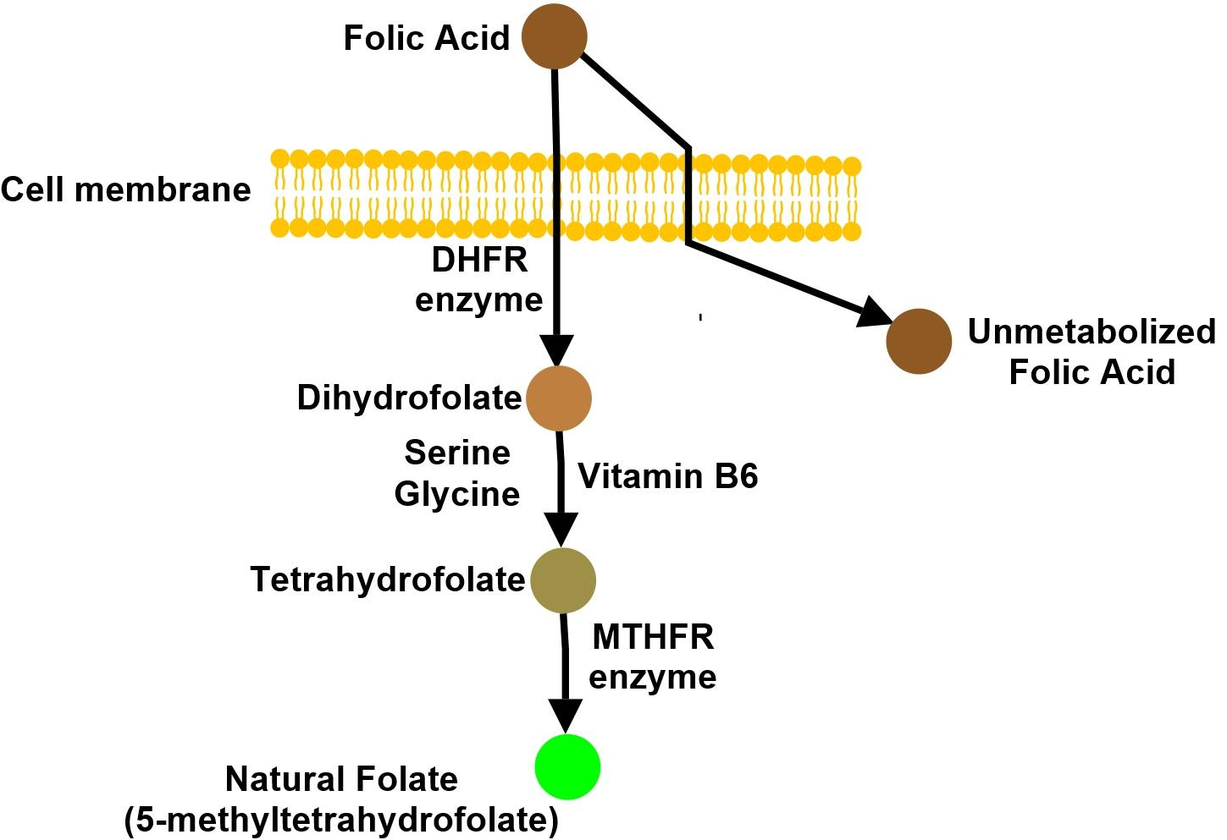
METABOLISM OF FOLIC ACID

Slide 20
Biochemical Functions
Folates act as coenzymes in the transfer of single-carbon units.
Two of these reactions are involved in purine synthesis and one in pyrimidine synthesis necessary for DNA and RNA replication.
Folate is also a coenzyme for methionine synthesis, in which methylcobalamin is also involved and in which THF is regenerated.
THF is the acceptor of single carbon units newly entering the active pool via conversion of serine to glycine.

Slide 21
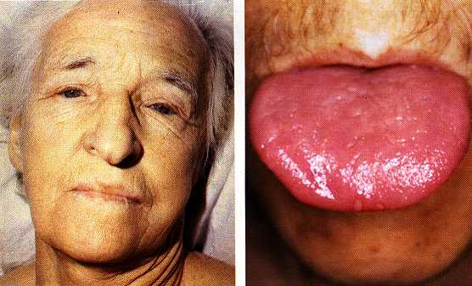
Clinical Features
Symptomless patients are detected through the finding of raised MCV on routine blood count
Easy fatigability, Weakness
Anorexia, Weight loss , Diarrhoea or Constipation
Glossitis, Angular cheilosis, Jaundice and Reversible melanin skin hyperpigmentation
Thrombocytopenia can lead to bruising and aggravated by vitamin C deficiency or alcohol in malnourished patients.
Anemia and leucocytopenia may predispose to respiratory and urinary tract infections

Slide 22
General Tissue Effects of Cobalamin and Folate Deficiencies
Epithelial surfaces: After marrow next most frequently affected tissues are epithelial cell surfaces of the mouth (with glossitis), stomach and small intestine and the respiratory, urinary, and female genital tract. The cell show macrocytosis with increased number of multinucleate and dying cells.
Complications of pregnancy: Infertility is common in men and women with severe deficiency of either vitamin. Maternal folate deficiency has been implicated as a cause of prematurity and both folate and cobalamin deficiency implicated in recurrent fetal loss and neural defects.

Slide 23
Cardiovascular disease:
Children with severe homocystinuria (>100µmol/l) due to deficiency of one of three enzymes: methionine synthase, MTHFR or cystathionine synthase have vascular disease like IHD, CVD, pulmonary embolus.
Lesser degrees of raised serum homocysteine and low levels of serum folate and homozygous inherited mutations of MTHFR have been found to be associated with cerebrovascular, peripheral vascular, and coronary heart disease and with DVT.
Malignancy:
Polymorphism in MTHFR gene is strongly associated with hyperdiploid leukemia.

Slide 24
Neurological Manifestations
Bilateral peripheral neuropathy
Degeneration of the cervical and thoracic posterior and pyramidal tracts of the spinal cord
Optic atrophy and cerebral symptoms including dementia , depression , psychotic symptoms and cognitive impairment may be prominent
Anosmia and loss of taste
Paraesthesias , muscle weakness or difficulty in walking
Loss of proprioception and vibration sense with positive Romberg and Lhermitte signs
Ataxic Gait with spasticity
ANS dysfunction can result in hypotension, impotence and incontinence
Convulsions and myoclonus
Long-term cobalamin deficiency in infancy leads to poor brain and impaired intellectual development, feeding difficulties , lethargy and coma.

Slide 25
Hematological Findings
Peripheral blood:
Oval macrocytes usually with anisocytosis and poikilocytosis
MCV usually >100fL
Neutrophils are hypersegmented (five nuclear lobes)
Leucopenia and thrombocytopenia
Bone marrow:
Hypercellular with an accumulation of primitive cells due to selective death by apoptosis. Erythroblast nucleus maintains a primitive appearance despite maturation and hemoglobinisation of cytoplasm
Cells are larger than normoblasts and an increased number of cells with eccentric lobulated nuclei or nuclear fragments may be present.

Slide 26
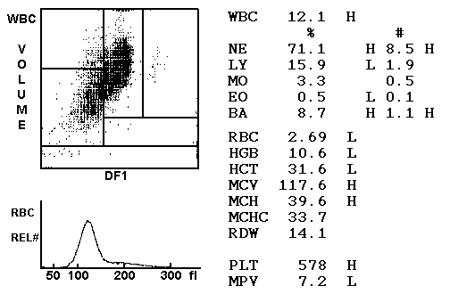
Macrocytic anemia

Slide 27
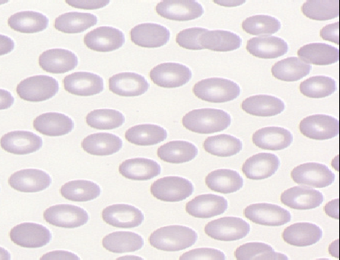
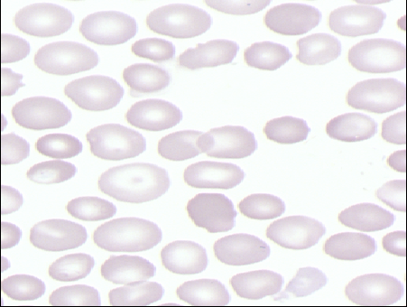
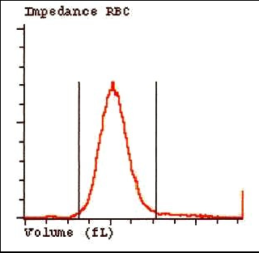
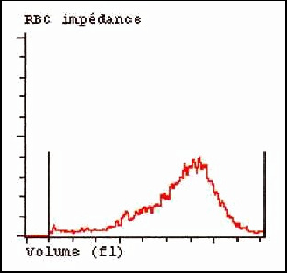
Top: Normal Red Blood Cells
MCV 88 fl.
Top: large, dense, oversized, red blood cells in Megaloblastic anemia.MCV>100fl

Slide 28
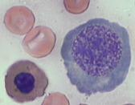
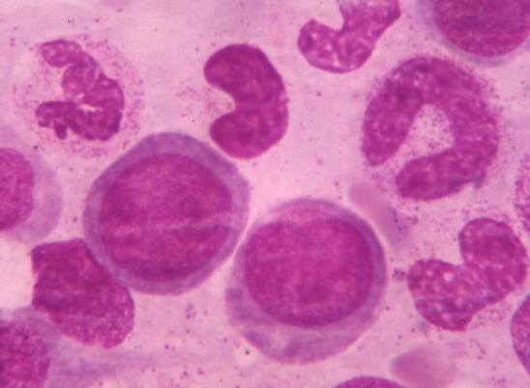
Giant and abnormally shaped metamyelocytes and enlarged hyperpolypoid megakaryocytes are characteristic
In severe cases the accumulation of primitive cells may mimic AML where as in less anemic patients , the changes in the marrow may be difficult to recognise.

Slide 29
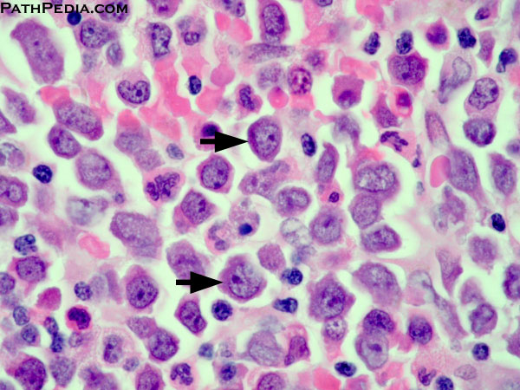
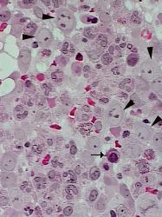
Bone Marrow Biopsy showing Megaloblasts, Abnormal mitosis

Slide 30
Causes of cobalamin deficiency
Gastric causes
– Simple atrophic gastritis
– Zollinger Ellison Syndrome
– Total or partial gastrectomy
– Use of proton pump inhibitor
Intestinal causes
– Severe Pancreatitis
– Gluten induced enteropathy
– HIV infection
– Graft Versus Host disease
– Radiotherapy
Therapy with Colchicine, Para-amino salicyalate, Neomycin, Metformin, Anticonvulsant drugs, alcohol

Slide 31
Causes of folate deficiency
Nutrional
Malabsorption
Tropical sprue, Gluten induced enteropathy, Extensive jejunal resection, Crohn’s disease, partial gastrectomy, congestive heart failure
Excessive utilization or loss
  pregnancy , prematurity
  hematologic disorder
  inflammatory conditions
Homocystinuria
Long term dialysis
Congestive heart failure
Antifolate drugs
Alcoholism

Slide 32
Diagnosis of Folate and Cobalamin Deficiencies
Cobalamin Deficiency
Serum cobalamin:
Measured by ELISA or competitive-binding immunosorbent assay.
Normal serum levels ranges from 118-148pmol/L to 738 pmol/L
In cobalamin deficiency the level is <74 pmol/L.

Slide 33
Folate deficiency, transcobalamin 1 (HC) deficiency, oral contraceptives and multiple myeloma have all been associated with low serum B12 levels that do not indicate B12 deficiency.
On the other hand high serum B12 levels are usually due to raised serum transcobalamin 1 levels and can be due to the presence of liver, renal or myeloproliferative diseases or to cancer of breast, colon and liver.
Serum Methylmalonate and Homocysteine are usually raised.
Serum homocysteine levels are raised in both cobalamin and folate deficiency and may also be raised in conditions like alcoholism, smoking, pyridoxine deficiency, hypothyroidism and therapy with steroids, cyclosporine and other drugs, inborn errors of metabolism affecting enzymes in trans- sulfuration pathways of homocysteine metabolism.

Slide 34
Folate Deficiency
Serum folate:
Measured by ELISA technique
Normal range is from 11 to 82 nmol/L
Low in all folate deficient patients
Rises in severe cobalamin deficiency because of block in conversion of MTHF to THF inside cells.
Red cell folate:
It is a valuable test of body folate stores.
In normal adults concentration range from 880-3520 µmol/L of packed red cells.
Subnormal levels occur in patients with megaloblatic anemia due to folate deficiency but also in nearly two-thirds of patients with severe cobalamin deficiency

Slide 35
Tests for the cause of folate deficiency:
Diet history is important.
Tests for transglutaminase antibodies are performed to confirm or exclude celiac disease, if positive duodenal biopsy is needed.
An underlying disease causing increased folate breakdown should also be excluded.

Slide 36
Treatment
It is usually possible to establish which of the two deficiencies, folate or cobalamin, is the cause of the anemia and to treat only with the appropriate vitamin.
In patients who enter the hospital severely ill, however, it may be necessary to treat with both vitamins in large doses once blood samples have been taken for cobalamin and folate assays and a bone marrow biopsy has been performed
Transfusion is usually unnecessary and inadvisable. If it is essential, packed red cells should be given slowly, one or two units only.

Slide 37
Cobalamin Deficiency
It is necessary to treat patients who have developed cobalamin deficiency with lifelong cobalamin injections.
In a few instances, the underlying cause of cobalamin deficiency can be permanently corrected for example, fish tapeworm, tropical sprue or an intestinal stagnant loop that is amenable to surgery.
The indications for starting cobalamin therapy are a well documented megaloblastic anemia or other hematological abnormalities and neuropathy due to the deficiency.
Patients with borderline serum cobalamin levels but no hematological or other abnormality may be followed to make sure that the cobalamin deficiency does not progress.

Slide 38
Cobalamin should be given routinely to all patients who have had a total gastrectomy or ileal resection.
Patients who have undergone gastric reduction for control of obesity or who are receiving long-term treatment with PPIs should be screened and if necessary, given cobalamin replacement.
Replenishment of body stores should be complete with six 1000µg IM injections of hydroxycobalamin given at 3 to 7 day intervals. For maintenance therapy, 1000µg hydroxycobalamin IM once every 3 months is satisfactory.

Slide 39
Because a small fraction of cobalamin can be absorbed passively through mucous membranes even when there is complete failure of physiologic IF dependent absorption, large daily oral doses (1000-2000µg) of cyanocobalamin are used for replacement and maintenance of cobalamin status in for example, food malabsorption of cobalamin.
Sublingual therapy therapy has also been proposed for those in whom injections are difficult because of a bleeding tendency and who may not tolerate oral therapy.
In patients with subnormal vitB12 levels and no evidence of any other abnormality repeat vit B12 levels after 6-12 months and homocysteine levels should be considered.

Slide 40
Folate Deficiency
Oral doses of 5-15 mg folic acid daily are satisfactory, as sufficient folate is absorbed from these extremely large doses even in patients with severe malabsorption.
The length of time therapy must be continued depends on underlying disease. It is expected to continue therapy for about 4 months, when all folate-deficient red cells will have been eliminated and replaced by new folate-replete populations.
Before large doses of folic are given, cobalamin deficiency must be excluded and if present, corrected; otherwise cobalamin neuropathy may develop despite a response of the anemia of cobalamin deficiency to folate therapy.
Long term folic acid therapy is required when the underlying cause of the deficiency cannot be corrected and the deficiency is likely to reappear like in chronic dialysis or hemolytic anemia.

Slide 41
It may also be necessary in gluten-induced enteropathy that does not respond to a gluten free diet.
Where mild but chronic folate deficiency occurs, it is preferable to encourage improvement in the diet after correcting the deficiency with a short course of folic acid.
In any patient receiving long term folic acid therapy, it is important to measure the serum cobalamin level at a regular (once yearly) intervals to exclude the coincidental development of cobalamin deficiency.
Folinic acid: Stable form of fully reduced folate. It is given orally or parenterally to overcome the toxic effects of methotrexate or other DHF reductase inhibitors for example, trimethoprim and cotrimoxazole.

Slide 42
Prophylactic Folic Acid
Pregnancy:
Folic acid 400µg daily should be given as a supplement before and through out pregnancy to prevent megaloblastic anemia and reduce the incidence of NTDs
In women who had a previous fetus with an NTD, 5mg daily is recommended when pregnancy is contemplated and through out the subsequent pregnancy.
Infancy And Childhood:
The incidence of folate deficiency is so high in the smallest premature babies during the first 6 weeks of life that folic acid 1mg daily should be given routinely to those weighing <1500g at birth and to larger premature babies who require exchange transfusions or develop feeding difficulties, infections or vomiting and diarrhoea.

Slide 43
THANK YOU

