Slide 1
Basics of Rotational Atherectomy
Dr Cinosh Mathew
Associate professor
Dept of Cardiology
SBKS MI & RC

Slide 2
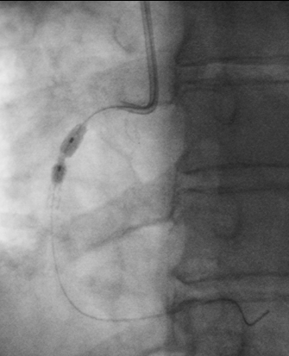
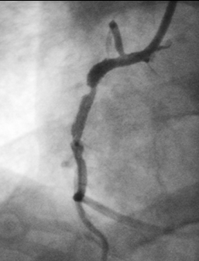
Clinical Application
Case Example – “Rota Regret”
Single 2.75 mm stent placed
Post Dilatation:
3.5x9mm NC balloon x 30 sec @ 22 atm
4.0x9mm NC balloon x 30 sec @ 16 atm
Results sub-optimal
Results from case studies are not predictive of results in other cases. Results in other cases may vary.
Case images courtesy of Dr. Arthur Lee, Santa Clara Valley Medical Center, Kaiser Permanente, San Jose, CA

Slide 3
Increasing Complexity and Calcification of PCI Patients
ACC/AHA LESION CLASSIFICATION
% OF PATIENTS WITH CALCIFIED LESIONS*
*as reported to NHLBI Dynamic Registry. Bortnick, et. al. Am J Cardiol 2014;113:573-579.

Slide 4
Presence of Calcium in ACS Patients
This degree of calcification, because it is grossly visible by fluoroscopy, is much more severe than other estimations (IVUS, etc.)²
6,855 ACS pts pooled from 2 pivotal randomized controlled trials¹
¹Généreux P, et. al. J Am Coll Cardiol 2014;63:1845–54. ²Waters, et al. JACC 2014;63:1855-1856.

Slide 5
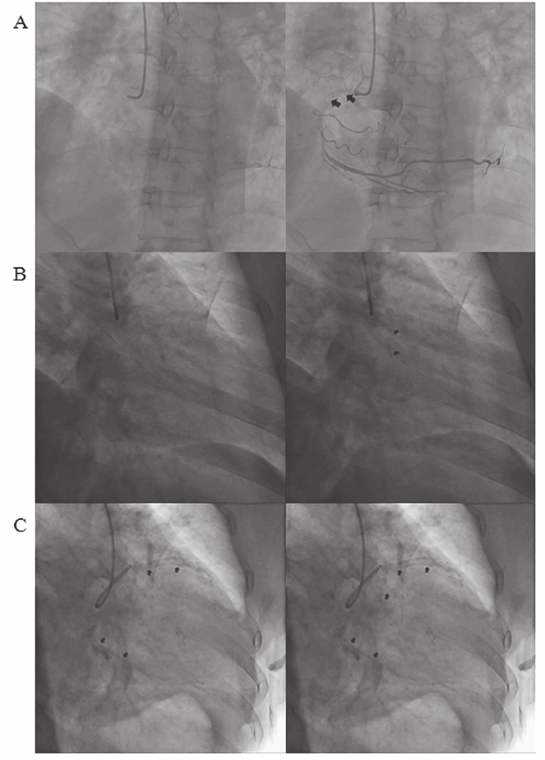

Slide 6
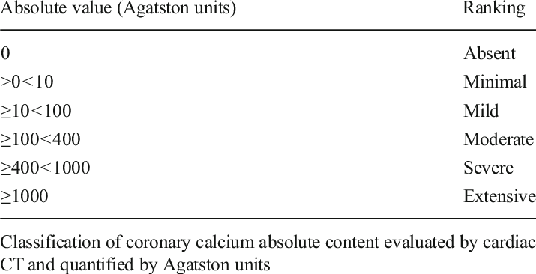

Slide 7
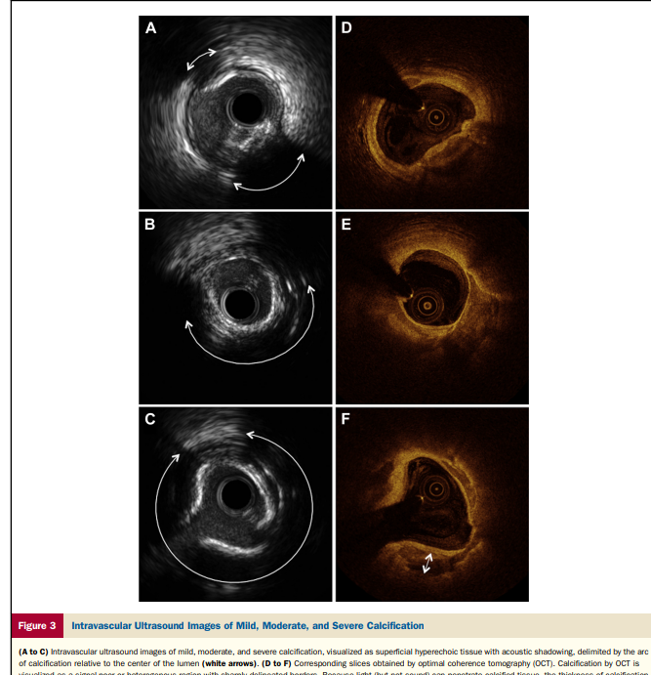

Slide 8
Calcium Inhibits Stent Expansion
 | Ca⁺² arc 0-90° n = 120 | Ca⁺² arc 91-180° n = 58 | Ca⁺² arc 181-270° n = 71 | Ca⁺² arc 271-360° n = 74 | p
Ca⁺² by angiography | 21% | 40% | 71% | 78% | <0.001
Age (mean, yrs) | 61.2 | 63.4 | 65.7 | 66.9 | 0.005
Arc of Ca⁺² (mean) | 20° | 127° | 217° | 322° | <0.001
Arc of superficial Ca⁺² | 8° | 84° | 200° | 311° | <0.001
Max press. (mean atm.) | 14.2 | 14.8 | 16.7 | 16.3 | <0.001
HSRA used | 0% | 21% | 69% | 76% | <0.001
Acute angiographic measures
-Acute gain (mean, mm) | 2.06 | 1.91 | 1.81 | 1.78 | 0.007
-Final MLD (mean, mm) | 3.01 | 3.04 | 2.85 | 2.83 | 0.03
PSS with IVUS in 323 consecutive lesions in 303 pts
Hoffman R et al. EHJ 1998;19:1224-31. PSS= Palmaz-Schatz stent

Slide 9
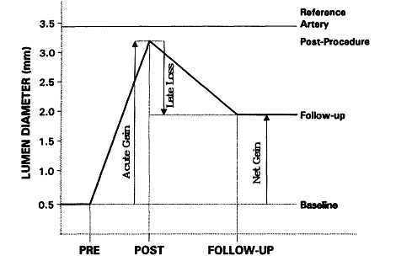
Acute lumen gain and its implications on restenosis
Notes:
The advent of these instruments in the late 1980s came in the early PTCA era....Restenosis:1) acute gain, 2) vessel recoil, 3) intimal hyperplasia,4) vessel remodelling... Restenosis was proportionate to the vessel inflammation....which in turn was proportional to the initial vessel trauma inflicted during the PTCA procedure.

Slide 10
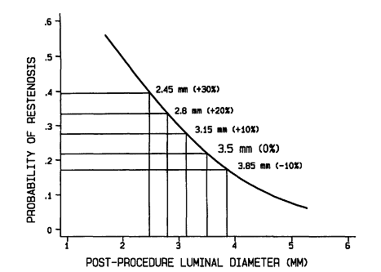
Importance of acute lumen diameter in determining restenosis after coronary atherectomy or stenting.
- Kuntz et al . Circulation 1992
However no difference in restenosis rates post-DCA or routine PTCA.
The better the acute gain the lower the chance of restenosis
Notes:
236 PTCAs done – 134 got DCAs.....BMS stents.....Angiographic analysis immediately after and 6 months after......restenosis expressed as binary restenosis rates.

Slide 11
Treatment of Calcified Lesions
Interventional Techniques
Noncompliant (NC) balloon (high pressure inflation up to 20-24 atm)
NC balloon with another side-by-side wire in the vessel and high pressure inflation
Cutting balloon (up to 8-12 atm)
AngioSculpt® balloon (up to 16-20 atm)
Laser angioplasty
Rotational atherectomy (heavily calcified)
® AngioScore Inc., Fremont, Calif

Slide 12
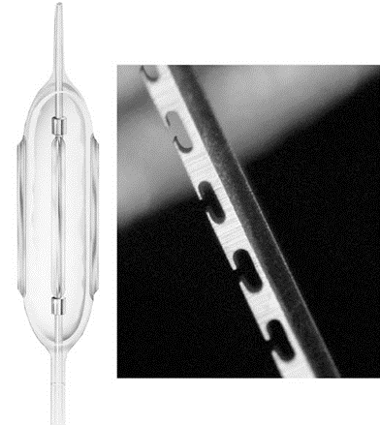
CUTTING BALLOON ANGIOPLASTY
Makes controlled microincisions into the atheromatous plaque
(radial atherectemy)
Lesser barotrauma to vessel

Slide 13
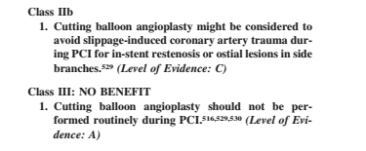
GUIDELINES on CBA (ACC/AHA 2011)
*Bittl et al. Meta-Analysis of RCTs of percutaneous transluminal coronary angioplasty versus atherectomy, cutting balloon atherotomy, or laser angioplasty. JACC 2004;43(6):936-942.
* RESCUT, *REDUCE1, *GRT

Slide 14
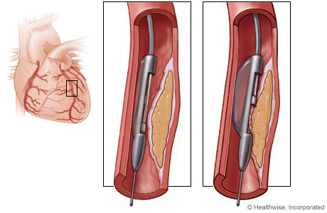
DIRECTIONAL ATHERECTOMY
Apposes a cutting device to a section of the plaque.
Manually advances the cutting cup
Debulking procedure

Slide 15
EVIDENCE ON DCA
CAVEAT 1 and 2 (NEJM 1993, Circulation 1995)
BOAT (Circulation 1993)
AMIGO (AJC 2004)
Similar TVR, MACE rates and restenosis rates
More periprocedural MI
All trials had similar non-encouraging results.
Currently not marketed

Slide 16
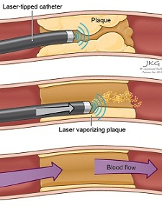
LASER ANGIOPLASTY
Laser beam is channelled in pulse/continuous from to help in debulking.
Photo-thermal effect, photo-acoustic effect, photo-chemical dissociation

Slide 17
EVIDENCE ON LASER ANGIOPLASTY
LAVA trial (AJC1997, N=256): No benefit over routine PTCA
- more complicated hosp course
ERBAC trial (Circ1997, N=454): No benefit, Higher TVR and
restenosis
Metanalysis (JACC 2004) : Routine Laser-PTCA is inferior to
conventional PTCA
Stone et al. Prospective, Randomized, Multicenter Comparison of Laser-Facilitated Balloon Angioplasty Vs Stand-Alone Balloon Angioplasty in Patients With CAD. J Am Coll Cardiol.1997;30(7):1714-1721.
Reifart et al. Randomized comparison of angioplasty of complex coronary lesions at a single center. Excimer Laser, Rotational Atherectomy, and Balloon Angioplasty Comparison (ERBAC) Study.Circulation.1997 Jul 1;96(1):91-8.

Slide 18
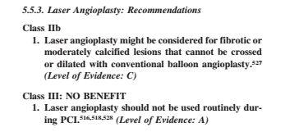
GUIDELINES on LASER (ACC/AHA 2011)

Slide 19
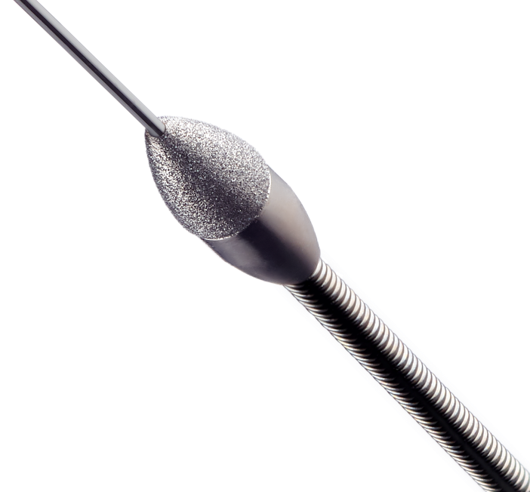
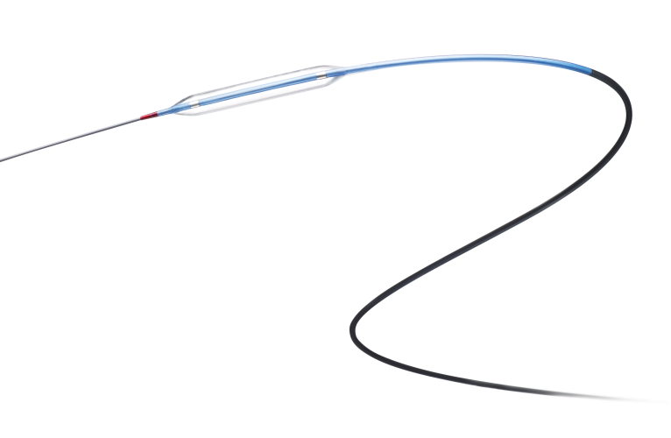
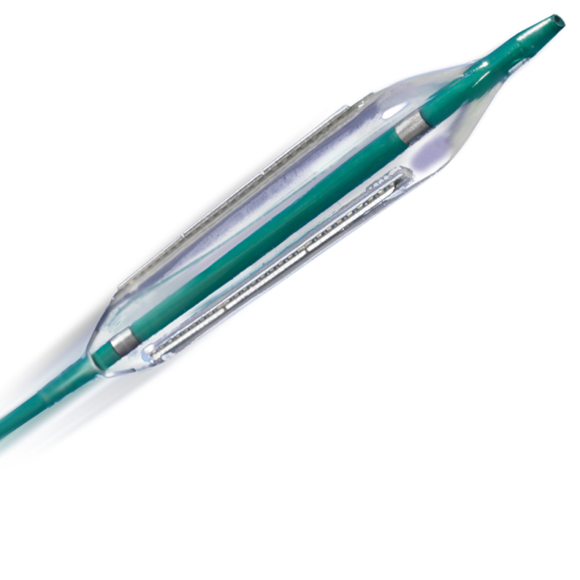
Lesion Preparation by Plaque Type
Role of Rotational Atherectomy
Soft/fatty
Fibrotic
Calcific
Optimize stent placement
Avoid Slippage
Avoid Plaque Shift
Change Lesion Compliance
POBA
Cutting Balloon® Device
Rotational Atherectomy

Slide 20
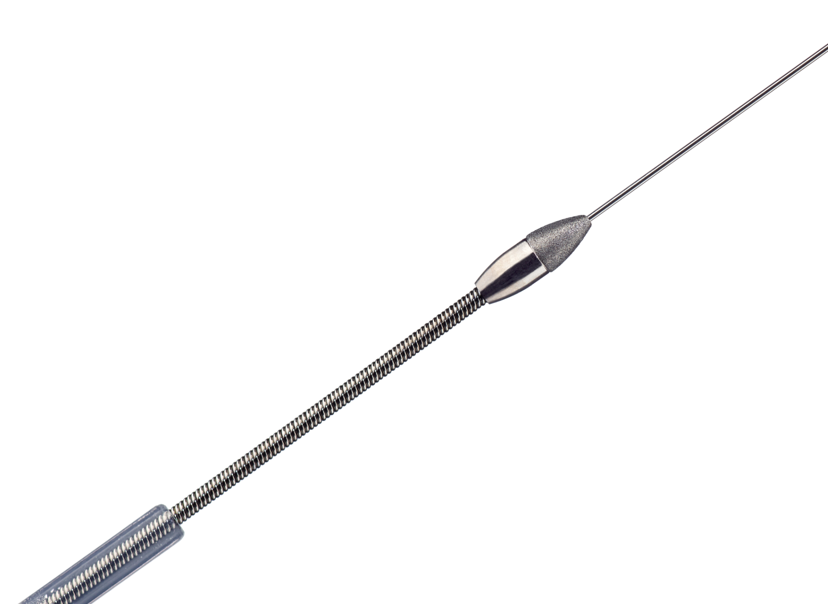
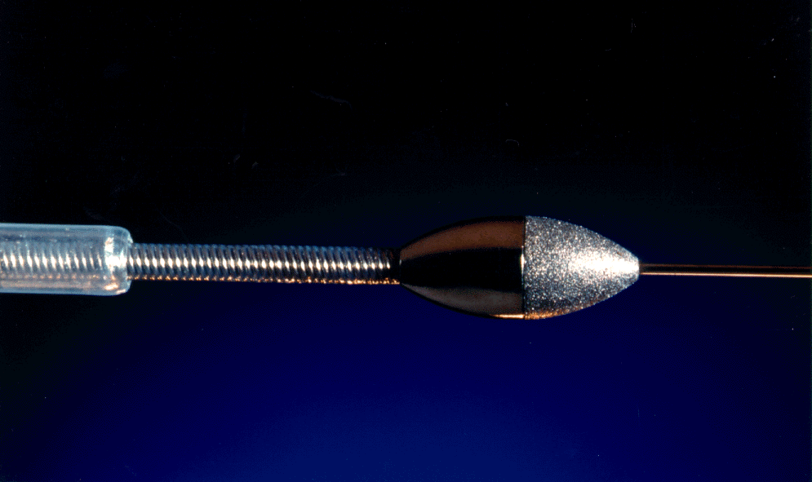
Rotablator® Rotational Atherectomy System
What is Rotablator?
A catheter-based interventional cardiology procedure using a high-speed rotational device designed to ablate atherosclerotic plaque and restore luminal patency
FDA approved May 1993
guide wire
diamond coated burr
1.25 mm - 2.5 mm
(0.25 mm increments)
drive shaft
sheath
4.3 french O.D.
Notes:
20

Slide 21
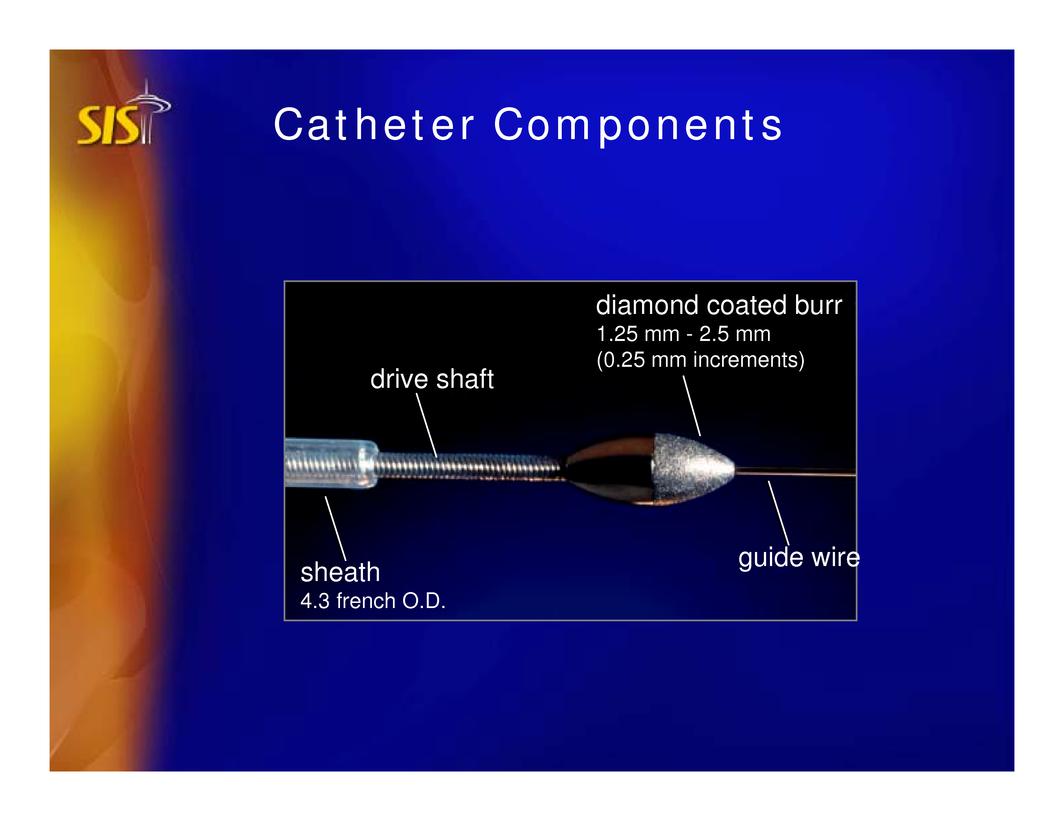
Diamond Coated Burr
Rotational Atherectomy

Slide 22
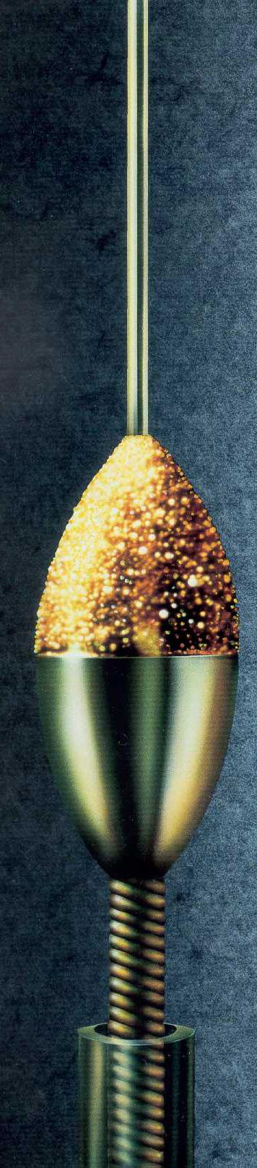
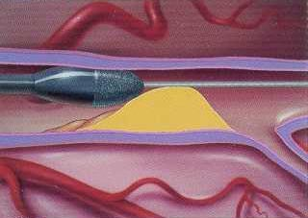
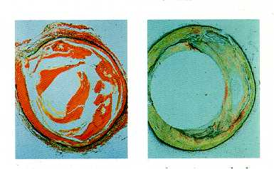
Atherectomy: Rotablator®
Diamond
microchips
Differential cutting
PTCA PRCA
Rotablator®; Boston Scientific, Inc., Natick, Mass.

Slide 23
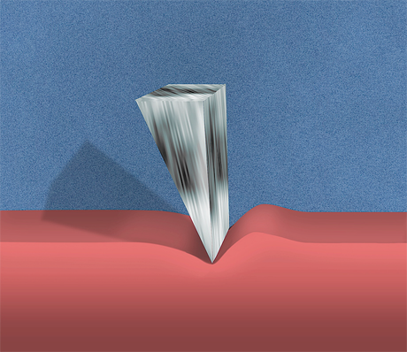
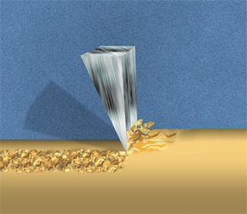
Differential Cutting
DIFFERENTIAL CUTTING
The ability to cut one material while sparing another based on differences in composition.
ELASTIC TISSUE
Normal vascular tissue has elastic properties that allow it to deflect away from the advancing diamonds on the rotating burr.
INELASTIC TISSUE
Selectively ablates inelastic tissue (i.e. plaque) whether composed of calcium, fibrotic tissue, neointima or lipid-rich material.
Elastic Tissue
Inelastic Tissue
Results in preferential cutting of inelastic substrate
are functional at low and high speeds
Reisman, M.D, Guide to Rotational Atherectomy. Physicians Press, Birmingham, MI 1997
Notes:
23

Slide 24
Principle of Operation
Differential Cutting
  All plaque is inelastic
  Rotablator differentiates tissue:
    healthy elastic vessel deflects
    Inelastic plaque is ablated
  Rotablator preferentially cuts plaque
Notes:
124

Slide 25
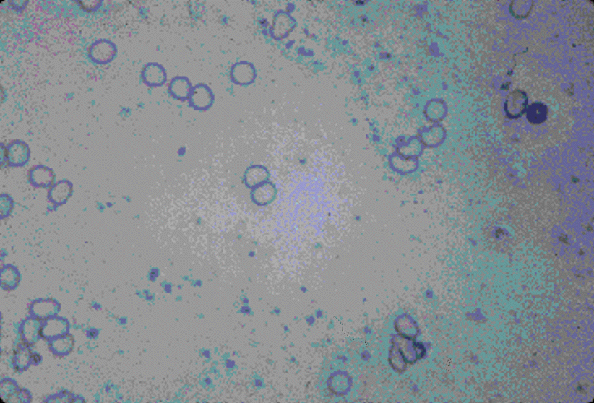
Particle Size
THE ROTABLATOR® SYSTEM
is designed to ablate plaque into micro particles.
The micro particles pass through the coronary circulation and are then removed by the reticuloendothelial system.
Rotablator®
System
Micro
Particles
5 Micron Bead
Red Blood Cells
Reisman, M.D, Guide to Rotational Atherectomy. Physicians Press, Birmingham, MI 1997. Image Boston Scientific, Inc.

Slide 26
STEPS for Rotational Atherectomy
Mechanism of action: Plaque ablation and pulverization by the abrasive diamond-coated burr:
Physical principles:
1. Differential cutting is defined as the ability to ablate one material selectively while sparing and maintaining the integrity of another, based on differences in substrate composition, resulting in a polished smooth lumen compared with multiple intimal tears/dissections with balloon angioplasty; ie, able to ablate inelastic tissue selectively (ie, plaque) while maintaining the integrity of elastic tissue (ie, the normal vessel wall) due to the principle of differential cutting.

Slide 27
STEPS for Rotational Atherectomy (cont)
Physical principles:
2. Orthogonal displacement of friction at rotational speeds
> 60,000 rpm; the friction, which occurs when sliding surfaces are in contact, is virtually eliminated. As a result, there is reduced surface drag and unimpeded advancement and withdrawal of the burr, allowing the rotating burr to pass through tortuous and diseased segments of the coronary tree.
The abraded plaque is pulverized into microparticles (size of RBCs), which are 5–10 μm in diameter. These particles are small enough to pass through the coronary microcirculation and ultimately undergo phagocytosis in the liver, spleen, and lung.

Slide 28
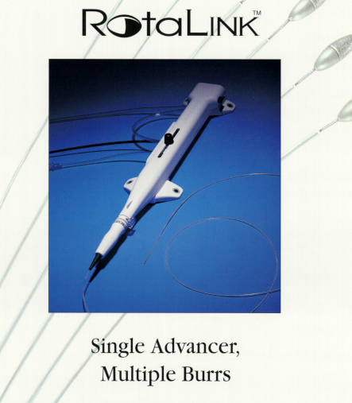
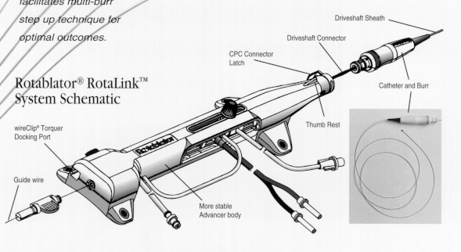
RotalinkTM Advancer
Brake Defeat
Image Source: Boston Scientific

Slide 29
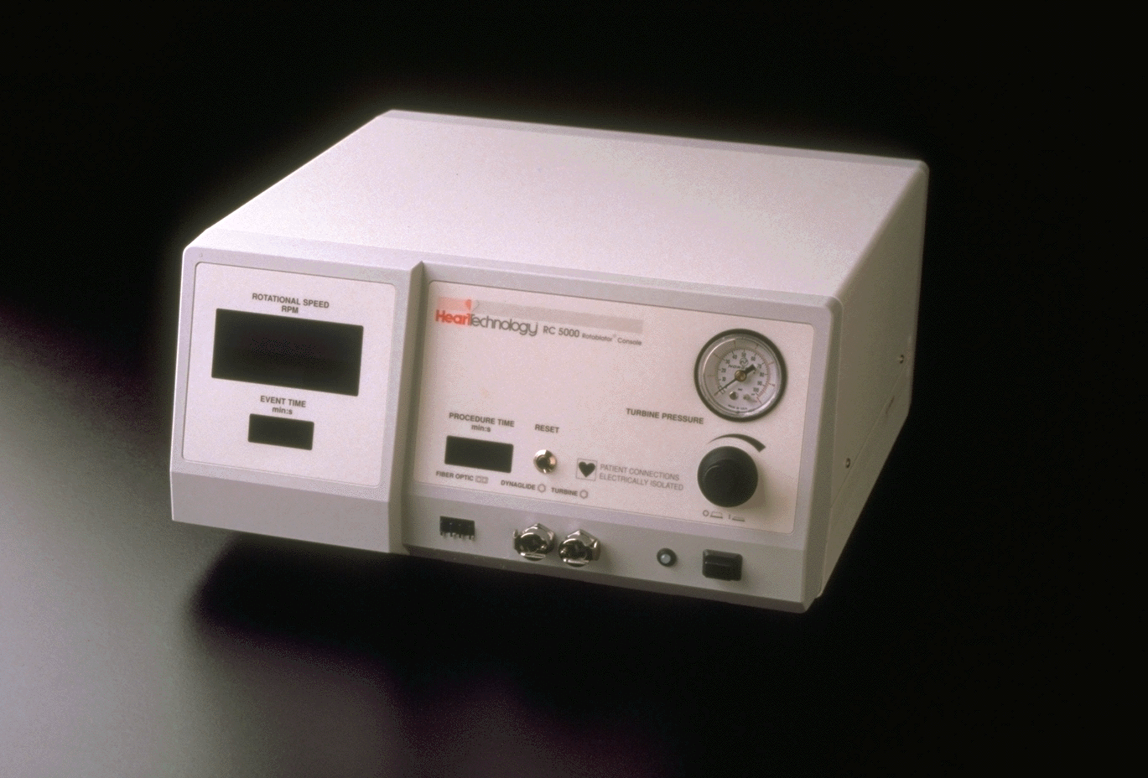
Console
turbine pressure gauge
(delivered to advancer)
procedure
timer
rotational speed display
(tachometer)
reset button
turbine pressure
control knob
(adjusts RPM)
event timer
power switch
advancer
fiber optic
tachometer
connector
power lamp
Dynaglide™
connector
advancer turbine
(pneumatic) connector
Image Source: Boston Scientific

Slide 30
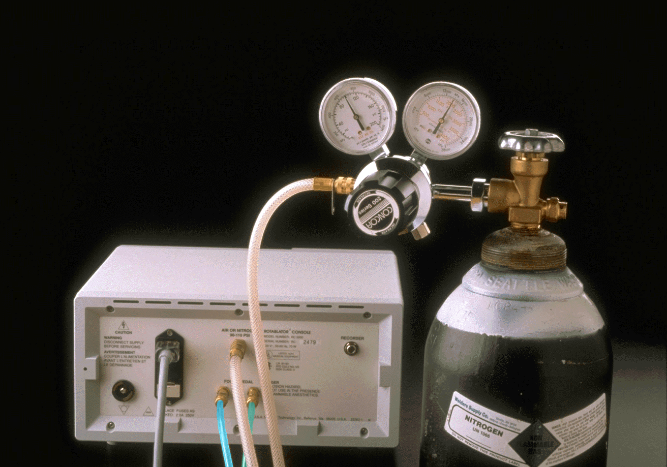
Air Supply Set Up
Dual Gauge Regulator
Pressure regulator (relieving type is preferred) capable of delivering at least 5 scfm (140 litre / min or 0.1m³/min) at 620kPa-758kPa (90-110 psi or 6.5-7.5 bar or 6.3-7.7atm). Pressure of the gas supplied to the air or nitrogen connector does not exceed 758kPa (110 psi or 7.6 bar).
If the pressure in the tank is below 6,205kPa-6,894kPa (900-1000 psi or 63.3-70.3atm) consider changing tanks before the procedure begins.
Cylinder Tank. Compressed Air or Nitrogen
Power cord
Dynaglide™ connectors
From Pg 277-280, Guide to Rotational Atherectomy. Mark Reisman. Physicians Press, Birmingham, Michigan. ISBN 1-890114-02-02. 1997

Slide 31
Foot Pedal
Dynaglide™ button
Dynaglide™ indicator illuminated on RPM display on console

Slide 32
RotaWire™ Floppy Guidewire
325cm total length
Flexible and torqueable
Short Soft Spring Tip (2.2cm)
More flexible and less rail support than the previous Rotablator™ C wire, significantly reduces guidewire bias
From Pg 270-272, Guide to Rotational Atherectomy. Mark Reisman. Physicians Press, Birmingham, Michigan. ISBN 1-890114-02-02. 1997

Slide 33

RotaWire™ Extra Support Guidewire
325cm total length
Soft Spring Tip (2.8cm)
Lead wire for those cases requiring a “stiffer” wire
From Pg 270-271, Guide to Rotational Atherectomy. Mark Reisman. Physicians Press, Birmingham, Michigan. ISBN 1-890114-02-02. 1997

Slide 34
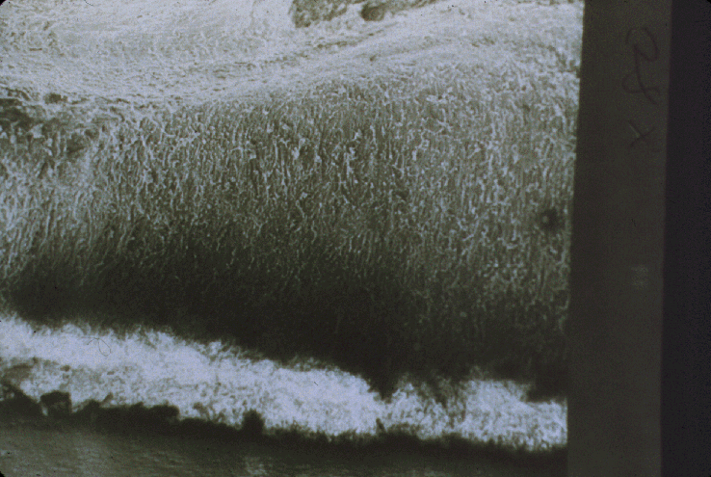
Porcine Model Histology
Post-Rotablator® System Procedure
Picture from Pg 8, Guide to Rotational Atherectomy. Mark Reisman. Physicians Press, Birmingham, Michigan. ISBN 1-890114-02-02. 1997
Notes:
122

Slide 35
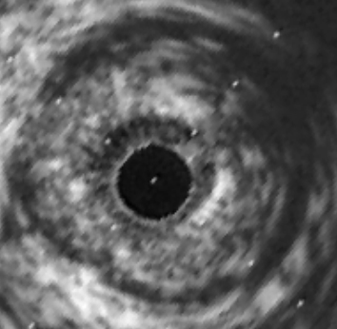
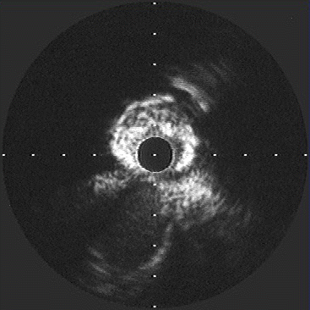
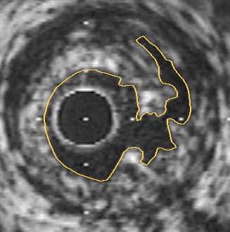
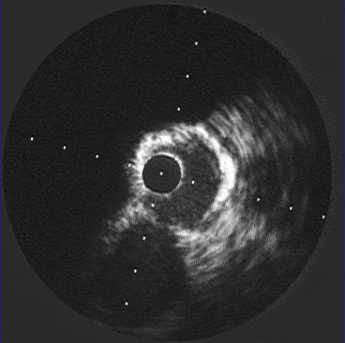
IVUS Image
Post-PTCA Procedure
Post-Rotablator® System
Procedure
Kocach JA Mintz GS, Pichard AD, et al. Sequential intravascular ultrasound characterization of the mechanisms of rotational
atherectomy and adjunct balloon angioplasty. J Am Coll Cardiol 1993; 22 (4):1024-32.
Notes:
123

Slide 36
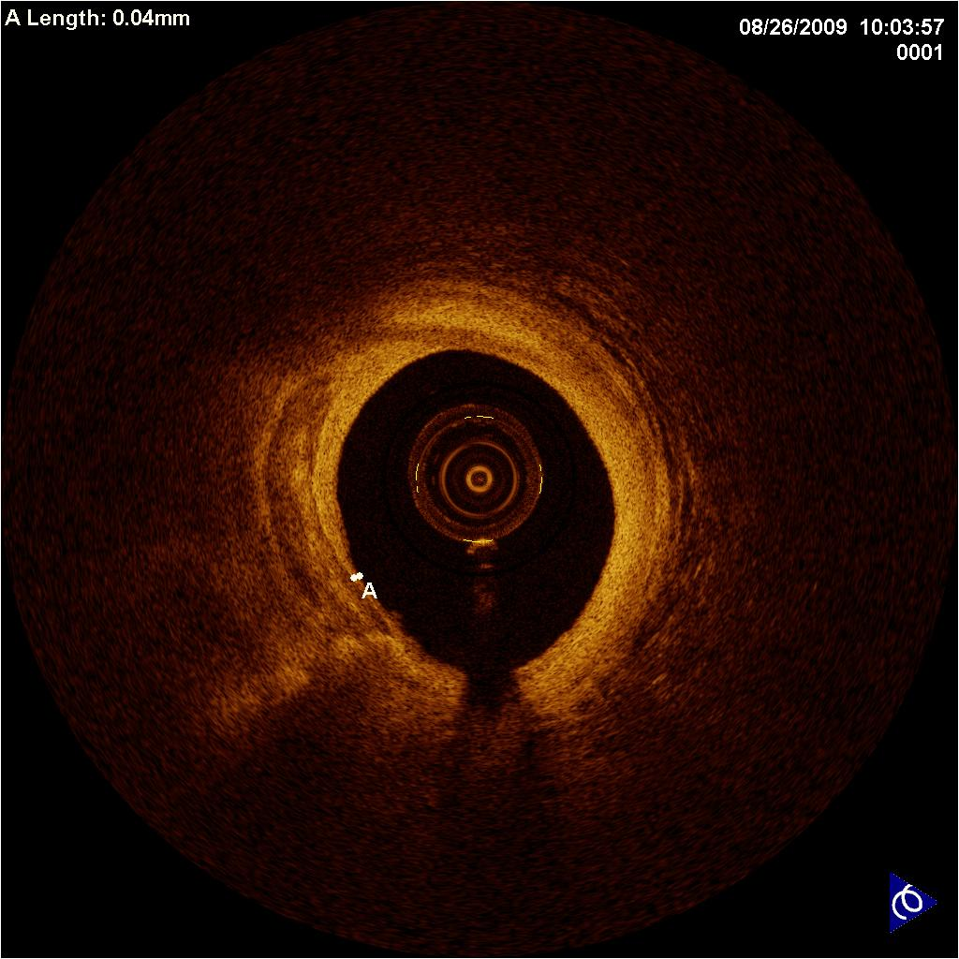
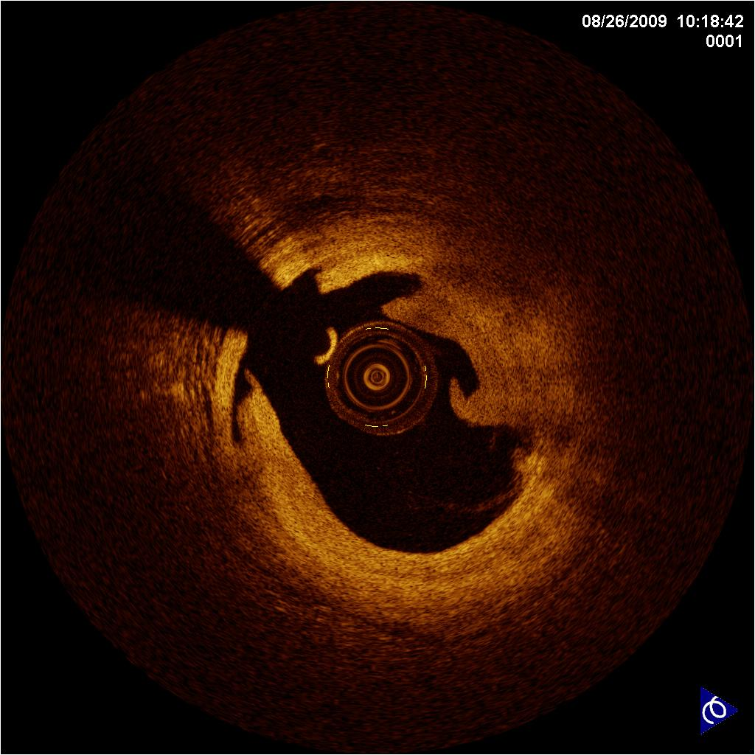
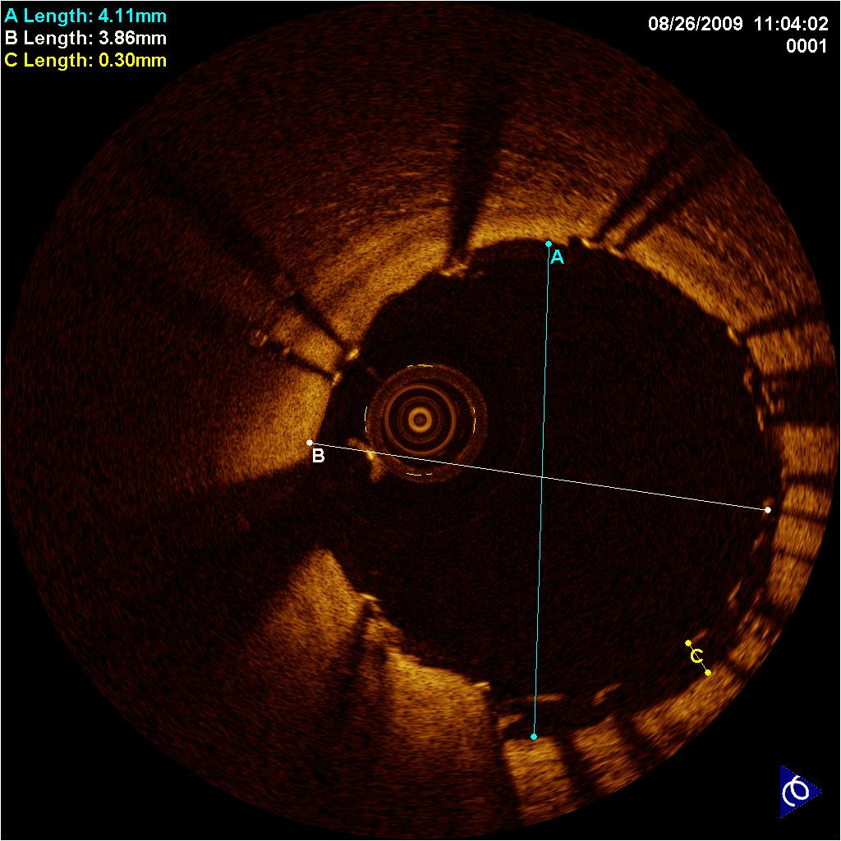
A Closer Look – RCA Example
Rotablator® Atherectomy System, POBA, and Stent
After Rotablator®
Atherectomy
After Pre-Dilation
After Stenting
Images courtesy of Georg Gaul, MD, FESC, Vienna, Austria

Slide 37
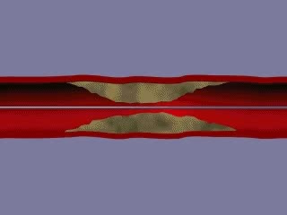
Optimal Technique
TECHNICAL CONSIDERATIONS
Single burr with burr-to-artery ratio of 0.5 to 0.6
Rotational speed of 140,000 to 150,000 rpm
  OPERATOR TECHNIQUE
Gradual burr advancement using a pecking motion
Short ablation runs of 15 – 20 sec
Avoidance of decelerations > 5,000 rpm
Final polishing run
Tomey, et al. Current Status of Rotational Atherectomy. 2014. JACC Cardiovasc Int. epub ahead of print.

Slide 38
Rotational Atherectomy
When to Use
Calcified Vessels
  Particularly Heavy Ca++
Failure to Dilate
In-stent Restenosis
  Multiple stent layers

Slide 39
Rotational Atherectomy
Case Selection
Mild Ca⁺⁺ ( <90° arc): routine PCI
Moderate Ca⁺⁺ (90-180° arc):
  Non-compliant balloon
  Plaque modification:
    Cutting balloon, Scoring balloon
    Rotablator
Heavy Ca⁺⁺: Rotablator

Slide 40
Case Selection
Rotational Atherectomy
Avoid unfavorable anatomy
  Severe tortuosity
  Marked bend angles
Ca++ plus angulation: h risk
  Guide wire bias
  Perforation

Slide 41
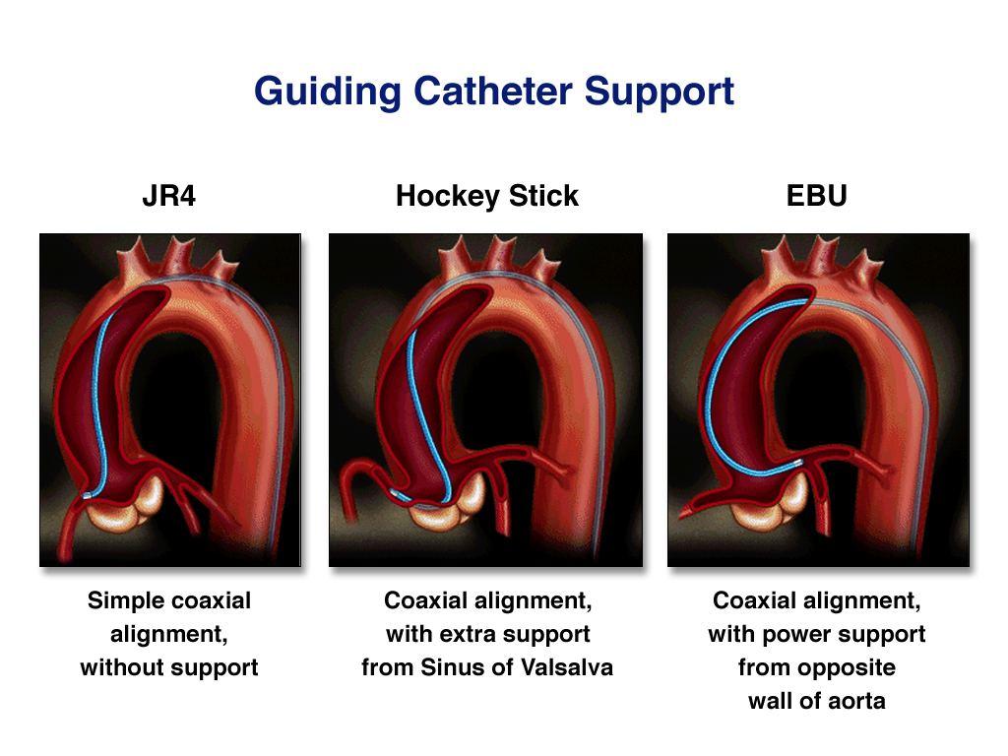
Guide Catheter Selection
Coaxial Alignment
Relaxed Curve
GC lumen > 0.004" larger than burr
  6F: 1.5-1.75 burr
  7F: 2.0 burr
Side holes optional

Slide 42
Guide Wires
Rotational Atherectomy
Floppy
Extra Support

Slide 43
Rotational Atherectomy
Technique
Burr sizes: 1.25, 1.5, 1.75, 2.0, 2.15, 2.25, 2.5
Usually start with 1.50 mm burr
  Smaller (1.25) if very tight or long lesion
Optimal technique
  slow burr advancement
  short ablation run times
  avoid rpm drops
May need larger burrs (stepped approach)

Slide 44
Rotational Atherectomy
Ablation Technique
  Slower burr speeds (140,000-150,000 rpm)
  Short ablation run times (15-20 seconds)
  Avoid decelerations >5,000 rpm

Slide 45
Intra-Procedure Patient Management
Rotational Atherectomy
Adequate blood pressure for use of vasodilators
  phenylephrine intraprocedure (100-300 μgm)
ACT 350 seconds
Prophylactic pacing
  often needed for RCA and dominant LCx
  occasionally for proximal LAD
PA pressure monitoring for high risk patients

Slide 46
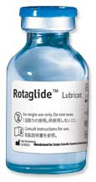
Rotaglide Lubricant
Ingredients: Emulsion of olive oil, phospholipids, egg yolk, Na de-oxycholate, L-histidine, disodium EDTA, NaOH, and H2O
Decreases friction
Increased tactile feel
Decreased heat generation

Slide 47
Rotational Atherectomy
Rotaglide Lubricant
Heat Generation
Over time, effluent heat increases due to friction in the system
Increased heat in artery is associated with h platelet aggregation
Rotaglide emulsion minimizes heat buildup
  Baseline temperature is low compared to standard saline flush
  Baseline temperature remains stable

Slide 48
Calcified Lesions
Plaque Modification
Rotablator
Only device which removes plaque
Only effective device for heavy Ca⁺⁺

Slide 49
Impact of Rotational Atherectomy on Stent Expansion in Heavily Calcified Lesions
 | STENT ALONE n = 40 | ROTA + STENT n = 105 | p | FAVORS ROTA + STENT
IVUS PRE
Arc of superficial Ca⁺² ° | 225 ± 82 | 269 ± 77 | 0.003
Length of Ca⁺² (mm) | 10.0 ± 4.7 | 11.6 ± 6.5 | 0.18
Reference CSA (mm²) | 9.89 ± 3.24 | 9.03 ± 3.44 | 0.17
Max balloon pressure (atm) | 16.0 ± 4.2 | 16.6 ± 2.5 | 0.33
IVUS POST
Acute CSA gain (mm²) | 4.57 ± 1.97 | 5.41 ± 1.99 | 0.02
CSA stenosis (%) | 23 ± 15 | 16 ± 24 | 0.08
QCA FINAL
Acute gain (mm) | 1.72 ± 0.57 | 1.94 ± 0.48 | 0.02
Diameter stenosis (%) | 9 ± 11 | 4 ± 12 | 0.03
✓
✓
✓
✓
Hoffman R et al. EHJ 1998;19:1224-31

Slide 50
Historical Data: SPORT Trial
(Stent Implantation Post Rotational Atherectomy Trial)
 | ROTA + STENT (N=360) | PTCA + STENT (N=375) | P-VALUE | FAVORS ROTA + STENT
Post Procedure MLD | 2.81 ± 0.44 | 2.74 ± 0.40 | 0.032
Acute Gain | 1.94 ± 0.50 | 1.86 ± 0.48 | 0.041
Technical Success | 93.1% | 87.7% | 0.0146
Procedural Success | 93.6% | 88.1% | 0.0114
Clinical Success | 91.6% | 87.0% | 0.0495
✓
✓
✓
✓
✓
Study limitations: included a lesion subset of mostly lesions with minimal calcification where de-bulking with RA is known to be of limited value
Buchbinder, M., et al, presentations at TCT 2001 & ACT 2001
Notes:
While moderate de-bulking did not significantly improve clinical outcomes (TVR and TLR), it did result in higher acute procedural success and larger final lumen

Slide 51
Pre procedure test memory rule: D.R.A.W.
System Test (Outside Body)
  Drip – Saline drip from bottom of advancer and catheter
  Rotate – Burr is rotating and RPMs are stabile
  Advancer – Free movement of advancer knob
  Wire – Wire is visible and brake is functioning

Slide 52
Ablating Technique
Set baseline RPM proximal to lesion
Slowly advance burr
Adjust burr RPM
  SARS Study, and STRATAS Trial:
  Low speed RA (140,000-160,000 rpm)
  Avoid decelerations > 3000 rpm
  Intermittent pull back for coronary perfusion and/or contrast injection
Independent Studies:
SARS: Catheter Cardiovasc Interv, September 1999
STRATAS: Whitlow et.al., Am J Cardiol 2001;87:699-705

Slide 53
Burr Positioning
Before advancing burr over wire, position advancer knob 2-3 cm forward and lock
Evenly advance burr while pulling back on wire
With burr proximal to lesion, relieve tension on drive shaft
  Confirm by freely moving advancer knob
Confirm proximal positioning and burr/artery ratio with contrast injection
Rotalink™ Instructions for use.

Slide 54
Pecking technique
Time of runs 15“
Independent Studies:
STRATAS: Whitlow et.al., Am J Cardiol 2001;87:699-705
From Pg 89, Guide to Rotational Atherectomy. Mark Reisman. Physicians Press, Birmingham, Michigan. ISBN 1-890114-02-02. 1997

Slide 55
Angiographic Complications
Complication Rate
Perforation 0.7%
Abrupt closure post procedure 1.1%
No flow 0.5%
Flap/dissection 13.7%
N = 2,953 Procedures
Wart DC, Leon MB. O’Neill W, et al. Rotational Atherectomy Multicenter Registry. Acute results, complications and 6 month follow-up in 709 patients. J Amer Coll Cardiol 1994; 24(3): 641-8 (unfinished report). Industry-sponsored
Reisman M, Harms V, Feldman T, Fortuna R, Buchbinder et al. Comparison of Early and Recent Results With Rotational Atherectomy. J Am Coll Cardiol 1997; 29:353-7. Industry-sponsored.

Slide 56
Overall Major Complications
Complication Rate
Death 1.0%
Q-Wave myocardial infarction (MI) 1.2%
Coronary Artery Bypass Graft (CABG) 2.5%
N = 2,953 Procedures
Wart DC, Leon MB. O’Neill W, et al. Rotational Atherectomy Multicenter Registry. Acute results, complications and 6 month follow-up in 709 patients. J Amer Coll Cardiol 1994; 24(3): 641-8 (unfinished report). Industry-sponsored
Reisman M, Harms V, Feldman T, Fortuna R, Buchbinder et al. Comparison of Early and Recent Results With Rotational Atherectomy. J Am Coll Cardiol 1997; 29:353-7. Industry-sponsored.

Slide 57
Angiographic Complications
Bradicardia and AV Block
Vasospasm
Slow flow or no flow
Abrupt closure
Dissection
Perforation
From Pg 241, Guide to Rotational Atherectomy. Mark Reisman. Physicians Press, Birmingham, Michigan. ISBN 1-890114-02-02. 1997

Slide 58
Management of Angiographic
Complications
Bradicardia and AV Block
Mechanism of bradycardia or AVB.
- Unclear
- Various Theories
micro particles interfering with vessels per fusing AVnode
vibrations and heat of burr causing reflex bradycardia.
Ask the patient to cough
Atropine
Pacemaker Limiting ablation times (<15- 20sec)
Deactivate the burr when slowing of heart rate is noted

Slide 59
Management of Angiographic
Complications
Some operators advances pacemaker only into the IVC and place it into the RV when needed.
Present recommendations are the placement of temp pacemaker in pts under going treatment of RCA ,Dominant LCX, proximal LAD giving collaterals to RCA .
Vasospasm
IC nitroglycerin
Verapamil
Low pressure balloon inflations if persistent
From Pg 242-243, Guide to Rotational Atherectomy. Mark Reisman. Physicians Press, Birmingham, Michigan. ISBN 1-890114-02-02. 1997

Slide 60
Management of Angiographic
Complications
Slow flow/no flow
IC Nitroglycerin
Maintain adequate perfusion pressure and vasopressure drugs if needed.
Short balloon inflations at low pressure — distal to proximal
Intraortic balloon pump
From Pg 247-248, Guide to Rotational Atherectomy. Mark Reisan. Physicians Press, Birmingham, Michigan. ISBN 1-890114-02-02. 1997

Slide 61
Management of Angiographic
Complications
Abrupt Closure
Must be distinguished from spasm and slow/no flow
Management similar to conventional PTCA.
• Abrupt closure from severe dissection or flap should be treated with prolonged balloon inflations or stenting.
And prolonged balloon inflations will not improve situation incase of slow or no flow
From Pg 247-248, Guide to Rotational Atherectomy. Mark Reisan. Physicians Press, Birmingham, Michigan. ISBN 1-890114-02-02. 1997

Slide 62
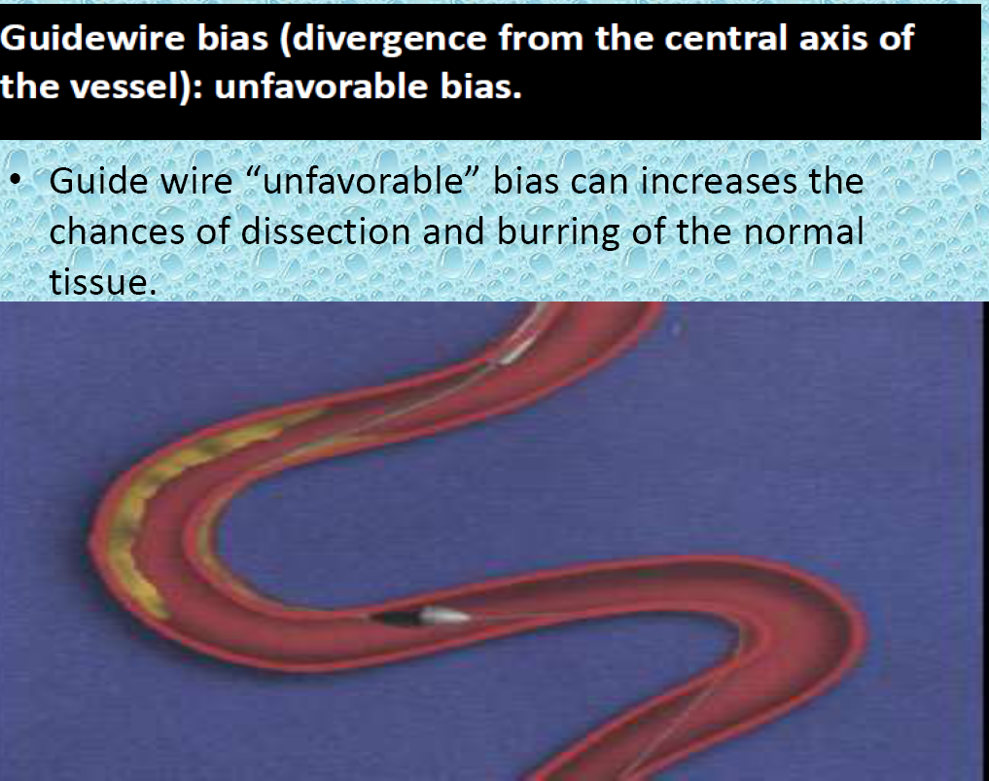

Slide 63
Management of Angiographic
Complications
Dissection
Once identified, do not go to a larger burr size
Management similar to those after PTCA
Stent
Perforation
Management similar to conventional PTCA
From Pg 249-254, Guide to Rotational Atherectomy. Mark Reisman. Physicians Press, Birmingham, Michigan. ISBN 1-890114-02-02. 1997

Slide 64
Management of Angiographic
Complications
PERFORATIONS
Incidence 0.7% reported from multicentre registry.
Mechanism:- Oversize burr OR Tangentially oriented burr due to trajectory of guide wire .
More common in severely angulated lesions,
Undersize the burrs in severely angulated lesions especially those are straightened with guide wire or showing psudolesions.
“pecking” technique should be used to avoid excessive cutting .
From Pg 249-254, Guide to Rotational Atherectomy. Mark Reisman. Physicians Press, Birmingham, Michigan. ISBN 1-890114-02-02. 1997

Slide 65
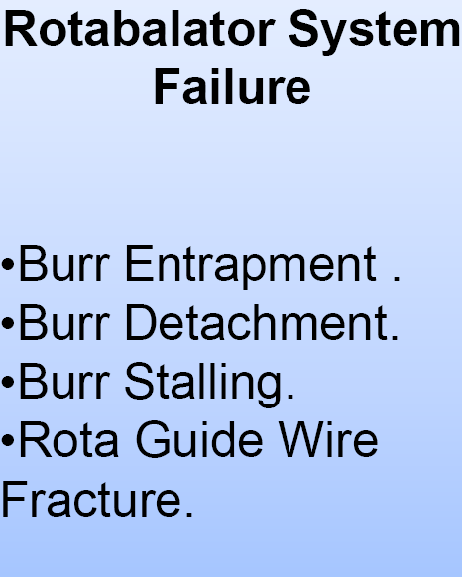

Slide 66
Burr Entrapment
Can occur if a burr slips across the lesion without the burring (coefficient of friction is less at the high speed than at the rest ).
Ledge of the calcium behind the elliptical burr causes “Kokesi” effect.
It may get entrapped in the tortuous segment of the lesion

Slide 67
Rotational Athectomy
Contraindications
Occlusions not passable with guide wire
Last remaining vessel
Severe LV dysfunction
Saphenous vein grafts
Angiographic thrombus pre-treatment
Significant dissection at treatment site
Notes:
402

Slide 68
Indications for Use
Rotational Atherectomy
Calcified Vessels
Failure to Dilate
In-stent restenosis
  Multiple stent layers
  Jailed branches

Slide 69
IMPORTANT TRIALS
ARTIST(INSTENT RESTENOSIS)
ROSTER(IN STENT RESTENOSIS)
STRATAS(AGGRESSIVE STRATEGY)
DART( ROTA IN SMALL CALCIFIED CORONARIES)
SPORT(ROTA + STENT V/S STENT)
ROTATAXUS (ROTA + STENT V/S STENT)

Slide 70
ROTABLATION for complex lesions
Randomized comparison of angioplasty of complex coronary lesions at a single center. Excimer Laser, Rotational Atherectomy, and Balloon Angioplasty Comparison.
Circulation. 1997 Jul 1;96(1):91-8. :ERBAC study
N=685, Elective PCI for symptomatic CAD
POBA vs ELCA vs PTRA
Procedural success (diameter stenosis < 50%, absence of death, QWMI/CABG)
PTRA had a higher rate of procedural success than ELCA or POBA (89% versus 77% and 80%, P = .0019)
No difference in major in-hospital complications (3.2% versus 4.3% versus 3.1%, P = .71).
At 6-months follow-up, TVR more in PTRA (42.4%) and the ELCA (46.0%) than in POBA(31.9%, P = .013).
➔ Procedural success of PTRA though superior to laser angioplasty and balloon angioplasty; does not result in better late outcomes.

Slide 71
ROTABLATION for complex lesions
A randomized comparison of balloon angioplasty versus rotational atherectomy in complex coronary lesions.EHJ 2000: COBRA study
RCT , N=502
70-99% stenosis, absolute criteria- 1mm and > 5mm length
Secondary criterion– heavy calcification, ostial, bifurcation, diffuse, eccentric, >45deg angulation
Procedural success 78% (PTCA) vs 85% (rotablation) (P=0·038)
Crossover from PTCA to rotablation was 4% and 10% vice versa (P=0·019).
No difference in MACE at 6months
However, more stents were required after PTCA (14·9% versus 6·4%, P<0·002), predominantly for bailout or unsatisfactory results.
At 6 months symptomatic outcome, TVR and restenosis rates (PTCA 51% versus rotablation 49%,P=0·33) were not different
➔ PTRA has higher procedural success with comparable long-term efficacy

Slide 72
ROTABLATION in routine PCI
Comparison of PTRA with conventional POBA in the prevention of restenosis of small coronary arteries: results of the Dilatation vs Ablation Revascularization Trial.
Am Heart J. 2003 May;145(5):847-54. :DART trial
N=446, Coronary diam 2-3mm, <20mm lesion
Primary endpoint-- TV failure(death, QWMI, TVR) at 12 months
Acute procedural success (91.6% for PTRA, 94.1% for POBA, P =.36)
TVF at 12 months -- (30.5% vs 31.2%, P =.98).
Similar MLD(1.28 +/- 0.63 mm vs 1.19 +/- 0.54 mm, P =.26), restenosis rates (50.5% vs 50.5%, P = 1.0), MACE and no mortality.
➔ Though PTRA appeared safe, no definite advantage over POBA in PCI to small vessels.

Slide 73
ROTABLATION in routine PCI – Burr size
Coronary angioplasty and Rotablator atherectomy trial: immediate and late results of a prospective multicenter randomized trial.
Catheter Cardiovasc Interv. 2001 Jun :CARAT trial
Large burr(Burr: artery>0.7 -Lesion debulking) vs small burr (Burr:artery≤0.7 – lesion modification)
N=222,
No differences in procedural success, the extent of immediate lumen enlargement, in hospital complications, or late TVR.
Large burrs were more likely to experience serious angiographic complications (5.1% vs. 12.7%, P < 0.05) immediately after atherectomy.
➔Small burrs have similar early and late efficacy with fewer angiographic complications

Slide 74
ROTABLATION for ISR
Randomized trial of Rotational Atherectomy Versus Balloon Angioplasty for Diffuse In-stent Restenosis. Am Heart J. 2004 Jan;147(1):16-22. :ROSTER trial.
N=200, Diffuse ISR, Single centre
PTCA(high pressure POBA) vs PRCA
A higher rate of repeat stenting occurred in the PTCA group (31% vs 10%; P <.001).
IVUS analysis--- lower residual intimal hyperplasia area after PRCA versus PTCA (2.1 +/- 0.9 mm2 vs. 3.3 +/- 1.8 mm2; P =.005).
1 yr f/u – Similar mortality and MACE.
TLR -- 32% in the PRCA vs 45% in the PTCA group (P =.042)
➔ In diffuse ISR, PRCA is safe, effective and lesser TLR
Notes:
High pressure POBA 12atm

Slide 75
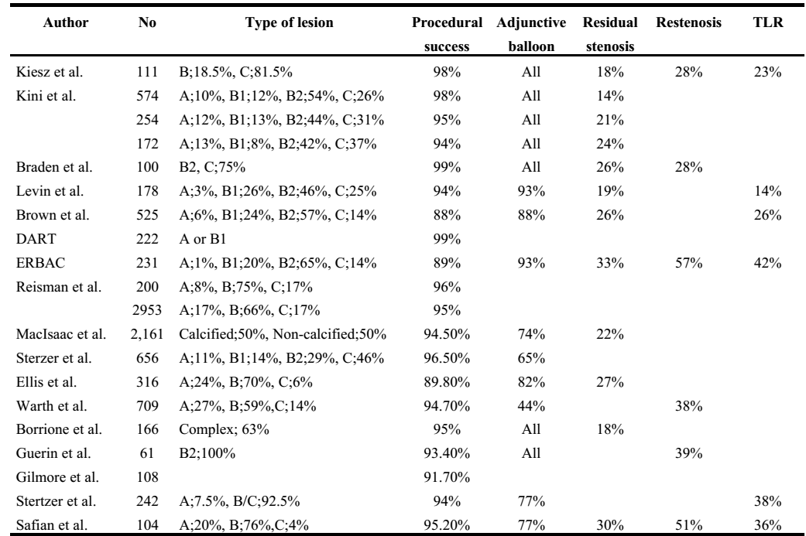
Effectiveness of Rotablation in 90’s and early 2000s
~95%
<30%
~28-57%
Current Overview of Rotational Atherectomy. Does Rotablator Make Sense? Emodynamica 2000.

Slide 76
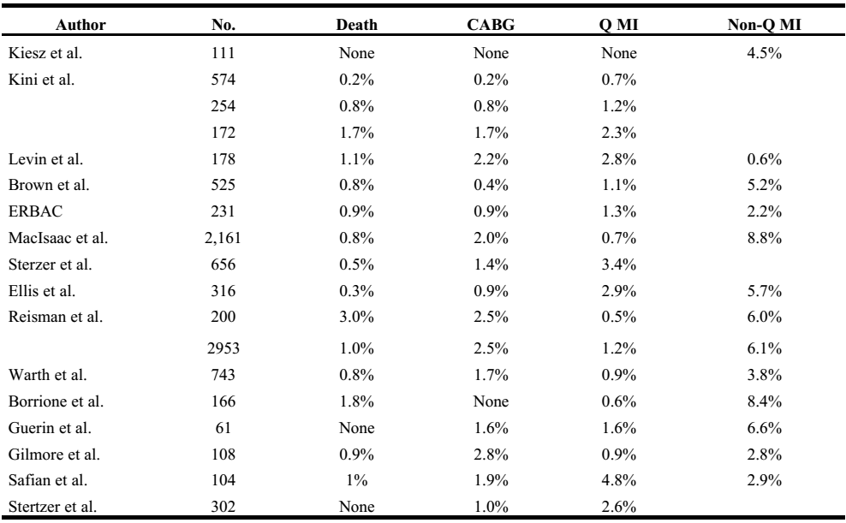
In-hospital complications
~0.2-1.8%
~0.5-4.8%
~0.6-8.8%

Slide 77
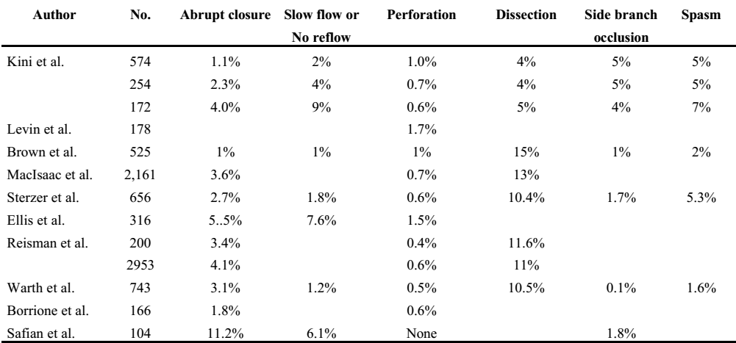
Angiographic complications after Rotablation
~1.1-11%
~1-9%
~0-1.7%
~4-15%

Slide 78
ROTASTENTING strategy
Mousse et al .Coronary stenting after rotational atherectomy in calcified and complex lesions. Angiographic and clinical follow-up results. : Circulation. 1997 Jul 1;96(1):128-36.
Background– poor results in the POBA era
N=75 (106 lesions), rota-stenting (BMS) (IVUS-guided)
Indications –calcified(70%), long lesions(10%), Inability to pass balloon(20%)
Majority (>90%) B to C lesions
Procedural success was achieved in 93.4% of lesions.
Acute stent thrombosis -2 lesions (1.9%), and subacute ST in 1lesion (0.9%).
Angiographic follow-up at 6m -- restenosis rate of 22.5%.
6m TVR of 18%, QWMI in 1.3%, CABG in 4% and mortality in 1.3%
➔Rotastenting in calcified/complex lesions had high success rate, with acceptable complication and relatively low restenosis rates.

Slide 79





Meta-Analysis of Randomized Trials of Percutaneous Transluminal Coronary Angioplasty Versus Atherectomy,Cutting Balloon Atherotomy, or Laser Angioplasty. JACC 2004
N=2434, PTRA vs routine PTCA
Pre-DES era data
➔ Mechanical plaque modification by itself has no beneficial effect in terms of MACE, mortality or restenosis.
30 day mortality
30 day MACE
Angiographic restenosis
1 year TVR
Cumulative MACE at 1y

Slide 80
Facts from trials in pre-DES era
ROTA helps in lesion preparation and improves procedural success in ‘difficult’ lesions in complex/calcified coronary lesions
ROTA improves the acute gain in lumen diameter
ROTA has no effect/worsens restenosis rates compared to routine PTCA ( 20-58%)
No definite mortality benefit documented.
Notes:
CTO recanalization has possible long term benefits in terms of survival, LV fn and symptoms (TOAST–GISE), though good RCTs are unavailable.
Failed PCI to CTO has higher mortality compared to successfully recanalized CTO-PCI.

Slide 81
ROTABLATION in the DES era
DES-era has significantly decreased the restenosis rates and 1-yr TVR rates.
However for best results, the lesion needs to be completely tackled and stents optimally deployed.
Optimal stent deployment is affected in calcified coronary plaques– disruption of stent polymer during dilatation, poor drug elution, underexpansion.
Questions that need to be addressed:
Effect of ROTA for routine ‘difficult’ lesions in DES-era?
Effect of ROTA for complex/calcified lesions compared to routine PCI?
Effect of ROTA for PTCA-failed patients vs GDMT/CABG?

Slide 82
Clavijo et al. SES and calcified coronary lesions: Clinical outcomes of patients treated with and without rotational atherectomy.
: Cathet. Cardiovasc. Intervent. 2006, 68: 873–878.
Prospective study of Heavily calcified coronary lesions
Depending on clinician decision and procedural difficulty
N=150--- 69 PTCA with SES, 81 with ROTA-SES
Clinical success >98% in both groups
No in-hospital outcome differences.
6m TLR -- 4.9% in SES vs. 4.2% in ROTA-SES ( P = NS).
6m mortality 7.9% in SES vs 6.8% in ROTA-SES (NS)
➔Lesions requiring ROTA to facilitate dilation and stenting had similar outcomes after SES implantation to those that did not require ROTA

Slide 83
Rotational Athectomy
Summary
Case selection is key
  Ca⁺⁺ in major bend angles or severe tortuosity is high risk for complications (perforation)
  Avoid lesions where stenting may not be feasible
Start with Rotablator for heavy Ca⁺⁺
  saves time and reduces complications
Optimal technique assures best results
RA is an essential tool for complex PCI

