Slide 1
REACTIVE ARTHRITIS

Slide 2
DEFINITION
HISTORY
EPIDEMIOLOGY
PATHOGENESIS
CLINICAL FEATURES
INVESTIGATIONS
ROLE OF HLA B27 TESTING
IMAGING
DIAGNOSIS AND CLASSIFICATION CRITERIA
NATURAL HISTORY
TREATMENT
CONCLUSION
KEY POINTS

Slide 3
DEFINITION
Reactive arthritis is defined as a sterile arthritis following a genitourinary or gastrointestinal infection.
It is to be differentiated from post infectious arthritis by the features it shares with spondyloarthrities (SpA) and its extra articular manifestations

Slide 4
HISTORY
Although Reiter’s syndrome was a popular eponym, the description was actually initially published by Fiessinger and Edgar Leroy.
Reiter had also mistakenly attributed the cause of urethritis and conjunctivitis to a spirochaetal organism.
Due to evidence of reiter’s participation in various Nazi activities in the second world war, the term reiter’s syndrome was later removed from the medical literature.

Slide 5
EPIDEMIOLOGY
Common in young adults(20 to 40 years)
Both the sexes are equally effected when ReA follows gastrointestinal infections.
But there is a male predominance following chlamydial infections.
Incidence varies between 1.3 to 30/1,00,000 population depending on the geographic area, triggering infections and diagnostic methods used

Slide 6
PATHOGENESIS
ReA develops as a result of genetic and infectious agent interactions.
In chlamydial infections a type 1 immune response leads to increase in INF gamma levels and help in killing phagocytosed bacteria.
A dominant type II immune response predisposes to susceptibility to infection and persistence of chronic infection

Slide 7
Tiggers for Reactive Arthritis include gastrointestinal infections with
Shigella flexneri
Campylobacter jejuni
Campylobacter coli
Yersinia enterocolitica
Genitourinary infections with Chlamydia trachomatis.
Respiratory infections with Chlamydia pneumoniae

Slide 8
Other organisms which have been reported to cause Reactive Arthritis include
Ureaplasma ureolyticum
Clostridium difficile
Salmonella typhimurium
Salmonella enteriditis
Mycobacterium bovis
Neisseria gonorrhoea
Mycoplasma genitalium
Enterotoxigenic E coli

Slide 9
Organisms implicated in Reactive Arthritis are usually gram negative and intracellular organisms and contain lipopolysaccharide in the cell membranes.
In genetically predisposed individuals there is persistence of organisms in dormant state in the synovial cavity.
These persistent antigens lead to an immune response in the individual in the form of a sterile arthritis.
The organisms can be identified accurately by PCR .

Slide 10
Some characteristics of various serovars of Chlamydia such as ability to survive in hypoxic environments and variations in outer membrane proteins also dictate the duration of infection.
HLA B27 is a risk factor for the occurrence of severe arthritis, prolonged course and extra articular manifestations.
However, the exact mechanisms by which HLA-B27 causes disease susceptibility and ReA develops are still unclear.

Slide 11
CLINICAL FEATURES
ARTICULAR MANIFESTATIONS:
Most common manifestation is an asymmetric acute mono or oligo arthritis predominantly affecting the lower limbs although polyarthritis and upper limb involvement can also occur.
Enthesistis and dactylitis or “sausage digit,” a diffuse swelling of a solitary finger or toe, may also occur.
Inflammatory back pain is found in around 30% of the individuals.

Slide 12
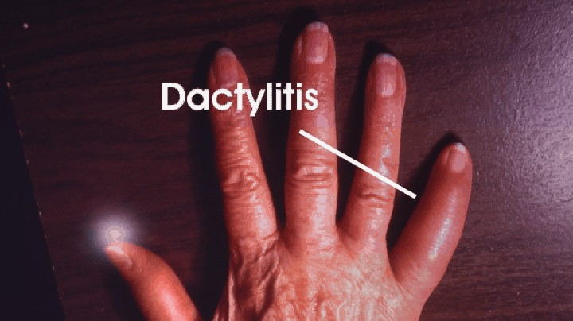

Slide 13
EXTRA ARTICULAR MANIFESTATIONS:
Ocular manifestations are more common with Chlamydial ReA than post dysentery ReA.
Ocular manifestations includes conjunctivitis , acute anterior uveitis.
Conjunctivitis seen in 30 to 60 % of patients is usually bilateral, occurs early in the course of disease but typically after urethritis.
Presents as erythema, burning sensation, discharge and photophobia
Conjunctivitis is more common with sexually acquired and after shigella infection than with other post dysentery ReA.
Male to female ratio is 1.3:1.

Slide 14
Uveitis is typically characterised by acute unilateral attacks of inflammation of anterior chamber ( seen in 5% of patients )
Presents as ocular pain, erythema and photophobia.
Chronic inflammation of eye can lead to progressive intraocular damage and visual loss.

Slide 15
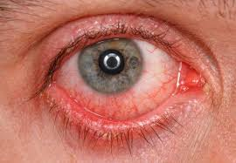

Slide 16
Urogenital lesions may occur throughout the course of the disease.
In males, urethritis may be marked or relatively asymptomatic and may be either an accompaniment of the triggering infection or a result of the reactive phase of the disease; interestingly, it occurs in both post-venereal and post-enteric ReA.
Prostatitis is also common.
Similarly, in females, cervicitis or salpingitis may be caused either by the infectious trigger or by the sterile reactive process.

Slide 17
CUTANEOUS MANIFESTATIONS:
Occurs in upto 50% of the patients.
Keratoderma blenorrhagicum is a hyperkeratotic lesions usually on the soles and palms seen in above 25% of the affected men.
It begins as clear vesicle on an erythematous base, developing into nodules .
It eventually crusts over and adjacent lesions coalesce.
Nail changes similar to those of psoriasis are seen in 15% of the patients with ReA.

Slide 18
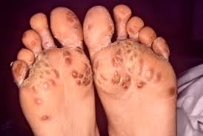

Slide 19
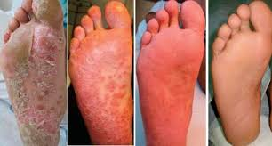

Slide 20
Circinate balanitis is a painless shallow erythematous ulcer of the glans penis, seen in upto 25% of the men.
In circumcised men it is dry, plaque like , and hyperkeratotic resembling psoriasis or keratoderma.
In uncircumcised it is typically moist, shallow ulcer surrounding the meatus.
Superficial, usually painless oral ulcer occurs in approximately 5-15% of the patients they are typically located in the hard palate or tongue but may also found on the soft palate, gingival and cheeks.

Slide 21
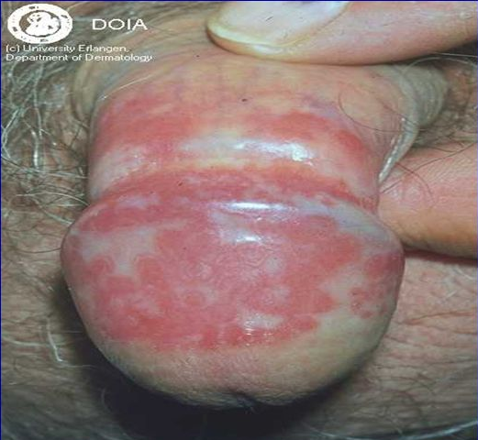

Slide 22
Cardiac involvement in the form of Aortic Regurgitation ,AV nodal block and Pericarditis can occur in up to 10% of affected individuals.
Constitutional symptoms are common, including fatigue, malaise, fever, and weight loss.
The triad of arthritis, urethritis, and conjunctivitis represents a small part of the spectrum of the clinical manifestations of ReA and only a minority of patients present with this “classic triad” of symptoms.

Slide 23
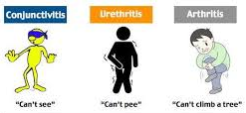

Slide 24
A careful history will usually elicit evidence of an antecedent infection 1–4 weeks before onset of symptoms of the reactive disease, particularly in post-enteric ReA.
However, in a sizable minority, no clinical or laboratory evidence of an antecedent infection can be found, particularly in the case of post-chlamydial ReA.
In cases of presumed venereally acquired reactive disease, there is often a history of a recent new sexual partner, even without laboratory evidence of infection.

Slide 25
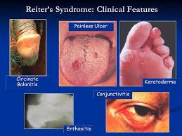

Slide 26
DIAGNOSTIC CRITERIA FOR ReA proposed at the fourth international workshop on ReA in Berlin, 1999
MAJOR CRITERIA:
Arthritis with two of three of the following findings:
Asymmetric
Monoarthritis or oligoarthritis
Affecting predominantly lower limbs.
2.Preceding symptomatic infection, with one of the following findings:
Enteritis (diarrhoea for atleast 1 day, 3 days to 6 weeks before the onset of arthritis)
Urethritis (dysuria or discharge for atleast 1 day , 3 days to 6 weeks before the onset of arthritis)

Slide 27
MINOR CRITERIA: (at least one of the following)
Evidence of triggering infection.
Positive nucleic acid amplification test in the morning urine or urethral Or cervical swab for Chlamydia trachomatis
Positive stool culture for enteric pathogens associated with reactive arthritis
2. Evidence of persistent synovial infection (positive result on immunohistologic analysis or polymerase chain reaction assay for Chlamydia)

Slide 28
Definite reactive arthritis: Both Major criteria and one relevant Minor criterion.
Probable reactive arthritis: Both Major criteria but no relevant Minor criteria. (Or) Major criteria and one or more Minor criteria.

Slide 29
NATURAL HISTORY
Arthritis typically persists for 3–5 months, it has a self limiting course but more chronic courses do occur.
Chronic joint symptoms persist in about 15% of patients and in up to 60% of patients in hospital-based series, but these tend to be less severe than in the acute stage.
Recurrences of the acute syndrome are also common.

Slide 30
Factors which determine the progression to chronic arthritis or SpA are presence of HLA B27.
In most studies, HLA-B27–positive patients have shown a worse outcome than B27-negative patients.
Patients with Yersinia- or Salmonella-induced arthritis have less chronic disease than those whose initial episode follows epidemic shigellosis.

Slide 31
DIFFERENTIAL DIAGNOSIS
Gonorrhea with gonococcal arthritis and other types of infectious urethritis. A urethral swab can be used to check. It’s important to be aware that gonococcal arthritis does not affect the spine.
Exacerbation of existing ankylosing spondylosis preceded by diarrhoea is reported to have similar clinical features.
Septic arthritis may mimic ReA.

Slide 32
INVESTIGATIONS
Elevated ESR and CRP, thrombocytosis, normal or elevated WBC count
There may be mild transaminitis.
There are no diagnostic tests for ReA.
Cultures are typically sterile in cases of ReA.
The triggering infection usually does not persist at the site of primary mucosal infection through the time of onset of the reactive disease,
Stool or urine culture may be required.
The organisms can be isolated in only 60% of the cases.
For Chlamydial infection PCR of early morning urine is the preferred method.

Slide 33
Serological testing by enzyme immune assay, complement fixation, and micro immunofluorescence is useful only in cases of upper genital tract infections by Chlamydia trachomatis.
PCR is also useful in case of respiratory infetions of Chlamydia.
In enteric infections, stool culture is usually unyielding as the patient has already recovered from the infection and the organism is no longer identifiable from the stool sample.
However Salmonella , Yersinia may persist in the gut for weeks after the symptoms have resolved.

Slide 34
Special techniques like preserving the sample at low temperatures of 4-8 C before culture helps improve the yield of Yersinia infection.
Serological tests to identify Salmonella (Widal) , Campylobacter and Yersinia infections are available but only raising titres can be considered significant.
Many infections are asymptomatic leading to difficulty in diagnosis.

Slide 35
IMAGING
Radiographs are not useful in the diagnosis of ReA.
In early or mild disease, radiographic changes may be absent or confined to juxtaarticular osteoporosis.
With long-standing persistent disease, radiographic features share those of psoriatic arthritis;
Newer imaging modalities like USG and power doppler detect enthesitis, bursitis and subclinical synovitis.

Slide 36
TREATMENT
Most of the cases of ReA are self limited.
Symptomatic treatment with NSAIDs is sufficient in most cases.
Indomethacin, 75–150 mg/d in divided doses, is the initial treatment of choice, but other NSAIDs may be tried.
In case of active disease in spite of NSAIDs intra-articular glucocorticoids can be given in case of mono or oligoarthritis.
Tendinitis and other enthesitic lesions may benefit from intralesional glucocorticoids.

Slide 37
Disease modifying anti-rheumatic drugs (DMARDs) are useful in patients with
chronic arthritis,
HLA-B27 positivity,
Severe arthritis, and
Poly arthritis.
Sulfasalzine is effective in inducing remission in peripheral arthritis.

Slide 38
Sulfasalazine, up to 3 g/d in divided doses, may be beneficial to patients with persistent ReA.
Patients with persistent disease may respond to azathioprine, 1–2 mg/kg per day, or to methotrexate, up to 20 mg per week;
The TNF inhibitors infliximab, etanercept and adalimumab have been used in the treatment of refractory ReA. Synovial biopsy specimens have shown partial improvement after treatment.

Slide 39
Acute anterior uveitis requires treatment with tropical glucocorticoids and mydriatics. Some cases may progress to chronic uveitis.
Keratoderma and pustular lesions are treated with topical glucocorticoids.
Circinate balanitis and oral mucosal lesions usually respond to mild topical glucocorticoids.

Slide 40
Role of antibiotics
Data regarding the potential benefit of antibiotic therapy that is initiated after onset of arthritis are conflicting, but several trials suggest no benefit.
Since chlamydia infection is known to persist in the synovium, this has led to trails of prolonged courses of antibiotics for treatment of chlamydia induced arthritis.

Slide 41
A promising recent double-blind placebo-controlled study assessing combination antibiotics showed that
a majority of patients with chronic ReA due to Chlamydia benefited significantly from a 6-month course of rifampin 300 mg daily plus azithromycin 500 mg daily for 5 days, then twice weekly,
or 6 months of rifampin 300 mg daily plus doxycycline 100 mg twice daily.

Slide 42
CONCLUSION
ReA is a sterile arthritis occurring 1-3 weeks after an infection, common in young adults , presents as asymmetric oligoarthritis, mostly of lower limbs.
ReA is an acute HLA-B27-associated inflammatory joint disease triggered by certain bacteria.
LPS and nucleic acids from the bacteria have been isolated from affected joints, suggesting that bacterial antigens might have a direct role in the pathogenesis of ReA.
However, the exact mechanisms by which HLA-B27 causes disease susceptibility and ReA develops are still unclear.

Slide 43
Extra articular manifestations like uveitis, cutaneous lesions and cardiac involvement may occur.
Most cases are self limited though some may become chronic.
Treatment is by NSAIDs, intraarticular corticosteroids and sulfasalazine in chronic cases.
Biologicals have been used in chronic arthritis or extra-articular manifestations.

Slide 44
Key points
Reactive arthritis is a sterile joint inflammation that develops after a distant infection.
ReA should be a part of the differential diagnosis of undifferentiated oligoarthritis or monoarthritis
Musculoskeletal symptoms usually begin 2 to 4 weeks following a gastrointestinal or genitourinary infection.
Chronic inflammation of the eye can lead to progressive intraocular damage and visual loss.

Slide 45
Urine analysis should be carried out at diagnosis and should be repeated at the follow up, in order to detect possible aseptic pyuria resulting from urethritis.
Joint fluid should always be aspirated when possible. Gram –stain and bacterial culture should be performed to exclude septic arthritis.
Hip arthritis, HLA-B27, and high ESR are associated with a more chronic course.
Sulphasalazine can be given in chronic ReA in patients with peripheral joint involvement.

Slide 46
THANK YOU

