Slide 1
Congenitally corrected transposition of great arteries
Dr Tejas Shah
Assistant Professor
Dept of Cardiology
SBKS MI & RC
.

Slide 2
contents
Definition
History
Morphology
Clinic features
Diagnostic
Treatment
Results

Slide 3
DEFINITION
Congenitally corrected transposition of the great arteries is a congenital cardiac anomaly with ventriculoarterial discordant connection (transposition of the great arteries) and atrioventricular (AV) discordant connection, the right atrium connecting to left ventricle and left atrium connecting to right ventricle.
Circulatory pathways are therefore in series.

Slide 4
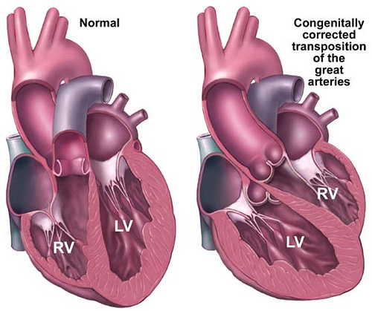

Slide 5
HISTORICAL NOTE
Rokitansky probably was first to describe a case of congenitally corrected transposition of the great arteries (CCTGA) in 1875.
In 1913, Monckenberg and again in 1936, Uher, described the anterior position of the AV node, its usual location in CCTGA.
First repairs of a cardiac malformation associated with CCTGA were reported in 1957 by Anderson, Lillehei, and Lester from the University of Minnesota.
In 1990, Ilbawi and colleagues introduced the "double switch" concept in which the morphologic left ventricle serves the systemic circulation.

Slide 6
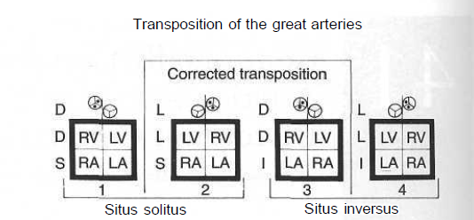
MORPHOLOGY

Slide 7
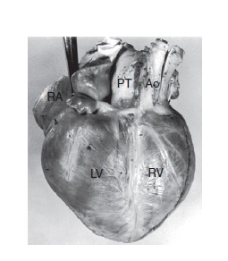

Slide 8
Ventricles
Usually there is fibrous continuity in the right-sided LV between the right-sided mitral and pulmonary valves and a well-developed left-sided RV infundibulum separating leftsided tricuspid and aortic valves.
Ventricular outflow tracts do not cross, and aorta and pulmonary trunk are parallel.
Dextrocardia exists in about 25% of cases.

Slide 9
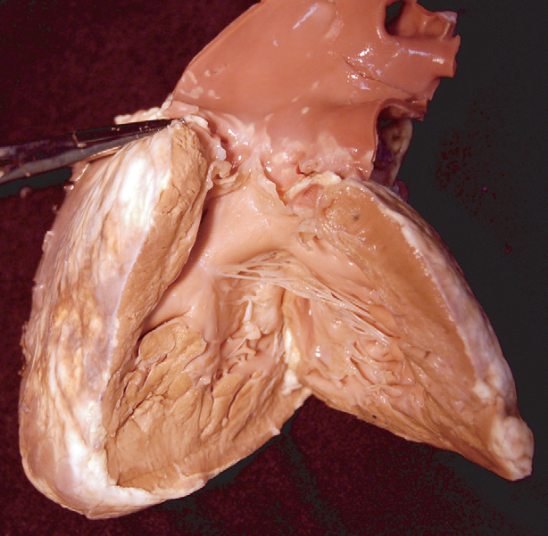

Slide 10
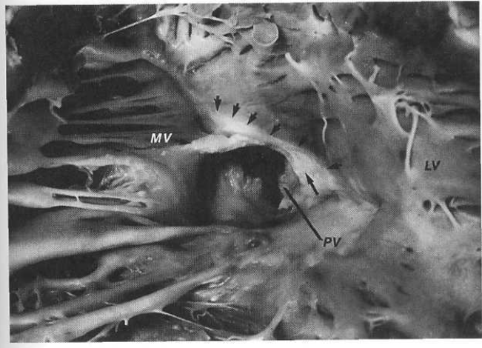

Slide 11
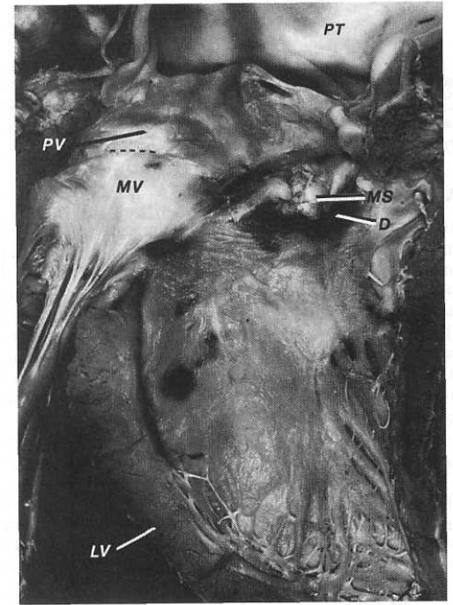

Slide 12
Pulmonary Outflow Tract
The pulmonary valve lies in a transverse plane and arises from the right-sided LV in a wedged position between mitral and tricuspid valves.
The pulmonary valve lies to the right and posterior to the aortic valve.
Hemodynamically significant LVOTO is seen in 25 % cases and causes are:
The long axis of pulmonary outflow from the right-sided LV is obliquely oriented and is potentially restrictive, particularly when there is left ventricular hypertrophy.
2. Pulmonary valve cusps may be thickened and fused or occasionally bicuspid or unicuspid.
3. pulmonary atresia .
4 subvalvar narrowing due to a membrane .
5. aneurysmal bulging of the membranous septum into the posterior part of the outflow tract with or without a ventricular septal defect (VSD).
6. fibrous tags (valvar excrescences) attached to the LV-pulmonary trunk junction ("anulus"), membranous septum.

Slide 13
Atrial Septum
Atrial and ventricular septa are malaligned.
These alignment differences are usually severe enough in hearts with atrial situs solitus to prevent the normally positioned (regular) AV node (known as posterior, inferior, or lateral node) from reaching the underlying ventricular septum.

Slide 14
Mitral Valve
The right-sided mitral valve lies at the entrance to the right-sided left ventricle.
The mitral valve is rotated so that its usual septal leaflet, which is in fibrous continuity with the pulmonary valve and can therefore be called the pulmonary leaflet, is posterior and its mural leaflet anterior.
Mitral valve abnormalities are common, having been found in 55% of an autopsy series.
The smaller papillary muscle arises from the anterolateral free wall of the ventricle, where it can be damaged by left ventriculotomy.
The larger papillary muscle arises from the posterolateral LV free wall.

Slide 15
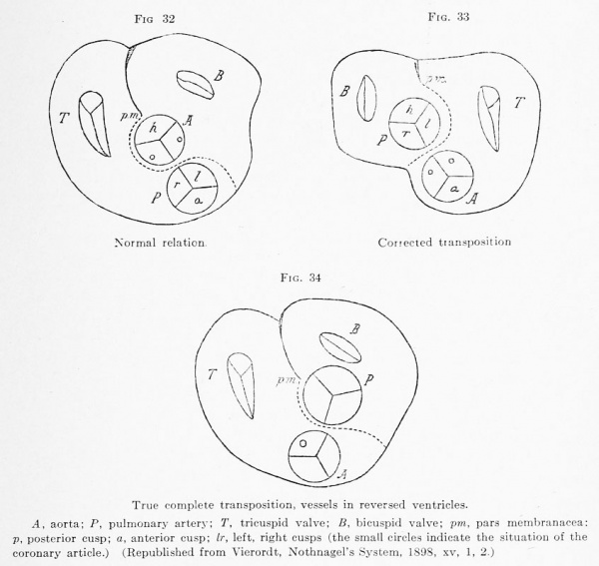

Slide 16
Aortic Valve
The aortic valve, usually normal, is over the RV infundibulum, and it and the aorta are usually in a leftward and anterior position (SLL).
In atrial situs inversus, the aorta is virtually always to the right (IDD).

Slide 17
Tricuspid Valve
The left-sided tricuspid valve lies at the entrance to the left-sided RV.
prevalence of structural abnormalities, ranging from 23% to 43%.
Structural anomelies involve:
leaflet dysplasia with abnormal thickened chordal attachments of the septal and posterior leaflets,
In a minority a true Ebstein anomaly with downward displacement of origins of septal and posterior leaflets.
• The anterior leaflet is normal in size rather than large and sail-like.
• The anulus is not dilated.
• The RV sinus is not enlarged.

Slide 18
Atrioventricular Node and Bundle of His
a regular (posterior) AV node is present in front of the coronary sinus ostium in the apex of the triangle of Koch, the penetrating bundle of His rarely extends from it because of septal malalignment.
In all hearts with atrial situs solitus, there is a second anterior (superior) node located adjacent to the right AV orifice beneath the ostium of the right atrial appendage at its junction with the anterior atrial wall where the anterior horn of the limbus of the atrial septum joins the AV anulus.
It is from this node that the penetrating bundle of His usually arises. Immediately beneath the node is the right fibrous trigone through which the penetrating bundle passes to lie immediately inferior (caudad) to the pulmonary "anulus“ in the anterior LV free wall . It then passes over the "anulus" and descends away from it onto the anterior part of the infundibular septum.

Slide 19
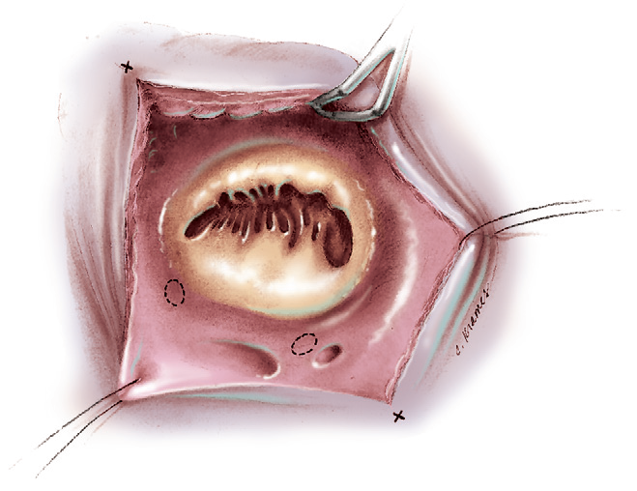

Slide 20
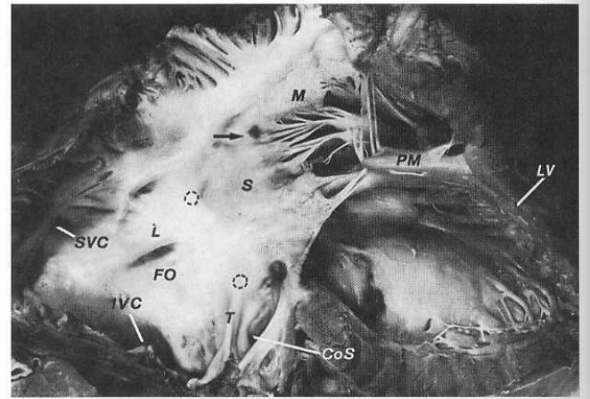

Slide 21
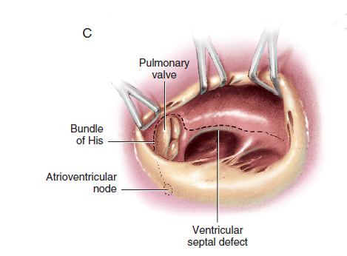

Slide 22
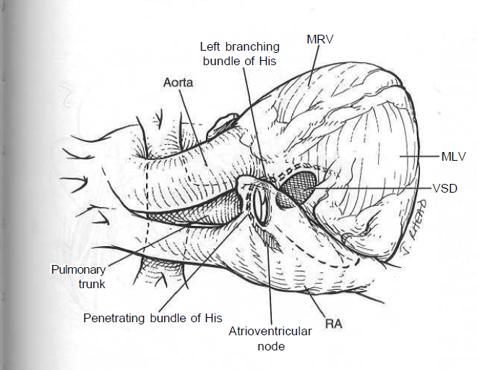

Slide 23
The encircling portion of the AV bundle is prone to fibrosis in older people, a feature that may explain spontaneous occurrence of complete heart block.

Slide 24
Ventricular Septum
Septal malalignment and separation result in enlargementof the membranous septum and filling of the gap between atrial, ventricular, and conal septa.
The AV part of the membranous septum lies between left atrium and LV (rather than right atrium and LV as in the normal heart), and its interventricular portion lies beneath the posterior part of the pulmonary "anulus.

Slide 25
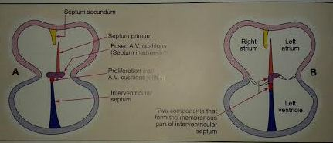
Malposition of ventricular septum

Slide 26
Ventricular Septal Defect
VSD is the most common coexisting anomaly and is present in about 80% of hearts.
Usually, it is large, subpulmonary, and associated with virtual absence of the membranous septum (conoventricular).
In about 10% of cases, it is immediately below both great arteries (doubly committed, juxta-arterial) .
Uncommonly, it is muscular, lying in the sinus (trabecular)septum.
A large, typical inlet septal VSD may uncommonly occur. Also, there may be multiple VSDs.

Slide 27
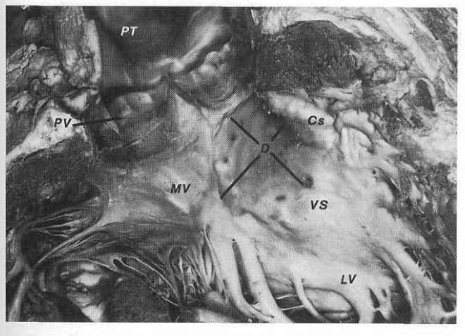
Boundaries of VSD

Slide 28
Coronary Arteries
Coronary arteries demonstrate anatomy appropriate to their ventricles.
the right-sided left coronary artery (coronary artery to right-sided LV) with its left anterior descending and circumflex branches supplies the LV, and the right coronary artery and its conal and posterior descending branches supplies the RV.
The anterior sinus is the noncoronary one; the right-sided left coronary artery arises from the right posterior sinus and passes directly in front of the pulmonary valve to divide into left anterior descending and circumflex branches.
the left-sided right coronary artery arises from the left posterior sinus.
The most common major variation from this arrangement is for a single coronary artery to arise from the right sinus and divide into right and left main branches; this occurs in less than 10% of cases.

Slide 29
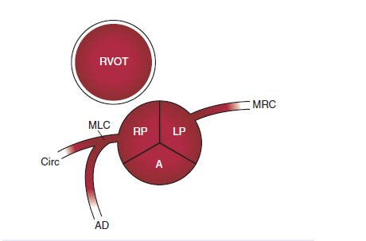
The coronary anatomy
in CCTGA.

Slide 30
Other Associated Anomalies
a supravalvar leftatrial ring, which may be a cause of left-sided (tricuspid) valve stenosis.
coarctation of the aorta in association with a VSD.Coarctation may be particularly common when severe forms of Ebstein anomaly are present.
A patent ductus arteriosus is sometimes present.
atrial septal defect in about 20% of cases.
Overriding or straddling of AV valves is more common when there are positional anomalies, as is hypoplasia of one or other ventricle.
The left-sided tricuspid valve straddles the posterior part of the ventricular septum, The mitral valve straddles the anterior part of the septum.

Slide 31
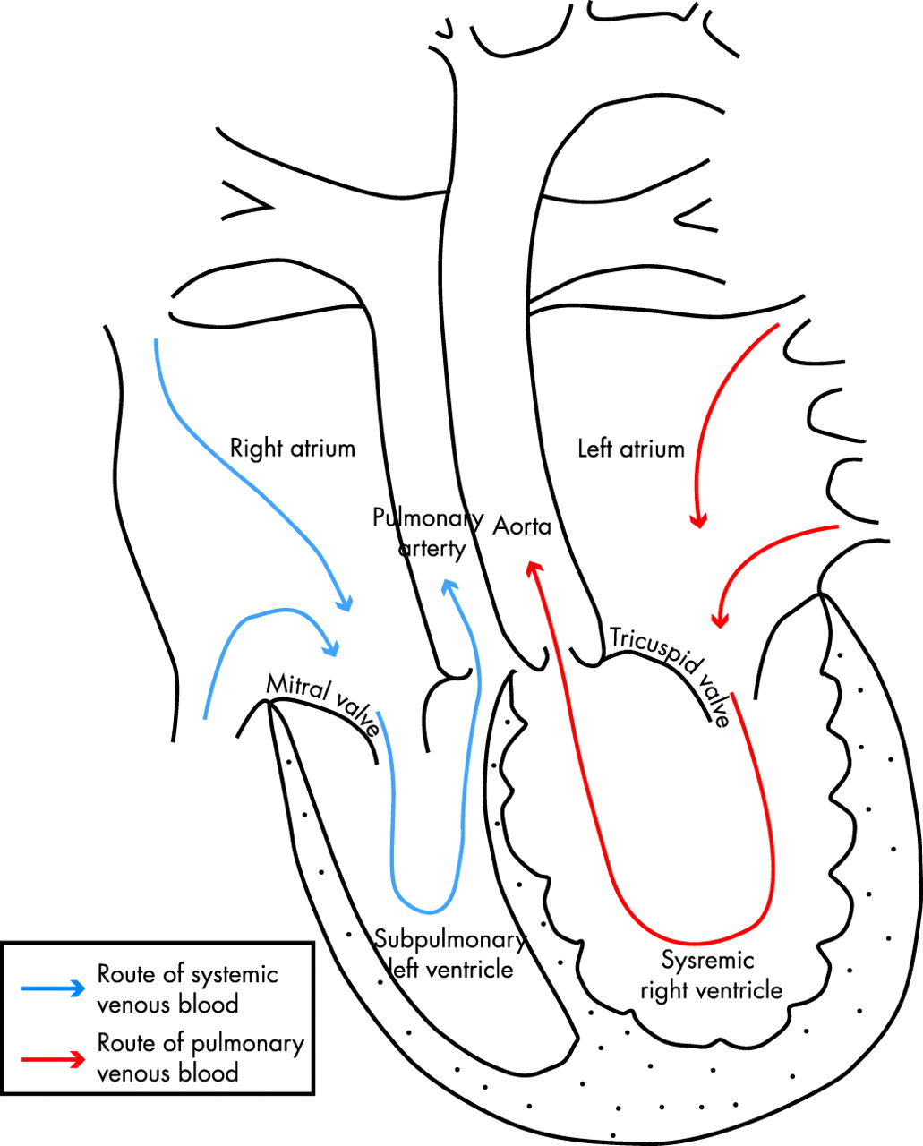
physiology

Slide 32
CLINICAL FEATURES
Presentation depends on pulmonary blood flow , pulmonary outflow tract obstruction and associated anomelies.
1. CCTGA WITH NO ASSOCIATED ANOMELY: the two circulations are in series , patients remain asymptomatic for years and then presents with features of RV failure or angina on exertion.
2. CCTGA WITH LARGE VSD: these patients presents with features of CHF in childhood and second decade and 30% of such patients present in 3-4 months due to CHF.
3. CCTGA WITH PULMONARY OUTFLOW TRACT OBSTRUCTION: most patients present with some cyanosis after early childhood and only 30% of these patients presents with cyanosis with in 1st year of life as pulmonary outflow tract is severely stenosed, they require shunt.

Slide 33
4. CCTGA WITH SEVERE TR: these patients presents with signs and symptoms of CHF in 3rd and 4th decade of life.
5. CCTGA WITH CHB: Patients presents soon after birth with bradycardia and 1st and 2nd degree heart blocks.
6. CCTGA WITH VSD AND PULM. OUTFLOW TRACT OBSTRUCTION: this is the most common presentation . Patients presents with growth failure and effort intolerance due to large left to right shunt. If associated with severe pulmonary outflow tract obstruction cyanosis is also present.

Slide 34
Dignostic modalities
Physical examination: non specific
a loud second heart sound at the second left intercostal space. Due to closure of the leftward and anterior aortic valve.
2. chest radiography: this is not diagnostic
an ascending aortic shadow appearing along the left uppercardiac silhouette.
3. ECG: may suggest a correct diagnosis

Slide 35
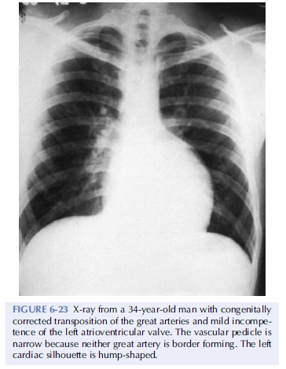
Chest XRAY
Narrow vascular pedicle
‘HUMP SHAPED’ appearance of left cardiac silhouette of right ventricle due to inverted infundibulum.
‘Septal notch’ – which is subtle indentation just above the diaphragm corresponding to inter-ventricular groove

Slide 36
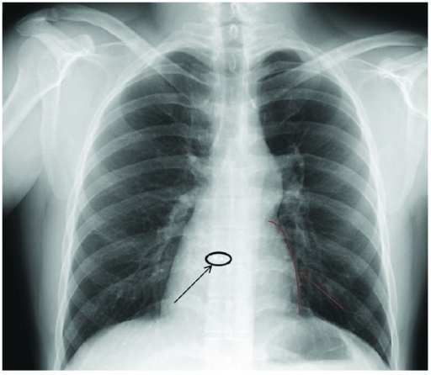

Slide 37
ELECTROCARDIOGRAM
The P wave
  Is normal in direction and configuration but broad notched P waves may be seen when left AV valve is regurgitant or large VSD with L → R SHUNT.
AV BLOCK-
  More than 75% pts exhibits varying degree of heart blocks from PR prolongation to CHB, even in same pt block varies from time to time
  CHB associated with narrow QRS complex duration.

Slide 38
ELECTROCARDIOGRAM
QRS complex
  Activation of septum is in reverse direction as that of normal heart so Q wave will appear in right Precordial leads and will be absent in left Precordial leads even in presence of volume overload of systemic ventricle.
  Left axis deviation is diagnostically important ; cause of this is abnormal location of AV NODE and its connection with ventricular conduction system .
T wave
  In more than 80% of cases T waves are positive in all six Precordial leads a distinctive feature attributed to the side by side relation ship of the inverted ventricle

Slide 39
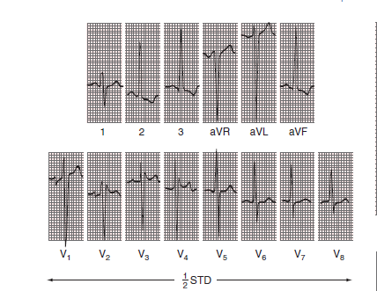
ELECTROCARDIOGRAM
Upright T waves
Broad notched P waves
8 yr old boy with CCTGA large non restrictive VSD with left to right shunt
Absence of Q waves

Slide 40
ECHO CARDIOGRAPHY
Echo examination of pt with complex AV AND VA connection should begin with defining situs in abdomen .
Sub costal views are important in identification of a case of CC TGA.
First clue for presence of AV Discordance is Significant malalignment between the atrial and ventricular septum.
Look for features of right and left morphologic ventricles
Short axis view at the level of aortic and pulmonary valves is very useful in defining the anatomical position of aorta and pulmonary artery.

Slide 41
ECHOCARDIOGRAPHY
LEFT VENTRICLE
  Ovoid or ellipsoid shaped
  Fine Trabeculations
  AV valve that inserts into the ventricular septum proximally than contra lateral valve
  Bicommisural valve with fish mouth appearance
  paired papillary muscle and chordae tendineae that inserts into free wall of LV
  Continuity between AV valve and great artery
RIGHT VENTRICLE
  Crescent shaped
  Coarse Trabeculations
  Distal insertion of AV valve into the septum
  Tricommissural valve
  Multiple irregular papillary muscle with chordal attachment to ventricular septum
  Discontinuity between AV valve and great artery

Slide 42
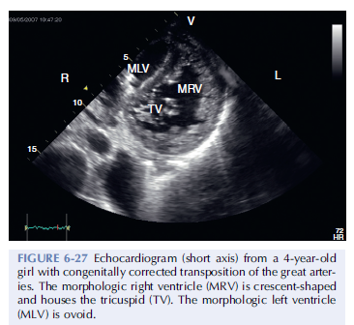
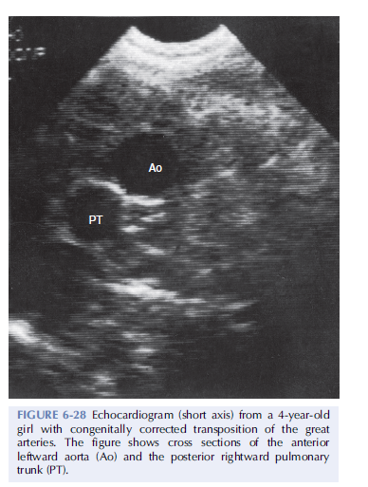

Slide 43
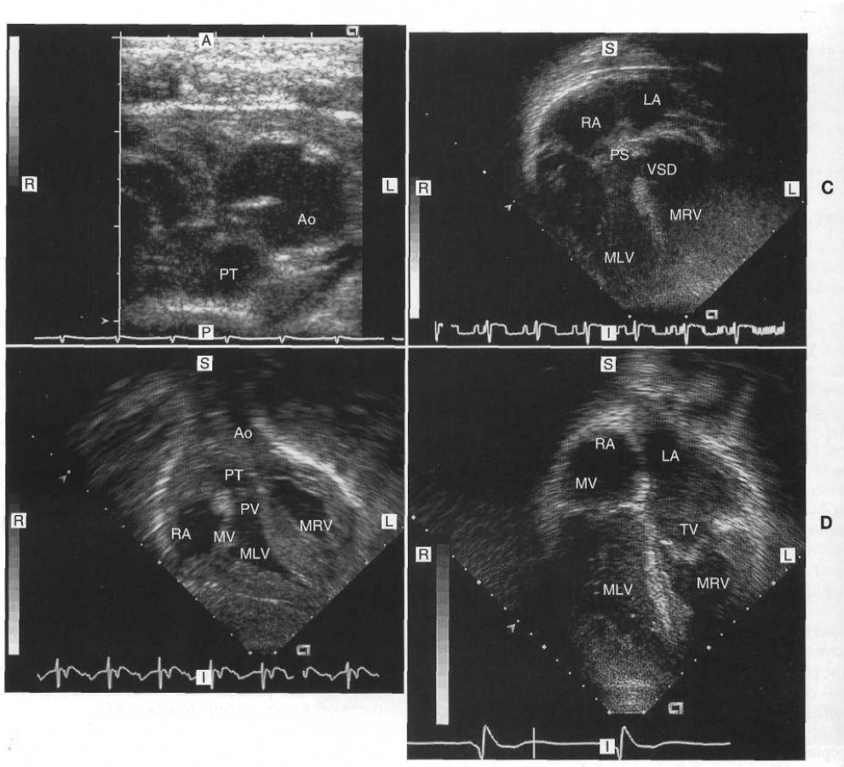

Slide 44
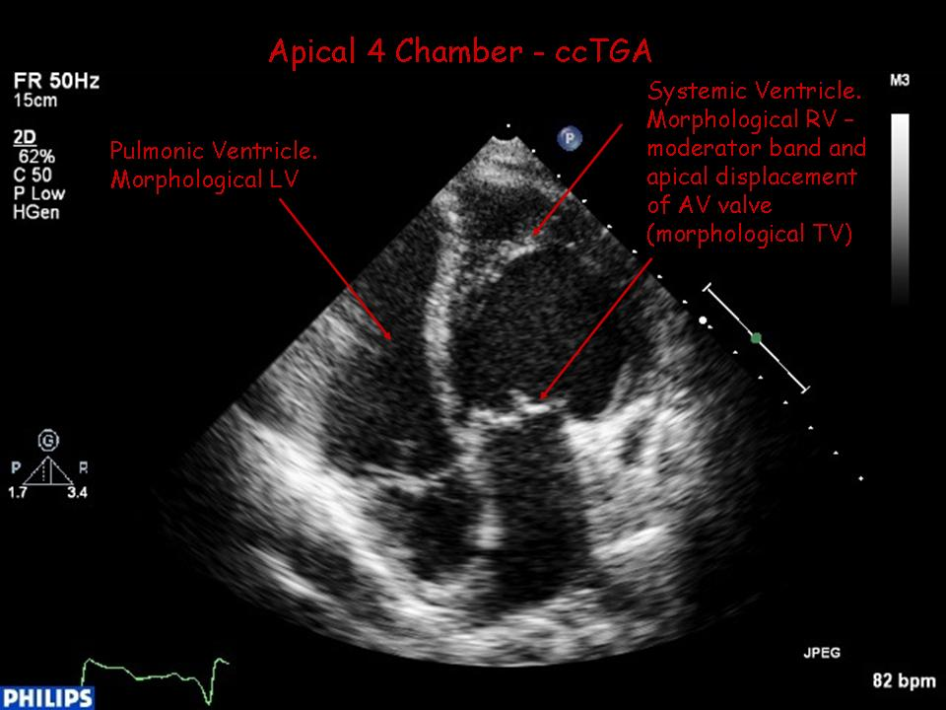

Slide 45
DIAGNOSTIC MODALITIES
4. Echocardiography : provides accurate diagnosis of CCTGA
spatial orientation of the ventricular septum is abnormal.
the left-sided AV valve inserts more toward the apex than the right-sided one.
There is also continuity between the right-sided AV valve and the posterior (pulmonary) semilunar valve.
aorta anterior and to the left.
left-sided ventricle containing a coarsely trabeculated endocardial surface and moderator band.
Presence of VSDs, valve function and venous connections can all be defined.

Slide 46
5. Cardiac catheterization and cineangiography : provide confirmatory diagnostic data.
Pressure and flows are measured to quantify severity of pulmonary stenosis and any intracardiac shunt.
Angiographic views profile the ventricular septum and establish morphology of various chambers and sites of systemic and pulmonary venous connection.
location and number of VSDs,
nature of the pulmonary stenosis
tricuspid valve function
associated anomalies

Slide 47
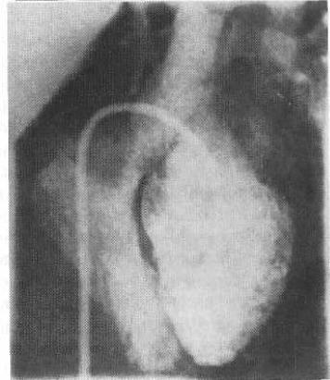
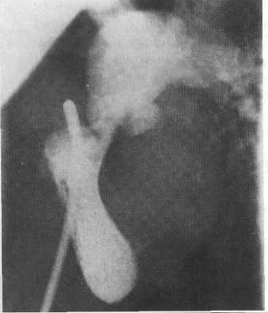
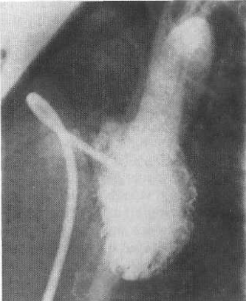
Cath study

Slide 48
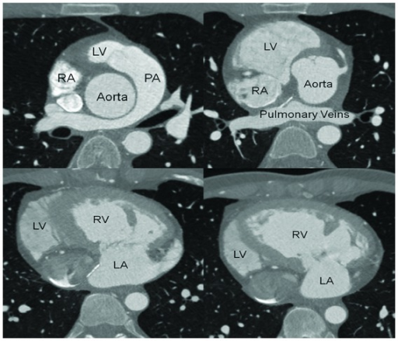

Slide 49
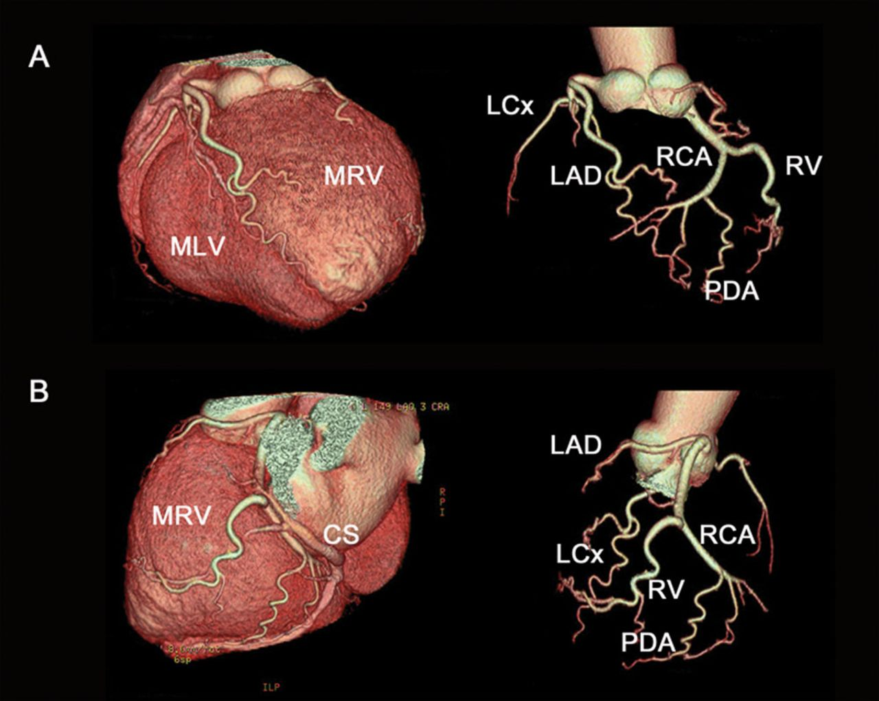

Slide 50
NATURAL HISTORY
Heart Block:
About 5% to 10% of infants with CCTGA have complete heart block at birth.
This proportion slowly increases at about 2% a year to reach a prevalence of about 10% to 15% by adolescence and 30% by adulthood.

Slide 51
2. Ventricular Function:
Ventricular function is not normal but is sufficiently good that a large proportion of patients maintain essentially normal functional status well into adult life.
systemic ventricular function (function of the RV) tends gradually to deteriorate during and after the second decade of life.
In CCTGA without other cardiac anomalies, an adequate cardiac index is usually sustained during exercise. increase in heart rate accounts for this.
Systemic (right) ventricular end-systolic and end-diastolic volumes also behave variably during exercise, but on the average do not change, whereas in normal individuals, systemic (left) ventricular end-systolic volume decreases with exercise.

Slide 52
3. Effect of Coexisting Cardiac Anomalies:
The natural history of patients with coexisting large VSD tends to be slightly better than that of patients with isolated large VSDs ; this may be because their VSDs are smaller than in patients presenting with isolated VSDs.
Chronic symptoms of effort intolerance and growth failure are common in first two decades of life but death infrequent. presumably death from chronic heart failure occurs with increasing frequency during the third, fourth, and fifth decades of life.
When important pulmonary stenosis coexists with VSD, cyanosis appears in early life and the natural history may be similar to that of tetralogy of Fallot.

Slide 53
The natural history of the left AV valve in patients with CCTGA is unclear. Presumably, it functions well in the first few years of life, but then prevalence and magnitude of regurgitation increases progressively during the second through fifth decades.
In atrial situs inversus, VSD and pulmonary stenosis are more likely to be present than in atrial situs solitus.
There is less likelihood of developing spontaneous complete heart block, because of the considerably higher prevalence of a normally positioned AV node.

Slide 54
TECHNIQUE OF OPERATION
Repair of Coexisting Ventricular Septal Defect.
2. Repair of Coexisting Ventricular Septal Defect and Pulmonary Stenosis.
3. Correction for Regurgitant Left-Sided Tricuspid Valve.
Double Switch" Procedures.
5. Double Switch" Procedures Combined with Bidirectional Superior Cavopulmonary Anastomosis

Slide 55
INDICATIONS FOR OPERATION
CCTGA per se is not a definitive indication for a reparative operation.
When VSD coexists.
When VSD and important pulmonary stenosis coexist
When important left-sided tricuspid regurgitation coexists
When complete heart block develops
(1) presence of straddling tricuspid chordae (increasing risk of postoperative complete heart block), (2) AV septal defect, and (3) presence of left-sided tricuspid regurgitation may be considered by some to be indications for a Fontan, rather than biventricular repair.

Slide 56
Repair of Coexisting Ventricular Septal Defect
Preparations for operation, median sternotomy, and placing pericardial stay sutures are as usual.
It is done where the large VSD is only associated anomaly and it keeps RV as systemic ventricle and has disadvantage of increased incidences of late RV failure.
Different approaches to repair the VSD includes:
Through Right-Sided Mitral Valve
Through Aorta
Through Left-Sided Tricuspid Valve

Slide 57
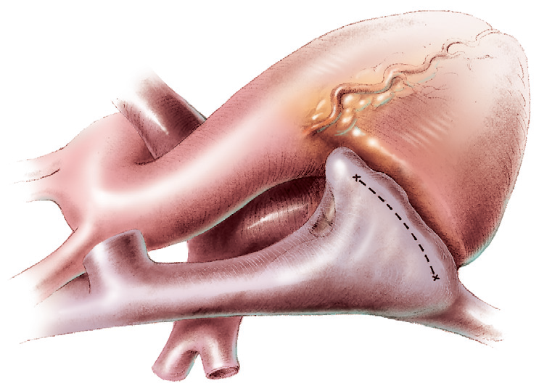

Slide 58
Through Right-Sided Mitral Valve
Cardiopulmonary bypass (CPB) is established in the usual manner.
The right atrium is opened through an oblique incision.
The VSD is examined through the right-sided mitral valve.
When exposure is suboptimal, an incision is made in the base of the mitral valve septal leaflet near the superior commissure and through the base of the commissural tissue into the mural leaflet.
Location of anterior AV node and bundle of His arching over the subpulmonary outflow tract and passing anterior to the VSD are conceptualized.
VSD repair is made by sewing into place a properly sized patch of either glutaraldehyde-treated autologous pericardium or double-velour-knitted polyester, keeping sutures on left (RV) side of defect anterosuperiorly, anteriorly, and as much as possible inferiorly.

Slide 59
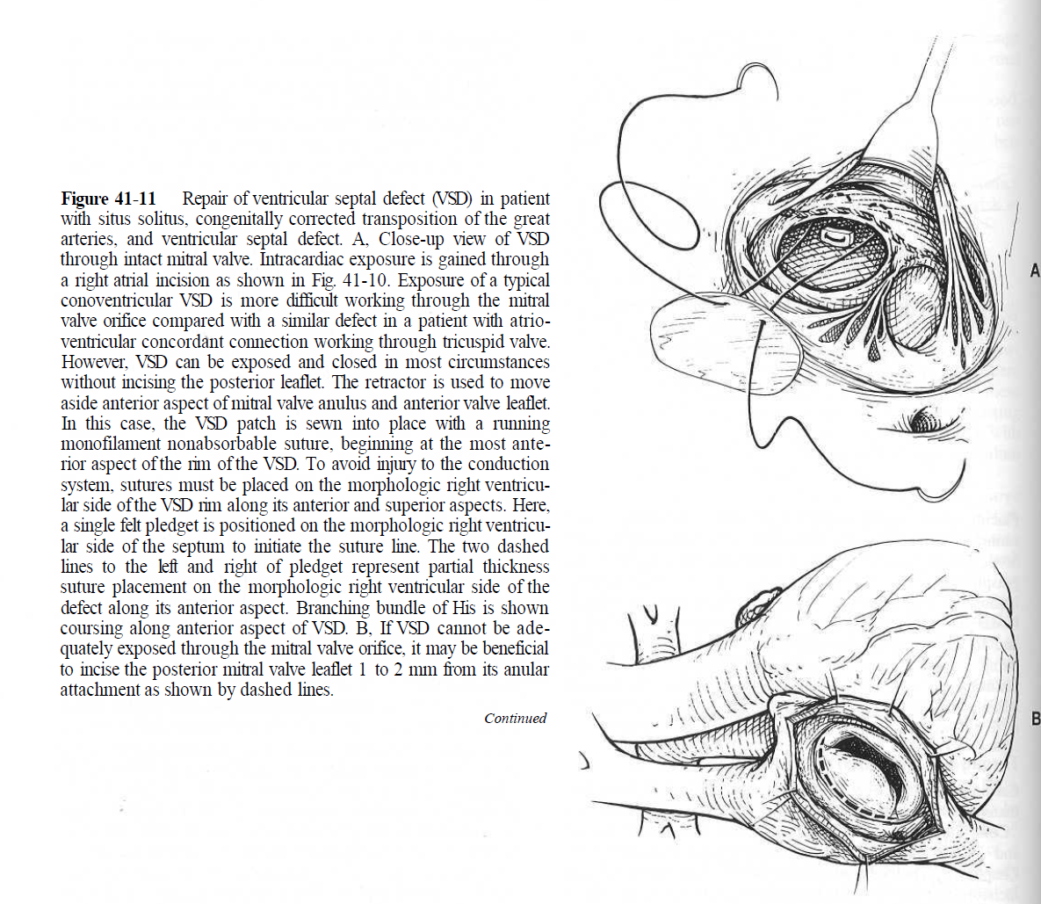

Slide 60
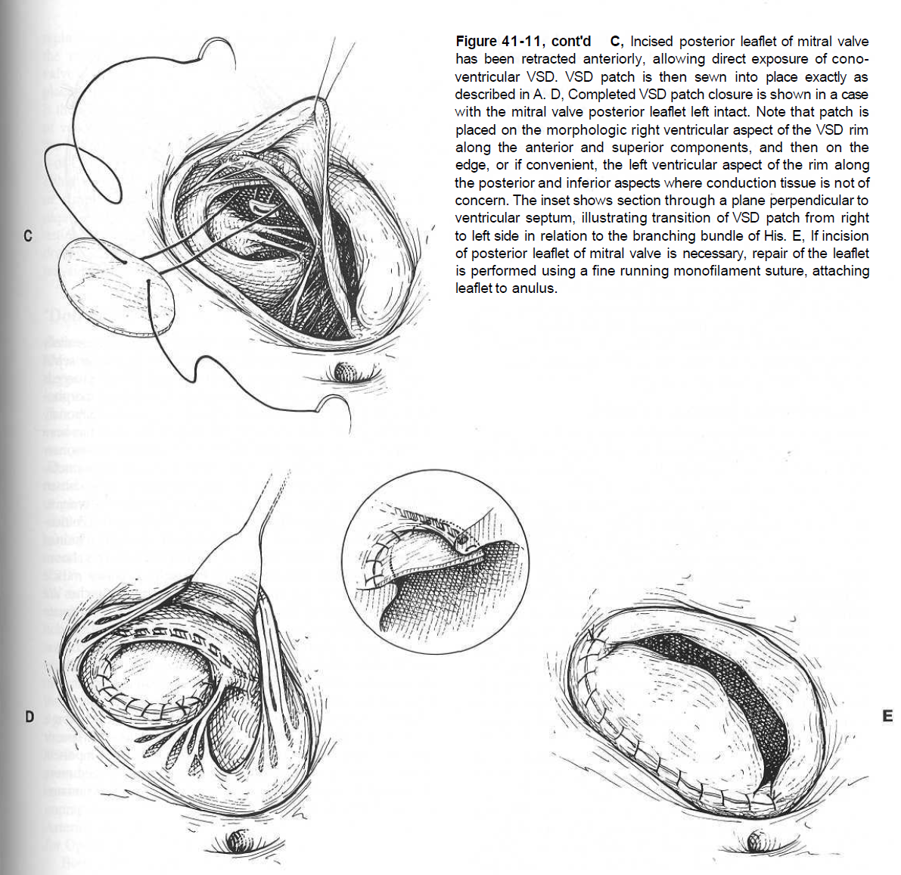

Slide 61
Through Aorta
An attractive alternative approach is closing the VSD through the aorta, which allows the patch to be sutured into place from the RV (left-sided) aspect of the septum.
this may reduce prevalence of perioperative complete heart block.

Slide 62
Through Left-Sided Tricuspid Valve
When isolated dextrocardia complicates CCTGA and VSD, the VSD can be repaired through a left-sided incision in the usually large left-sided left atrium.
Exposure through the left-sided tricuspid valve usually allows good exposure, and surgically induced heart block should be avoidable because suturing is all on the RV (left) side of the septum.

Slide 63
Repair of Coexisting Ventricular Septal Defect and Pulmonary Stenosis
valvotomy is performed as for isolated pulmonary valve stenosis .
Obstructing fibrous subvalvar tags are excised.
A subvalvar fibrous membrane can be excised, except at the anteroinferior angle.
Aneurysm of the membranous ventricular septum is excised and the deficiency closed as part of VSD repair.
Muscle must never be removed from the rightward (medial) aspect of the right-sided LV outflow tract or from the anterior part adjacent to the pulmonary "anulus," because the His bundle lies there.

Slide 64
it has seemed reasonable not to revert to CPB and place a valved extracardiac conduit if the PLV/RV in operating room is less than about 0.85, considering that the right-sided ventricle and valve are a morphologic LV and mitral valve.

Slide 65
Placing Valved Extracardiac Conduit
When pulmonary stenosis is so severe that the patient is cyanotic
if simple procedures are unsatisfactory or postrepair PLV/RV is too high, a valved extracardiac conduit is used.

Slide 66
a site is chosen for attaching the conduit to the right-sided LV by examining the LV interior through the mitral valve. A site is chosen on the anterior wall, but rather inferior and away from any papillary muscles. Left ventriculotomy is then made.
There is reasonable flow across the native LV-pulmonary trunk outflow tract, it can be left intact, creating an end-to side anastomosis of conduit to pulmonary trunk. This results in LV ejection via two routes: native tract and conduit.
More commonly, when a conduit is required, obstruction is severe; therefore the pulmonary trunk is transected at the valve level, proximal stump oversewn, and conduit connected end to end to distal pulmonary trunk.

Slide 67
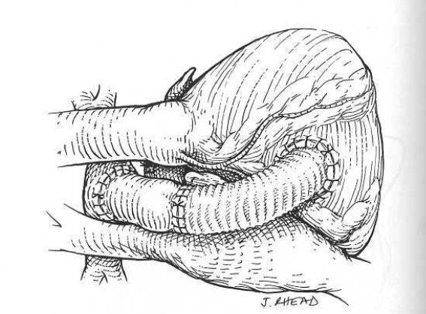

Slide 68
Estimating length and lie of the conduit is important to avoid its compression by the sternum.
the conduit must be of sufficient length to prevent kinking, and the valve must lie away from the LV so it is not distorted.
The conduit curves to the right around the right atrium and atrial appendage.
Typically conduit is positioned to right side of the midline and ascending aorta.
A composite conduit is usually constructed using a distal valved allograft and a proximal polytetrafluoroethylene or polyester tube.
Distal position of valved conduit component within the composite allows the valve to be positioned more posteriorly in mediastinum, thereby avoiding compression and distortion of valve with sternal closure.

Slide 69
Transanular Patch
Doty and colleagues have proposed using a posteriorly placed transanular patch across the pulmonary valve "anulus“ in this situation.
average gradient across the repair was 40 mmHg.

Slide 70
Correction for Regurgitant Left-Sided
Tricuspid Valve
When important left-sided tricuspid valve regurgitation coexists, repair and anuloplasty are only occasionally successful, but should be attempted if it seems feasible.
Valve replacement is the same as for a left-sided mitral valve.
The replacement device is either sewn in with interrupted pledgeted mattress sutures or simple interrupted sutures. A continuous suture technique is not desirable when there is absence of a welldefined anulus.

Slide 71
Double Switch Procedures
The "double switch" concept was originally suggested by Ilbawi and colleagues for patients with CCTGA, VSD, and pulmonary stenosis.
the morphologic LV is connected to the aorta by creating an intraventricular baffle (which also closes the VSD); an extracardiac conduit is placed from morphologic RV to pulmonary trunk, and a Mustard or Senning intraatrial transposition of venous return is performed.
individual components of "double switch" procedures:
1. The atrial component for both procedures is performed exactly as for simple TGA.
2. For patients with VSD and pulmonary stenosis, the morphologic LV-to-aortic intracardiac baffle component is accomplished through a subaortic incision in the infundibulum of the morphologic RV.
3. For patients without pulmonary stenosis, the arterial switch component is performed.

Slide 72
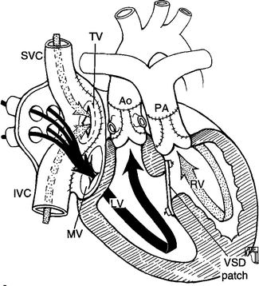

Slide 73
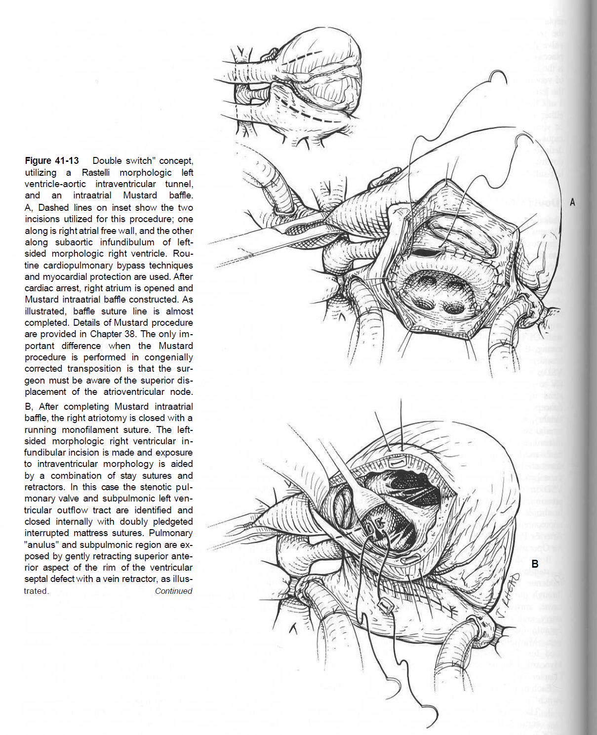

Slide 74
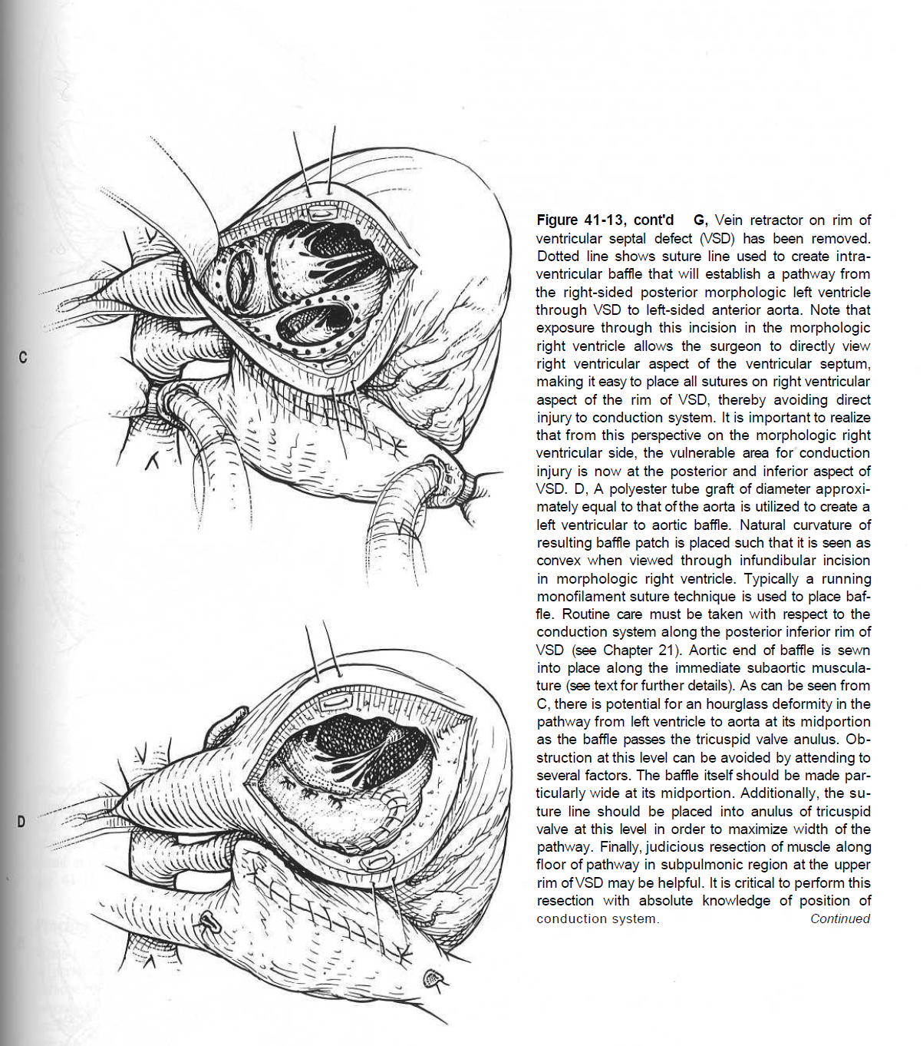

Slide 75
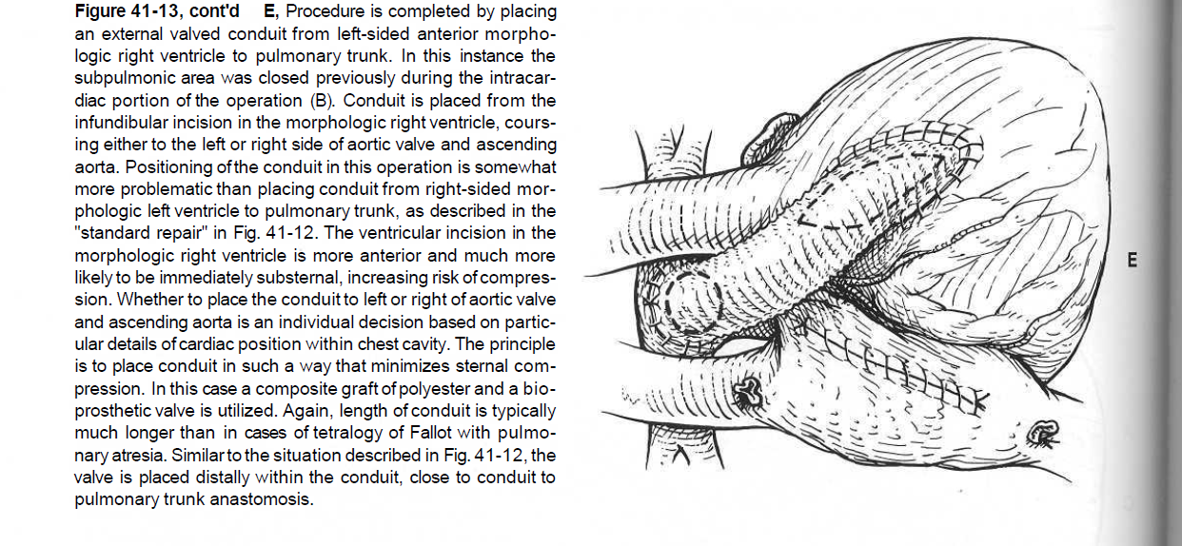

Slide 76
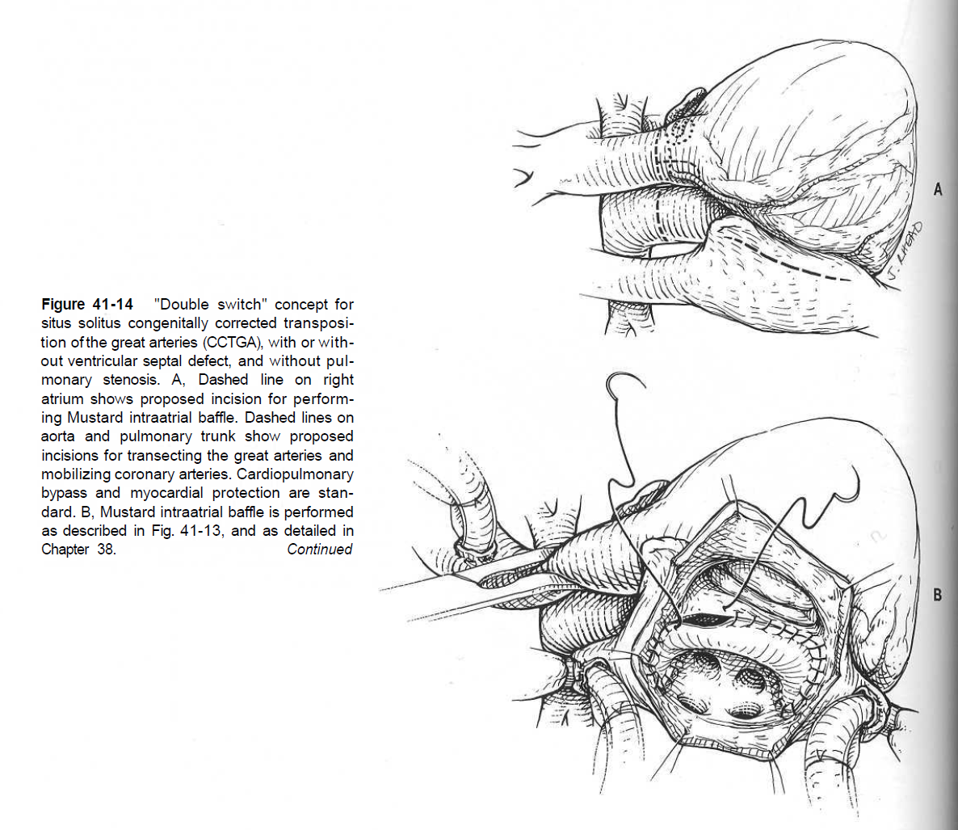

Slide 77
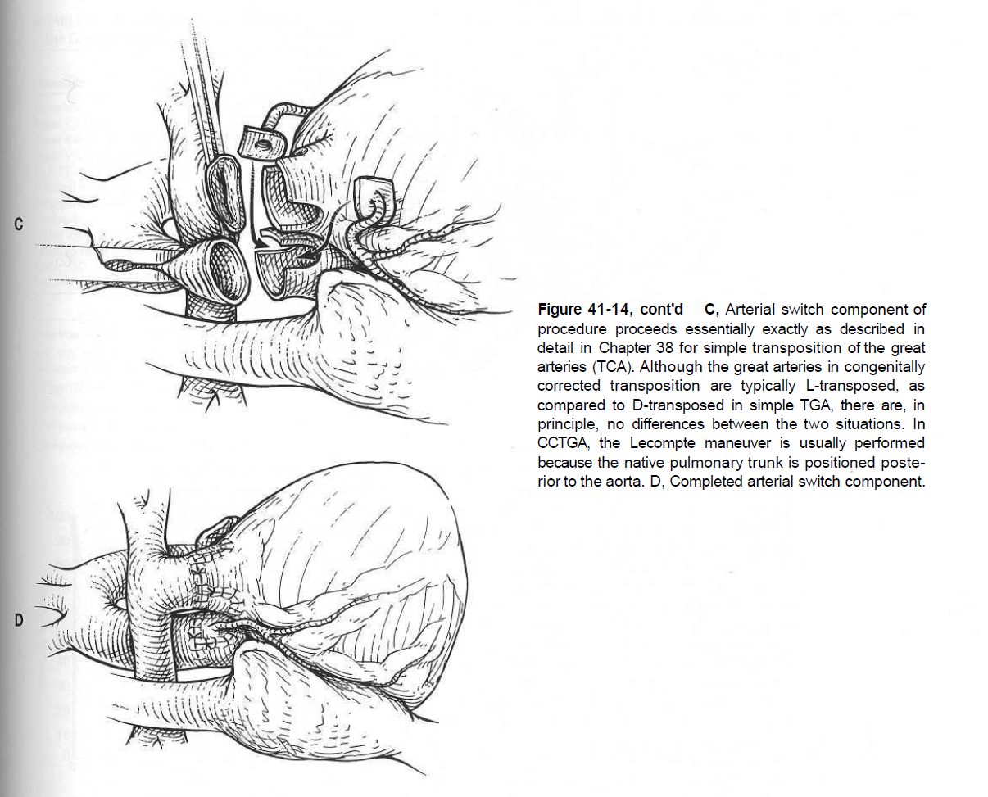

Slide 78
"Double Switch" Procedures
Combined with Bidirectional Superior
Cavopulmonary Anastomosis
Use of the bidirectional superior cavopulmonary anastomosis, as part of operations for CCTGA when the morphologic LV is placed in the systemic circulation has a number of specific advantages:
• It may benefit the small or poorly functioning RV
• It importantly reduces complexity of the atrial baffle procedure
• It eliminates complications related to the superior limb of the atrial baffle
• It reduces flow across an RV-pulmonary trunk conduit
• It likely increases conduit longevity
This reduces myocardial ischemia time because the cavopulmonary anastomosis can be performed during rewarming after aortic clamp removal and myocardial reperfusion is established.

Slide 79
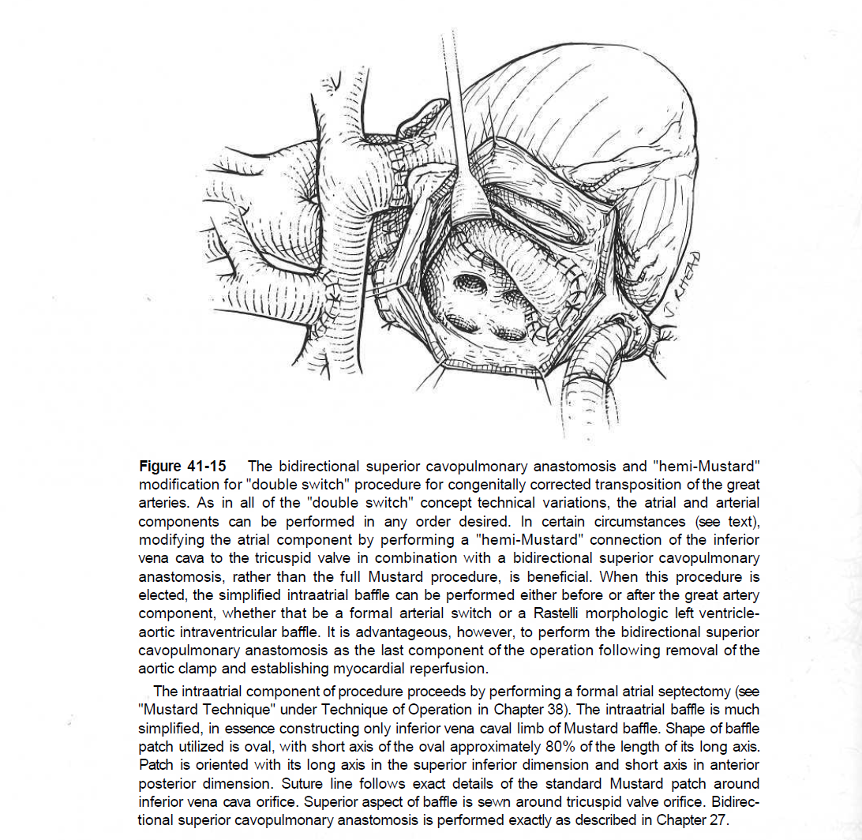

Slide 80
RESULTS
1. Morphologic Right Ventricle Supporting Systemic Circulation.
2. Morphologic Left Ventricle Supporting Systemic Circulation

Slide 81
Morphologic Right Ventricle Supporting Systemic Circulation.
Early (hospital) death:
for CCTGA and VSD, hospital mortality has been 5% or less .
When performed for CCTGA with coexisting VSD and important pulmonary stenosis, it has been 10% to 20%.
When performed for coexisting left-sided tricuspid valvar regurgitation requiring valve replacement, it has been 15% to 25%.

Slide 82
Time-related survival:
1-, 5-, 10-and 20-year survivals after of patients with CCTGA repaired over the past 35 years have been about 88%, 80%, 76%, and 46%, respectively.
In patients without heart block, survival has been much higher, with 10- and 15-year survivals, including hospital mortality, of about 90%.

Slide 83
Morphologic Left Ventricle Supporting
Systemic Circulation
Early (hospital) death:
several studies suggest that early outcomes are as good or better with more complicated "double switch" procedures that assign the morphologic LV to the systemic circulation.
patients with structurally abnormal tricuspid valves, mortality was 11% following "anatomic repair," and 33% following "physiologic repair“.
Early mortality ranged from 0% to 14%.

Slide 84
Time-related survival:
Limited late follow-up is available in this patient group

Slide 85
Modes of Death
A few patients die suddenly. this is due to sudden appearance of complete heart block with ventricular asystole or fibrillation.
RV dysfunction.

Slide 86
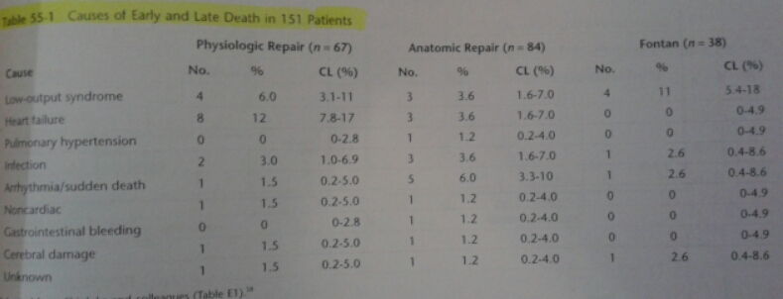

Slide 87
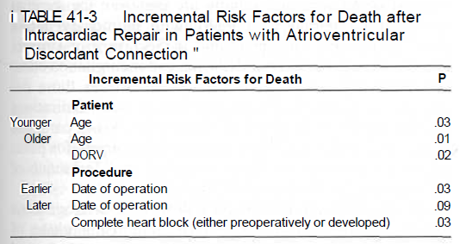
Incremental risk factors for CCTGA

Slide 88
Postrepair Complete Heart Block
In all reported series, prevalence has been 15% to 30%.
chordal straddling or insertion on the septal crest (usually from the left-sided tricuspid valve) increases the probability of producing complete heart block at the time of VSD repair.

Slide 89
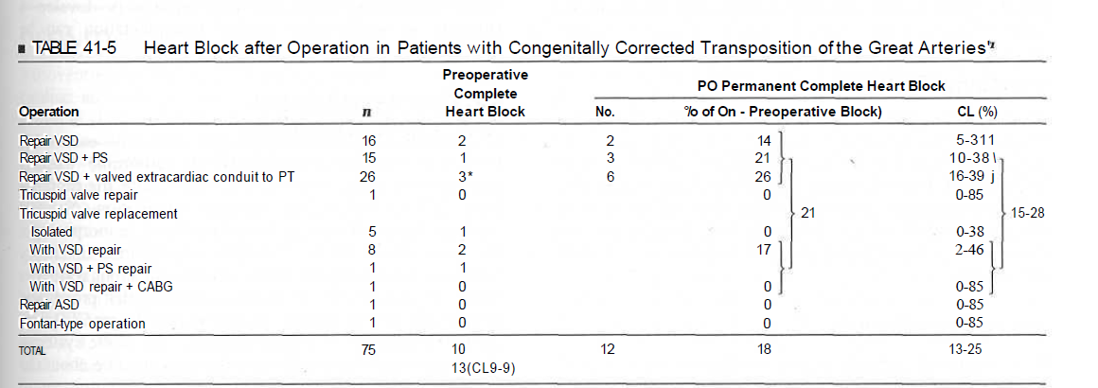

Slide 90
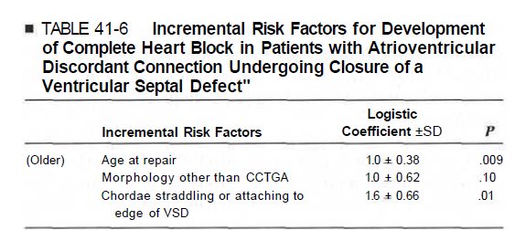

Slide 91
Development of Tricuspid Valve Regurgitation
Immediately after simple, classic repair of CCTGA with VSD, left-sided tricuspid valve regurgitation sometimes appears.
Operations assigning the morphologic LV to the systemic circulation result in improved tricuspid valve function.
Tricuspid valve regurgitation also may be associated with development of complete heart block.
When the RV is placed in the pulmonary circulation, tricuspid valve function typically improves, often without specifically surgically addressing the valve.

Slide 92
Functional Status
Most surviving patients with CCTGA consider themselves to have normal functional capacity.
78% to 83% were in New York Heart Association (NYHA) functional class I, and the remainder in class II.

Slide 93
Ventricular Function
When surgery involves placing the morphologic LV in the systemic circulation, early follow-up and midterm follow-up studies demonstrate both well-maintained LV and RV function but converse is not true.

Slide 94


