Slide 1
MINERALS-1
DR. MIHIR MEHTA

Slide 2
Minerals
Minerals are inorganic compounds that are required for the body as one of the nutrients

Slide 3
Minerals
Macrominerals
Required in excess of 100mg/day
Ca⁺⁺, P, S, Mg, Cl, Na, K.
Microminerals
Required in amounts less than 100mg/day
Fe, Cu, Zn, Mo, I, Fl, Cr, CO, Mn

Slide 4
Iron
Sources
RDA
Metabolism
Functions
Disorders

Slide 5
Iron - sources
Green leafy vegetables
Liver and meat
Jaggery
Pulses
Cereals
Egg

Slide 6
Iron - RDA
Adult
10-20 mg/day
Pregnancy
40mg/day

Slide 7
Iron - metabolism
Absorption
Transport
Storage
Excretion

Slide 8
Iron - absorption
Site
Small intestine
Forms
Efficiency
About 10% of total food iron is absorbed
Heme
Non-haem

Slide 9
Factors affecting iron absorption
Factors increasing iron absorption
Ferrous form
Ascorbic acid
Factors decreasing iron absorption
Phytates and phosphate
Antacid, achlorhydria
Cysteine
HCl
Gastrointestinal diseases

Slide 10
Mechanism of iron absorption

Slide 11
Lumen
Mucosal cell
Blood
Ferroreductase
Ferric Iron
Fe⁺⁺⁺
Ferritin
Fe⁺⁺
Fe⁺⁺
Ceruloplasmin
Vit C
Ferric reductase
Apoferritin
Fe⁺⁺⁺
Ferrous Iron
Fe⁺⁺
Fe⁺⁺
Fe⁺⁺⁺
Ferroxidase
Apotransferrin
Transferrin
Fe⁺⁺⁺
Heme iron
Heme iron

Slide 12
Regulation of Iron absorption
Mucosal block theory

Slide 13
Storage of iron
Storage Site
Liver
Intestine
Storage Form
Ferritin
Hemosiderin
Spleen
Bone marrow

Slide 14
Excretion of iron
Normal excretion
Very little
About 1mg/day
Stool
0.7mg/day
Physiological loss
Menstruation
20-30mg/cycle
Delivery
750mg

Slide 15
Functions of iron
Iron is a component of several functionally important compounds
Heme compounds
Non-haem compounds

Slide 16
Functions of iron
Haem compounds
Haemoglobin
Myoglobin
Non-haem compounds
Succinate dehydrogenase
Xanthine oxidase
Cytochrome
Catalase
Iron sulfur proteins

Slide 17
Disorders of iron metabolism
Iron deficiency
Iron excess

Slide 18
Iron deficiency anemia
Causes
Features
Lab findings
Treatment

Slide 19
Iron deficiency - Causes
Decreased intake of iron
Malnutrition
Decreased absorption of iron
Achlorhydria and chronic diarrhea
Increased loss of Iron
Bleeding, hookworm infestation
Increased iron requirement
Pregnancy, infancy

Slide 20
Iron deficiency – features
Pallor
Fatigue
Dyspnea
Dizziness
Palpitation
Angular stomatitis
Pica

Slide 21
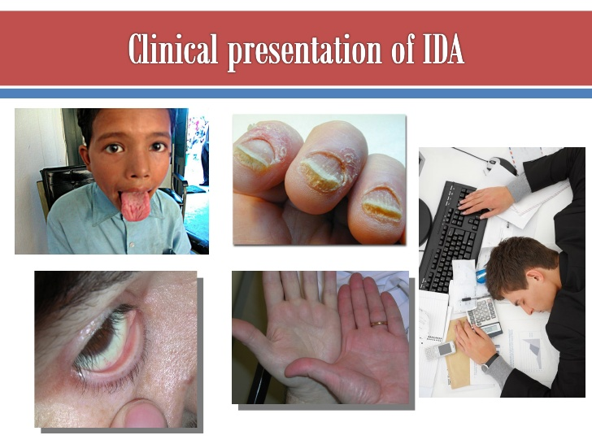

Slide 22
Iron deficiency – lab findings
Hematological findings
Decreased hemoglobin
Microcytic hypochromic anemia
Biochemical findings
Decreased serum iron
Increased serum total iron binding capacity
Decreased plasma ferritin

Slide 23
Iron deficiency – treatment
Treatment of underlying causes
Treating
Hookworm
Controlling bleeding
Administration of iron preparations
Orally
I.V

Slide 24
Iron overload
Haemosiderosis
Increase in iron stores as haemosiderin
Without associated with tissue injury
Haemochromatosis
Excessive deposition of iron in the tissue
Associated with tissue injury

Slide 25
Author/year | Study design | Level | Results | Outcome
Peña-Rosas JP¹, De-Regil LM, Dowswell T, Viteri FE. Cochrane Database Syst Rev. 2012 Dec 12;12:CD004736. doi: 10.1002/14651858.CD004736.pub4. | RCT | L-II | We included 60 trials. Forty-three trials, contributed data and compared the effects of daily oral supplements containing iron versus no iron or placebo. Overall, women taking iron supplements were less likely to have low birth weight newborns compared with controls and mean birth weight was 30.81 g greater for those infants whose mothers received iron during pregnancy. Preventive iron supplementation reduced the risk of maternal anaemia at term by 70% and iron deficiency at term by 57% . Although the difference between groups did not reach statistical significance, women who received iron supplements were more likely than controls to report side effects particularly at doses 60 mg of elemental iron or higher. Women receiving iron were on average more likely to have higher haemoglobin (Hb) concentrations at term and in the postpartum period, but were at increased risk of Hb concentrations greater than 130g/L during pregnancy and at term. Twenty-three studies were conducted in countries that in 2011 had some malaria risk in parts of the country. In some of these countries malaria is present only in certain areas or up to a particular altitude. Only two of these reported malaria outcomes. There is no evidence that iron supplementation increases placental malaria. For some outcomes heterogeneity was higher than 50%. | Prenatal supplementation with daily iron are effective to reduce the risk of low birthweight, and to prevent maternal anaemia and iron deficiency in pregnancy. Associated maternal side effects and particularly high Hb concentrations during pregnancy at currently used doses suggest the need to update recommendations on doses and regimens for routine iron supplementation.

Slide 26
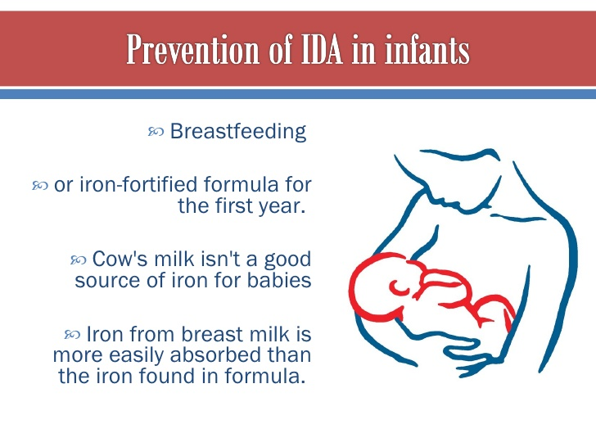

Slide 27

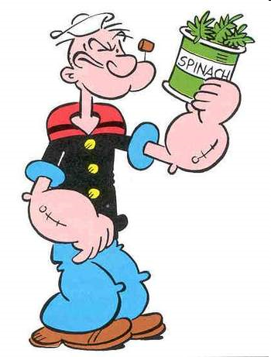
Iron obtained from animal products is much more easily absorbed by the body than iron from plant sources,

Slide 28


