Slide 1
CANDIDA AURIS – AN EMERGING FUNGAL INFECTION

Slide 2
Introduction
Mycology (from the Greek mykos, meaning fungus) is the branch of microbiology that deals with the study of fungi (yeasts and moulds).
Medically important fungi are classified based on their morphology as yeasts, yeast-like fungi, moulds (filamentous fungi) and thermally dimorphic fungi.
While from the standpoint of disease-causing potential in humans, fungi are regarded as primary pathogens and opportunist pathogens

Slide 3
Candida is a Yeast-like Unicellular fungi
Reproduce by budding and by fission
Macroscopic appearance-pasty colonies (resembling bacterial colonies) in culture
Microscopic appearance-spherical or oval forms in tissues and in culture; filamentous structures Pseudohyphae may be seen

Slide 4
The genus Candida encompasses >150 species, only a few of which cause disease in humans.
With rare exceptions (although the exceptions are increasing in number), the human pathogens are C. albicans, C. guilliermondii, C. krusei, C. parapsilosis, C. tropicalis, C. kefyr, C. lusitaniae, C. dubliniensis, C. glabrata, and C. auris.
Ubiquitous in nature, they inhabit the gastrointestinal tract (including the mouth and oropharynx), the female genital tract, and the skin.

Slide 5
The advent of Candida species as common human pathogens dates to the introduction of modern therapeutic approaches that suppress normal host-defense mechanisms.
Of these relatively recent advances, the most important is the use of antibacterial agents that alter the normal human microbiota and allow nonbacterial species to become more prevalent in the commensal flora.
With the introduction of antifungal agents, the causes of Candida infections shifted from an almost complete dominance of C. albicans to the common involvement of C. glabrata and the other species listed above.

Slide 6
The non-albicans species now account for approximately half of all cases of candidemia and hematogenously disseminated candidiasis.
Hence, Recognition of this change is clinically important, since the various species differ in susceptibility to the newer antifungal agents.
Of great recent concern has been the global emergence of C. auris; certain strains of this organism are resistant to all classes of antifungal agents, and mortality rates from infection have been very high.

Slide 7
Candida Auris
1st case report, Japan 2009, EAC of a patient .
Same year in South Korea, isolated from 15 patients with otitis media .
1st candidaemia cases, Korea 2011.
Retrospective 1st isolate 1996, Korea , BSI in a child.
Majority of the South Korean isolates displayed elevated fluconazole MICs, which suggested that this new species is largely resistant to fluconazole.

Slide 8
India 2013 HVS.
Now been isolated on five continents.
This global emergence has been attributed to the near-simultaneous appearance of at least 4 geographically restricted clades, with clonal transmission identified both within and across health care facilities.
Can be challenging to identify in the clinical laboratory, and this species frequently exhibits multidrug resistance.

Slide 9
BSI is the most commonly observed invasive infection, with in-hospital mortality rates reported on the order of 30 to 60% .
Cases have mainly involved patients with underlying medical comorbidities and significant health care exposure, with infection typically occurring weeks after hospital admission.

Slide 10
In a recent report from India, the risk for the development of C. auris BSI compared to other Candida spp. was associated with : longer intensive care unit (ICU) stays, underlying respiratory illness, vascular surgery, prior antifungal drug exposure, and lower acute physiology and chronic health evaluation II (APACHE II) scores.
The majority of the C. auris isolates in this study were clonal and came from public hospitals in the northern portion of the country.

Slide 11
Epidemiology
Given the flurry of recent reports, a review of _15,000 Candida isolates deposited in the international SENTRY repository was conducted to look for previously misidentified strains.
Sentry began cataloguing Candida isolates in 2004, yet only 4 previously misidentified C. auris cultures were found in the search, implying that this pathogen has recently emerged.

Slide 12
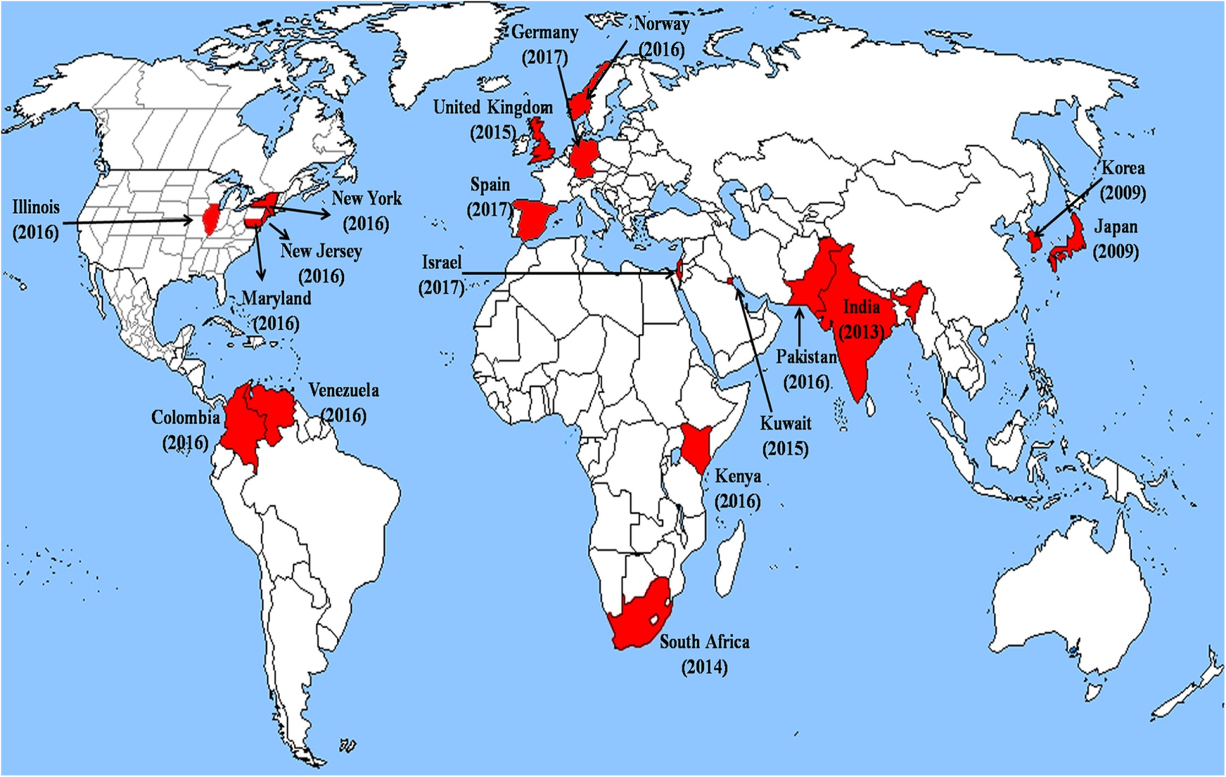

Slide 13
IDENTIFICATION – Diagnostic Challenge
The haploid genome of C. auris is approximately 12.5 Mb, with a guanine-cytosine content of nearly 45%.
Genome analysis suggests that there are between 6,500 and 8,500 protein-coding sequences, with a number of these genes coding for proteins characterized as virulence factors in other Candida species, such as biofilm formation.
In addition, multiple transporter genes and protein kinases, which may facilitate the acquisition of drug resistance, have been identified .

Slide 14
Genetic analyses have shown a striking divergence of C. auris from some Candida species, while it remains more closely related to C. lusitaniae and C. haemulonii (82%)
C. auris can often be misidentified in conventional diagnostic laboratories using biochemical typing.
More recently, the development of PCR assays specific for C. auris and for C. auris-related species using cultured colonies has shown promise for the rapid and accurate identification of C. auris, which could prove particularly useful in outbreak situations .
Confirmation of the sensitivity of these assays for the different clades of C. auris is warranted.

Slide 15
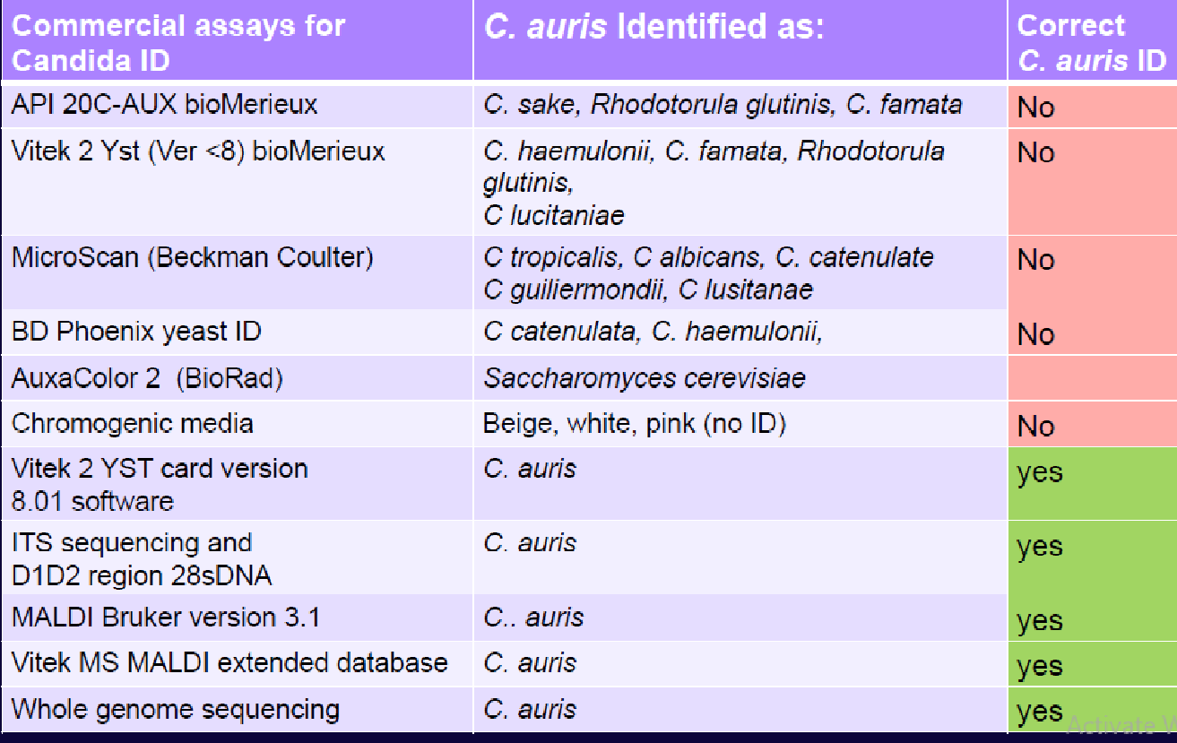

Slide 16
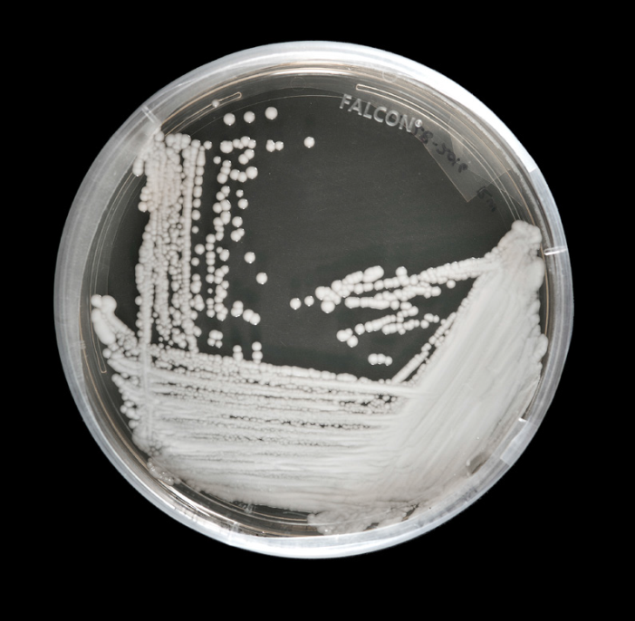
C. auris forms pink to beige colonies on chromogenic agar Candida medium and grows well at 42°C but with variable growth at higher temperatures and no growth in the presence of 0.01% cycloheximide.
It forms oval or elongated yeast cells, which can occur singly, in pairs, or in groups.
Importantly, no hyphal or pseudohyphal forms have been noted.

Slide 17
Colonization and Infection
In the absence of a unified case definition for C. auris infection, and variable screening practices for Candida species, colonization rates and the significance of colonization in terms of the development of invasive infection are difficult to characterize.
Colonization with C. auris has been detected at multiple body sites, including nares, groin, axilla, and rectum, and has been isolated for 3 months or more after initial detection in spite of negative screens and echinocandin treatment in the intervening period.
These uncertainties suggest the need for multiple screens with ongoing patient isolation after treatment and upon readmission to health care facilities.

Slide 18
Risk factors for colonization include contact with patients known to harbor C. auris or their environment. The contact time for the acquisition of C. auris from a colonized patient or environment is suggested to be as little as 4 h and invasive infections have been acquired within 48 h of admission to intensive care settings .
The use of empirical antifungal therapy would need to be considered if a patient colonized with C. auris subsequently deteriorates.
As might be expected, the majority of patients with invasive C. auris infections have received broad-spectrum antimicrobial agents and, in some cases, antifungal agents prior to the development of invasive candidiasis .
An association with medical devices such as CVCs and urethral catheters has also been reported

Slide 19
Candida auris infection cases by disease type reported in the literature
Type of disease or location of isolation | No. of cases
Candidemia | 291
Central venous catheter tip | 2
CNS | 1
ENT | 21
Respiratory tract | 18
Urogenital system | 17
Abdominal | 13
Skin and soft tissue, including surgical wounds | 12
Bone | 2

Slide 20
RANGE OF CLINICAL MANIFESTATIONS
SITE | COUNTRY
Ear | Japan, Korea, USA, Pakistan
Blood stream | Korea, UK, India, Pakistan, Spain, Venezuela, South Africa etc
Pericardial fluid | India
Peritoneal fluid,bile | Colombia, USA, Pakistan
CSF, meningitis | UK, Columbia, Spain, Pakistan
Vascular line, pustule, surgical wound, jejunal biopsy | UK, India, USA, Pakistan
Urine | UK, India, Israel, USA, Columbia
HVS | India
Keratitis | Pakistan
Endocarditis | Spain
Joint/spinal disc space/osteomyelitis | Spain

Slide 21
At present, there are no antifungal clinical breakpoints reported for C. auris.
MICs obtained for C. auris isolates have been compared to the breakpoints determined for other Candida species (CLSI and EUCAST clinical breakpoint tables).
Increased fluconazole MICs, in a high proportion of cases (_64 mg/liter), have been demonstrated to be present in all geographic clusters.

Slide 22
Treatment failure with fluconazole has been reported for fluconazole-sensitive isolates in the United States.
Reduced susceptibility to other triazole antifungals, including voriconazole, itraconazole, and isavuconazole, has also been demonstrated.
In addition, there is variability in the susceptibilities of isolates to amphotericin B.

Slide 23
The concern about resistance to triazole antifungal agents and amphotericin B has led to the recommendation for the use of echinocandins as empirical treatment prior to the availability of specific susceptibility testing results, as with invasive candidiasis in general in some regions.
Micafungin demonstrated the highest efficacy in comparison to fluconazole and amphotericin B in a PK/PD study of C. auris candidemia in mice. However, as echinocandin use is becoming more widespread, C.auris isolates with reduced susceptibility to this class of drugs have been reported.

Slide 24
The site of infection plays a critical role in the choice of antifungal agent for invasive infections.
Echinocandins have limited penetration into a number of sites, including cerebrospinal fluid, due to their high molecular weight, and very little active drug can be recovered from urine.
Therefore, other medications should be used for central nervous system (CNS) or renal tract infections with Candida species.

Slide 25
The use of amphotericin B preparations with the possible addition of 5-flucytosine has been suggested for urinary tract infections.
For CNS disease, as with other Candida species infections, empirical amphotericin B and 5-flucytosine have had some success,with optimization of therapy as informed by sensitivity testing.

Slide 26
In vitro investigations into the synergistic use of antifungal agents have resulted in initial promising data for the use of combination treatment of micafungin and voriconazole for multiresistant isolates.
This was not reflected in other combinations of azole and echinocandins.

Slide 27
Anti-fungal susceptibility C. auris
Anti fungal drug | Resistance | Breakpoint MIC ug/ml
Fluconazole | 88-98% | ≥32
Echinocandins | 7% | ≥8
5-flucytosine | 5% | ≥32
Amphotericin B | 10-35% | >2
Voriconazole | 54% | ≥4
Posaconazole | 22% | ≥8
Isavuconazole | 0% | >(0.03 – 0.25)
MDR isolates | 41%
Resistant to all 4 major antifungal classes | 4%

Slide 28
Management of C. auris infection
► Candidaemia/deep seated infection
1st line echinocandin (break through infections?)
2nd line Amphotericin,+/- 5FC
(reserve 3rd generation triazole)
► Urinary tract infection, CNS infection
1st line Amphotericin plus 5FC
(reserve 3rd generation triazole)
► Monitor serum B-D Glucan in at risk patients

Slide 29
Prevention of C. Auris infection
Standard Principles
Hand hygiene.
Use of Personal Protective equipment.
Hospital environment cleaning and hygiene.

Slide 30
Patient colonisation
Product | concentration | Site/application
Chlorhexidine | 2% | Wash cloth
Aqueous Chlorhexidine | 4% | Body wash
Chlorhexidine | nk | Impregnated exit line patch
Chlorhexidine | 0.2% | Mouth wash
Nystatin | 1ml qds | Mouth
Chlorhexidine dental gel | 1% | Trachy site
► Echinocandins had no effect on skin carriage
► Patient presumed long term carrier
► Persistent colonization on chlorhexidine

Slide 31
Medical equipment found contaminated
Reusable temperature probes (Oxford)
Pulse oximeter (Oxford)
Blood culture cuffs (Valencia)
Dialysis syphon (Valencia)
Infusion pump
Air: settle plate
- positive around bed spaces

Slide 32
High impact interventions
Prevention of ventilator associated pneumonia
Prevention of infections associated with peripheral vascular access devices
Prevention of infections associated with central intravascular access devices
Prevention of surgical site infection
Prevention of infections in chronic wounds
Prevention of urinary catheter associated infections
Promotion of stewardship in antimicrobial prescribing

Slide 33
Aseptic Non Touch -Technique
Practical way of implementing high impact intervention
Implementation of ‘biopatch’ line exit site
Training, implementation, recording and checking (monitoring compliance!)

Slide 34
Conclusion: C. auris
Globaly emerging MDR fungal pathogen
Transmissible within acute care setting
Early detection/speciation of C. auris crucial
High candidaemia rate: prompt treatment, low mortality

Slide 35
Environment easily contaminated-poses major risk of transmission
Enhanced IPC measures & high impact preventions and cleaning is vital
Outbreak: very costly, resource intensive
Need for good communication and resource allocation during outbreaks

