Slide 1
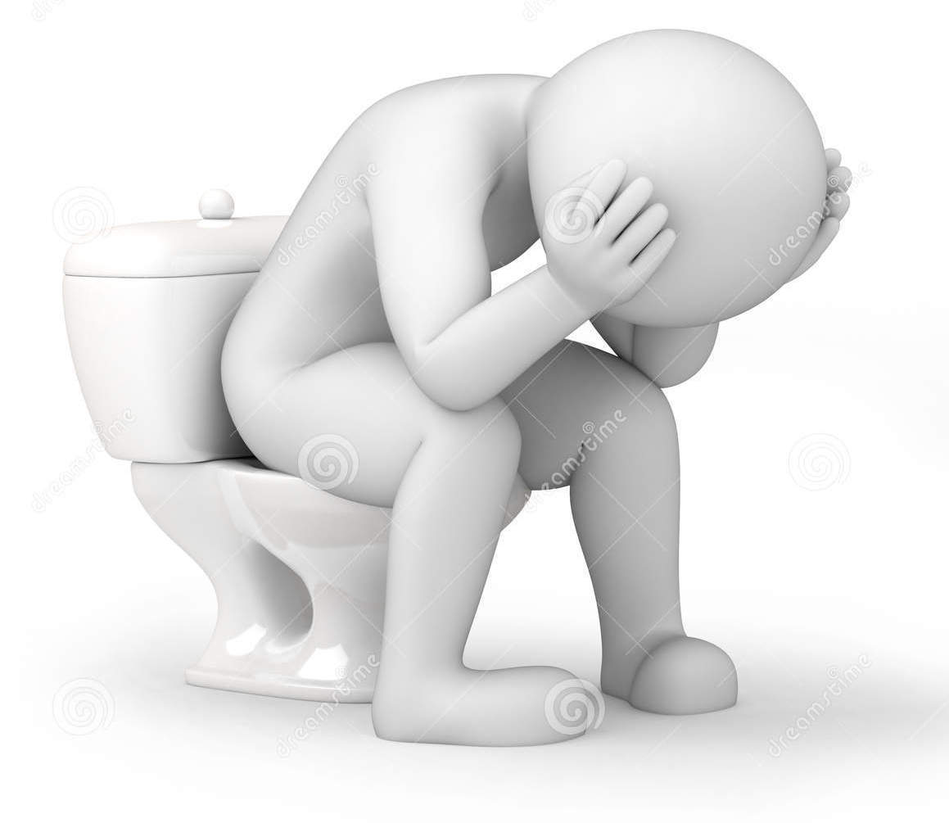
CONSTIPATION

Slide 2
INDEX
INTRODUCTION
DEFINATION
PATHOGENESIS & CAUSES
HISTORY & INVESTIGATIONS
SIGNS & SYMPTOMS
DIAGNOSIS
TREATMENT : A) CONSERVATIVE
: B) MEDICAL MANAGEMENT
: C) SURGICAL APPROACH
8) COMPLICATIONS

Slide 3
INTRODUCTION
Constipation is a symptom, NOT a disease.
Constipation has many causes and may be a sign of undiagnosed disease.
Risk Factors
Gender : Female (hormonal & structural causes)
Physical activity
Diet : low fibre diet
Polypharmacy
Metabolic diseases
Age (common in older age)
Pregnancy
1 .Prevalence of constipation among the general population: a community-based survey from India. Rajput M¹, Saini SK. 2014 Nov-Dec;37(6):425-9. doi: 10.1097/

Slide 4
DEFINATION
CONSTIPATION IS DEFINED ACCORDING TO:-
ROME CRITERIA III FOR CONSTIPATION
Presence of two or more of the following symptoms:
Straining during at least 25% of defecations
Lumpy or hard stools in at least 25% of defecations
Sensation of incomplete evacuations for at least 25% of defecations
Sensation of anorectal obstruction/blockage for at least 25% of defecations
Manual manoeuvres to facilitate at least 25% of defecations (such as digital evacuation, support of the pelvic floor)
Fewer than three bowel movements a week
Loose stools are rarely present without the use of laxatives
Criteria have to have been met for the previous three months, with the onset of symptoms six months prior to diagnosis

Slide 5
PATHOPHYSIOLOGY
Constipation can be caused by
1 )Primary
2 )Secondary factors.
Primary (idiopathic) constipation is categorized into 3 groups:
a) Normal-transit constipation
b) Slow-transit constipation
c) Dyssynergic defecation.^{[3]}

Slide 6
a) Normal-transit constipation:
Most common type of PRIMARY constipation;
Normal rate of stool movement through the colon, but patients feel constipated, mostly likely due to perceived difficulties in defecation and hard stools;
Patients may complain of abdominal pain, bloating, or both and may exhibit signs of emotional stress as a result; and
Possibility of increased rectal compliance, reduced rectal sensation, or both.

Slide 7
b) Slow-transit constipation:
Phasic colonic motor activity is significantly impaired;
Stool moves through the colon at a reduced rate;
Marked by less frequent high-amplitude peristaltic contractions after meals and slower emptying of colonic content; and
Patients often experience only a limited urge to defecate and no need to strain.

Slide 8
c) Dyssynergic defecation:
Caused most often by dysfunction of the pelvic floor or anal sphincter; and
Patients have lost the ability to coordinate contractions of the pelvic floor muscles and to relax the anal sphincter during defecation.

Slide 9
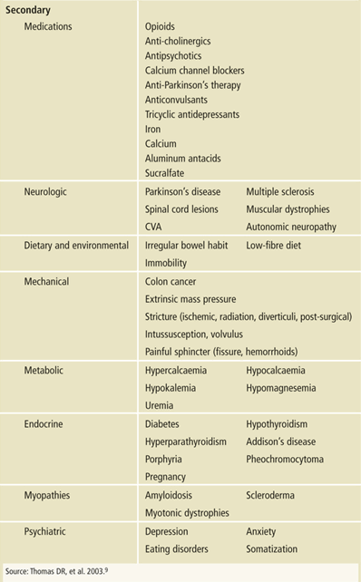

Slide 11
CAUSES OF CONSTIPATION IN ADULTS
ON BASIS OF ONSET
Recent onset | Examples
Colonic obstruction | Neoplasm:stricture :ischaemic diverticular
Anal sphincter spasm | Anal fissure: painful haemorrhoids Anismus, hypertonic anal spinter
CHRONIC | EXAMPLES
Irritable bowel syndrome | Constipation -predominant
medications | Ca2+ blockers, antidepressants
Colonic pseudoobstruction | Slow transit constipation, megacolon(rare hirschsprung’s, chagas’ disease)
Disorders of the rectal evacuation | Pelvic floor dysfunction,anismus,rectal mucosal prolapse,rectocele
endocrinopathies | Hypothyrodism ,hypercalcemia &pregnancy
Psychiatric disorders | Depression,eating disorders and drugs
Neurologic disease | Parkinson

Slide 12
SIGNS & SYMPTOMS
  Infrequent defecation
  Nausea
  Vomiting
  Anorexia
  Feeling full quickly
  Stools that are small, hard, and/or difficult to evacuate
  Rectal bleeding
  Weight loss (in chronic constipation)

Slide 13
APPROACH
HISTORY
A DETAILED HISTORY ABOUT PATIENTS BOWEL HABBITS CAN MAKE US RULE OUT TYPE OF CONSTIPATION
1) ONSET : ACUTE :- INTESTINAL OBSTUCTION
:- OGILVIE SYNDROME
:- NEW MEDICATIONS
:- RECENT PSYCHOSOCIAL EVENTS
:CHRONIC :- MALIGNANCIES
:- CONGENITAL ANAMOLIES
:-FISSURES/ FISTULAS… ETC

Slide 14
2) PATTERN
3) FREQUENCY
4) CONSISTENSY
5) AMOUNT OF TIME SPENT IN RESTROOM
6) DIET, FLUID INTAKE, BEVERAGES & LIFESTYLE
7) PREVIOUS HISTORY
8) OTHER DISEASES (Diabetes, spinal/ SOL/ Thyroid dysfunctions)
9) STD’s or SEXUAL ABUSE

Slide 15
WORKUP
IN PATIENTS WITH MILD CONSTIPATION OR RECENT HISTORY OF CONSTIPATION IT IS NOT ALWAYS NECESSARY TO INVESTIGATE
HOWEVER IN SEVERE AND REFRACTORY CONSTIPATION PROPER WORKUP WILL BE REQUIRED
PRIORITY OF INVESTIGATIONS COULD BE ON BASIS OF SIGNS, SYMPTOMS AND AGE OF PATIENT

Slide 16
INVESTIGATIONS
MEDICAL EVALUATION :-
CBC 8.ANA
ELECTROLYTES 9.TUMOUR MARKERS
CALCIUM 10.MRI / CT-SCAN
MAGNESIUM 11.ULTRASOUND
HBA1C 12.X-RAY ABDOMEN
UPT
THYROID PROFILE

Slide 17
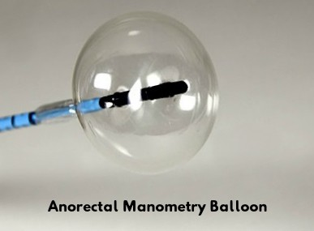
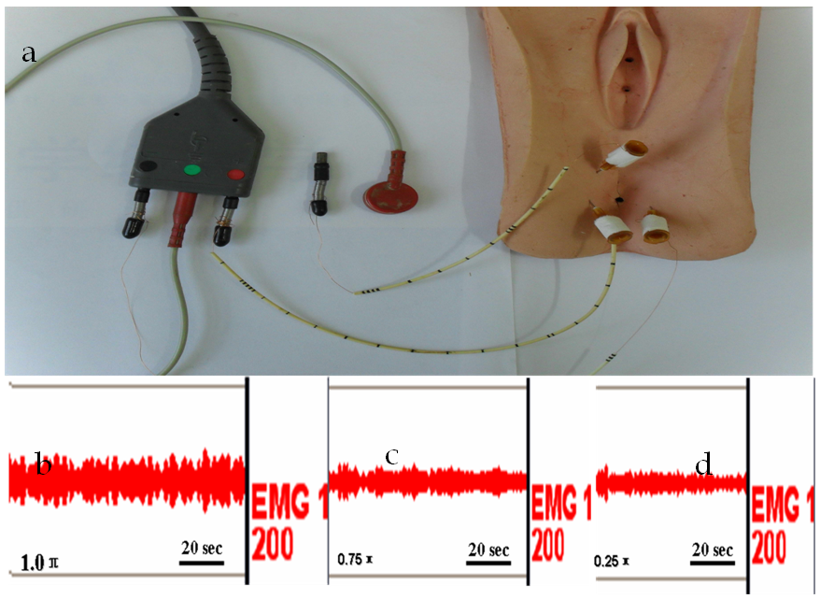
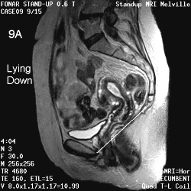
INVASIVE & NONINVASIVE Ix
ANORECTAL MANOMETRY/BALOON EXPULSION TEST
BARRIUM ENEMA
MR DEFOGRAPHY
SURFACE ANAL ELECTROMYOGRAPHY (EMG)

Slide 18
5.COLONIC TRANSIT STUDY BY WIRELESS MOTILITY CAPSULES/ SCINTIGRAPHY
6. COLONOSCOPY
7. PROCTOSIGMOIDOSCOPY

Slide 19
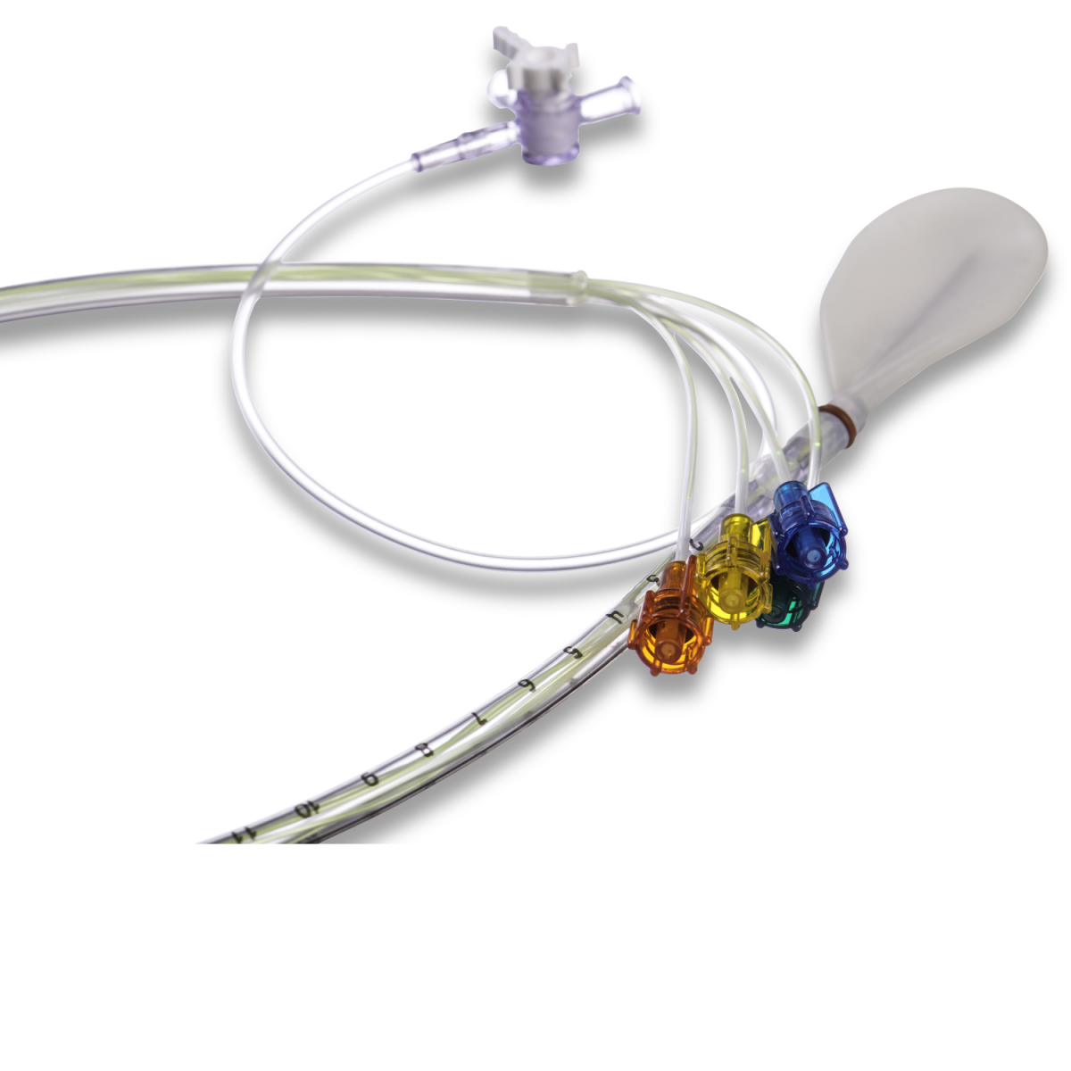
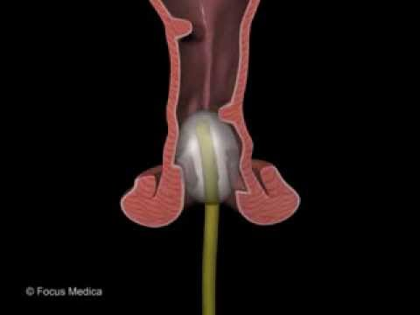
ANORECTAL MANOMETRY/ BALOON EXPULSION TEStT
A small, flexible sensor is placed in rectum. This is connected to a computer and a recording device that measures the pressure and strength of anal and rectal muscles
A small balloon attached to the catheter is inflated with 60cc NS in the rectum to assess the normal reflexes and to assess how patient perceives stool sensation in rectum.

Slide 20
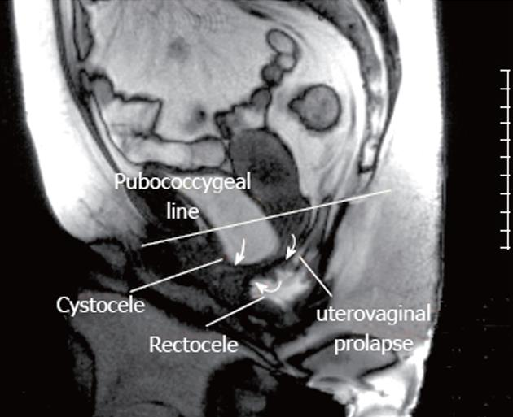
BARRIUM ENEMA :
A radioopaque dye is given as enema to visualize local cause of constipation
MR DEFOGRAPHY :
It is special type of MR imaging that produces detailed images during a bowel movement and provides information about the structure and function of the rectum and the pelvic floor, a network of muscles that stretches between the pubic bone and spine and the abdominal organs it supports & images are obtained at various stages of defecation

Slide 21
SURFACE ANAL ELECTROMYOGRAPHY (EMG)
Electromyography of the external anal sphincter is frequently used when investigating patients with defecation disorders.
It is invasive technique by perineal insertion of a needle or wire electrode.
It determines functional capacity of sphinter

Slide 22
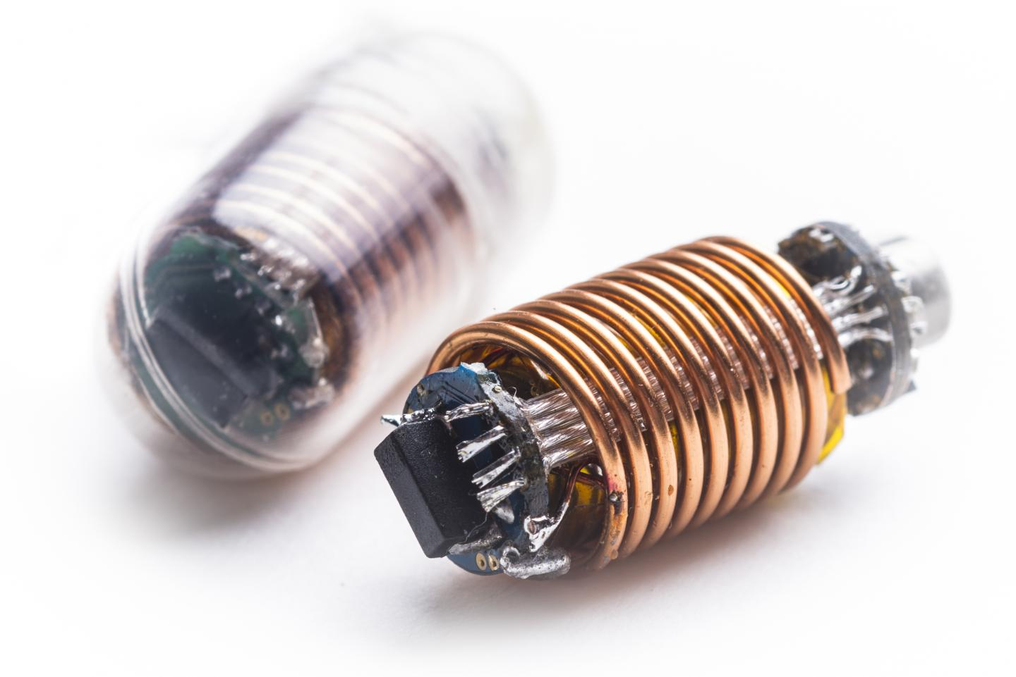
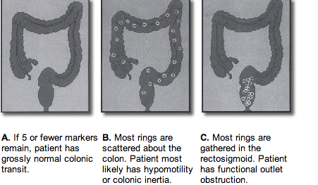
COLONIC TRANSIT STUDY BY WIRELESS MOTILITY CAPSULES/ SCINTIGRAPHY
Wireless motility capsules have been validated most recently
The capsule is ingested and patient carries on his daily activity
It contains rings that are released after ingetion
It evaluates :
pH level, pressure and temperature throughout gut
Gastric emptying time
Whole gut transit time
Combined small-large bowel transit time

Slide 23
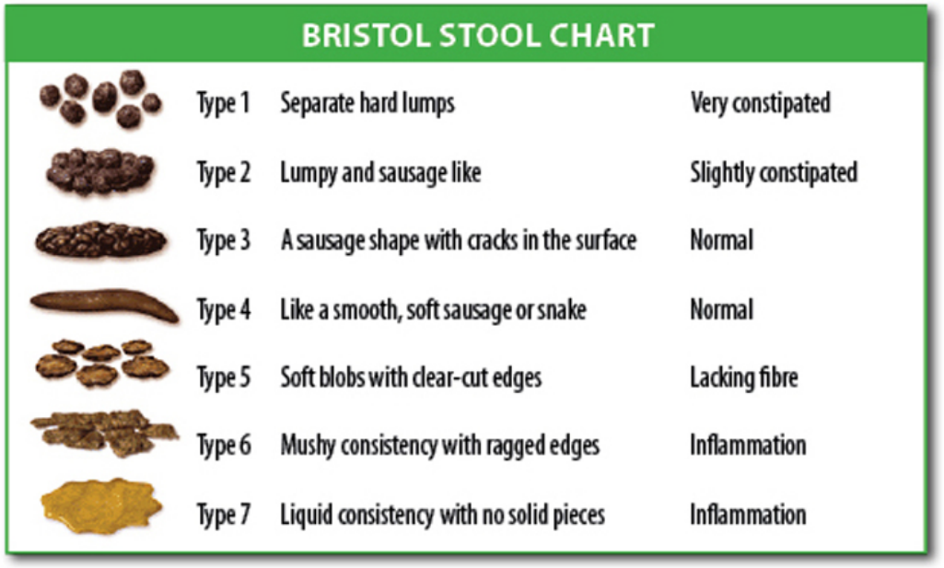

Slide 24
EXAMINATION
PER ABDOMEN :- DISTENTION
:-MASS (COLONIC STOOLS)
:- ABDOMINAL WALL TUMOURS
b) Perianal &
Per Rectum :-Perianal excoriation
                :-Skin tags/ hemorrhoids
                :-Anal fissure
                :-Anocutaneous reflex
:-Prolapse during straining
:-Stool amount&consistency -

Slide 25
Alarm symptoms
Change in stool caliber
Heme-positive stool
Iron-deficiency anemia
Obstructive symptoms
Patients > 50 years with no previous colon cancer screening
Recent onset of constipation
Rectal bleeding
Rectal prolapse
Weight loss
(Recommended test: colonoscopy)

Slide 26
Laboratory studies, imaging or endoscopy, and function tests are only indicated in patients with severe chronic constipation or alarm symptoms
TEST | STRENGTH | WEAKNESS | COMMENT
Colonic transit study with radiopaque markers | Evaluates the presence of slow, normal, or rapid colonic transit; inexpensive and widely available | Inconsistent methodology; validity has been questioned | Useful for classifying patients according to pathophysiological subtype
Anorectal manometry | Identifies evacuation disorder, rectal hyposensitivity, rectal hypersensitivity, impaired compliance, Hirschsprung disease | Lack of standardization | Used for establishing diagnoses of Hirschsprung disease, evacuation disorder, and rectal hyposensitivity or hypersensitivity
Balloon expulsion test | Simple, inexpensive, bedside assessment of the ability to expel a simulated stool; identifies evacuation disorder | Lack of standardization | Normal balloon expulsion test does not exclude dyssynergia; should be interpreted alongside results of other anorectal tests

Slide 27
Clinical evaluation Classification of the patient’s constipation should be possible on the basis of the medical history and appropriate examination and testing.
Constipation type | Typical findings
Normal-transit constipation, constipationpredominant IBS | • Patient history, no pathology at physical inspection/examination • Pain and bloating • Feeling of incomplete evacuation
Slow-transit constipation | • Slow colonic transit • Normal pelvic floor function
Evacuation disorder | • Prolonged/excessive straining • Difficult defecation even with soft stools • Patient applies perineal/vaginal pressure to defecate • Manual maneuvers to aid defecation • High basal sphincter pressure (anorectal manometry)
Idiopathic/organic/secondary constipation | • Known drug side effects, contributing medication • Proven mechanical obstruction Idiopathic/organic/secondary constipation • Metabolic disorders—abnormal blood tests

Slide 28
MANAGEMENT
CONSERVATIVE | MEDICAL | SURGICAL
DIET | TREATING SECONDARY CAUSE | Total colectomy with ileorectal anastomosis
EXERCISE | 2) BULKING AGENTS | Ventilng ileostomy
POSTURE WHILE DEFECATION | 3)LAXATIVE :OSMOTIC :STIMULENT
FLUID INTAKE | 4)STOOL SOFTNER
 | 5)LUBRICANTS
 | 6)PROSTAGLANDINS
 | 7) PROKINETICS

Slide 29
Scheme for general management of constipation
Interview and physical examination
Consider metabolic and structural evaluation ,baseline labs
Therapeutic trial-
Fiber ± laxatives

Slide 30
Inadequate response
Anorectal manometry
Balloon expulsion test
Normal
abnormal
inconclusive
Colonic transit
Defecatory disorder
Barium or MR defecography
slow
normal
Normal
abnormal
Slow transit constipation
Normal transit constipation

Slide 31

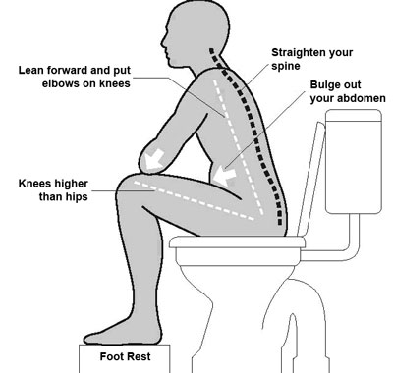
CONSERVATIVE
DIET
High Fibre Diet :- 25gm of fibre/day
Fluid supplementation : 1.5-2.0 litres/day
EXCERSICE
Daily exercise has been proved benefitail
POSTURE
Educating patients about correct posture has also been
proved beneficial

Slide 32
Symptomatic approach if organic and secondary constipation have been evaluated and excluded, most cases can be managed adequately with a symptomatic approach.
A graded approach to treatment is based on recommending changes in lifestyle and diet, stopping or reducing medications that cause constipation, and administering fiber supplementation or other bulk-forming agents. A gradual increase in fiber (either as standardized supplements or incorporated in the diet) and fluid intake is generally recommended.
• The second step in the graded approach is to add osmotic laxatives. The best evidence is for the use of polyethylene glycol, but there is also good evidence for lactulose. The new drugs lubiprostone and linaclotide act by stimulating ileal secretion and thus increasing fecal water.

Slide 33
• The third step includes stimulant laxatives, enemas, and prokinetic drugs. Stimulant laxatives can be given orally or rectally to stimulate colorectal motor activity. Prokinetic drugs are also meant to increase the propulsive activity of the colon, but in contrast to stimulant laxatives, which should only be taken occasionally.

Slide 34
Diet and supplements
• Dietary modification may consist of a high-fiber diet (25 g of fiber) and fluid supplementation (up to 1.5–2.0 L/day) and may improve stool frequency and decrease the need for laxatives.
• There is no evidence that dietary and lifestyle measures have any effect on constipation in the elderly; fiber supplements and simple osmotic laxatives are usually an adequate approach for constipation in these patients.
• In patients with colonic dilation, fiber supplementation should be avoided.
• Psyllium supplements and lactulose may be appropriate for the treatment of chronic constipation.

Slide 35
Medication
• Evacuation disorders respond poorly to standard oral laxative programs. If an evacuation disorder plays a considerable role in constipation, biofeedback and pelvic muscle training may be considered. Critical success factors are the patient’s level of motivation, the frequency of the training program, and participation of a behavioral psychologist and dietitian.
• If a dietary approach fails, polyethylene glycol (17 g PEG laxative for 14 days) or lubiprostone (24 mg twice per day) can be used to promote bowel function in patients with chronic constipation.
• Prokinetic agents (e.g., the 5-HT4 receptor agonist prucalopride) can be used in constipation-predominant IBS.
• Simple laxative agents, such as milk of magnesia, senna, bisacodyl, and stool softeners are a reasonable choice for treating constipation

Slide 36
MEDICAL MODALITIES
1)BULKING AGENTS | PYSYLLIUM BRAN METHYLCELLULOSE
2) LAXATIVES :- OSMOTIC :- STIMULENTS | POLYETHYLENE GLYCOL LACTULOSE BISACODYL/SODIUM PICOSULPHATE SENNA
3) STOOL SOFTNER | DUCOSATE
4)LUBRICANTS | LIQUID PETROLATUM
5) PROSTAGLANDINS | POLYETHYLENE LUBIPROSTONE
6)PROKINETIC | PRUCALOPRIDE (5-HT4 RECEPTOR ANTAGONIST)

Slide 37
Surgery
• If there is persistent treatment failure in slow-transit constipation, then carefully selected, well evaluated and informed patients may benefit from total colectomy with ileorectal anastomosis.
The exceptional indication for colectomy must be established in a specialized and experienced tertiary center. Disappointing results may be seen, with fecal incontinence due to surgery and recurrent constipation, especially in patients with evacuation disorder.
• Only very few patients benefit from a (reversible) colostomy to treat constipation

Slide 38
Pouch of douglas protrusion is best addressed with sacrocolpopexy and is usually performed in conjunction with other gynaecologic procedures in patients with pelvic floor abnormalities such as cystocele,rectoceles , enteroceles & vaginal vault prolapse
A NEW RESEARCH HAS SHOWN GOOD RESULTS IN PUBORECTAL DYSSYNERGIA WITH USAGE OF BOTOX INJECTION IN PUBORETALIS MUSCLE
EUROPEAN JOURNAL OF NEUROLOGY SIPL2 S82-S83

Slide 39
COMPLICATIONS
ANAL PROLAPSE d/t prolonged and daily straining
ANAL FISSURES
FAECAL INCONTINENCE d/t pudendal neuropathy
MEGARECTUM

Slide 40


