Slide 1
Dilemma in
Diagnosis of
Rheumatic Fever
Dr. Tejas Shah
Assistant professor
Department of Cardiology
SBKS MI & RC

Slide 2
“Eva, Eva ,with rising fever
What does your work up show?
Is there arthritis?
A touch of st.virus?
The sound I hear,I fear, my dear,
mark regurgitant flow.
But Jones criteria
Have yet to appear to you
So you are still in FUO”
Anonymous medical student -1964.
Quoted from : Rh. Fever in Children
Am H.J 1980 Vol.99 No 5 p-636

Slide 3
Original Jones’ Criteria – 1944
_____________________________________________________________
Major Criteria Minor Criteria
________________________________________________________________________________________________________________
1. Carditis 1. Fever
2. Arthralgia 2. Abdominal pain
3. Chorea 3. Precordial pain
4. Subcutaneous nodules 4. Rashes (erythema marginatum)
5. History of previous definite 5. Epistaxis
rheumatic fever or 6. Pulmonary findings
rheumatic heart disease 7.Laboratory findings
  (a) Electrocardiographic abnormalities
  (b) Microcytic anemia
  (c) Elevated total leucocyte count
  (d) Elevated erythrocyte sedimentation rate
_____________________________________________________________________
Source – JAMA – 1944; 126: 481-484

Slide 4
Original Jones’ Criteria – 1944
(objective of these “rather strict diagnostic criteria”)
About Joint pain
“If the patient had had tonsillitis, pharyngitis or even a cold in the past two or three weeks, and serologic tests (such as antistreptolysin determinationn) indicate a recent hemolytic streptococcus infection, the burden of proof rests with the physician who would not interpret such a syndrome as rheumatic fever, since this represents the usual epidemiologic pattern of the disease.”
_______________________________________________________________________________
Source – JAMA – 1944; 126: 481-484

Slide 5
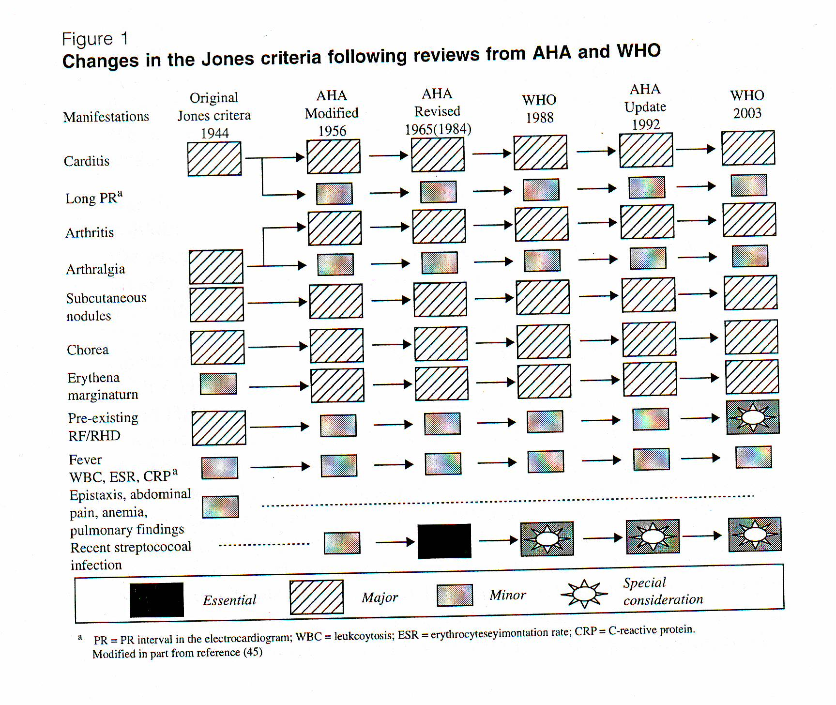

Slide 6
Evidence of antecedent group A Streptococcal infection
    Positive throat culture
    Rapid Antigen Test
    Streptococcal Antibodies
        Anti Streptolysin O (ASO Titre)
        Anti DNase – B
        Anti hyaluronidase
        Anti streptokinase
        Anti Nicotinamide adenine dinucleo tidase
    Recent Scarlet Fever *

Slide 7
Evidence of antecedent group A Streptococcal infection
(Limitations)
Positive throat culture
  Occurs in only 25% cases of ARF
  Can’t distinguish between carrier and active infection
  GAS carrier rate in school going children - 10-50%
          Temperate climate Tropical Countries
Group A 50% - 60%
Group C & G 30% 60% - 70%
Group C & G Streptococci can produce extracellular antigen like
Streptolysin O.
Ripid Antigen Test
  Very specific but less sensitive
  Can not distinguish between carrier and active infection

Slide 8
Streptococcal antibodies
(Limitations)
Increased ASO titre has been reported to be present in 15%-70% of school children.
Positive ASO titre is found only 80% of patient with ARF.
A single negative ASO Titre does not rule out presence of streptococcal infection.
To demonstrate rising ASO Titre to confirm recent streptococcal infection, acute and convalascent serum sample should be obtained at 2-4 weeks intervals and all sample should be tested simultaneously.
Using three antibody tests- an elevated titer for at least one antibody can be demonstrated in about 95% of all patients with ARF.
Source : JAMA,1992;268:2069-2073

Slide 9
Differential Diagnosis of Common Major Presentations of Acute Rheumatic Fever
Arthritris Carditis Chorea
Septic arthritis (including Innocent murmur Systemic lupus
gonococcal) Mitral valve prolapse erythematosus
Connective tissue and other Congenital heart disease Drug intoxication
auto-immune disease Infective endocarditis Wilson’s disease
Viral arthropathy Hypertrophic cardio- Tic disorder
Reactive arthropathy myopathy Choreoathetoid cerebral palsy
Lyme disease Myocarditis – Viral Encephalitis
Sickle-cell anaemia or idiopathic
Infective endocarditis
Leukaemia or lymphoma Pericarditis – Viral Familial chorea (including
Gout andpseudogout Huntington’s) Intracranial tumour Lyme disease
Source: Carapetis, J. et al, Seminar: Acute rheumatic fever, Lancet, 2005. 366: 155-68.

Slide 10
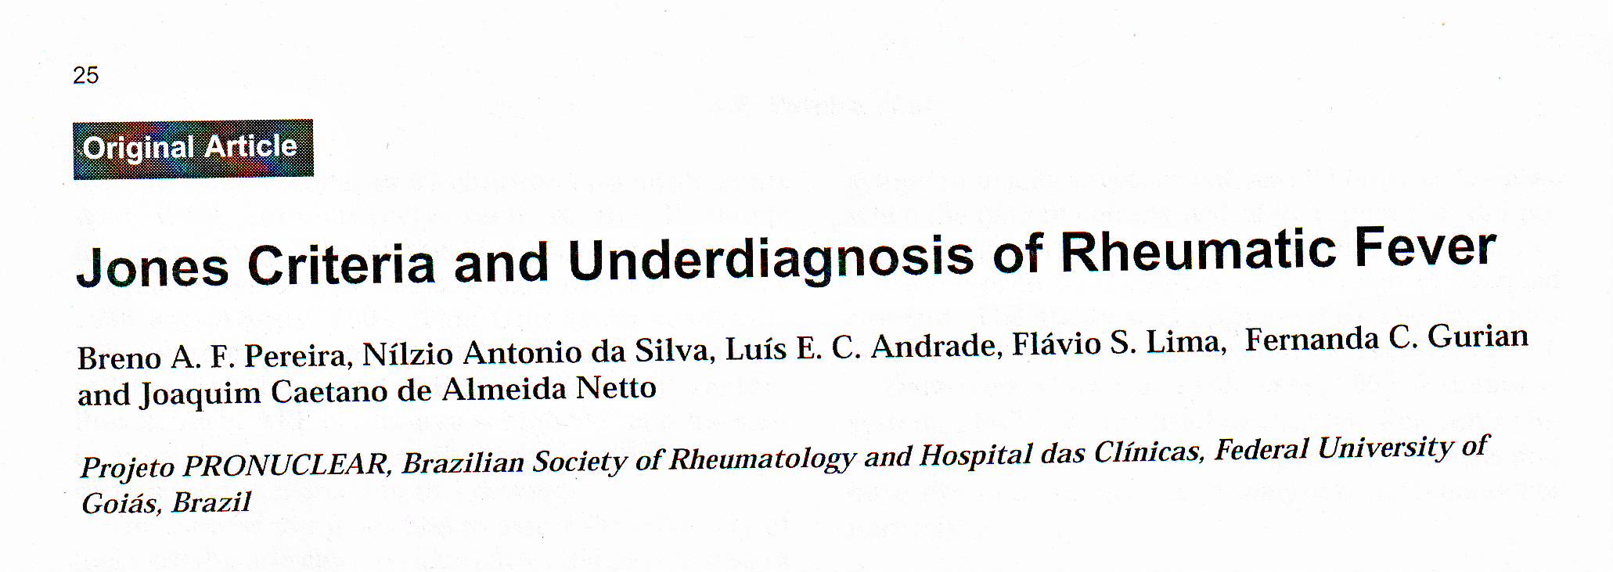
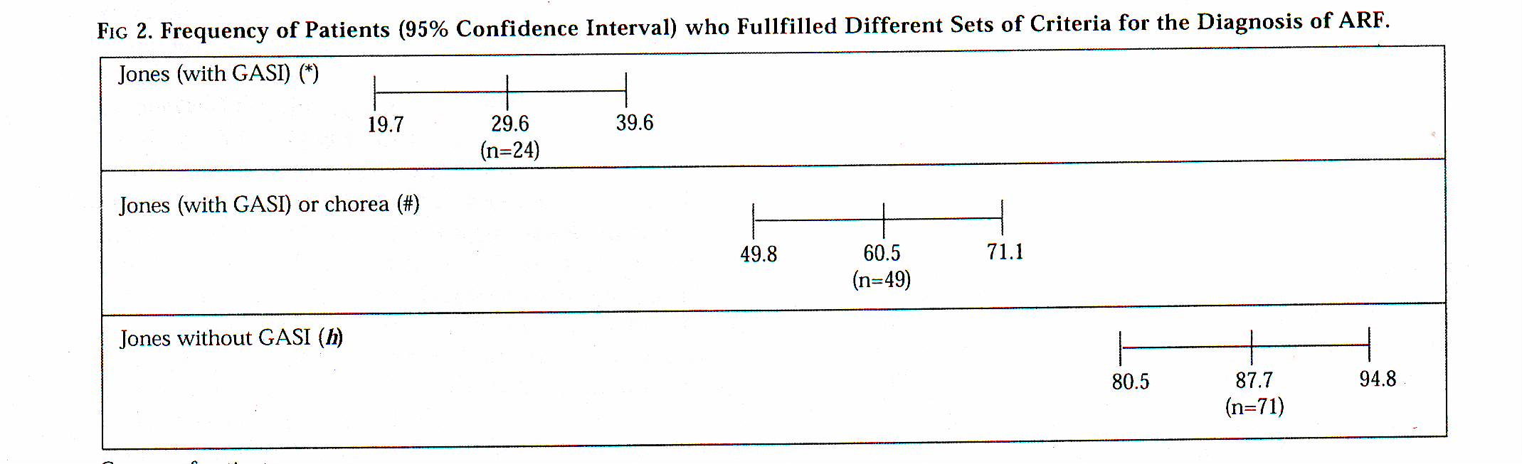
Source: Indian J Pediatr 2007; 74 (2) : 117-121

Slide 11
Echocardiography in RF/ RHD
Valvular abnormalities
Pericardial effusion
    Normal LV systolic function
Subclinical Carditis - Echo identified valvular lesion in the setting of ARF.
Subclinical RHD - Echo identified valvular lesion in asymtomatic children.

Slide 12
Clinical Situations
Polyarthralgia with fever, with increased ESR and positive ASO Titre.
Monoarthritis, fever, increased ESR and positive ASO Titre.
Polyarthralgia, increased ESR, increased ASO Titre and echo evidence of mild MR (No murmur).

Slide 13
2005 Australian Guidelines For The Diagnosis of Acute Rheumatic Fever
High-risk groups All other groups
___________________________________________________________________________________________________________________
Initial episode of ARF 2 major or 1 major and 2 minor As for high-risk groups
manifestations Plus evidence of a
preceding GAS infection
___________________________________________________________________________________________________________________
Recurrent attack of ARF in a 2 major or 1major and 2minor or 3 As for high-risk groups
Patient with known past ARF minor manifestations PLUS evidence
or RHD of a preceding GAS infection
___________________________________________________________________________________________________________________
Major manifestations Carditis (including subclinical Carditis (excluding subclinical
evidence of rheumatic valve evidence of rheumatic valve disease on echocardiogram) sease on echocardiogram)
Polyarthritis or aseptic mono- Polyarthritis
arthritis or polyarthralgia Chorea
Chorea Erythema marginatum
Erythema marginatum Subcutaneous nodules
Subcutaneous nodules
___________________________________________________________________________________________________________________
Minor Manifestations Fever Fever
ESR ≥30mm/hr or CRP ≥ 30mg/L Polyarthralgia or aseptic mono-
Prolonged P-R interval on ECG arthritis ESR ≥30mm/hr or CRP ≥30mg/L
Prolonged P-Rinterval on ECG
___________________________________________________________________________________________________________________
High-risk groups – ARF (incidence >30 per 100000 per year in 5-14 year olds or RHD (all-age prevalence > 2per 1000.
___________________________________________________________________________________________________________________
Source – MJA.Valume 186 Number 11 . 4 June 2007; 581-586

Slide 14
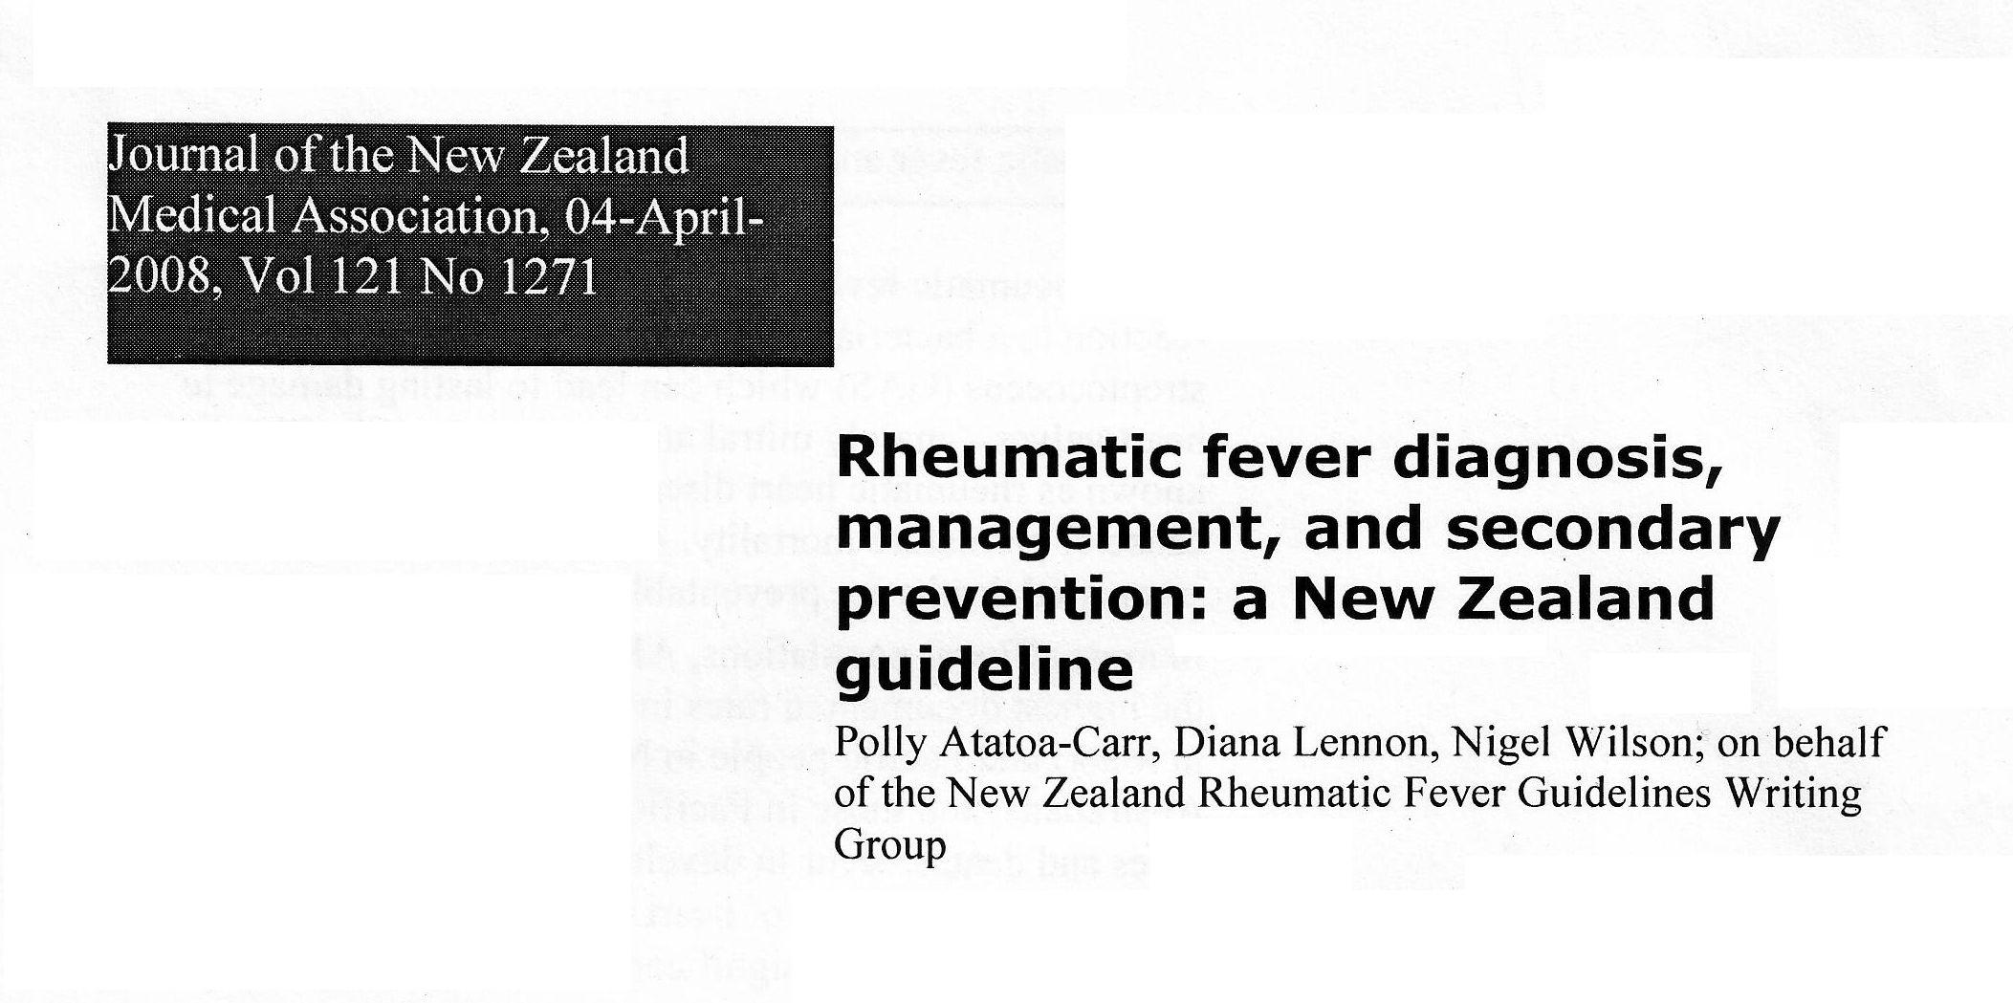

Slide 15
New Zealand guidelines for the diagnosis of acute rheumatic fever…
Recurrent Attack of ARF in a case with known past ARF or RHD | 2 major or 1 major and 2 minor or several minor Plus Evidence of a preceding of a GAS infection (jones 1992) ₁₉
Major manifestations modified from Jones 1992 ₁₉ | Carditis( including evidence of sub clinical rheumatic valve disease on echocardiogram) * Polyarthritis ** or aseptic monoarthritis with history of NSAID use Chorea (can be stand-alone for ARF diagnosis) Erythema marginatum Subcutaneous nodules
Minor Manifestations | Fever Raised ESR or CRP Polyarthralgia ** Prolonged P-R interval on ECG

Slide 16
New Zealand guidelines for the diagnosis of acute rheumatic fever
Variables | Diagnostic requirements | Category
Initial episode of ARF | 2 major or 1 major and 2 minor manifestations Plus Evidence of a preceding GAS infection | Definite ARF
Initial Episode of ARF | 1 major and 2 minor with the inclusion of evidence of a preceding GAS infection as a minor manifestation (Jones 1956)₂₂ | Probable ARF
Intial episode of ARF | Strong clinical suspicion of ARF, but insufficient signs and symptoms to fulfill diagnosis of definite or probable ARF | Possible ARF

Slide 17
G U I D E L I N E S
Consensus Guidelines on Pediatric Acute Rheumatic Fever and
Rheumatic Heart Disease
WORKING GROUP ON PEDIATRIC ACUTE RHEUMATIC FEVER AND CARDIOLOGY CHAPTER OF
INDIAN ACADEMY OF PEDIATRICS
Indian Pediatrics -July 2008

Slide 18
Clinical and laboratory Criteria Supportive evidence of preceding streptococcal infection (essential except for diagnosis of Chorea)
Major criteria (more specific) Anti streptolysin O
– Carditis ASO titer: >333 unit for children and > 250 for adults.
– Polyarthritis Anti-deoxyribonuclease B
– Chorea (normal values Anti DNase B titer 1:60 unit in
preschool, 1:480 units in
– Subcutaneous nodule school children & 1:340 in adults)
– Erythema marginatum
Minor criteria (less specific) History of (within previous 45 days)
– Fever – streptococcal sore throat
– Polyarthralgia – scarlet fever
– ESR, CRP, – positive throat culture
polymorphonuclear leukocytosis
(follow standard laboratory values) – positive rapid streptococcal antigen detection test
– *ECG: Prolonged PR interval
Normal upper range; – PR Interval:3-12 yrs:0.16sec; 12-14 y: 0.18 sec; >17y:0.20 sec)

Slide 19
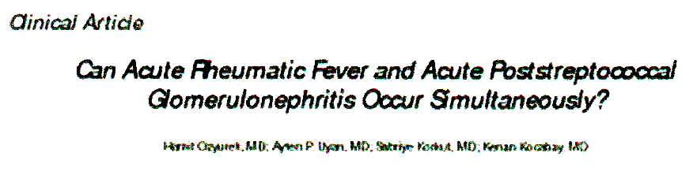
ARF and APSGN, both, are sequel of Group A Beta Haemolyticus Streptococcal (GABHS) infection.
ARF occurs due to GABHS infection of pharynx .
APSGN occurs due to GABHS infection of skin.
Usually GABHS infection of skin dose not cause ARF.
Nephritogenic stains of streptococci (Type 49 and Type 12) causing throat infection may cause both ARF and APSGN.
Incidence of ASPGN occurring in patients of ARF has been reported to be 0.7 to 1.3%.
Source: International Pediatric 2002 - Vol 17; No.3

Slide 20
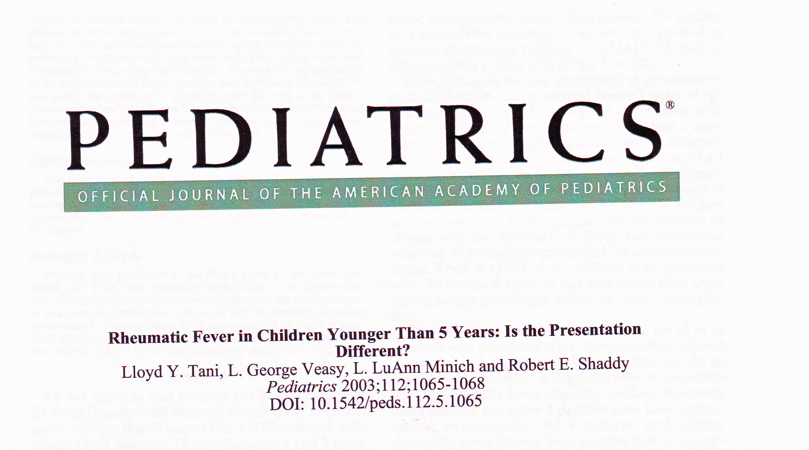
Total no. of patients - 541
Total no. of Children
Less than 5 yrs - 27
4-5 yrs - 12
3-4 yrs - 10
2-3 yrs - 04
<2 yrs - 01

Slide 21
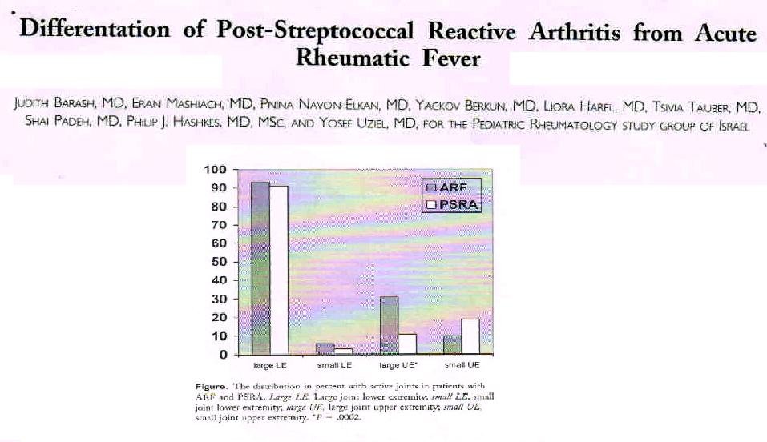
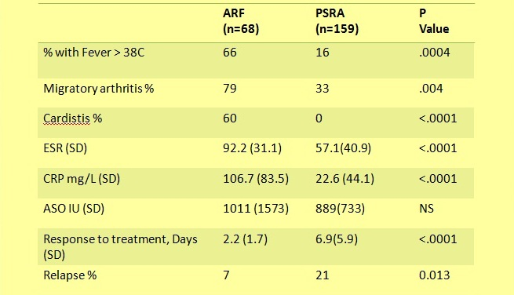
Source:- J Pediatr 2008; 153: 696-9

Slide 22
Accurate Diagnosis of ARF
Over-diagnosis will result in the individual receiving benzathine penicillin G (BPG) injections unnecessarily every 3-4 weeks for a minimum of 10 years.
Under-diagnosis of ARF may lead to the individual, suffering a further attack of ARF, cardiac damage and premature death.

Slide 23
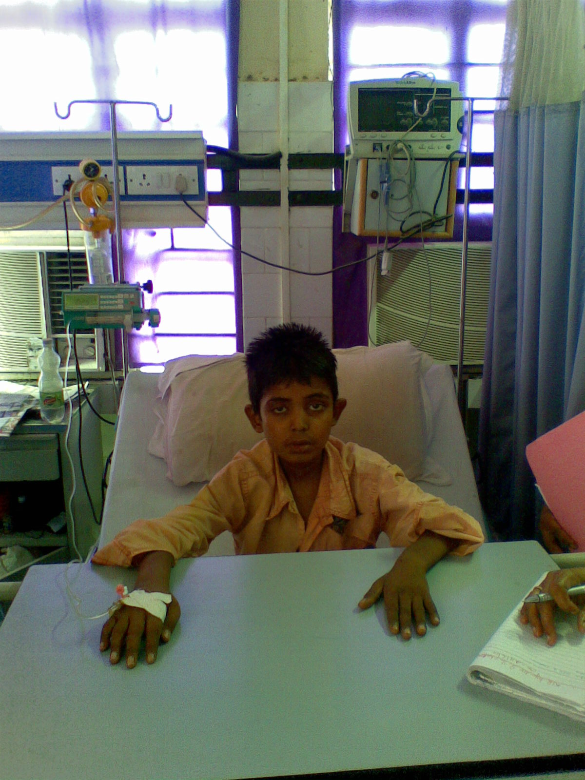
Are we trying to forget it deliberately ?

Slide 24
Thank You

Slide 25
Post – streptococcal reactive arthritis (PSRA)
Arthritis may effect joints that are not commonly effected in ARF, such as small joints of hands and is less responsive to anti inflammatory treatment.
Some patients with PSRA develop latter episodes of ARF or valvular heart disease.
Diagnosis of PSRA Should rarely be made in high risk population and with caution in low risk population.
Patient should received secondary profile access for at least five years in high risk population and at least for one year in low risk population.
Echocardiography should be used to confirm the absence of valvular heart disease.
Indian Pediatric –July 2008

Slide 26
“ Forgotten Heart Disease “ !!

Slide 27
Percentage of RHD patients at IGIC, Patna
_________________________________________________________________________________
Total No. IHD RHD Cardiomyopathy Arrhythmia Misc.
_________________________________________________________________________________
1029 481 (46%) 163(15.8%) 98 (9.5%) 107 (10.4%) 180(17.5%)
M 682 364 81 61 80 96
F 347 117 82 37 27 54
_________________________________________________________________________________

Slide 28
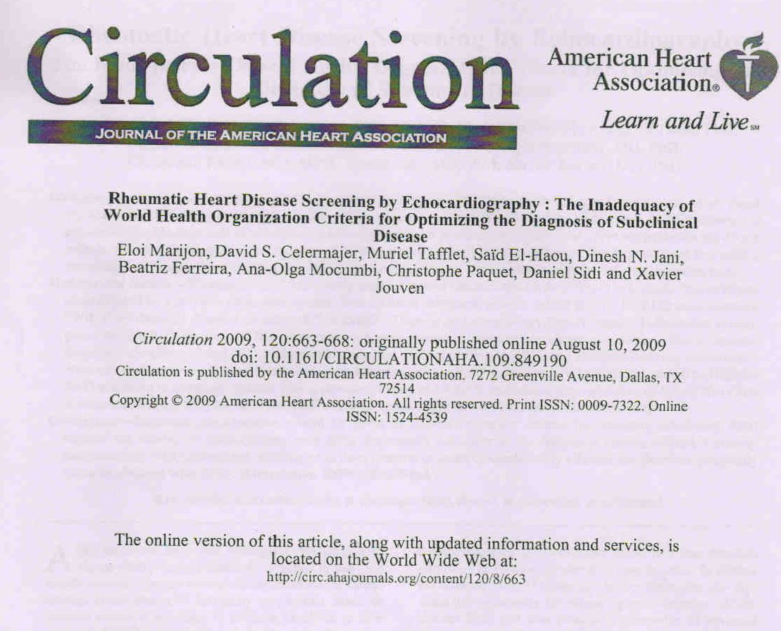

Slide 29
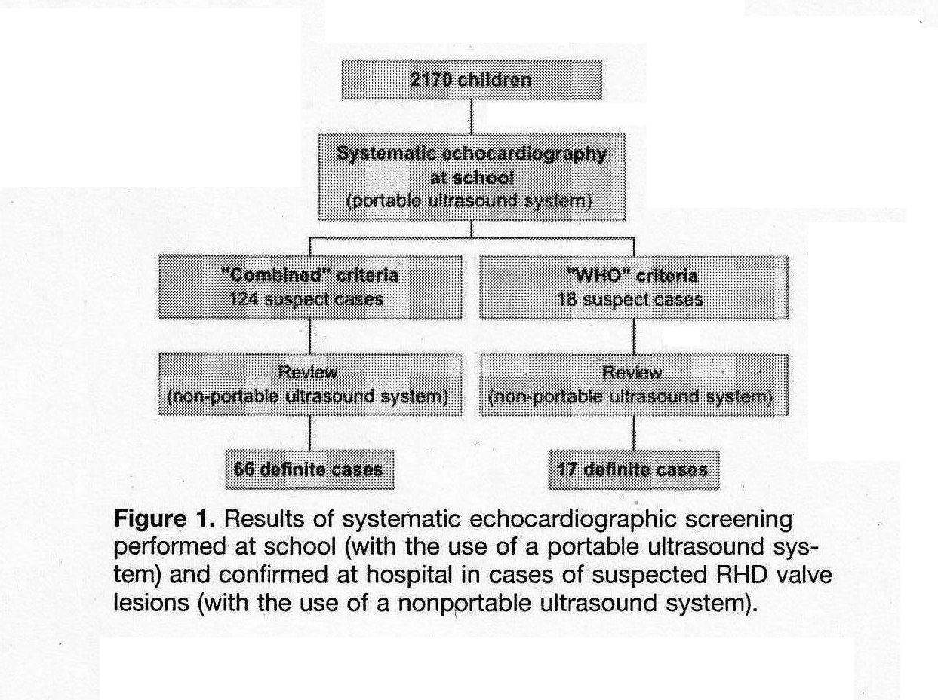
Echocardiographic Diagnosis of RHD by different criteria
Ref:- Circulation 2009, 120:663-668:

Slide 30
Criteria Used to Define Subclinical RHD Using Echocardiography
WHO Criteria
Doppler Criteria
A regurgitant jet > 1 cm in length
      A regurgitant jet in at least 2 planes
      A mosaic colour jet with a peak velocity > 2.5 m/s
      The jet persists throughout systole or diastole
Morphological criteria
Nil
Combined Criteria
Doppler Criteria
Any degree of valvular regurgitation seen in at least 2 planes
Associated with at least 2 morphological signs
Morphological criteria-
Leaflet restriction
Subvalvular thickening
valvular thickening
Ref:- Circulation 2009, 120:663-668:

