Slide 1
Bifurcation Stenting
Dr Cinosh Mathew
Associate professor
Dept of Cardiology
SBKS MI & RC

Slide 2
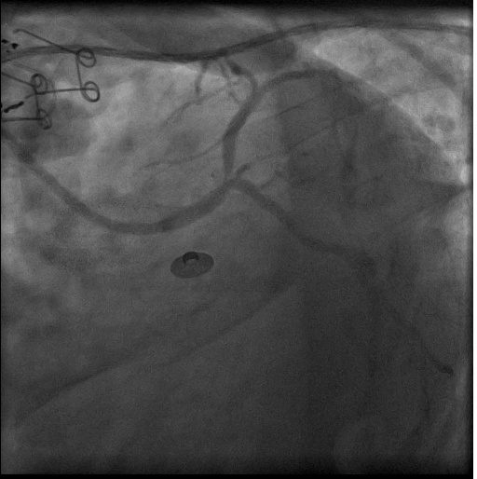
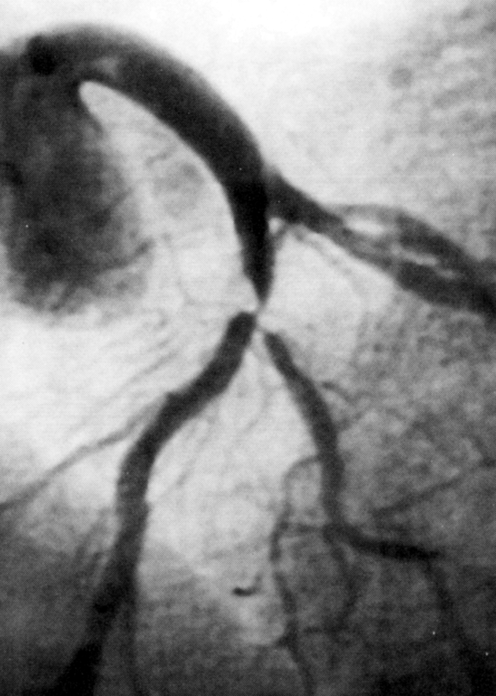
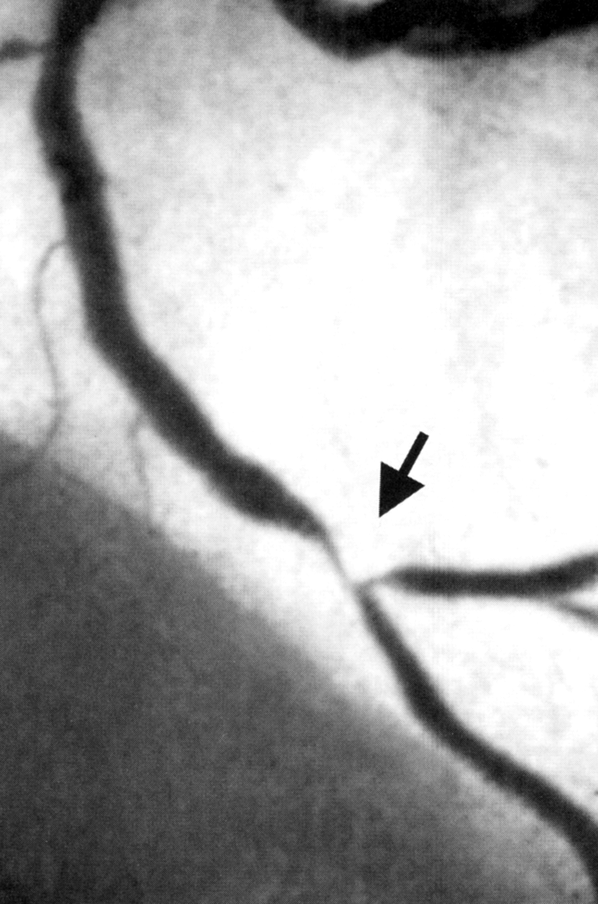
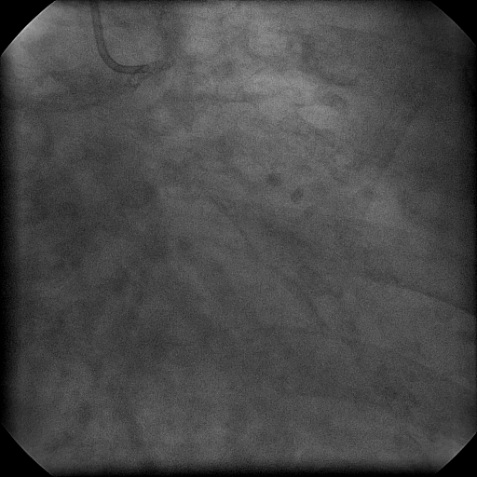
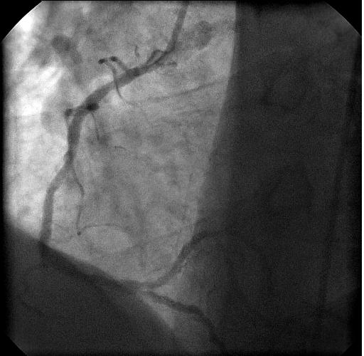
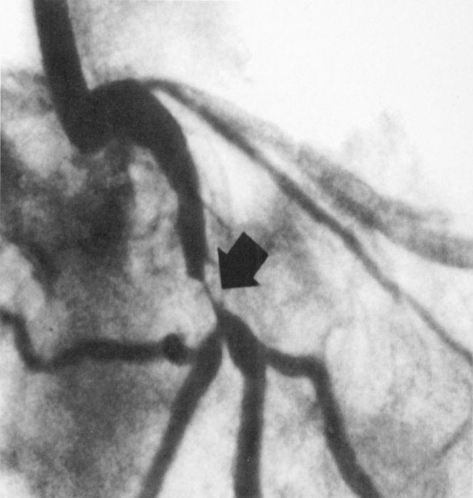
Bifurcation Lesions Come in Many Shapes and Sizes

Slide 3
Bifurcation PCI: Multiple Challenges
Clinical/Anatomical Variations
Procedural Options
Clinical presentations
Myocardial jeopardy
Vessel size variations
SB accessibility
SB takeoff angulations (3D)
Plaque distribution
Plaque volume
Plaque compliance
Peripheral Vascular Issues
IVUS guidance
Single vs double vs triple wire
Balloon predilation MB and SB
Adjunctive debulking or plaque modification
Provisional vs multiple stents
DES vs BMS
Kiss?
Multiple Stent Deployment Strategies
Adjunctive Pharmacotherapy

Slide 4
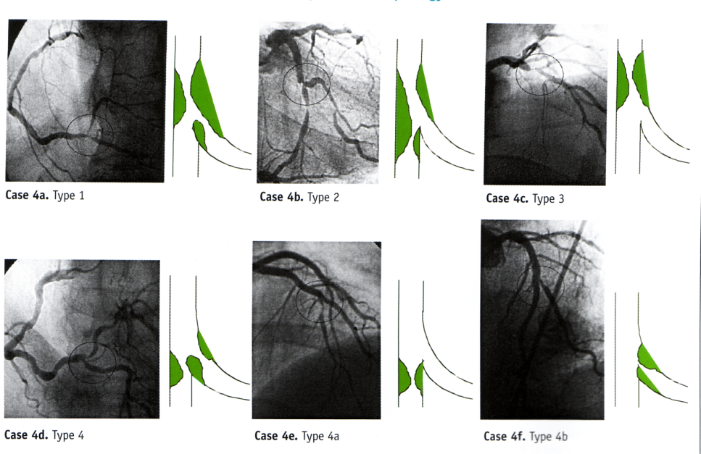
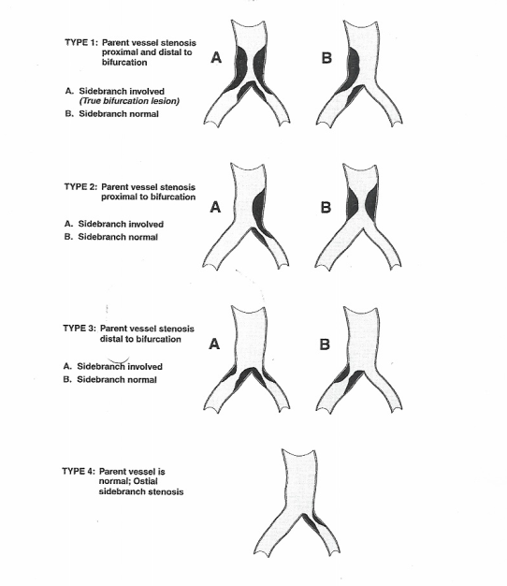
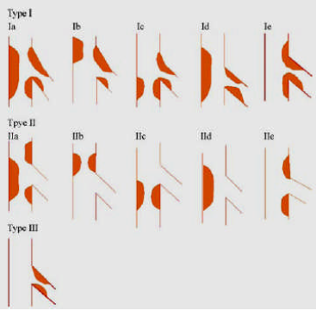
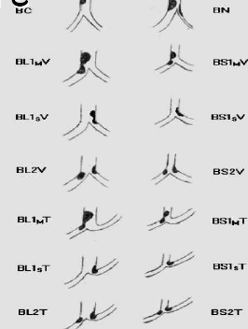
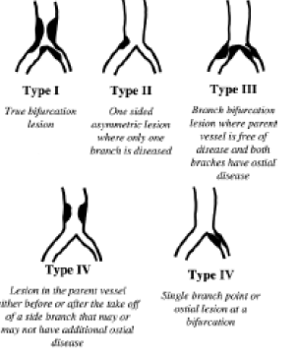
Classification Schemes
Prebranch
Parent Vessel Only
French/Lefevre
Duke
Postbranch
Bifurcation
Ostial
Prebranch and Branch
Safien
Chen-Gao
Movahed
Sanborn

Slide 5
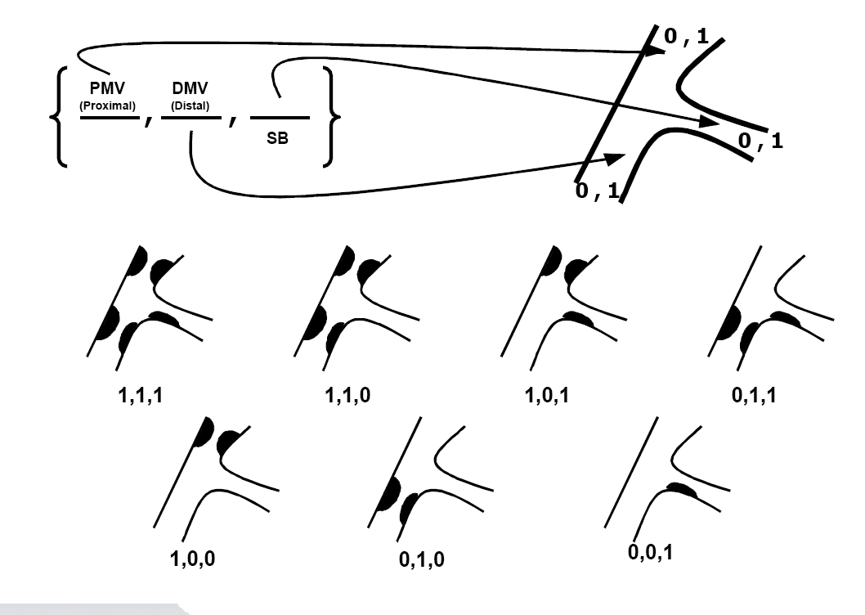
Coronary Bifurcation Lesions
Medina Classification
Medina A, Rev Esp Cardiol.2006 Feb;59(2):183

Slide 6
Main Consideration: The Branch
Will the side branch close?
  Plaque at ostium and angulation (Aliabadi: Am J Cardiol,1997;80:994-997)
Is the side branch large enough to Stent? (>2.5 mm) Dauerman HL, et al. JACC.1998;32:1845-52)
Is the side branch plaque lengthy (not focal)?
What’s the sidebranch angle? (<70º or > 70º)
Can you rewire after main branch stent?

Slide 7
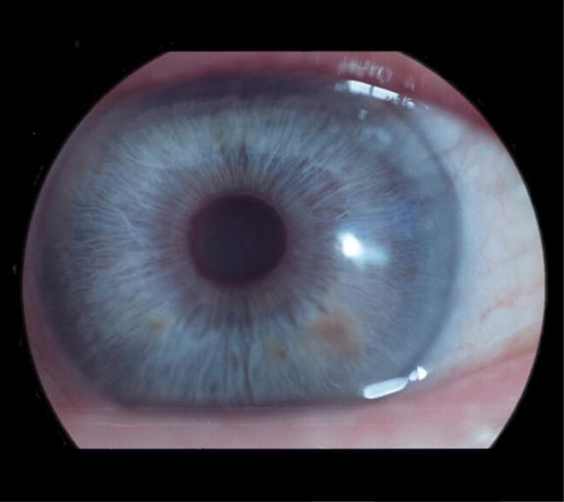
Oculostenosis and Branch Lesions
97 consecutive branch ostial lesions
2mm side branch with > 50% angiographic stenosis
FFR measured in 94 of the vessels
No lesion less than 75% stenosis had abnormal FFR < 0.75
Of the 73 with >75% stenosis, only 20 had were functionally significant. In those > 2.5 mm in diameter only 38% had abnormal FFR
Koo BK. JACC. 2005;46:633-637

Slide 8
When Possible….One Stent Better than Two
NORDIC TRIAL
Circulation 2006;114:1955-1961
BBK (Bifurcations Bad Krozingen)
Eur Heart J. 2008; 29(23): 2859–2867.
CACTUS
Circulation 2009;119:71-78.
BBC ONE
Circulation 2010;121:1235-1243

Slide 9
One stent vs. Two: TLR
4.3%
Crossover;
TIMI 0 post
SB PTCA
%TLR
18.8%
Crossover;
>60% and/
or flow-limiting dissection
31%
Crossover;
>50% and/
or flow-limiting dissection
3%
Crossover;
>70% and/
or < TIMI 3
N= 413 202 350 500

Slide 10
BBC ONE
a randomized comparison of simple versus complex drug-eluting stenting for bifurcation lesions
TOTAL POPULATION n=500
SIMPLE
Provisional T n=249
STAGE 1
Stent main vessel n=176
STAGE 2
Stent main vessel plus kiss n=66
STAGE 3
T-stent and kiss (failed n=1) n=7
COMPLEX
Total coverage n=248
Crush n=169
Culotte n=75
Simple (operator decision) n=4
Strict rules for progression to SB Intervention
<TIMI 3 flow
>90% ostial pinching
Threatened SB closure
Complicated SB dissection
Circulation 2010;121:1235-1243

Slide 11
PRIMARY ENDPOINT
Death, MI, TVF
20%
Complex
Simple
15%
p=0.009
Cumulative % death, MI, TVF
10%
5%
0%
0
3
6
9
Follow-up time (months)
Complex | 250 | 218 | 214 | 208
Simple | 250 | 241 | 234 | 227

Slide 12
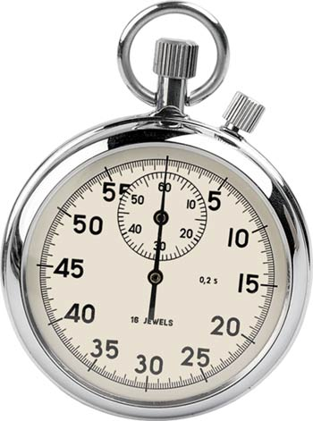
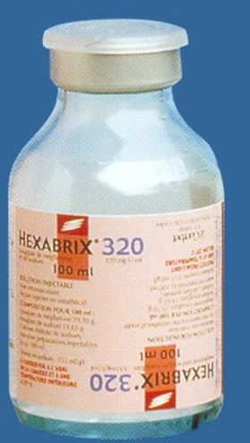
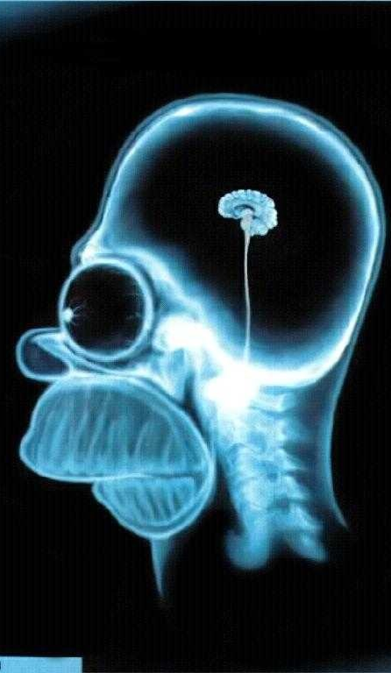
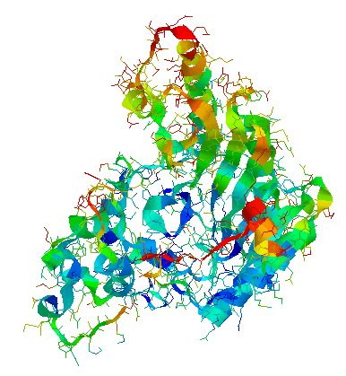
Down Side of Two Stents
CKmb

Slide 13
Keep It Open (KIO)
When the SB has ostial or diffuse disease AND when the SB is not suitable (too small) for stenting or clinically not relevant
6 Fr guiding catheter
Wire both branches
Dilate MB if needed
Stent MB and leave wire in the SB
Perform post-dilatation of the MB with jailed wire in the SB
Do not re-wire SB or postdilate or predilate SB
Notes:
13

Slide 14
Trapping the Wire
TULIPE study (N=186):
Failure to use a “jailed wire in the SB was an independent predictor of reintervention at 7 months (OR 4.26; 95% CU 1.27 –14.2)
Favorably modifies angulation
Maintains patency of SB
Identifies ostium when rewiring
Non-hydrophilic/no-shaping ribbon
Don’t trap large amount of wire
If trouble removing – balloon backup
Brunel et al CCI 2006;68:67-73

Slide 15
NORDIC 3: KISS vs No KISS
In a randomized clinical trial, to compare outcome of two side-branch strategies in coronary bifurcation lesions treated with main vessel stenting using sirolimus eluting stents
No kissing balloon dilatation
Kissing balloon dilatation

Slide 16
NORDIC 3: KISS vs No KISS
Primary end point
MACE (cardiac death, index lesion MI, TLR, stent thrombosis) after 6 months
2.9
2.9
%
ns
NO KISSING
KISSING
Notes:
16
16
This is the Bulleted List slide.
To create this particular slide, click the NEW SLIDE button on your toolbar and choose the BULLETED LIST format. (Top row, second from left)
The Sub-Heading and footnote will not appear when you insert a new slide. If you need either one, copy and paste it from the sample slide.
If you choose not to use a Sub-Heading, let us know when you hand in your presentation for clean-up and we’ll adjust where the bullets begin on your master page.
Also, be sure to insert the presentation title onto the BULLETED LIST MASTER as follows:
Choose View / Master / Slide Master from your menu.
Select the text at the bottom of the slide and type in a short version of your presentation title.
Click the SLIDE VIEW button in the lower left hand part of your screen to return to the slide show. (Small white rectangle)

Slide 17
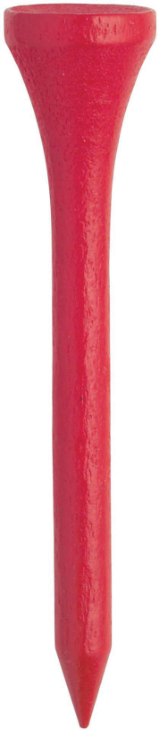
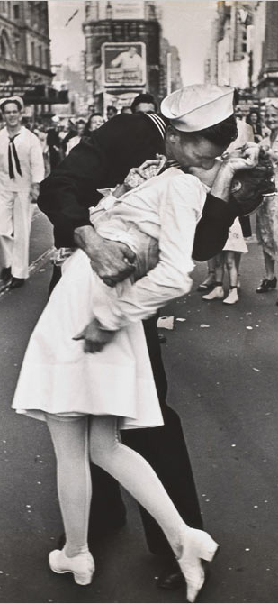
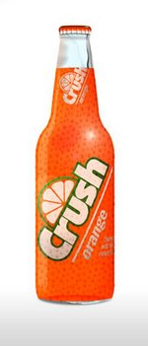
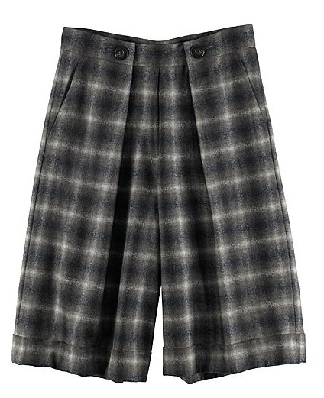
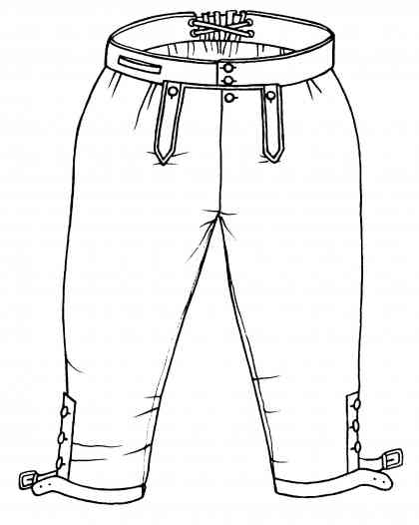
Two Stent Appoaches
T
Kiss (SKS)
Crush
Culotte
Notes:
17

Slide 18
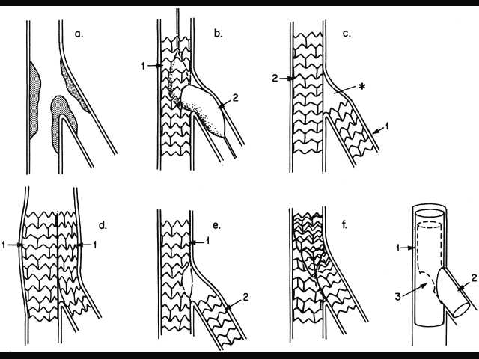
Various Techniques for Stenting Bifurcation Lesions
Bifurcation Lesion
Stent+PTCA
Stent+stent
(“T stenting”)
Stent+stent
(“reverse-T”)
TAP
Side-
branch
Main
vessel

Slide 19
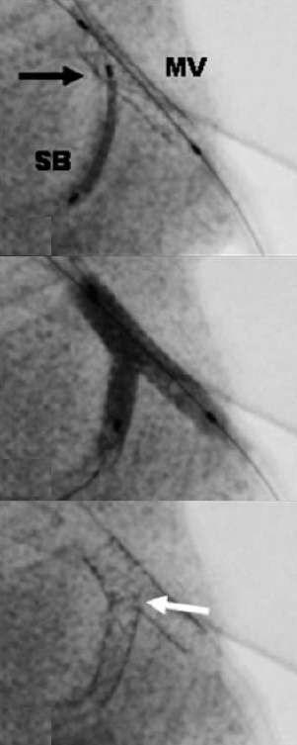
Reverse T Stenting
TAP: T-stenting and small protrusion
Stent main branch trapping wire
Rewire sidebranch
Dilate through struts of MB stent
Deliver SB stent (proximal end of SB stent 1 mm into MB)
Deploy SB stent (balloon in MB)
Pull back SB deployment balloon slightly and kiss
Exchange for non-compliant SB balloon – 2 step SB dilatation (high pressure in SB then Kiss)

Slide 20
T Stent Summary
Indications
  Bifurcation lesions with an angle between MB and SB of ~ 90 degrees.
  TAP default strategy when single stent strategy fails
Advantages
  The technique is easy, fast and not technically demanding.
Drawbacks
  When trying to position the SB stent exactly at the ostium without minimal protrusion into the MB the stent often misses the ostium (gap) – particularly true as the side branch angle becomes less acute

Slide 21
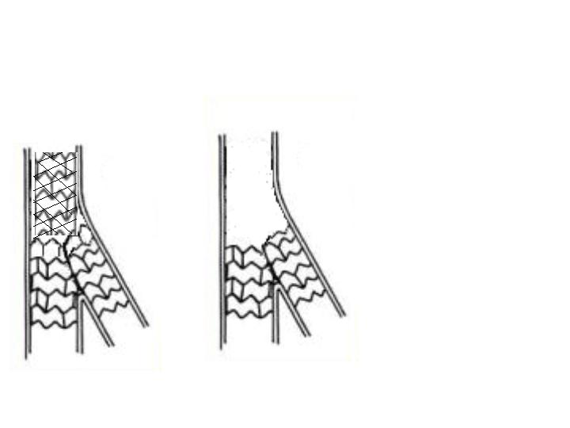

Various Techniques for Stenting Bifurcation Lesions
Bifurcation Lesion
Stent+PTCA
Stent+stent
(“T stenting”)
Stent+stent
(“reverse-T”)
Side-
branch
Main
vessel
Stent+stent
(“V” - < 5mm)
Stent+stent
(“Kissing” “SKS”)
“V”
1
1

Slide 22
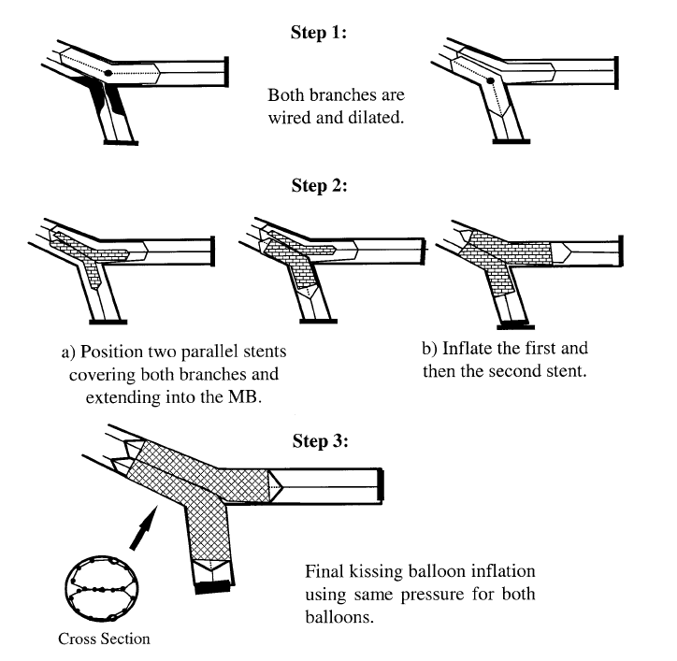
Iakovou et al. JACC
2005:46:1446-55.

Slide 23
Summary: SKS (V-stent)
Indication
  Medina 0,1,1 bifurcations - proximal MB relatively free of disease - angle between both branches < 90 degree.
Advantages
  Access preserved - no need for rewiring any of the branches. Its is relatively easy and fast.
Disadvantages
  Creation of a metallic neo carina (particularly the SKS) - with stent mal-apposition - several concerns:
    The risk of proximal dissection
    Re-intervention - rewiring the stented vessels may be complicated by wire passage behind stent struts.
    Restenosis in neo carina or proximal stent edge

Slide 24
Various Techniques for Stenting Bifurcation Lesions
Bifurcation Lesion
Stent+PTCA
Stent+stent
(“T stenting”)
Stent+stent
(“reverse-T”)
Side-
branch
Main
vessel
Stent+stent
(“V” - < 5mm)
Stent+stent
(“Kissing” “SKS”)
(“Crush”)
“V”
1
2
1
1
Stent+stent
(“Culotte”)
2
1

Slide 25
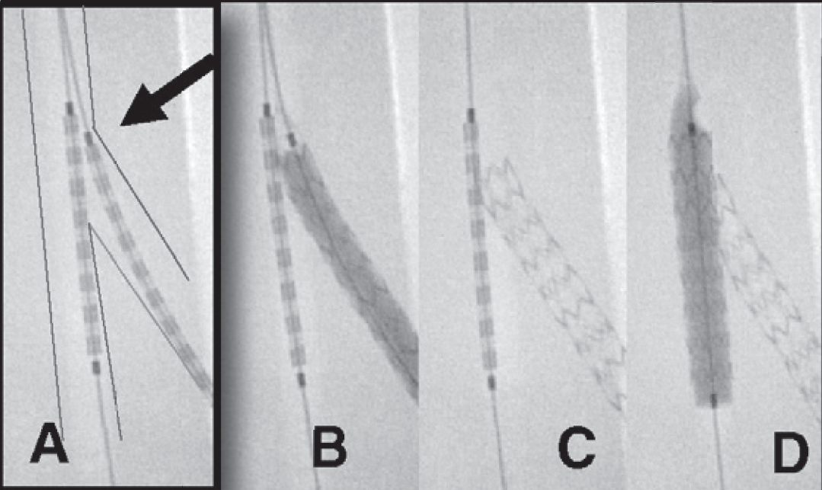
Mini-Crush
1-2 mm of SB stent positioned in MV (proximal SB stent marker on MB wire or SB just covers proximal edge of ostium)
The SB stent is deployed & stent balloon withdrawn slightly with high RBP inflation (flares proximal stent) – then angiogram to make sure no distal dissection
The SB is crushed by a MV balloon or a stent
Ormiston J, JACC Intervention 2008

Slide 26
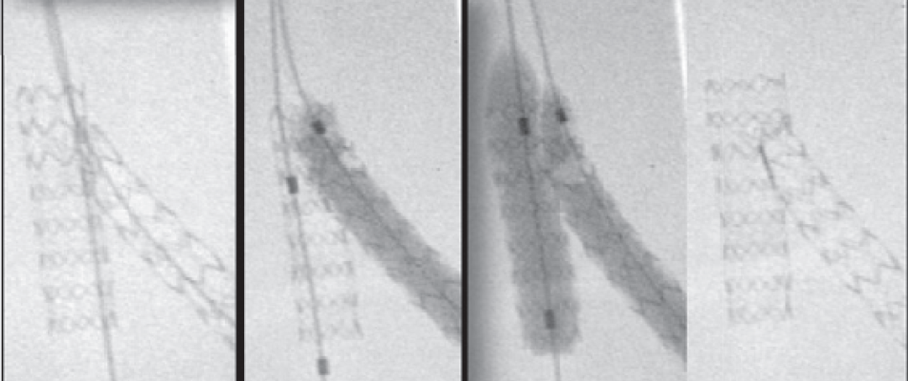
Mini-Crush
Rewire SB with two step dilatation
SB – high pressure dilatation NC balloon and then HP NC MB
Final kissing balloon inflation 12 ATM
Ormiston J, JACC Intervention 2008

Slide 27
Various Techniques for Stenting Bifurcation Lesions
Bifurcation Lesion
Stent+stent
(“V” - < 5mm)
Stent+stent
(“Kissing” “SKS”)
Stent+PTCA
“V”
Side-
branch
Main
vessel
1
1
(“Crush”)
(“Culotte”)
Stent+stent
(“T stenting”)
Stent+stent
(“reverse-T”)
2
1
2
1
Stent+stent
(“Culotte”)
2
1

Slide 28
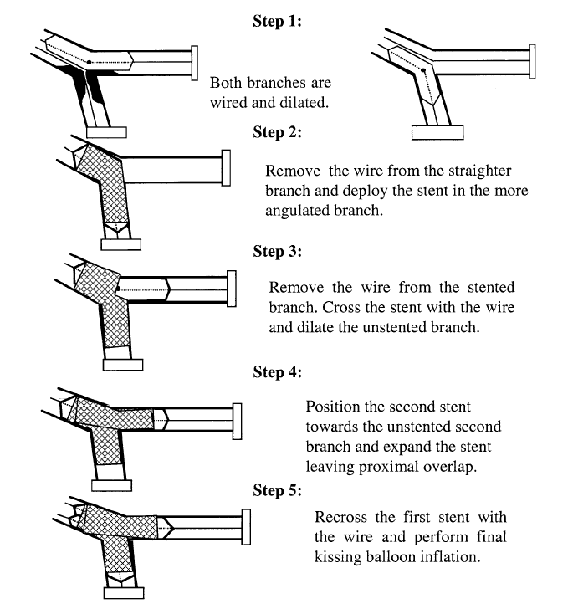
Culotte
Iakovou et al. JACC
2005:46:1446-55.

Slide 29
Proposed Approach to Bifurcation
True Bifurcation Lesion
(Significant Stenosis in MB and SB – Medina 1,1,1 – 1,0,1 – 0,1,1)
No
Yes
Provisional Stent Bailout
Sidebranch Suitable for Stenting
No
Yes
Stent MB & Wire/PTCA SB (KIO)
Sidebranch Disease Focal < 3mm
No - Diffuse
Yes
Elective MB and SB Stenting
Provisional SB Stenting

Slide 30
Proposed Approach to Bifurcation
Lesions with DES
Two Stents Necessary
(SB>2.5mm)
Long Plaque in Sidebranch
Severe Dissection pre-Dilatation
Unfavorable Geometry for Rewiring
Acute Side Branch Angle – Near 90º?
Yes
Mini-Crush
Culotte
  -- MB = SB
V-stent (0,1,1)
TAP
No
Modified T
TAP

Slide 31

Dedicated Bifurcation Stents

Slide 32
Bifurcations remain a problem for PCI
Immediate and long-term outcomes
Early and late stent thrombosis
Restenosis (esp at SB ostium)
Techniques with conventional stents are limited by
Technical difficulty Lack of SB security Multiple layers of stent High rate of TLR
Suboptimal ostial support and drug application

Slide 33
Classification
Red=BMS Yellow=DES
Side branch Access Stents (SB safety with 2 wires, deliver over 2 wires so may wrap, must rotate to align with SB, variable SB scaffolding, facilitate provisional SB stenting)
Taxus Petal, Nile CroCo, Pathfinder, Medtronic, Ariste (TriReme), Sidekick (Ymed)
B Dedicated Side-Branch stents (No provisional SB stenting option)
Sideguard (Cappella), Tryton
C Self expanding (delivery over one wire with limited SB protection, no need to rotate, facilitate provisional SB stenting)
Devax, Stentys

Slide 34
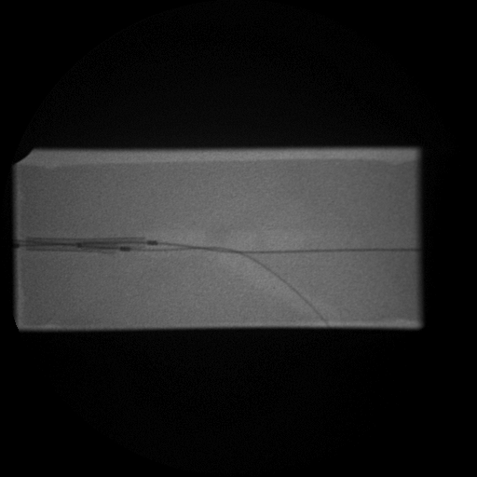
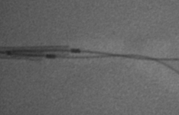
Wire wrap and rotational alignment can limit delivery of stents that deliver over two wires

Slide 35
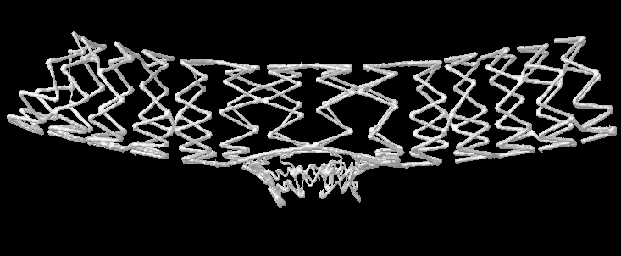
Taxus Petal (Boston Scientific)
SB access stent, 2 wires, passive rotation to align
  Unique SB ostial petals that fully scaffold and apply drug to the commonest site for restenosis

Slide 36
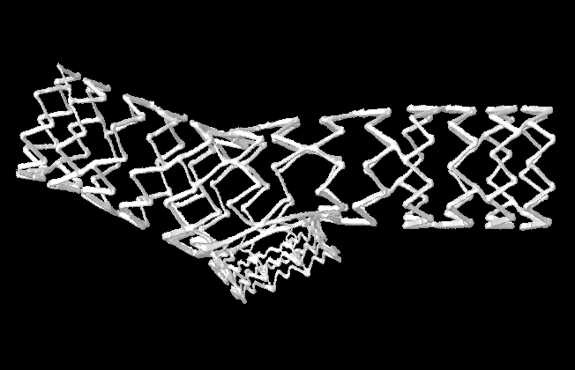
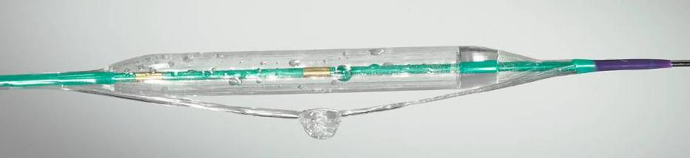
Taxus Petal SB access stent, wrap possible, passive rotation
  Platinum Chromium Alloy
  Unique SB ostial petals fully support apply drug to commonest site for restenosis
  7F guide
  Balloon expandable
  Droplet shaped SB balloon deploys petals
  Paclitaxel-eluting
  Taxus Petal Trial Phase 1 completed
CCI: 70-335-40 (2007) FIM
Ongoing OUS trials
Ormiston

Slide 37
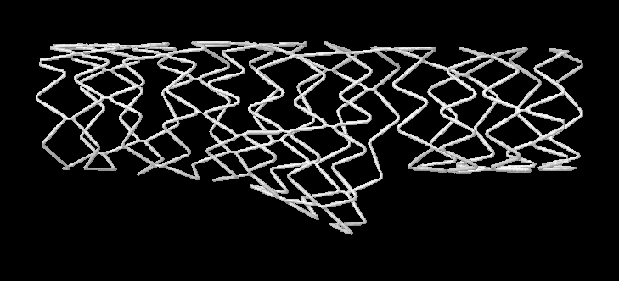
Nile CroCo (Minvasys)
SB access stent, provisional SB stenting, two wires with potential for wrap, passively rotates to align

Slide 38

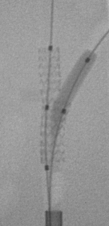
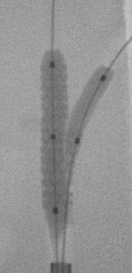
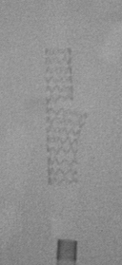
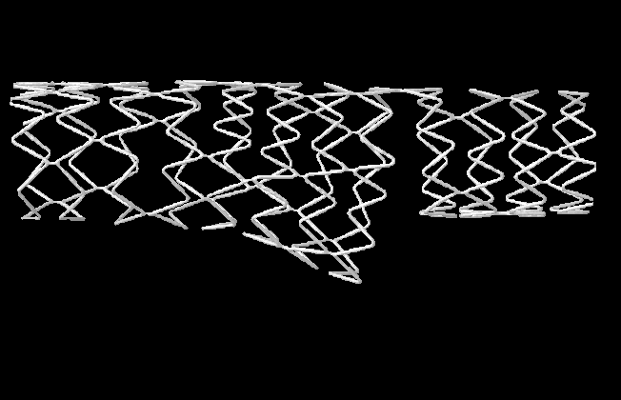
Nile CroCo (Minvasys)
  Balloon expandable cobalt chromium
  6F Compatible
  Partially scaffolds SB ostium
  Kissing with deploying balloon and tapered balloon to limit proximal overexpansion
  BMS currently
  Clinical trial completed
Ormiston

Slide 39
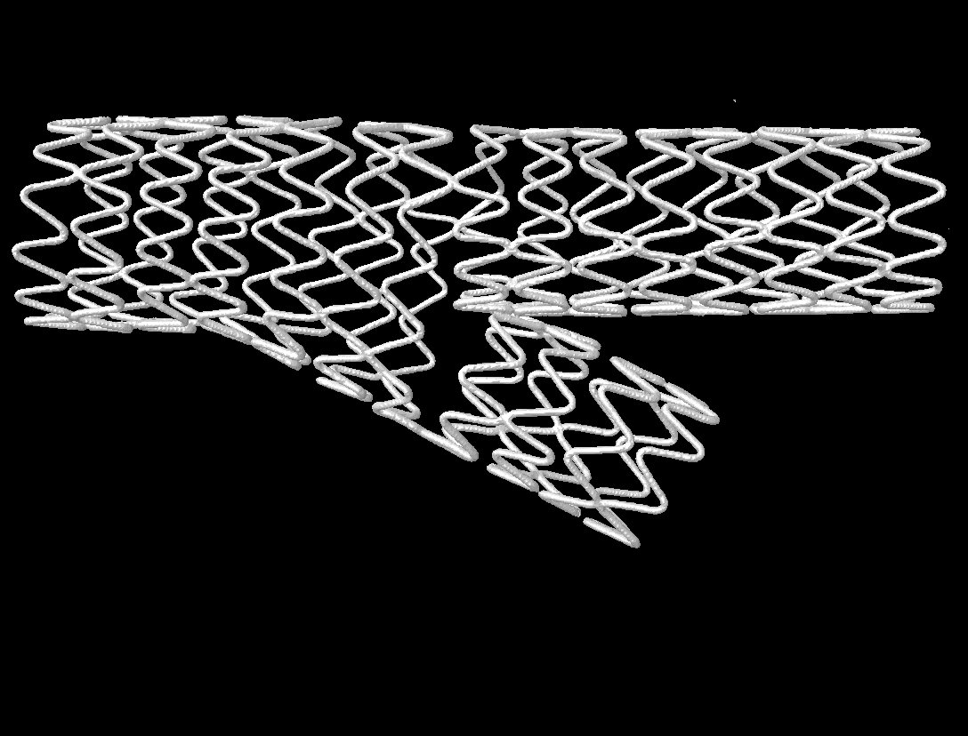
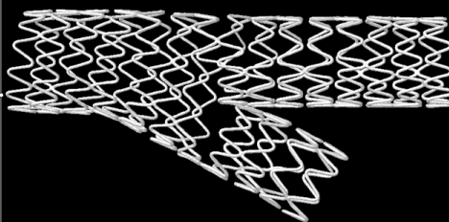
Medronic Dedicated Bifurcation Stent
Trouser design based on the Driver
SB access stent with provisional SB stenting option
Delivers over two wires after use of a “wire management system” that limits but does not abolish wrap
Passive rotation to align

Slide 40

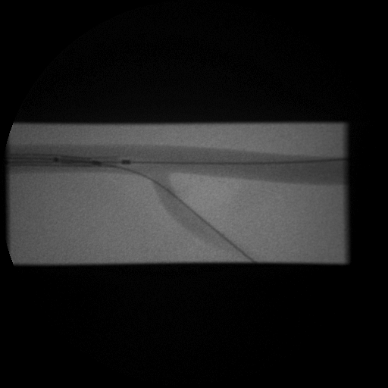
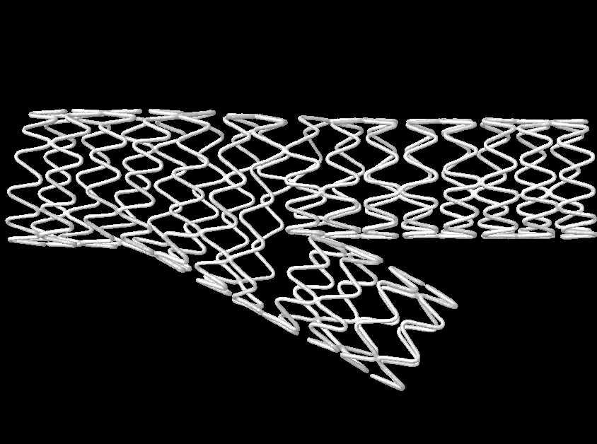
Medronic Dedicated Bifurcation Stent
Potential to support fully the SB ostium
BMS
?8F Guide
Branch Trial enrolling in New Zealand and Australia

Slide 41
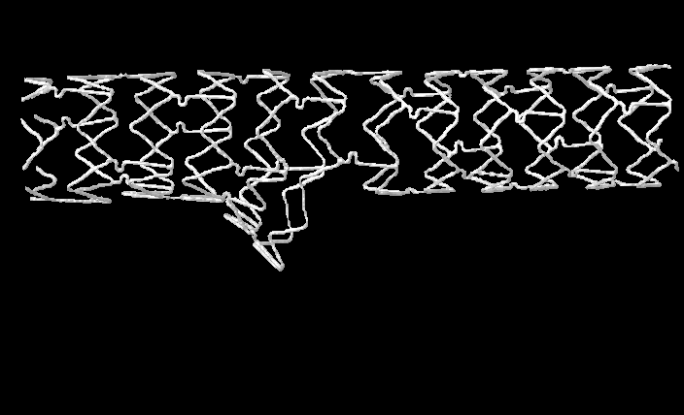
Pathfinder (Abbott)
Everolimus-eluting SB access stent

Slide 42
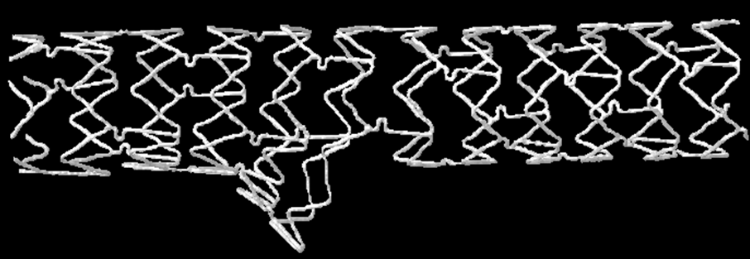
Pathfinder Everolimus-eluting SB access stent
Passive rotation
Cobalt Chromium balloon expandable- based on vision/Xience
Partially supports SB ostium
Everolimus-eluting

Slide 43
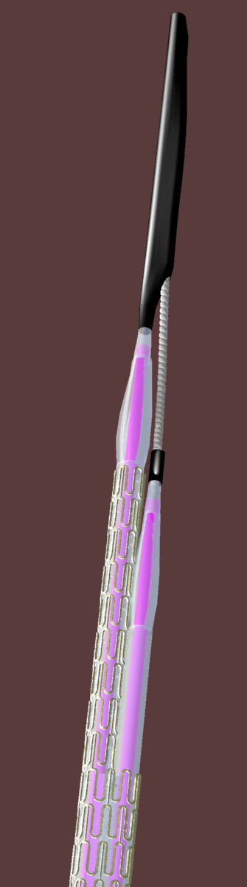
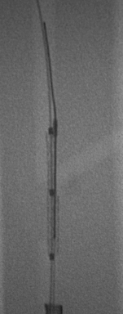
Pathfinder Drug-Eluting Side-Branch Access Stent has mechanism to limit wrap
Delivers over 2 wires
To limit wrap, the pathfinder is advanced to the bifurcation over 1 wire
A mandrel restrains SB component
Mandrel is removed and wire advanced to SB
Frontier

Slide 44
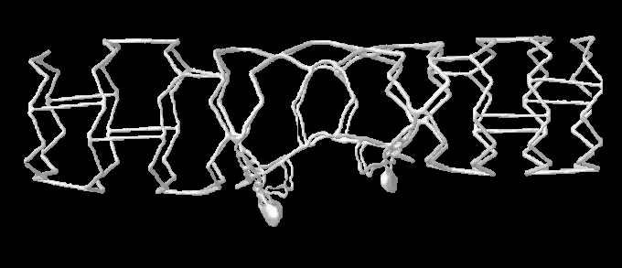
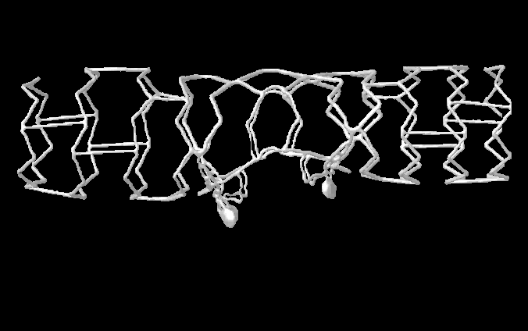
Ariste (TriReme Medical)
1. SB access stent 2. Wrap limited by concealed wire 3. Torqueable shaft- Active rotation to align

Slide 45
Ariste (TriReme Medical)
Balloon expandable
Stainless steel
Elements project into SB partially supporting the SB ostium
Profile similar to conventional stents
BMS
6F guide
FIM trial (BMS) completed

Slide 46
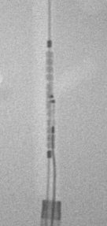
Ariste (TriReme Medical)
The stent is advanced over a single wire in MB to region of SB
1:1 Torquable shaft facilitates alignment of SB elements with SB

Slide 47

Ariste Stent Delivery and Deployment
1:1 Torquable shaft for alignment of SB elements with SB
Color coded side-branch stabilizing wire is advanced to SB (wrap limited)

Slide 48

Ariste, TriReme Medical
Ariste Stent Delivery and Deployment
1:1 Torquable shaft for alignment of SB elements with SB
Side-branch stabilizing wire is advanced to SB (wrap limited)
SB elements are deployed into SB ostium by differential strut motion of the MB cells as the stent is expanded
Kissing Balloon Post-dilatation

Slide 49


SideKick (Y-med Medical)
Delivery system for deployment of SB access stent
Two wires –one RX, the other fixed to limit wrap
Torqueable shaft actively rotates stent to align with SB
Expanded balloon
Fixed wire for MB
SB port for moveable wire
Torquable Hub

Slide 50




SideKick Delivery System (Y-med Medical)
Fixed wire in MB
6F (or 5F) Guide
FIM BMS completed
RX wire in SB
Side-kick is advanced to bifurcation over SB RX wire
No wrap because one wire is fixed, other RX
Torqueable shaft – active rotation to align with SB

Slide 51
Dedicated Side-Branch Stents
Elective SB stenting (no provisional strategy)

Slide 52

Dedicated Side-Branch Stents
Sideguard, Capella
Ormiston

Slide 53


Dedicated Side-Branch Ste Sideguard, Capella
Trumpet-shaped
Nitinol self-expanding stent mounted on delivery balloon
Conforms to anatomy
Single wire- no wrap
Does not need to rotate – no alignment issues
Elective SB stenting
MB usually stented, no provisional SB stenting
BMS
FIM trial

Slide 54

Dedicated Side-Branch Stents
Tryton Side-Branch Stent, Tryton Medical

Slide 55

Dedicated Side-Branch Stents
Tryton Side-Branch Stent, Tryton Medical
Stainless steel balloon expandable SB stent
3 ZONES
MB zone
Transition zone
SB zone-conventional design
Single wire delivery (no wrap or alignment)
6F
Elective SB, no provisonal SB
Facilitates “Culotte” with stent of operator choice
FIM trial completed
Acute and 6 mo data 100 pts
CCI: October 2010 in press

Slide 56

Axxess (Devax)

Slide 57

Axxess (Devax)
Conical shape
Self-expanding nitinol
Sheathed
Biolimus eluting
Delivers over single wire (no wrap) but limited SB protection
Does not depend on rotational alignment
SB partially protected
8F guide

Slide 58

Axxess (Devax)
Potentially “Spares” the carina
Provisional MB and SB stenting
Usually needs one or more additional stents
Diverge Trial has completed enrolment
>300 pts reported with 9 mo follow-up
JACC 2009;53:1031-39

Slide 59


Stentys (Stentys)
A self expanding stent
Interconnections between Z hoops are disconnected by balloon inflation to create SB access

Slide 60


Stentys (Stentys)
A self expanding stent
Self-expanding, sheathed
Nitinol
Drug-eluting
7F guide
Delivers over single wire so SB not fully protected
No wrap issues or rotation
SB balloon inflation disconnects interconnections
Limited SB ostial scaffolding
FIM early 30 d results
Eurointervent 2009

Slide 61
Limitations
Deployment in phantoms may not represent deployment in patients
Not all dedicated stents have been studied
Suboptimal deployments are not examined here
This is an overview

Slide 62
Dedicated bifurcation stents that deliver over 2 wires protect the SB, but have potential for wire wrap that may limit delivery. Need to rotate to align
Some devices have ways to limit wrap
Some devices have a torqueable shaft, and can be actively rotated (do not rely on passive rotation) to align with SB
Variable SB scaffolding
Dedicated SB stents do not allow provisional SB stenting
Some dedicated devices are drug-eluting

