Slide 1
HEART FAILURE WITH PRESERVED EJECTION FRACTION
Dr. Bhavesh Roy

Slide 2
Definition
The diagnosis of Heart failure with Preserved Ejection Fraction is based on the clinical finding of congestive heart failure with the echocardiography findings of preserved left ventricular ejection fraction and the absence of valvular abnormalities.
(ACC/AHA guidelines)

Slide 3
Symptoms of heart failure with normal or near normal ejection fraction (HFPEF)
Synonyms
Heart failure with normal ejection fraction
(HF nlEF)
Diastolic heart failure ( DHF) (rarely used)
EF usually more than 50%
Border line EF 40-50% also included

Slide 4
Ejection Fraction in Subjects with CHF in the Cardiovascular Health Study
4,842 community-dwelling elderly (>66 yr.) subjects; CHF prevalence 8.8%
80% had normal EF(>45%)
Men
Women
Normal (55%)
1
0
%
3
1
%
4
2
%
2
3
%
Mildly Reduced
(45% - 54%)
6
7
%
2
7
%
Moderately (30-44%) or severely reduced (< 30%)
Kitzman, et. al.Am. J. Cardiol. 87:413-419 (2001)
Notes:
The Cardiovascular Health Study (CHS) was a National Heart Lung & Blood Institute projects that enrolled 5,888 non-institutionalized,independent-living, community-dwelling participants ≥65 years in 4 counties from CA, MD, NC, PA. The prevalence of HF was reported in 4,842 of these subjects by Kitzman, et. al. last year. Of the 4,842 subjects, 425 had CHF. Of these, 2-D Echo was available of 272 (64%) of the subjects. Of these 272 subjects, 149 (55%) had and normal LV fxn and 67 (25%) subjects had mildly reduced systolic function. 69% of men and 90% of women carried a clinical diagnosis of HF and an EF>=45%. The overall prevalence of HF-PSF was 80%, but the prevalence of “isolated” diastolic heart failure was reduced to 42% when patients with prior MI, significant valvular disease, and COPD patients were excluded. This 42% prevalence rate of HF-PSF is similar to that reported by others.. [next slide]

Slide 5
13 Community Based Studies
1997- 2006
100
Median = 52% Mean = 55%
80
HF-PEF Prevalence (%)
60
40
20
0
Reviewed by Hogg K et al, 2004 and Owan T et al, 2005, Owan T, NEJM, 2006; Bursi F, JAMA, 2006

Slide 6
Characteristics of Patients with Reduced and Preserved LVEF
Baseline Variables
Reduced EF
Preserved EF
P-value
(<40%, n=1570)
(>50%, n = 880)
Mean LVEF %
25.9
62.4
<0.001
Age-years
71.8 ± 12
75.4 ± 11.51
<0.001
Female (%)
37.4
65.7
<0.001
Coronary artery disease (%)
48.7
35.5
<0.001
Angina (%)
28.0
22.8
<0.005
Prior myocardial infarction (%)
39
16.6
<0.001
Prior CABG (%)
12.9
5.8
<0.001
Hypertension (%)
84
91
<0.001
Diabetes (%)
38.9
31.7
<0.001
Atrial Fibrillation (%)
23.6
31.8
<0.001
COPD (%)
13.2
17.7
<0.002
Hemoglobin <10 g/dl (%)
9.9
21.1
<0.001
Systolic blood pressure-mm Hg
146
156
<0.001
Bhatia et al. NEJM 2006;355:251-9
Notes:
6
Key Point: Anemia appears to be more common in HF patients than in the general population, ranging in prevalence from 16% to 48% in the HF population.
References:
1. Herzog CA, Guo H, Collins AJ. The prevalence of CHF, chronic kidney disease, anemia, and multiple comorbid conditions in the Medicare population [abstract 228; S63]. 6th Annual Scientific Meeting of the Heart Failure Society of America: September 22-25, 2002; Boca Raton, Fla.
2. Ezekowitz JA, McAlister FA, Armstrong PW. Anemia is common in heart failure and is associated with poor outcomes: insights from a cohort of 12 065 patients with new-onset heart failure. Circulation. 2003;107:223-225.
3. Kosiborod M, Smith GL, Radford MJ, Foody JM, Krumholz HM. The prognostic importance of anemia in patients with heart failure. Am J Med. 2003;114:112-119.
4. Tang WHW, Miller H, Partin M, Harris CM, Young JB. Anemia in heart failure: a single-center experience [presentation]. 52nd Annual Scientific Session of the American College of Cardiology: March 30 to April 2, 2003; Chicago, Ill.
5. Horwich TB, Fonarow GC, Hamilton MA, MacLellan WR, Borenstein J. Anemia is associated with worse symptoms, greater impairment in functional capacity and a significant increase in mortality in patients with advanced heart failure. J Am Coll Cardiol. 2002;39:1780-1786.
6. Anker SD, Sharma R, Francis D, et al. Patients with chronic heart failure (CHF) in the ELITE II trial [abstract 2335]. Circulation. 2002;106(suppl): #19 I-II-I 992.

Slide 7
Comorbid conditions/Risk factors
Age
Gender
Hypertension
Cor. Artery disease
Atrial fibrillation
Diabetes
Renal dysfunction
Anemia
Obesity

Slide 8
Pathophysiology
Abnormal diastolic function
Subtle abnormalities of Systolic function
Ventricular-arterial Coupling
Decreased arterial distensibility
Chronotropic Incompetence

Slide 9
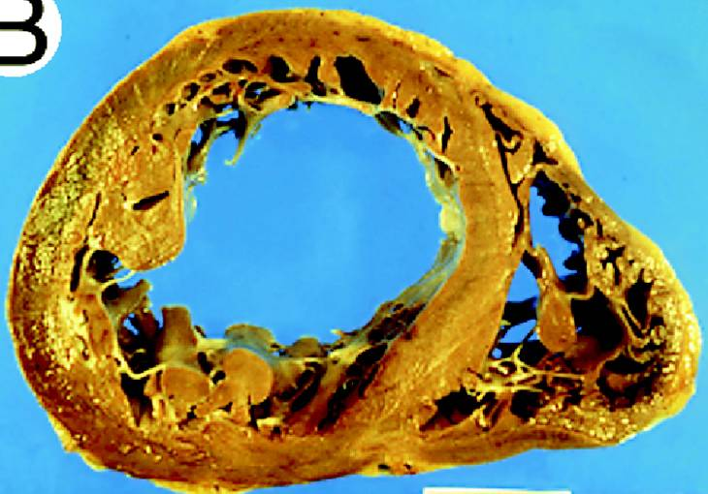
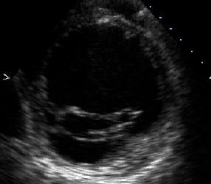
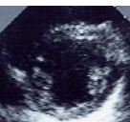
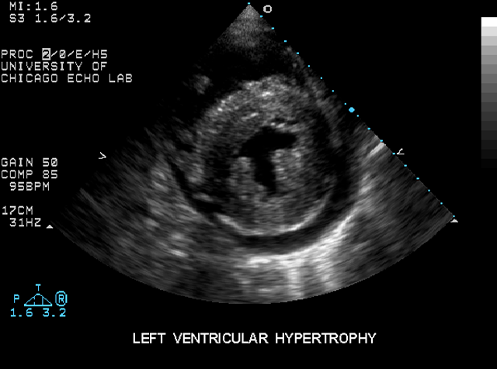
Systolic
Heart Failure
Normal
Diastolic
Heart Failure
Aurigemma, Zile, Gaasch
Circulation 2005

Slide 10
DIAGNOSIS OF HF-PEF
Symptoms and clinical signs of HF
Absence of a major co-morbid condition that mimics an HF presentation (CKD, COPD, Anemia)
Echocardiographic abnormalities: increased LV Mass, LA size, Doppler parameters of diastolic dysfunction
Elevated Natriuretic Peptides

Slide 11

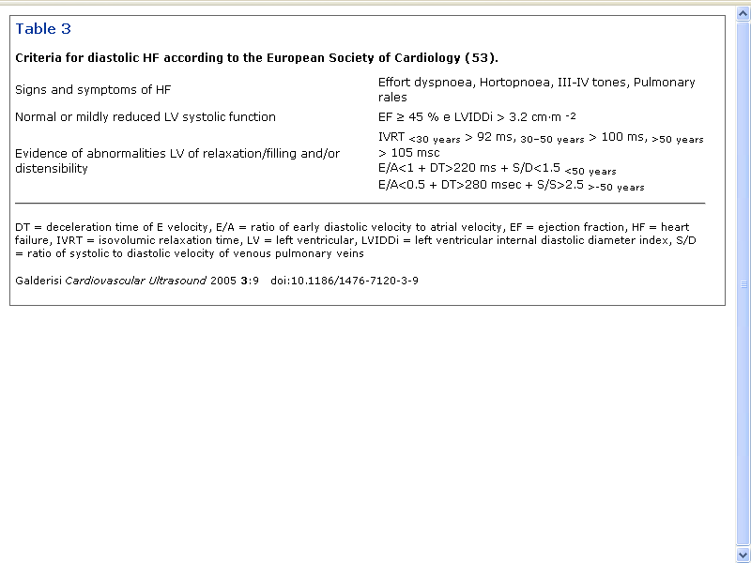
DHF
(2003)
Orthopnoea

Slide 12
Clinical Types
Acute decompensated HFPEF
Raised JVP, rales, edema
Severe DOE, PND,Orthopnea
PVH, interstitial edema
Elevated BNP
Usually with AF or Hypertensive urgencies
Mild/chronic type
Difficult to diagnose
Usually evaluated for non cardiac dyspnea

Slide 13
The typical patient with HFPEF is an elderly woman with a history of hypertension often with diabetes whose heart failure is episodic often precipitated by an episode of AF, ischemia or infection.

Slide 14
Mechanisms for Diastolic Dysfunction
Delayed relaxation
(↑ Tau)
Increased stiffness
(↓chamber compliance)

Slide 15
Hemodynamic diagnosis
Assessment of left ventricular relaxation (active energy dependent process)
Time constant of relaxation Tau (rate of LV pressure decay during IVR )
High fidelity manometric catheters in LV
Pressure and time data from end systole (peak dP/dT to onset of LV filling LA-LV cross over or 5mm Hg above LVEDP used to calculate Tau
Normal value <40-50 ms
Relaxation complete by 3.5 Tau (<140 msec)

Slide 16
LV Diastolic Stiffness
EDPVR - simultaneous assessment of pressure and volume during acute alteration in preload
LV diastolic stiffness is affected by
Cardiac extra cellular matrix
Cellular processes at myocyte level and myofibers
Difficult to perform and not used routinely

Slide 17
Echocardiography
Variable degrees of LV enlargement
LVH criteria met in less than 50%
Increased wall thickness
Increase in LA volume
RWMA may be present
RV enlargement
Pulmonary arterial hypertension

Slide 18
Dopler Echo cardiography
Impaired Relaxation E/A reversal (normal LAP)
Elevated LAP pseudonormalisation
Restrictive pattern in severe increase in LV diastolic stiffness
Increased E vel, decreased A vel,and decreased DCT
Trans mitral flow patterns alone cannot be used to assess relaxation in all patients

Slide 19
Tissue doppler imaging
Mitral annular ascent velocity during early diastole (E’ velocity) preload independent measure of LV relaxation
Correlates with Tau
E/E’ ratio predicts elevated filling pressures
Other methods
Pulmonary venous flow velocity
Valsalva maneuvre

Slide 20
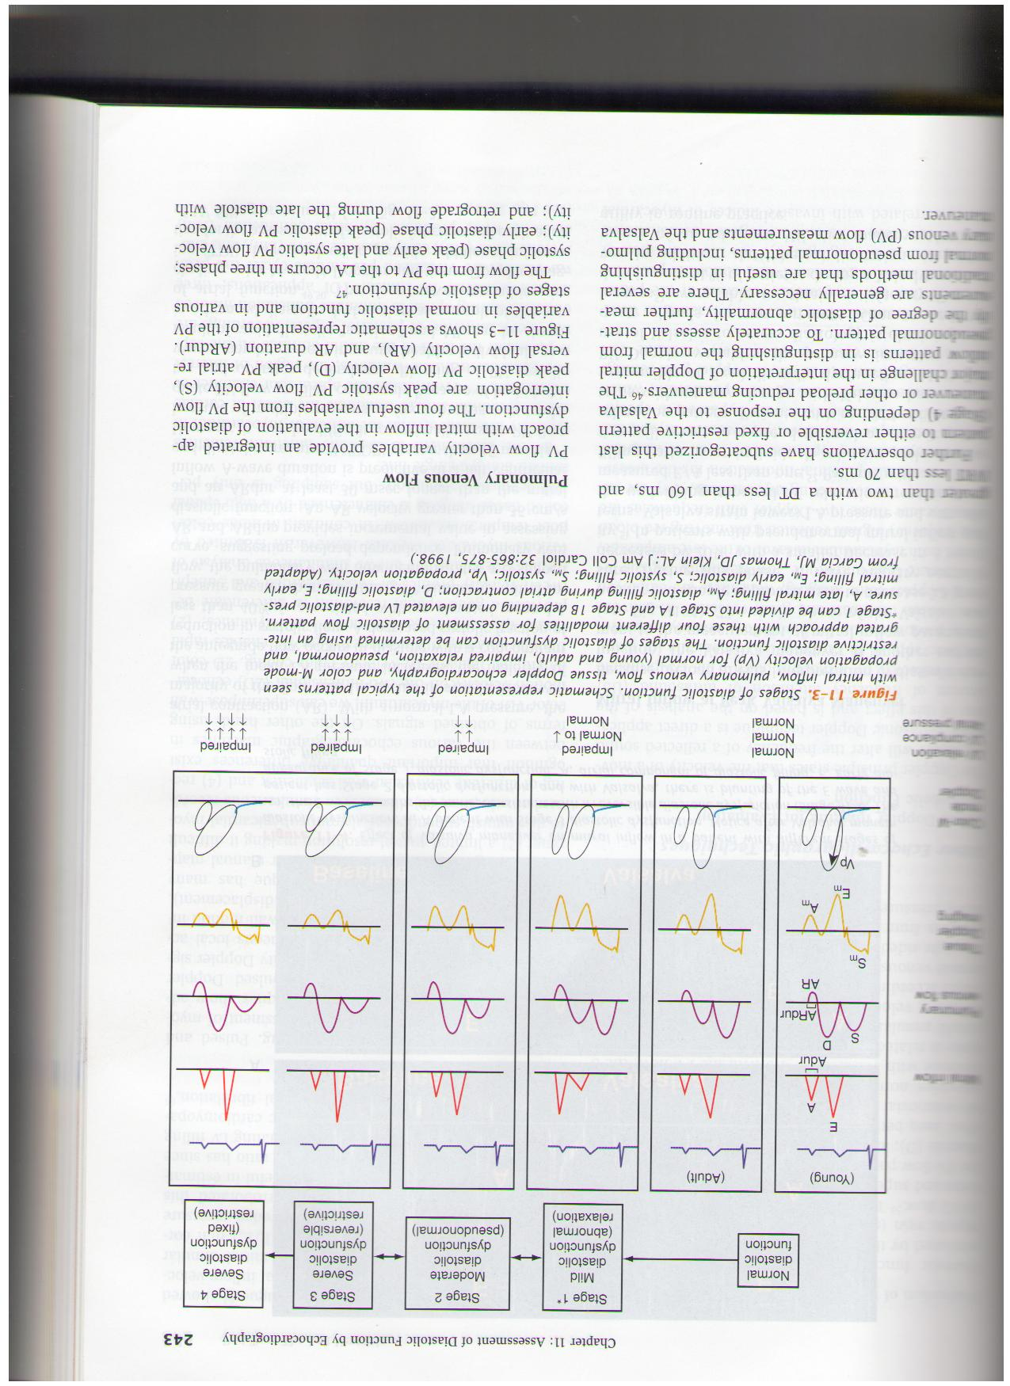
Diastolic Dysfunction – Doppler Evaluation
DHF
MMMMV
PPVV
TDI
Color
M mode
LV relax
Compliance
LA Pressure

Slide 21
Biomarkers
BNP and N Terminal –Pro BNP are elevated in HFPEF
Levels lower than in systolic heart failure
Standard value of 100 pg/ml may not be ideal as older women tend to have values >100 pg/ml
Higher values highly predictive of future events.

Slide 22
PROGNOSIS
Mortality of HFPEF similar to SHF
Only small differences in survival (better in HFPEF)
No advances in the treatment of HFPEF while significant advances have been made in SHF
Death due to non cardiac causes more common in HFPEF (49%) than in SHF (36%)
Henkel et al Circuln Heart Fail 2008
Drug treatment same as for SHF

Slide 23
Treatment of HFPEF
Diuretics
Verapamil
Digoxin
Beta blockers
Hydralazine/ISDN
Ace inhibitors/ ARBs

Slide 24
Management principles for patients with diastolic heart failure
Management principles for patients with diastolic heart failure, continued

Slide 25
Management principles for patients with diastolic heart failure
Management principles for patients with diastolic heart failure, continued

Slide 26
Important Differences in the Mode of Death in HF-PEF versus HF-REF
Mode of Death | I-Preserve | HF-REF
Sudden Death | 26 | 28
Heart failure | 14 | 45
Sudden/HF deaths | 1.9 | 0.6
MI | 5 | 6
Stroke | 9 | 5
Non-Cardiovascular | 30 | 15
Zile et al. Circulation 2010

Slide 27
Major clinical Trials
DIG Digoxin did not change mortality but reduced hospitalisation
Charm –Preserved Candesartan in addition to standard therapy vs placebo and std therapy
I-Preserve Irbesartan did not affect the end points in HFPEF but reduced hospitalisations
PEP-CHF Perindopril vs placebo
SENIORS nebivilol main effect on decrease in hospitalisations

Slide 28
Ongoing Trials
TOPCAT
Sitaxsentan sodium and spironolactone
Results expected in 2013
RELAX trial
Sildenafil in HFPEF

Slide 29
Recommendations ACC/AHA 2005
Control systolic and diastolic HTN
as per guidelines Class 1 A
Control VR in AF Class 1 C
Diuretics for edema and
Pulmonary congestion Class 1 C
Cor. Vascularisation
in symptomatic patients Class 11 a C
Restore and maintain Class 11 a C
SR in AF
BB, ACEI,ARBsCCBs in pts with Class 11 b C
Controlled HTN
Role of digitalis not well established Class 11 b C

Slide 30
THANK YOU

