Slide 1
Second Heart Sound
Dr Bikramaditya Padhi
Assistant Professor
Dept of Cardiology
SBKS MI & RC

Slide 2
INTRODUCTION
End of the ejection phase of systole.
Closure of the semilunar valves.
Two semilunar valves – Aortic and pulmonary.
  Two components for the S2 – 1st Aortic component (A2) and 2nd pulmonary component (P2).

Slide 3
Mechanism of Formation of S2
Systole - blood ejected → Ao and PA → aortic and pulmonary pressures rise → Ao and PA become distended.
End systole - Ventricular pressures fall, elastic components of the great vessels maintain higher pressure → pressure gradient → drives blood column back into ventricles.
Blood column in the great vessels flows towards the ventricles at this time because of the lower resistance with the dropping ventricular pressures compared to the periphery.
This reverse flow of blood column in Ao and PA parachutes AoV and PV cusps → closing them.
Dissipation of energy → A2 and P2 components of S2

Slide 4
Sounds A2 and P2 represent ---- abrupt tensing of closed leaflets
  as the valves, great vessels, ventricle outflow tracts and blood mass oscillate with an intense medium to high frequency vibrations.

Slide 5
Normal S2
Sharper and shorter (compared to S1).
  Semilunar valves close at much higher pressures than the A-V valves.
  Dissipated energy in the columns of blood is much greater.
Normal (SPLIT SOUND) – Often both components of S2 can be heard.
Higher resistance to forward flow in the systemic circulation →early reverse flow in aortic root → Early closure of aortic valve → A2.
Pulmonary arterial bed offers markedly less resistance to forward flow → reverse flow occurs late and slower compared to the left side → P2.
In addition, lower pressures of RV during systole → slower rate of RV relaxation compared to LV → P2 component occurs late.

Slide 6
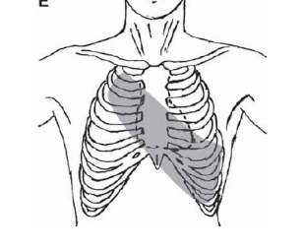
A2 – Area extending from second Rt. ICS at the sternal border to apex.
P2 – Second and third Lt. ICS near the sternal border.
Normal P2 is somewhat softer than A2, even at Pulmonary area.
Splitting of the normal S2 is best appreciated at the second and third left intercostal space.

Slide 7
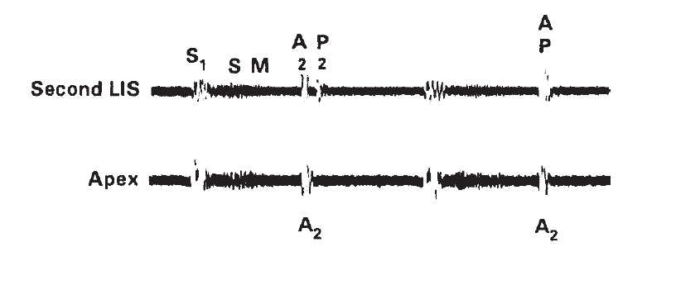

Slide 8
Intensity
Aortic Component
Amplitude and intensity of A2 and P2 are directly proportional to the rate of change of the diastolic pressure gradient that develops across the semilunar valves.
Normally – diastolic pressure gradient in Ao > PA, which explains the normal increased intensity of A2 compared with that of P2.
A2 is louder than P2 normally and in most abnormal states, unless PH is present or sound of aortic closure is diminished.

Slide 9
The Increased Intensity
Decreased Intensity
Systemic hypertension.
Aneurysm of the ascending aorta.
Immobility of calcified, sclerosed aortic valves in calcific aortic stenosis.
AR – resulting from fibrosed and retracted aortic valve leaflets, as in syphilitic AR, aortic component of the S2 is decreased in intensity.

Slide 10
Pulmonic Component
Softer than A2.
Normal P2 – Rarely audible at the apex.
Increase in intensity of P2 – pulmonary hypertension, irrespective of its etiology.
In only approximately 5% of healthy subjects, and only when they are young (<20 years old), P2 can be recorded by phonocardiography over the cardiac apex.
Palpable P2 over the left second ICS → severe pulmonary hypertension.

Slide 11
P2 heard at apex without PH:
  Cardiac apex occupied by RV (large ASD).
  Widely split S2 secondary to RBBB.
Decreased intensity of P2 – Reduction in PA diastolic pressure (pulmonary valve stenosis).
Absence of P2 – congenital absence of the pulmonary valves.

Slide 12
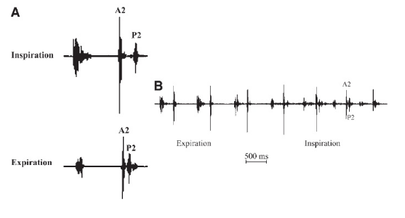
Splitting
In adults, the splitting of S2 during expiration is not appreciated - degree of splitting usually does not exceed 30 ms.
Inspiration – splitting is easily appreciated.
Splitting of the S2 should be assessed during normal respiration - diaphragm of the stethoscope over left 2nd and 3rd ICS close to the sternal border.
Normally, A2 precedes P2.

Slide 13
Normal splitting of the S2 primarily results from the differences between PA and Ao hangout times .
LV ejection starts a few msec. before the onset of RV ejection → contributes to the earlier completion of LV ejection → accounts for 10 to 15 ms of the degree of splitting of the S2.

Slide 14
Whenever a subject has audible expiratory splitting (interval of atleast 30-40 msec) of S2 in supine position, examination should then be done in sitting or standing.
RV systole shortens more than LV systole in sitting or standing → enhanced respiratory variation of S2 in upright.
In normal cases, audible expiratory splitting of S2 in supine position → sitting/standing → single S2.
In abnormal cases, audible expiratory splitting of S2 → Further increase in A2-P2 interval on inspiration.
  If no detectable change in interval → Fixed splitting.

Slide 15
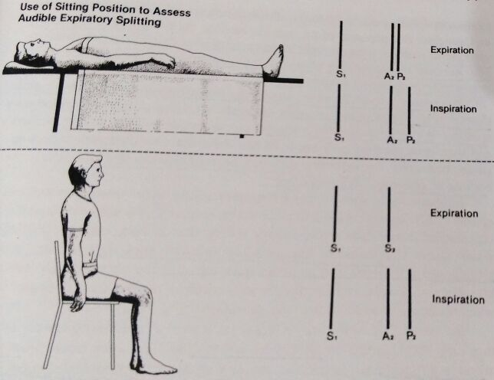

Slide 16
Normal Respiratory Variations of A2-P2 Split
INSPIRATION
Both components tend to move away from each other.
Increased venous return because of the fall in the intra-thoracic pressures.
EXPIRATION
Both components tend to move closer to each other.
There is also expansion of the lungs, resulting in decreased resistance in the pulmonary circulation and increased pulmonary vascular capacity, leading to a slightly decreased left-sided filling.
These changes affect both components of the S2 in terms of their timing, causing the A2 to come earlier and the P2 to be delayed.
The lungs collapse, the pulmonary capacity will diminish, and the resistance will rise. These changes will result in P2 occurring early on expiration.
A2 is affected to a very small degree because the systemic resistance is not affected by respiration.
Rise in intra-thoracic pressure, venous return to the right heart decreases and RV ejection time will shorten.

Slide 17
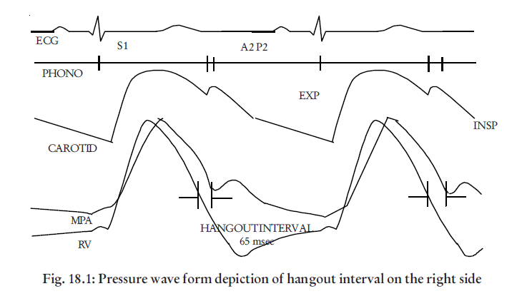
Hangout interval - Interval between the end of ventricular ejection and the closure of the semilunar valves.

Slide 18
Normal PVR is 10-20% of SVR → Forward flow during systole continues in PA over a longer period of time than flow in Ao.
Hangout interval in Ao < PA. (PA ~ 2-5 times Ao)
PA may be as long as 60 to 70 ms; A0 as short as 15 to 30 ms.
Difference between PA and Ao hangout times determines the degree of splitting of the S2, both in physiologic situations and in many pathologic conditions.
Hangout time also is determined by the compliance of Ao and PA.
Normally, Ao is much stiffer than PA, characteristic that accounts for the shorter hangout time in Ao than PA.

Slide 19
Inspiratory splitting therefore depends upon:
  Increased PA hangout interval (2/3rd contribution)
  Increased RV systole time (1/3rd contribution)
Inspiration → Reduction LV stroke volume and LV ejection time → A2 occurs slightly earlier. (negligible contribution)

Slide 20
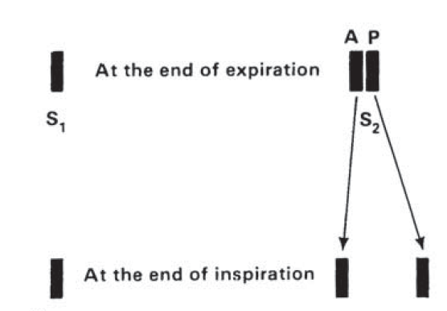

Slide 21
Common factors altering S2
Inspiratory splitting
Delay or Shortening of RV or LV systole
Alteration in great vessel resistance and distensibility.
  Disturbances of ventricular electrical activation.
  Abnormal contractile performance.
  Outflow obstruction.
  Changes in Vascular Resistance.
Intensity
Elevation of pressure in Ao or PA → more rapid and forceful deceleration of blood at en-systole → Increased amplitude of S2.

Slide 22
Wide Splitting
In adults, S2 splitting during expiration → abnormal wide splitting of the S2 should be suspected.
Inspiratory increase in the degree of splitting of S2 indicates → delay in PV closure sound.
Widely split S2 during expiration (with further increase in splitting during inspiration)
  RBBB (most common cause).
  LV pacing (also produces RBBB type of conduction disturbances).
Wide splitting of the S2 in conduction disturbances occurs from delayed activation of RV → delayed completion of RV ejection.

Slide 23
Wide splitting of the S2
  Delayed P2 (prolonged RV systole)
    Complete RBBB
    PS
    Massive pulmonary embolism
    PH with RV failure
    ASD
  Early A2 (shortened LV systole)
    Severe MR
    VSD (both shorten LV systole and prolong RV systole).
    Pericardial tamponade (reduction in LV stroke volume > RV stroke volume).
    Constrictive pericarditis (LV volume reduction, RV volume fixed)

Slide 24
Single Second Heart Sound
Single S2 --- absence of either of the two components of the S2 or from the fusion of A2 and P2 without the inspiratory splitting.
Most common cause -- inability to hear the faint P2 because of COPD, obesity, or even normal but accentuated respiratory noise.
Another common cause -- advanced age → Decreased inspiratory delay in P2, rather than a delayed A2.
Decreased inspiratory delay of P2 probably results from a decreased right-sided hangout interval related to aging changes in the pulmonary artery compliance.
All conditions that can delay A2 may produce a single S2 when the splitting interval becomes less than 30 ms.

Slide 25
Single S2 → conditions in which one component of the S2 is absent or inaudible.
  e.g., severe TOF, TOF with Pulmonary atresia, severe PV stenosis, severe AS, pulmonary atresia, and tricuspid atresia.

Slide 26
CLINICAL ASSESSMENT OF S2
S2 is a sharper, crisper sound.
Marks the end of systole and beginning of diastole.
With normal heart rates, diastole is longer than systole.
JVP contour is normal and visible → S2 coincides with systolic descent or the x′ descent.
When assessing the S2, one needs to pay attention to:
-intensity.
-the nature of the individual components.
-variation with respiration.

Slide 27
A2 is equally loud at LV apex as it is in 2nd right ICS.
The intensity of theA2 does not vary with respiration.
A2 is never palpable unless significant systemic hypertension is present.
  Exception – TGA (whether congenitally corrected or not) where the aortic root is anterior, superior, and leftward.

Slide 28
P2 often can be noted to increase in intensity with inspiration.
Increased volume in the right side → greater RV stroke volume → distending the pulmonary root to a greater degree.
Palpable P2 → s/o pulmonary hypertension (2nd LIS) ~ PASP at least 75 mmHg.
P2, is never heard normally beyond the second and third left interspace.
Loud P2 – when heard at an another area (pulmonary hypertension or RV is enlarged because of a volume-overload state).

Slide 29
Pulmonary
P2 is never heard normally beyond the second and third left interspace
P2 is not usually audible at the normal apex area, which is usually formed by the left ventricle
P2 often can be noted to increase in intensity with inspiration.

Slide 30
Aortic
A2 is equally loud at LV apex as it is in second right intercostal space, and it may occasionally be loudest at the apex
A2 is never palpably loud unless significant systemic hypertension is present.
The intensity of theA2 does not vary with respiration.

Slide 31
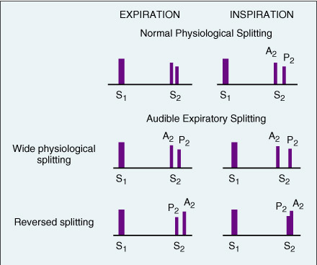

Slide 32
Young, thin individuals and children → thinner chest wall → P2 may be normally audible over a larger area (easy audible split of the S2).
In patients older than 60 yrs. → poor chest wall compliance as well as age-related increase in pulmonary impedance → unusual to hear a good split of S2.
Therefore, split S2 in the elderly is often abnormal and deserves clarification.

Slide 33
Proper identification of Systole:
  Difficult to distinguish S1 from S2 in rapid tachycardias or with severe myocardial disease.
  Also in MS, MVP ---- OS and midsystolic click can mistaken for S1 or S2 (during tachycardia).
  PALPATE CAROTIDS or APEX IMPULSE.
Begin auscultation as base.
S1 is louder at apex.
Inspiratory motion of A2 and P2 will identify S2.

Slide 34
Mechanisms and causes Of Single Second Sound
Disease | Mechanism
Truncus arteriosus | Only one semilunar valve is present
Pulmonary atresia | Semilunar valve is atretic
TGA | Posterior location of pulmonary valve
AS or PS, Severe TOF. | Severe stenosis of one semilunar valve
Eisenmenger VSD, Single ventricle | RV and LV systoles are identical in length.

Slide 35
Wide split second heart sound
Causes | Mechanism
Moderate to severe PS Severe PAH Acute pulmonary embolism ASD, Severe RVF | Prolonged RV ejection
RBBB LV pacing LV ectopy | Delayed electrical impulse to RV
Idiopathic dilatation of pulmonary artery, ASD | Increase in hangout interval
Severe MR | Earlier completion of LV ejection
Restrictive cardiomyopathy HCM Constrictive pericarditis | Impaired diastolic filling

Slide 36
Reversed Splitting
S2 is maximally split on expiration → narrows or fuses on inspiration.
LV electromechanical systole is significantly delayed → Delayed A2.
Expiration → Prolonged LV systole → A2 after P2 (audible expiratory splitting).
Inspiration → P2 normally gets delayed, but A2 shortens or unchanged.
P2 comes so close to A2 that S2 is heard as one sound to human ear.
A2 I I P2 (normal)
I P2 I A2 (expiration)
P2II A2 (inspiration)

Slide 37
Mechanism And Causes Of Reversed Splitting
Causes | Mechanism
LBBB RV pacing RV ectopy | Delayed electrical activation of LV
Sever AS Severe Hypertension Acute MI Severe AR Large PDA | Prolonged LV mechanical systole
Aneurysm of ascending aorta Post stenotic dilation in AS | Increase of hangout interval on aortic side
Severe TR WPW syndrome right lateral pathway | Early pulmonary closure
In patients with AS, reversed splitting in absence of LBBB indicates hemodynamically significant AS.

Slide 38
Mechanisms And Causes Of Fixed Split
RV or LV stroke volume doesn’t change during inspiration
Similar degree of alteration in both RV and LV filling.
  Narrow fixed A2-P2
  Wide fixed A2-P2 (more noticeable).
Causes | Mechanism
ASD | Defect in interatrial septum allowing free communication between two atria
All causes of wide split with associated severe RVF Acute/Chronic Pulmonary embolism. | RVF failing to increase the stroke volume from the increased venous return
Fixed splitting → confirm after ausculatation in both supine and upright position.

Slide 39
Causes And Mechanism Of Loud A2
Causes | Mechanism
Systemic hypertension | Elevated pressure beyond valve Dilated ascending aorta
Aneurysm of ascending aorta | Dilatation of vessel
AR | Aortic root disease Dilated ascending aorta
Congenital bicuspid aortic valve | Thickened but mobile aortic leaflets
Increased flow in central Ao.
Increased Pressure in central Ao.
Ao root dilatation.
Thickened Aortic Valve leaflets – retaining good mobility
CHD – Anterior Ao.

Slide 40
DECREASED A2
Valvular AS → Extensive leaflet distortion, fibrosis, calcification.
Aortic valve sclerosis → Thickened valve tissue dampens oscillations of leaflets.

Slide 41
Loud P2
Almost always indicates Pulmonary Hypertension (PH).
TWO AUDIBLE components of S2 at Apex → PH.

Slide 42
Loud P2
CAUSES | MECHANISM
Normal in infants and children | High pulmonary arterial pressure
Adults with chest deformity or thin chest | Proximity of pulmonary artery to steth.
PAH | Higher closing pressure of valve, Dilated PA
L →R shunts | Increased flow across valve with exaggerated valve excursion, Dilated PA, PAH
Hyperkinetic circulatory states | Increased flow across valve with exaggerated valve excursion, Dilated PA

Slide 43
Causes Of Diminished P2
Diminished
Normal in elderly
Absent
TOF
Thick chest wall, COPD, Marked obesity.
Pulmonary stenosis
Dysplastic valve
TGA
Truncus arteriosus
Pulmonary atresia
Absent pulmonary valve

Slide 44
Masking of A2 or P2 → Long, prominent systolic murmurs.
  VSD
  PS
  AS
  MR
TOF, TGA → Loud A2 masks soft P2.

Slide 45
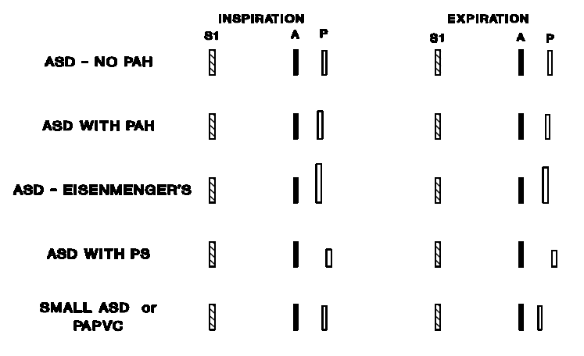
Second Heart Sound In ASD

Slide 46
Second Heart Sound In VSD
No PH --- S2 normal.
PVR (Eisenmenger’s complex) → Both ventricles act as a common reservoir.
Ejection: LV → Ao and RV → PA face equivalent resistance.
  Equal delay of A2 and P2 → Fixed.

Slide 47
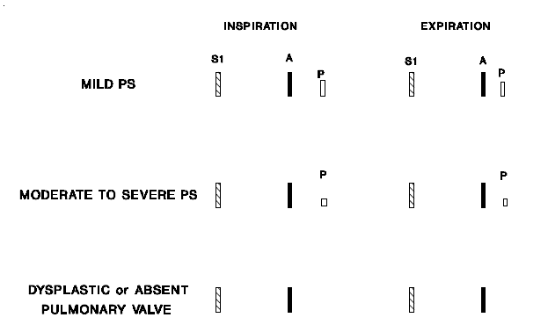
Second Heart Sound In PS

Slide 48
Thank you

