Slide 1
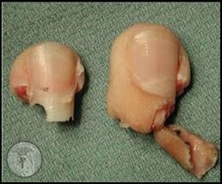
Fingertip Injuries
Dr. Priyank Katwala (M. Ch.)
Associate Professor
Department of Plastic Surgery, SBKSMI & RC

Slide 2
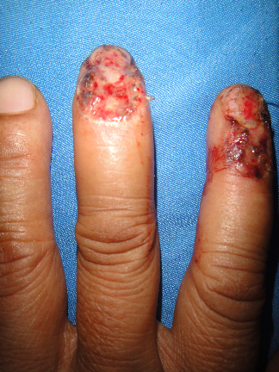
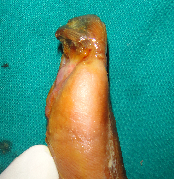
What is finger tip
•Typically considered the region distal to the insertion of the FDP/EDC
•Includes the perionychium, the nail, and the volar pad
• Volar skin is thick, non hair bearing and adherent to bone

Slide 3
Importance of fingertip
Hands are also called second eye and finger tips Macula because of ability of sensations
Fingertip and nails play a great role in fine and gross movements of hand

Slide 4
Embryology
Upper limb developes from arm bud at 30th day of I U life
Finger rays appear at 44th day and separate on 52nd day
Distal phallanx derived from ectoderm and mesoderm
Nails are ectodermal in origin

Slide 5
Anatomy of Fingertip
PULP:
•Fibro fatty tissue stabilized by fibrous septa extending from dermis to periosteum
•Thick epidermis with deep papillary ridges

Slide 6
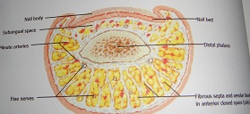

Slide 7
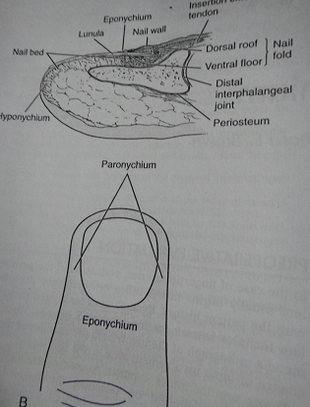
Nail
–Made from flattened cells, collagen, GAG’s
–Proximal nail fold (eponychium)
–Lateral nail folds (paronychium)
–Nail pocket
•Contains germinal matrix
–Dorsal roof
•Undersurface of eponychium

Slide 8
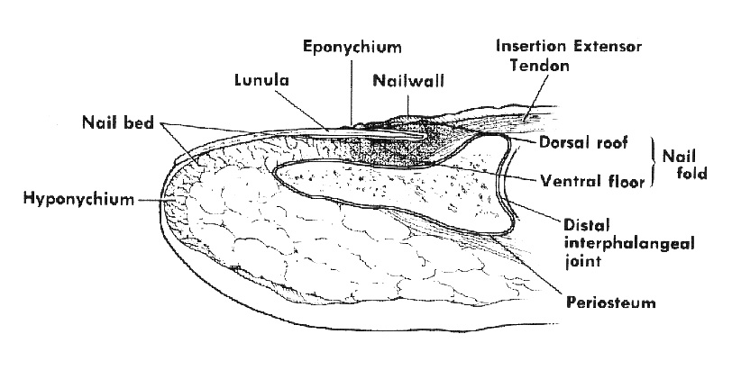
Nail

Slide 9
Growth of the Nail Plate
•Nail growth follows contour of the nail bed
•A smooth nail bed is essential of re-growth of normal appearing nail
•A functionally stable nail requires 5 mm of healthy nail bed distal to the lunula for nail adherence

Slide 10
Growth of the Nail Plate
•Average growth of 0.1 mm/day
•Complete longitudinal growth in 3-6 months
•Growth rate is variable: more rapid in longer fingers, summer, younger adults, nail biters
•After injury to nail bed, nail growth is not physiologically normal for 100 days

Slide 11
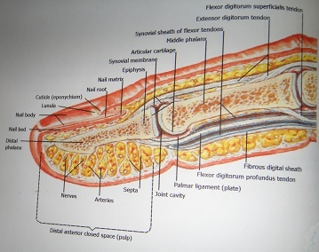

Slide 12
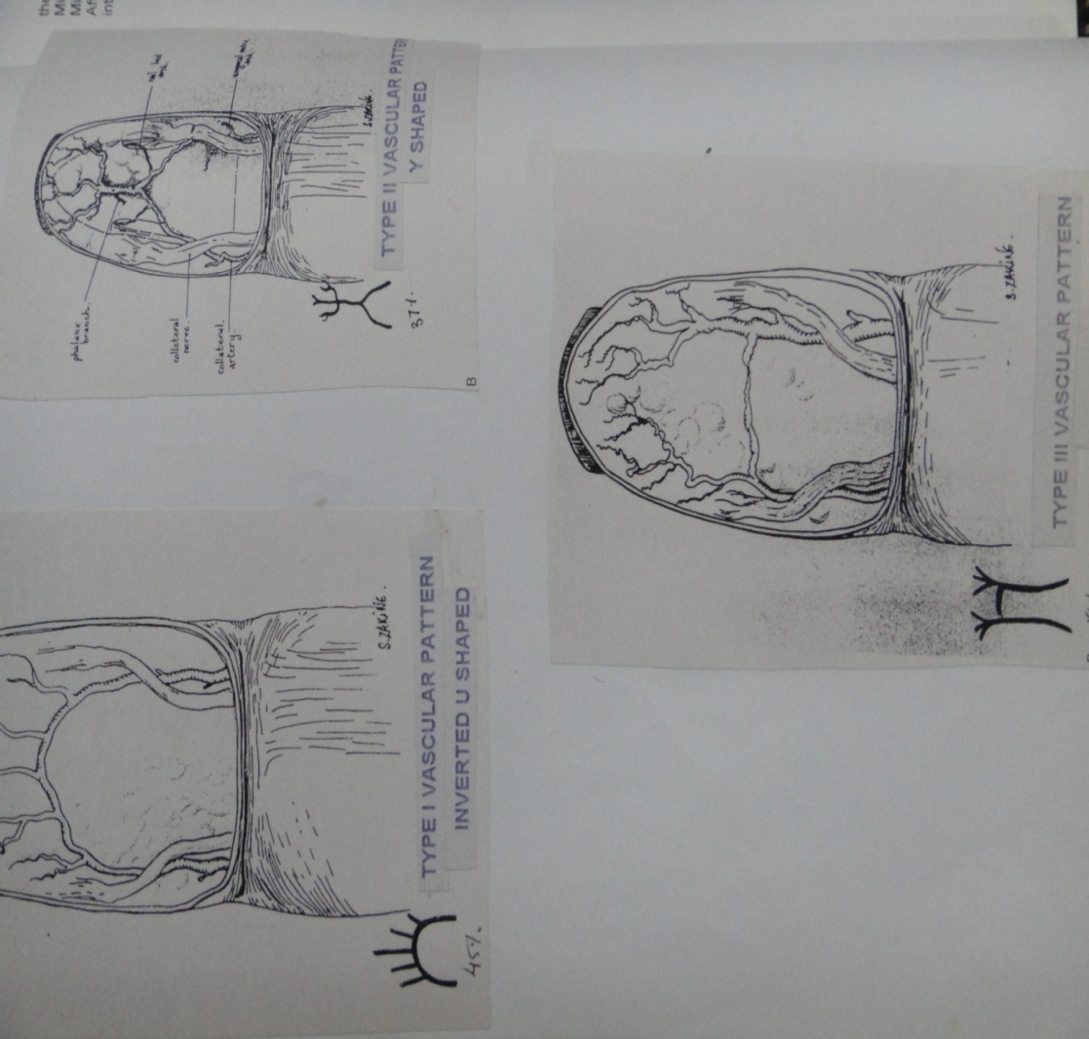
Arterial Supply
•Proper digital artery
gives up 2 dorsal
branches which form
a plexus at the nail

Slide 13
Venous drainage
•Venous drainage coalesces in the skin proximal to the nail fold

Slide 14
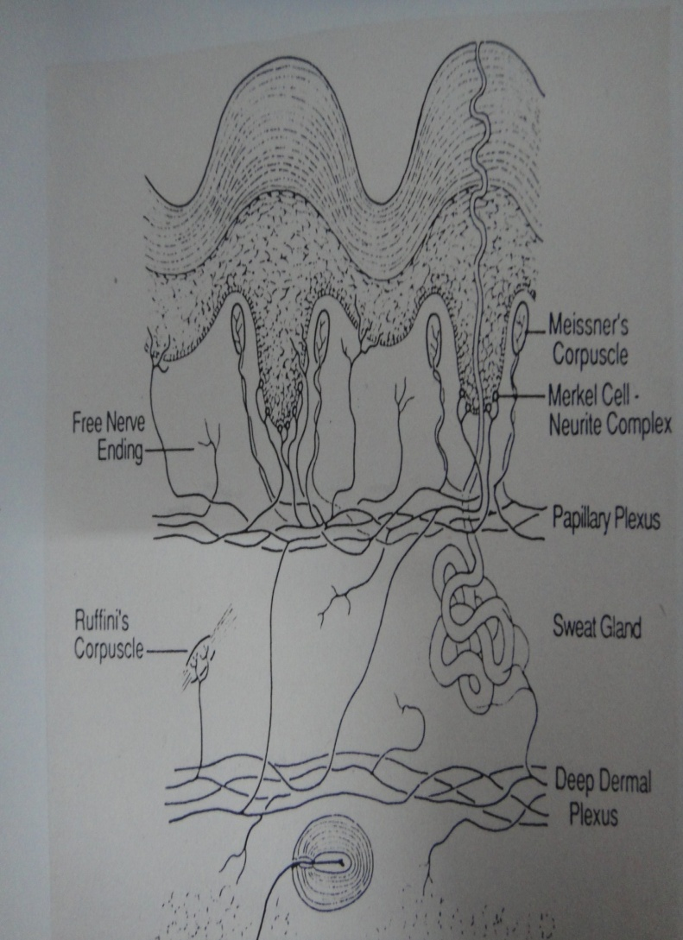
Nerve Supply
–Proper digital nerves trifurcate at the level of the DIP joint
•Dorsal branches to
dorsal nail fold/nail organ
•Mid axial branches to lateral
nail fold and nail bed
•Palmar branches to pad

Slide 15
Nail plate function
•Supports, protects fingertip dorsally
•Stabilizes finger tip for picking up fine objects
•Enhances sensibility of pulp
•Role in regulation of peripheral circulation
•Cosmesis

Slide 16
Finger pad functions
•Highly innervated for tactile sensibility
–Normal 2-Point Discrimination <6mm (2-6mm)
–Pinch, grasp

Slide 17
Epidemiology
•Most common injury of the hand
–Age :< 1 year- Until death
•Older children and young adults most commonly affected
•Male>female
•Most common: long fingers(MF)
•Least common: thumb
•50% of injuries involve fracture
Setting
Home
Industrial
Recreational

Slide 18
Patient Evaluation
–History
–age
–gender
–handedness
–occupation
–avocation
–mechanism of injury
–previous injury
–skin
–vascularity
–neurologic function
–muscular tendinous integrity –wound characteristics
–associated injuries
–X-ray

Slide 19
Local Examination
Hand involved dominant/non dominant
Finger involved
Wound size/ site/ obliquity
Pulp loss/intact
Level
Nail intact/avulsed
Nailbed intact/avulsed/crushed/lacerated
Bone exposed/non exposed/fractures
Movement
Vascularity
Sensations
Other fingers
Contamination

Slide 20
Goals of treatment
•Painless fingertip
•Durable, sensate skin
•Provide well-padded fingertip
•Maintain length, if possible
•Preserve nail bed and nail
•Cosmesis

Slide 21
History
Early 20th cent : conservative
Gilchrist 1926 shortening and closure
Gatewood 1926 thenar flap
Tranquilli-Leali 1935 Volar V Y plasty
Gilles 1940 autograft of amputed digit
Zedi 1942 STG
Kutler 1947 Bilateral V Y plasty
Gordin and Pangman 1950 cross finger flap
Mccash 1958 pulp loss. Transfer from toe
Littler 1960 free pulp transfer
Barret Brown 1938 free replantation
Klinert 1973 microvascular replantation

Slide 22
Fingertip Injury classification
–No single classification
–Level and angle of injury
–Mechanism of injury

Slide 23
Zones of Injury
•Zone I - Distal to bony phalanx
•Zone II - Distal to lunula
•Zone III - Proximal to distal end of lunula

Slide 24
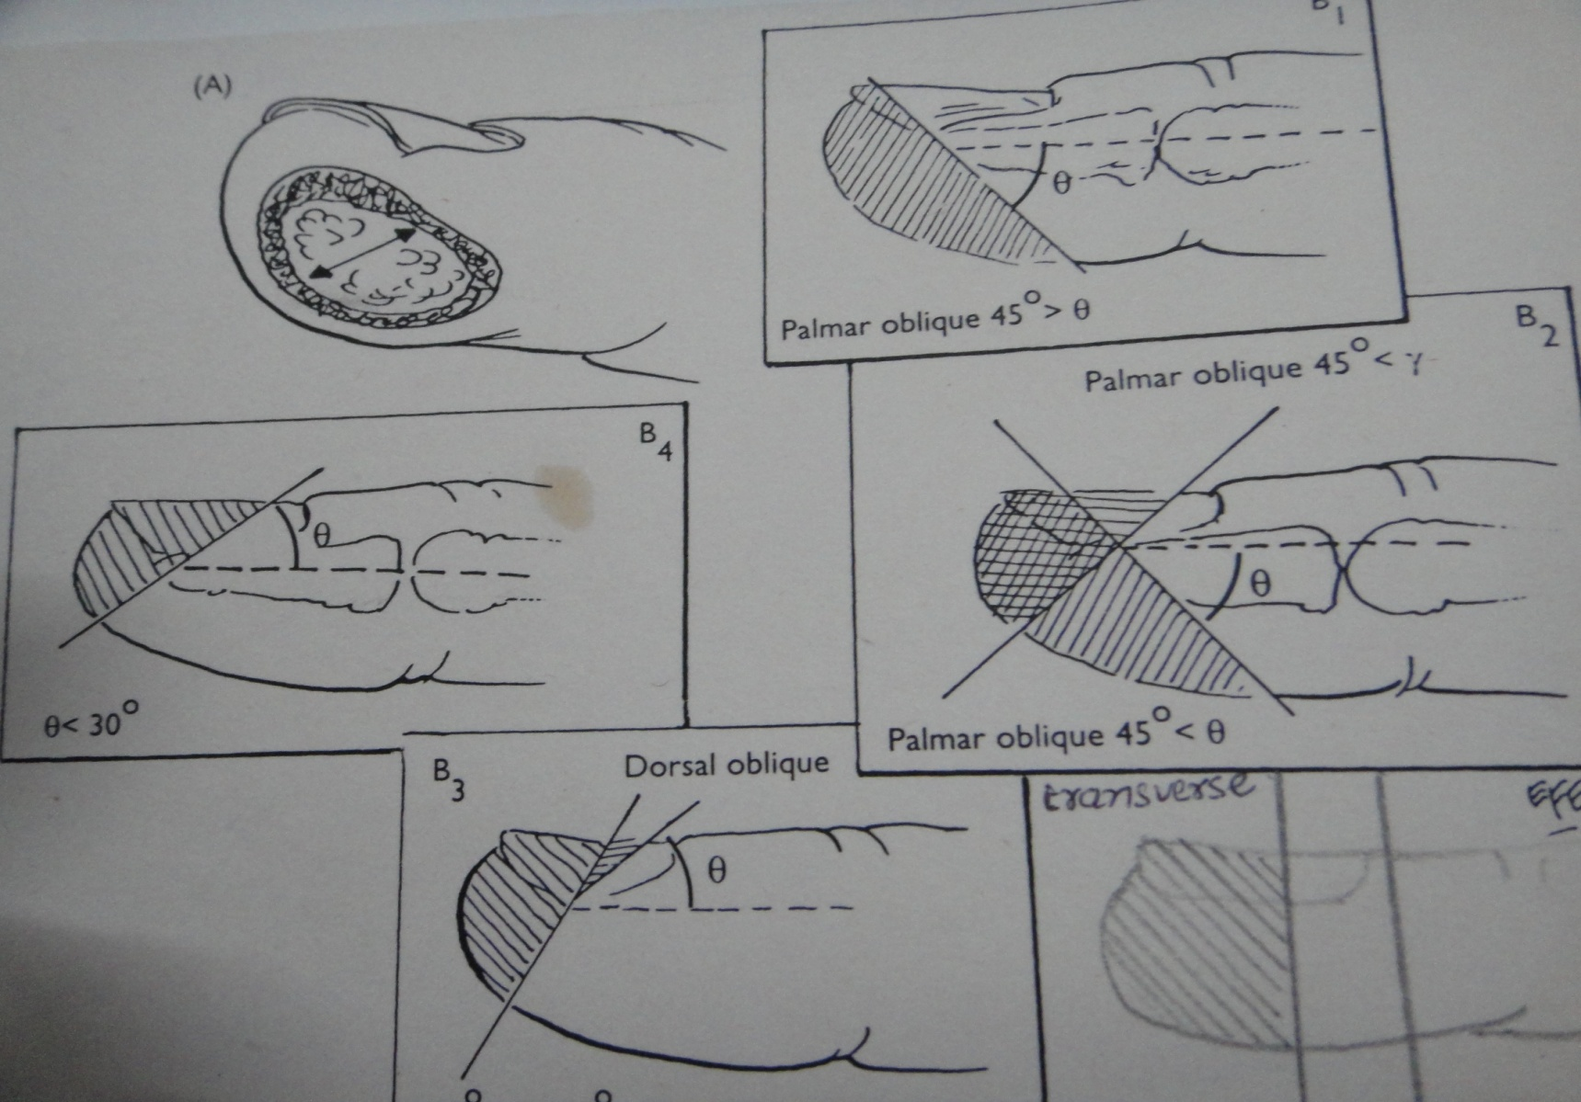
angle of injury

Slide 25
P N B classification system
Grade | Pulp | Nail | Bone
0 | No injury | No injury | No injury
1 | Laceration | Sterile matrix Laceration | Tuft #
2 | Crush | Sterile-germinal matrix Laceration | Comminuted non-articular #
3 | Loss distal transverse | Crush | Comminuted articular #
4 | Loss palmar oblique/partial | Nailbed dislocation | Displaced #
5 | Loss dorsal oblique | Loss distal 1/3rd | Tip exposure
6 | Loss lateral | Loss distal 2/3rd | Loss distal 1/2
7 | Loss complete | Loss lateral | Loss partial
8 |  | Loss complete | Loss complete

Slide 26
General Rules
•Dorsal oblique and transverse injuries are more suited for local grafts
•Volar oblique injuries often require a regional flap
•Attempt to preserve length, especially in the thumb

Slide 27
Zone 1
–Best treatment is controversial
–Conservative Treatment
–Full thickness skin graft
–Local advancement flap

Slide 28
Zone II-III
Conversion to Zone I injury and conservative treatment
Revision Amputation
Composite graft (non-microvascular Reattachment)
Local Flaps
Regional flaps

Slide 29
Zone II-III
if sufficient nail matrix remains to provide stable and adherent nail plate, consider local advancement flap
If angle of amputation does not permit local flap, consider regional flap.
If amputation is more proximal or patient is poor candidate for regional flap, consider revision amputation

Slide 30
Revision amputation
•Indications:
•<5mm sterile matrix remaining
•angle of amputation precludes other options
•advanced age
–Medical co-morbidities

Slide 31
Healing by secondary intention
Indication:
Late pt with untidy wound
Pulp tissue intact without bone exposed
Pt refusal for operation
Children
Disadvantage:
Loss of volume of pulp tissue
Loss of pulp firmness
Increased sensibility
Cold intolerance

Slide 32
Skin grafting
Indication:Intact sufficient pulp tissue without skin loss
No bone exposure
Particularily volarily directed injury
Advantage:Good recovery ,outdoor basis t/t,easily available donor site,early recovery
Disadvantage:Parasthesia,hyposthesia,cold intolerance

Slide 33
Local flap
transferred tissue is confined to the injured digit with at least one side of flap adjacent to defect
•preserve length
•similar tissue
•normal sensory end organs

Slide 34
Local flap
Volar V-Y advancement flap
Kutler lateral V-Y flap
Unipedicle rotation advancement
Bipedicled advancement
Volar advancement
Joshi’s dorso lateral island flap
Venkataswamy unipedicled island flap
Step advancement flap
Homodigital island
Reversed digital artery flap
Oblique dorsal flaps

Slide 35
Atasoy-Kleinert V-Y advancement flap
First described by Tranqulili-Leali
Popularized by Atasoy 1970
Indication:Transverse amputation of fingertip through distal 1/3 of terminal phalanx, with minimum proximal half of nail is preserved
Base of triangle of flap< less than transeverse diameter of defect
Apex:proximal to DIP crease
Advantage:Local glaborous skin,done in LA,no donor morbity
Disadvantage;Limited application for transverse amputation,shortening

Slide 36
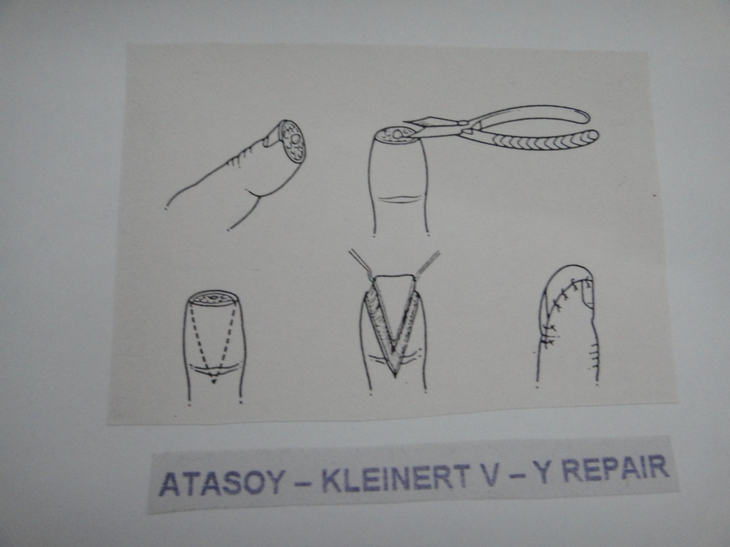


Slide 37
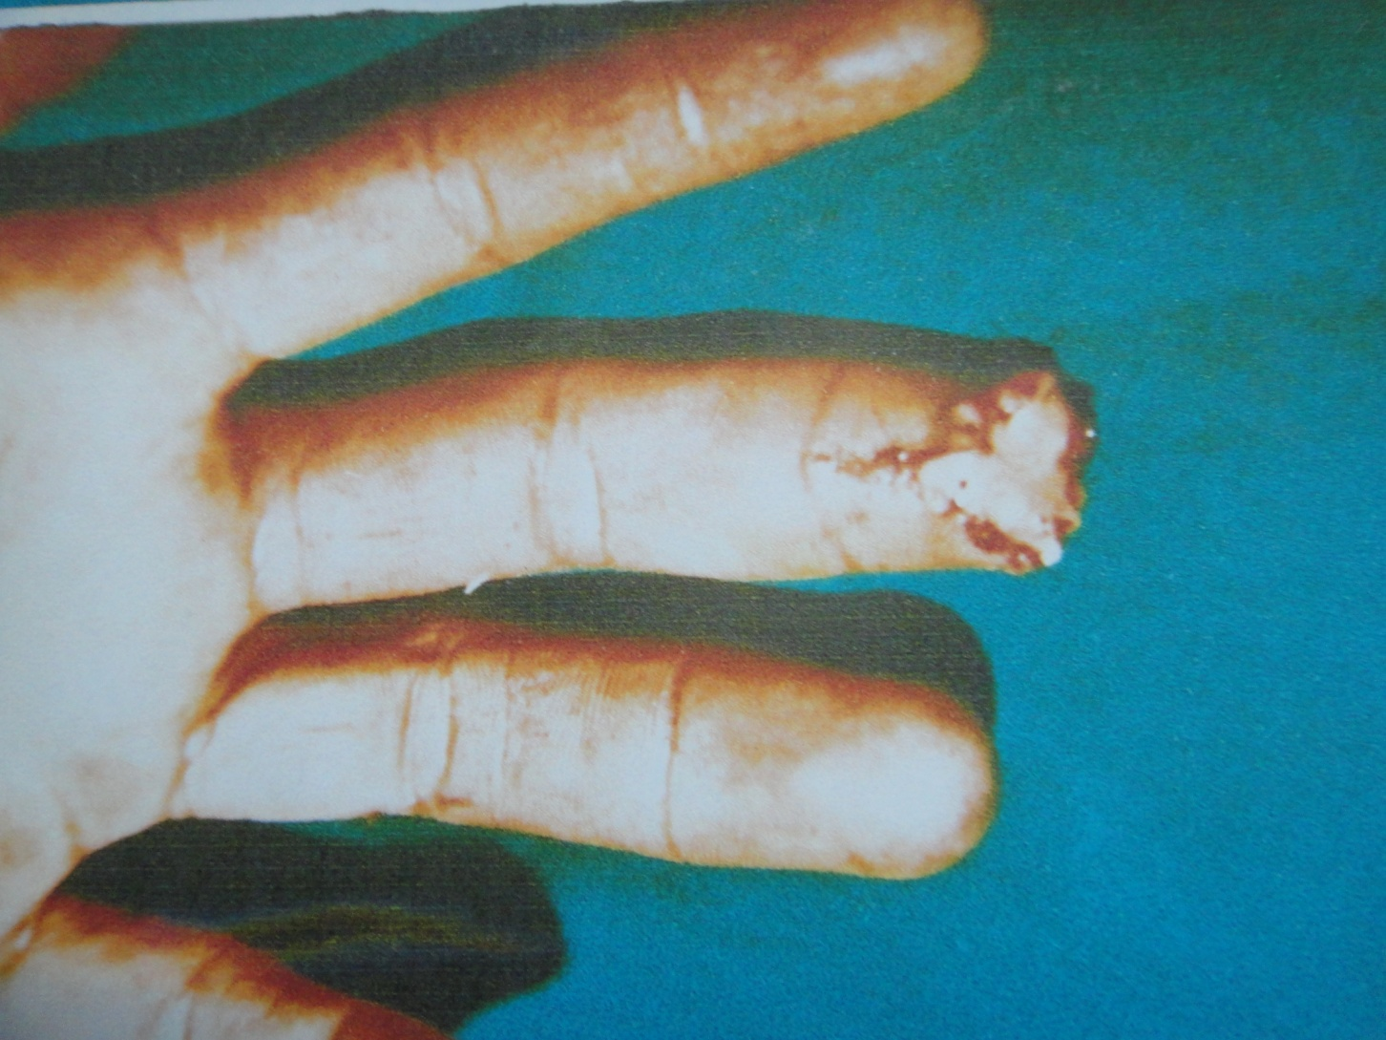

Slide 38
Bilateral V-Y ADVANCEMENT
–Kutler W. 1947
–Transverse amputations
–Limited advancement (0.5 cm)
•Bilateral V flaps
•May have high incidence of persistent hypersensitivity at suture lines.
Three scars in midline at point of tip

Slide 39
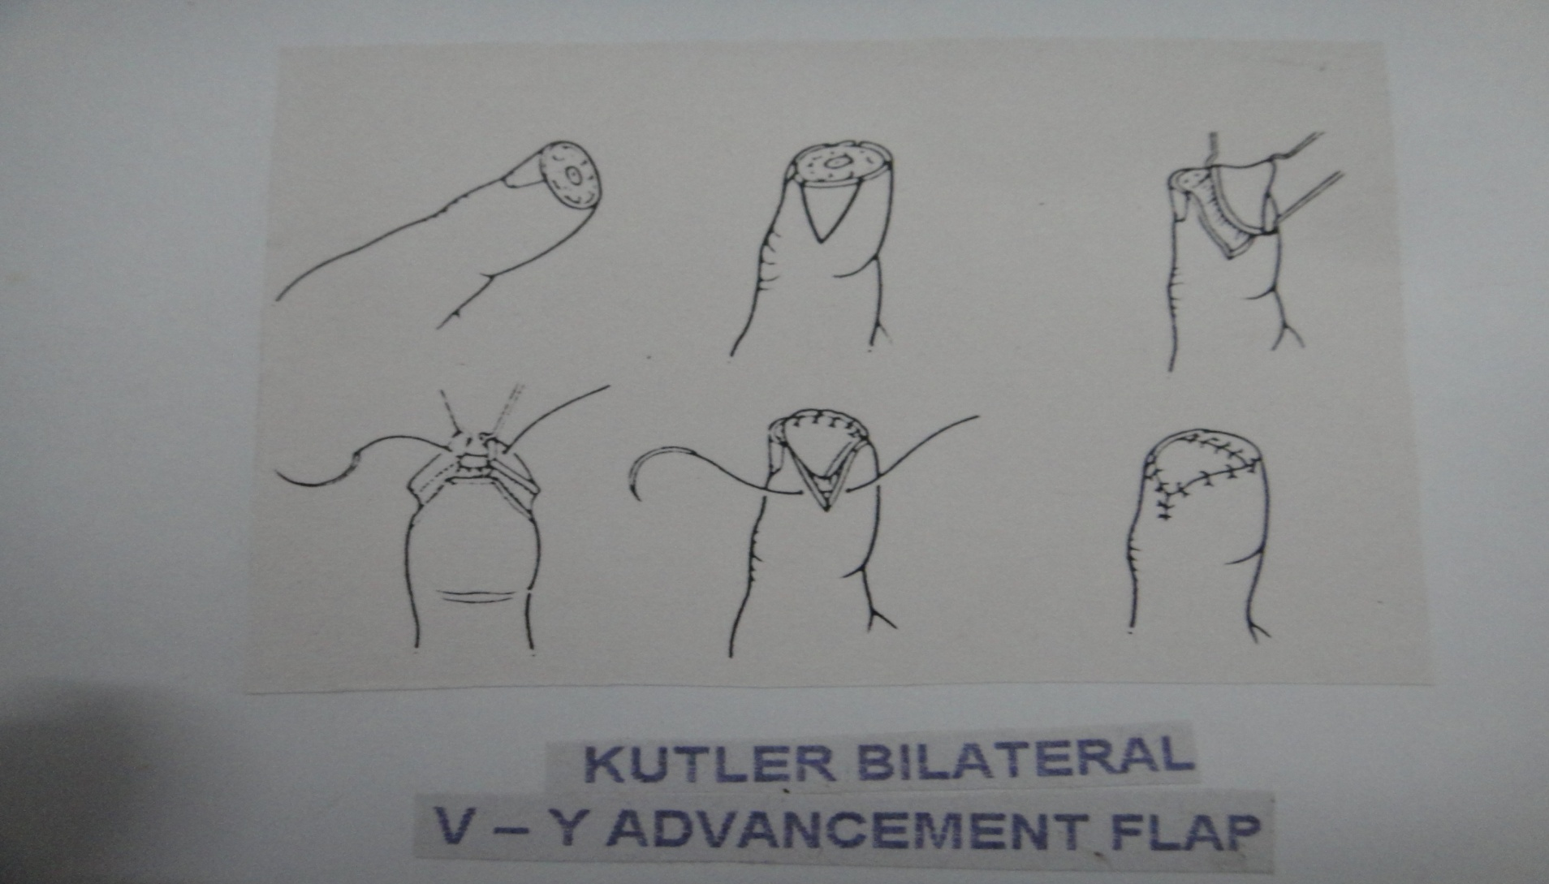

Slide 40
Unipedicled Rotation Advancement Flap
Hueston has modified the Moberg flap this is to avoid bilateral midaxial incisions and carry out the rotation of the volar thumb skin based only on the vascular pedicle on one side.
The base of flap is classically positioned on the ulnar side of the thumb so as to preserve maximum innervetion to ulnar side of the reconstructed tip.
On the free edge of the flap skin is raised superficial to the neurovascvular structures and then incised transversely at the proximal crease.
The tringular secondary defect at the base of the thumb required FTG.

Slide 41
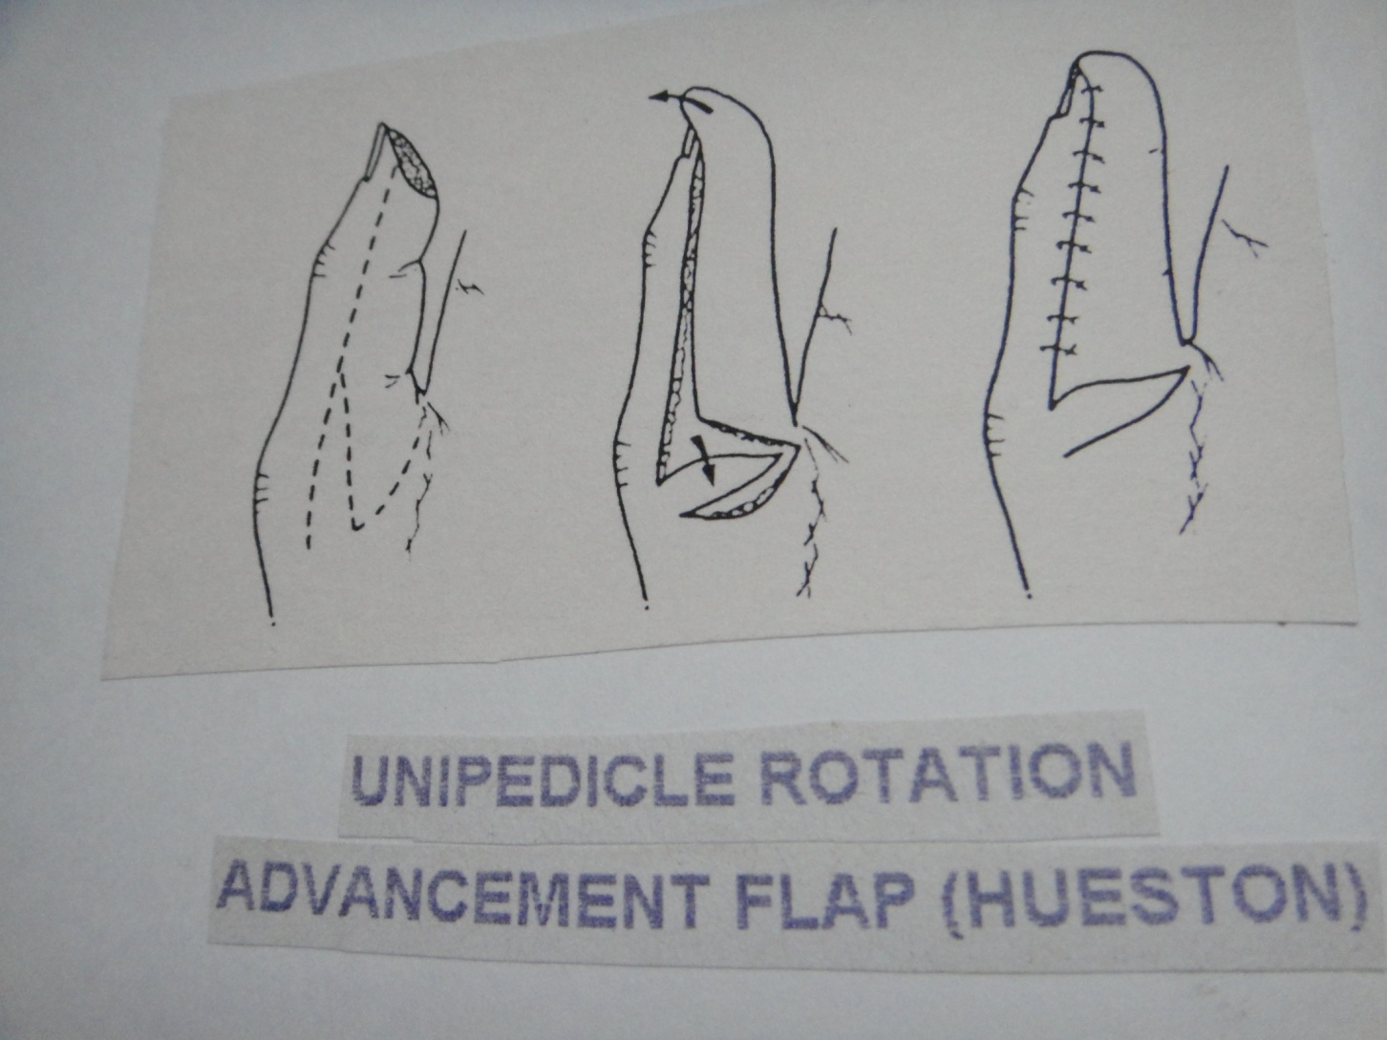

Slide 42
Bipedicled Island Advancement Falp:(O”BRIEN)
Modification of the Moberg flap
Midlateral incisions are joined by transverse incision at level of proximal third of the proximal phalanx taken through skin only.
The neurovascular pedicles are dissected out from beanth the proximal flap to permit mobilization of the distal skin island.
This island is then advanced and secondary defect filled with a FTG.

Slide 43
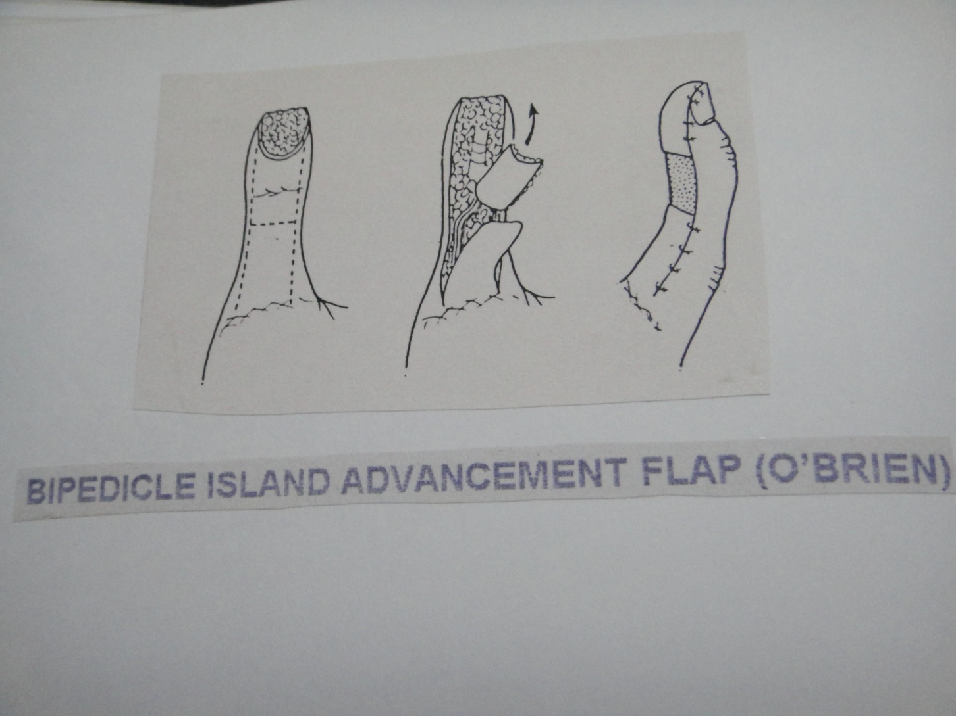

Slide 44
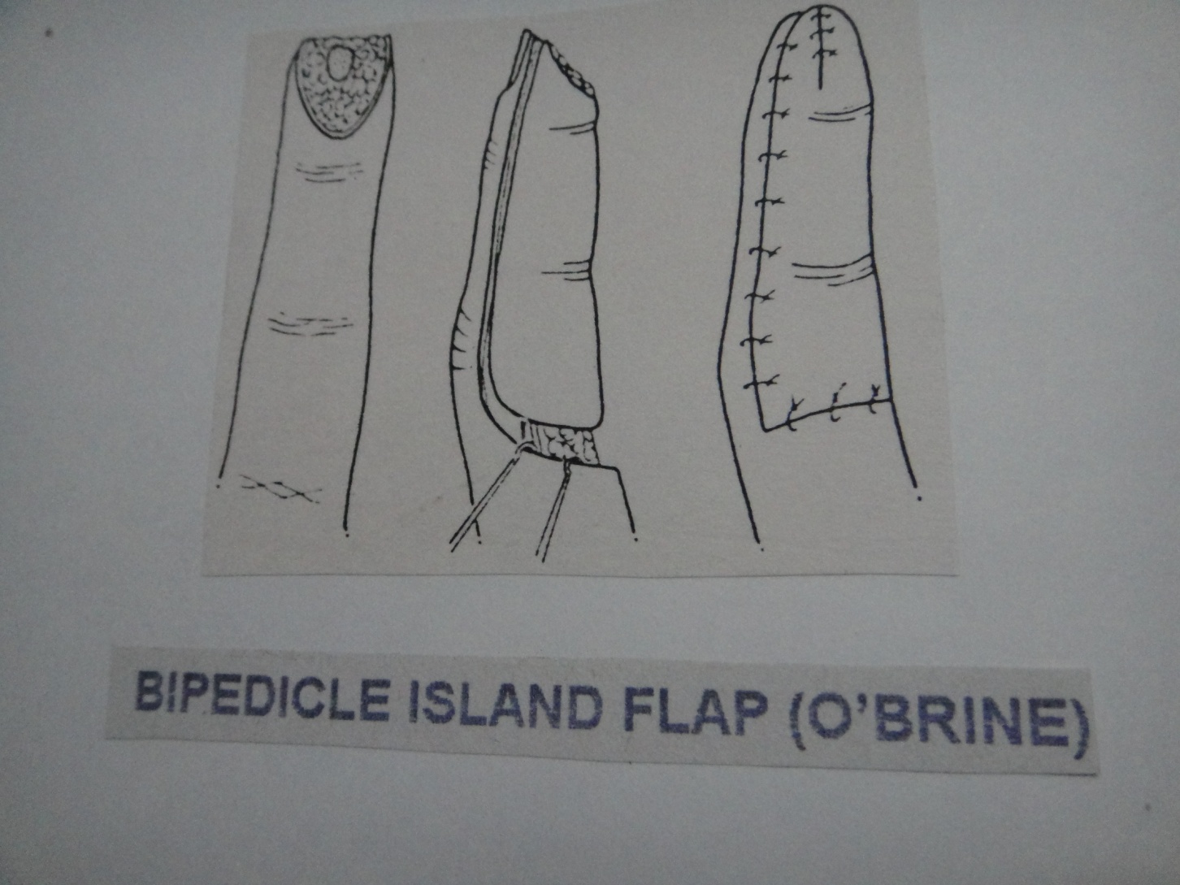

Slide 45
Volar Advancement Flap On The Digits(SNOW-1967)
This applies the Moberg advancement concept used on the thumb to the fingers.
It is hazardous because the dorsal skin does not have the separate vascularization.
It has been suggested that the procedure can be applied to a finger if the soft tissues are left attached as a mesentry to the flap.
Snow has described dissecting out the dorsal branches of the digital arteries when mobilizing the flap,there by preserving the blood supply to the dorsum.

Slide 46
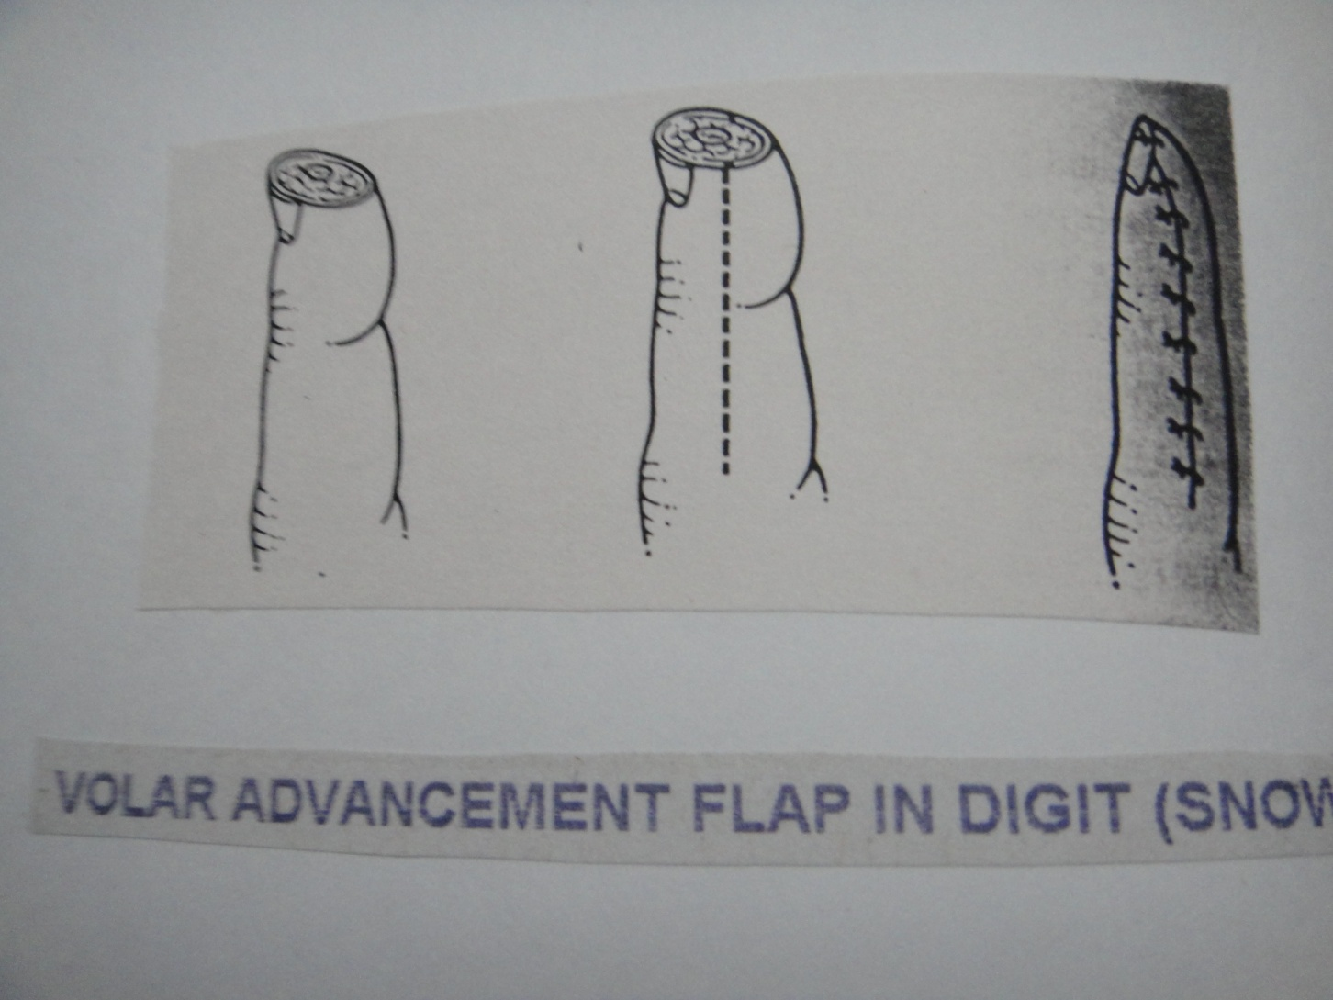

Slide 47
Unipedicled Island Advancement Flap(VENKATSWAMY):
Indicated for lateral or medial oblique tip loss by advancing a tringular island flap from the less damaged side.
Base of flap is as wide as defect and two sides 2-2.5 times as long.
One side follows mid lateral line while other crosses the volar side of the digit.
The dorsal incision deepned to a plane beneath the subcutaneous fat so the neurovascular bundle raised with the flap.
On volar aspect incision is through the skin and fibrous septa divided with scissors preserving vessels and nerves entering the volar side of the triangle.
After advancement ,donor defect closed in v-y manner.

Slide 48
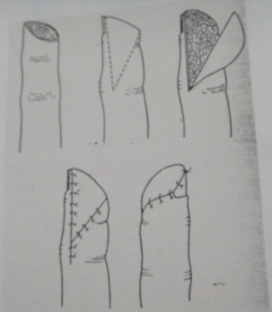

Slide 49
Dorsalateral Island Advancement Flap(JOSHI):
This flap reconstructs the pulp using neurovascular island flap from dorsum and lateral aspect of the finger.
The volar margin of the flap borders the defect and then tapers towards the mid lateral line at the PIP joint crease.
The dorsal margin of the flap passes from the defect past the proximal corner of the nail, about 3mmfrom it, reaches midline on dorsum of finger and then tapers down to meet the volar incision at pip crease.
From proximal corner of flap mid lateral incision made down to the web and the pedicle isolated preserving digital branch.
The volar margin is incised and flap elevated in subcutaneous plane.
The dorsal incision is made and attempt is made to preserve dorsolateral vein at this point.
The flap is advanced with MCP joint flexed and donor site closed with FTG.

Slide 50
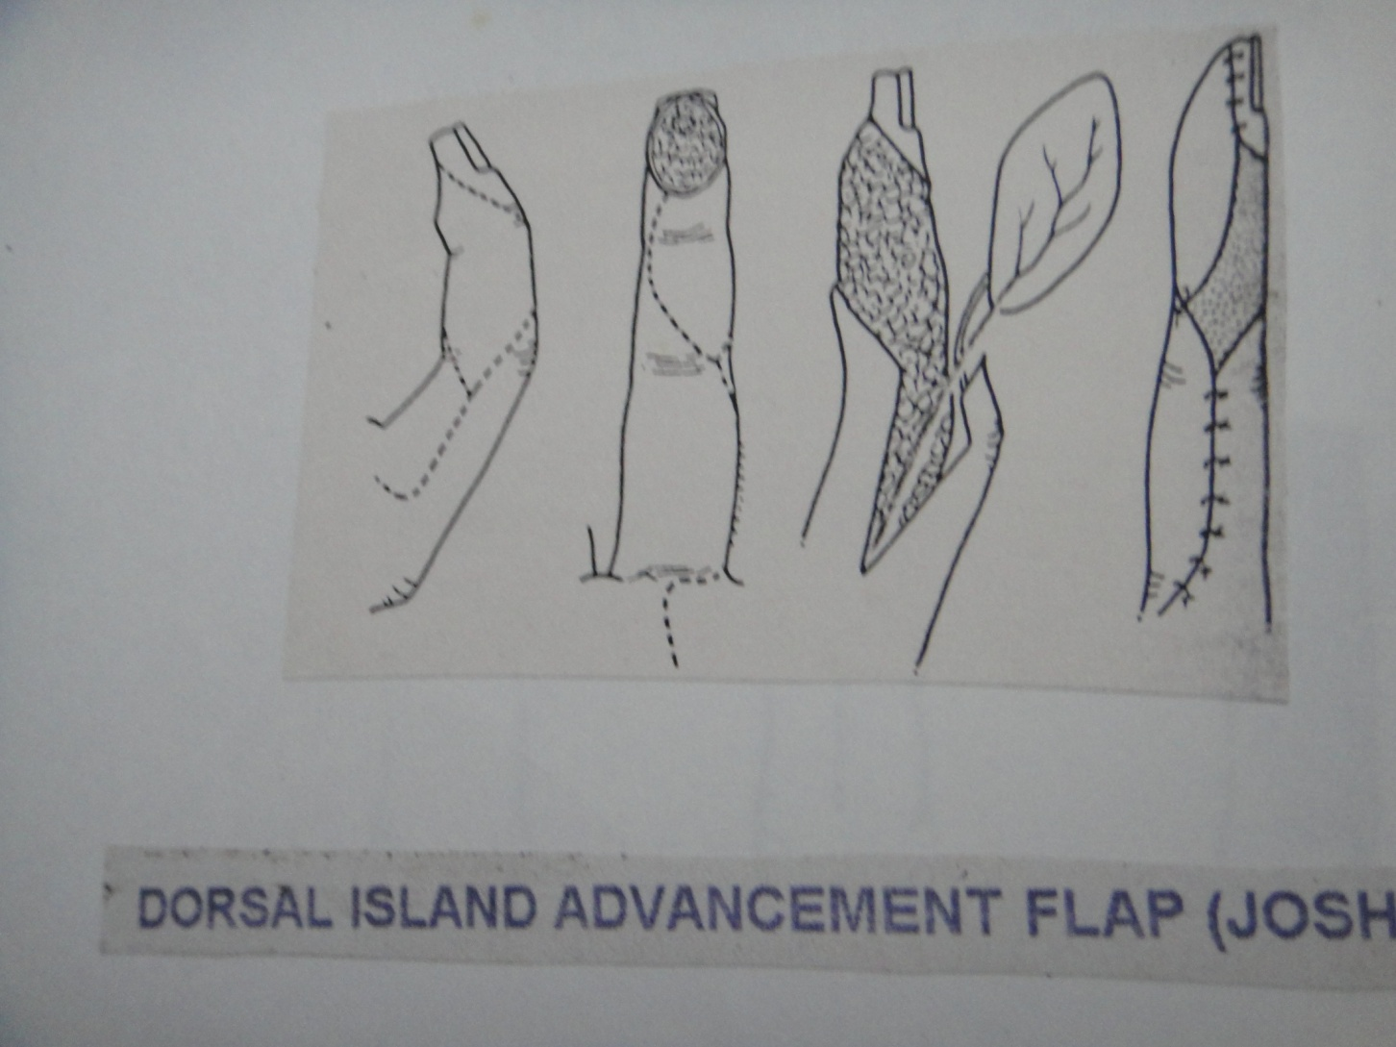

Slide 51
RETROGRADE FINGER DORSUM PEDICLE FLAP(OGO)
Used for pulp reconstruction of same digit.
Pedicle either radial or ulnar based.
Amputation proximal to nail matrix the pedicle need to be 6 to 8 mm wide, for amputation distal to nail matrix pedicle need to be 8 to 10 mm wide.

Slide 52
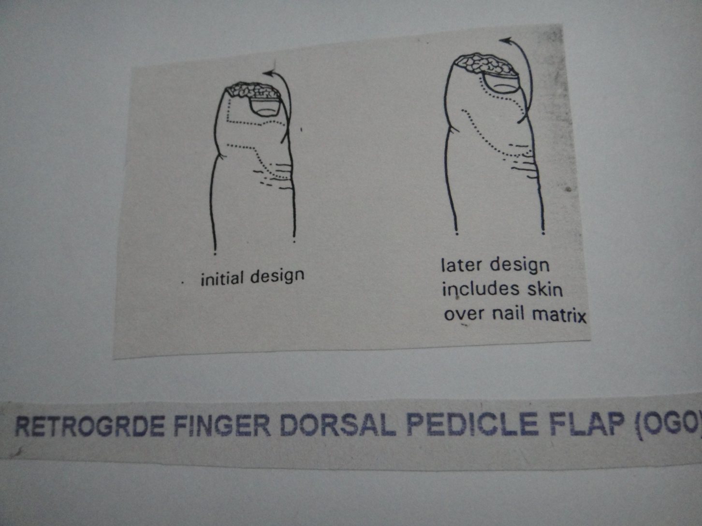

Slide 53
STEP ADVANCEMENT ISLAND FLAP(EVANS 1988)
Flap achieves advancement for tip reconstruction without creating a significant secondary defect.
Volar margin of flap design as a three triangles.
Dorsal incision is convex and tapers to meet volar incision at midlateral line.
The flap is advanced ,engaging each triangular flap distally, and closing the proximal triangles and gap over the pedicle.

Slide 54
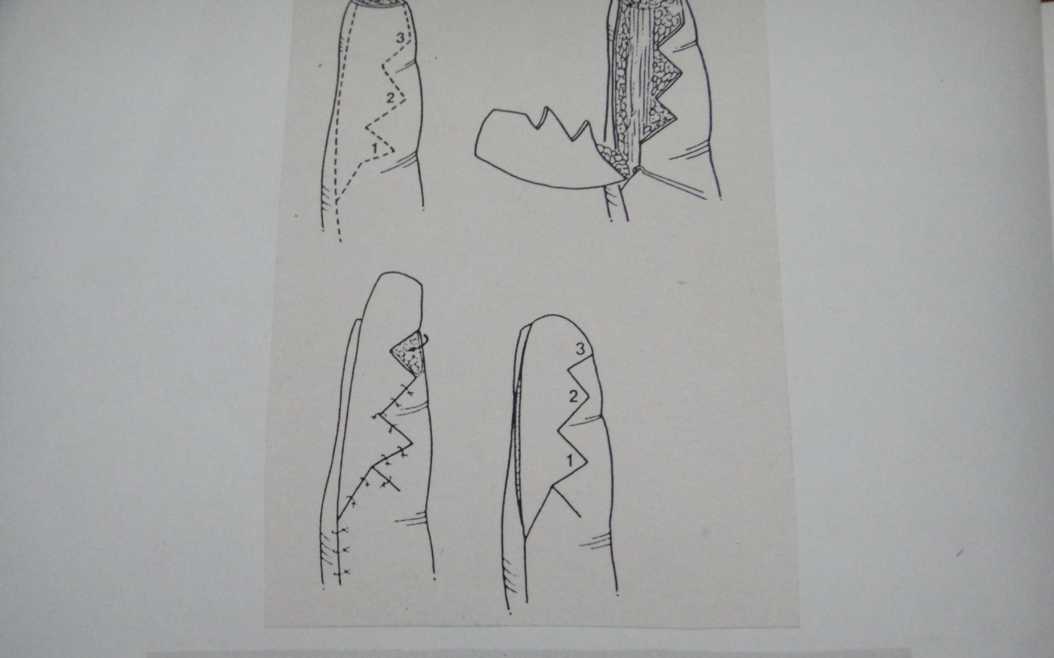

Slide 55
REVERSE DIGITAL ARTERY FALP
Digital arteries not accompanied by venae comitantes and there for venous drainge of this flap is depended on cuff of adipose tissue taken with artery to include enough small vessels to provide network for drainage.
Allen test should be performed.
Zigzag incision

Slide 56
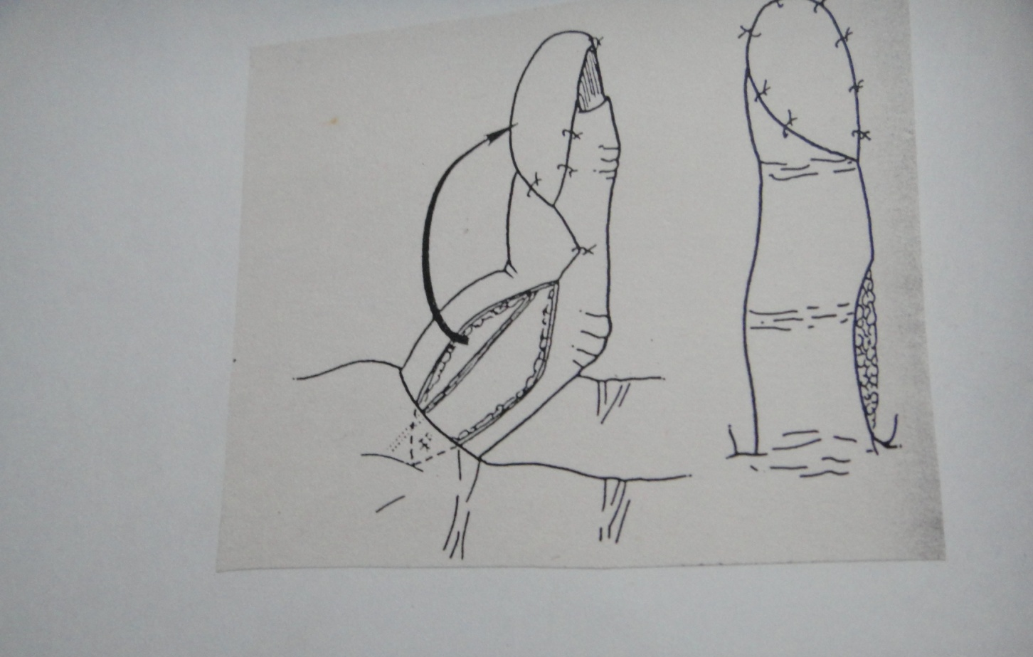

Slide 57
Neurovascular Exchange Island Falp
Similar to small Littler flap but is used within the same digit as mean of restoring sensate skin cover to an area of scarred and insensate pulp on a dominant half finger.
As digital nerve to a skin island is transferred from one side of the digit to the other, some cortical reorientation is required.
Foucher has modified this flap to overcome this problem by dividing the digital nerve on the donor site proximal to the flap and then joining it to the stump of the damaged digital nerve on the recipient side.

Slide 58
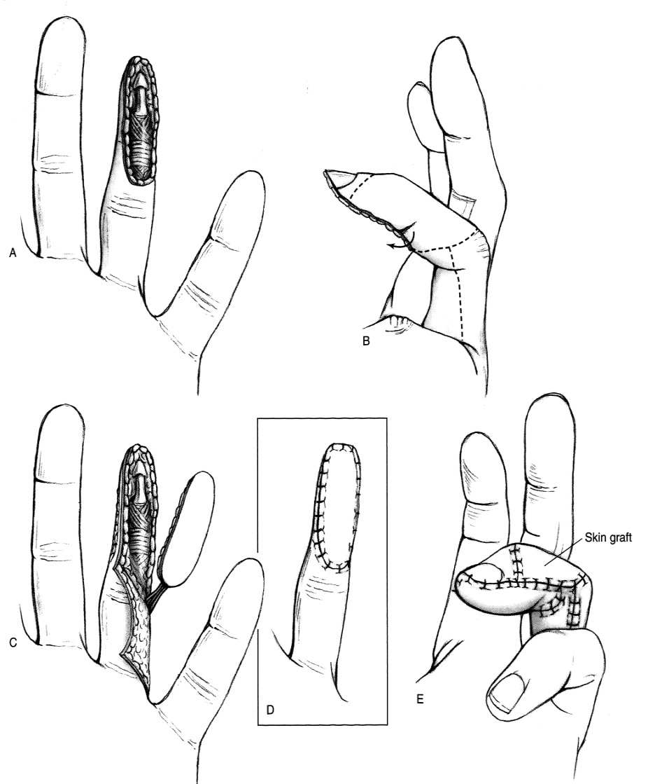
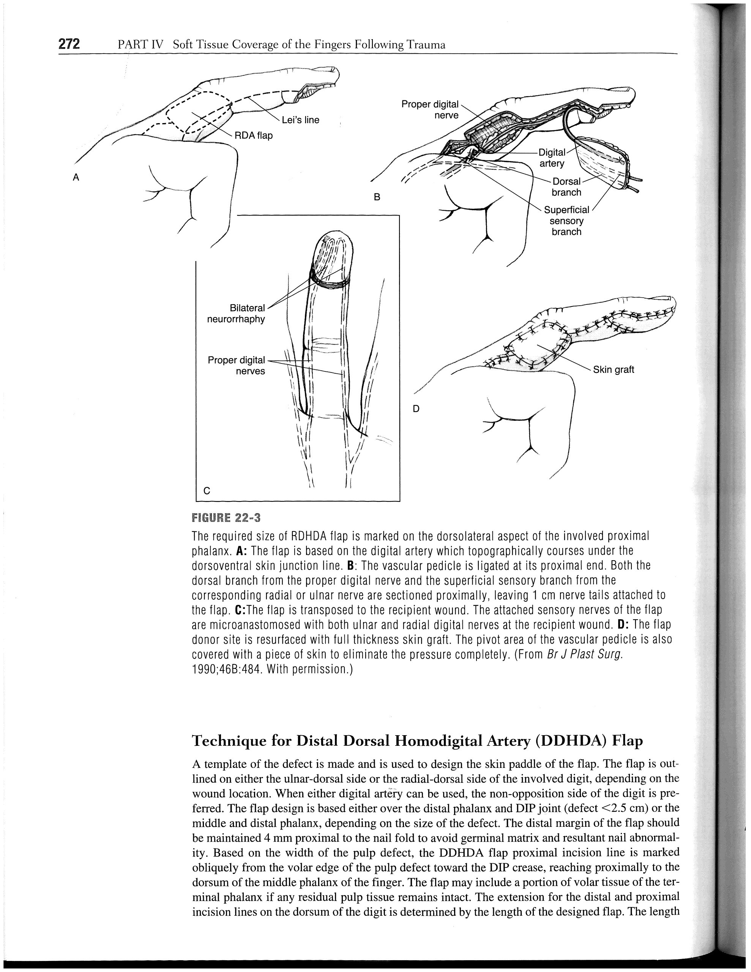
Homodigital island flap
*Brunelli 1987
Notes:
*Brunelli 1987
Make sure that contralateral proper artery is sufficient.
Preferred in middle, ring finger due to co-dominant proper artery.
Avoid damage to vein, release and rotate at DIP level
Divided in 2 designs
Proximal base (less advance, more flexion DIP→ PIP extension lag, scar contracture, less innervation)
Distal base (more advance, can innervate by nerve anastomosis)

Slide 59
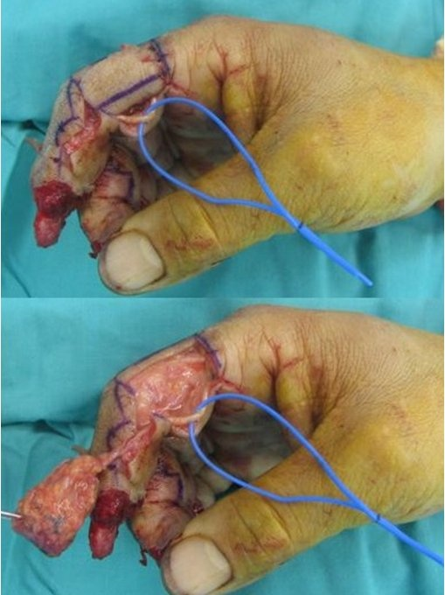
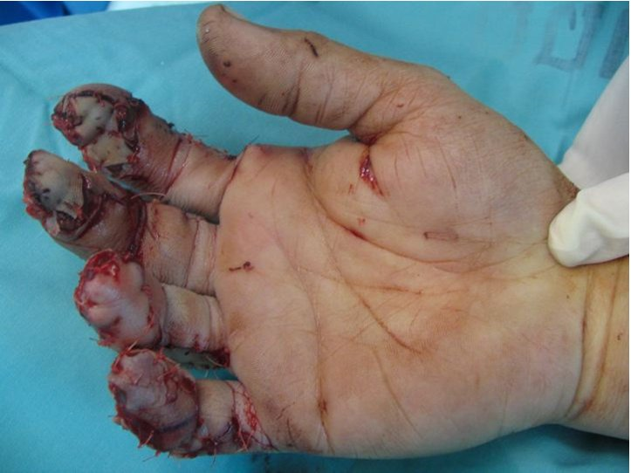
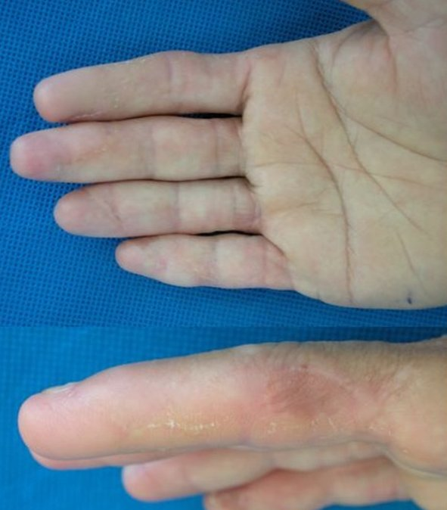
Homodigital island flap
Notes:
Make sure that contralateral proper artery is sufficient.
Preferred in middle, ring finger due to co-dominant proper artery.
Avoid damage to vein, release and rotate at DIP level
Divided in 2 designs
Proximal base (less advance, more flexion DIP)
Distal base (more advance)

Slide 60
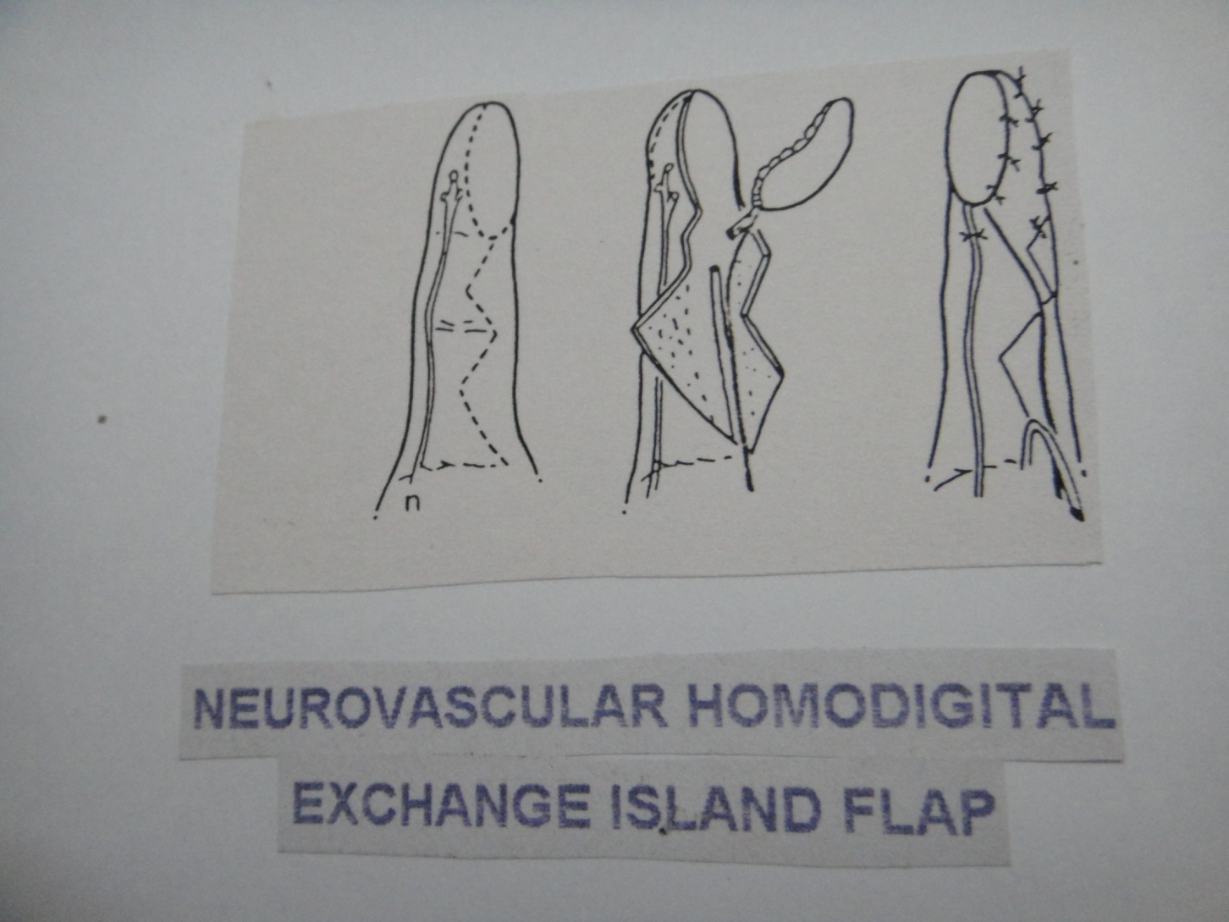

Slide 61
OBLIQUE DORSAL FLAP(FLINT&HARRISON)
Flap is for homodigital pulp reconstruction.
Palmar digital branches to dorsal skin of DIP joint included.
Proximal incision runs from PIP joint crease at midlateral line,oblique across the dorsum of finger to the DIP joint crease on opposite side.
Distal incision is placed parallel to this.

Slide 62
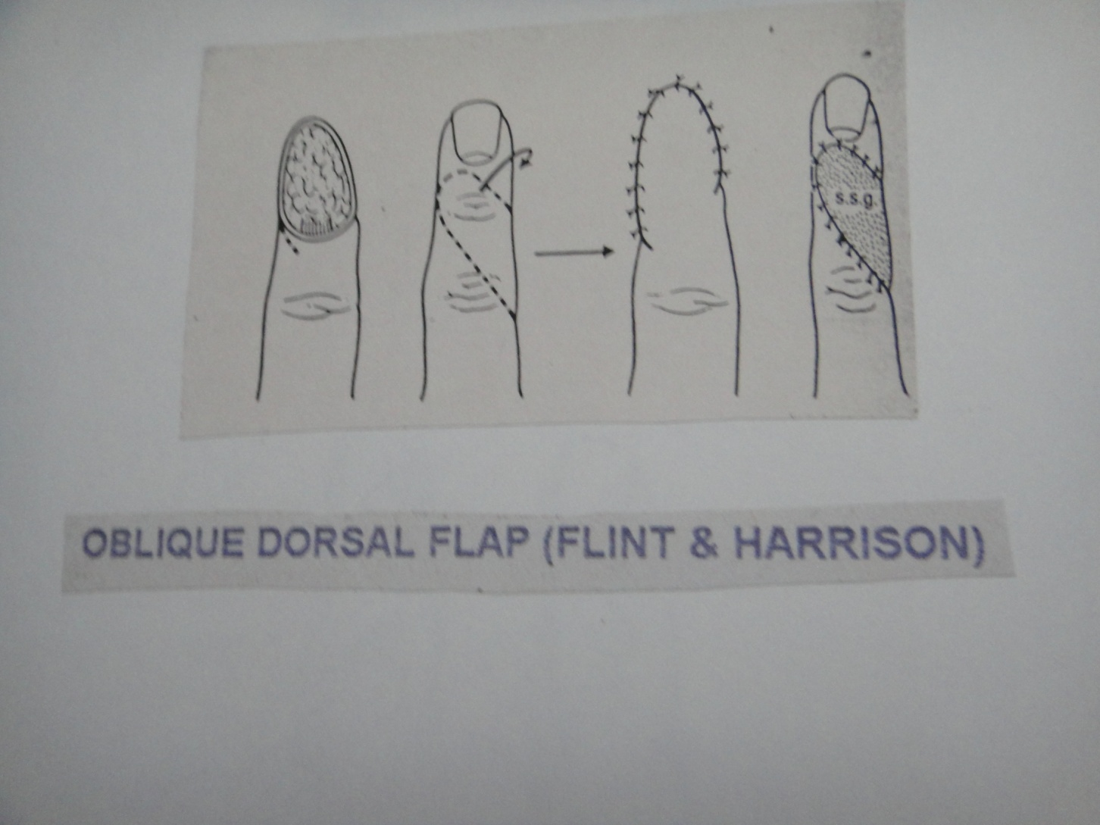
OBLIQUE DORSAL FLAP(FLINT & HARRISON)

Slide 63
Regional Flap
derived from tissues not immediately adjacent to defect
Indications:
  Volar oblique amputation
  amputation too proximal to perform local flap –preserves length
disadvantages:
  2-stage procedure
  stiffness due to prolonged immobilization

Slide 64
Main types
•Cross-Finger Flap
variable designs
+/- innervation
–reversed cross finger flap for dorsal defect
•Thenar Flap
For tip and volar injuries
•Littler Flap

Slide 65
contra-indicated
in patients with significant systemic illness
OA
RA
Dupuytren's contracture

Slide 66
Cross finger flap
Gurdin and Pangman 1950
used for volar oblique amputations through middle of distal phalanx
Rectangle flap is raised on dorsum of the middle phalanx of the finger with base of flap is medial or lateral side and the flap turnover through 180 degree.
Division of the cleland’s ligament at the base of the flap improves its mobility.
Flap is situated as follows;
  Index : MF,middle phalanx,lateral base
  MF : RF,middle phalanx,lateral base
  Ring : MF,middle phalanx,medial base
  Little : Ring finger,middle phalanx,medial base

Slide 67
Cross-Finger Flap
–random pattern flap
–flap based over dorsal P2 of adjacent digit
–FTSG/SSTG to donor defect
–divide at 14-21 days

Slide 68
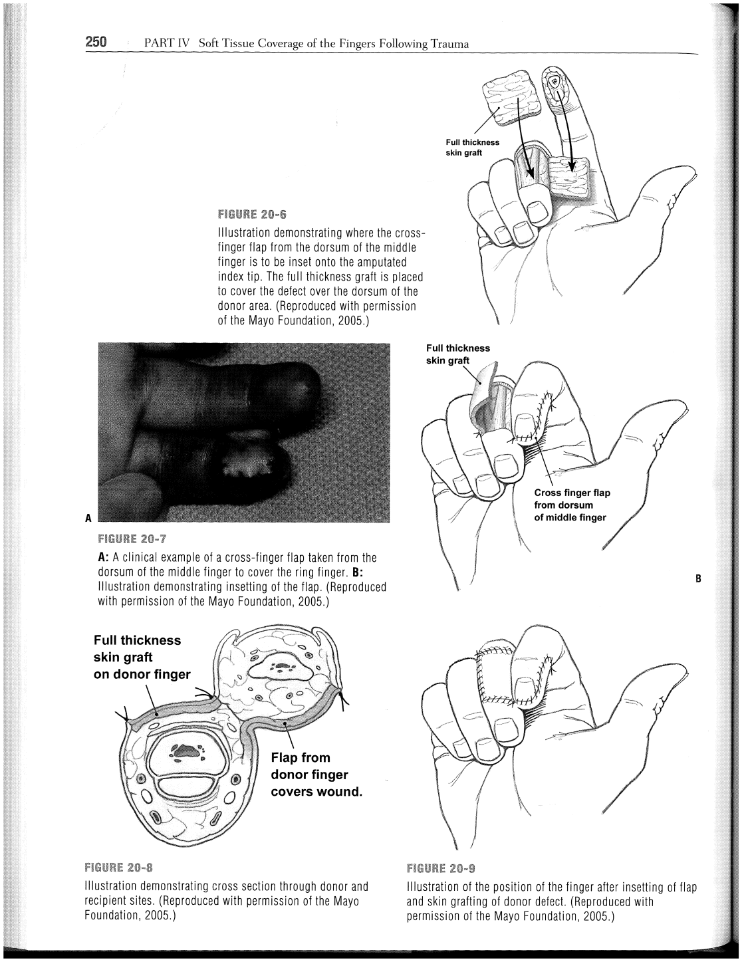
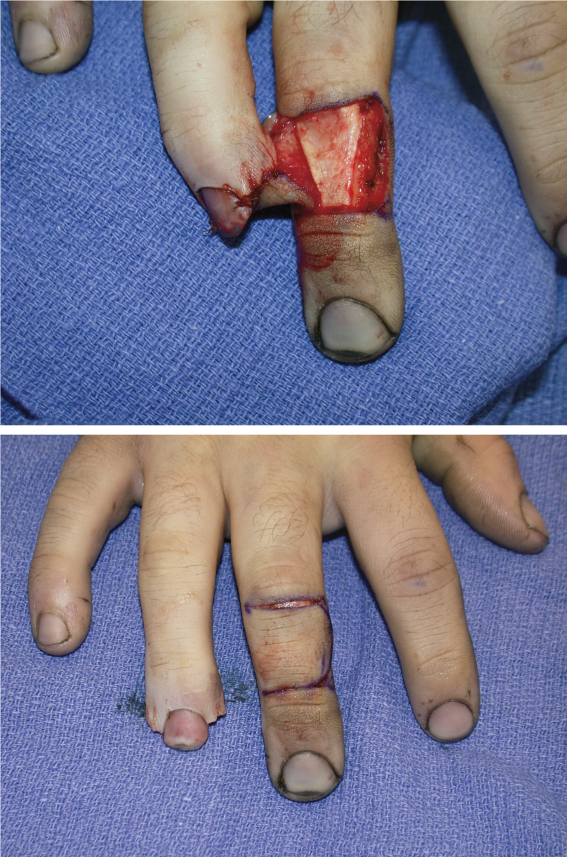

Cross-finger Flap
Courtesy from Wattana T, MD
Notes:
Need to spare paratenon of extensot tendon
Might need to release cleland to have more mobilizatiopn
Could be innervated by anatomosis of dorsal sensory branch of donor to collateral nerve of recipient. (Might nave deorientation ofsensory)

Slide 69
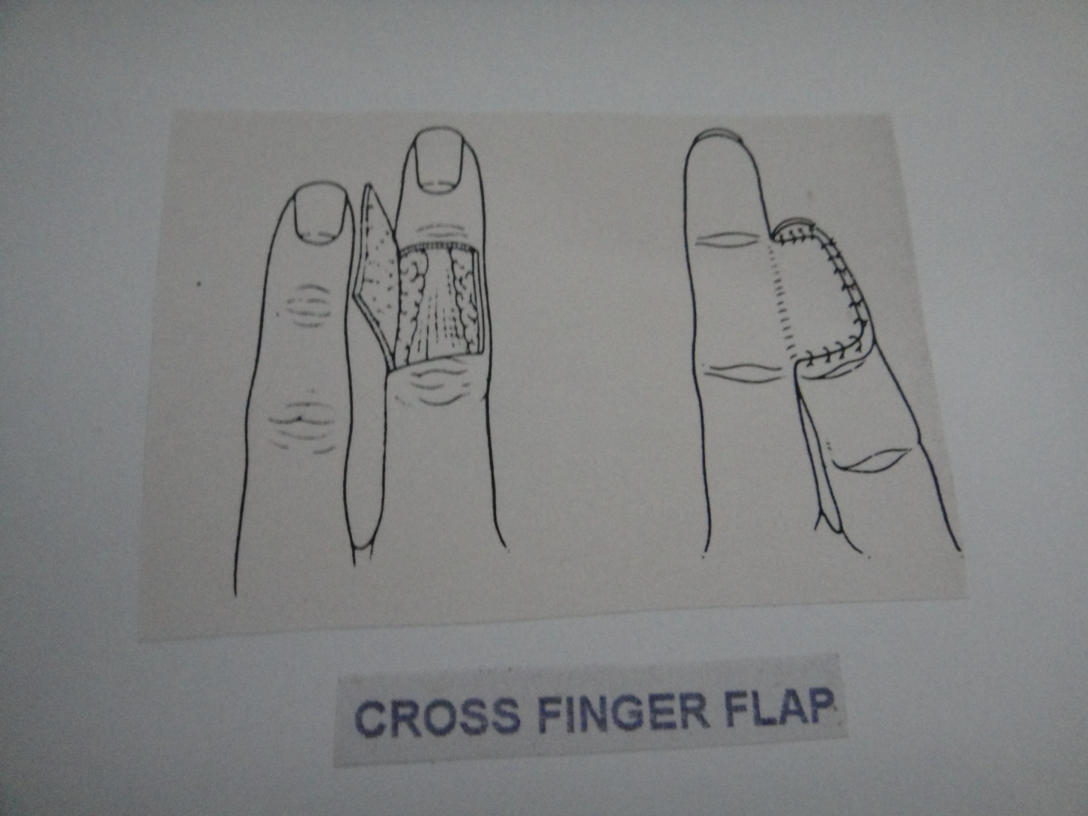

Slide 70
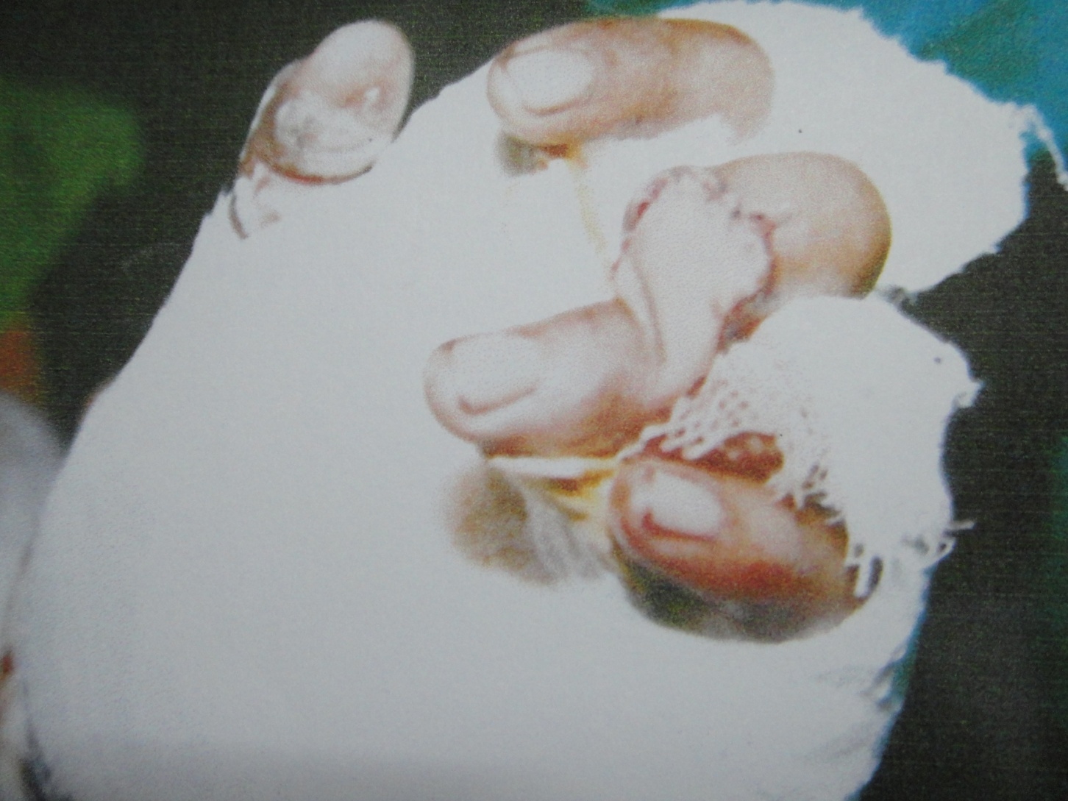

Slide 71
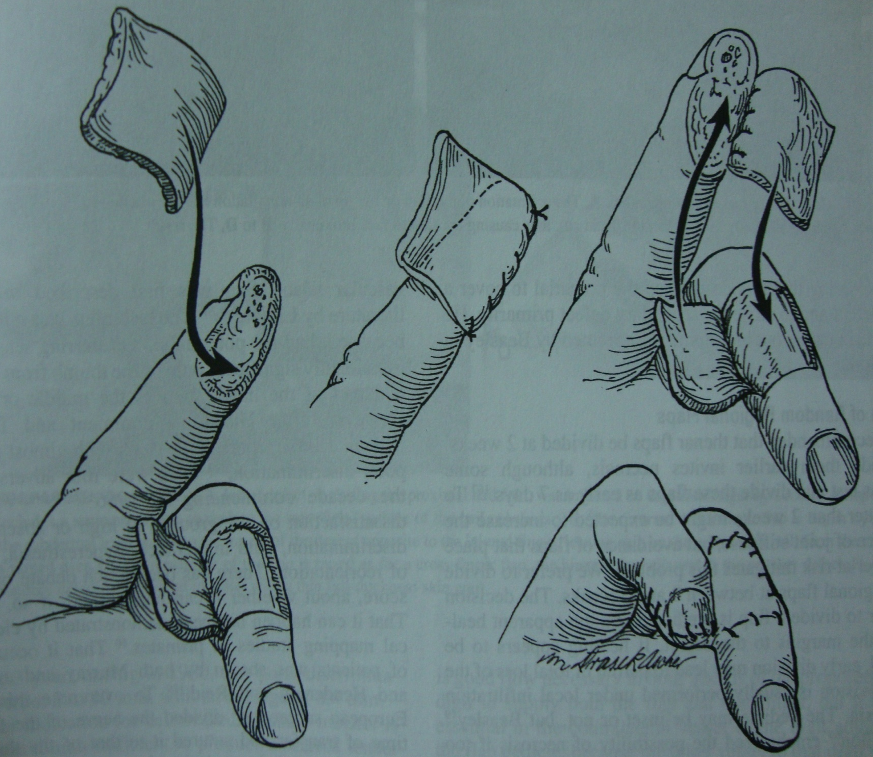

Slide 72
Advantage:Simple
  local flap
  LA
  no hospitalization
Disadvantage:Donor site morbity
  poor colour and texture match
  less subcutaneous tissue for pulp loss
  unpredictable sensory recovery

Slide 73
Innervated cross finger flap
Berger:1975 Cohen:1983
For finger tip injury:Incision is made from proximal corner of free edge of flap towards web space.
Dorsal branch of palmar digital nerve located and dissected and transected about 1.5-2 cm proximal to edge of flap.
Exposure of amputed digital nerve and neurorraphy done.

Slide 74
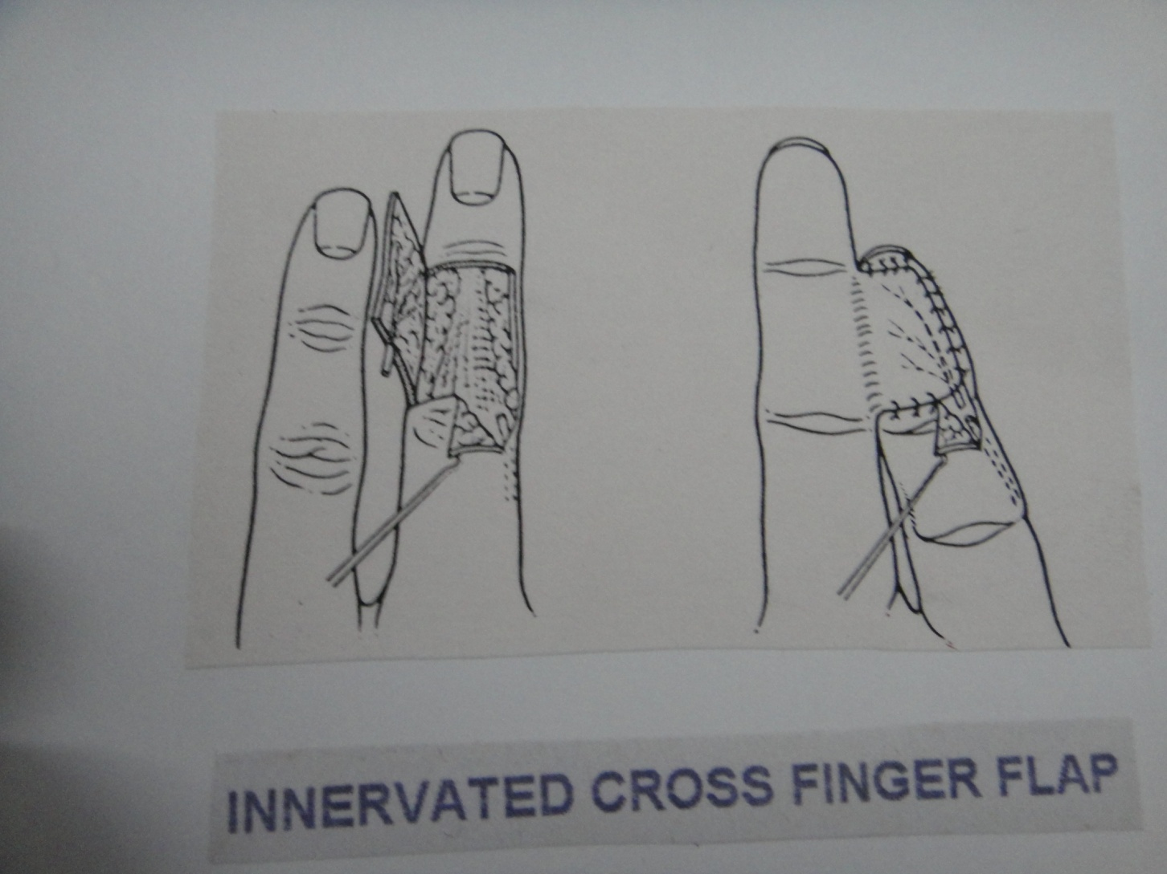

Slide 75
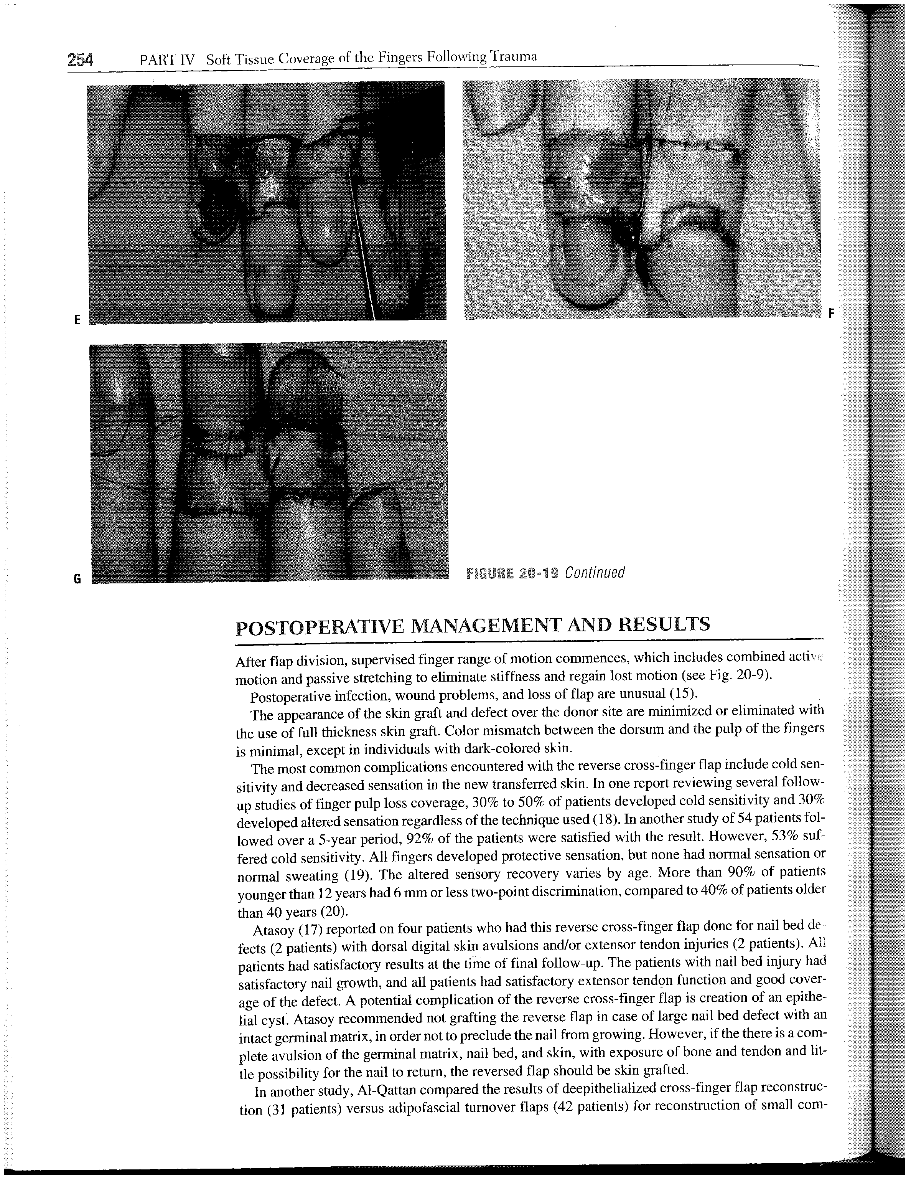
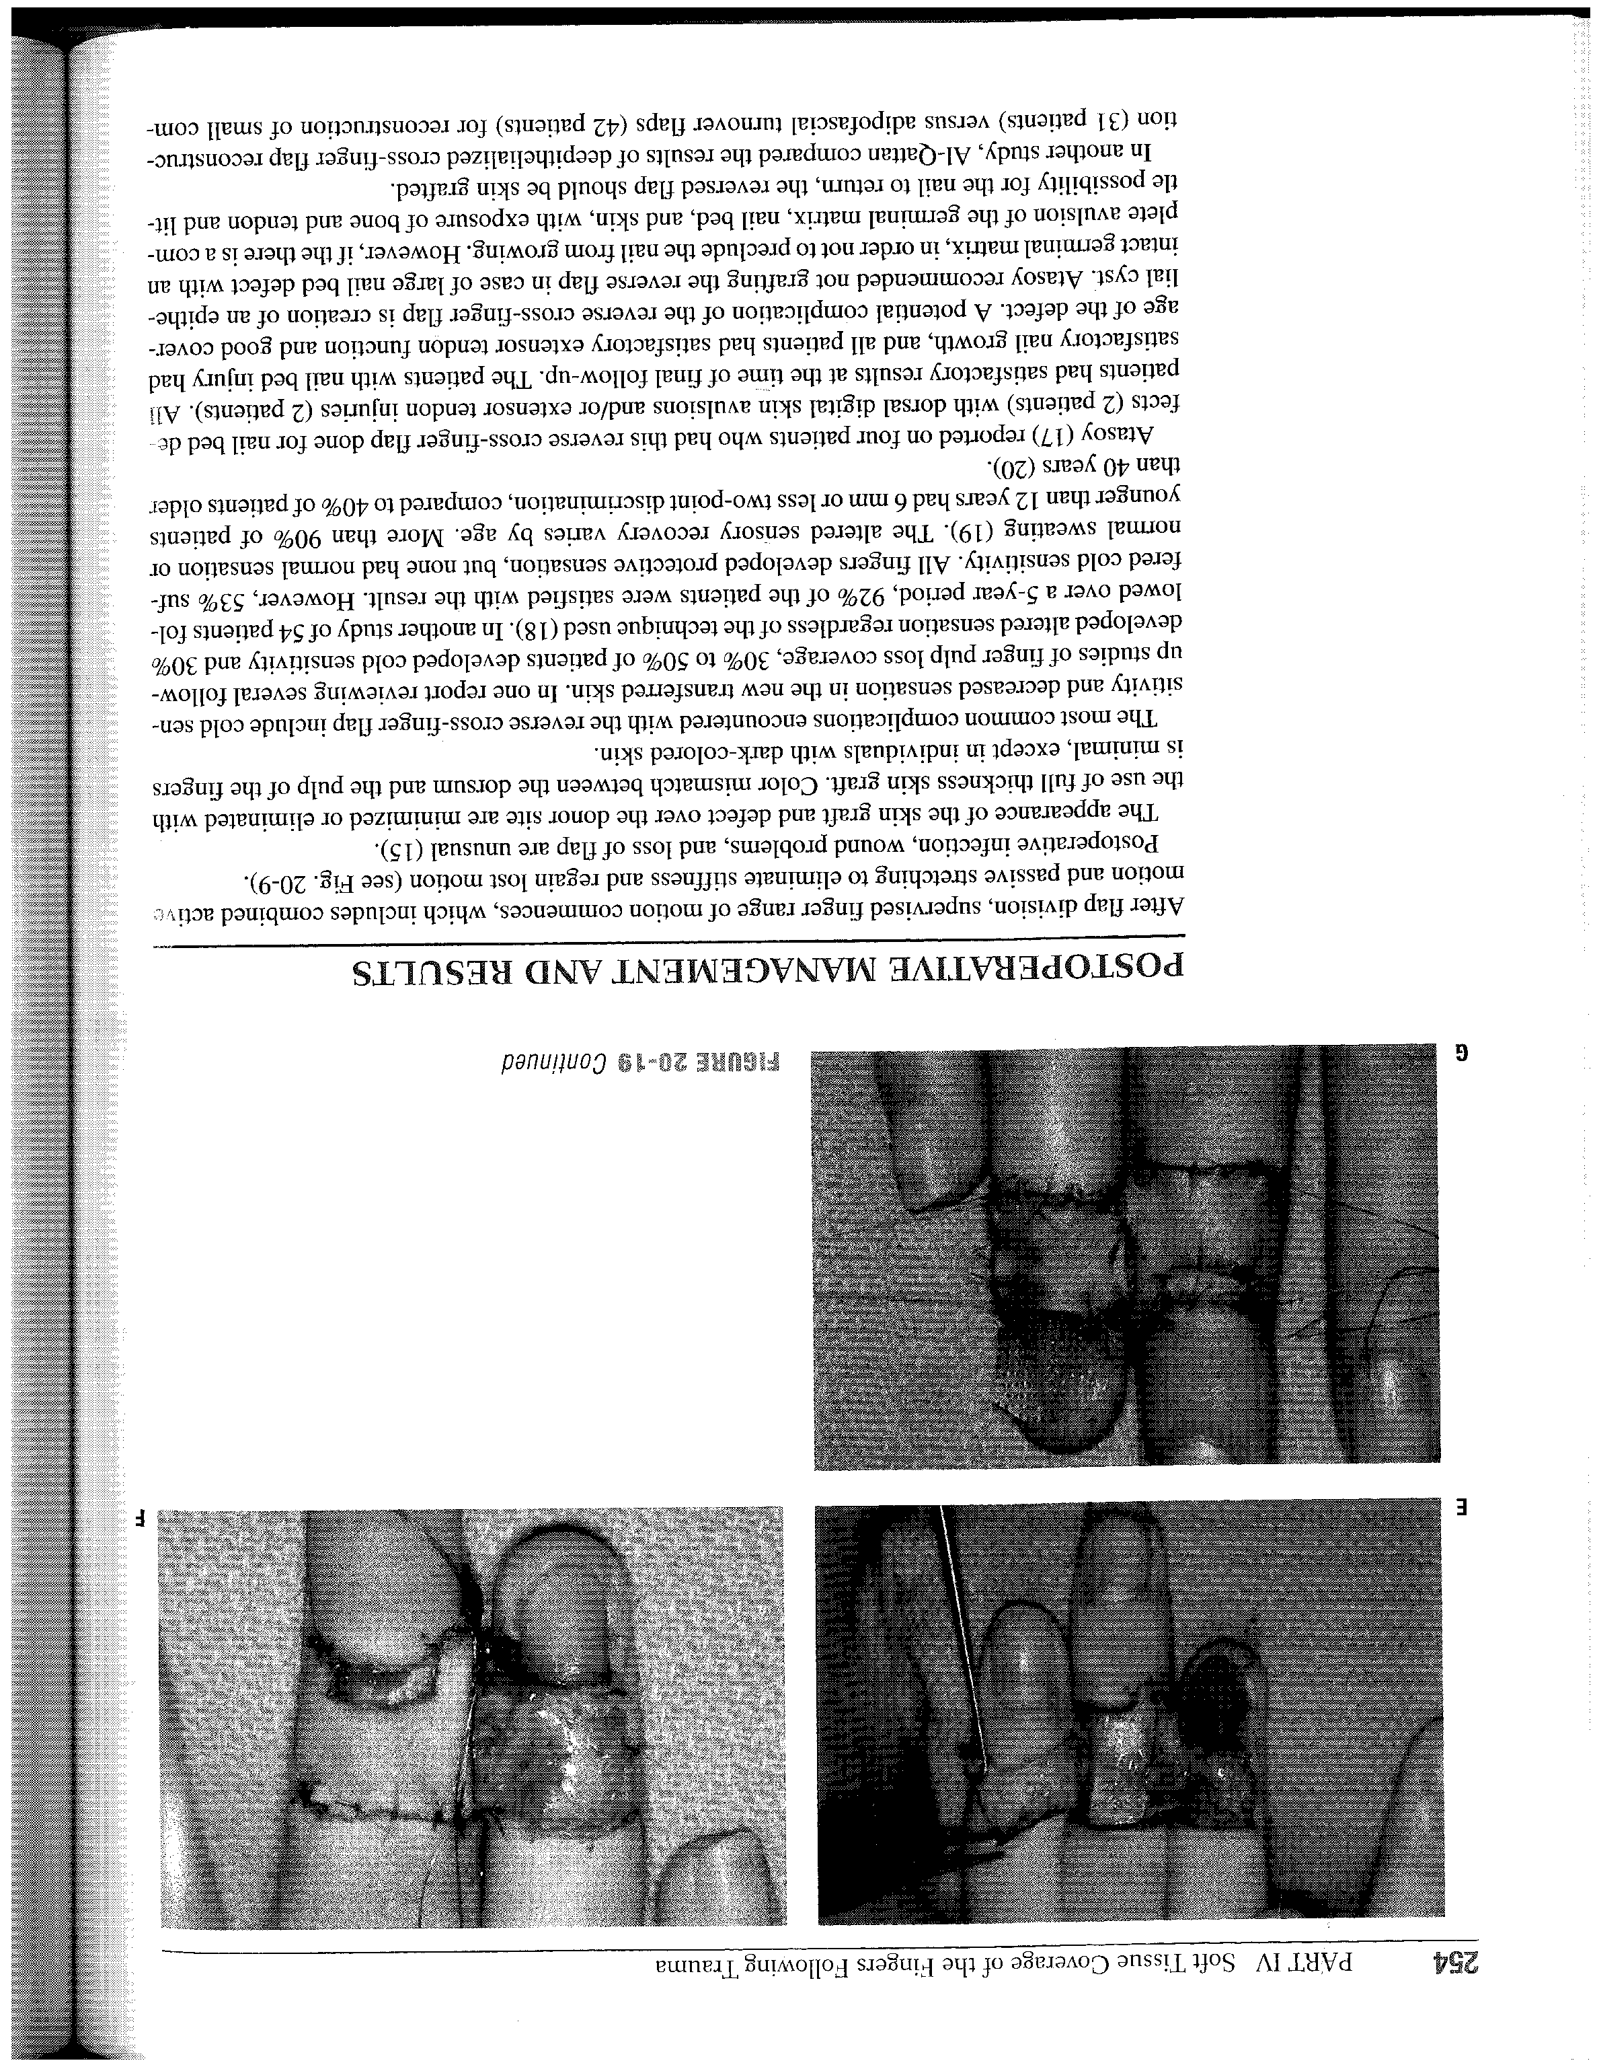
Reverse cross-finger flap
Notes:
Useful in dorsal defect

Slide 76
Thenar flap
Gatewood 1926
Orginal:posted stamp like ulnarly based
Modifacton: Radially based
Distally based
Proximally based
H-shaped
Advantage: Local, good colour and texture match; sufficient tissue to restore bulk of pad; primary closure donor
Disadvantage: Painful scar; PIP contracture

Slide 77
Thenar Flap
–Base of flap high on thenar eminence, adjacent to thumb MP joint
–Protect radial digital n.
–Difficult to position ring, small finger comfortably
–Divide flap at 14 days
–Donor defect options: 1° closure
  FTSG
  “H-flap”

Slide 78
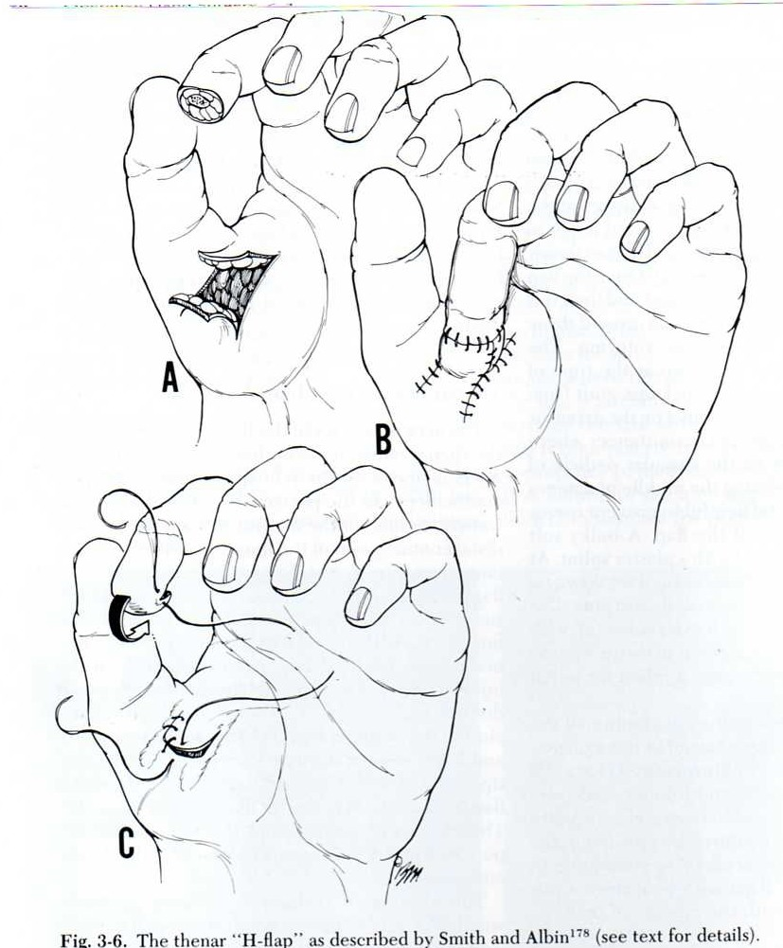
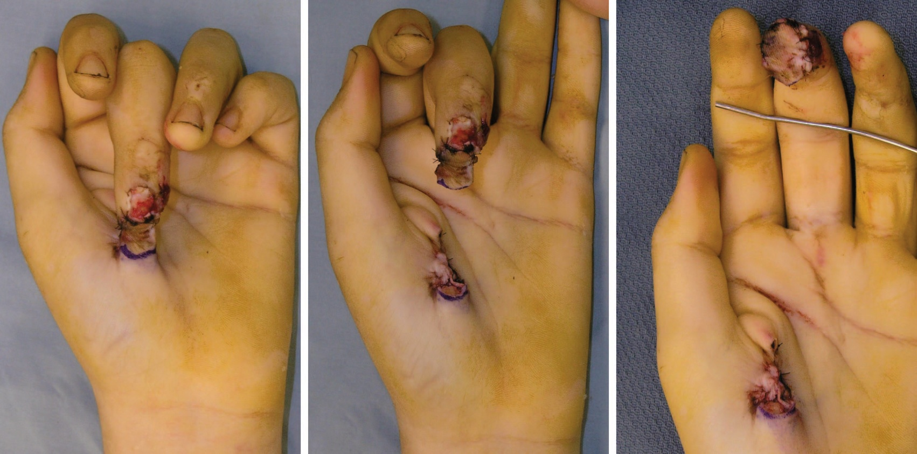
Thenar Flap

Slide 79
Heterodigital neurovascular island flap:(LITTLER)
Original:Ulnar aspects of RF and MF favoured as donor areas since at these sites loss sensibility is atleast in convenient.
Skin island is taken from palmar and medial side of terminal phalanx of RF.
To preserve the innervation to adjacent side of the LF the palmar digital nerve must be split proximal to web space.
Ideally dorsal digital branch should also be split off palmar digital nerve in order to preserve the sensation on dorsum of RF,but this is not always done.
Wherethe common palmar digital artery divides in fourth web space, its LF digital branch will have to ligated and divided.

Slide 80
Indicatons:Extensive loss of palmar thumb pulp,loss of terminal digital nerve innervation,particularly ulnar thumb
Donor digit based on remaining intact innervatoin:either ulnar MF(median nerve intact) or ulnar RF(ulnar nerve lntact).
Flap outline extending from distal palmar pad to just short of proximal crease
Center of donor flap begins at mid-palmar aspect of the digit and extends onto dorsum of donor digit
Zigzag incision connect the proximal flap
Extension of recipient site via an incision into palm
Identification of common digital artery and nerve
Ligation of proper digital artery to adjacent nondonor digit radial aspect at least 5-10 mm away from bifurcation
Dissection of donor artery and nerve to the base of flap
Raise the flap,including skin,subcutaneous tissue,and neurovascular pedicle

Slide 81
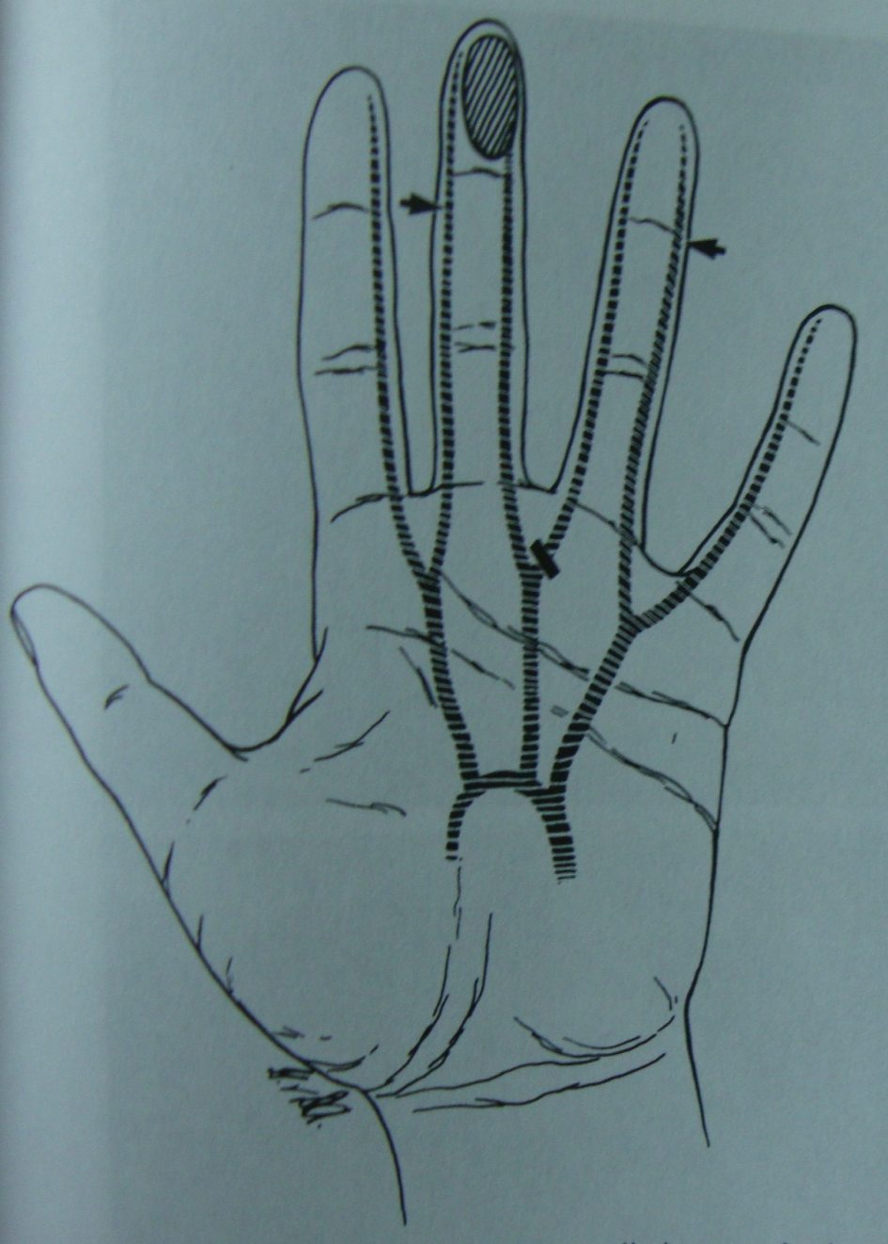
Hetero-digital island flap
Major indications
- Sufficient damage
Possible tender scarred pulp, anesthesia, ischemia
Pre-requisites: normal arterial flow in doppler test (hand, ulnar artery of ring, radial artery of middle)
* Preferred ulnar aspect of middle finger > radial aspect of little finger

Slide 82
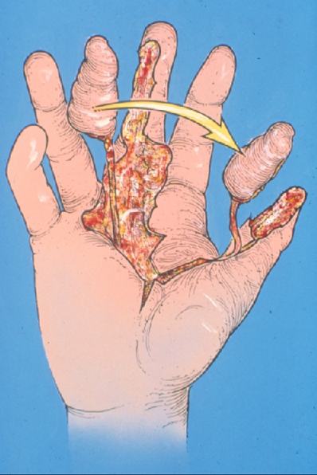
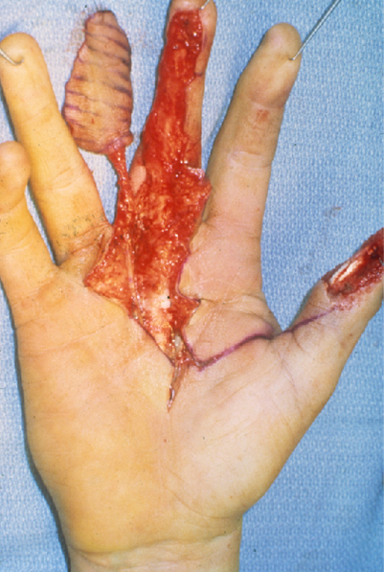
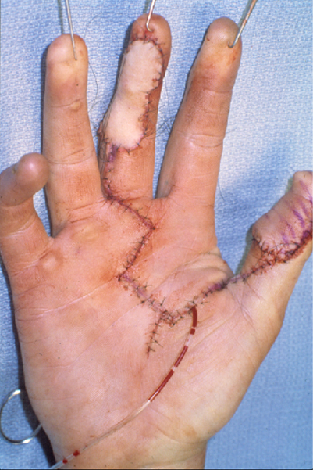
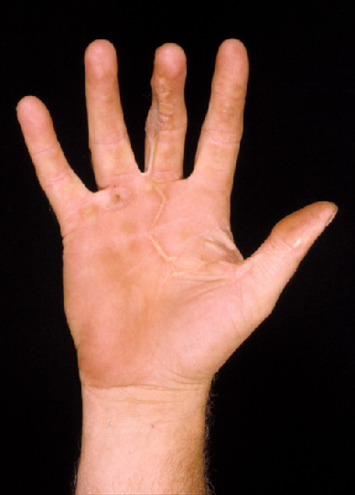
Hetero-digital island flap
*Litter 1960
Notes:
- For prevent neuroma, one need to divide ulnar digital nerve of thumb and turn it back in to carpal tunnel.

Slide 83
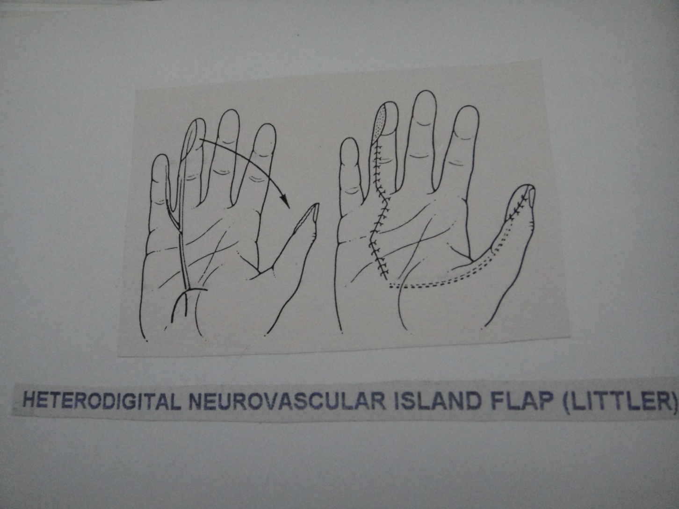

Slide 84
THUMB TIP INJURY

Slide 85
The Thumb
•Same principles of other digits, however more important to preserve length and sensibility
•Need more extensive coverage procedure when thumb suffers substantial soft tissue loss

Slide 86
Specific considerations
choice of donor digit index finger
Superficial Radial nerve located

Slide 87
Primary suturing
Indication:
non contaminated sharp cut
Lacerated wound without much skin loss
Earlier presention of pt

Slide 88
Volar advancement flap
–Moberg E 1964
–Advance volar skin on a neurovacular pedicle
–2 cm advancement
–potential complications of flap necrosis and flexion deformity

Slide 89
Volar Advancemnt Flap On Thumb:(Moberg)
The volar skin of the thumb is supplied by digital arteries while dorsal skin is supplied by separate vessels-The ulno dorsal vessels,being a branch of first metacarpal artery and the radio dorsal vessel a branch of the radial artery.
This means that on the thumb longitudinal mid lateral incision can be made which will not impair the blood supply of the skin on dorsum.
After making mid lateral incisions from the defect down to the proximal thumb crease,the volar skin may be elevated on the vascular support of the digital arteries and advanced up to 1 cm to cover the defect at the tip.

Slide 90
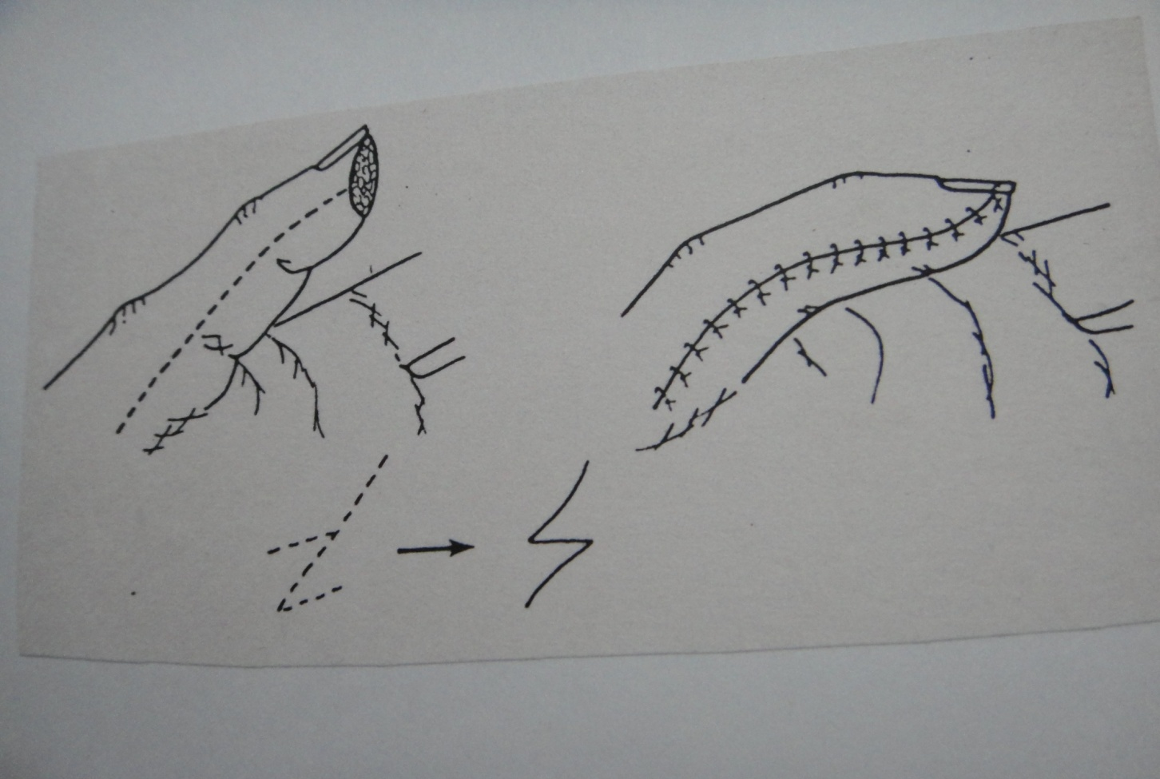

Slide 91
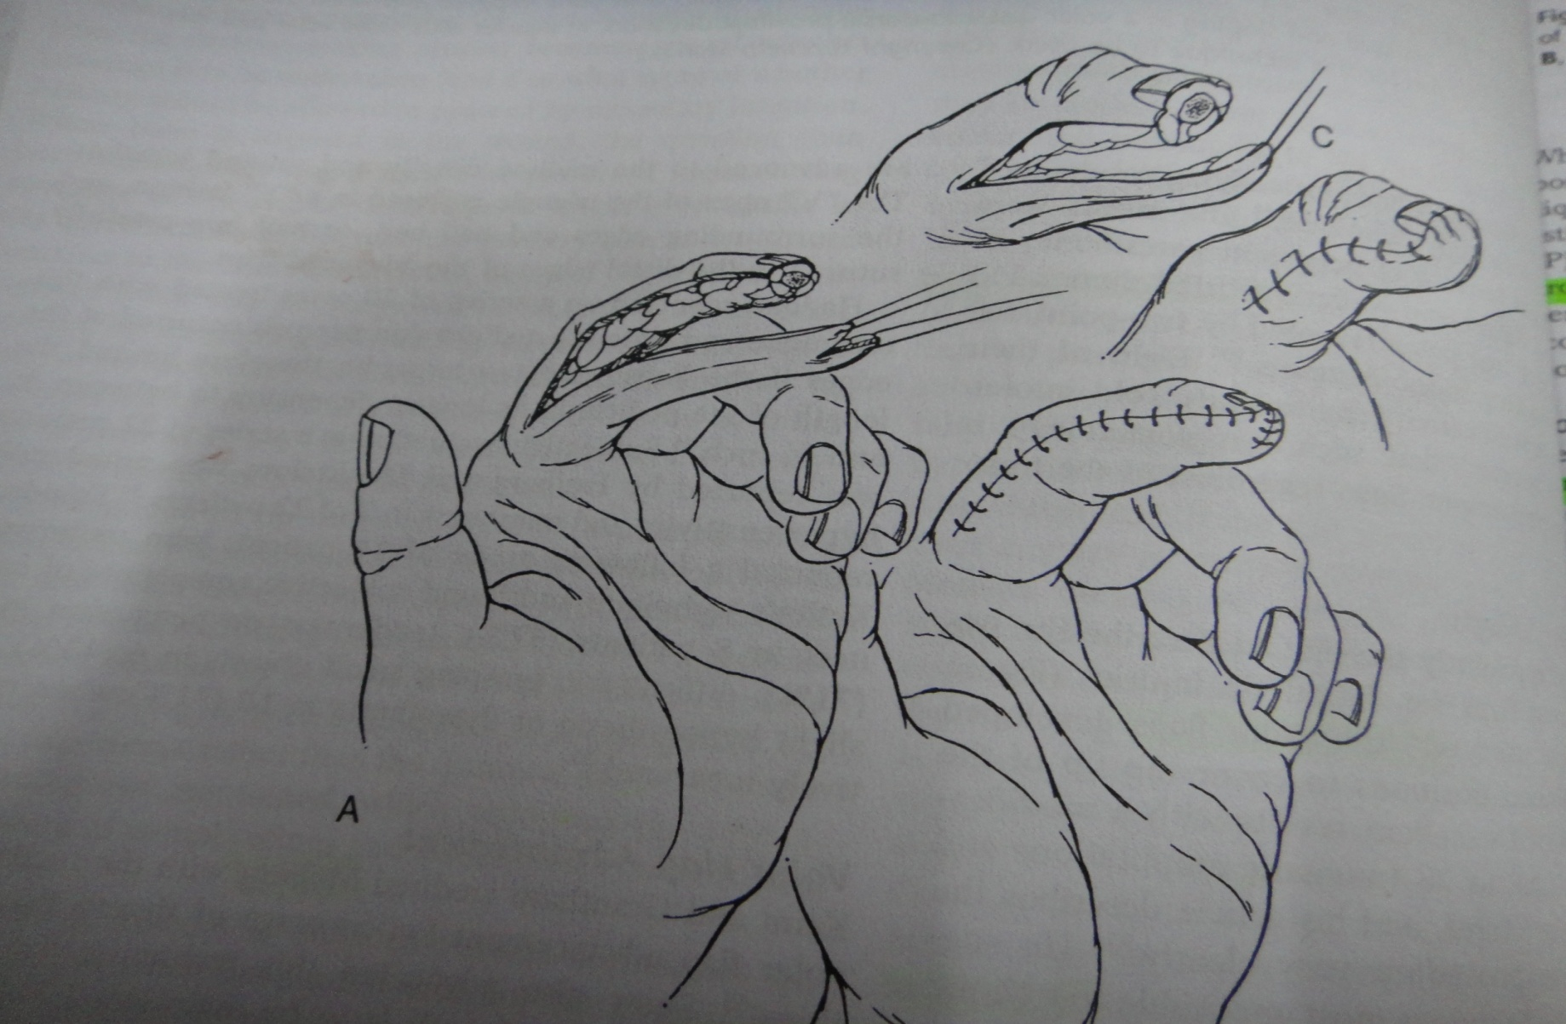

Slide 92
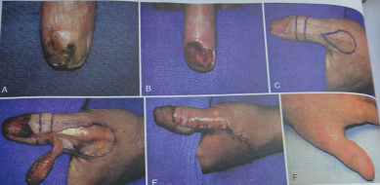
Brunelii flap

Slide 93
Cross-Finger Flap
–Flap designed from proximal phalanx of index finger
–FTSG/SSTG to donor-site
–+/- nerve transposition
–Detach flap at 2-3 weeks

Slide 94
Radial-innervated cross-finger flap
Markings for size and location of flap same as non-innervated cross-finger flap
Beginning at the midpoint of proximal transverse outline of flap ,an oblique incision extends proximally to thumb web.
Position of dorsal sensory radial nerve identified.
Reflection of flap after dissection of nerve branch.
Position of the thumb and transferred flap,with closure of incisions and free graft closure of donor defect.

Slide 95
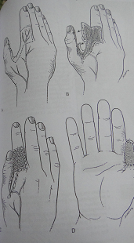

Slide 96
Dual innervated cross finger flap
Dorsal sensory branch of index radial digital nerve innervates dorsal aspect of index proximal phalanx.
Elevation of index-to-thumb cross finger flap with joining incisions for transposition of dorsal sensory branch of radial nerve.
Microneurorrhapy of the thumb ulnar digital nerve to the dorsal branch of index radial digital nerve.

Slide 97
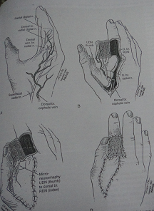

Slide 98
FOUCHER’S FLAP
Colema 1961 Holevich1963
Foucher incorporated neural structure-kite flag
Indication:
thumb amputaion/defects

Slide 99
First dorsal metacarpal artery island flap
FDMA,subcutaneous vein,branch of radial sensory nerve in single stage
Size of defect drawn on dorsum of IF proximal phalanx
Proximal limit: MP joint,Distal limit:proximal IP joint
Dissecction: distal to proximal,from ulnar to radial side
Lazy S or teardrop shaped incision
Pivot point:junction of first and second metacarpals

Slide 100

INNERVATED CROSS FINGER FLAP FROM INDEX TO THUMB(FOUCHER)

Slide 101





Slide 102




Courtesy from Wattana T, MD

Slide 103
Neurovascular island pedicle flap
–Transfer of tissue form ulnar side of long or ring finger, NV pedicle intact
–Restore sensibility and padding to ulnar side of thumb pulp
–Very limited application

Slide 104

THUMB RADIO DORSAL NEUEROVASCULAR FLAP(PHO) similar to joshi flap in other finger

Slide 105

Nail Bed Injuries
Outcome of nail bed injury is most dependent on the severity of the injury to the germinal matrix
Initial treatment important to prevent nail deformity
Can explore up to 7 days from injury
If nail bed heals by granulation, scar may result

Slide 106

Classification
•Subungual hematoma
•Simple laceration
•Stellate laceration
•Crush
•Nail bed avulsion
Subungual hematoma drainage

Slide 107

Laceration
–Treated with nail bed repair under loupe magnification
–May need to incise eponychium at 90° angle to visualize proximal injury
–Repair volar and dorsal roof separately
–Replace nail or substitute into nail fold

Slide 108

Nail bed laceration

Slide 109

Nail bed avulsion
•Attempt to approximate avulsed nail bed as closely as possible
•Proximal avulsions of germinal matrix must be replaced into nail fold

Slide 110

Nail avulsion
Figure of 8 suture

Slide 111


Nail bed defects
May find nail bed on nail
May require split-thickness sterile matrix graft
Donors- undamaged portion of digit, other amputated parts, great toe
Full thickness germinal matrix graft

Slide 112
complications
–Non-adherence
–Split nail
–Linear riding
–Crooked nail
–Hooked nail
–Total nail loss
–Nail horn
–Neuroma

Slide 113

Phalangeal Tuft Fractures
Often associated with nailbed injury
Displacement uncommon
Support of nail and pulp
Percutaneous K-wire occasionally

Slide 114
DISTANT FLAP
Indicated in more severe injuries with complete circumferential loss of skin and exposure of bone particularly thumb and IF.
Pectoral, Abdominal, Groin skin tube pedicle flap.
Advantages:Large defect can be covered and length of the finger can be salvaged.
Disadvantages: Bulky, poor colour and texture match, prolong hospitalization, joint stiffness, poor donor site appeareance
Notes:
gedg

Slide 115
Fingertip Replantation
Technically difficult
Questionable benefit

Slide 116
PROSTHESIS
Considered in cases of complete or partial amputation of the distal phalanx ,particularly complete nail loss,when patient seeks aesthetically normal looking fingertip with nail.
Made from silicon .
Disadvantage:Cost

Slide 117
Specific Conditions

Slide 118



Multiple Digits Injury

Slide 119



Animal Bite

Slide 120
Thank you

