Slide 1
Reconstruction of plantar defects
Dr. Priyank Katwala (M.Ch.)
Assistant Professor
Department of Plastic Surgery, SBKSMI & RC

Slide 2
Overview
Introduction
Anatomy
Clinical evaluation
Reconstruction
Postoperative care

Slide 3
Introduction
Human foot supports the body's weight on standing
Provides a stable interface between the body and the ground during ambulation
Interaction of numerous small bones, small joints, an intact and durable soft tissue envelope, appropriate sensory feedback required for normal ambulation.
Success can be achieved only through the multidisciplinary, coordinated efforts of plastic, orthopedic, and vascular surgeons as well as podiatrists and rehabilitation specialists

Slide 4
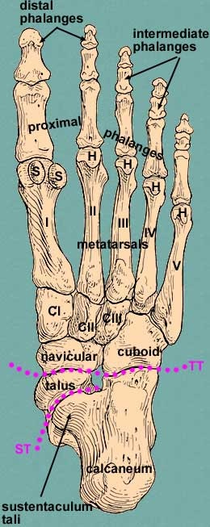
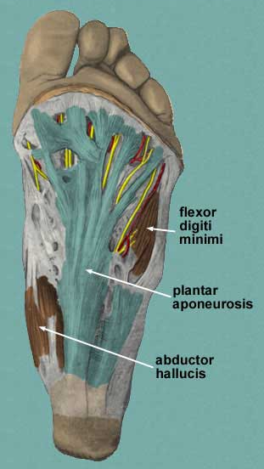
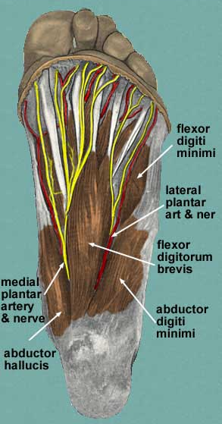

Slide 5
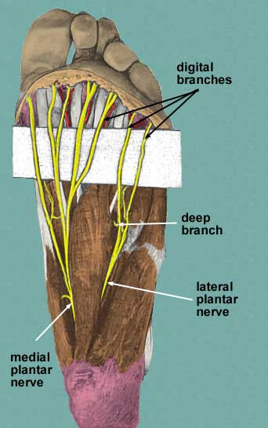
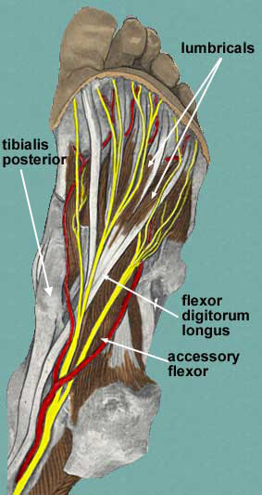
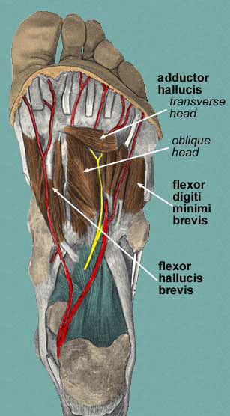

Slide 6
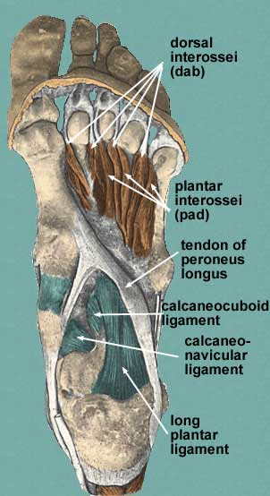
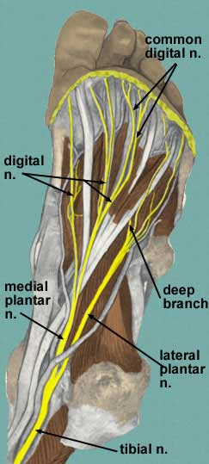
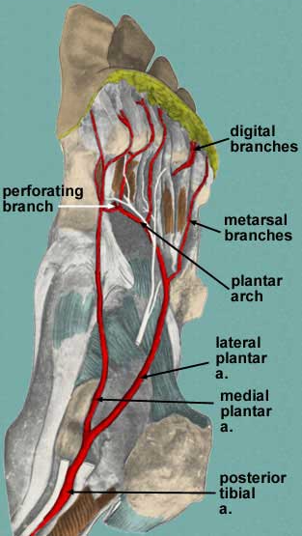

Slide 7
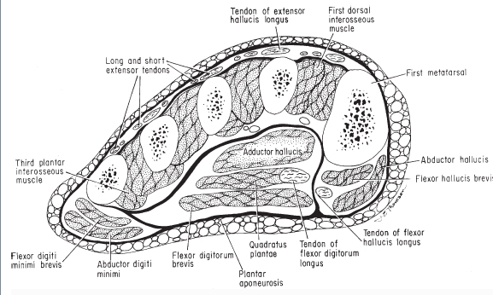

Slide 8
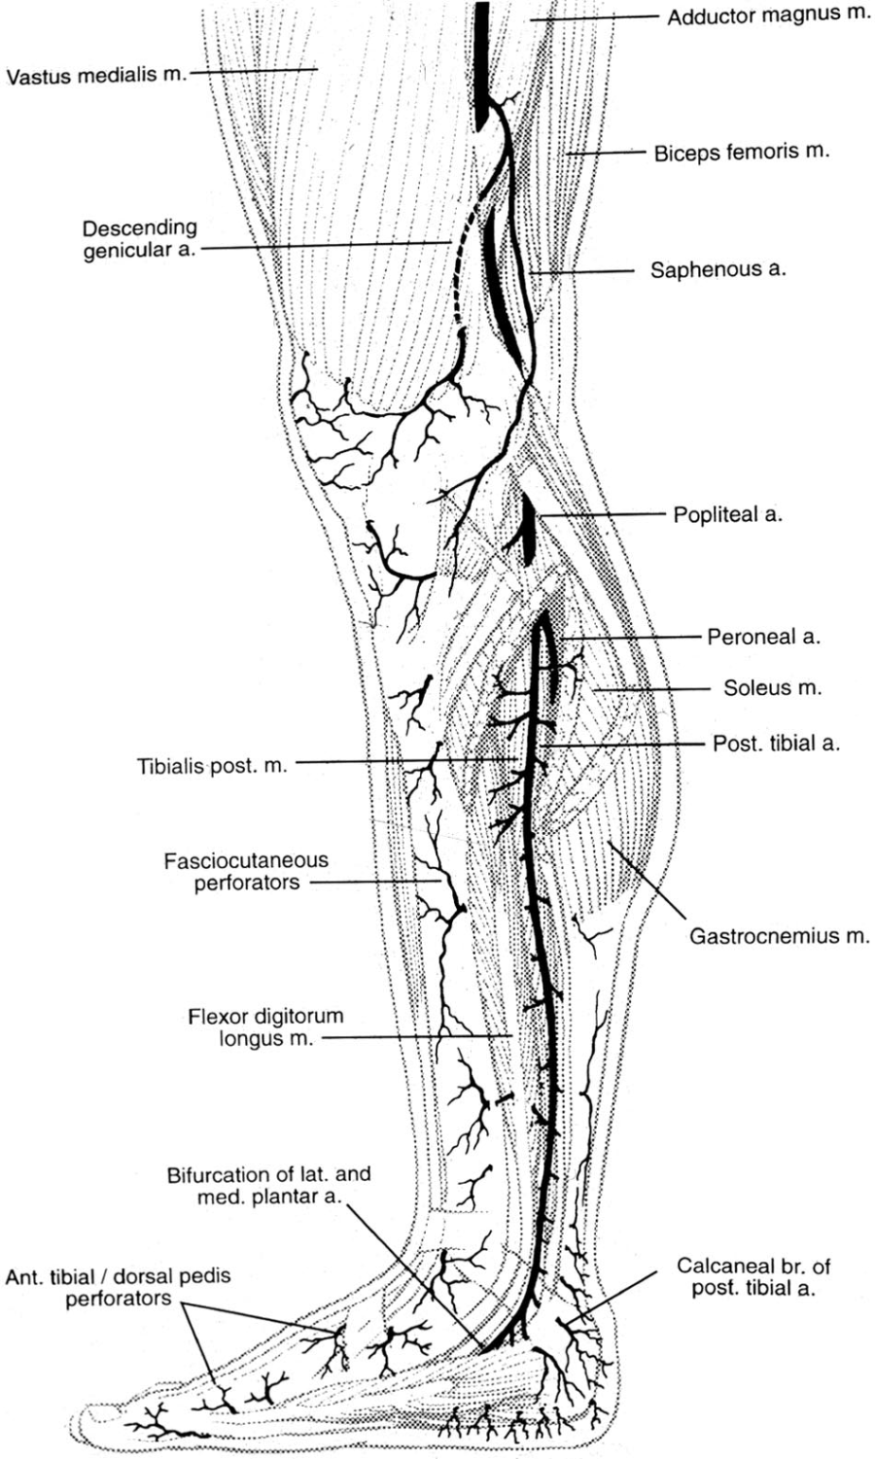
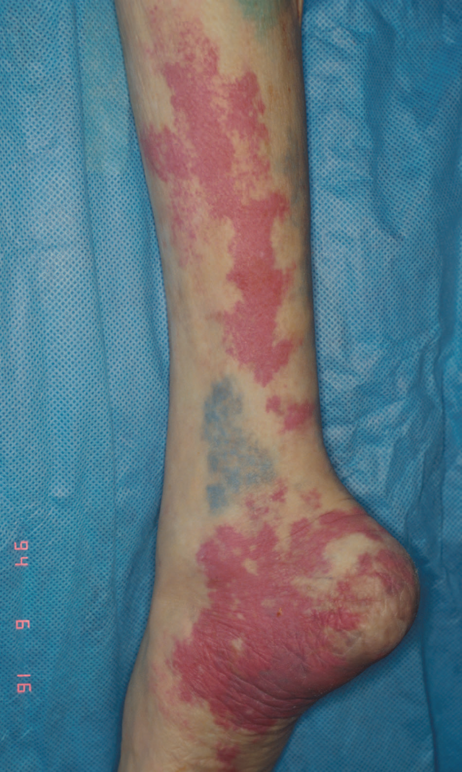

Slide 9
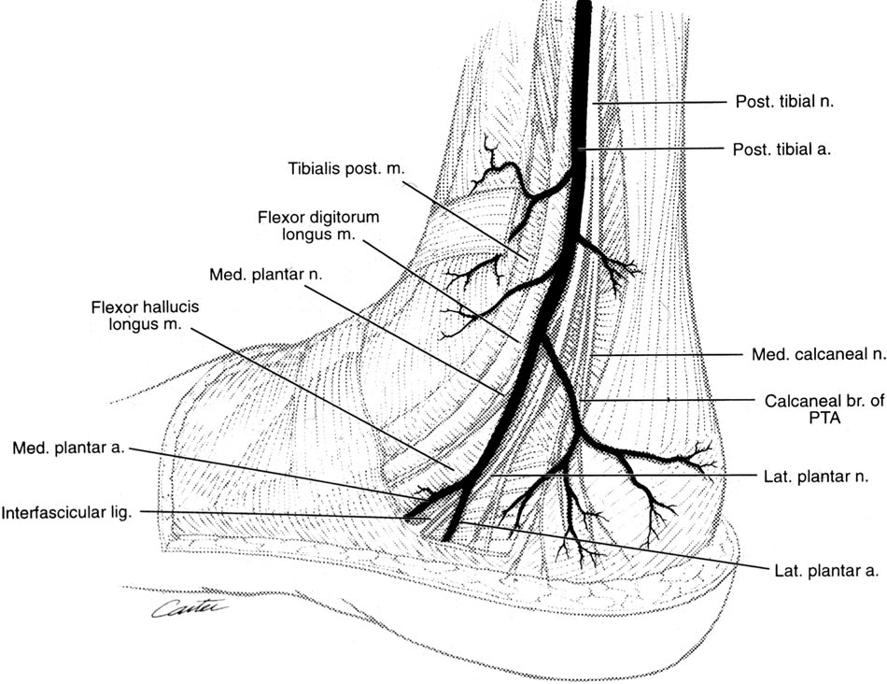
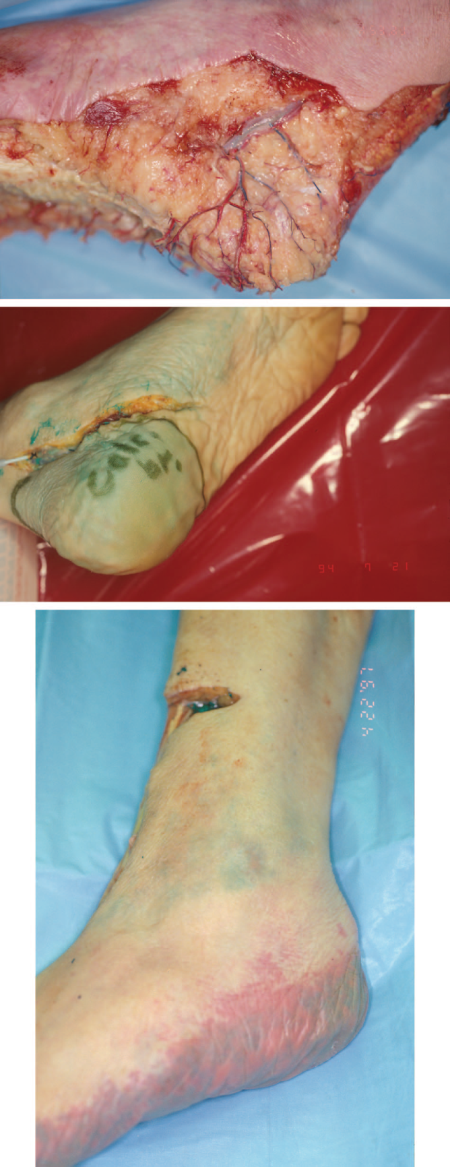

Slide 11
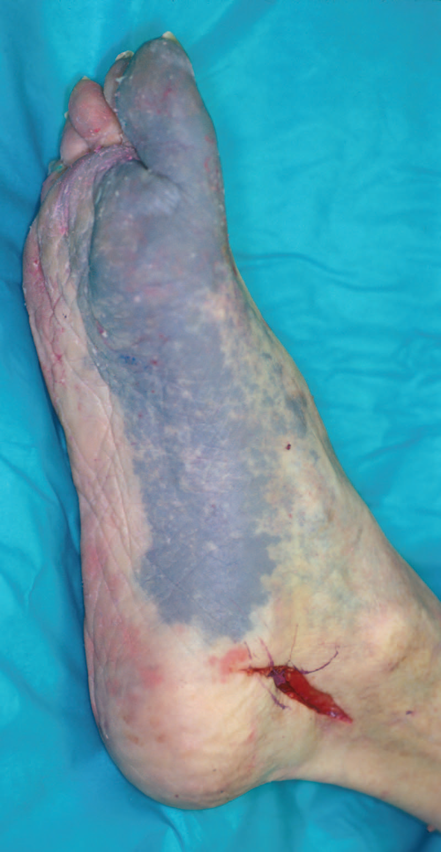
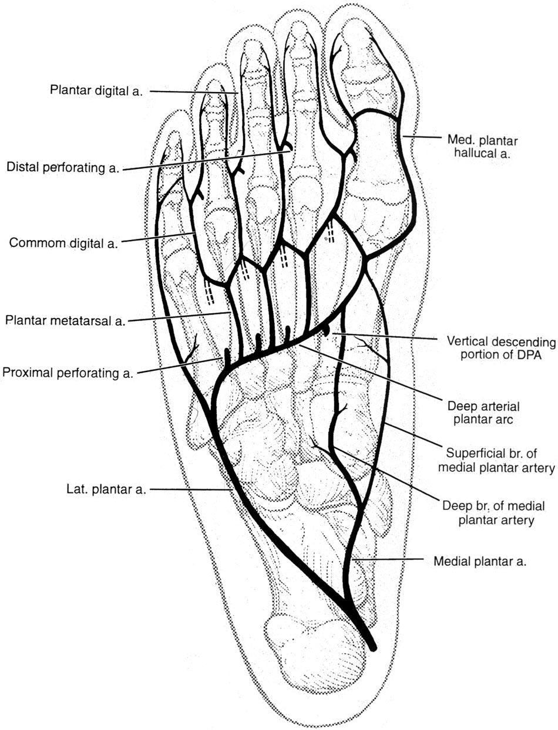

Slide 12
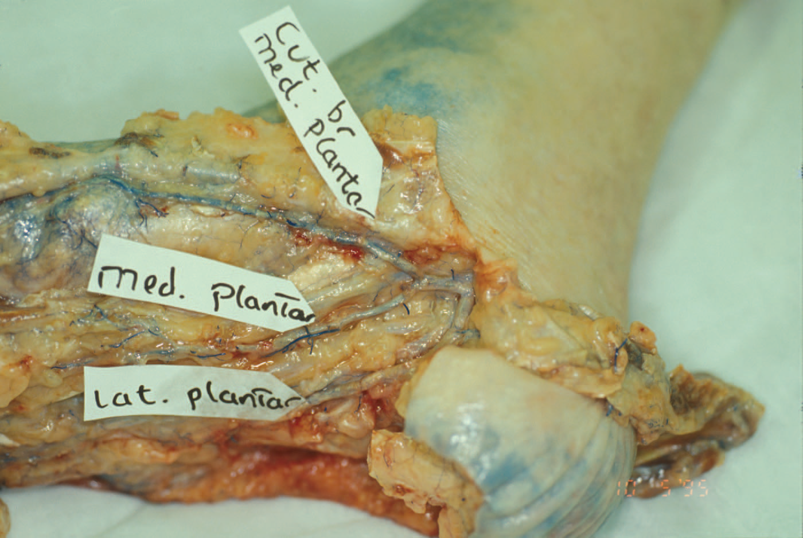

Slide 13
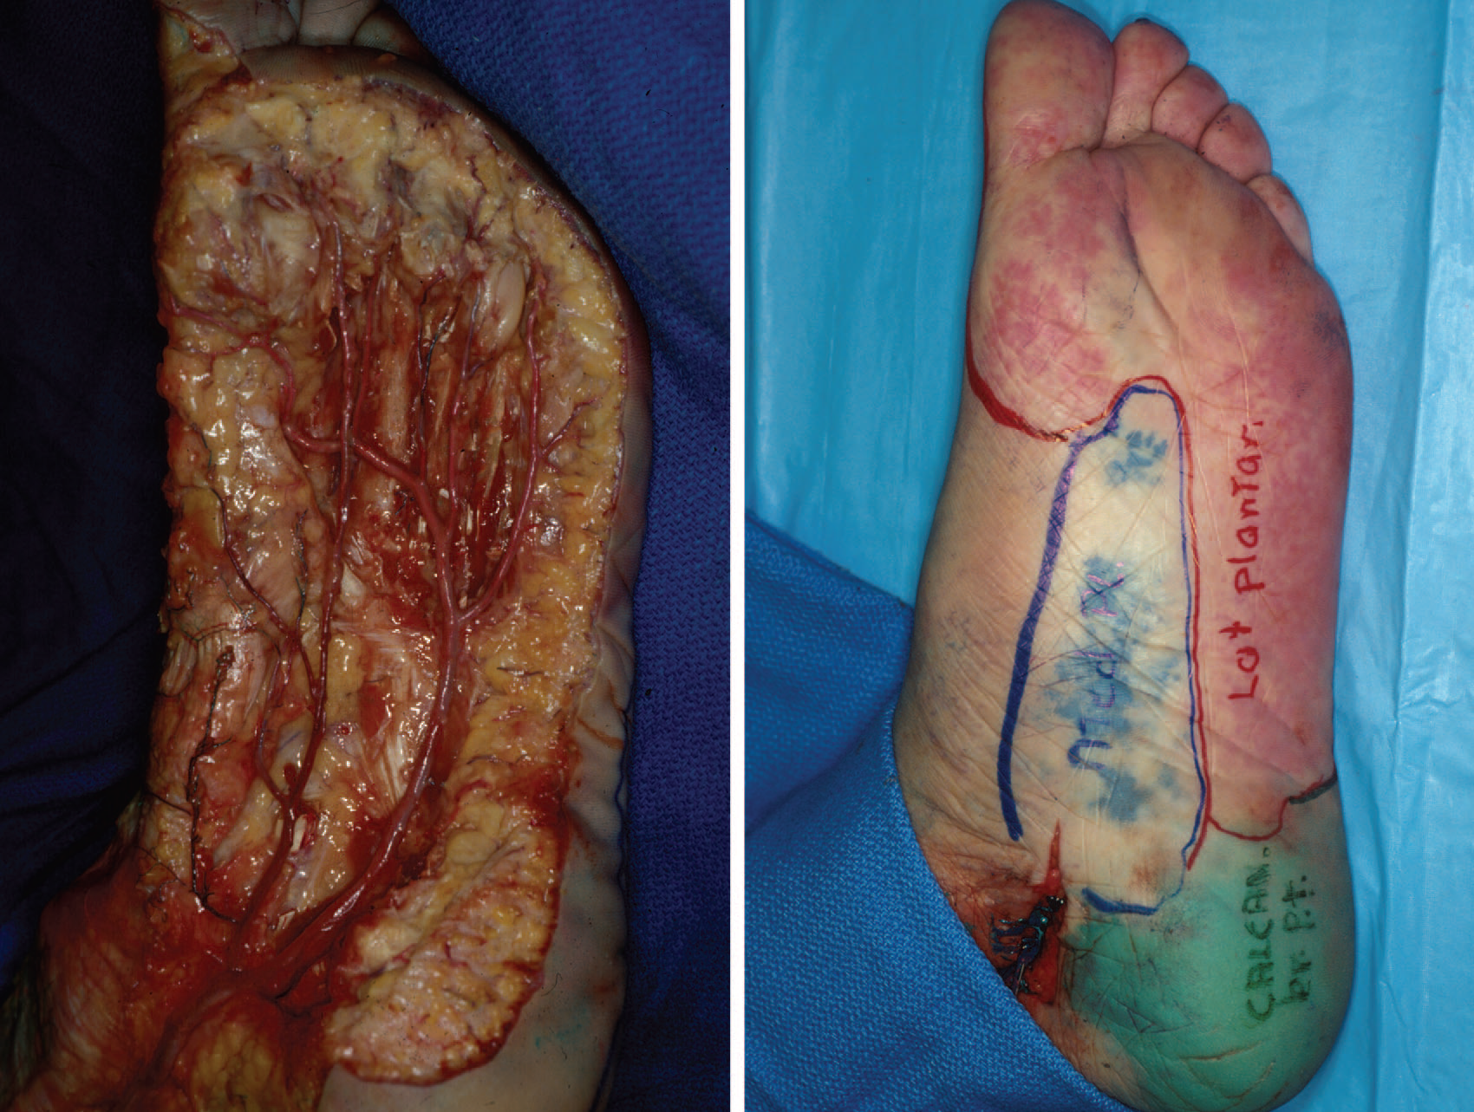

Slide 14
Clinical evaluation
Vascular assessment
Sensory assessment
Bone assessment
Compartment pressure measurement
Gait analysis

Slide 15
Mangled extremity severity score
Skeletal / soft-tissue injury
Low energy (stab; simple fracture; pistol gunshot wound): 1
Medium energy (open or multiple fractures, dislocation): 2
High energy (high speed MVA or rifle GSW): 3
Very high energy (high speed trauma + gross contamination): 4
Limb ischemia
Pulse reduced or absent but perfusion normal: 1
Pulseless; paresthesias, diminished capillary refill: 2
Cool, paralyzed, insensate, numb: 3
Shock
Systolic BP always > 90 mm Hg: 0
Hypotensive transiently: 1
Persistent hypotension: 2
Age (years)
< 30: 0
30-50: 1
> 50: 2
* Score doubled for ischemia > 6 hours

Slide 16
Mangled extremity severity score
Interpretation:
minimum score 1
maximum score 14
A score >= 7 is 100% predictive for amputation in the study population.
A score < 7 can usually be salvaged

Slide 17
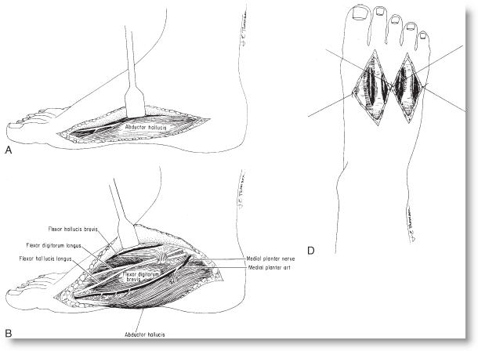
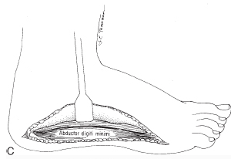
Management
Compartment release

Slide 18
Soft tissue reconstruction
Reconstruction of soft tissue defects of the foot remains a complex and challenging undertaking despite advances
The plantar skin is a unique weight-bearing surface. The glabrous epidermis and dermis are much thicker measure up to 3.5 mm.
The vertical fibrous septa tend to resist the shearing forces of ambulation and produce numerous "shock absorbers" by enclosing the subcutaneous fat into discrete compartments.

Slide 19
Principles
The underlying cause of the wound must be investigated because it will have implications for the reconstruction
The underlying bone architecture and its dispersion of weight must be thoroughly evaluated
The reconstruction should provide some degree of protective sensation.

Slide 20
Classification
Type ST-0 - No tissue damage
Type ST-I (calcaneus, dorsal, plantar) - Small tissue defect 1-3 cm2
Type ST-II (calcaneus, dorsal, plantar) - Large tissue defect greater than 3 cm2
Type BT-0 - No bone damage
Type BT-P - Phalanges defect 1-5
Type BT-M - Metatarsal defect 1-5
Type BT-T - Tarsal defect
Type BT-C - Calcaneal defect

Slide 21
Classification
Plantar forefoot
Plantar midfoot
Plantar hindfoot

Slide 22
Plantar forefoot
The area from the midshaft of the metatarsals distally is referred to as the forefoot
Local flaps
Severe injury single toe may be managed best by toe or ray amputation

Slide 23
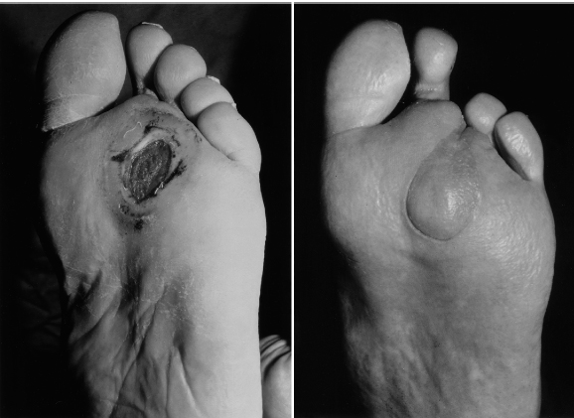
Toe fillet flap

Slide 24
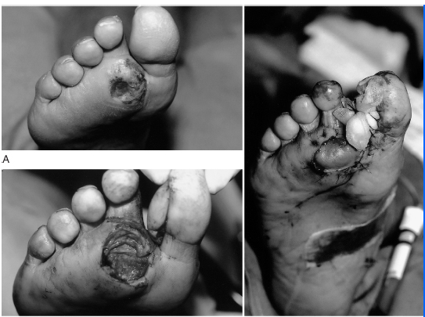
Neurovascular island flap

Slide 25
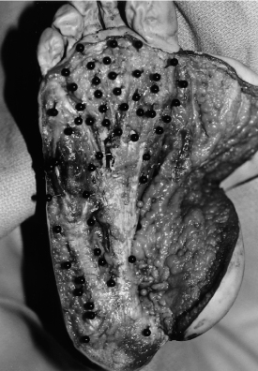
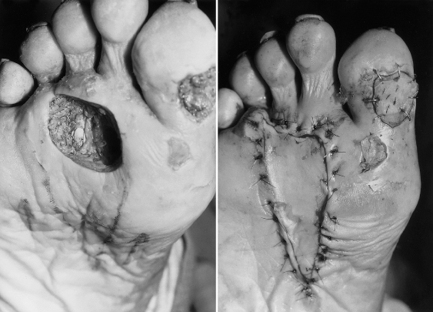
VY Advancement flap

Slide 26
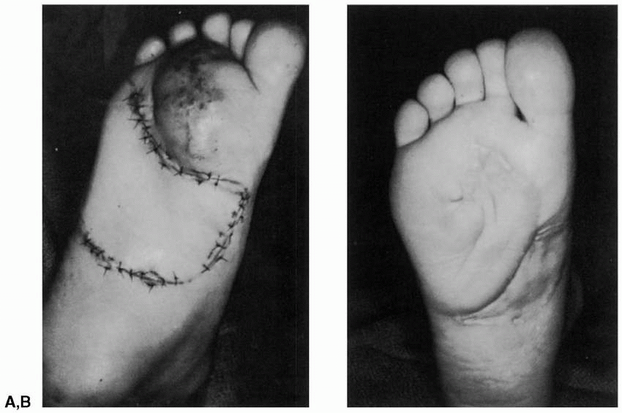
Suprafascial flaps

Slide 27
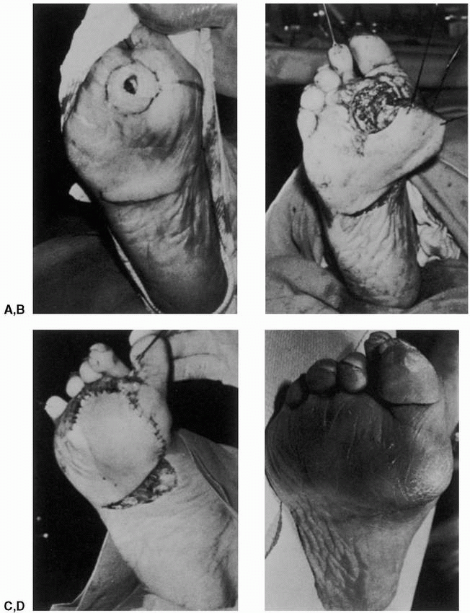

Slide 28
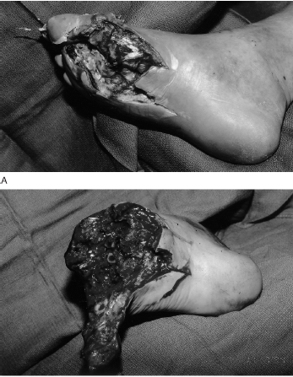
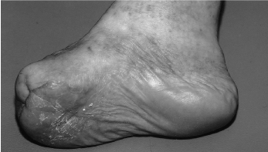
Forefoot amputation

Slide 29
Plantar midfoot
Region between the proximal tarsal row and the midshaft of the metatarsals
Comprises the medial non-weight-bearing arch as well as the more lateral weight-bearing soft tissues

Slide 30
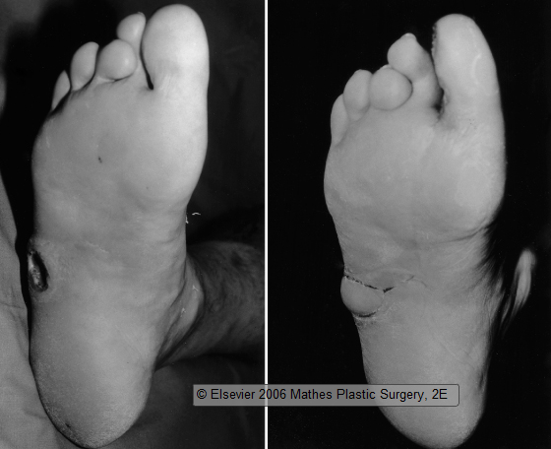
Neurovascular island flap

Slide 31
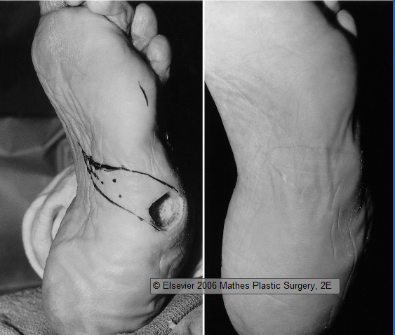
VY advancement flap

Slide 32
Suprafascial flaps
Medially or laterally based plantar flaps
Medially based flaps are raised by incising laterally and elevating the subcutaneous tissues off of the abductor digiti minimi muscle and plantar fascia from lateral to medial
identification and preservation of the cutaneous branches of the medial plantar nerve

Slide 33
Branches of the medial plantar artery and nerve are seen coursing into the flap from the cleft between the plantar fascia and the abductor hallucis muscle
The medial and lateral branches of the plantar nerve are separated from the main trunk
Laterally based flap, a similar dissection may be performed; however, all branches of the medial plantar artery are sacrificed to permit flap rotation.

Slide 34
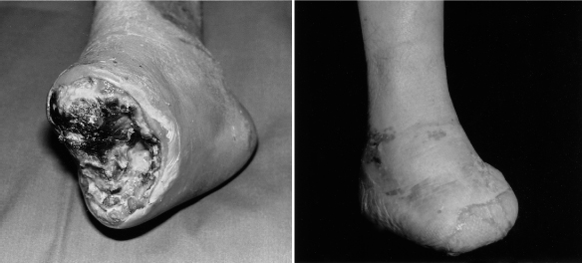
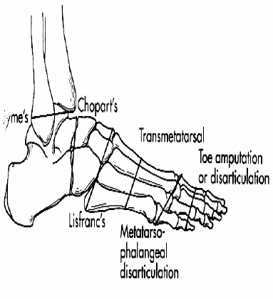
Midfoot amputation
Lisfranc
Chopart

Slide 35
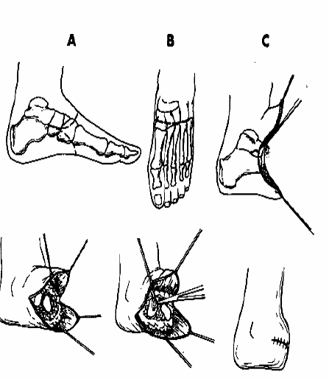

Slide 36
Plantar hindfoot
Greatest challenge to the reconstructive surgeon
Specialized location, with specific requirements for its repair.
In addition to the thick, durable heel pad and the underlying calcaneus, the Achilles tendon and its thin, pliable soft tissue envelope must be managed appropriately.
Reconstruction should provide durable soft tissues for safe weight bearing while permitting nearly normal ankle motion.

Slide 37
Intrinsic muscles
Abductor hallucis
Abductor digiti minimi
Flexor hallucis brevis

Slide 38
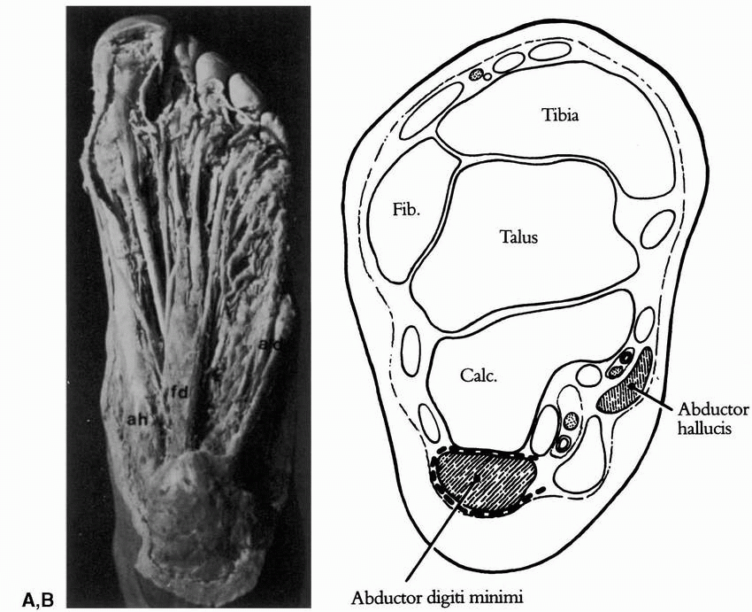
Abductor digiti minimi

Slide 39
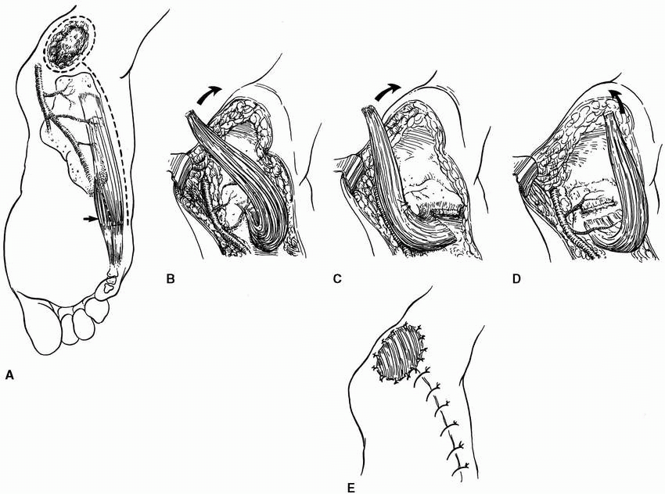

Slide 40
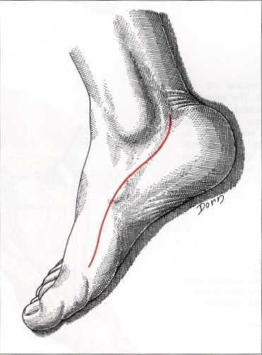
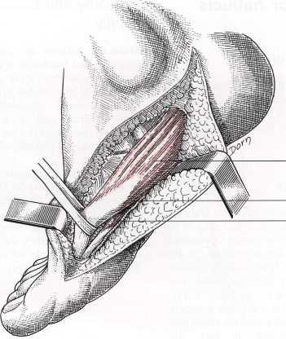
Abductor hallucis brevis

Slide 41
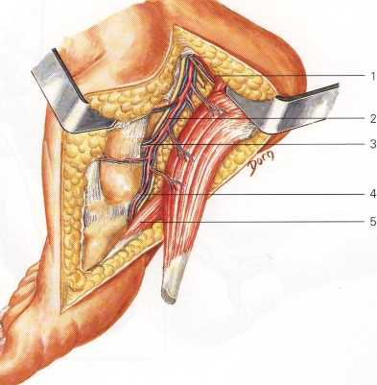
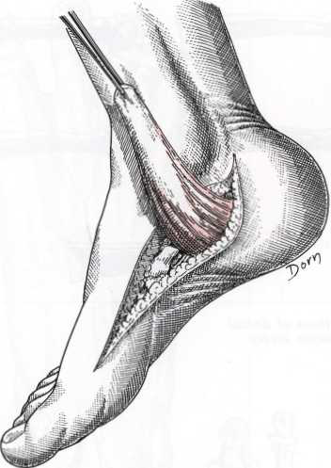

Slide 42
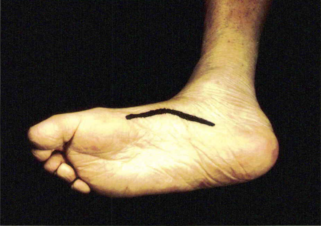
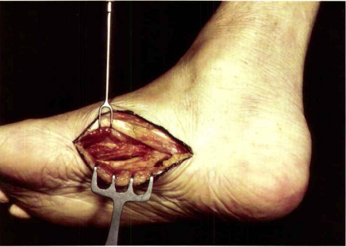
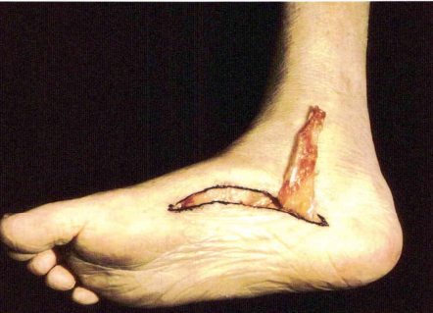
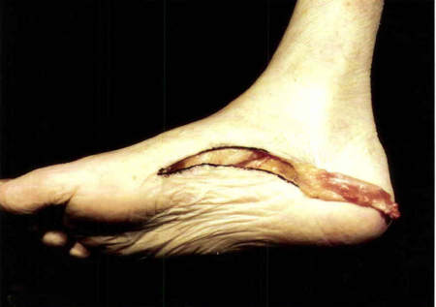

Slide 43
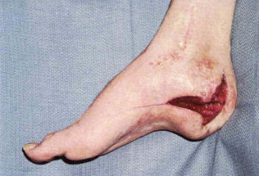
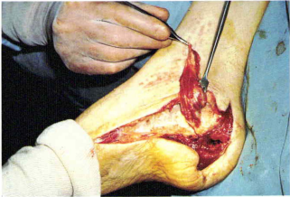
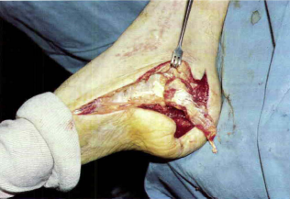
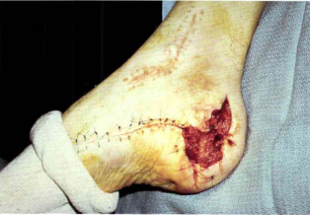

Slide 44
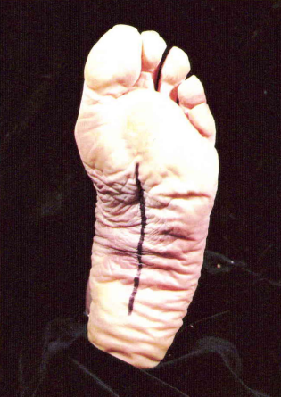
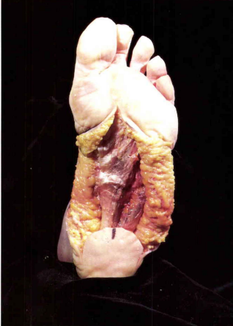
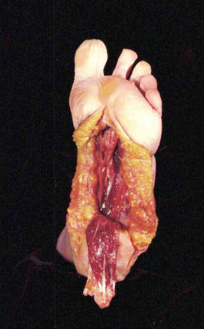
Flexor digitorum brevis

Slide 45



Slide 46


Medial plantar artery flap

Slide 47



Slide 48



Slide 49



Slide 50



Slide 51


Slide 52


Slide 53


Heel pad flaps

Slide 54


Slide 55

Sural artery flap

Slide 56

Microvascular free flaps

Slide 57


Hindfoot Symes amputation

Slide 58
Postoperative care
Require a structured, well-planned, multidisciplinary recovery program to ensure success
Non-weight-bearing regimen for at least 3 weeks
Local flaps generally require a day of elevation; skin grafts, 3 to 5 days; and free flaps, up to 2 weeks
Control of pedal edema is important
Antibiotic use as dictated by surgery

Slide 59





Slide 60

Thank You

