Slide 1
ACANTHOLYSIS: BACK TO BASICS

Slide 2
INTRODUCTION
Derived from Greek words akantha meaning thorn or prickle and lysis meaning loosening.
Defined as loss of coherence between epidermal cells due to breakdown of their intercellular bridges.

Slide 3
PATHOGENESIS
Desmosomal cadherins are the primary pathological targets in the pemphigus group of disorders and some conditions like bullous impetigo.
I/C space of desmosomes includes desmogleins and desmocollins which in conjunction with their cytoplasmic counterparts plakoglobin and plakophilin bring about intercellular attachment.

Slide 4
Separation of interdesmosomal regions
Splitting & disappearance of desmosomes forming I/C gaps
Fluid influx leading to cavity formation (suprabasal, mid-epidermal or subcorneal)

Slide 5
Acantholytic cells remain metabolically active for some time and retain their capacity for DNA synthesis.
Degeneration and cell death represent secondary phenomenon.

Slide 6
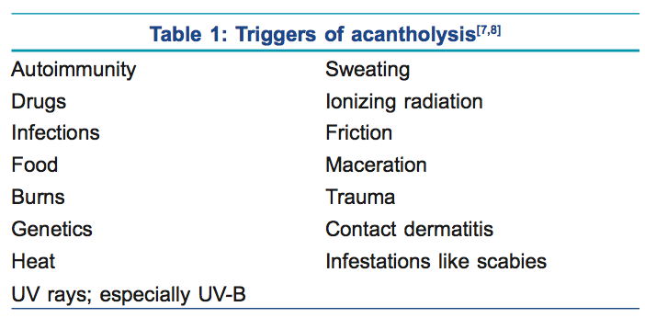

Slide 7
CLASSIFICATION
Primary acantholysis
Secondary acantholysis

Slide 8
Primary Acantholysis
Dissociation and disintegration of desmosomes leads to separation of keratinocytes either due to direct injury to desmosomes or due to hereditary defects in their constitution
Thus, in these diseases acantholysis is the primary event leading to formation of intra-epidermal cavities and hence the manifestations of the disease.

Slide 9
Primary acantholysis
Observed in:
  Pemphigus vulgaris and its variants
  Pemphigus foliaceus and its variants
  Hailey Hailey disease
  Darier’s disease
  Bullous impetigo
  SSSS

Slide 10
Mechanism in pemphigus
Major auto-antibodies in pemphigus target Dsg-1 (PF & PV) and Dsg-3 (PV).
Plasminogen activation in lesional epidermis is also believed to contribute to acantholysis

Slide 11
Conventional concept
PV IgG binds to Dsgs resulting in stearic hindrance
Interference with desmosomal cadherin trans-interactions
Loss of intercellular adhesion

Slide 12
However, in latest immuno-electron studies it has been shown that desmosomes remain intact till the late stages of acantholysis
Therefore, the pivotal role of anti-Dsgs antibodies in pemphigus is being questioned.

Slide 13
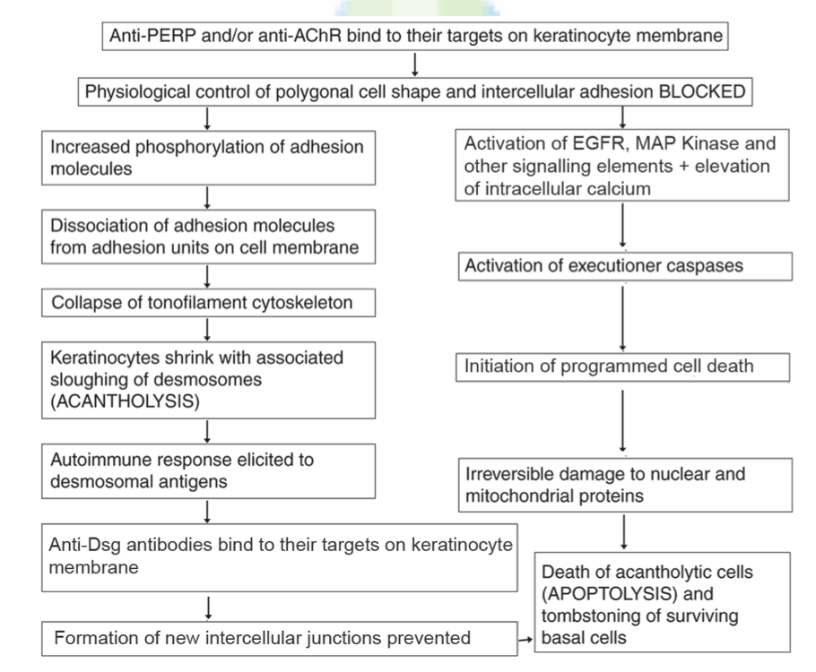

Slide 14
Secondary Acantholysis
Keratinocytes are injured first followed by subsequent disintegration of desmosomes.
This includes secondary shedding of keratinocytes from the walls of established intra-epidermal blisters due to other causes

Slide 15
Observed in:
  Herpes simplex infections
  Herpes zoster
  Condyloma acuminatum
  Tinea corporis
  BT leprosy
  Epidermolysis bullosa
  Solar keratosis

Slide 16
  Melanocytic nevi
  BCC
  Dermatofibromas
  Pityriasis rubra pilaris
  Epidermolytic hyperkeratosis

Slide 17
Biochemical acantholysis
Special type of primary acantholysis brought about without antibody mediation.
Seen in drugs and food items of thiol or phenol group
Mech: direct biochemical effect by formation of thiol-cysteine bonds disturbing cell adhesion, protease activation and immunological reaction with formation of a neo-antigen

Slide 18
Phenol induced acantholysis: induction of IL-1a and TNF-a release from keratinocytes which result in dysregulation of proteases like plasminogen activator

Slide 19
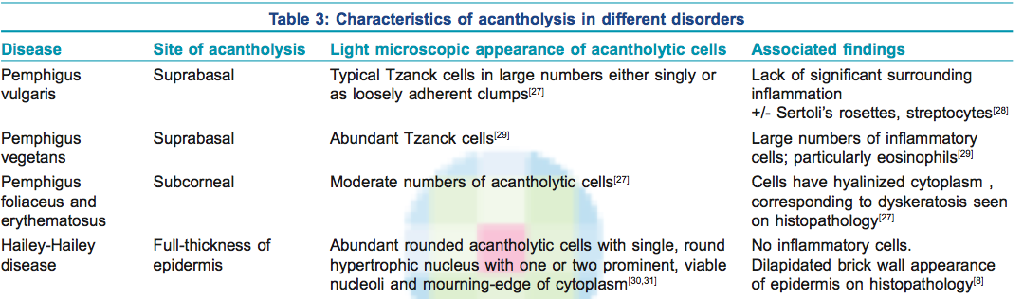
Sites of acantholysis

Slide 20
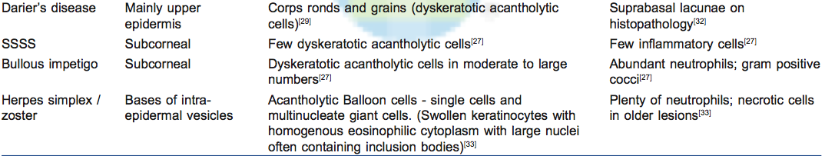

Slide 21
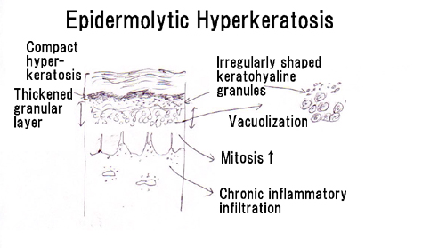

Slide 22
Clinical Signs
Nikolsky sign
Bulla spread sign

Slide 23
Nikolsky sign
Elicited by applying tangential pressure with a finger or thumb to the affected ,perilesional or normal skin in patients with pemphigus
Positive if there is extension of blister and/or removal of epidermis in the rubbed area.
Positive in diseases with epidermal acantholysis and typically negative in dermo-epidermal separation

Slide 24
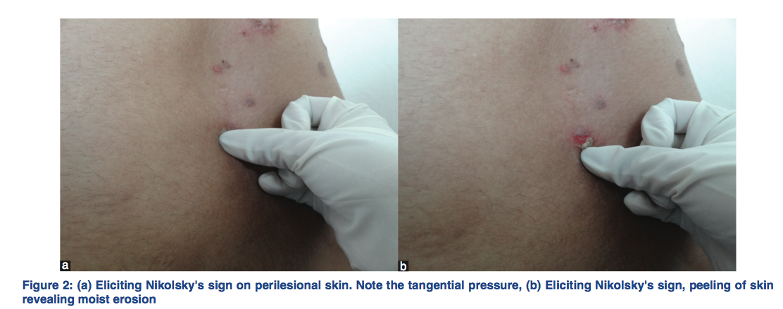

Slide 25
Marginal Nikolsky
Direct Nikolsky
Extension of erosion on the surrounding normal appearing skin by rubbing the skin surrounding existing lesions.
More sensitive (69%) in pemphigus
Induction of an erosion on normal appearing skin distant from the lesions
More specific (100%) in pemphigus

Slide 26
Wet Nikolsky
Dry Nikolsky
Moist, glistening eroded base is seen after pressure is exerted on the skin
Active PV.
Base of eroded skin is dry.
Re-epithelialization beneath a PV blister
PF

Slide 27
Bulla spread sign
Aka Asboe-Hansen sign
Enlargement of an intact blister by the application of mechanical pressure on its roof
Seen in PV
Blister extension has a sharp angle

Slide 28
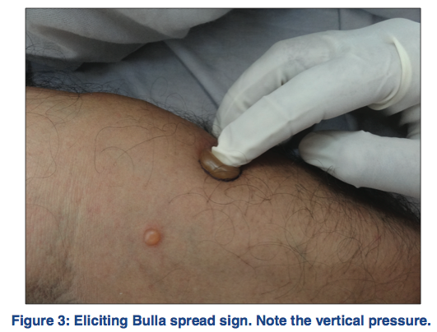

Slide 29
Lab investigations
Acantholytic cells are easily demonstrated using a side-lab cytological smear (Tzanck smear)
Simple technique used to analyze vesicobullous disorders.

Slide 30
Base of an unroofed blister is gently scraped
Material obtained is smeared on a glass slide & allowed to air dry
Giemsa staining done to demonstrate acantholytic cells

Slide 31
Typical acantholytic cell (Tzank cell)
  Rounded keratinocyte with a hypertrophic or dysmorphic nucleus
  Hazy or absent nucleoli
  Inc N:C ratio
  Abundant eosinophilic to basophilic cytoplasm. Staining is more intensely basophilic near the cell membrane (mourning edge) because of cytoplasmic condensation at the periphery resulting in a perinuclear halo

Slide 32
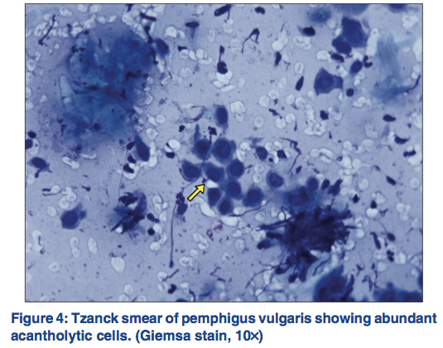

Slide 33
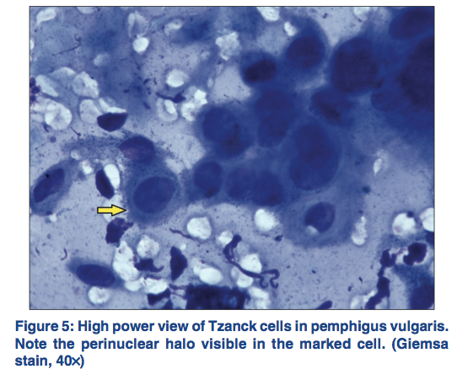

Slide 34
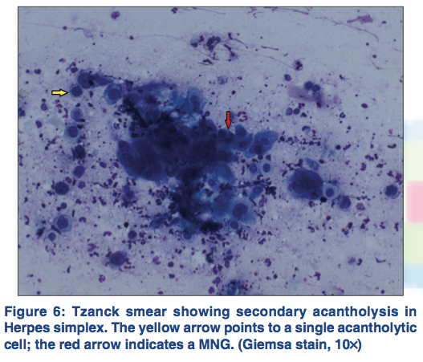

Slide 35
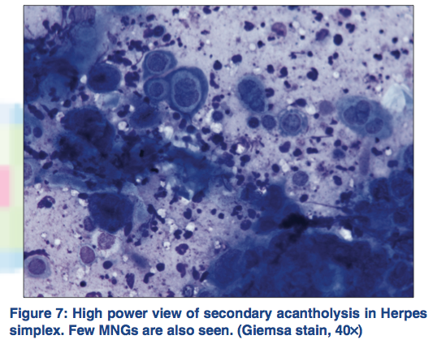

Slide 36
Other findings frequent in pemphigus
  Streptocytes: chain of leukocytes joined by a filamentous glue like substance
  Sertoli rosettes: central necrobiotic keratinocyte with a surrounding leukocyte rosette

Slide 37
THANKS!!!

