Slide 1
Transgender surgery– Male to female
By:
Dr. Priyank Katwala (M.Ch.)
Assistant Professor
Department Of Plastic Surgery
SBKSMI & RC

Slide 2
History
In 1945– Sir Harold Delf Gillies with Ralph Millard– 1st sex change surgery– F to M
In 1951, he did 1st male to female sex change surgery.
In 1967, British Laws allowed sex change surgery.
In 1972, American Medical Association sanctioned it as treatment for gender dysphoria.
In Japan, 1st legal sex change( F to M) was done in 1998.
In Vadodara, 1st male to female sex change was performed in October 2015.

Slide 3
Definition of sex, gender & gender dysphoria
Sex : Differentiation into male or female by external appearance of genitalia/gonads
Gender: Psychological recognition of self & wish to be regarded by others fitting into boy/man or girl/woman. Thus it is identity what one feels.
Gender dysphoria (DSM V): Feeling of marked incongruence between sex and gender.

Slide 4



Slide 5
DSM – III------ Transsexualism
DSM – IV------ Gender Identity Disorder
DSM – V (2013) ------ Gender Dysphoria
HBIGDA---- SOC (Feb 2001)
WPATH
Transgender male
Transgender female

Slide 6


Slide 7
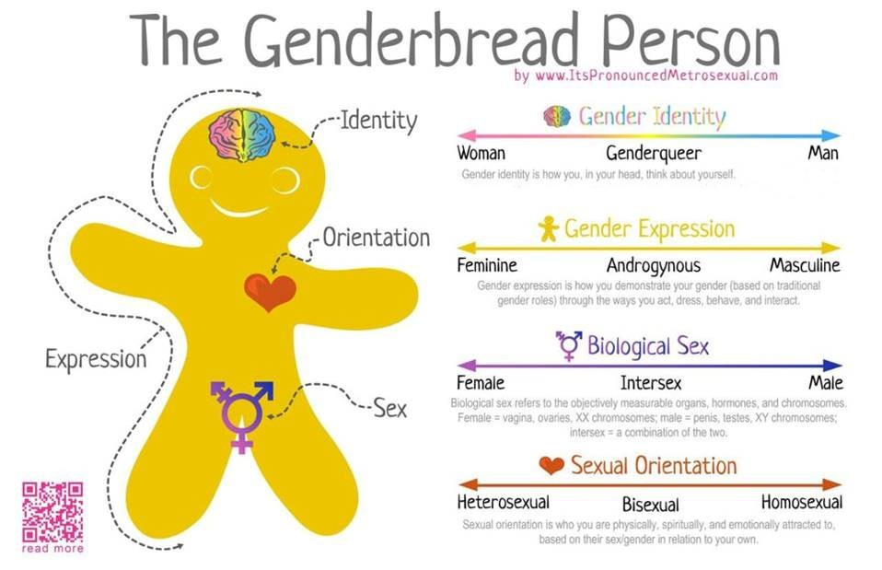

Slide 8


Slide 9
Etiology
Prevelance: 0.005 to 0.014 for the male assigned and 0.002-0.003 in female assigned gender.
( Total approx.5 lakh third gender- LGBT according to census in May 2014). (Source: TOI)
Neural– unusual neurodevelopment of foetal brain. Several sexually dimorphic nuclei in hypothalamus.
Normally, in males volume and neurons are twice as compared to females.

Slide 10
But in transsexuals, the nucleus has sex reversed structure.
Genetic– Transwomen have more longer version of gene which modifies action of testosterone.
Reduce testosterone action & masculinisation of fetal brain

Slide 11
PROBLEMS OF TRANSGENDERS
1. Discrimination: in terms of education, employment, entertainment, justice etc.
2. Disrespect: in all aspects of life except in few cases like after the birth of a child for their blessings or to bless the newly wedded couple.
3. Downtrodden:. These people are treated badly or oppressed by people in power. They are prone to struggle for social justice because of their identity as Transgender.
4. Child Nabbing:. They always search for those babies/ infants/ children who are born with this feature of Transgender. Once they come to know, they try to nab the child from their parents.
5. Prostitution:. They are forced to enter the prostitution by their community friends or relatives.

Slide 12
6.Forced to leave parental home: they are forced and pressurize to leave the parental home by the society as they cant be a part and parcel of normal community and class.
7.Unwanted attention: People give unwanted attention in public. They try to create the scene by insulting, punishing, abusing or cursing them.
8. Rejection of entry: At religious places, public places like hotels, restaurants, theaters, parks etc.
9. Rape and verbal and physical abuse: most common..
10. Lack of educational facilities: Like normal people, they are not entitled to take education in schools and colleges.

Slide 13
11. STI and HIV/AIDS
12. Human Trafficking
13.They experience high rates of psychological distress, attempted suicide, abuse of drugs and alcohol.
.
(International Research Journal of Human Resources and Social Sciences (IRJHRSS)
PROBLEMS OF TRANSGENDER IN INDIA: A STUDY FROM SOCIALEXCLUSION TO SOCIAL INCLUSION
Vol 4, Issue 4, April 2017.)

Slide 14
WPATH SOC 2012
World Professional Association for Transgender Health, Standards of Care 2012
Flexible Standards
  To promote optimal health care
  To guide treatment of people experiencing gender dysphoria.
  Multidisciplinary approach:
  Psychiatrist/ Psychologist
  Endocrinologist
  Plastic surgeon
  Urologist
  Ent surgeon
  Lawyer
WPATH SOC 2012

Slide 15
How to start: Criteria for Hormones
Persistent, well documented Gender Dysphoria (letter from one MHP)
Capacity to make informed decision and consent
Age of Majority (some different standards for <18)
Significant medical issues reasonably controlled
A real life experience of at least 3 months prior to hormone therapy or 3 months period of psychotherapy.
Expected changes---Time course: 1 month to 3 years
WPATH SOC 2012

Slide 16
Medication Regimens
Feminizing (MtF)
Estradiol
  Oral – 1-2 mg/day
  IM – MPA once every month
Spironolactone
  Oral – 25 mg
Contraindications:
Estrogen
  Absolute
    Estrogen-sensitive cancer
    End stage chronic liver disease
  Relative
    Thrombosis
Spiro Relative
  hyperkalemia

Slide 17
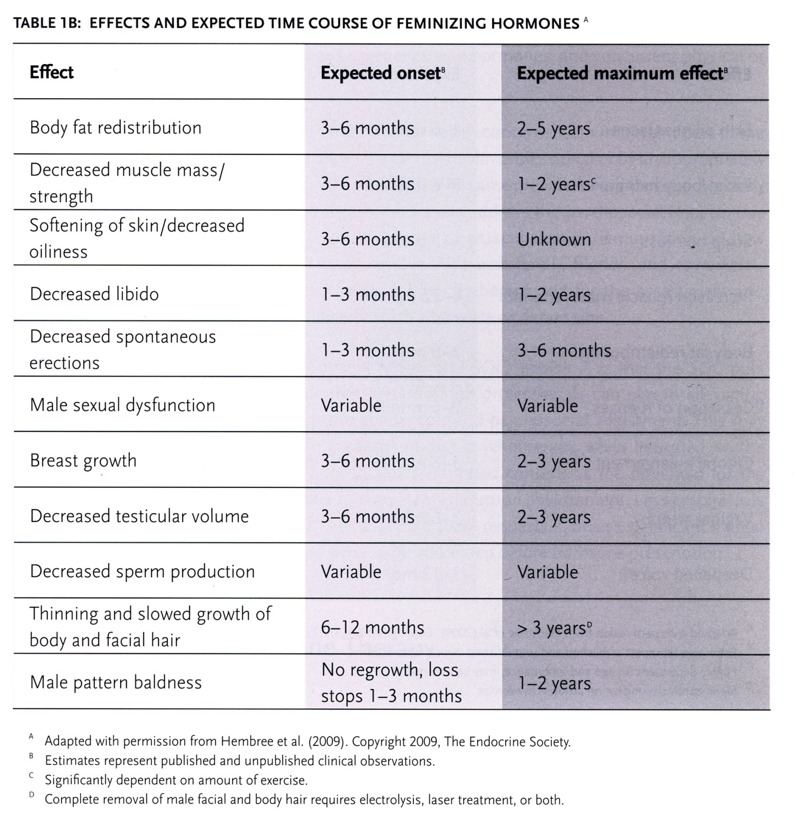
Changes with Feminizing
Hormones
Source: WPATH’s Standards of Care, v. 7, 2012.

Slide 18
Criteria for Breast/Chest Surgery (One MHP Referral)
Criteria for breast augmentation (implants/lipofilling) in MtF patients:
Persistent, well-documented gender dysphoria
Capacity to make a fully informed decision and to consent for treatment;
Age of majority (if younger, follow SOC for children & adolescents);
If significant medical or mental health concerns are present, they must be reasonably well controlled.
(WPATH, Standards of Care, 7th version, 2012).

Slide 19
It is recommended that MtF patients undergo feminizing hormone therapy (minimum 12 months) prior to breast augmentation surgery. The purpose is to maximize breast growth in order to obtain better aesthetic results.
(Treating a Transgender Patient: Overview of the Guidelines
Cory Wilczynski, MD., Mary Ann Emanuele, MD
Postgraduate Medicine, Volume 126, Issue 7, November 2014, ISSN – 0032-5481, e-ISSN – 1941-9260)

Slide 20
PREREQUISITES FOR GENDER AFFIRMATION SURGERY
Firm diagnosis for the transsexual condition.
The criteria are:
1. A sense of discomfort (distress) about one’s sex.
2. A wish to be rid of one’s genitalia and to live
life as of the opposite sex.
3. This discomfort has been continuously present for a min. of 2 years.
4. An absence of physical intersex or genetic abnormality.
5. Absence of a mental disorder such as schizophrenia
(Treating transsexuals in India: History, prerequisites for surgery and legal issues. Indian J Plast Surg July-December 2009 Vol 42 Issue 2)

Slide 21
Requirement of referral letters from mental health professionals---
1) Letter from one mental health professional is required for instituting hormone therapy, or for breast surgery.
2) Letters from two mental health professionals are required before carrying out Genital Surgery.
For male to female transsexuals----
includes - orchiectomy, penectomy, clitoroplasty, labiaplasty & creation of a neovagina

Slide 22
Letter from MHP should contain---
1) Diagnosis of gender dysphoria
2) Absence of any other mental disorder
3) Whether patient can undergo surgery/hormone therapy or not?
4) Degree to which the patient has followed the Standards of Care and the likelihood of future compliance
5) Type of psychotherapy and evaluation

Slide 23
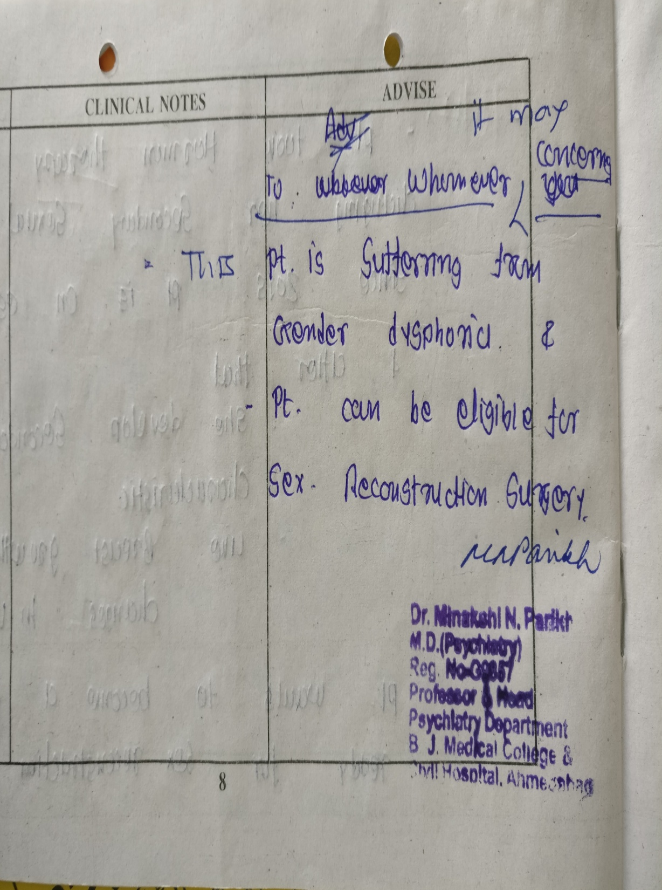

Slide 24
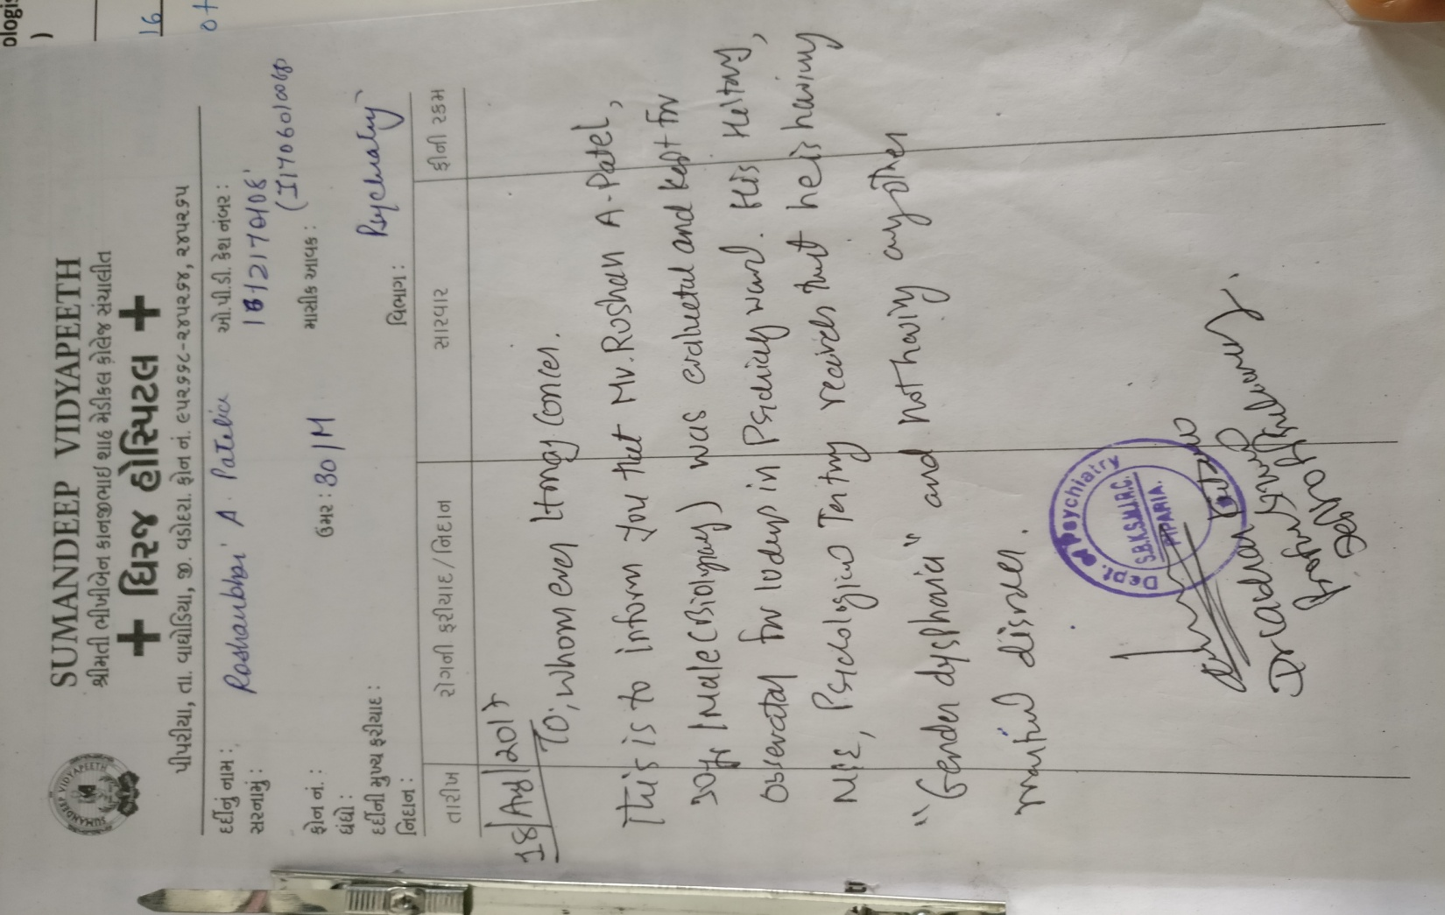

Slide 25
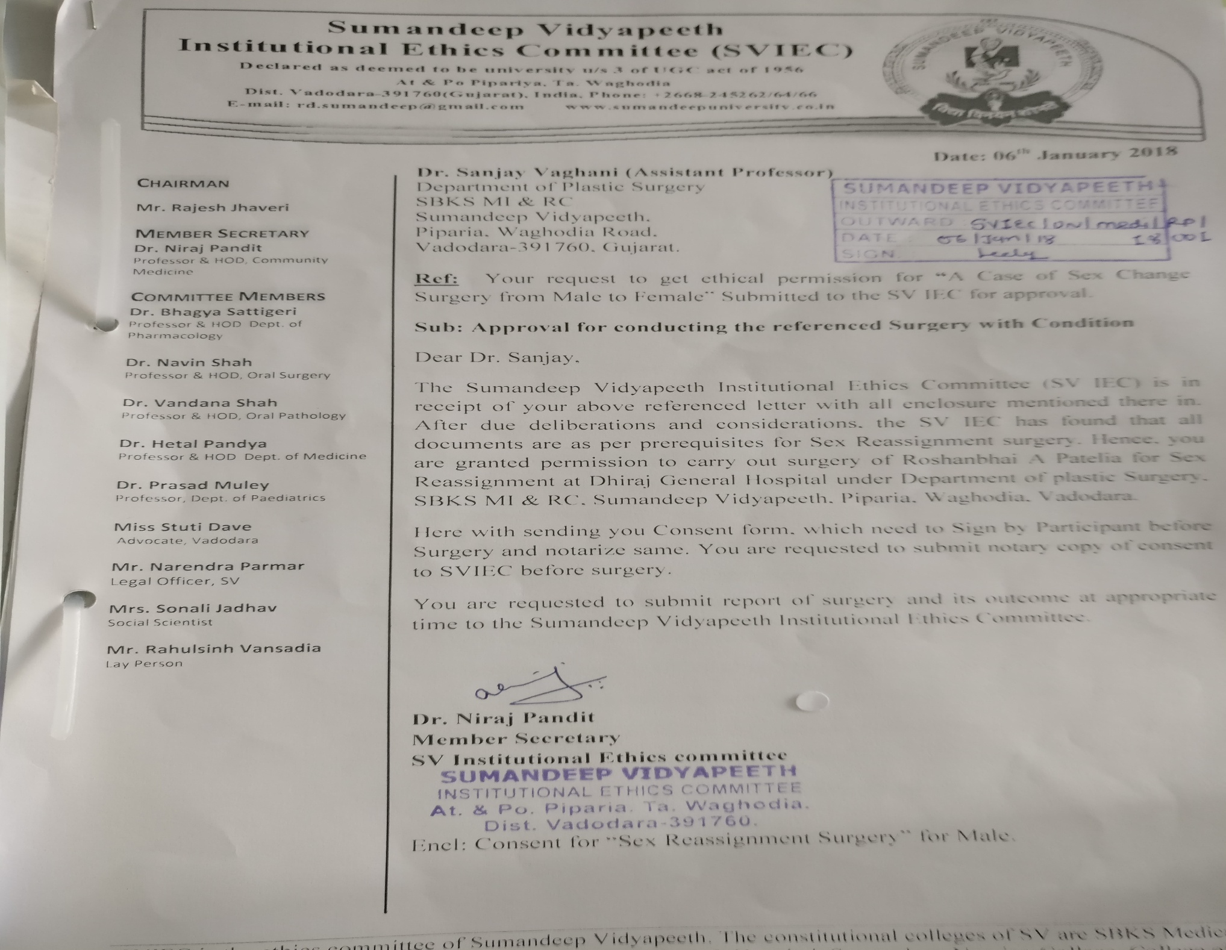

Slide 26
Consent:
a)Procedure : It includes a description of the surgical procedure. It also mentions the surgical and anaesthetic complications that may occur.
b) Waiver of Liability: It contains a waiver of liability from the change in sexual appearance, long term use of hormones and permanent, irreversible change in current sexual functioning.
c) Spousal Release: This is used if the patient is married.
d) Parental Consent: This is used if patient is less than 20 years of age. Currently the management of transsexuals is not started before the age of 18 years.

Slide 27
Convert consent forms into affidavits by paying the Notary or Court Fee and getting the counter signatures of a Notary or Magistrate, respectively.
This means that now the state is a witness.

Slide 28
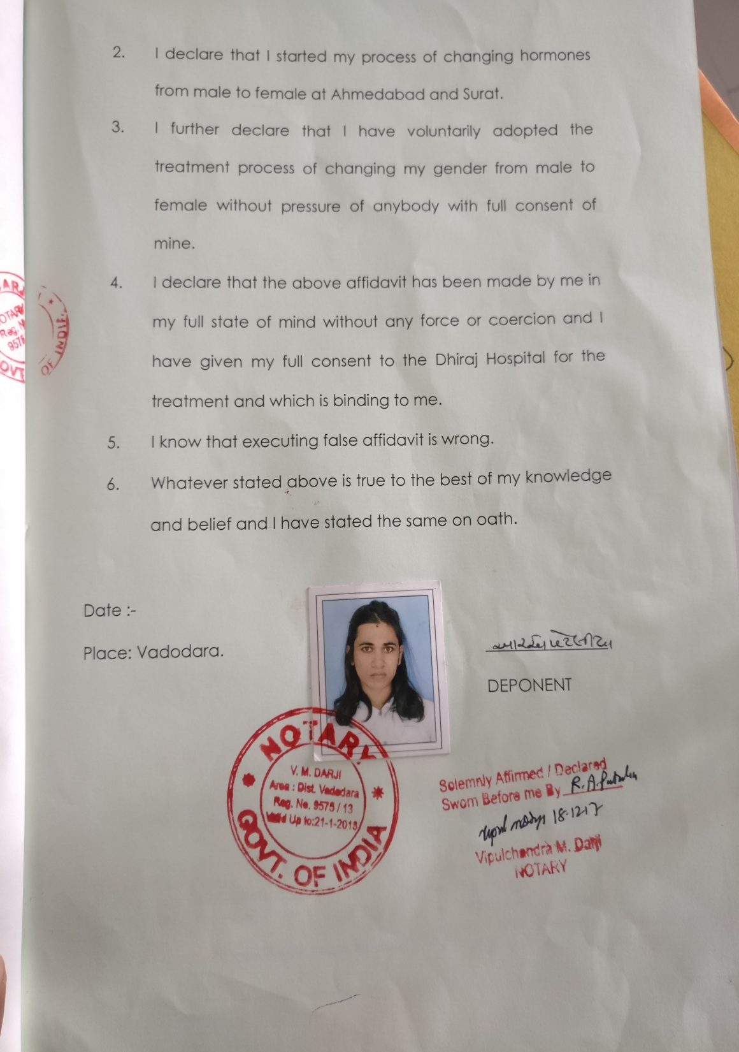
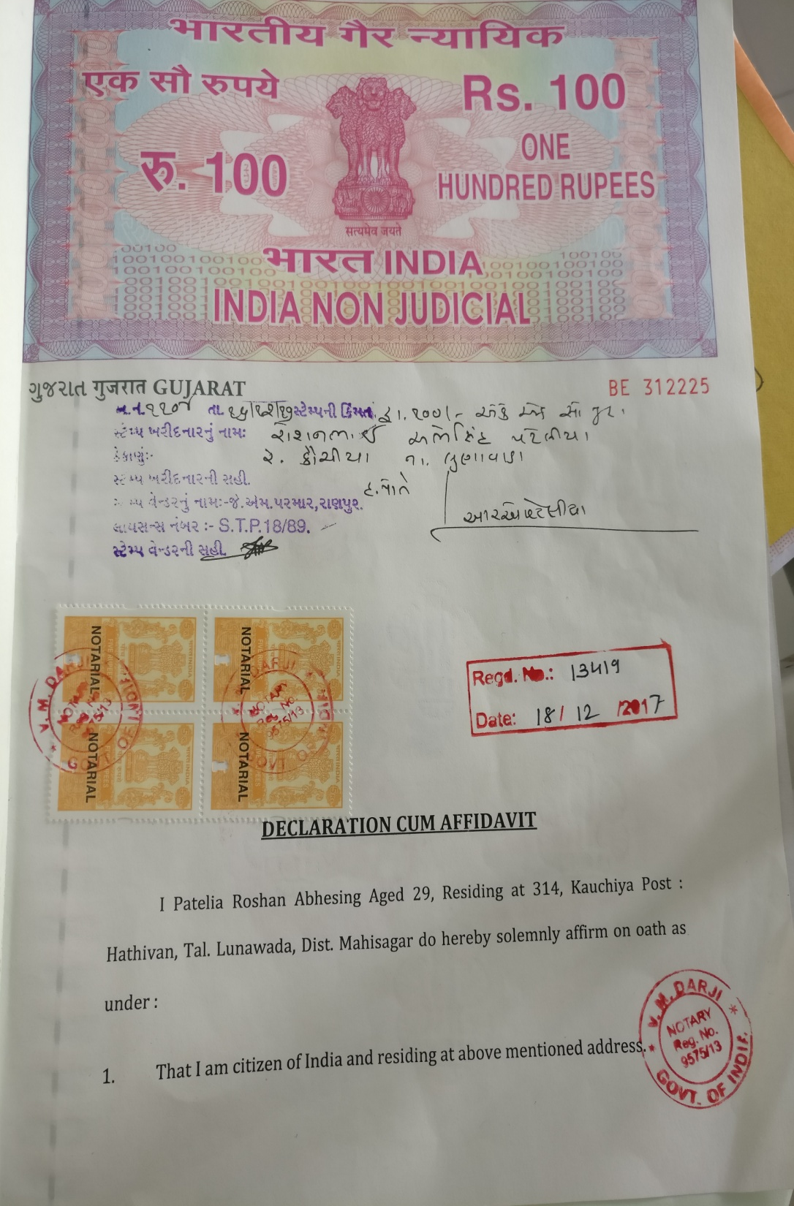

Slide 29
POSTOPERATIVE & legal ISSUES CONCERNING THE PATIENT
A) Change of Name
B) Change of Name and Sex in various certificates
C) Change of Name and Sex in Identity Cards and Passport
SC gives legal status to gender after sex change surgery
TNN | Apr 16, 2014.
(TIMES OF INDIA)

Slide 30
The court said, “If a person has changed his/her sex in tune with his/her gender characteristics and perception, which has become possible because of the advancements in medical science, and when that is permitted in medical ethics with no legal embargo, we do not find any impediment, legal or otherwise, in giving due recognition to the gender identity based on the reassign sex after undergoing SRS.”
The court directed the centre and states to treat them as socially and educationally backward classes for the purposes of quotas in admission to educational institutions and public appointments.

Slide 31
On 24th April 2016, a bill entitled “The Rights of Transgender Persons Bills, 2014” was passed by the Rajya Sabha and introduced in the Lok Sabha.
The Bill deals with the different aspects like Social inclusion of Transgender, their rights and entitlements, financial and legal aids, education and skill development and prevention of abuse, violence and exploitation of Transgender.

Slide 32
A person can, at any point during the course of SRS (and even without it as well), go to a lawyer if they want to change their name and gender in their official documents. Steps:----
(i) Getting an affidavit notarised at the court: It should mention the change in gender identity (male to female, female to male, or male/female to transgender).
(ii) An official gazette notification must be done to notify the change.
(iii) Two newspaper advertisements need to be published that include age, date of birth, place of residence, previous official name, and current gender and name.

Slide 33
(iv) Filing an application before employer: --which requests relevant changes in the employee ID card and attach copies of the gender-change affidavit, newspaper advertisements and/or gazette notification.
(v) Pursuant to this, applications can be filed before relevant authorities for changes to Voter’s ID Card, PAN Card, Bank documents including Debit/Credit Card, Driving License, Passport, Ration Card, etc. These applications must include copies of the affidavit, advertisements and the fresh employee identity card.
(vi) Renewal of passport is not yet possible without SRS certificate.
(Source: A good practice guide to Gender Affirmative Care, 2017
Initiative by Sappho for equality, Kolkata.)

Slide 34
At completion of sex reassignment surgery, a Gender Certificate should be issued to patient by the gender team consisting of the operating surgeon, psychiatrist and endocrinologist.
Present Indian Laws regarding marriage, adultery, sexual offences, unnatural offences, adoptions, labour and industrial laws will require modifications when dealing with these individuals and protecting their rights.

Slide 35
Criteria for genital surgery in MtF patients: (Two MHP Referrals)
1. Persistent, well-documented gender dysphoria;
Capacity to make a fully informed decision and to consent for treatment;
2. Age of majority;(>18 years)
3. If significant medical or mental health concerns are present, they must be reasonably well controlled;
4. Twelve continuous months of hormone therapy as appropriate to the patient’s gender goals.
5. Twelve months of successful real life experience as opposite sex
6. Two letters/ certificates from MHPs

Slide 36


1st Miss Transqueen of India
Thank You

Slide 37

Discussion

